Slide 1
Spoofing of EDMG Control Mode PPDUs
Date: 2017-01-16
Authors:

Slide 2
Abstract
We propose a maximum spoofing error requirement for EDMG Control Mode PPDUs.

Slide 3
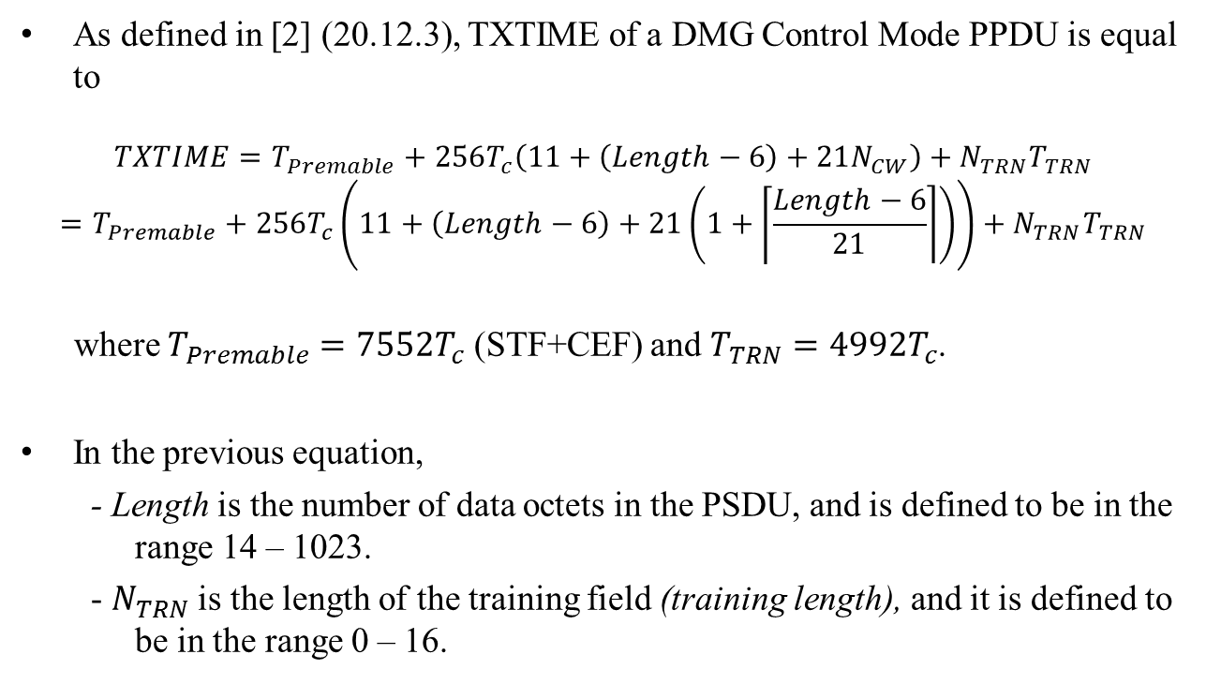
TXTIME of a DMG Control Mode PPDU
As defined in [2] (20.12.3), TXTIME of a DMG Control Mode PPDU is equal to
$$TXTIME=T_{Premable}+256T_{c}\left(11+\left(Length−6\right)+21N_{CW}\right)+N_{TRN}T_{TRN}$$
$$=T_{Premable}+256T_{c}\left(11+\left(Length−6\right)+21\left(1+\left\lceil \frac{Length−6}{21}\right\rceil \right)\right)+N_{TRN}T_{TRN}$$
where $T_{Premable}=7552T_{c}$ (STF+CEF) and $T_{TRN}=4992T_{c}$.
In the previous equation,
  - Length is the number of data octets in the PSDU, and is defined to be in the range 14 – 1023.
  - $N_{TRN}$ is the length of the training field (training length), and it is defined to be in the range 0 – 16.

Slide 4
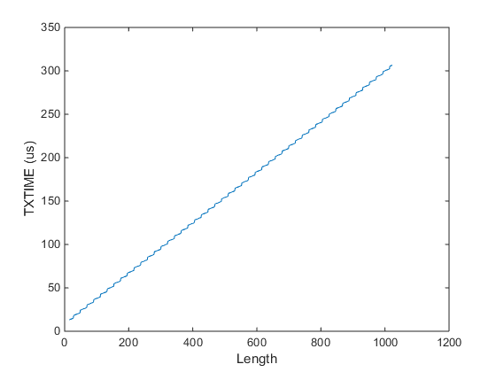
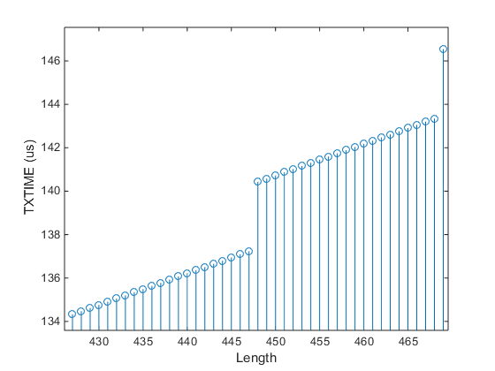
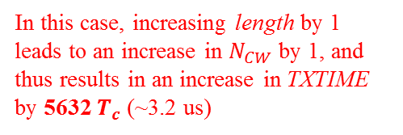
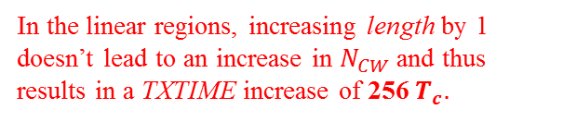
TXTIME of a DMG Control Mode PPDU
Plotting TXTIME for the case when $N_{TRN}=0$, we have
In this case, increasing length by 1 leads to an increase in $N_{CW}$ by 1, and thus results in an increase in TXTIME by 5632 $T_{c}$ (~3.2 us)
In the linear regions, increasing length by 1 doesn’t lead to an increase in $N_{CW}$ and thus results in a TXTIME increase of 256 $T_{c}.$

Slide 5
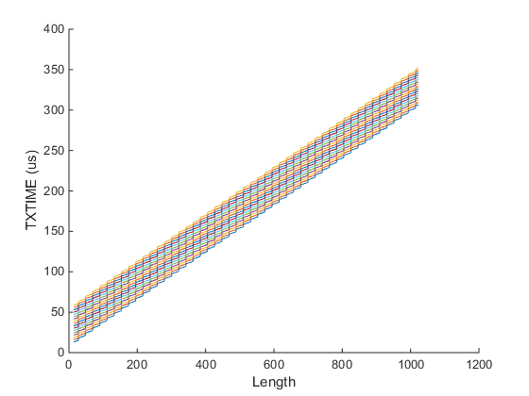
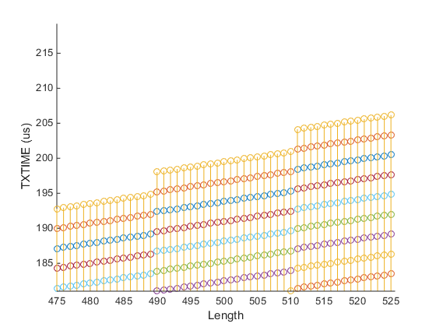
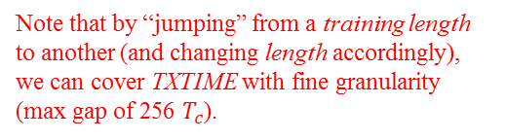
TXTIME of a DMG Control Mode PPDU
When $N_{TRN}>0$, we have
Different colors correspond to different training lengths
Training length: 0 - 16
In most cases, multiple configurations (length/training length) result in approximately the same TXTIME.
Note that by “jumping” from a training length to another (and changing length accordingly), we can cover TXTIME with fine granularity (max gap of 256 $T_{c}$).

Slide 6
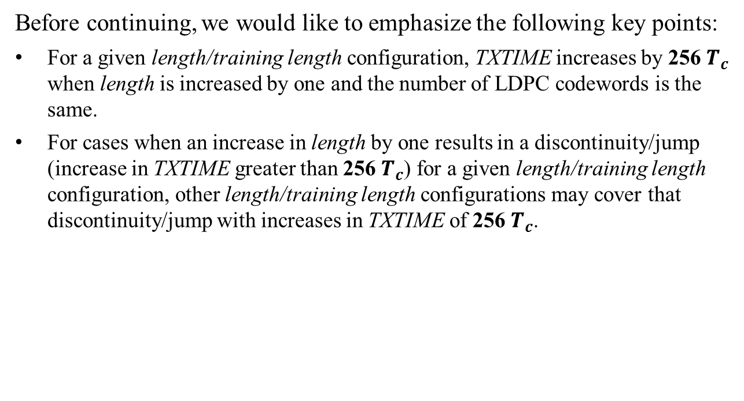
Intermediate Results – Summary
Before continuing, we would like to emphasize the following key points:
For a given length/training length configuration, TXTIME increases by 256 $T_{c}$ when length is increased by one and the number of LDPC codewords is the same.
For cases when an increase in length by one results in a discontinuity/jump (increase in TXTIME greater than 256 $T_{c}$) for a given length/training length configuration, other length/training length configurations may cover that discontinuity/jump with increases in TXTIME of 256 $T_{c}$.

Slide 7
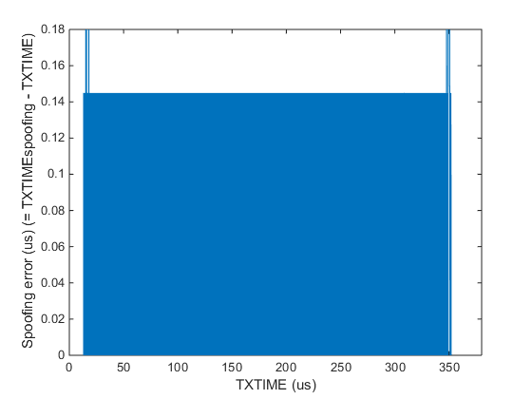
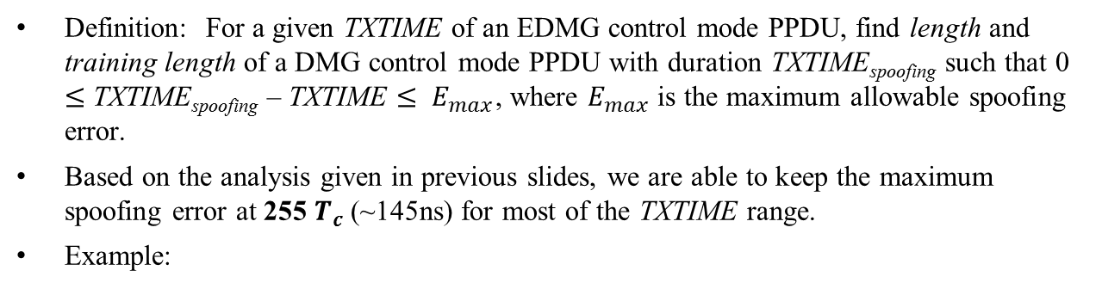
Spoofing
Definition: For a given TXTIME of an EDMG control mode PPDU, find length and training length of a DMG control mode PPDU with duration TXTIME_{spoofing} such that 0 $≤$ TXTIME_{spoofing} – TXTIME $≤ E_{max}$, where $E_{max}$ is the maximum allowable spoofing error.
Based on the analysis given in previous slides, we are able to keep the maximum spoofing error at 255 $T_{c}$ (~145ns) for most of the TXTIME range.
Example:

Slide 8
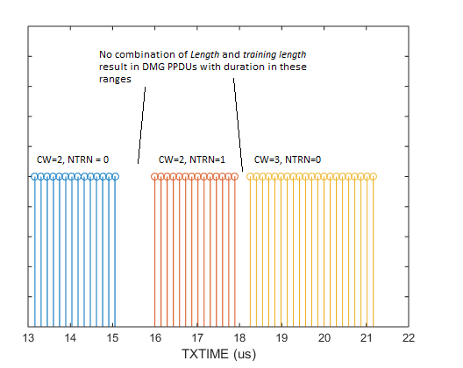
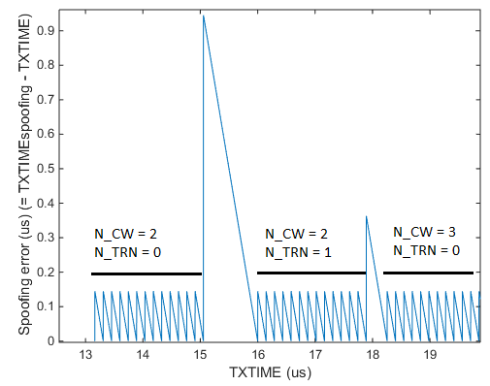
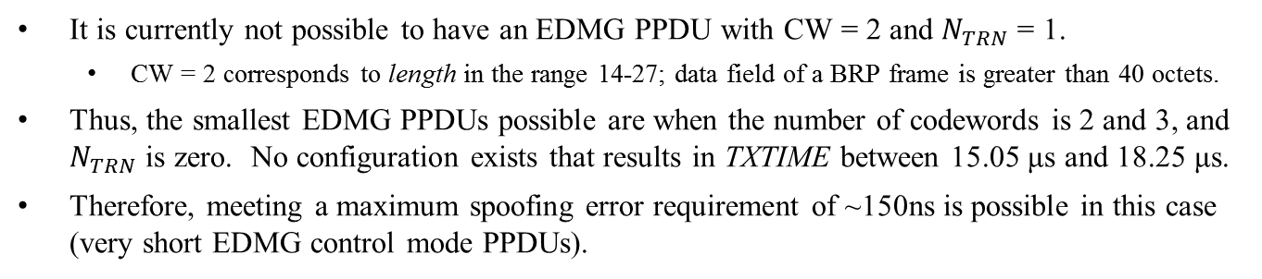
Spoofing: Very Short PPDUs
It is currently not possible to have an EDMG PPDU with CW = 2 and $N_{TRN}$ = 1.
  CW = 2 corresponds to length in the range 14-27; data field of a BRP frame is greater than 40 octets.
Thus, the smallest EDMG PPDUs possible are when the number of codewords is 2 and 3, and $N_{TRN}$ is zero. No configuration exists that results in TXTIME between 15.05 μs and 18.25 μs.
Therefore, meeting a maximum spoofing error requirement of ~150ns is possible in this case (very short EDMG control mode PPDUs).

Slide 9
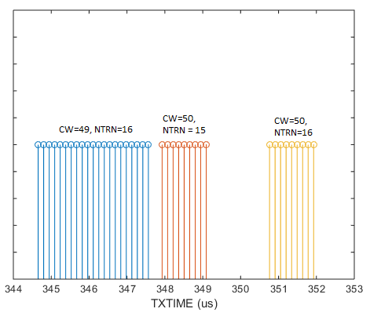
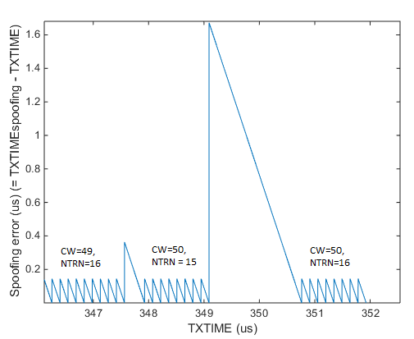
Spoofing: Very Long PPDUs
Because the TRN field structure of DMG and EDMG PPDUs is different, it is possible for EDMG PPDUs to have TXTIME in the ranges between 347.56 μs and 347.93 μs and between 349.10 μs and 350.76 μs.
If the maximum spoofing error is limited to ~150 ns, it would not be possible to have EDMG PPDUs with duration between 347.56 μs and 347.93 μs, and between 349.10 μs and 350.76 μs.

Slide 10

SP/M
Do you agree that the spoofing error for EDMG control mode PPDUs shall be defined to be non-negative and less than or equal to 150ns, except between 611713 $T_{c}$(approx. 347.56 μs) and 612351 $T_{c}$ (approx. 347.93 μs) and between 614401 $T_{c}$(approx. 349.10 μs) and 617343 $T_{c}$(approx. 350.76 μs) when the spoofing error shall be non-negative and less than or equal to 639 $T_{c}$ (approx. 364 ns) and 2943 $T_{c}$(approx. 1.67 μs), respectively? Spoofing error is defined as (TXTIME calculated based on L-Header) – (TXTIME).

Slide 11
References
1. IEEE Std 802.11-2016

