Slide 1
Header-A Definition for EDMG Control Mode
Date: 2017-01-16
Authors:

Slide 2
Abstract
We propose a definition for the EDMG-Header-A of EDMG control mode PPDUs

Slide 3
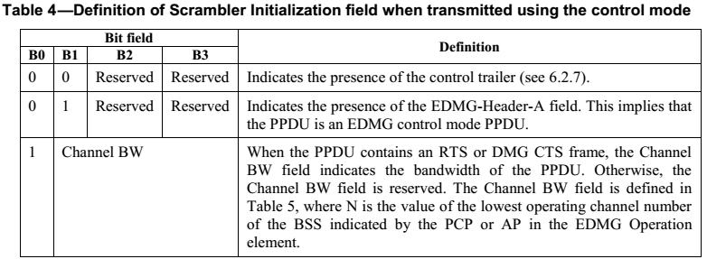
EDMG Control Mode
The presence of an EDMG-Header-A for control mode PPDUs is indicated in the L-Header by setting bits 22 and 23 both equal to 1 and the Scrambler Initialization field to the values shown below:
  The EDMG-Header-A field has not been defined for control mode PPDUs yet.
In this presentation, we propose a definition for the EDMG-Header-A of control mode PPDUs.

Slide 4
EDMG-Header-A for Control Mode
The EDMG-Header-A is used to indicate the transmission bandwidth, data field length, and TRN configuration, possibly in addition to other TBD fields.
Field | Number of bits | Description
BW | 8 | Indicates the channel(s) in which the PPDU is transmitted. If a bit is set to 1, it indicates that the corresponding channel is used for the PPDU transmission. Bit 0 corresponds to channel 1, bit 1 corresponds to channel 2, and so on. BW field is restricted to 2.16, 4.32, 6.48 and 8.64 GHz channels.
Primary Channel Number | 3 | Contains the 3 LSBs of the primary channel number of the BSS minus one
Length | 10 | Number of data octets in the PSDU. Range 14–1023.
EDMG TRN Length | 8 | Indicates the number of TRN-Units present in the TRN field of the PPDU.
RX TRN-Units per Each TX TRN-Unit | 8 | This field is reserved if the value of the EDMG TRN Length field is 0. Otherwise, this field indicates the number of consecutive TRN-Units in the TRN field for which the transmitter remains with the same transmit AWV.
TRN config | 8 | Indicates the TRN field configuration.
Reserved | 11
HCS | 16 | Header Check sequence. Calculation of the header check sequence is defined in 20.3.7.

Slide 5
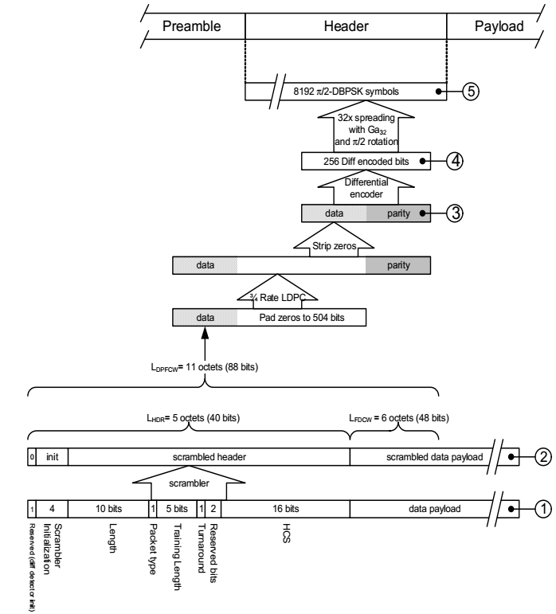
DMG Control Mode Header
The 11ad spec [2] defines that the header field in legacy stations is transmitted using the scheme shown in the right.
Please note that this scheme is different from the one used in the transmission of the header field when in SC mode.
  The header is transmitted just once, no duplication

Slide 6
EDMG-Header-A for Control Mode
As seen in the previous slide, the first LDPC codeword of a control mode DMG PPDU consists of
  - 5 octets corresponding to the Header field (24 info bits + 16 HCS)
  - 6 octets of “additional data”
For the EDMG-Header-A, assuming that the TRN-Unit configuration requires 8 bits, we would have
  - BW + primary channel: 11 bits
  - Length: 10 bits
  - TRN field config: 24 bits
  - Total: 45 bits
Thus, some subfields of the control mode EDMG Header A can be transmitted in the same codeword as the L-Header.
  - It is advantageous (latency/extra decoding) for a receiver to have access to the EDMG-Header-A in the same codeword as the L-Header.
  - Same level of protection as the L-Header.

Slide 7
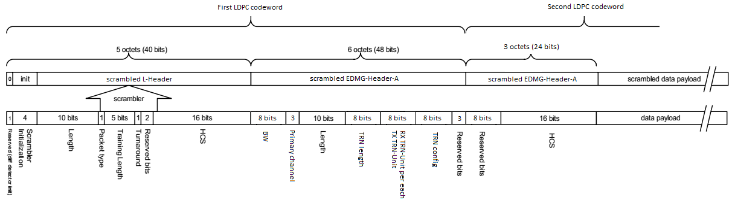
EDMG-Header-A for Control Mode
In a control mode PPDU, the first 6 octets of the EDMG-Header-A could be transmitted in the first codeword and the remaining bits in the second codeword:
  - First codeword (6 octets): Data bits (45 bits) plus 3 reserved bits
  - Second codeword (3 octets): 8 reserved bits plus HCS (16 bits)
  - Same HCS calculation procedure as L-Header
  - Continue scrambling from the L-Header

Slide 8
SP/M
Do you agree with the EDMG-Header-A definition proposed in slide 7 of this presentation?

Slide 9
References
11-15-1358-09-00ay-11ay Spec Framework
Draft P802.11REVmc_D8.0

