Slide 1
Performance Evaluation of
Multi-DFT-spread OFDM for 802.11ay
Date: 2017-01-16
Authors:

Slide 2
Abstract
In [1], a waveform with multi-DFT-spread operation was introduced for 802.11ay
  to support SU and orthogonal MU transmissions over wideband channels
  to address hardware impairments, i.e., non-linear power amplifier and phase noise
  to exploit channel selectivity in 60 GHz channels
In this contribution, we demonstrate those benefits of this waveform via simulation results and compare it with single carrier (SC) and CP-OFDM

Slide 3
Introduction (1/2)
TGay has agreed that [2]
  11ay shall enable both SC and OFDM waveforms for SU-MIMO and MU-MIMO data transmission and support multiple STAs allocated to different frequency resources in downlink
  The bandwidth of bonded channels can be up to 8.64GHz
For very wide BW transmission, the PAPR for OFDM can be very large. While SC maintains lower PAPR,
  Using matched filter at receiver is a suboptimum solution in selective channels
  It is not trivial how to achieve orthogonal FDMA with SC
  SC cannot exploit the frequency selectivity as OFDM does
The channel characteristics at 60 GHz can vary significantly, depending on beamforming at TX and RX, existence of line-of-sight (LoS), and environment
  The maximum delay spread can be as large as several hundreds of ns due to rich non-line-of-sight (NLoS) paths [3][4], especially in outdoor scenarios, or very low in LoS scenarios

Slide 4




Introduction (2/2)
In [1], it is shown that multi-DFT-spread OFDM can address the shortcomings of SC and OFDM
  Use of multi-DFT-s OFDM can lead to much lower PAPR than that of OFDM for wide band channels. This translates to increased coverage range for 802.11ay [5-9]
  Multi-DFT-spread OFDM allows receiver to exploit the frequency selectivity and enable orthogonal FDMA for MU transmitter
  Use of multi-DFT-s OFDM can facilitate the compensation of ICI due to the phase noise correction at receiver
  The guard interval with multi-DFT-spread OFDM can be adjusted by changing the length of the sequence without affecting the block duration [5-9]
multi-DFT-spread
$$0$$
Data symbols
DFT
(M)
Mapping
$N$ samples
Golay sequence
IDFT
(N)
RF
Data Symbols
Golay S.
P
/
S
Data symbols
DFT
(M)
Mapping
$$t$$
$i$th block
Golay sequence
$$0$$

Slide 5

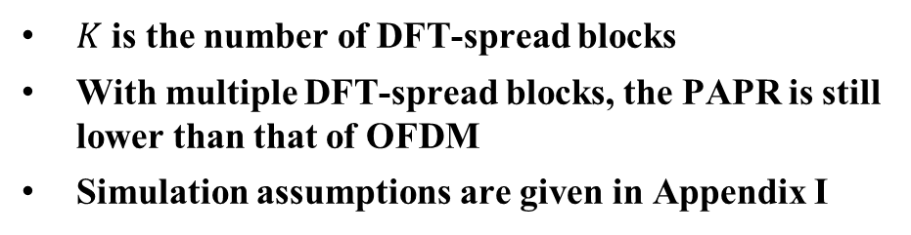

PAPR results with multi-DFT-s OFDM
$K$ is the number of DFT-spread blocks
With multiple DFT-spread blocks, the PAPR is still lower than that of OFDM
Simulation assumptions are given in Appendix I
IDFT
$$d_{1}$$
DFT
…
$$d_{K}$$
DFT

Slide 6


Reducing PAPR Further with Frequency Domain Windowing
Golay
sequence
Data
symbols
Golay
sequence
Data
symbols
Output of
DFT (M)
DFT
(M)
DFT
(M)
(a)➔
$$f$$
(a)
…
(a)
Extending
Extending
(b)
(b)
(b)➔
$$f$$
Windowing
Windowing
(c)
(c)
(c)➔
IDFT
(N)
$$f$$
DFT-spread operation is compatible with low-complexity PAPR reduction methods
In [10, 11], it is shown that the PAPR can be reduced further if the output of DFT is extended cyclically (b) and the extended block is windowed (c)
  This operation changes the sinc kernel of DFT-spread OFDM
DFT-spread OFDM receiver can exploit the energy on the extended bands with coherent additions (see Appendix III)

Slide 7


PAPR Results with Frequency Domain Windowing
The results show that frequency domain windowing (i.e., DFT-s Windowed OFDM) reduces PAPR of DFT-spread OFDM further, even for 64 QAM
Windowing functions are provided in Appendix II
$$d_{1}$$
IDFT
DFT
Ext. & Win.
…
$$d_{K}$$
DFT
Ext. & Win.

Slide 8
Spectrum Results
Multi-DFT-spread OFDM jointly reduces the out-of-band (OOB) leakage and PAPR as compared to CP-OFDM without applying extra operation
Frequency domain windowing also reduces the OOB emission

Slide 9
Throughput Results (1/3) – Assumptions
Fixed location
and orientation
PPA
AP
PPA
Random location
and orientation
STA
Channel: 11ay channel model, conference room, STA-AP
  The location of the STA and the rotation of the PAA around vertical axis are chosen randomly. For each drop, the boresight of the STA and AP antenna patterns are aligned on LoS
  Vertical polarization, LoS path exists
Numerology:
  The 8 GHz numerology for CP-OFDM and SC is obtained based on 802.11ad
  The numerology for DFT-spread OFDM is obtained based on 11ad CP-OFDM
  Details are provided in Appendix I
Equalization: Single tap MMSE-FDE
CHEST: Ideal
Impairments: None

Slide 10
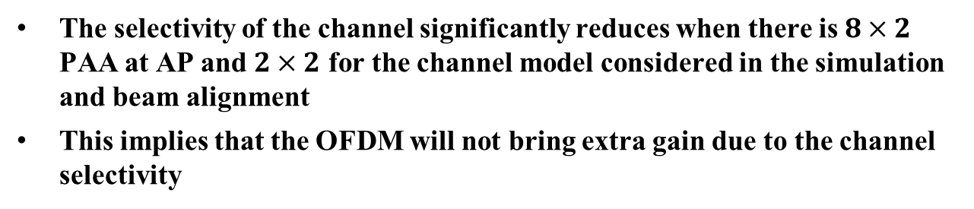
Throughput Results (2/3) – Channel
a) Normalized channel impulse response
b) Channel frequency response
The selectivity of the channel significantly reduces when there is $8×2$ PAA at AP and $2×2$ for the channel model considered in the simulation and beam alignment
This implies that the OFDM will not bring extra gain due to the channel selectivity

Slide 11


Throughput Results (3/3) – Simulation (8 GHz BW)
a) $8×1$ PAA @ AP, $1×1$ PAA @ STA
b) $8×2$ PAA @ AP, $2×2$ PAA @ STA
SC is worse than CP-OFDM and DFT-spread OFDM as the matched filtering loses its optimality in selective channels
When the channel is selective, CP-OFDM is better than DFT-spread OFDM and SC OFDM as it maximally resolves the channel in frequency. The price is high PAPR.
Under the practical PAA settings, i.e., case (b), there is little difference between DFT-spread OFDM and OFDM performance
The windowing operation approximately provides the same performance with the case without windowing

Slide 12
Conclusion
In this contribution, we compare the use of multi-DFT-spread OFDM with CP-OFDM and SC
The simulation results show that the DFT-spread OFDM achieves approximately the same throughput performance of CP-OFDM while jointly reducing PAPR and OOB substantially
DFT-spread OFDM also allows low complexity PAPR reduction techniques, e.g., frequency domain windowing
For further investigation
  Outdoor channel model for 802.11ay needs to be developed
  RF impairments, including phase noise, should be included
Welcome to any suggestion (e.g., numerology) for further evaluation of this method

Slide 13
References
[1] “On the Single Carrier Waveforms for 11ay”, IEEE 802.11-15/01455r0
[2] “Specification Framework for TGay,” IEEE 802.11-15/01358r6
[3] “Channel Models for IEEE 802.11ay,” IEEE 802.11-15/1150r7
[4] “Outdoor measurement for a rooftop to street scenario at 60 GHz,” IEEE 802.11-16/1221r0
[5] G. Berardinelli, et.al., “Zero-tail DFT-spread-OFDM signals,” Globecom 2013 Workshop - Broadband Wireless Access
[6] U. Kumar, et.al., “A Waveform for 5G: Guard Interval DFT-s-OFDM,” 2015 IEEE Globecom Workshops (GC Wkshps)
[7] F. Hasegawa, et.al., “Static Sequence Assisted Out-of-Band Power Suppression for DFT-s-OFDM,” Proc. IEEE 26th Annual International Symposium on Personal, Indoor, and Mobile Radio Communications (PIMRC), Hong Kong, 2015, pp. 61-66.
[8] A. Sahin, et.al., “An Improved Unique Word DFT-Spread OFDM Scheme for 5G Systems,” 2015 IEEE Globecom Workshops (GC Wkshps)
[9] G. Berardinelli, K. I. Pedersen, T. B. Sorensen and P. Mogensen, "Generalized DFT-Spread-OFDM as 5G Waveform," in IEEE Communications Magazine, vol. 54, no. 11, pp. 99-105, November 2016.
[10] Stefania Sesia, Issam Toufik, and Matthew Baker, “The UMTS Long Term Evolution: From Theory to Practice” Wiley Publishing, 2009
[11] A. Sahin, R. Yang, E. Bala, M. C. Beluri and R. L. Olesen, "Flexible DFT-S-OFDM: Solutions and Challenges," in IEEE Communications Magazine, vol. 54, no. 11, pp. 106-112, November 2016.

Slide 14
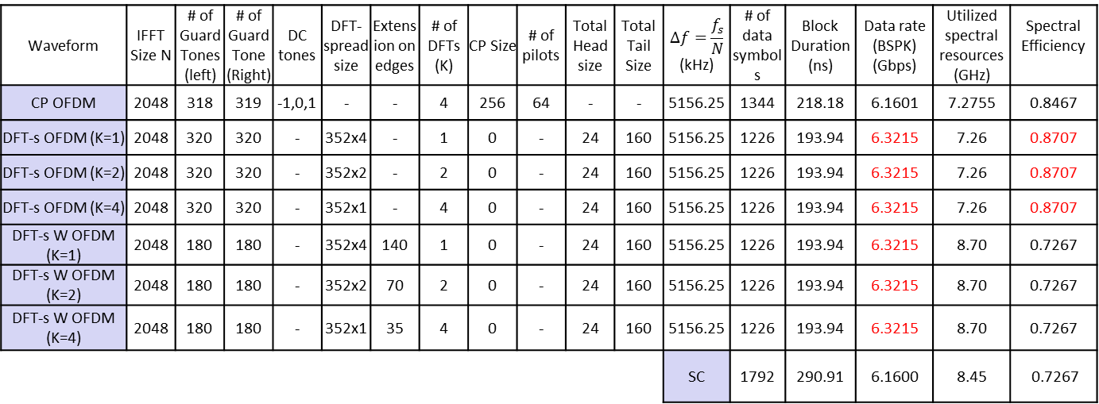
Appendix I – Numerology (8 GHz)
Waveform | IFFT Size N | # of Guard Tones (left) | # of Guard Tone (Right) | DC tones | DFT-spread size | Extension on edges | # of DFTs (K) | CP Size | # of pilots | Total Head size | Total Tail Size | $$Δf=\frac{f_{s}}{N}$$ (kHz) | # of data symbols | Block Duration (ns) | Data rate (BSPK) (Gbps) | Utilized spectral resources (GHz) | Spectral Efficiency
CP OFDM | 2048 | 318 | 319 | -1,0,1 | - | - | 4 | 256 | 64 | - | - | 5156.25 | 1344 | 218.18 | 6.1601 | 7.2755 | 0.8467
DFT-s OFDM (K=1) | 2048 | 320 | 320 | - | 352x4 | - | 1 | 0 | - | 24 | 160 | 5156.25 | 1226 | 193.94 | 6.3215 | 7.26 | 0.8707
DFT-s OFDM (K=2) | 2048 | 320 | 320 | - | 352x2 | - | 2 | 0 | - | 24 | 160 | 5156.25 | 1226 | 193.94 | 6.3215 | 7.26 | 0.8707
DFT-s OFDM (K=4) | 2048 | 320 | 320 | - | 352x1 | - | 4 | 0 | - | 24 | 160 | 5156.25 | 1226 | 193.94 | 6.3215 | 7.26 | 0.8707
DFT-s W OFDM (K=1) | 2048 | 180 | 180 | - | 352x4 | 140 | 1 | 0 | - | 24 | 160 | 5156.25 | 1226 | 193.94 | 6.3215 | 8.70 | 0.7267
DFT-s W OFDM (K=2) | 2048 | 180 | 180 | - | 352x2 | 70 | 2 | 0 | - | 24 | 160 | 5156.25 | 1226 | 193.94 | 6.3215 | 8.70 | 0.7267
DFT-s W OFDM (K=4) | 2048 | 180 | 180 | - | 352x1 | 35 | 4 | 0 | - | 24 | 160 | 5156.25 | 1226 | 193.94 | 6.3215 | 8.70 | 0.7267
 |  |  |  |  |  |  |  |  |  |  |  | SC | 1792 | 290.91 | 6.1600 | 8.45 | 0.7267
Windowing functions are provided in the next slide
Corresponds to
Approximately 266 samples in time for guard interval
Waveform | Block Size | Upsampling | Downsampling | Roll-off factor
SC | 2048 | 3 | 1 | 0.2

Slide 15
Appendix II – Windowing Functions
Raised cosine function is considered for the edge of the windowing function

Slide 16

Appendix III – The DFT-spread Windowed OFDM Receiver
CFR
(includes the impact of windowing)
Correct phases
Weight and
sum
RF
DFT
(N)
MMSE
S
/
P
IDFT
(M)
P
/
S
Symbols
Coherent addition
+
+
$$f$$
$$f$$

Slide 17
Appendix IV – PAPR for QPSK

Slide 18


Appendix V – Throughput Results
(4 GHz BW)
a) $8×1$ PAA @ AP, $1×1$ PAA @ STA
b) $8×2$ PAA @ AP, $2×2$ PAA @ STA

Slide 19
Straw Poll (for survey)
Do you agree that the TGay should further study the feasibility of including multi-DFT-spread OFDM as an additional waveform for 11ay?

