Slide 1
WUR power save mode and clock drifting problem
Date: 2017-01-16
Authors:

Slide 2
Background
WUR is a low power circuit that can wake up the primary radio when a wake-up (WU) signal is received.
In [1, 2], the usage models show that WUR devices may have very low duty cycle but require long battery life.
The power consumption of WUR is required to be smaller than 1mW in the PAR.
In order to further reduce the
power consumption, WUR
may also work in power save
mode.
Primary radio
802.11
802.11
802.11
802.11
ON
OFF
OFF
ON
Wake-up
signal
Wake-up signal
WUR
ON
Extremely low power
Wake up radio

Slide 3
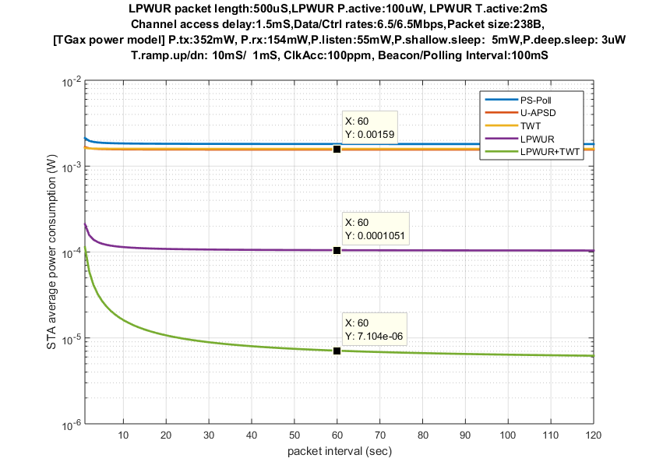
Power consumption comparison
In [3], the power consumption is compared for legacy power save mode, WUR always on mode and WUR power save mode
  The power consumption for
  WUR PS mode can dramatically
  save the power
  The WUR always on mode is
  not very attractive
    if the WUR power is close
    to 1mW as required by
    the PAR or
    the latency requirement
    is low so that the legacy
    power save mode will
    consume similar power
    as WUR always on mode.
Legacy power
save modes
1.6 mW
~15x
LP-WUR always on
~224x
105 µW
LP-WUR duty-cycled
(2 mS active every
100 mS)
7 µW

Slide 4
WUR power save mode
Example of WUR power save mode
  WUR periodically wake up. WUR radio is on during WUR awake window and go to sleep during WUR sleep window. The length of WUR sleep window depends on latency requirement.
  When there is downlink data for WUR STA, AP send the WU signal to the WUR STA during WUR awake window.
  There will be no signal arriving during the WUR awake window if there is no DL data. In some important use cases such as IoT, the duty circle of data traffic is very low and the primary radio may stay in deep sleep mode for a long time. In the case, the clock of WUR STA will run independently from AP’s clock for a long time.
WUR sleep window
WUR awake window
WUR on
WUR off
WUR on
WUR off
Time

Slide 5
Clock drifting problem
Since the clock of WUR STA is running on its own, the clock difference will accumulate and lead to large timing mismatch for the WUR awake window.
  Assume 40us clock drift per second, timing difference between AP and STA will be 2.4ms every minute. If WUR wake up 2ms every 100ms, AP will completely lose track of wake up window within one minute.
  WUR power save mode does not work with accumulating clock drifting. We need a solution for this problem to enable WUR power save mode.
WUR awake windows based on AP’s clock. (Expected WUR awake window at AP). AP will only send WU signal in the green window.
Completely lose track!
Timing at AP
…
…
Timing at STA
Timing mismatch!
Time
Wake up windows based on STA’s clock. WUR will only wake up in the gold window.

Slide 6
SP1
Do you agree that 11ba shall define a WUR power save mode?

Slide 7
SP2
Do you agree that 802.11ba shall provide a mechanism to solve the timing mismatch problem in WUR power save mode?

Slide 8
Reference
[1] 11-16-0974-00-0wur-wur-usage-scenarios-and-applications
[2] 11-16-1465-00-0wur-wur-usage-model
[3] 11-16-0027-00-lrlp-lp-wur-enabling-low-power-low-latency-capability-for-802-11

