Slide 1
WUR Reconnection Usage Model
Jan. 2017
Date: 2017-01-16
Authors:

Slide 2
Abstract
This presentation introduces the re-connection issues if wearable devices are equipped with WUR.
Our goal is to provide a good user experience when User would like to read data from a disconnected wearable device.
This is the further work of “WUR Usage Model” [1] presented on IEEE meeting in Nov. 2016.
[1] 11-16-1465-00-0wur-wur-usage-model

Slide 3
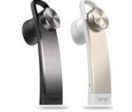

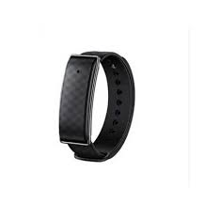

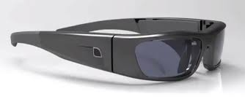
Background
Nowadays, Bluetooth is one of the major technologies for connecting wearable devices, rather than Wi-Fi.
One of main reasons is that Bluetooth consumes less energy compared with Wi-Fi.
It is possible to use WUR for wearable devices in this case.
  The average energy consumption of WUR is lower than Bluetooth.
    E.g. Awake mode: 5~10mW(BLE) vs less than1mW (WUR)
  WiFi provides both high/low data rate.
WUP to WUR, then message to MR
Smart phone
WiFi signal
WUR signal
Smart watch, equipped with WUR

Slide 4

Scenario of re-connection
Scenario for wearable devices equipped with WUR
  User took smart watch outside for running, then smart watch and smart phone are disconnected.
    Configuration info. may be fully/partly removed.
  User takes smart watch back, and would like to read the data saved in smart watch with a simple way.
    E.g. One click on smart phone to get the data, no operation on smart watch.
WUR operation
  Smart watch keeps WUR On after disconnection from smart phone.
Smart phone
Smart phone
Smart phone
WUP to WUR, then message to MR
disconnected
WUR signal to WUR, then re-connection
Smart watch, equipped with WUR
WUR ON
WUR ON
User took smart watch outside
User took smart watch back

Slide 5
Re-connect to Wi-Fi (with WUR)
Possible methods for re-connecting to Wi-Fi when wearable devices equip with WUR
  Re-setup/Initial the Wi-Fi link between wearable devices
    Usually bad user experience.
  Automatic re-connection
    Smart watch keeps listening WUR message (periodically sent, e.g. WUR beacon) from smart phone after disconnection. If WUR message is received, smart watch may wake up its Main Radio (MR) and tires to re-connect with smart phone via Wi-Fi signal.
      The WUR message should be verified by smart watch, avoiding attacks to WUR which may drain smart watch’s battery quickly.
      Smart phone (Mobile AP) may consume some energy by frequently sending the WUR message, if we would like the smart watch to re-establish the connection with low latency.
      A significant delay may occur, when the WUR message interval is long (e.g. several minutes), if we would like the smart phone to save more energy.
      Smart phone may stop to send beacon frame, if it has terminated its P2P link (e.g. Wi-Fi Direct).
  Manual re-connection
    Smart phone is able to send Reference WUR message to a disconnected smart watch’s WUR, expecting to re-establish the connection.
Ref. WUR message first, and then re-connection
Smart phone
WUR On
Smart phone
Smart watch (equipped with WUR)
WiFi signal
WUR signal
User
Smart watch (equipped with WUR)
User

Slide 6
Requirement
Requirement of re-connecting wearable devices equipped with WUR
  WUR consumes less energy compared with Bluetooth.
  STA keeps WUR On after losing connectivity with AP.
  (Mobile) AP is able to send Reference WUR message to a disconnected STA’s WUR, expecting to re-establish the connection.
  The Reference WUR message should be verified by WUR.

Slide 7
Conclusion
The wearable devices may equip WUR to reduce energy consumption and provide Wi-Fi based wireless connection.
The re-connection procedure of wearable devices equipped with WUR may be considered via WUR messages.
  Operate on one device only, provide convenient user experience.

