Slide 1
Consideration on WUR Frame Structure
Date: 2017-01-15
Authors:
Name | Affiliation | Address | Phone | Email
Dongguk Lim | LG Electronics | 19, Yangjae-daero 11gil, Seocho-gu, Seoul 137-130, Korea |  | dongguk.lim@lge.com
Jinsoo Choi |  |  |  | js.choi@lge.com
Eunsung Park |  |  |  | esung.park@lge.com
Sunwoong Yun |  |  |  | Sunwoong.yun@lge.com
HanGyu Cho |  |  |  | hg.cho@lge.com

Slide 2
Introduction
WUR (11ba) should support the following scope in PAR [1]
  The WUR devices coexist with legacy IEEE 802.11 devices in the same band
  The WUR meets the same range requirement as the primary connectivity radio
  The wake-up frames carry only control information
As introduced in [2], WUR signal may be transmitted by using the different transmission scheme from conventional system, such as OOK modulation and narrow bandwidth
To satisfy the decided target and to apply the different transmission method, we need a new WUR frame structure for the WUR signal
In this contribution, we discuss how to design the WUR frame structure

Slide 3
Overview
For the new WUR frame structure, we discuss the following points in this contribution
First,
  We discuss how to design the preamble by considering the characteristic of OOK signals and the following functions such as
    Coexistence with legacy devices, Time synch. and packet detection
Second,
  To wake-up the primary radio, we discuss what control information is needed and how to configure it
Third,
  WUR can be transmitted by using a narrow band or a part of available tones in 20MHz. So, we also discuss how to use the narrow band to transmit the WUR signals

Slide 4
Frame Structure :
Preamble (1/4) - Coexistence
Considered requirement: “The WUR devices coexist with legacy IEEE 802.11 devices in the same band”
If the WUR signal consists of OOK signal, it requires a part for legacy device to decode the packet for deferring channel access
  As the WUR signal starts with L-part, legacy devices can detect the WUR packet and decide how long they need to defer channel access
    L-length field in L-SIG can be used by legacy devices for the information
We support to use the L-part in the WUR signal at the beginning of the WUR preamble
L-STF
L-LTF
L-SIG
WUR-preamble part
···
WUR symbols
L-Part, OFDM symbol
WUR Part, OOK symbol

Slide 5
Frame Structure :
Preamble (2/4) –Time Synch
L-part is only for legacy devices rather than WUR devices (assuming the WUR receiver may not decode an OFDM signal)
So, the timing synch. and packet detection should be done in the other part (e.g. WUR preamble) when the WUR devices receive a WUR signal
It can be considered to add a WUR preamble right after the L-part
Candidate design on the WUR preamble with OOK signal
  Timing synchronization: we can consider using a training field (symbols) after L-part
    An OOK ON symbol (“1”) is used for the purpose of training symbol
      This training field can be repeated over more than 1 symbols
      To minimize latency and preamble overhead, it is desirable to use a few number of training symbols as possible
      Training field with a few symbols shows no performance degradation compared to using larger number of training symbols as shown in appendix A
        But, we should take into account the power consumption in receiver, because we assumed dozen’s of samples within a symbol to be used for sync. So it’s expected more symbols will be required if we want the similar performance with lower power consumption.

Slide 6
Frame Structure :
Preamble (3/4) – Time Synch
    An OOK OFF (“0”) symbol can be inserted after the last training symbol
      Only one OOK OFF symbol may be enough
      By using the OOK OFF symbol at WUR preamble part, the WUR receiver can recognize the end of preamble
      And, it is able to help measuring the timing synch.
        It can prevent data part from being used when performing the timing synch. with preamble because same OOK symbol can be used for data
L
Preamble part
-
part
Repetition of same
symbol
L
Training
Training
OFF symbol
-
STF
L
-
LTF
L
-
SIG
Symbol
1
Symbol
2
4
us

Slide 7
Frame Structure :
Preamble (4/4) – Packet Detection
  Packet detection: the WUR preamble can be used for the purpose of WUR packet recognition
    The WUR preamble consists of repeated value of training symbols that enables for the WUR receiver to recognize a WUR packet
      Through decoding OOK ON symbols of preamble, WUR receiver can figure out continuously identical bit information
        For more reliable packet detection, it may be required to use more training symbols (FFS)
    By decoding the last symbol of preamble, the WUR receiver detects the one termination bit information (e.g. 0) after consecutive bits with same value
      This can help recognizing the WUR packet as a known pattern

Slide 8
Frame Structure :
Control information (1/2)
  Considered requirement: “wake-up frames carry only control information”
A WUR frame can be constructed by following two parts
  The preamble part (as discussed in previous slides)
  The control information part
For the control information part, since the primary goal of WUR is to wake up the primary radio, it is desirable to carry the simple and compact control information considering an OOK symbol has a difficulty in conveying multiple bits
  BSS identification
    To distinguish whether the received WUR frame is from its own BSS or not
    Full BSSID will be most accurate, but the required overhead may be too high
      BSS color, partial BSSID can be considered
  STA identification
    To identify the intended recipient(s)
      For single STA : AID or P-AID
      For multiple STA : a series of AID or Group ID
      A type indication like SU/MU may be needed depending on the control information type

Slide 9
Frame Structure :
Control information (2/2)
  Other beneficial information (FFS)
    Channel/bandwidth (e.g. indicating which or how many channels are used for the main data transmission)
    DL/UL indication of WUR PPDU (e.g. Different identification type/size or control information may be required depending on DL/UL)
Also, we may consider conveying BSS identification information (e.g. BSS color) right after preamble part for early indication
  We can put a PHY header (no interaction proceeded with MAC if other BSS)
  After checking, if it is from its own BSS, the receiver continue decoding the other information in control information part
  And, we may consider BSS identification can be included in preamble part like as in [3]

Slide 10
Frame Structure :
Channelization (narrow band)
The WUR frame should be started with 20MHz channel because of L-part in front of the frame
But, as introduced in [2], WUR signal except the L-part can be transmitted by using narrow band than 20MHz
The narrow band can consist of a part of available tones within 20MHz [3]
  For example, 4MHz (i.e. 13 subcarriers), 8MHz (i.e. 26 subcarrier), 10MHz (i.e. 32 subcarriers)
According to used band size, multiple allocations in 20MHz might be considered for WUR signal transmission
  For example, if 8MHz band is used for a WUR signal, we can use maximum two bands in 20MHz
  But, by using the two bands simultaneously, we may not get enough power gain from narrow band transmission (under the regulation limit)
  And, more power might be needed at WUR receiver because it requires more accurate filtering
  Therefore, using one narrow band in 20 MHz for WUR transmission may be desirable (but, open to using multiple narrow bands)
Notes:
세번째 블록에서 센터 고정하지 말고 오픈 할것,
여러 band중 하나를 사용하는 경우 와 고정하여 사용하는 경우로 기술

Slide 11
Candidate WUR Frame Structure
Based on the previous slides, our considered WUR frame structure is shown as following
  If the WUR frame is transmitted for a certain case without control information, e.g. broadcasting to all WUR STAs, the WUR frame may be simply constructed by L-part and Preamble part
Notes:
그림 수정 할 것. Frequency에서 tone location 제거

Slide 12
Conclusion
In order to satisfy the target scope of PAR, we considered the WUR frame structure from various perspectives such as
  Coexistence, timing synchronization and packet detection, control information and channelization
Considering all of factors as described above, we can design a new WUR frame structure as shown in slide 11
  For the coexistence with legacy devices, the L-part should be transmitted at the first in a WUR PPDU with 20MHz
  The preamble part can be constructed with consecutive ON symbols and one OFF symbol for the time synch. and packet detection
  Also, by considering symbol overhead with OOK modulation, compact control information is recommended

Slide 13
Straw Poll 1
Do you agree that a WUR PPDU includes the L-part (L-STF, L-LTF, L-SIG)?

Slide 14
Straw Poll 2
Do you agree that a WUR PPDU includes the WUR preamble, which is different from that in the L-part?

Slide 15
Reference
[1] 11-16-1045r09-a par proposal for wake-up radio
[2] 11-16-034r0 LP-WUR(Low-Power Wake-Up Receiver Follow Up)
[3] 11-17-0030r0 - On the Performance of Timing Synchronization and OOK Pulse Bandwidth
[4] 11-17-0031r0 - Channel issue in WUR

Slide 16
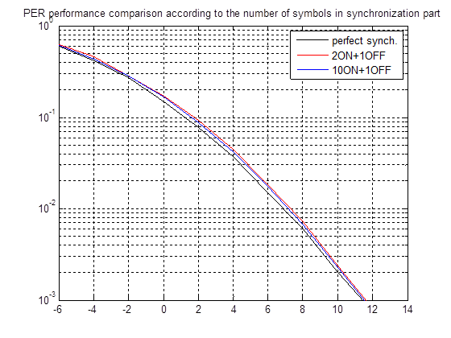
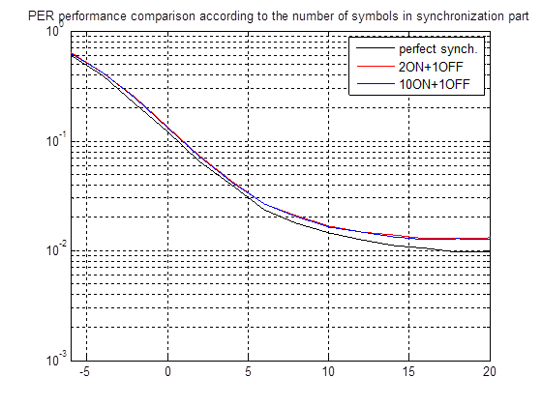
Appendix A
Performance according to the number of symbols
TGnD
- 48 bit control information assumed
UMi

