Slide 1
WUR Phase Noise Model Study
Date: 2017-01-10
Authors:

Slide 2
Abstract
This presentation describes a phase noise model for WUR that takes power consumption into account

Slide 3
Introduction
The power consumption target for a wake-up receiver is much lower than a legacy 802.11 STA
  WUR SG PAR [802.11-16/1045r9]:
  “The WUR has an expected active receiver power consumption of less than one milliwatt”
In 802.11, a simple phase noise model proposed in [802.11-04/224r1] has been used for a legacy 802.11 STA but without any constraint on power consumption
We believe TGba should have a new phase noise model that takes the power consumption into account

Slide 4
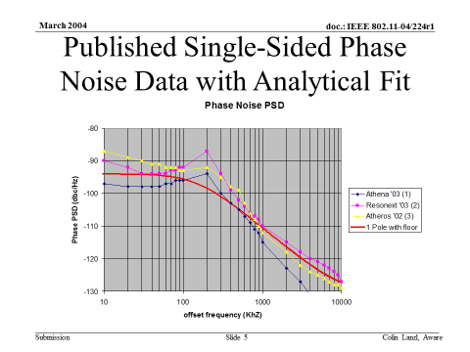
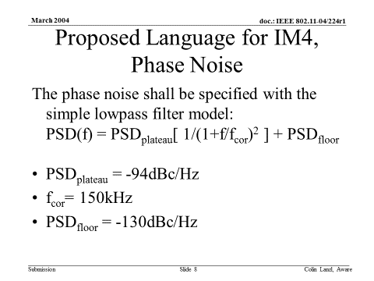
TGn Phase Noise Model [11-04/224r1]

Slide 5
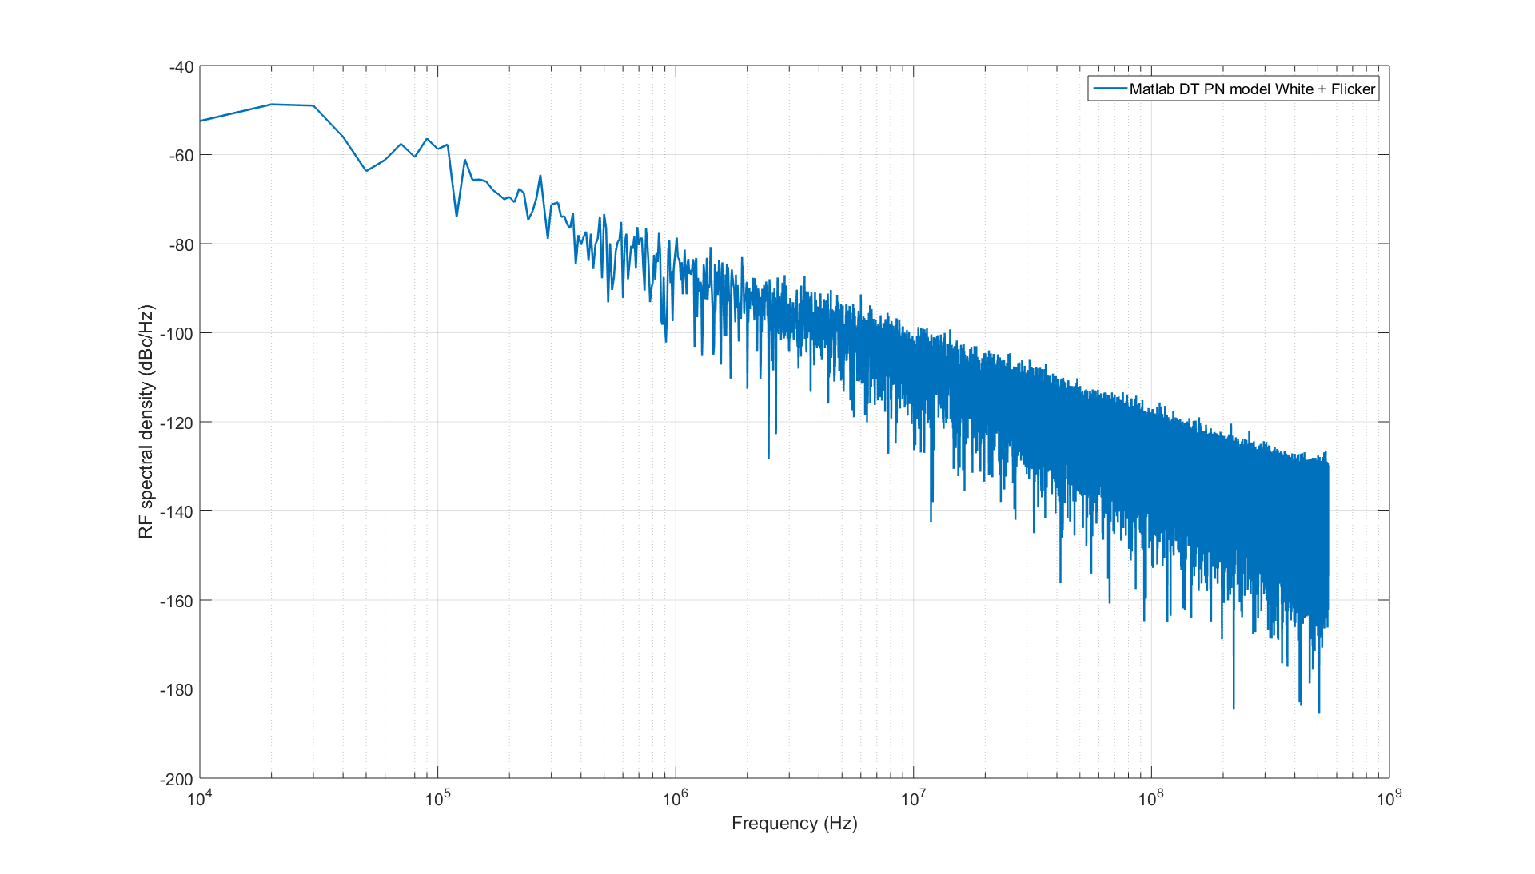
Phase Noise Profile of a Ring Oscillator [1]
Example: 65 nm, 75 µW power consumption
[1] O. Khan; B. Wheeler; F. Maksimovic; D. Burnett; A. M. Niknejad; K. Pister, "Modeling the Impact of Phase Noise on the Performance of Crystal-Free Radios," in IEEE Transactions on Circuits and Systems II: Express Briefs , vol.PP, no.99, pp.1-1

Slide 6
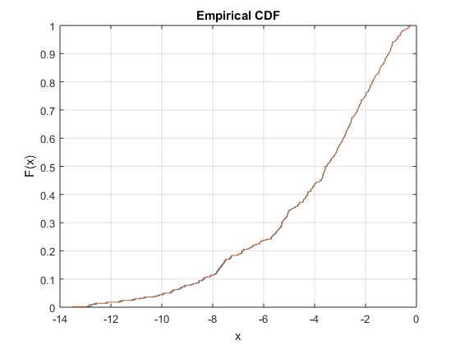
CDF of Integrated Phase Noise [1]
500 iterations
Fc=2.447 GHz
Integration bandwidth
  10 KHz – 2 MHz and 10 MHz
  10 KHz resolution
Statistics
  Min: -13.5dBc
  Max: -0.25dBc
  Mean: -4.24dBc
  Median: -3.6dBc
  Std: 2.87dBc

Slide 7
Minimum Phase Noise of a Ring Oscillator
Minimum phase noise of a ring oscillator with the minimum power consumption is shown in [2]:
  Definitions
    PN_{min}: minimum phase noise; P_{min}: minimum power dissipation
    f₀: oscillation frequency; Δf: offset frequency
    k: Boltzmann constant, T: temperature
  [2] Navid, T. H. Lee, R. W. Dutton, “Minimum Achievable Phase Noise of RC Oscillators”, JSSC 2005
(1)

Slide 8
Single-Sideband Phase Noise Spectrum in dBc/Hz
The single-sideband phase noise L(f_{m}) (in dBc/Hz) is expressed as follows for small values of c and for 0<=f_{m}<<f₀ in [3]
where f_{m}= Δf: offset frequency and L(f_{m})=PN(Δf).
[3] A. Demir, A. Mehrotra, and J. Roychowdhury., "Phase noise in oscillators: a unifying theory and numerical methods for characterization," Transactions on Circuits and Systems I: Fundamental Theory and Applications, vol. 47, no. 5, pp. 655-674, May 2000.
(2)

Slide 9
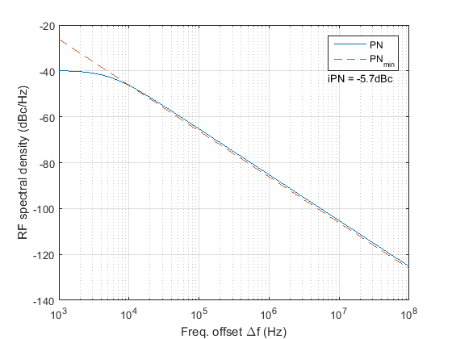
Finding the Constant c for a Given LO Power Consumption
Choose power consumption P_{min}
Find constant c that makes PN overlap with PN_{min}
Example 1:
  f0 = 2.437GHz
  PNmin(Δf) at Pmin=75µW
  PN(Δf) with c = 0.5e-15
  Integrated PN (iPN) =-5.7dBc
    10 KHz ~ 2 MHz

Slide 10
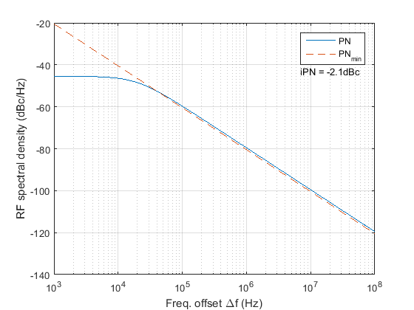
Example 2: P_{min}=20 µW
Parameters
  f0 = 2.437GHz
  PNmin(Δf) at Pmin=20 µW
  PN(Δf) with c = 1.875e-15
  Integrated PN (iPN) =-2.1dBc
    10 KHz ~ 2 MHz

Slide 11
Conclusions
The phase noise model (Slide 8 eq.(2)) shown in [1] and [3] is a good candidate phase noise model for WUR development in TGba with some margin
The minimum phase noise model (Slide 7 eq.(1)) shown in [2] can be used to estimate the power consumption of a ring oscillator

Slide 12
References
[1] O. Khan; B. Wheeler; F. Maksimovic; D. Burnett; A. M. Niknejad; K. Pister, "Modeling the Impact of Phase Noise on the Performance of Crystal-Free Radios," in IEEE Transactions on Circuits and Systems II: Express Briefs , vol.PP, no.99, pp.1-1
[2] Navid, T. H. Lee, R. W. Dutton, “Minimum Achievable Phase Noise of RC Oscillators”, JSSC 2005
[3] A. Demir, A. Mehrotra, and J. Roychowdhury., "Phase noise in oscillators: a unifying theory and numerical methods for characterization," Transactions on Circuits and Systems I: Fundamental Theory and Applications, vol. 47, no. 5, pp. 655-674, May 2000.

