Slide 1
Training Field Structure Definition
Date: 2017-01-16
Authors:

Slide 2
Abstract
We propose and discuss AGC and TRN structures for the EDMG single-carrier and control modes.

Slide 3
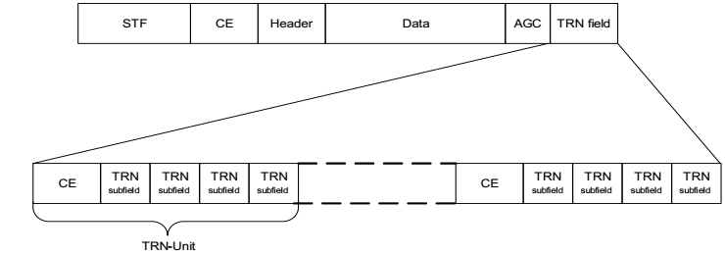
TRN
The following structure is defined in the 11ad spec for the TRN field:
where
CE subfield: [-Gb128 –Ga128 Gb128 –Ga128 –Gb128 Ga128 –Gb128 –Ga128 –Gb128]
TRN subfield: [Ga128 –Gb128 Ga128 Gb128 Ga128]
It should be noted that:
The TRN field is composed of two different sequences (CE and TRN)
Each TRN-Unit consists of one CE sequence (9×128) and 4 TRN subfields (5×128 each)

Slide 4
TRN
After analyzing different options to improve the TRN structure for CB and MIMO transmissions, we came to the conclusion that a structure which uses just one “subfield sequence” is advantageous.
We thus propose the following TRN structure:
First P sequences in a TRN-Unit: Same AWV as preamble/data.
Last M sequences in a TRN-Unit may use different AWV settings depending on whether transmit or receive training is used
Additional P sequences at the end of the training field allow for frequency tracking.

Slide 5
TRN
In addition, we propose to keep the structure of a TRN-Unit configurable :
P TRN sequences used for CE estimation and M TRN sequences used for BF training, where P and M are configurable values.
The “optimal” values for P and M for different implementations and BF training flows may be different.
Example: The values of P and M that a device supports shall be indicated via the STA’s EDMG Capabilities element. A STA may request a peer STA to use a combination of P and M that is different than the mandatory mode through the BRP Setup sub-phase.
Possible TRN sequence definition will be discussed in a different Intel presentation.
Extension of the proposed structure to MIMO and CB are given in the same presentation.

Slide 6
AGC
The 11ad spec defines that the AGC field is made up of $4N$ subfields, where the subfield is given by [Ga64 Ga64 Ga64 Ga64 Ga64] in the SC mode or by [Gb64 Gb64 Gb64 Gb64 Gb64] in the control mode, and N is the Training Length field (number of TRN-Units).
Our analysis of the legacy AGC structure showed that the gain obtained by completely deleting the AGC field (lower overhead, HW complexity) offsets potential performance losses.
Overhead: Training length $\left(N\right)$ increased to 256 from 32.
It is possible to set the AGC by using measurements obtained in other fields
We thus propose the removal of the AGC field from the EDMG PPDU definition.

Slide 7
SP 1
Do you agree that the training field of EDMG PPDUs shall be defined as shown below for the single-carrier and control modes? In the proposed structure, the number of TRN sequences used for channel estimation (that is, transmitted with the same AWV as the preamble/data fields) (P) and for BF training (which may use different AWV settings depending on whether transmit or receive training is used) (M) in a TRN-Unit is configurable.

Slide 8
SP 2
Do you agree that the AGC field currently defined for single-carrier and control mode EDMG PPDUs shall be removed?

Slide 9
References

