Slide 1
802.11 January 2017 Closing Reports
Date: 2017-01-19
Authors:

Slide 2
Abstract
This document is a digest of the closing reports of all 802.11 sub-groups for presentation at the January 2017 closing plenary meeting. Attendance information and liaison reports (including liaison reports from the mid-week plenary) are also included.

Slide 3
Attendance
Data as of 2017-01-19
16:40

Slide 4
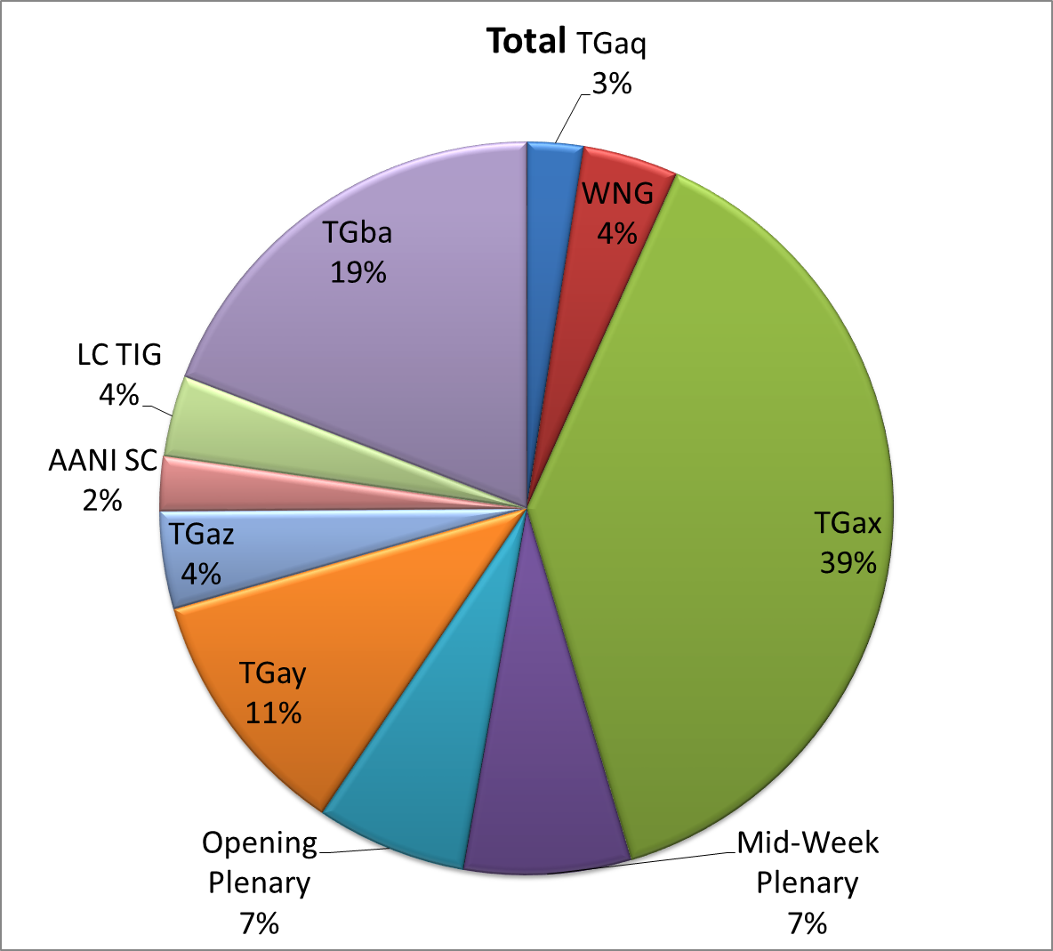
Attendance Total

Slide 5
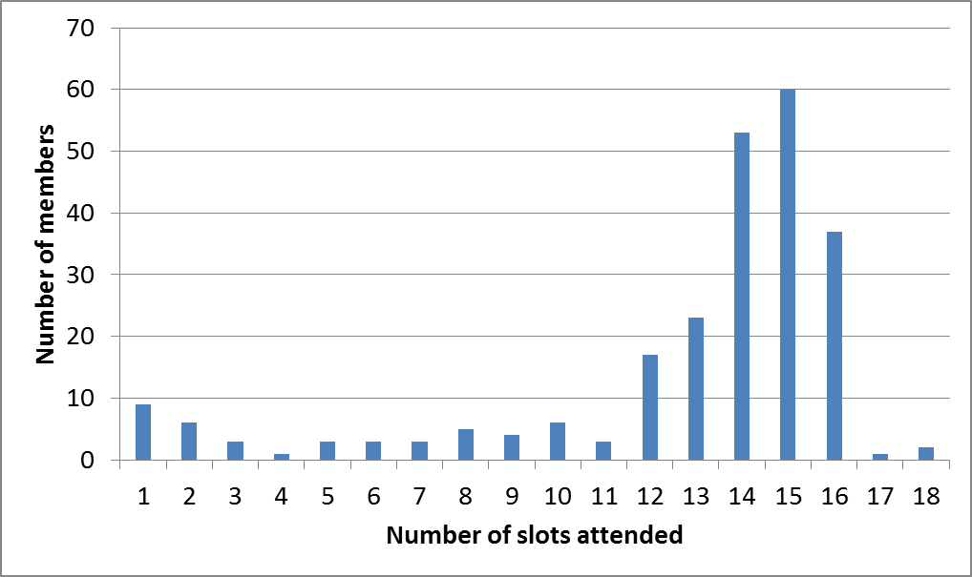
Attendance Histogram

Slide 6
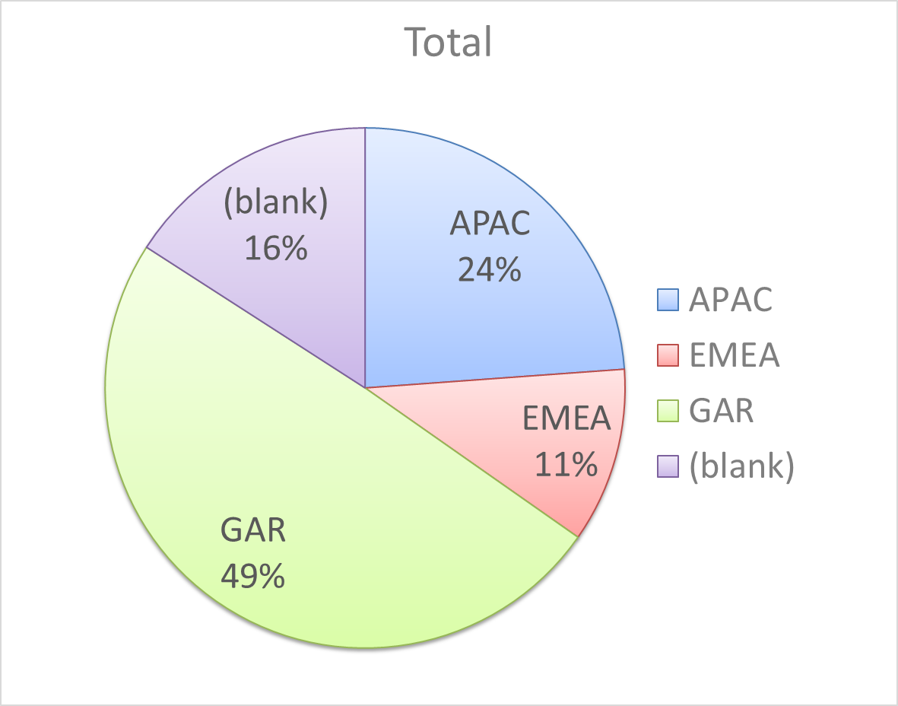
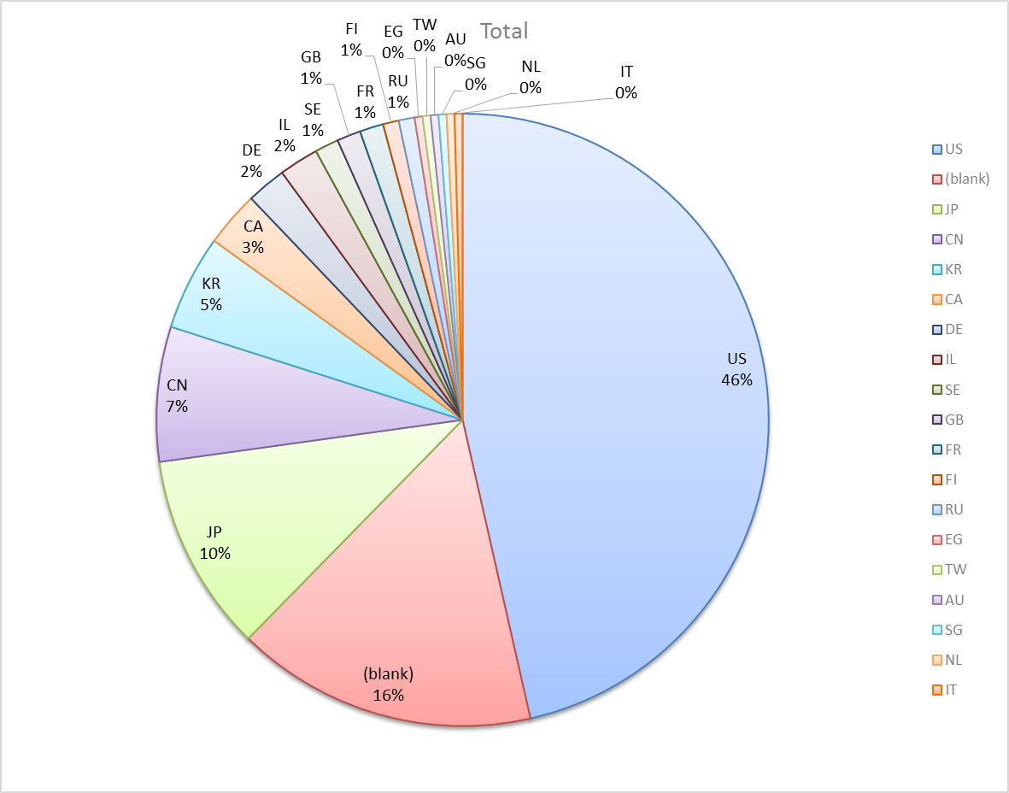
Attendance by Country

Slide 7
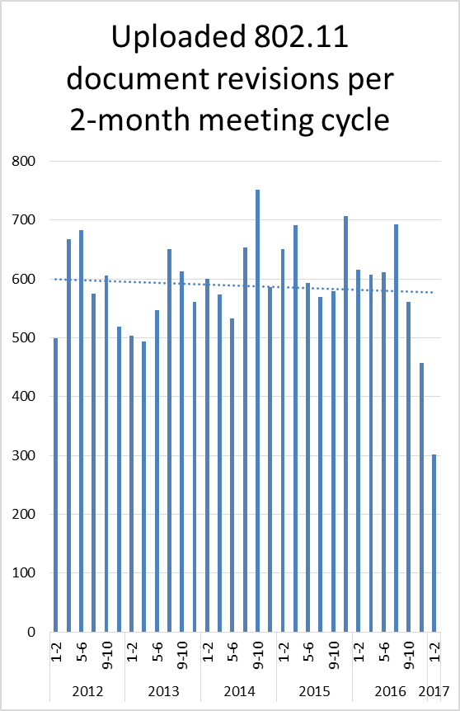
Doc Revision uploads by meeting (month #)

Slide 8
802.11 WG Editor’s Meeting (Jan ‘17)
Date: 2017-01-07
Authors:
from slide 1/8 of 11-17-0008 by Peter Ecclesine (Self)
Notes:
July 2007

Slide 9
Volunteer Editor Contacts
TGaj – Jiamin CHEN – jiamin.chen@mail01.huawei.com , Shiwen He – shiwenhe@seu.edu.cn
TGak – Donald Eastlake – d3e3e3@gmail.com
TGaq – Lee Armstrong – LRA@tiac.net
  TGax – Robert Stacey – robert.stacey@intel.com
  TGay – Carlos Cordeiro – carlos.cordeiro@intel.com
  TGaz – Chao Chun Wang – chaochun.wang@mediatek.com
  Editors Emeritus:
  TGaa – Alex Ashley – alex.ashley@hotmail.co.uk
  TGac – Robert Stacey – robert.stacey@intel.com
  TGad – Carlos Cordeiro – carlos.cordeiro@intel.com
  TGae – Henry Ptasinski – henry@LOGOUT.COM
  TGaf – Peter Ecclesine – petere@ieee.org
  REVmc – Adrian Stephens – adrian.p.stephens@ieee.org , Edward Au – edward.ks.au@huawei.com, Emily Qi – emily.h.qi@intel.com
  TGai - LRA@tiac.net, Ping FANG Ping.FANG@huawei.com
  TGah – Yongho Seok yongho.seok@gmail.com, Alfred Asterjadhi – aasterja@qti.qualcomm.com
  TGaq – Dan Gal – ddrgal@gmail.com
from slide 2/8 of 11-17-0008 by Peter Ecclesine (Self)
Notes:
July 2007

Slide 10
MDR Status
802.11 Working Group Mandatory Draft Review
  802.11-11/615r6 documents the process. MDR now in the 802.11 Operating Manual 802.11-14/0629r8. The process needs some change so the report is done after the editing is done.
P802.11aa D5.0 went through Working Group Mandatory Editorial Coordination before July 2011
P802.11ad D4.0 went through Working Group Mandatory Editorial Coordination before July 2011
P802.11ae D4.0 went through Working Group Mandatory Editorial Coordination before July 2011
P802.11ac D4.0 went through Working Group Mandatory Draft Review before January 2013
P802.11af D4.0 went through Working Group Mandatory Draft Review before May 18, 2013
REVmc D3.0 went through MDR process – 802.11-14/781r11 dated Sept 19, 2014
P802.11ah D4.0 went through MDR process – 802.11-15/247r3 dated Mar 12, 2015
P802.11ai D4.0 went through MDR process – 802.11-15/248r4 dated May 14, 2015
P802.11aq D4.0 went through MDR process – 802.11-16/801r0 dated June 22, 2016
P802.11aj D3.0 went through MDR process – 802.11-16/1333r5 dated Dec 9, 2016
  Final changes will go into D5.0
P802.11ak – expect 11ak D4.0 to be ready in late Jan. Edward Au volunteers to be the third reviewer. Review will be based on D3.0 in Word, 17/143r1 MDR draft report by Feb 7th.
from slide 3/8 of 11-17-0008 by Peter Ecclesine (Self)

Slide 11
The proliferation of STA types and their requirement inheritance
S1G
S1G relay
(unadorned)
STA
QoS
HT
VHT
HE
TVHT
DMG
EDMG
Mesh
One technique we use to define feature set applicability is the STA type
CDMG
45MG
FILS
GLK
from slide 4/8 of 11-17-0008 by Peter Ecclesine (Self)

Slide 12
802.11 Style Guide
See 11-09-1034-11-0000-wg11-style-guide.doc
  We updated 802.11 WG Style Guide based on 2012 IEEE Standards Style Manual and consistency changes in final publication of the 802.11 standard
Editor’s responsibility includes checking the 2014 IEEE Standards Style Manual when creating or updating drafts. https://development.standards.ieee.org/myproject/Public/mytools/draft/styleman.pdf
Submissions with draft text should conform to both the WG11 Style Guide and IEEE Standards Style Manual
Note that the Style Guide evolves with our practice, expect a revision in March
from slide 5/8 of 11-17-0008 by Peter Ecclesine (Self)

Slide 13
Editor Amendment Ordering
Data as of Jan 2017
See http://grouper.ieee.org/groups/802/11/Reports/802.11_Timelines.htm
In July 2016, Editors changed the running order and will revisit in Mar 2017, maintaining this order in the interim
Amendment Number | Task Group | Projected REVCOM Date
802.11REVmc | TGmc | Dec 2016
802.11-2016 Amendment 1 | TGai | Dec 2016
802.11-2016 Amendment 2 | TGah | Dec 2016
802.11-2016 Amendment 3 | TGaq - 36 | Mar 2017
802.11-2016 Amendment 4 | TGaj - 297 | Jul 2017
802.11-2016 Amendment 5 | TGak - 94 | Jan 2018
802.11-2016 Amendment 6 | TGax – 427 | Dec 2018
802.11-2016 Amendment 7 | TGay - 167 | Nov 2019
802.11-2016 Amendment 8 | TGaz | Mar 2020
Amendment numbering is editorial! No need to make ballot comments on these dynamic numbers!
from slide 6/8 of 11-17-0008 by Peter Ecclesine (Self)
Notes:
July 2007

Slide 14
Draft Development Snapshot
January 2017
Jan 2017
TG | Published or Draft Baseline Documents |  |  |  |  |  |  |  |  |  | Source | MDR | Style Guide | Editor | Snapshot Date
 | Published | mc | ai | ah | aq | ak | aj | ax | ay | az
mc | Y | Y |  |  |  |  |  |  |  |  | Frame 12.0 | Yes | 2012 | Adrian Stephens Edward Au, Emily Qi | 17-Jan
ai | Y | 8.0 | 11.0 |  |  |  |  |  |  |  | Frame 12.0 | Yes | 2012 | Lee Armstrong Ping FANG | 17-Jan
ah | N | 8.0 |  | 10.0 |  |  |  |  |  |  | Frame 11.0 | Yes | 2012 | Yongho Seok Alfred Asterjadhi | 13-Sep
aq | Y |  |  | 10.0 | 7.1 |  |  |  |  |  | Frame 12.0 | No | 2012 | Lee Armstrong | 17-Jan
ak | N | 6.0 | 7.0 | 8.0 | 4.0 | 3.0 |  |  |  |  | Word | No | 2012 | Donald Eastlake Norm Finn | 17-Jan
aj | N | 8.0 | 11.0 | 10.0 | 7.0 | 2.5 | 4.0 |  |  |  | Frame 10.0 | No | 2012 | Jiamin Chen Shiwen He | 17-Jan
ax | N | 8.0 | 10.0 | 9.0 | 3.0 | 2.0 | 3.0 | 1.0 |  |  | Frame 12.0 | No | 2012 | Robert Stacey | 17-Jan
ay | Y |  | 10.0 | 9.0 | 3.0 | 2.0 | 3.0 | 1.0 |  |  | Word | No | 2012 | Carlos Cordeiro | 17-Jan
az |  |  |  |  |  |  |  |  |  |  |  |  |  | Chao Chun Wang | 17-Jan
Changes from last report shown in red.
Most current doc shaded green.
from slide 7/8 of 11-17-0008 by Peter Ecclesine (Self)
Notes:
July 2009
July 2007
Peter Ecclesine (Cisco Systems)
Page 14

Slide 15
MIB style, Visio and Frame practices
I’m going to suggest going forward we use a single style with appropriately set tabs, and use leading Tabs to distinguish the syntax and description parts. (Adrian Stephens Feb 9, 2010)
Two ways to format a figure & its caption in frame:
  Insert a table. Insert anchored frame inside table cell to hold graphics. Use table caption as figure caption.
  Insert an anchored frame. Insert caption inside a text frame inside the anchored frame. Insert graphics inside the anchored frame.
Keep embedded figures using visio as long as possible
  Near the end of sponsor ballot, turn these all into .emf (windows meta file) format files (you can do this from visio using “save as”). Keep separate files for the .vsd source and the .emf file that is linked to from frame. There is likelihood we should use .emf
Frame templates for 11aa, 11ac, 11af
from slide 8/8 of 11-17-0008 by Peter Ecclesine (Self)

Slide 16
AANI SC Closing Report January 2017
Date: 2017-01-19
Authors:
from slide 1/4 of 11-17-0178 by Joseph Levy (Interdigital)

Slide 17
Abstract
Abstract
This Document is the closing report for AANI SC,
November 2016 Meeting in San Antonio, TX
This Document is the closing report for AANI SC,
January 2017 Meeting in Atlanta, GA, USA
The draft minutes are available 11-17/0150r0
from slide 2/4 of 11-17-0178 by Joseph Levy (Interdigital)

Slide 18
802.11 AANI SC – January 2017
January Goals:
  Progress LSs to 3GPP RAN and 3GPP SA on suggested technical areas of engagement and requesting guidance on 3GPP planning/timing
  Complete reply LS to 3GPP RAN2 on Estimated Throughput
  Elect/Appoint a Vice Chair
Meeting Activity:
  Completed the LS to 3GPP RAN on suggested technical areas of engagement and requesting guidance on 3GPP planning/timing.
    Decided by straw poll (4/1/12)that it was desirable to request planning/timing information from RAN prior to their March meeting
    Agreed by motion that the LS in 11-16/1573r3 should be sent to 3GPP RAN
  Completed the reply LS to 3GPP RAN2 on Estimated Throughput
    A straw poll to taken approving sending 11-16/1510r2 as edited in the meeting and posted as 11-16/1510r3 to 3GPP RAN2
  Confirm Roger Marks as Vice-Chair for the AANI SC (16/0/1)
from slide 3/4 of 11-17-0178 by Joseph Levy (Interdigital)

Slide 19
Future Sessions Planning
Teleconference:
  None Planned
15-20 March 2017 F2F, in Vancouver, BC, Canada:
  Goals:
    Continue to work on 11-16/1574: the LS to 3GPP SA Requesting Status and Information on WLAN integration in 3GPP NextGen System
    Continue to work to define technical areas to discuss with 3GPP RAN
    Continue to work to define technical areas to discuss with 3GPP SA
    Continue to track 802.1 OmniRAN Ad Hoc IC activity (ICAID) – Note: the ICAID due to be completed at the March meeting
  Tuesday:
    TBD
  Thursday:
    TBD
from slide 4/4 of 11-17-0178 by Joseph Levy (Interdigital)

Slide 20
ARC Closing Report
Date: 2017-01-19
Authors:
from slide 1/6 of 11-17-0174 by Mark Hamilton, Ruckus/Brocade

Slide 21
Abstract
This document is the closing report for ARC SC,
January 2017 Meeting in Atlanta, Georgia, USA
from slide 2/6 of 11-17-0174 by Mark Hamilton, Ruckus/Brocade

Slide 22
Work Completed
Agenda is here: 11-16/1591r4
Noted status of IEEE 1588 mapping to IEEE 802.11
  No changes. No action needed.
Noted IEEE 802 activities relevant to 802.11/ARC
  802.1AC approved by RevCom, will be published soon.
  802.1Q revision underway. Roll-in.
IETF/802 coordination
  Multicast issue has been explained. No further action needed (for now).
  Tutorial on .11/.15 has been updated and given. No further action.
Status of joint topics with TGak (General Links – joint mtg)
  “Up is up, down is down” with 802.1 bridges, etc: 11-17/0136r0
from slide 3/6 of 11-17-0174 by Mark Hamilton, Ruckus/Brocade

Slide 23
Work Completed (cont)
MIB Design Pattern work item
  Discussed https://mentor.ieee.org/802.11/dcn/15/11-15-0355-04-0arc-mib-truthvalue-usage-patterns.docx, last time – no progress since.
  Have reviewed and discussed all known open issues, with consensus direction given.
  Chair will update, per direction, for (hopefully final) review and approval in March. (Really need to complete this.)
Joint with TGak and 802.1: Architecture, aligned with 802.1 concepts, including addition of 11ak features. 11-17/0136r0
  Agreement with 802.1 on intent and mapping to 802.11. Need to capture this in 11ak and perhaps REVmd.
YANG/NETCONF
  Good overview and introduction with 802.1 experts.
  Will consider input received and review reference materials in preparation, and make a recommendation in March.
  Anybody with experience on these, please come help us out!
from slide 4/6 of 11-17-0174 by Mark Hamilton, Ruckus/Brocade

Slide 24
Teleconference(s)
None planned
May schedule with 10 days’ notice
from slide 5/6 of 11-17-0174 by Mark Hamilton, Ruckus/Brocade

Slide 25
March 2017 Plans
Three standalone meeting slots planned:
  Finish Design Pattern for MIB attribute use
  Come to a recommendation on 802.11’s use of YANG/NETCONF
  DS/AP/Portal architecture discussions, and “what is an ESS?”
  Status updates on IETF work, IEEE 1588 work
Potentially one joint session with either/both TGak and 802.1
  Architecture modeling follow-up
from slide 6/6 of 11-17-0174 by Mark Hamilton, Ruckus/Brocade

Slide 26
Closing Report
Date: 2017-01-20
Authors:
from slide 1/3 of 11-17-0172 by Jim Lansford, Chair (Qualcomm)

Slide 27
Abstract
Closing report for WNG SC for January 2017 in Atlanta, Georgia (USA)
from slide 2/3 of 11-17-0172 by Jim Lansford, Chair (Qualcomm)

Slide 28
Final Agenda
https://mentor.ieee.org/802.11/dcn/16/11-16-1588-01-0wng-agenda-for-wng-2017-01.ppt
Presentations at January 2017 meeting
  “Issue of 802.11 WLAN on Congested Primary Channel,” Kazuto Yano, Advanced Telecommunications Research Institute International (ATR)
      https://mentor.ieee.org/802.11/dcn/17/11-17-0129-03-0wng-issue-of-congested-primary-channel-in-802-11-wlan.pptx
    Straw poll:
      Do you think that IEEE 802.11 wireless LAN should have a new way to overcome the situation that the primary channel is heavily congested?
      Voting: 3 yes / 5 no / 54 abstain
Minutes
  https://mentor.ieee.org/802.11/dcn/17/11-17-0146-00-0wng-wng-meeting-minutes-of-2017-january-atlanta-meeting.docx
Plans for March 2017
  TBD
No motions, no conference calls
from slide 3/3 of 11-17-0172 by Jim Lansford, Chair (Qualcomm)

Slide 29
IEEE 802.11 PDED ad hoc closing report in Atlanta in Jan 2017
January 2017
20 Jan 2017
Authors:
Name | Company | Phone | email
Andrew Myles | Cisco | +61 2 84461010 +61 418 656587 | amyles@cisco.com
from slide 1/3 of 11-17-0170 by Andrew Myles, Cisco

Slide 30
IEEE 802.11 PDED ad hoc achieved its goals in Atlanta in Jan 2017
January 2017
IEEE 802.11 PDED achievements in Atlanta in Jan 2017
(agenda, draft/unapproved minutes on Tuesday & Wednesday )
  Reviewed LS from 3GPP RAN1 related to ED issue
    Agreement that little benefit in continuing discussion with RAN1 at this time
    Will decide in Vancouver whether to:
      Send no further LS’s to RAN1,
      Send a final LS to RAN1 that “agrees to disagree”
  Heard further simulation results relevant to ED issue
    Authors agreed to refine and clarify for Vancouver
  Discussed the threat to 802.11ax if exception for 802.11ac in EN 301 893 is not extended to 802.11ax
    Key observation is that a case can be made that an exception is “technology neutral” (this is important in European regulations)
Adrian Stephens, Intel Corporation
from slide 2/3 of 11-17-0170 by Andrew Myles, Cisco

Slide 31
IEEE 802.11 PDED ad hoc wants to continue its work until at least the Vancouver meeting in Mar 2017
January 2017
  IEEE 802.11 PDED ad hoc have plans for work until at least March 2017
    Use e-mail reflector for discussions and to encourage work
      Draft LS to RAN1 will be discussed by e-mail
    Hold one or more teleconferences as required
      Will be called with 10 days notice
    Hold two sessions in Vancouver
      Approve LS on ED issue to RAN1 (or decide not to send LS)
      Hear further simulation results related to ED issue
      Refine plans for how to address ED rules in EN 301 893
  The 802.11 WG Chair is requested to authorise the continuation of the IEEE 802.11 PDED ad hoc in Vancouver
Adrian Stephens, Intel Corporation
from slide 3/3 of 11-17-0170 by Andrew Myles, Cisco

Slide 32
IEEE 802 JTC1 Standing Committee
Jan 2017 closing report
January 2017
19 January 2017
Authors:
Name | Company | Phone | email
Andrew Myles (Chair) | Cisco | +61 2 84461010 +61 418 656587 | amyles@cisco.com
Peter Yee (Vice Chair) | AKAYLA | +1 415 215 7733 | peter@akayla.com
from slide 1/3 of 11-17-0181 by Peter Yee, AKAYLA

Slide 33
The IEEE 802 JTC1 SC mainly focused on executing the PSDO process in Atlanta in Jan 2017
January 2017
IEEE 802 JTC1 SC achievements in Atlanta in Jan 2017
  Processed PSDO submissions
    Noted status of 38 standards in the PSDO pipeline
  Obtained working group statuses to be submitted to the upcoming JTC1/SC6 meeting in Tunisia
    Nothing that should concern IEEE 802.11 on WG1’s agenda
from slide 2/3 of 11-17-0181 by Peter Yee, AKAYLA

Slide 34
The IEEE 802 JTC1 SC mainly focused on executing the PSDO process in Atlanta in Jan 2017
IEEE 802 JTC1 plans for Vancouver in Mar 2017
  Execute PSDO process
  Review the outcome of the February JTC1/SC6 meeting
  Review feedback from Jodi Haasz (IEEE Staff) on reaching out to JTC1/SC6 national bodies regarding abstentions
Adrian Stephens, Intel Corporation
from slide 3/3 of 11-17-0181 by Peter Yee, AKAYLA

Slide 35
IEEE 802.11aj January 2017 Closing Report
Date: 2017-01-19
Author:
from slide 1/7 of 11-17-0160 by Jiamin Chen (Huawei)

Slide 36
Abstract
This document is the TGaj closing report for the January 2017 session.
from slide 2/7 of 11-17-0160 by Jiamin Chen (Huawei)

Slide 37
Work Completed (1/2)
  Approved November 2016 meeting minutes (11-16/1555r0)
The following comment resolution proposals have been presented
    11-17/0087r1 – Proposed resolution to CID 601, 602, 603, 604, 605, 606, 607, 609, 610, 611, 613, 614, 615, 616, 623 in LB226
    11-17/0080r1 – Proposed resolutions for CID 612, 617, 618, 619, 620, 621, 622 in LB226
    11-17/0083r0 – Proposed resolution to CID 625,626,627 in LB226
    11-17/0130r0 – Proposed resolution to CID 608, 624 in LB223
Completed all comment resolution of the LB226 for D4.0
Approved those comment resolutions and instruct editor to incorporate them into D5.0.
from slide 3/7 of 11-17-0160 by Jiamin Chen (Huawei)

Slide 38
Work Completed (2/2)
Approved resolutions for updated TGaj MDR report.
    11-16/1333r7 – TGaj MDR report
Approved a 15 day Working Group Technical Recirculation Letter Ballot asking the question “Should P802.11aj D5.0 be forwarded to Sponsor Ballot?”
from slide 4/7 of 11-17-0160 by Jiamin Chen (Huawei)

Slide 39
Plan for March 2017 meeting
Comment resolution for 802.11aj WG 4th Recirculation Letter Ballot
Conditional Sponsor Ballot
from slide 5/7 of 11-17-0160 by Jiamin Chen (Huawei)

Slide 40
Conference Call Time
  2nd March, 2017, 8 pm ET for 1 hour
  (3rd March, 2017, 9am Beijing Time)
from slide 6/7 of 11-17-0160 by Jiamin Chen (Huawei)

Slide 41
January 2017
Thank you！
from slide 7/7 of 11-17-0160 by Jiamin Chen (Huawei)

Slide 42
TGak January Closing Report
Date: 2017-01-19
Authors:
Abstract
Closing Report of the 802.11 TGak meeting January 2017 in Atlanta, Georgia.
from slide 1/4 of 11-17-0182 by Donald Eastlake, Huawei Technologies

Slide 43
TGak Closing Report
Accomplishments
  TGak entered the week with the 57 comments from recirculation LB227 unresolved. During the week, it resolved 49 of these comments.
  Met jointly with 802.11 ARC SC and 802.1 Thursday AM1.
  An annotated agenda is in 11-16/1586.
  The minutes will be in 11-16/469.
from slide 2/4 of 11-17-0182 by Donald Eastlake, Huawei Technologies

Slide 44
TGak Closing Report
Submissions
  11-17/0145, Joseph Levy (InterDigital), “Letter Ballot 227 Comment Resolution for CID 1404, 1405, 1447, 1456”
  11-17/0151, Ganesh Venkatesan (Intel), “LB 227 GLK-GCR related comment resolutions (relative to P802.11ak D3.0 and IEEE 802.11-2016)”
  11-17/0136r2, Mark Hamilton (Ruckus, Brocade), “Bridging Architecture Considerations ”
  11-17/0154, Donald Eastlake (Huawei), “Disambiguating SYNRA”
from slide 3/4 of 11-17-0182 by Donald Eastlake, Huawei Technologies

Slide 45
TGak Closing Report
Teleconferences
  Decided to hold 1 ½ hour teleconferences through the March 2017 802.11 meeting on Mondays January 30th and February 13th, 20th, and 27th at 10am Eastern US Time.
March 2017 Plans
  Finish resolving comments from LB227.
  Re-ciruclation LB on 11ak D4.0.
  Joint meeting with 802.11 ARC SC.
from slide 4/4 of 11-17-0182 by Donald Eastlake, Huawei Technologies

Slide 46
TGaq Closing Report
Date: 2017-01-19
Authors:
from slide 1/3 of 11-17-0165 by Stephen McCann, BlackBerry

Slide 47
Abstract
Closing report for TGaq (Pre-Association Discovery) for January 2017, Atlanta, Georgia, USA.
from slide 2/3 of 11-17-0165 by Stephen McCann, BlackBerry

Slide 48
Sponsor Ballot status
  Initial sponsor ballot finished on 4th November 2017
  235 comments, 87% approval
  19 technical comments unresolved
  Re-circulation ballot planned for February 2017
Teleconferences
  Fridays in February and March.
Plans for March 2017
  Sponsor ballot comment resolution
  Possible joint meeting with ARC
from slide 3/3 of 11-17-0165 by Stephen McCann, BlackBerry

Slide 49
TGax January 2017 Closing Report
Date: 2017-01-19
Authors:
from slide 1/5 of 11-17-0179 by Osama Aboul-Magd (Huawei Technologies)

Slide 50
Abstract
This document is the closing report for the TGax for the January 2017 session.
from slide 2/5 of 11-17-0179 by Osama Aboul-Magd (Huawei Technologies)

Slide 51
Work Completed
Assignment of comments is completed.
The TG started discussing resolutions of comments submitted on draft D1.0
  Approximately 200 comments are resolved
Spatial Reuse issues were discussed at length
  Slow progress on SRP-based SR
Proposal to include simplified simulation models in the TG simulation scenarios document was discussed and passed straw poll.
Agreed to hold an ad hoc meeting in San Diego, March 8-10.
The agenda is available at: https://mentor.ieee.org/802.11/dcn/16/11-16-1587-04-00ax-tgax-january-2017-meeting-agenda.ppt
from slide 3/5 of 11-17-0179 by Osama Aboul-Magd (Huawei Technologies)

Slide 52
March 2017 Goals
Continue with the resolution of comments on draft D1.0
from slide 4/5 of 11-17-0179 by Osama Aboul-Magd (Huawei Technologies)

Slide 53
Conference Call Times
February 2, 23, March 30 10:00 – 12:00 ET
February 16, March 2, 23, April 6 20:00 -22:00 ET
from slide 5/5 of 11-17-0179 by Osama Aboul-Magd (Huawei Technologies)

Slide 54
Task Group AY
January 2017 Closing Report
Date: 2017-01-20
Authors:
from slide 1/5 of 11-17-0002 by Edward Au (Huawei Technologies)

Slide 55
Abstract
This document is the closing report for Task Group AY for the January 2017 session.
from slide 2/5 of 11-17-0002 by Edward Au (Huawei Technologies)

Slide 56
Work Completed
29 submissions were covered during the meeting covering areas related to:
  Channel model
  Specification framework document
Significant progress is made in the development of specification framework document
Draft 0.1 review
from slide 3/5 of 11-17-0002 by Edward Au (Huawei Technologies)

Slide 57
Goals for March 2017 plenary
Advance on Draft amendment
Technical presentation
Consider approval of Draft 0.2 for comment collection
from slide 4/5 of 11-17-0002 by Edward Au (Huawei Technologies)

Slide 58
Teleconference Schedule
February 15 (Wednesday), 10:00am ET – 11:00am ET
February 22 (Wednesday), 10:00am ET – 11:00am ET
March 1 (Wednesday), 10:00am ET – 11:00am ET
from slide 5/5 of 11-17-0002 by Edward Au (Huawei Technologies)

Slide 59
TGaz Next Generation Positioning
Jan. Closing Report
Date: 2017-01-19
Authors:
from slide 1/7 of 11-17-0096 by Jonathan Segev, Intel Corporation

Slide 60
Abstract
This document is the TGaz Next Generation Positioning closing report for the Atlanta Buckhead meeting, Jan. 2017.
from slide 2/7 of 11-17-0096 by Jonathan Segev, Intel Corporation

Slide 61
Work Completed This Week
Reviewed and adopted text to Spec. Framework on ranging protocol sounding format and sounding sequence for the <6Ghz band as well LOS requirements for the 60Gz band.
Reviewed and adopted a threat model for a secured location protocol to FRD, this will enable design and evaluation of secured protocol functionality.
Reviewed technical submissions on measurement exchange and negotiation and secured location approaches.
from slide 3/7 of 11-17-0096 by Jonathan Segev, Intel Corporation

Slide 62
Work Completed This Week
Defined goals for D0.1 (SFD feature freeze on 2/4 focus topics and 50% protocol complete).
Reviewed and approved updated program timelines.
Set telecon times and goals for March meeting.
Agenda: See 11-16/1599r3.
from slide 4/7 of 11-17-0096 by Jonathan Segev, Intel Corporation

Slide 63
Approved TGaz Timelines
2015
2016
2017
2018
2019
2020
2021
SG
Formation
1-15
TG formation
9-15
.11az SFD
11-2016
.11az requirement freeze
5-2017
.11az
Draft 0.1
March 2018
.11az
Draft 1.0
11-2018
.11az
Draft 2.0
5-2019
.11az
Final
3-2021
5/15-11/15
UCD
11/15-5/17
FRD
9/16-5/18
11az SFD
5/17-3/21
Range Accuracy
Coverage in <6Ghz
Amendment text
FRD
MU mode sequence
MU mode
Resource all.
SU sequence
Capability ex. and negotiation
FRD Freeze
SFD Freeze
SFD
Threat model
Security
FRD
SFD
60Ghz
FRD
SFD
Scalability
FRD
SFD
Angular in
<6Ghz
FRD
SFD
from slide 5/7 of 11-17-0096 by Jonathan Segev, Intel Corporation

Slide 64
Goals For The March Meeting
Continue development of FRD and SFD development.
Review technical submissions on measurement phase approaches, feedback types and design, negotiation phase and other adaptation to 11ax MU and SU modes, NG60/11ad and secured location schemes.
from slide 6/7 of 11-17-0096 by Jonathan Segev, Intel Corporation

Slide 65
Teleconference Schedule
Mar. 8th (Wed.) 10:00AM ET for 1hr.
from slide 7/7 of 11-17-0096 by Jonathan Segev, Intel Corporation

Slide 66
TGba
January 2017 Closing Report
Date: 2017-01-19
Authors:
from slide 1/6 of 11-17-0175 by Minyoung Park (Intel Corp.)

Slide 67
Abstract
This document is the TGba closing report for January 2017
from slide 2/6 of 11-17-0175 by Minyoung Park (Intel Corp.)

Slide 68
Work Completed
TG approved the TG leadership structure
  Chair, 2 Vice-chairs, Secretary
TG Secretary confirmed by the TG (Y/N/A: 57/0/2)
  TG Secretary: Leif Wilhelmsson
Discussed TG spec development process
TG approved to create four TG documents
  Use case document (1st draft [11-17/0029r4] approved by the TG)
  Functional requirements document
  Evaluation methodology and simulation scenario document
  Spec framework document
Reviewed technical presentations (21 out of 27 submissions)
Approved the TG timeline (next slide)
Set goals for the March 2017 meeting and teleconference schedule
Agenda: see doc.: IEEE 802.11-16/1593r6
from slide 3/6 of 11-17-0175 by Minyoung Park (Intel Corp.)

Slide 69
TGba Timeline [11-16/1593r6]
2017
  January: TGba formation meeting
  November: TGba Draft 0.1
2018
  March: TGba Draft 1.0
  September: TGba Draft 2.0
2019:
  March: MDR (mandatory document review)
  July: formation of sponsor ballot pool
  September: Sponsor ballot
2020
  July: RevCom
from slide 4/6 of 11-17-0175 by Minyoung Park (Intel Corp.)

Slide 70
Goal for March 2017
TG Vice-Chair election
Review technical presentations
Work on TGba task group documents
  Use case document (editor: RossYu)
  Functional requirement document (editor:Ming Gan)
  Evaluation methodology and simulation scenario document (editor: Shahrnaz Azizi)
  Spec framework document (editor: TBD)
Review TG timeline
from slide 5/6 of 11-17-0175 by Minyoung Park (Intel Corp.)

Slide 71
Teleconference Call Schedule
  3 teleconference calls
    February 06 (Monday), 10:00 ET (1.5 hours)
    February 13 (Monday), 17:00 ET (1.5 hours)
    February 27 (Monday), 23:00 ET (1.5 hours)
from slide 6/6 of 11-17-0175 by Minyoung Park (Intel Corp.)

Slide 72
Light Communications Topic Interest Group January 2017 Closing Report
Date: 2017-01-19
Author:
from slide 1/4 of 11-17-0176 by Nikola Serafimovski (pureLiFi)

Slide 73
Abstract
This presentation contains the IEEE 802.11 Light Communications Topic Interest Group closing report for the January 2017 session.
from slide 2/4 of 11-17-0176 by Nikola Serafimovski (pureLiFi)

Slide 74
The LC TIG achieved its objective in the Atlanta Meeting
  Administration
  Tuncer Baykas (Istanbul Mediopol University) was appointed Secretary
  Structure
  The draft report outline in doc. 17/0023r1 was approved as suitable format to continue the work of the TIG.
  Content
  Parts of doc. 17/0161r0 were included in doc. 17/0023r2 as a start on the technical work in the report.
  The general applicability of LC were presented in doc. 17/0125r0 and doc. 17/0168r1
  The TIG decided that the 802.11 should reach out to relevant industry organizations to invite additional relevant stakeholders with a liaison statement that should be approved at the March meeting.
from slide 3/4 of 11-17-0176 by Nikola Serafimovski (pureLiFi)

Slide 75
The LC TIG approved the following calendar for conference calls and meeting
Date | Location | Goal
13 Feb. 2017 | Conference call | Draft 1 of the Use-cases and technical feasibility section of doc. 17/0023r1
6 Mar. 2017 | Conference call | Draft 2 of the Use-cases and technical feasibility section and Draft 1 of Economic Viability section of doc. 17/0023r1
12 – 18 Mar. 2017 | Plenary – Vancouver | Final consensus and sign-off on use-cases and technical feasibility sections as well as Draft 2 of Economic Viability section of doc. 17/0023r1 Tutorial to wider 802 on Light Communications
10 Apr. 2017 | Conference call | Review of draft report
1 May 2017 | Conference call | Agenda discussion and agreement for Interim Consensus of comprehensive report
7 – 12 May 2017 | Interim – Daejeon | Final review and sign-off of TIG report on all sections
5 Jun. 2017 | Conference call | Potentially necessary
26 Jun. 2017 | Conference call | Potentially necessary
8 – 13 Jul. 2017 | Plenary – Berlin | WG and EC LC Study Group approval
  From doc. 17/0169r0 – exact timings for the calls will be announced with 10 day notice
from slide 4/4 of 11-17-0176 by Nikola Serafimovski (pureLiFi)

Slide 76
RR-TAG (802.18) to 802.11 Liaison Report
Date: 2017-January-20
Authors:
from slide 1/7 of 11-17-0153 by Jay Holcomb, Itron

Slide 77
Overview
This document summarizes the activities of the IEEE 802.18 Radio Regulatory Technical Advisory Group (RR-TAG) during the IEEE 802 Interim in January 2017 in Atlanta, GA USA.
from slide 2/7 of 11-17-0153 by Jay Holcomb, Itron

Slide 78
Items Reviewed/Discussed in the RR-TAG
ETSI BRAN and ERM TG11 updates
  Tracking standards needed for equipment to meet the RED.
CEPT CPG PT-D meeting report
  Preparing for the WRC-19
EU Radio Equipment Directive Status
  Better news, in past couple weeks the EU Commission has a plan so there will be a 5GHz standard, with note, with the complying with the RED happens in June.
Developing IEEE 802 positions for WRC-19 agenda items
ACMA consultations, decided not to respond
from slide 3/7 of 11-17-0153 by Jay Holcomb, Itron, Inc.

Slide 79
ITU liaisons
11 new ITU liaisons uploaded to 802.18 mentor
  Looking at the different working groups to review and provide contributions.
  A couple of the 11 Liaisons that maybe of interest to 802.11, with the 802.18 DCN:
IEEE 802.11 & 802.15:
18-17-0010-00, “Multiple Gigabit Wireless Systems”, ITU-R WP5A is requesting data in support of a revision of Recommendation ITU-R M.2003, which provides the general characteristics and radio interface standards for Multiple Gigabit Wireless Systems in frequencies around 60 GHz.
(due 15May17)
18-17-0015-00, “CHARACTERISTICS FOR USE OF VISIBLE LIGHT* FOR BROADBAND COMMUNICATIONS”, ITU-R WP 1A started development of a working document towards a preliminary draft new Report ITU-R SM.[VISIBLE-LIGHT] under Question ITU-R 238/1.
(due 06Jun17)
IEEE 802
18-17-0018-00, “PRELIMINARY DRAFT REVISION OF REPORT ITU-R SM.2351-1 ON SMART GRID UTILITY MANAGEMENT SYSTEMS”, ITU-R WP1A has begun a revision of SM.2351-1, which was influenced by IEEE802, to incorporate 3GPP contributions.
(due-30apr17)
from slide 4/7 of 11-17-0153 by Jay Holcomb, Itron, Inc.

Slide 80
Other
No Ad Hoc meetings needed this week.
Status from Ofcomm
  ETSI
  CEPT CPG PT-D
  ITU-R WP5A
Documents approved:
  Minutes for San Antonio plenary 18-17/0017r00
from slide 5/7 of 11-17-0153 by Jay Holcomb, Itron, Inc.

Slide 81
Next
Continue on IEEE 802 position paper for WRC-19
Build up a regulatory calendar, e.g. RED, WRC-19, etc.
Monitor / support ITU liaisons
Stay on top of the ETSI standard updates for the RED
from slide 6/7 of 11-17-0153 by Jay Holcomb, Itron, Inc.

Slide 82
802.18 Meeting Close
The RR-TAG adjourned in AM1 on Thursday.
Will hold weekly, as needed, teleconferences, 14:30 ET Thursdays.
  Scheduled through 04 May 17.
  Next teleconference planed for 02 Feb 17
  All notices are sent through the 802.18 list server reflector.
The next face to face meeting of the 802.18 TAG will be the Plenary 17 – 19 March 2017 at the Hyatt Regency in Vancouver, BC, Canada
from slide 7/7 of 11-17-0153 by Jay Holcomb, Itron, Inc.

Slide 83
802.24 Vertical Applications
Technical Advisory Group
Liaison Report
Date: 2017-01-19
Author:
from slide 1/3 of 11-17-0183 by Tim Godfrey, EPRI

Slide 84
802.24 Overview
802.24 Vertical Applications TAG
802.24.1 Smart Grid TG
802.24.2 IoT TG
802.24.1 Smart Grid Task Group
  Internal / external coordination in matters related application of IEEE 802 standards for Smart Grid
  802.24.1 TG meets at Plenaries and Wireless Interims
802.24.2 IoT Task Group
  Internal / external coordination in matters related application of IEEE 802 standards for Internet of Things (IoT)
  802.24.2 TG meets at Plenaries and all-802 Interims
Jan Agenda: 24-17-0001r1
Closing Report 24-17-0002r2
Minutes 24-17-0003r0
from slide 2/3 of 11-17-0183 by Tim Godfrey, EPRI

Slide 85
802.24 Activities – Jan 2017
Worked on updating SGIP PAP2 Wireless Matrix 24-17-0004r1
Reviewed and discussed draft of IoT White Paper 25-15-0036r1
Developed initial outline for TSN white paper on applications of IEEE 802 Time Sensitive Networking (TSN) for utilities. 24-17-0006r0
  Joint Session with 802.1 TSN TG
from slide 3/3 of 11-17-0183 by Tim Godfrey, EPRI

Slide 86
IEEE 802.1 OmniRAN TG Status Report to IEEE 802 WGs
Date: 2017-01-19
Authors:
from slide 1/4 of 11-17-0180 by Max Riegel, Nokia Bell Labs

Slide 87
IEEE 802.1 OmniRAN TG Resources
OmniRAN TG maintains a Wiki page on mentor to reflect its status and achievements
  https://mentor.ieee.org/omniran/bp/StartPage
  Also showing meeting announcements and conference call dial-in information
OmniRAN filespace on mentor is used for contributions and meeting documents
  https://mentor.ieee.org/omniran/documents
Recent P802.1CF D0.3 draft is available by
  http://www.ieee802.org/1/files/private/cf-drafts/d0/802-1cf-d0-3.pdf
    w/ 802.11 credentials
FYI: OmniRAN P802.1 PAR
  https://development.standards.ieee.org/get-file/P802.1CF.pdf?t=81644900003
from slide 2/4 of 11-17-0180 by Max Riegel, Nokia Bell Labs

Slide 88
OmniRAN TG Achievements
Atlanta meeting, Jan 16th – 19th
Completion of comment resolution on draft P802.1CF D0.3
  Major additions/revisions to draft specification on
    Network initialization
    SDN Chapter
    Instantiation of virtualized access network
    Mapping to IEEE 802 technologies
Going forward to draft D0.4
  All modifications and new content for D0.4 were agreed in January F2F
  D0.4 should become available at around February 15th
  Recirculation of TG ballot with submission deadline on March 9th
Estimated timeline for P802.1CF within current scope:
  Starting WG ballot after March 2017, Sponsor Ballot Nov 2017
Special session on Industry Connections activity on January 18th
  Quite productive session. ICAID maturing with only few remaining opens:
    (Brand) Name for the Industry Connections activity
    Exact phrasing of the goals
    Outcome of session: https://mentor.ieee.org/omniran/dcn/16/omniran-16-0084-02-5gaa-draft-icaid-for-5g-sc-action-a.docx
from slide 3/4 of 11-17-0180 by Max Riegel, Nokia Bell Labs

Slide 89
Looking forward to next session in
Vancouver, BC, Mar 12-17, 2017
Envisioned topics:
  Start of comment resolution on P802.1CF-D0.4
  Completion of Functional Description chapter
    Main topic: Mapping to existing IEEE 802 standards
  EC approval of the ICAID
Upcoming conference calls
    January 31st , 09:30am ET
      5G SC Action A: Conclude on ICAID proposal
    February 7th , 09:30am ET
      ICAID leftovers
      Resolution of editorial issues of P802.1CF D0.4
from slide 4/4 of 11-17-0180 by Max Riegel, Nokia Bell Labs

Slide 90
IEEE 802.11-IETF Liaison Report
Date: 2017-01-17
Authors:
from slide 1/20 of 11-17-01 by Dorothy Stanley, HPE

Slide 91
Abstract
This presentation contains the IEEE 802.11 – IETF liaison report for January 2017.
from slide 2/20 of 11-17-01 by Dorothy Stanley, HPE

Slide 92
IETF Meetings
Upcoming Meetings:
  March 26-31, 2017 – Chicago
  July 16-21, 2017 – Prague
  November 12-17, 2017 – Singapore
  March 18-23, 2018 – London
  July 22-27, 2018 – San Francisco
http://www.ietf.org
  Newcomer training: https://www.ietf.org/edu/process-oriented-tutorials.html#newcomers
  April 2016: Wireless Tutorial (Donald Eastlake), 802.11 & 802.15 tutorials (Dorothy Stanley, Charlie Perkins), see 11-16/500, July 2016: Pat Thaler & Juan Carlos – 802.1E (Privacy Considerations) and 802.c (Local MAC address usage) https://www.ietf.org/edu/tutorials.html
  http://tools.ietf.org/dailydose/
from slide 3/20 of 11-17-01 by Dorothy Stanley, HPE

Slide 93
IETF- IEEE 802 Liaison Activity
Joint meetings, agenda and presentations
  http://www.iab.org/activities/joint-activities/iab-ieee-coordination/
  2016-09-09 teleconference held; topics included Multicast, ITS, OWE, 5G, IoT, IRTF activities
  Tutorial request: present 802.11/.15 updates in Nov 2016, see https://mentor.ieee.org/802.11/dcn/16/11-16-0500-01-0000-ietf-95-wireless-tutorial-802-11-overview.pptx
  Next teleconference: January 30th, 2017
RFC 7241, “The IEEE 802/IETF Relationship” has been published (RFC4441 update)
  https://datatracker.ietf.org/doc/rfc7241/
IEEE 802 Liaisons list is available
  http://ieee-sa.centraldesktop.com/802liaisondb/FrontPage
802 EC “IETF/IAB/IESG” 802 EC Standing Committee
  Formed March 2014, Pat Thaler as chair
  Next meeting during March 2017 plenary
from slide 4/20 of 11-17-01 by Dorothy Stanley, HPE

Slide 94
Multicast Topics
Multicast issues were discussed at the IETF-IEEE 802 meeting Sept 29th 2015 and a presentation given at the November 2015 IETF meeting
  See https://mentor.ieee.org/802.11/dcn/15/11-15-1261-02-0arc-mulicast-performance-optimization-features-overview-for-ietf-nov-2015.ppt
  Further actions: ietf mailing list has been established for ongoing discussion, will include additional 802. wireless groups, see http://www.ieee802.org/11/email/stds-802-11/msg01838.html
  Multicast considerations Internet draft describing use cases, issues, etc. under development, see https://tools.ietf.org/html/draft-perkins-intarea-multicast-ieee802-01
Insights
  Multicast used for multiple types of traffic including ARP/ND, routing protocols, video applications, and these might need to be transmitted at different MCS
  Implementations might consider APIs to allow MCS differentiation
  Current Proxy ND support does not address Secure ND, see RFC 3971
  RFC 6775, Neighbor Discovery Optimization for IPv6 over Low-Power Wireless Personal Area Networks (6LoWPANs) defines a registration mechanism for accomplishing proxy ND: IoT and other applications motivating registration over discovery
from slide 5/20 of 11-17-01 by Dorothy Stanley, HPE

Slide 95
IETF BOFs at IETF November 13-18, 2016 meeting
See https://datatracker.ietf.org/wg/bofs/
banana | BANdwidth Aggregation for interNet Access, also see https://datatracker.ietf.org/wg/banana/charter/ and https://datatracker.ietf.org/doc/draft-zhang-banana-problem-statement/
dnsbundled | Bundled Domains, also see https://datatracker.ietf.org/wg/dnsbundled/charter/
from slide 6/20 of 11-17-01 by Dorothy Stanley, HPE

Slide 96
Recent IETF Charters under consideration
Approved: IPv6 over Low Power Wide-Area Networks (lpwan), see https://datatracker.ietf.org/doc/charter-ietf-lpwan/ and also https://tools.ietf.org/html/draft-farrell-lpwan-overview-04
Approved: IP Wireless Access in Vehicular Environments (ipwave), see https://datatracker.ietf.org/doc/charter-ietf-ipwave/ and also https://datatracker.ietf.org/wg/its/documents/
Under consideration: JSON Mail Access Protocol (jmap), see https://datatracker.ietf.org/doc/charter-ietf-jmap/
from slide 7/20 of 11-17-01 by Dorothy Stanley, HPE

Slide 97
IRTF Drafts of interest
Recall PKEX removed from 11ai, modified protocol review and discussion in IRTF: Password-authenticated protocol to allow two devices to exchange "raw" (uncertified) public keys and establish trust that the keys belong to their respective identities (PKEX) see https://www.ietf.org/id/draft-harkins-pkex-03.txt .
from slide 8/20 of 11-17-01 by Dorothy Stanley, HPE

Slide 98
BABEL
BABEL: Working Group website: https://tools.ietf.org/wg/babel/charters
  Focus: The Working Group will focus on moving the Babel protocol to IETF Proposed Standard with IETF review. This includes clarifying RFC 6126 and integrating RFC 7557 and feedback provided by independent implementations, and resolving comments.
  Babel [RFC6126] is a loop-avoiding distance-vector routing protocol that aims to be robust in a variety of environments.
Of interest: https://tools.ietf.org/html/draft-ietf-babel-applicability-01 :
  Babel is able to deal with both classical, prefix-based ("Internet- style") routing and flat ("mesh-style") routing over non-transitive link technologies. Because of that, it has seen a number of succesful deployments in medium-sized hybrid networks, networks that combine a wired, aggregated backbone with meshy wireless bits at the edges. No other routing protocol known to us is similarly robust and efficient in this particular type of network.
from slide 9/20 of 11-17-01 by Dorothy Stanley, HPE

Slide 99
Of Interest to Smart Grid
6LO
  Working Group website: http://datatracker.ietf.org/wg/6lo/charter/
  Focus: IPv6 over Networks of Resource-constrained Nodes
  See WNG presentation: https://mentor.ieee.org/802.11/dcn/15/11-15-1085-00-0wng-6lowpan-over-802-11.pptx and
  http://datatracker.ietf.org/doc/draft-delcarpio-6lo-wlanah/
  https://tools.ietf.org/html/draft-thubert-6lo-routing-dispatch-06
  https://tools.ietf.org/html/draft-thubert-6lo-backbone-router-02
  Unique IPv6 Prefix Per Host, https://tools.ietf.org/html/draft-jjmb-v6ops-unique-ipv6-prefix-per-host-00
    The concepts in this document were originally developed as part of a large scale, production deployment of IPv6 support for a community Wi-Fi service.
ROLL: Working Group website: http://datatracker.ietf.org/wg/roll/
  Focus: Routing over Low Power and Lossy Networks
  Of interest: https://tools.ietf.org/html/draft-ietf-6lo-ethertype-request-01
CORE : (Constrained RESTful Environments) Working Group website: http://datatracker.ietf.org/wg/core/
  Focus: framework for resource-oriented applications intended to run on constrained IP networks.
from slide 10/20 of 11-17-01 by Dorothy Stanley, HPE

Slide 100
CAPPORT WG
CAPtive PORTal: https://datatracker.ietf.org/wg/capport/charter/
The CAPPORT Working Group will define secure mechanisms and protocols to
  allow endpoints to discover that they are in this sort of limited environment,
  provide a URL to interact with the Captive Portal, - allow endpoints to learn about the parameters of their confinement,
  interact with the Captive Portal to obtain information such as status and remaining access time, and
  optionally, advertise a service whereby devices can enable or disable access to the Internet without human interaction. (RFC 7710 may be a full or partial solution to the first two bullets)
Note: related to OWE proposal in TGmc, see https://mentor.ieee.org/802.11/dcn/15/11-15-1184-05-000m-owe.docx
IETF draft incorporates recently approved IEEE 802.11 ANA values: see https://tools.ietf.org/html/draft-harkins-owe-05
from slide 11/20 of 11-17-01 by Dorothy Stanley, HPE

Slide 101
RADEXT WG
See http://datatracker.ietf.org/wg/radext/
RADIUS Extensions
  The RADIUS Extensions Working Group will focus on extensions to the
  RADIUS protocol required to define extensions to the standard attribute space as well as to address cryptographic algorithm agility and use over new transports.
  In addition, RADEXT will work on RADIUS Design Guidelines and define new attributes for particular applications of authentication, authorization and
  accounting such as NAS management and local area network (LAN) usage.
Updates [Jan 2017]
  Submitted for publication, in AUTH48: RADIUS Extensions for IP Port Configuration and Reporting. See https://datatracker.ietf.org/doc/draft-ietf-radext-ip-port-radius-ext/
  Considerations regarding the correct use of EAP-Response/Identity, see https://datatracker.ietf.org/doc/draft-ietf-radext-populating-eapidentity/
  (Related) RFC 7664, “Dragonfly Key Exchange” published, see https://datatracker.ietf.org/doc/rfc7664/
  Updated: Adding Support for Salted Password Databases to EAP-pwd has completed IETF last call, see https://datatracker.ietf.org/doc/draft-harkins-salted-eap-pwd/
from slide 12/20 of 11-17-01 by Dorothy Stanley, HPE

Slide 102
Home Networking (homenet) WG
See https://datatracker.ietf.org/wg/homenet/
This working group focuses on the evolving networking technology
within and among relatively small "residential home" networks
  The task of the group is to produce an architecture document that outlines how to construct home networks involving multiple routers and subnets.
  Home Networking Architecture for IPv6, Published as IPv6 Home Networking Architecture Principle: http://datatracker.ietf.org/doc/rfc7368/
  Home Networking Control Protocol, published as RFC 7788, see https://datatracker.ietf.org/doc/rfc7788/
Updates [Jan 2017] Documents of interest:
  Adopted as WG draft: Special Use Top Level Domain '.homenet‘, see https://datatracker.ietf.org/doc/draft-ietf-homenet-dot/
  Home Networking Control Protocol (revisions), see https://datatracker.ietf.org/doc/draft-ietf-homenet-hncp-bis/
  Of Interest (no longer active): Home Network Wi-Fi Roaming, see https://datatracker.ietf.org/doc/draft-barth-homenet-wifi-roaming/
from slide 13/20 of 11-17-01 by Dorothy Stanley, HPE

Slide 103
Operations Area Working Group
http://datatracker.ietf.org/wg/opsawg/
  Area WG processes submissions related to Operations Area WGs that have closed
  Control and Provisioning of Wireless Access Points (CAPWAP) Working Group closed in 2009
Responded to requests from OPSAWG chairs for IEEE 802.11 review
  “Alternate Tunnel Encapsulation for Data Frames in CAPWAP” http://www.ietf.org/id/draft-zhang-opsawg-capwap-cds-02.txt , see Slide 5 in11-14-0368-01
  “IEEE 802.11 MAC Profile for CAPWAP” https://datatracker.ietf.org/doc/draft-ietf-opsawg-capwap-hybridmac/ , see 11-14-0684-01
  CAPWAP Hybrid MAC published as RFC7494, http://datatracker.ietf.org/doc/rfc7494/
  “CAPWAP extension for 802.11n and Power/channel Autoconfiguration” http://datatracker.ietf.org/doc/draft-ietf-opsawg-capwap-extension/ , see 11-14-0913-01
Updates [Jan 2017] Operations Area Working Group work group items
  New: Manufacturer Usage Description Specification, see https://tools.ietf.org/html/draft-ietf-opsawg-mud-03
  Of interest: The TACACS+ Protocol, see https://datatracker.ietf.org/doc/draft-ietf-opsawg-tacacs/
  Of interest:In IESG evaluation: Alternate Tunnel Encapsulation for Data Frames in CAPWAP, see http://datatracker.ietf.org/doc/draft-ietf-opsawg-capwap-alt-tunnel/
  Of interest: RFC6632, An Overview of the IETF Network Management Protocols, see https://tools.ietf.org/html/rfc6632
  Of Interest: RFC7548, Management of Networks with Constrained Devices: Use Cases, see https://datatracker.ietf.org/doc/rfc7548/
from slide 14/20 of 11-17-01 by Dorothy Stanley, HPE

Slide 104
Transport Layer Security (TLS)
Transport Layer Security Working Group website: http://datatracker.ietf.org/wg/tls/charter/
Work underway on a new version of TLS (used in EAP methods): Transport Layer Security Protocol Version 1.3
Updates [Jan 2017]
  In WG Last Call: TLS version 1.3 https://datatracker.ietf.org/doc/draft-ietf-tls-tls13/
  New: Example Handshake Traces for TLS 1.3, see https://datatracker.ietf.org/doc/draft-ietf-tls-tls13-vectors/
  Updated: Elliptic Curve Cryptography (ECC) Cipher Suites for Transport Layer Security (TLS) Versions 1.2 and Earlier, see http://datatracker.ietf.org/doc/draft-ietf-tls-rfc4492bis/
from slide 15/20 of 11-17-01 by Dorothy Stanley, HPE

Slide 105
Extensions for Scalable DNS Service Discovery (dnssd)
Working Group website: http://datatracker.ietf.org/wg/dnssd/charter/
Charter: Develop scalable DNS-SD/mDNS Extension requirements and standard solutions to address problematic use of mDNS and DNS-SD in networks today
  mDNS discovery of services on other links is not possible
  Multicast transmissions over wireless are very expensive
  Addressed with different ad hoc technologies
Of interest to: Homenet, Zero configuration, Enterprise-grade vendors of 802.11 infrastructure, Multi-link mesh networking
Updates [Jan 2017]
  Updated: Hybrid Multicast/Unicast DNS-Based Service Discovery, see https://datatracker.ietf.org/doc/draft-ietf-dnssd-hybrid/
  New: On Interoperation of Labels Among Conventional DNS and Other Resolution Systems, see https://datatracker.ietf.org/doc/draft-ietf-dnssd-mdns-dns-interop/
  Of Interest: Privacy Extensions for DNS-SD, see https://datatracker.ietf.org/doc/draft-ietf-dnssd-privacy/
from slide 16/20 of 11-17-01 by Dorothy Stanley, HPE

Slide 106
Of Interest: Network-Based Mobility Extensions (NETEXT)
NETEXT: http://datatracker.ietf.org/wg/netext/charter/
RFC 7561 published: Mapping PMIPv6 QoS Procedures with WLAN QoS Procedures, see http://datatracker.ietf.org/doc/rfc7561/
Abstract: This document provides guidelines for achieving end to end Quality- of-Service (QoS) in a Proxy Mobile IPv6 (PMIPv6) domain where the access network is based on IEEE 802.11. RFC 7222 describes QoS negotiation between a Mobility Access Gateway (MAG) and Local Mobility Anchor (LMA) in a PMIPv6 mobility domain. The negotiated QoS parameters can be used for QoS policing and marking of packets to enforce QoS differentiation on the path between the MAG and LMA. IEEE 802.11, Wi-Fi Multimedia - Admission Control (WMM-AC) describes methods for QoS negotiation between a Wi-Fi Station (MN in PMIPv6 terminology) and an Access Point. This document provides a mapping between the above two sets of QoS procedures and the associated QoS parameters. This document is intended to be used as a companion document to RFC 7222 to enable implementation of end to end QoS.
from slide 17/20 of 11-17-01 by Dorothy Stanley, HPE

Slide 107
Protocols for IP Multicast (PIM)
PIM: http://datatracker.ietf.org/wg/pim/charter/
  The Working Group charter includes: “Optimization approaches for IGMP and MLD to adapt to link conditions in wireless and mobile networks and be more robust to packet loss.”
  And a work item (April 2016) “submit solutions for IGMP and MLD to adapt to wireless link conditions”
  RFC 7761 published, Protocol Independent Multicast - Sparse Mode (PIM-SM): Protocol Specification (Revised), https://datatracker.ietf.org/doc/rfc7761/
Of interest:
  A YANG data model for Protocol-Independent Multicast (PIM), see https://datatracker.ietf.org/doc/draft-ietf-pim-yang/ and A YANG data model for Internet Group Management Protocol (IGMP) and Multicast Listener Discovery (MLD), see https://datatracker.ietf.org/doc/draft-ietf-pim-igmp-mld-yang/
  RFC 2236: Internet Group Management Protocol, Version 2 (IPv4), https://tools.ietf.org/html/rfc2236
  RFC 2710: Multicast Listener Discovery (MLD) for IPv6, https://www.ietf.org/rfc/rfc2710.txt
from slide 18/20 of 11-17-01 by Dorothy Stanley, HPE

Slide 108
Deterministic Networking (DETNET)
DETNET: https://datatracker.ietf.org/wg/detnet/charter/
  The Deterministic Networking (DetNet) Working Group focuses on deterministic data paths that operate over Layer 2 bridged and Layer 3 routed segments, where such paths can provide bounds on latency, loss, and packet delay variation (jitter), and high reliability.
  Addresses Layer 3 aspects in support of applications requiring deterministic networking.
  The Working Group collaborates with IEEE802.1 Time Sensitive Networking (TSN), which is responsible for Layer 2 operations, to define a common architecture for both Layer 2 and Layer 3.
  Example applications for deterministic networks include professional and home audio/video, multimedia in transportation, engine control systems, and other general industrial and vehicular applications being considered by the IEEE 802.1 TSN Task Group.
Of interest:
  DetNet Data Plane Protocol and Solution Alternatives, see https://datatracker.ietf.org/doc/draft-ietf-detnet-dp-alt/
  Deterministic Networking Architecture, see https://datatracker.ietf.org/doc/draft-ietf-detnet-architecture/
  Deterministic Networking Use Cases, see https://datatracker.ietf.org/doc/draft-ietf-detnet-use-cases/ (note 5.1.1, reference to WiFi)
  Deterministic Networking Problem Statement, see https://datatracker.ietf.org/doc/draft-ietf-detnet-problem-statement/
  Integrated Mobile Fronthaul and Backhaul, see https://datatracker.ietf.org/doc/draft-huang-detnet-xhaul/
from slide 19/20 of 11-17-01 by Dorothy Stanley, HPE

Slide 109
Active Queue Management (AQM)
Active Queue Management and Packet Scheduling Working Group website: http://datatracker.ietf.org/wg/aqm/charter/
IETF Recommendations Regarding Active Queue Management to update https://datatracker.ietf.org/doc/rfc2309/
Updates [Jan 2017]
  Updated: “Guidelines for DiffServ to IEEE 802.11 Mapping”: https://tools.ietf.org/html/draft-ietf-tsvwg-ieee-802-11-01 . It is not intended to make any changes in priority mapping in 802.11 but does mention it extensively in Section 2. Also see https://www.ietf.org/proceedings/96/slides/slides-96-tsvwg-2.pdf .
  Publication requested: Controlled Delay Active Queue Management, see https://datatracker.ietf.org/doc/draft-ietf-aqm-codel/
  In RFC Editor queue: The Benefits and Pitfalls of using Explicit Congestion Notification (ECN), see http://datatracker.ietf.org/doc/draft-ietf-aqm-ecn-benefits/
  Published as RFC 7928: AQM Characterization Guidelines, see https://datatracker.ietf.org/doc/rfc7928/
  RFC 7567 published: IETF Recommendations Regarding Active Queue Management, see https://tools.ietf.org/html/rfc7567
from slide 20/20 of 11-17-01 by Dorothy Stanley, HPE

Slide 110
Wi-Fi Alliance Liaison Update
Date: 2017-01-18
Authors:
from slide 1/4 of 11-17-0121 by Ian Sherlock, Texas Instruments

Slide 111
The last WFA member meeting was held in the week of 17th Oct 2016 in Madrid Spain
Recent Items of note
  On Nov 14th 2016 Wi-Fi Vantage™ was announced
    http://www.wi-fi.org/news-events/newsroom/wi-fi-certified-vantage-provides-an-elevated-experience-in-wi-fi-networks
  On Jan 5th 2017 Wi-Fi Certified TimeSync™ was announced
    http://www.wi-fi.org/news-events/newsroom/wi-fi-certified-timesync-brings-precise-synchronization-to-wi-fi-devices
Ongoing technical activity at WFA leading to certification, based on IEEE programs
  Location
  60GHz
  HaLow
  Timing Measurement (TimeSync )
  Optimized Connectivity Experience
  Multiband Operations
  IoT Low Power
from slide 2/4 of 11-17-0121 by Ian Sherlock, Texas Instruments

Slide 112
Examples of other technical work ongoing in WFA
  Neighbor Awareness Networking – low power discovery, many-to-many data connectivity, and accurate ranging
  Wireless Serial Bus
  Display
  Security
  Device Provisioning Protocol
  Application Services
  LTE Coexistence
  Passpoint
  Home Experience
Examples of WFA Activity in other areas, potentially leading to technical work
  Automotive
  ax
from slide 3/4 of 11-17-0121 by Ian Sherlock, Texas Instruments

Slide 113
For more information on current areas of work see
  http://www.wi-fi.org/who-we-are/current-work-areas
If those sound like interesting topics please plan to attend the next member meeting which is scheduled for the week of 6th Feb 2017 in Sydney, Australia.
Further general information at http://www.wi-fi.org/
from slide 4/4 of 11-17-0121 by Ian Sherlock, Texas Instruments

