Slide 1
802.11 Working Group Opening Report
January 2017
Date: 2017-01-15
Authors:

Slide 2
Introduction
This presentation, together with the reports cited on the next slide, forms the opening report of the IEEE 802.11 Working Group for January 2017.
Subgroup status is reported in the “Snapshots” submission (see documents slide for link). This is incorporated by reference into this opening report.
“Mx.y.z” terminology indicates that the item was on the tentative agenda for the Monday 802.11 plenary, and was agenda item x.y.z.

Slide 3
M1.3 Meeting Decorum
%
Photography or recording by permission only (December 2014 IEEE-SA Standards Board Ops Manual 5.3.3.2)
Press (i.e., anyone reporting publicly on this meeting) are to announce their presence (December 2015 IEEE-SA Standards Board Ops Manual 5.3.3.3)
Laptop speakers, cell phone / tablet ringers off
Wear your badges at all times in meeting areas
  Help the hotel security staff improve the general security of the meeting rooms
  Laptops HAVE BEEN STOLEN at previous meetings
  DO NOT assume that meeting areas are secure
Please observe proper decorum in meetings

Slide 4
M2.3.1 Summary of Liaisons
Liaison from 3GPP RAN1 on LAA
http://www.ieee802.org/Communications/16_11/R1-1613770.zip
Those parts of the liaison related to coexistence will be handled in 802.19 using their existing mechanism.
Any parts requiring direct response from 802.11 will be handled in PDED.

Slide 5
M3.1 802.11 Working Group Session Documents
WG Session Reports
WG Agenda | https://mentor.ieee.org/802.11/dcn/11-16-1559
Opening report | https://mentor.ieee.org/802.11/dcn/11-16-1561
Snapshots | https://mentor.ieee.org/802.11/dcn/11-16-1578
1st vice chair | https://mentor.ieee.org/802.11/dcn/11-16-1597
2nd vice chair | https://mentor.ieee.org/802.11/dcn/11-16-1579
Treasurer | https://mentor.ieee.org/802.11/dcn/11-16-1596
Supplementary Material | https://mentor.ieee.org/802.11/dcn/11-16-1562
Motions | https://mentor.ieee.org/802.11/dcn/11-16-1580
Closing report | https://mentor.ieee.org/802.11/dcn/11-16-1581
Previous Session Minutes | https://mentor.ieee.org/802.11/dcn/11-16-1386

Slide 6
M3.2 Joint meetings and Reciprocal Credit
Internal Joint Meetings
  Thu am1: TGak & ARC
Reciprocal credit is provided to 802.11 voters for attendance at: 802.18, 802.19, 802.24, 802.1**
  Reciprocal credit for 802.1 is for 801.1Qbz, 802.1CF, 802E, 802c
** When meeting

Slide 7
M3.10 802 EC and IEEE-SA Standards Board decisions
December Standards Board
    Approved publication of P802.11 (revision mc)
    Approved publication of P802.11ah
    Approved publication of P802.11ai
    Approved new project P802.11ba (Wake up Radio)
The standards board also received notification from IEEE 802 on its actions related to dominance of 802.11ax. The standards board ratified the decisions taken by IEEE 802.

Slide 8
M3.11 – TGax Dominance Investigation - 1
The TGax Dominance allegation Report (11-16/1519r0) & Recommendations (EC-16/186r3) were considered by the IEEE 802 EC at the end of the November session.
The recommendations were approved by the EC in November, and this decision was ratified by the IEEE-SA standards board in December.
The Chair’s interpretation of how the remedy would be operated was posted in doc 11-16/1568r1.

Slide 9
M3.11 – TGax Dominance Investigation - 2
Received entity declarations are in 11-16/1575r7.
All entities named in the remedy have provided declaration of non-membership of Densifi. Therefore no 802.11 members remain subject to special measures.
The participation slide in ec-16/180r1 will be shown at all 802.11 WG and subgroup opening meetings.
An appeal on the decision of the Standards Board to ratify the recommendations has been made. See: http://ieee802.org/lmsc_appeals.shtml

Slide 10
M4.1.1 Type of Groups
Type of Group | Description
WG | Working Group
SC | Standing Committee
TG | Task Group
SG | Study Group
TIG | Topic Interest Group

Slide 11
M4.1.1 Groups
Type | Group | Description
WG | WG11 | The IEEE 802.11 Working Group
SC | AANI | Advanced Access Networking Interface (AANI)
SC | ARC | Architecture
SC | PAR | PAR review
SC | WNG | Wireless Next Generation
802 SC | JTC1 | ISO/IEC JTC1/SC6
TG | AJ | China Milli-Meter Wave (CMMW)
TG | AQ | Pre-association Discovery (PAD)
TG | AK | General Link (GLK)
TG | AX | High Efficiency Wireless LAN (HEW)
TG | AY | Next Generation 60 GHz (NG60)
TG | AZ | Next Generation Positioning (NGP)
TG | BA | Wake-up Radio
TIG | LC | Light Communication TIG

Slide 12
M4.1.2 PAR Expiration/Renewal Schedule
Project | PAR Expiration Date
AJ | 31-DEC-2018
AK | 31-DEC-2018
AQ | 31-DEC-2018
AX | 31-DEC-2018
AY | 31-DEC-2019
AZ | 31-DEC-2019
BA | 31-DEC-2020
http://www.ieee802.org/11/PARs/index.html

Slide 13
M4.1.3 802.11 WG Appointed positions
WG Secretary – Stephen McCann
Treasurer – Jon Rosdahl
ANA Authority – Robert Stacey
WG Technical Editors – Robert Stacey, Peter Ecclesine

Slide 14
M4.1.3 Officers
Cat | Group | Chair | Vice Chair | Technical Editor | Secretary
WG |  | Adrian STEPHENS | Jon ROSDAHL Dorothy STANLEY | Robert STACEY Peter ECCLESINE | Stephen MCCANN
SC | AANI | Joseph LEVY
SC | ARC | Mark HAMILTON | Joseph LEVY |  | Joseph LEVY
SC | PAR | Jon ROSDAHL | Michael MONTEMURRO
SC | WNG | Jim LANSFORD | Lei WANG
TG | AJ | Jiamin CHEN | Haiming WANG | Jiamin CHEN Shiwen HE (subeditor) | Open
TG | AK | Donald EASTLAKE | Mark HAMILTON | Donald EASTLAKE Norm FINN | Open
TG | AQ | Stephen MCCANN | Yunsong YANG | Lee ARMSTRONG | Open
TG | AX | Osama ABOUL-MAGD | Simone MERLIN Ron PORAT | Robert STACEY | Yasuhiko INOUE
TG | AY | Edward AU | Sang Kim | Carlos CORDEIRO | Jeorge HURTARTE
TG | AZ | Jonathan SEGEV | Carlos ALDANA | CC WANG | Open
TG | BA | Minyoung PARK (pro tem)
TIG | LC | Nikola Serafimovski
Changed since last session

Slide 15
IEEE 802.11 Revisions
802.11
-2016
802.11
-2012
802.11
-2007
802.11
-2003
11aa
Video Transport
11k
RRM
11s
Mesh
11e
QoS
MAC
11u
WIEN
11v
Network
Management
11h
DFS & TPC
IEEE
Std
802.11
-1997
11ae
QoS Mgt Frames
11z
TDLS
11i
Security
11d
Intl roaming
11w
Management
Frame
Security
11r
Fast Roam
11f
Inter AP
11af
TV Whitespace
11n
High
Throughput
(>100 Mbps)
11j
JP bands
11a
54 Mbps
5GHz
PHY & MAC
11ac -VHT
>1 Gbps @ 5GHz
11p
WAVE
11y
Contention
Based
Protocol
11g
54 Mbps
2.4GHz
11b
11 Mbps
2.4GHz
11ad - VHT
>1 Gbps @ 60GHz
Notes:
doc.: IEEE 802.11-11/0483r0
May 2011
Bruce Kraemer (Marvell)
Page 15

Slide 16
IEEE 802.11 Standards Pipeline
MAC
802.11
-2016
802.11aq
PAD
802.11az
NGP
802.11ak
GLK
802.11ba
WUR
802.11ai
FILS
WNG
Light Comms
(LC) TIG
802.11ax
HEW
802.11ah
< 1Ghz
802.11ay
NG60
802.11aj
CMMW
MAC & PHY
Discussion Topics
TIG/Study
groups
TG without
Approved draft
WG
Letter Ballot
Sponsor
Ballot
Published
Amendment
Published
Standard
16
Notes:
doc.: IEEE 802.11-11/0483r0
May 2011
Bruce Kraemer (Marvell)
Page 16

Slide 17
M4.1.5 Summary of ballots and comment collections
Type | Label | Group | Opened (mm-dd) | Dur (d) | # Comments | Ballot Group | Approve | Disapprove + invalid | Abstain | Return % | Approve % | Result
WI | 225 | TGax | 12-01 | 38 | 7334 | 371 | 145 | 106+4 | 25 | 75 | 58 | F
WR | 226 | TGaj | 12-06 | 15 | 27 | 377 | 234 | 21+3 | 55 | 83 | 92 | P
WR | 227 | TGak | 12-21 | 20 | 57 | 359 | 198 | 12+1 | 43 | 71 | 94 | P

Slide 18
M4.1.6 LB225 and Membership Status
Following recent changes to the 802.11 OM, updates to voting status based on invalid ballot response are applied to the end of a ballot series (initial + any recirculations).
Because WG ballot 225 failed, it comprises a ballot series of length 1, and results in an evaluation of membership status.
18 Voting members will lose their voting rights as a result of failing to return a valid vote on LB225.
As this ballot completed within 14 days of the start of a session, the change will be made immediately after the current session, and before any attendance credit is applied for the session.

Slide 19
M4.1.6 Current Membership Status
Status | Number
Aspirant | 115
Potential Voter | 32
Voter | 359
Ex Officio Voter | 12
Definitions:
  Aspirant: a member who has attended 1 qualifying meeting
  Potential Voter: a member who has attended 2 qualifying meetings and will become a voter at the start of the next plenary they attend
  Ex Officio Voter: a voter who has voting rights by virtue of their membership of the 802 EC and has requested to be recorded as an ex officio voter in 802.11
Data as of 2017-01-12

Slide 20
M4.1.6 Recent voting member history

Slide 21
background data

Slide 22
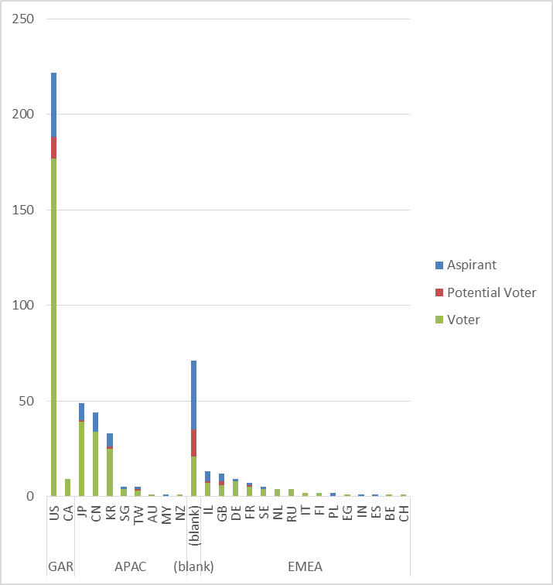
Membership by Country and Region

Slide 23
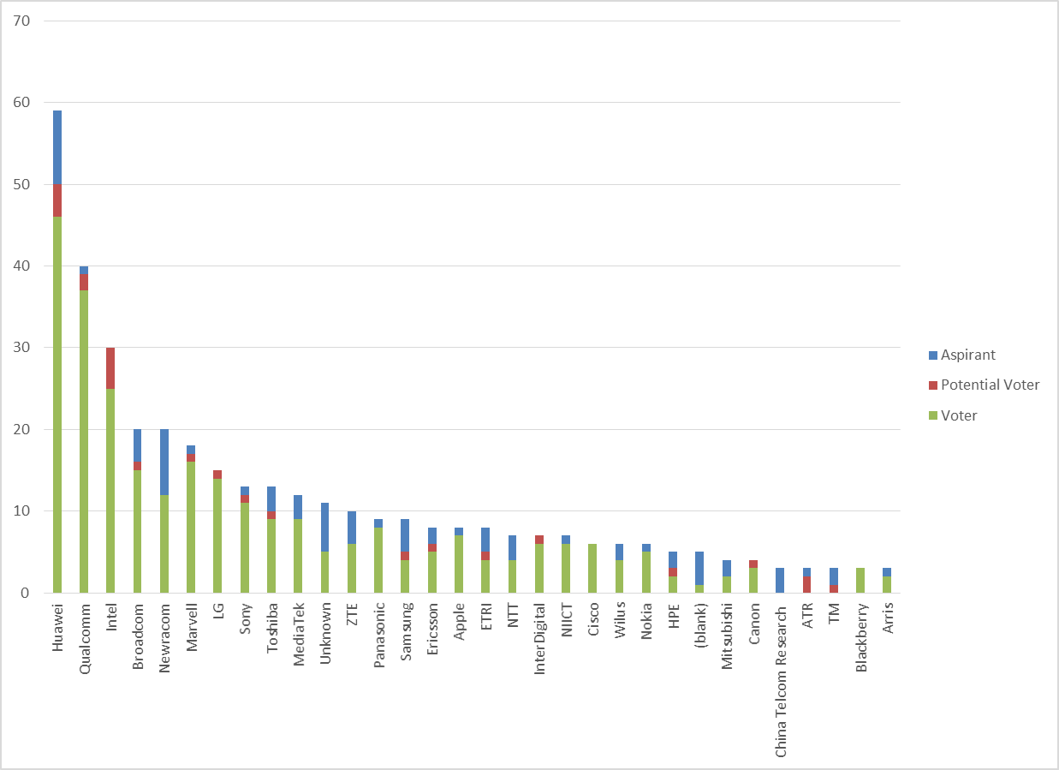
Members by Affiliation

Slide 24
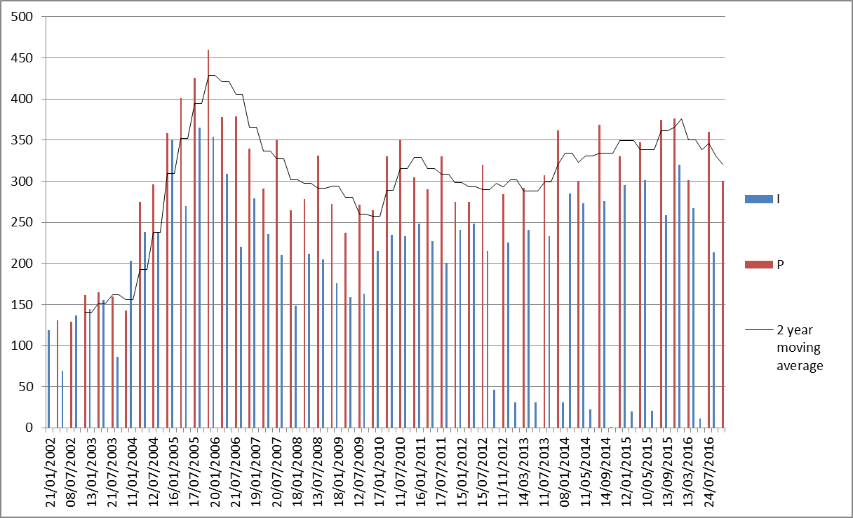
Meeting Attendance – Historic Data

Slide 25
Membership – Historic Data

