Slide 1
Comparing DL/UL Training Overhead for Hybrid Beamforming
Date: 2016-11-08
Authors:

Slide 2
Introduction
DL MU-MIMO is included in 11ay
An essential part of DL MU-MIMO operation is the obtaining of channel information for proper precoding
With massive arrays in 11ay, it is unclear if explicit training (DL training) is always to prefer, or if sometimes UL training could be more effective

Slide 3
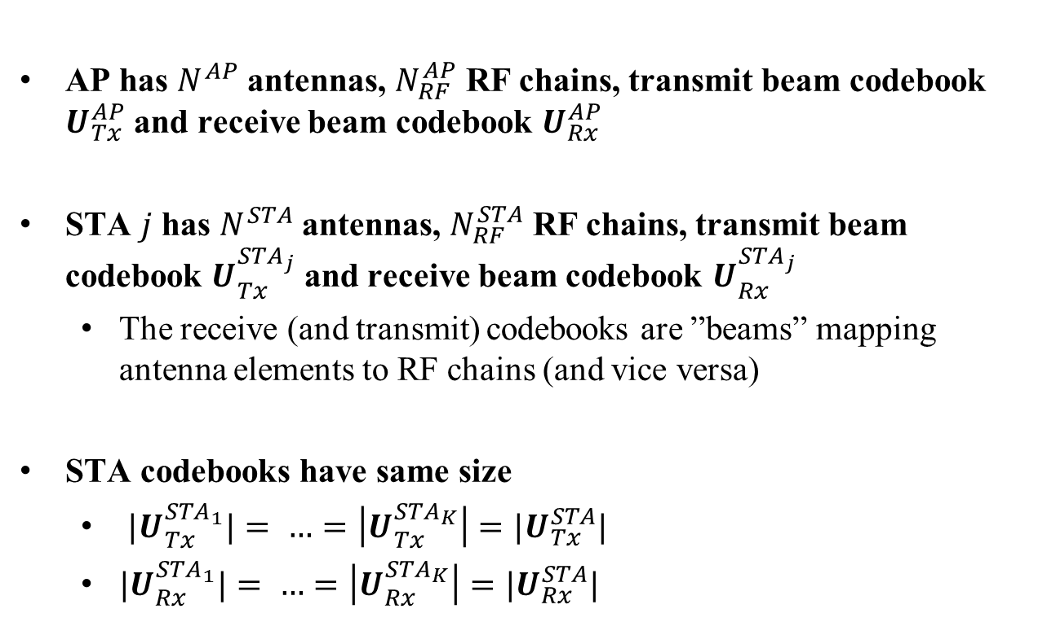
Assumptions
AP has $N^{AP}$ antennas, $N_{RF}^{AP}$ RF chains, transmit beam codebook $U_{Tx}^{AP}$ and receive beam codebook $U_{Rx}^{AP}$
STA $j$ has $N^{STA}$ antennas, $N_{RF}^{STA}$ RF chains, transmit beam codebook $U_{Tx}^{STA_{j}}$ and receive beam codebook $U_{Rx}^{STA_{j}}$
  The receive (and transmit) codebooks are ”beams” mapping antenna elements to RF chains (and vice versa)
STA codebooks have same size
  ${|U}_{Tx}^{STA_{1}}|= …=\left|U_{Tx}^{STA_{K}}\right|={|U}_{Tx}^{STA}|$
  ${|U}_{Rx}^{STA_{1}}|= …=\left|U_{Rx}^{STA_{K}}\right|={|U}_{Rx}^{STA}|$

Slide 4


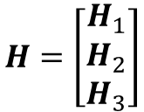



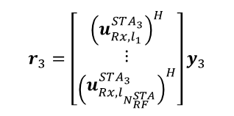

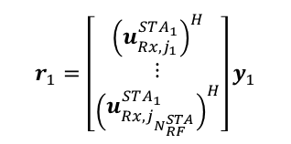

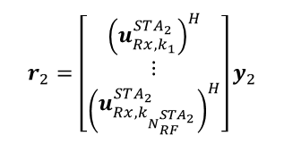
DL Training
$$U_{Tx}^{STA}=\left\{u_{Tx,1}^{STA},u_{Tx,2}^{STA},…,u_{}^{STA}\right\}$$
Transmitted in different
time slots
$$U_{Rx}^{STA_{1}}=\left\{u_{Rx,1}^{STA_{1}},u_{Rx,2}^{STA_{1}},…,u_{Rx,\left|U_{Rx}^{STA}\right|}^{STA_{1}}\right\}$$
$$r_{1}=\left[\begin{matrix}{\left(u_{Rx,j_{1}}^{STA_{1}}\right)}^{H} \\ ⋮ \\ {\left(u_{Rx,j_{N_{RF}^{STA}}}^{STA_{1}}\right)}^{H}\end{matrix}\right]y_{1}$$
STA1
$$ds$$
$$H=\left[\begin{matrix}H_{1} \\ H_{2} \\ H_{3}\end{matrix}\right]$$
$$u_{Tx,1}^{AP}, u_{Tx,2}^{AP},…,u_{Tx,\left|U_{Tx}^{AP}\right|}^{AP}$$
$$U_{Rx}^{STA_{2}}=\left\{u_{Rx,1}^{STA_{2}},u_{Rx,2}^{STA_{2}},…,u_{Rx,\left|U_{Rx}^{STA}\right|}^{STA_{2}}\right\}$$
AP
$$r_{2}=\left[\begin{matrix}{\left(u_{Rx,k_{1}}^{STA_{2}}\right)}^{H} \\ ⋮ \\ {\left(u_{Rx,k_{N_{RF}^{STA_{2}}}}^{STA_{2}}\right)}^{H}\end{matrix}\right]y_{2}$$
STA2
$$U_{Tx}^{AP}=\left\{u_{Tx,1}^{AP},u_{Tx,2}^{AP},…,u_{Tx,\left|U_{Tx}^{AP}\right|}^{AP}\right\}$$
$$U_{Rx}^{STA_{3}}=\left\{u_{Rx,1}^{STA_{3}},u_{Rx,2}^{STA_{3}},…,u_{Rx,\left|U_{Rx}^{STA}\right|}^{STA_{3}}\right\}$$
$$r_{3}=\left[\begin{matrix}{\left(u_{Rx,l_{1}}^{STA_{3}}\right)}^{H} \\ ⋮ \\ {\left(u_{Rx,l_{N_{RF}^{STA}}}^{STA_{3}}\right)}^{H}\end{matrix}\right]y_{3}$$
STA3

Slide 5



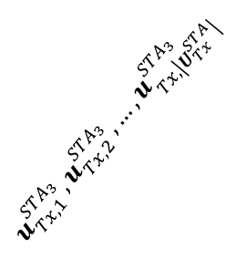
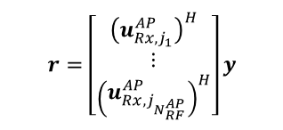
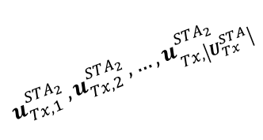
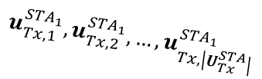


UL Training
$$U_{Tx}^{STA}=\left\{u_{Tx,1}^{STA},u_{Tx,2}^{STA},…,u_{}^{STA}\right\}$$
$$U_{Tx}^{STA_{1}}=\left\{u_{Tx,1}^{STA_{1}},u_{Tx,2}^{STA_{1}},…,u_{Tx,\left|U_{Tx}^{STA}\right|}^{STA_{1}}\right\}$$
STA1
$$u_{Tx,1}^{STA_{1}}, u_{Tx,2}^{STA_{1}},…,u_{Tx,\left|U_{Tx}^{STA}\right|}^{STA_{1}}$$
$$r=\left[\begin{matrix}{\left(u_{Rx,j_{1}}^{AP}\right)}^{H} \\ ⋮ \\ {\left(u_{Rx,j_{N_{RF}^{AP}}}^{AP}\right)}^{H}\end{matrix}\right]y$$
$$ds$$
$$H^{T}=\left[\begin{matrix}H_{1}^{T} \\ H_{2}^{T} \\ H_{3}^{T}\end{matrix}\right]$$
$$U_{Tx}^{STA_{2}}=\left\{u_{Tx,1}^{STA_{2}},u_{Tx,2}^{STA_{2}},…,u_{Tx,\left|U_{Tx}^{STA}\right|}^{STA_{2}}\right\}$$
AP
$$u_{Tx,1}^{STA_{2}}, u_{Tx,2}^{STA_{2}},…,u_{Tx,\left|U_{Tx}^{STA}\right|}^{STA_{2}}$$
STA2
$$U_{Rx}^{AP}=\left\{u_{Rx,1}^{AP},u_{Rx,2}^{AP},…,u_{Rx,\left|U_{Rx}^{AP}\right|}^{AP}\right\}$$
$$u_{Tx,1}^{STA_{3}}, u_{Tx,2}^{STA_{3}},…,u_{Tx,\left|U_{Tx}^{STA}\right|}^{STA_{3}}$$
$$U_{Tx}^{STA_{3}}=\left\{u_{Tx,1}^{STA_{3}},u_{Tx,2}^{STA_{3}},…,u_{Tx,\left|U_{Tx}^{STA}\right|}^{STA_{3}}\right\}$$
STA3

Slide 6
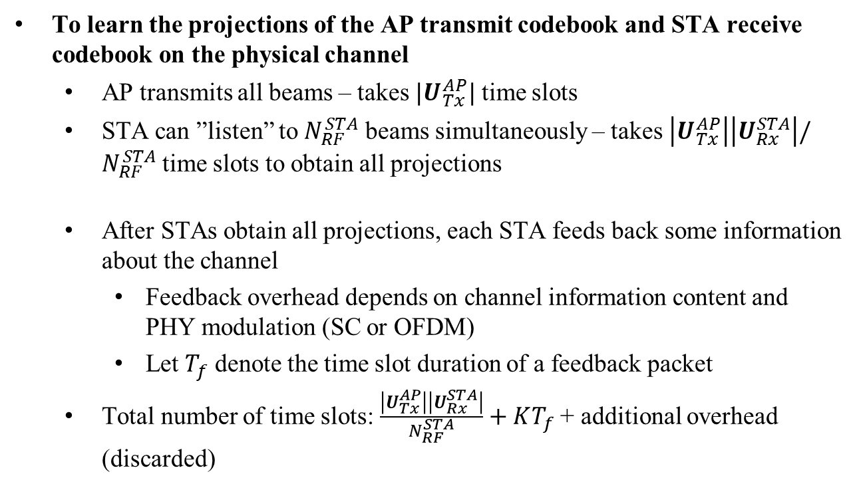
DL Training Overhead
To learn the projections of the AP transmit codebook and STA receive codebook on the physical channel
  AP transmits all beams – takes $|U_{Tx}^{AP}|$ time slots
  STA can ”listen” to $N_{RF}^{STA}$ beams simultaneously – takes $\left|U_{Tx}^{AP}\right|\left|U_{Rx}^{STA}\right|/N_{RF}^{STA}$ time slots to obtain all projections
  After STAs obtain all projections, each STA feeds back some information about the channel
    Feedback overhead depends on channel information content and PHY modulation (SC or OFDM)
    Let $T_{f}$ denote the time slot duration of a feedback packet
  Total number of time slots: $\frac{\left|U_{Tx}^{AP}\right|\left|U_{Rx}^{STA}\right|}{N_{RF}^{STA}}+KT_{f}$ + additional overhead (discarded)

Slide 7
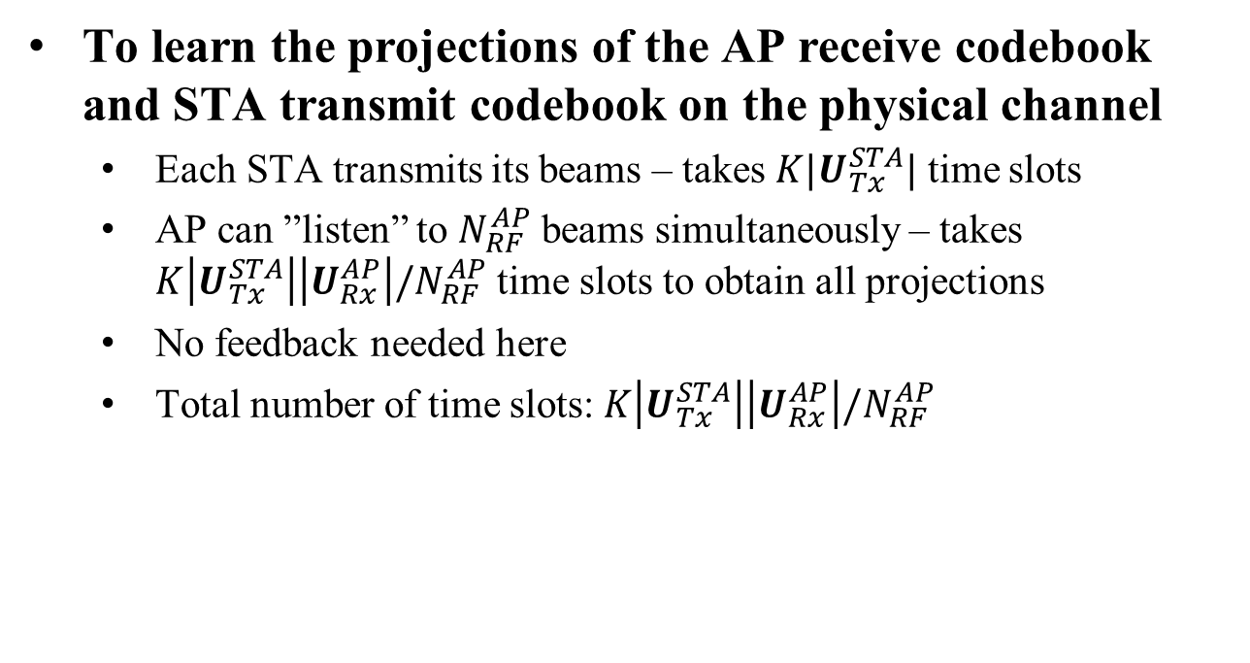
UL Training Overhead
To learn the projections of the AP receive codebook and STA transmit codebook on the physical channel
  Each STA transmits its beams – takes $K|U_{Tx}^{STA}|$ time slots
  AP can ”listen” to $N_{RF}^{AP}$ beams simultaneously – takes $K\left|U_{Tx}^{STA}\right|\left|U_{Rx}^{AP}\right|/N_{RF}^{AP}$ time slots to obtain all projections
  No feedback needed here
  Total number of time slots:$K\left|U_{Tx}^{STA}\right|\left|U_{Rx}^{AP}\right|/N_{RF}^{AP}$

Slide 8
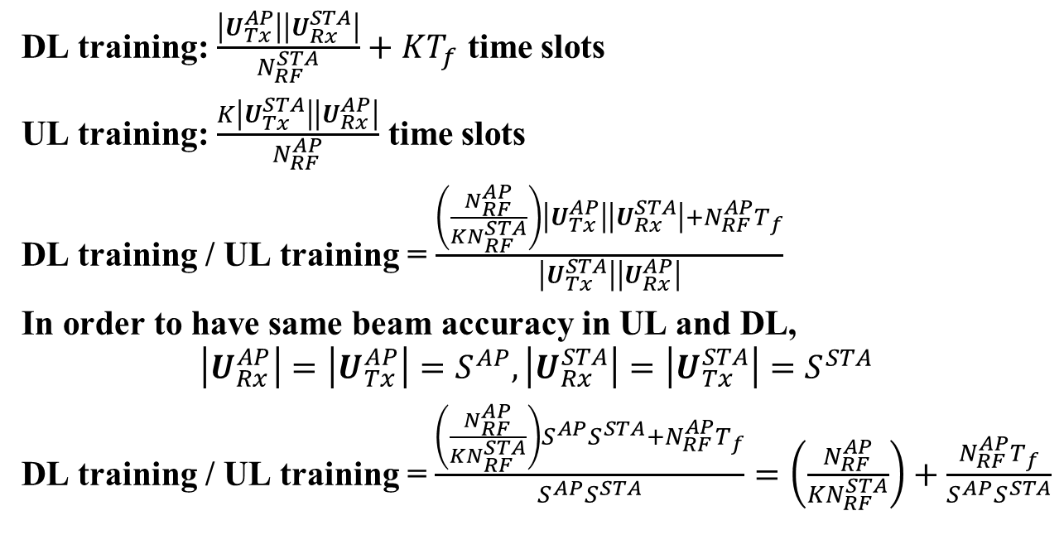
DL/UL Overhead Comparison
DL training: $\frac{\left|U_{Tx}^{AP}\right|\left|U_{Rx}^{STA}\right|}{N_{RF}^{STA}}+KT_{f}$ time slots
UL training: $\frac{K\left|U_{Tx}^{STA}\right|\left|U_{Rx}^{AP}\right|}{N_{RF}^{AP}}$ time slots
DL training / UL training = $\frac{\left(\frac{N_{RF}^{AP}}{KN_{RF}^{STA}}\right)\left|U_{Tx}^{AP}\right|\left|U_{Rx}^{STA}\right|+N_{RF}^{AP}T_{f}}{\left|U_{Tx}^{STA}\right|\left|U_{Rx}^{AP}\right|}$
In order to have same beam accuracy in UL and DL,
$$\left|U_{Rx}^{AP}\right|=\left|U_{Tx}^{AP}\right|=S^{AP}, \left|U_{Rx}^{STA}\right|=\left|U_{Tx}^{STA}\right|=S^{STA}$$
DL training / UL training =$\frac{\left(\frac{N_{RF}^{AP}}{KN_{RF}^{STA}}\right)S^{AP}S^{STA}+N_{RF}^{AP}T_{f}}{S^{AP}S^{STA}}=\left(\frac{N_{RF}^{AP}}{KN_{RF}^{STA}}\right)+\frac{N_{RF}^{AP}T_{f}}{S^{AP}S^{STA}}$

Slide 9
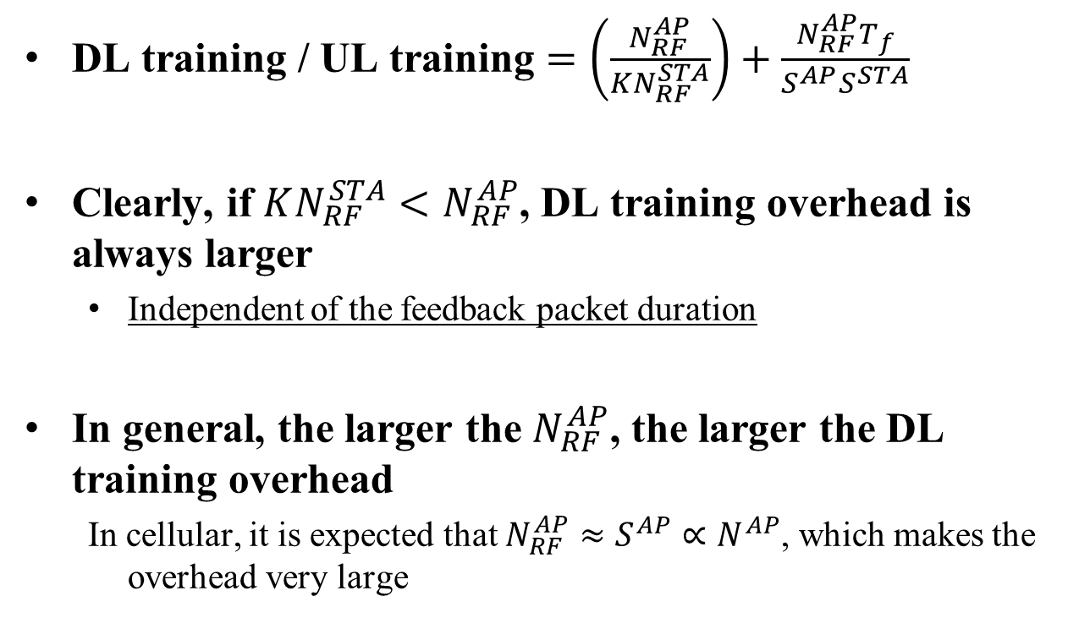
DL/UL Overhead Comparison
DL training / UL training $=\left(\frac{N_{RF}^{AP}}{KN_{RF}^{STA}}\right)+\frac{N_{RF}^{AP}T_{f}}{S^{AP}S^{STA}}$
Clearly, if $KN_{RF}^{STA}<N_{RF}^{AP}$, DL training overhead is always larger
  Independent of the feedback packet duration
In general, the larger the $N_{RF}^{AP}$, the larger the DL training overhead
  In cellular, it is expected that $N_{RF}^{AP}≈S^{AP}∝N^{AP}$, which makes the overhead very large

Slide 10
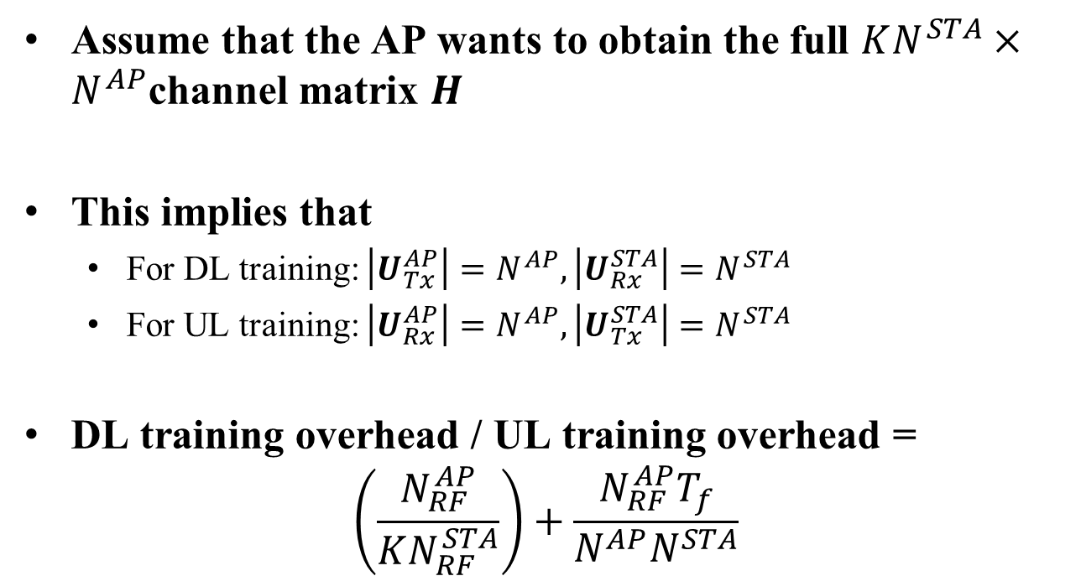
Example: Full Channel Overhead
Assume that the AP wants to obtain the full $KN^{STA}×N^{AP}$channel matrix $H$
This implies that
  For DL training: $\left|U_{Tx}^{AP}\right|=N^{AP}, \left|U_{Rx}^{STA}\right|=N^{STA}$
  For UL training: $\left|U_{Rx}^{AP}\right|=N^{AP}, \left|U_{Tx}^{STA}\right|=N^{STA}$
DL training overhead / UL training overhead =
$\left(\frac{N_{RF}^{AP}}{KN_{RF}^{STA}}\right)+\frac{N_{RF}^{AP}T_{f}}{N^{AP}N^{STA}}$

Slide 11
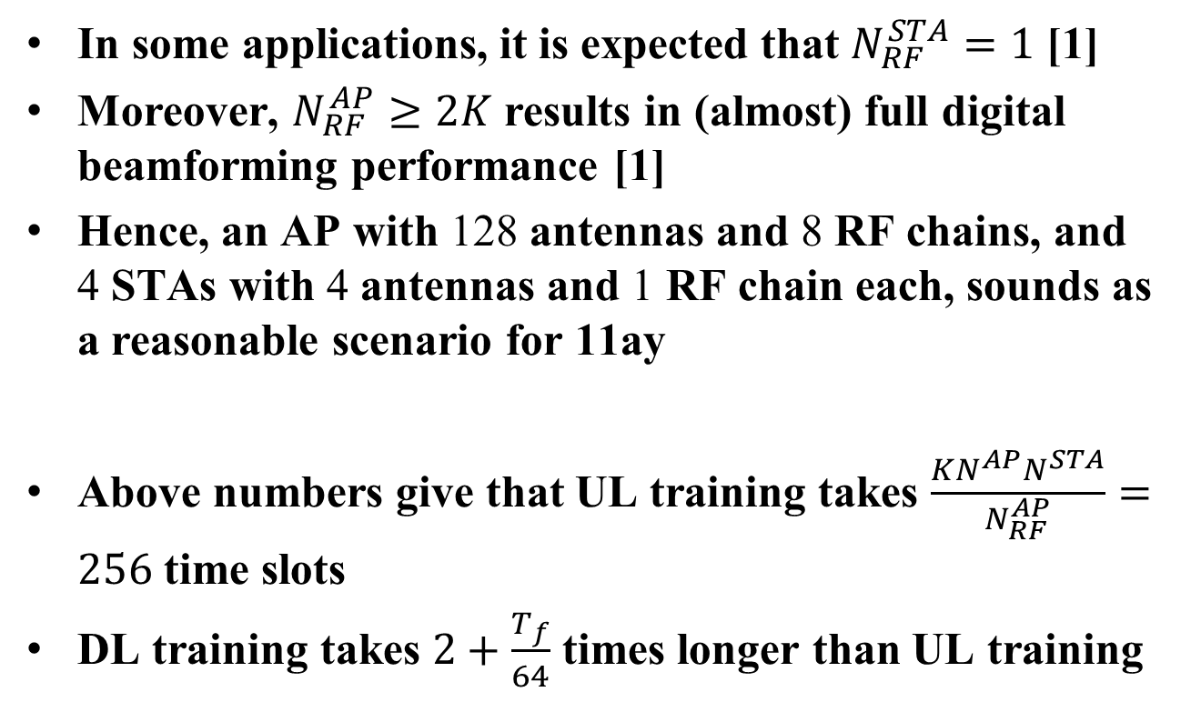
Example: Full Channel Overhead
In some applications, it is expected that $N_{RF}^{STA}=1$ [1]
Moreover, $N_{RF}^{AP}≥2K$ results in (almost) full digital beamforming performance [1]
Hence, an AP with 128 antennas and 8 RF chains, and 4 STAs with 4 antennas and 1 RF chain each, sounds as a reasonable scenario for 11ay
Above numbers give that UL training takes $\frac{KN^{AP}N^{STA}}{N_{RF}^{AP}}=256$ time slots
DL training takes $2+\frac{T_{f}}{64}$ times longer than UL training

Slide 12
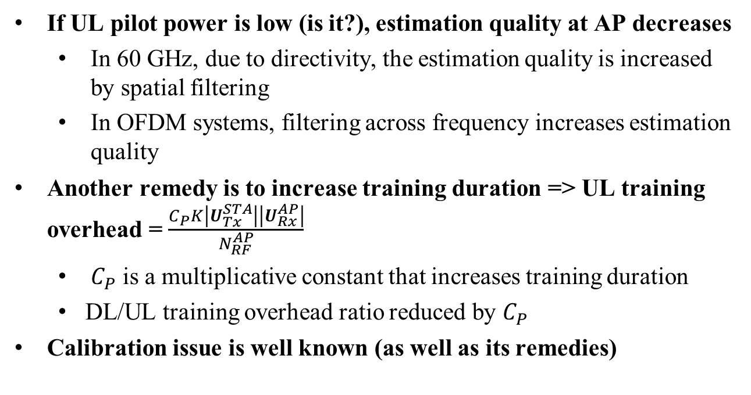
UL Training Issues
If UL pilot power is low (is it?), estimation quality at AP decreases
  In 60 GHz, due to directivity, the estimation quality is increased by spatial filtering
  In OFDM systems, filtering across frequency increases estimation quality
Another remedy is to increase training duration => UL training overhead = $\frac{C_{P}K\left|U_{Tx}^{STA}\right|\left|U_{Rx}^{AP}\right|}{N_{RF}^{AP}}$
  $C_{P}$ is a multiplicative constant that increases training duration
  DL/UL training overhead ratio reduced by $C_{P}$
Calibration issue is well known (as well as its remedies)

Slide 13
DL Training Pros & Cons
DL Training
  Pros:
    Transparent to DL-UL channel reciprocity
  Cons
    Training overhead can be large (for good channel knowledge) -> outdated CSI
    Requires quantization and feedback from STA

Slide 14
UL Training Pros & Cons
UL Training
  Pros
    Can substantially reduce training overhead compared to DL training
    No channel quantization and feedback from STAs
    If calibrated, same performance can be achieved as with DL training (let UL codebooks = DL codebooks)
  Cons
    Pilot power issue?
    Imperfections (if not calibrated) can decrease performance (UL codebooks != DL codebooks)

Slide 15
References
[1] A. Molisch et al., ”Hybrid Beamforming for Massive MIMO – A Survey”, available on ArXiv.

Slide 16
Straw Poll
Do you believe UL training for DL MU-MIMO shall be included as an optional feature in the 802.11ay SFD?
Yes
No
More information needed
No opinion:

Slide 17
Straw Poll
For those who voted ”more information needed”
  What type of information do you request?
Simulation results
Extended theoretical background
Motivation for the feature

