Slide 1
Coexistence Mechanism for Wakeup Radio Signal (follow-up)
Date: 2016-11-06
Authors:

Slide 2
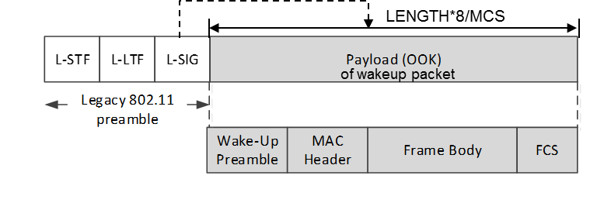

Background [11-16/0722r1]
Wakeup packet = Legacy 802.11 preamble (OFDM)
+ new LP-WUR signal waveform (OOK)
  Legacy 802.11 preamble provides coexistence with legacy STAs
802.11 stations can detect
beginning of this packet
802.11 stations know
end of this packet
CRC
Wakeup packet may carry other information
Receiver address
Wakeup preamble (e.g. PN sequence)
Example signal waveform
1bit /1 OFDM symbol period (= 4usec) = 250kbps
Legacy 802.11
preamble
Wake-up
preamble
MAC Header + Frame Body + FCS

Slide 3
Coexistence Mechanism for Wakeup Radio Signal
Two coexistence mechanisms discussed in [11-16/1114r0]
  Coexistence Mechanism based on L-SIG
  Coexistence Mechanism based on Energy Detection
This document brings follow-up discussion of a coexistence mechanism based on L-SIG

Slide 4
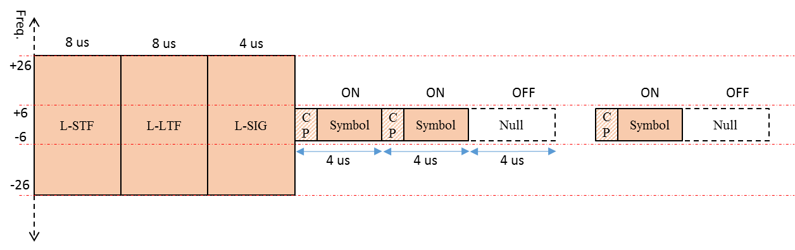
Coexistence Mechanism based on L-SIG
As proposed in 11-16/0722r1 and 11-16/1114r0,
L-SIG protection can be used for the coexistence with 802.11 device
  If a valid L-SIG parity bit is indicated, the 802.11 device maintain PHY-CCA.indication(BUSY, channellist) primitive for the predicted duration of the transmitted PPDU, as defined by RXTIME
WUR
Transmitter
BUSY
EIFS
802.11 STA
802.11 PPDU

Slide 5
Coexistence Mechanism based on L-SIG
Considerations on L-SIG protection
  If 802.11 device correctly decodes L-SIG of a wakeup radio packet, it always uses an EIFS before a transmission
    A DCF shall use EIFS before transmission, when it determines that the medium is idle following reception of a frame for which the PHY-RXEND.indication primitive contained an error or a frame for which the FCS value was not correct. Similarly, a STA’s EDCA mechanism under HCF shall use the EIFS–DIFS+AIFS[AC] interval.
  The use of EIFS is a pure overhead because there is no immediate response frame after the wakeup frame
    For example, the EIFS is 44us on 5 GHz band.

Slide 6
Coexistence Mechanism based on L-SIG
Another observation is that EIFS also provides an protection mechanism
  802.11 device shall not begin a transmission until the expiration of the later of the NAV and EIFS or EIFS–DIFS+AIFS[AC]
It looks like that L-SIG protection on slide 4 overprotects the wakeup radio packet

Slide 7
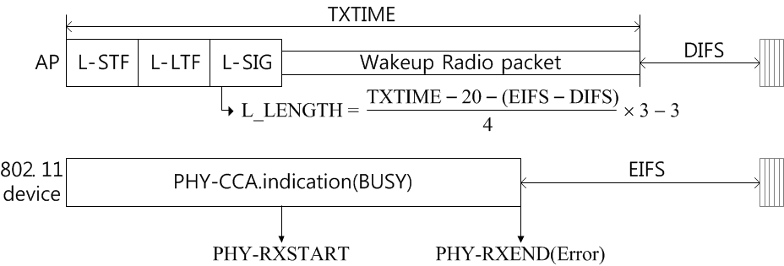
Coexistence Mechanism based on L-SIG
Desired L-SIG protection
  L-SIG protection should be reduced as much as (EIFS – DIFS) as shown on the below figure
  Then, it is equivalent that 802.11 devices uses a DIFS (or an AIFS) before a transmission on the behalf of an EIFS
Busy
DIFS

Slide 8
Summary
When the L-SIG protection is used for a coexistence mechanism for a wakeup radio packet, the overprotection shown on slide 4 should be avoided

Slide 9
References
[1] https://mentor.ieee.org/802.11/dcn/16/11-16-0722-01-0000-proposal-for-wake-up-receiver-study-group.pptx
[2] https://mentor.ieee.org/802.11/dcn/16/11-16-1114-00-0wur-coexistence-mechanism-for-wakeup-radio-signal.pptx

