Slide 1
AP Discovery using WUR
Date: 08/11/2016
Authors:
Name | Affiliations | Address | Phone | Email
Igor Kim | ETRI | Korea | +82-42-860-5525 | ikim@etri.re.kr
Sunghyun Hwang | ETRI | Korea | +82-42-860-1133 | shwang@etri.re.kr
Seungkeun Park | ETRI | Korea | +82-42-860-5993 | seungkp@etri.re.kr

Slide 2

Introduction
Problem statement
  When mobile devices move outside of the coverage area they still perform channel sensing and scanning wasting battery power
  Unnecessary probing can bring huge overhead and interference to other devices
    According to the measurements made in [1] over 75% of packets are management frames in congested environments
This contribution describes the AP discovery method for WUR equipped devices (e.g. smartphones with WUR)
STA
eNB
AP
AP coverage
eNB coverage

Slide 3

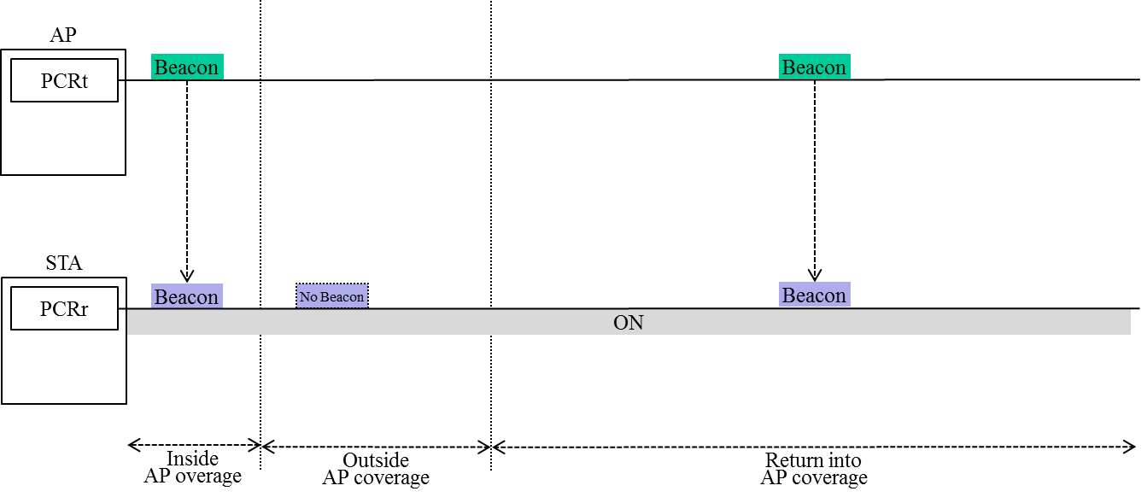
Non-WUR Capable Devices
Location | PCR | Operation
① | ON | Inside AP coverage Receiving periodic beacon from AP
② | ON | Outside AP coverage No beacon from AP Keep doing AP discovery (increase power consumption) (cons)
③ | ON | Return into AP coverage Connecting to AP immediately (low latency) (pros)
②
③
①
Conflicting goals!
AP coverage
eNB coverage

Slide 4
WUR Capable Devices (1)
Location | WUR | PCR | Operation
① | OFF | ON | Inside AP coverage Receiving periodic beacon from AP
② | OFF | ON | Outside AP coverage No beacon from AP Power off PCR and power on WUR after T_{timeout} No AP discovery (power saving) (pros)
 | ↓(after T_{timeout})
 | ON | OFF
③ | ON | OFF | Return into AP coverage PCR is sleeping until WUR detects the non-periodic WUR packet Use of expensive mobile data or increase the latency (cons)
 | ↓(after WUR packet detection)
 | OFF | ON
②
③
①
AP coverage
Still conflicting!
eNB coverage

Slide 5
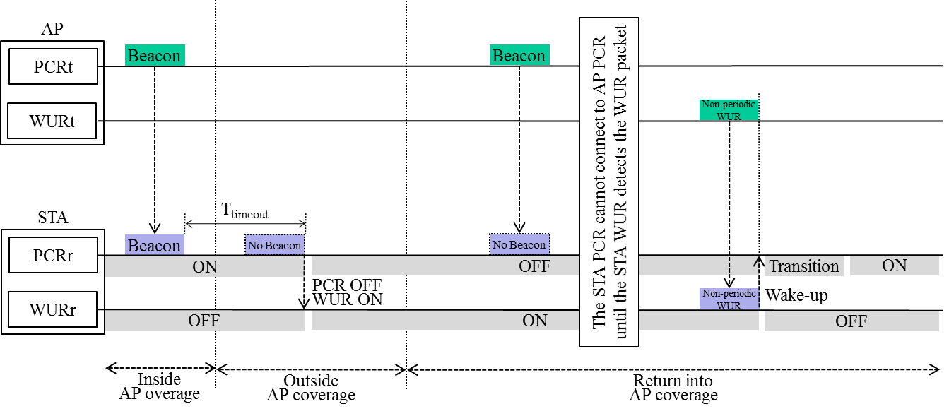
WUR Capable Devices (2)
STA can detect AP once receiving non-periodic WU packet

Slide 6
WUR Capable Devices with Periodic WUR Broadcast Packet (1)
AP transmits periodic broadcast WU packets
  Returning back to the same network
Location | WUR | PCR | Operation
① | OFF | ON | Inside AP coverage Receiving periodic beacon from AP
② | OFF | ON | Outside AP coverage No beacon from AP Power off PCR and power on WUR after T_{timeout} No AP discovery (power saving) (pros)
 | ↓(after T_{timeout})
 | ON | OFF
③ | ON | OFF | Return into AP coverage Detecting non-periodic WUR or periodic WUR broadcast packet with T_{period} Wake-up the PCR (small latency) (pros)
 | ↓(after WUR packet detection)
 | OFF | ON
②
③
①
AP coverage
Note: T_{timeout} and T_{period} are configurable parameters, TBD
Non-conflicting!
eNB coverage

Slide 7
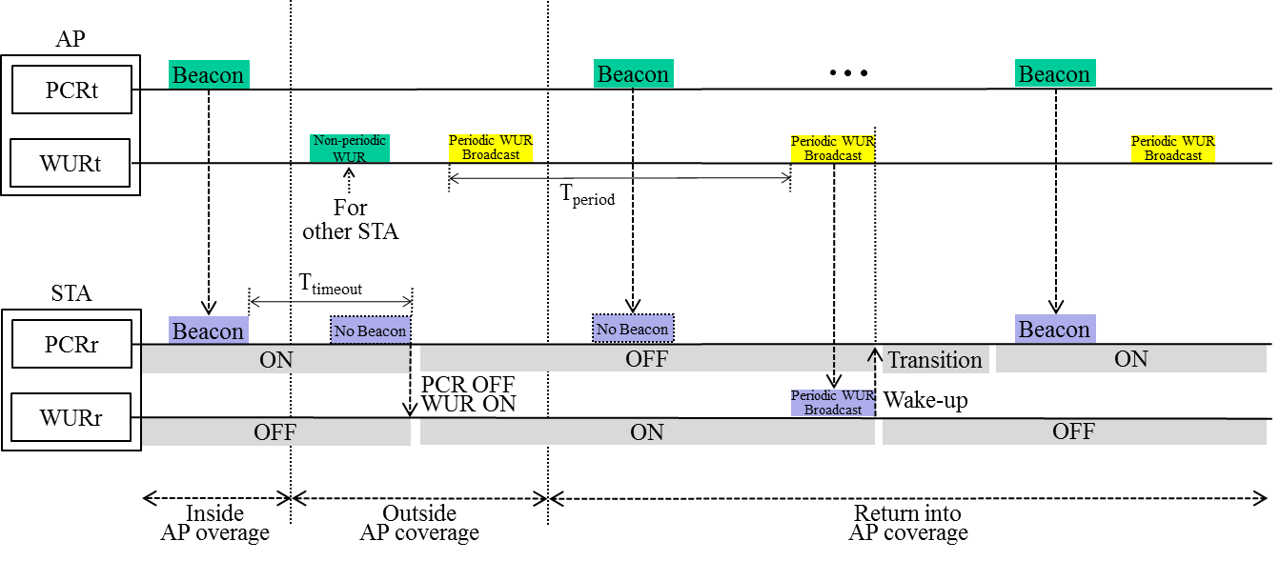
WUR Capable Devices with Periodic WUR Broadcast Packet (2)

Slide 8
WUR Capable Devices with Periodic WUR Broadcast Packet (3)
AP transmits periodic broadcast WU packets
  Visiting another networks
③
Location | WUR | PCR | Operation
① | OFF | ON | Inside AP coverage Receiving periodic beacon from AP
② | OFF | ON | Inside other AP coverage Receiving periodic beacon from other AP
③ | OFF | ON | Outside AP coverage No beacon from AP Power off PCR and power on WUR after T_{timeout} No AP discovery (power saving) (pros)
 | ↓(after T_{timeout})
 | ON | OFF
④ | ON | OFF | Reenter into AP coverage Detecting non-periodic WUR or periodic WUR broadcast packet with T_{period} Wake-up the PCR (small latency) (pros)
 | ↓(after WUR packet detection)
 | OFF | ON
②
④
①
AP coverage
eNB coverage
Non-conflicting!

Slide 9
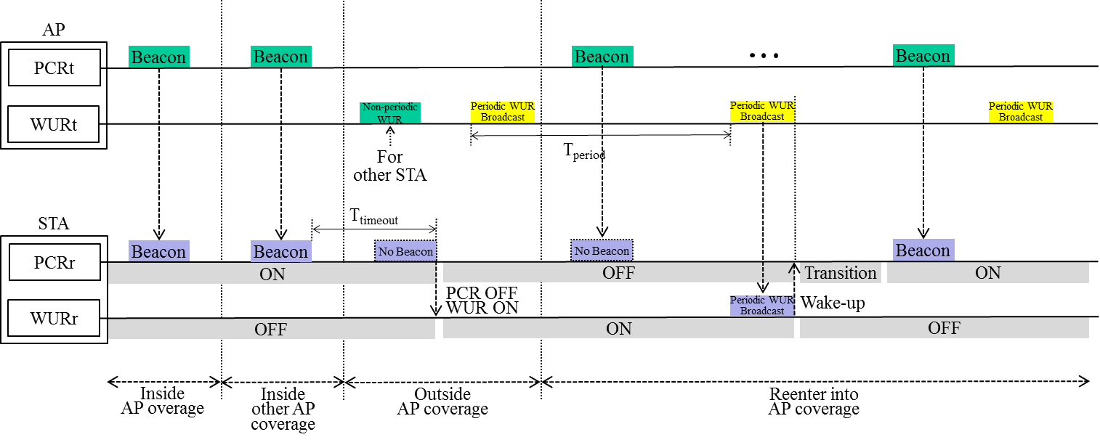
WUR Capable Devices with Periodic WUR Broadcast Packet (4)

Slide 10
Conclusion
Legacy devices and conventional WUR devices cannot perform AP discovery with low power and low latency simultaneously
Periodic WUR broadcast packet solves the problem of two conflicting goals
  Reduce the battery consumption while being away from AP (Power saving)
  Allows fast discovery of available APs once entering into the coverage area (Low latency)
  Reduces unnecessary Probe request/response exchange resulting in more efficient resource utilization

Slide 11
References
[1] IEEE 802.11-16/0977r0, “Measurements of 802.11 Behavior in Different Environments,” WNG SC contribution

