Slide 1
Rate 7/8 LDPC Code for 11ay
Date: 2016-11-10
Authors:

Slide 2
Introduction
An LDPC code of rate 7/8 [1] was adopted in 802.11REVmc [2]
- to further increase the data rate of 802.11ad. By combining the 64QAM modulation, the peak data rate of DMG single carrier can be up to 8Gbps;
- to fill a gap between MCS9 (QPSK, code rate 13/16) and MCS10 (16QAM, code rate 5/8) in 802.11ad. Currently the gap is about 4 dB;
- to fill a gap between the MCS of16QAM and the highest rate and the MCS of 64QAM and the lower rates.
The proposed rate 7/8 LDPC code [1] is generated by puncturing the first 48 parity bits from rate 13/16 LDPC code words. The LDPC code of rate 13/16 is specified in 802.11ad.
Since the punctured rate 7/8 code has not been optimized, its performance may require to improve.
Since the new rate 7/8 LDPC code is obtained by puncturing the rate 13/16 11ad LDPC code, the codeword length is 624 (no longer to be 672). This will impact on the implementation of the bit-symbol mapping at the transmitter and the decoding at the receiver.
Another rate 7/8 LDPC code which keeps the codeword length 672 unchanged. Its parity check matrix is generated by removing the first row of the parity-check matrix of rate 13/16 LDPC specified in 11ad [3].

Slide 3
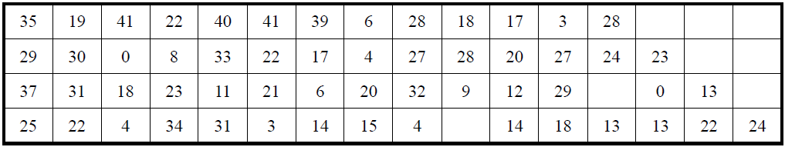
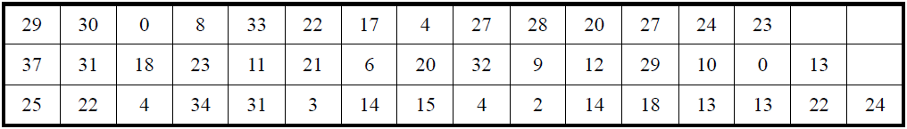
Rate 3/4 and 13/16 LDPC Codes in 11ad [4]
Rate-3/4 LDPC code matrix H = 168 rows x 672 columns, Z = 42
Rate-13/16 LDPC code matrix H = 126 rows x 672 columns, Z = 42

Slide 4
Rate 7/8 LDPC Code in 802.11REVmc [1][2]
Rate 7/8 LDPC introduced in [2] is generated by puncturing the first 48 parity bits from rate 13/16 code words
It uses existing LDPC matrix of rate 13/16.
Transmitter does not transmit the punctured bits; receiver puts equal likelihood for 1/0 for these bits.
The lengths of a source word and a codeword of the rate 7/8 code are 546 and 624. The codeword length is different from 672 as other LDPC codes of different rates in 802.11ad.

Slide 5
SC Blocking in 11ad and in 11REVmc [1]
SC QPSK Blocking in 802.11ad
SC QPSK Blocking (rate 7/8) in 802.11REVmc
Source
word1
Source
word2
Source
word3
Source
word4
Source
word1
Source
word2
…
Source
word56
encoding
encoding
Codeword1
Codeword2
Codeword3
Codeword4
Codeword1
Codeword2
…
Codeword56
(bits)
672
672
672
672
(bits)
624
624
624
Bit-to-symbol mapping
Bit-to-symbol mapping
Codeword1
Codeword2
Codeword3
Codeword4
Codeword1
Codeword2
…
Codeword56
(symbols)
336
336
336
336
(symbols)
312
312
312
blocking
blocking
BLK 1
BLK 2
BLK 3
BLK 1
BLK 2
…
BLK 39
(symbols)
448
448
448
(symbols)
448
448
448
Note: Every three blocks are constructed from four codewords
(Each block is constructed from two codewords.)
Note: Every 39 blocks are constructed from 56 codewords
(Each block is constructed from two or three codewords.)

Slide 6
SC Blocking in 11ad and in 11REVmc [1]
SC 16QAM Blocking in 802.11ad
SC 16QAM Blocking (rate 7/8) in 802.11REVmc
Source
word1
Source
word2
…
Source
word7
Source
word1
Source
word2
…
Source
word112
encoding
encoding
Codeword1
Codeword2
…
Codeword7
Codeword1
Codeword2
…
Codeword112
(bits)
672
672
672
(bits)
624
624
624
Bit-to-symbol mapping
Bit-to-symbol mapping
Codeword1
Codeword2
…
Codeword7
Codeword1
Codeword2
…
Codeword112
(symbols)
168
168
168
(symbols)
156
156
156
blocking
blocking
BLK 1
BLK 2
BLK 3
BLK 1
BLK 2
…
BLK 39
(symbols)
448
448
448
(symbols)
448
448
448
Note: Every three blocks are constructed from seven codewords.
(each block is constructed from three or four codewords)
Note: Every 39 blocks are constructed from 112 codewords.
(each block is constructed from three or four codewords.)

Slide 7
SC Blocking for 7/8 LDPC (n=672, k=588) and 802.11REVmc [1]
Expected SC 64QAM Blocking
(rate 7/8, codeword length=672)
SC 64QAM Blocking (rate 7/8) in 802.11REVmc
Source
word1
Source
word2
Source
word3
Source
word4
Source
word1
Source
word2
…
Source
word56
encoding
encoding
Codeword1
Codeword2
Codeword3
Codeword4
Codeword1
Codeword2
…
Codeword56
(bits)
(bits)
624
624
624
672
672
672
672
Bit-to-symbol mapping
Bit-to-symbol mapping
Codeword1
Codeword2
Codeword3
Codeword4
Codeword1
Codeword2
…
Codeword56
(symbols)
112
112
112
112
(symbols)
104
104
104
blocking
blocking
BLK 1
BLK 1
BLK 2
…
BLK 13
(symbols)
448
(symbols)
448
448
448
Note: Each block is constructed from four codewords.
Note: Every 13 blocks are constructed from 56 codewords
(each block is constructed from five or six codewords )

Slide 8
Rate 7/8 LDPC (n=672, k=588) [3] – Obtained by Modifying the Parity-Check Matrix of 13/16 LDPC
The rate 13/16 code of the 802.11ay standard is modified by eliminating its first row of its parity-check matrix to generate the parity-check matrix of the rate 7/8 LDPC., i.e., a matrix with H = 84 rows x 672 columns. The codeword length 672 is preserved.
-
However, as shown in [2] the performance of this proposal is not satisfactory.

Slide 9
New rate 7/8 LDPC codes (n=672, k=588) based on the 11ad 3/4 LDPC
A new 7/8 code with parameters (n=672, k=588) with the block cyclic structure of the 802.11ad standard codes.
Code design based on the rate ¾ LDPC in 11ad
Parity-check matrix of the 7/8 code obtained by adding 1st with 3rd row and 2nd with 4th row of the parity-check matrix of the LDPC in 802.11ad
Example of cyclic-permutation matrices (Z=4)

Slide 10
Simulation Assumptions (I)
SC modulations: QPSK, 16QAM and 64QAM;
frame size 8192 bytes;
AWGN channel;
no hardware impairments taken into account;
rate 7/8 LDPC code; a layered LDPC decoder using 8 iterations.

Slide 11
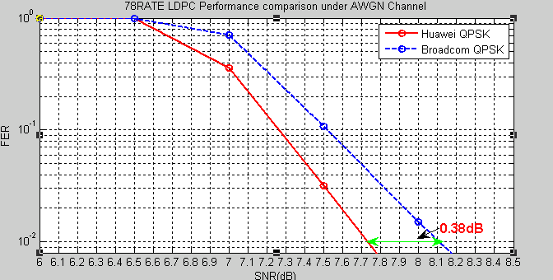
FER Performance (I-a)
R=7/8, QPSK, AWGN
For the case of QPSK under AWGN, the Huawei’s rate 7/8 LDPC code yields about 0.38dB gain w.r.t. punctured 13/16 LDPC code [2] at 1% FER.

Slide 12
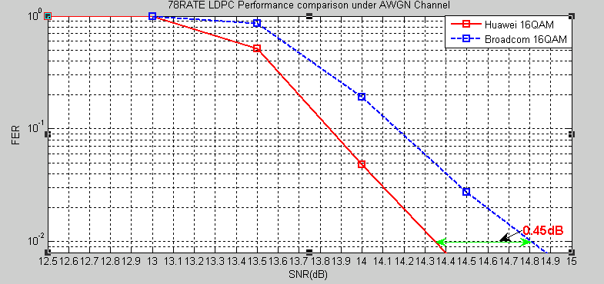
FER Performance (I-b)
R=7/8, 16QAM, AWGN
    For the case of 16QAM, the Huawei’s 7/8 Rate LDPC yields about 0.45dB gain w.r.t. the punctured 13/16 LDPC code [2] at 1% FER.

Slide 13
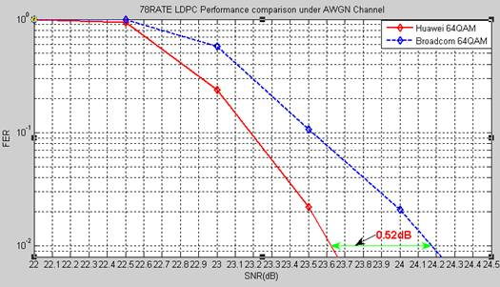
FER Performance (I-c)
R=7/8, 64QAM, AWGN
    For the case of 64QAM, the Huawei’s 7/8 Rate LDPC yields about 0.52dB gain w.r.t. the punctured 13/16 LDPC code [2] at 1% FER.

Slide 14
Simulation Assumptions (II)
SC modulations: QPSK, 16QAM and 64QAM;
frame size 8192 bytes;
AWGN channel;
hardware impairments: phase noise, frequency offset;
rate 7/8 LDPC code; a layered LDPC decoder using 8 iterations.

Slide 15
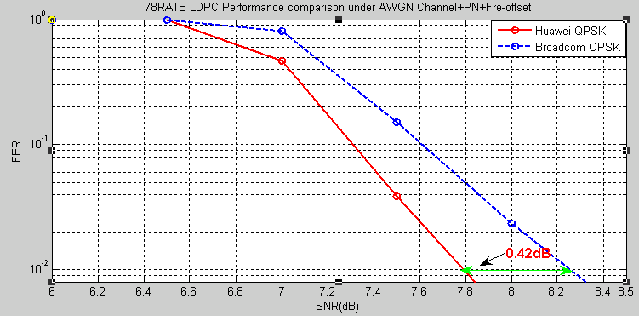
FER Performance (II-a)
R=7/8, QPSK, AWGN + PN + Frequency offset
For the case of QPSK, the Huawei’s rate 7/8 LDPC code yields about 0.42dB gain w.r.t. punctured 13/16 LDPC code [2] at 1% FER.

Slide 16
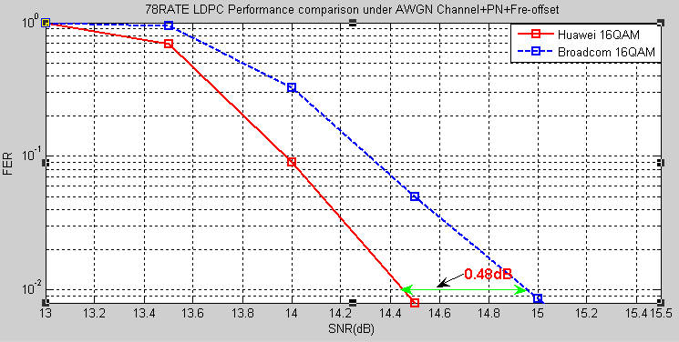
FER Performance (II-b)
R=7/8, 16QAM, AWGN + PN + Frequency offset
    For the case of 16QAM, the Huawei’s 7/8 Rate LDPC yields about 0.48dB gain w.r.t. the punctured 13/16 LDPC code [2] at 1% FER.

Slide 17
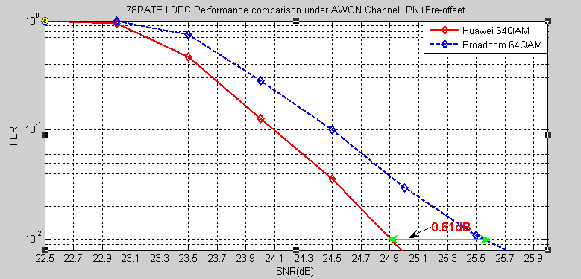
FER Performance (II-c)
R=7/8, 64QAM, AWGN + PN + Frequency offset
    For the case of 64QAM, the Huawei’s 7/8 Rate LDPC yields about 0.61dB gain w.r.t. the punctured 13/16 LDPC code [2] at 1% FER.

Slide 18
Simulation Assumptions (III)
SC modulations: QPSK, 16QAM and 64QAM;
frame size 8192 bytes;
11ad conference room channel model;
hardware impairments: phase noise, frequency offset
rate 7/8 LDPC code; a layered LDPC decoder using 8 iterations.

Slide 19
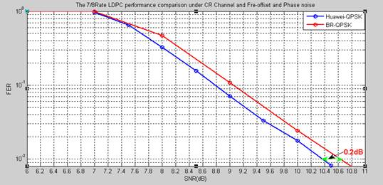
FER Performance (III-a)
R=7/8, QPSK, 11ad conference room
For the case of QPSK under the 11ad conference room scenario with impairments of phase noise and frequency offset, the Huawei’s rate 7/8 LDPC code yields about 0.2dB gain w.r.t. the punctured 13/16 LDPC code [2] at 1% FER.

Slide 20
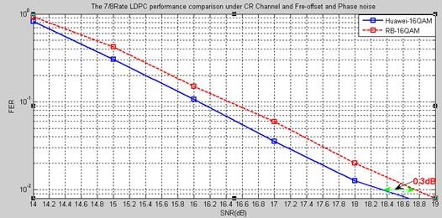
FER Performance (III-b)
R=7/8, 16QAM, 11ad conference room
For the case of 16QAM under the 11ad conference room scenario with impairments of phase noise and frequency offset, the Huawei’s rate 7/8 LDPC code yields about 0.3dB gain w.r.t. the punctured 13/16 LDPC code [2] at 1% FER.

Slide 21
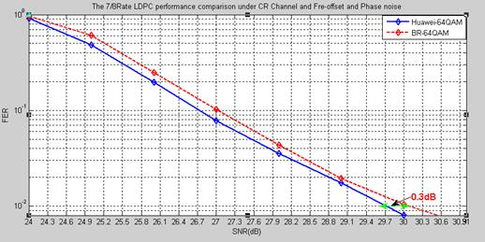
FER Performance (III-c)
R=7/8, 64QAM, 11ad conference room
For the case of 64QAM under the 11ad conference room scenario with impairments of phase noise and frequency offset, the Huawei’s rate 7/8 LDPC code yields about 0.3dB gain w.r.t. the punctured 13/16 LDPC code [2] at 1% FER.

Slide 22
Summary of Performance Gains
The performance gains (in dB) of the 7/8 LDPC code proposed in this contribution against the punctured 13/16 LDPC code [2] at 1% FER are summarized below.
 | Assumption I | Assumption II | Assumption III
QPSK | 0.38 | 0.42 | 0.2
16QAM | 0.45 | 0.48 | 0.3
64QAM | 0.52 | 0.61 | 0.3

Slide 23
LDPC Decoder Complexity
The presence of superimposed layers in the parity-check matrix of the proposed new codes has a minor impact in the implementation of the LDPC decoder, which is assumed to have a layered architecture.
In a layered architecture of the LDPC decoder, Z (=42 in this case) parallel check node processors process sequentially the messages of the edges (16 in this case) relative to a block of Z rows of the parity-check matrix. The cyclic shift structure simplifies the decoder architecture allowing to feed the parallel processors with a simple barrel shifter. When the processing of a layer is terminated, the parity-check processors are re-initialized and the next layer is processed.
When two rows are superimposed the parity-check node processors are not initialized after the end of the first layer but rather they continue processing the next 16 edges of the superimposed block-row. The decoding complexity thus remains the same as the one of the original code and also the original hardware architecture can be reused.

Slide 24
Summary
New 7/8 LDPC codes (N=672, k=588) have been obtained based the LDPC codes in 802.11ad .
The new codes can outperform previously proposed 7/8 LDPC code generated by puncturing the 13/16 LDPC codewords in 802.11ad in both AWGN and 11ad conference room channels.
The new codes remain the codeword length unchanged as other LDPC codes in 802.11ad, which simplify the implementation.

Slide 25
References
[1] IEEE 802.11-16/0233, Additional SC MCSs in clause 20 (DMG PHY).
[2] 2016-TECH-Broadcom-0001-00-On SNR Granularity.
[3] 2015-TECH-Intel-0039-00-SC 64 QAM NG60
[4] IEEE Std 802.11ad™-2012.
[5] L. Dinoi, F. Sottile and S. Benedetto, ”Design of versatile eIRA codes for parallel decoders”, IEEE Transactions on Communications, vol. 56, December 2008, pp. 2060-2069.

Slide 26
Straw Poll/Motion
Do you agree to include the parity check matrix shown in Slide 9 for the rate 7/8 LDPC code of length 672 in the IEEE 802.11ay SFD?
Yes:
No:
Abstain:

