Slide 1
DCM SQPSK for Channel Aggregation in 11ay
Date: 2016-11-08
Name | Affiliation | Email
Tao Wu | Huawei Technologies | walnut.wutao@huawei.com
Yan Xin | Huawei Technologies | Yan.Xin@huawei.com
Edward Au | Huawei Technologies | edward.ks.au@huawei.com
Teyan Chen | Huawei Technologies | chenteyan@huawei.com

Slide 2
Introduction
In [1], the performance of Dual Carrier Modulations (DCMs) and regular modulation is compared. DCM is suggested to be used in 2x2 SU MIMO.
This presentation compares the SC mode performance of DCM SQPSK we proposed for 11ay with other methods of the same data rate transmitted over two aggregated channels or over a single channel. The considered transmissions include:
  BPSK over two aggregated channels (CA BPSK);
  BPSK with an interleaver over two aggregated channels (CA BPSK interleaver);
  DCM SQPSK over two aggregated channels (CA DCM SQPSK);
  QPSK over one channel (One channel);
For DCM SQPSK over two aggregated channels, two receiver algorithms are considered:
  Combining the received signals from two aggregated channels in the time domain;
  Combining the received signals from two aggregated channels in the frequency domain;
Based on our simulation evaluation, DCM SQPSK over two aggregated channels outperforms the other alternative methods. It can yield up to 2.1 dB and 2.7 dB performance gains compared to the BPSK with an interleaver over two aggregated channels and the QPSK over one channel, respectively.
We suggest that the DCM SQPSK is used for two-channel aggregation in the single carrier transmission mode.
11-16-0631-00-00ay-performance-comparison-of-dual-carrier-and-regular-modulations-for-su-mimo-in-11ay

Slide 3
Simulation Assumptions
Single Carrier mode:
  No backoff;
  BPSK, QPSK and DCM SQPSK modulations;
  Interleaver which interleaves the coded bits from two encoder;
  Two-channel aggregation and one channel;
  11ad CR NLOS channel;
  11ad phase noise model;
  11ad non–linear PA model;
  Non-Ideal channel estimation;
  L-MMSE Equalization;
  11ad LDPC code;

Slide 4
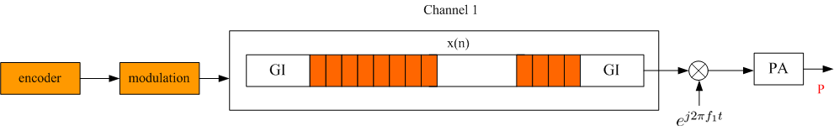
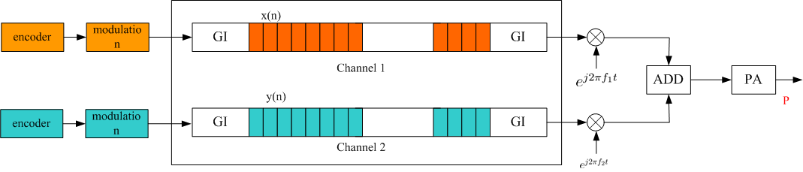
Channel Aggregation
One Channel
Two Channel Aggregation
In our simulation, the transmit power is assumed to be the same for both the signals transmitted over one channel and two aggregated channels.
For the case of two-channel aggregation, the transmitted signals over each channel are encoded and modulated independently.

Slide 5
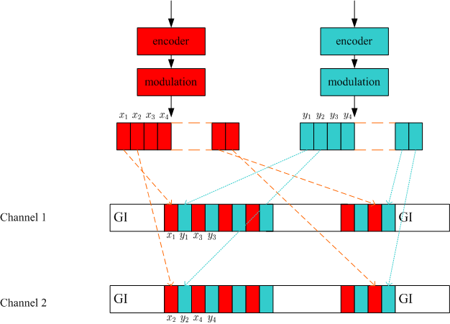
BPSK with an Interleaver for channel aggregation
After interleaving, the transmitted signals over each channel include coded bits from both encoders:
  The outputs of the two encoders are transmitted alternately on each channel;

Slide 6
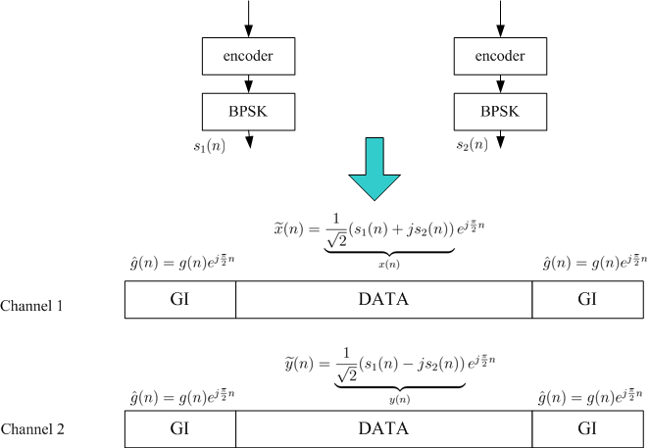
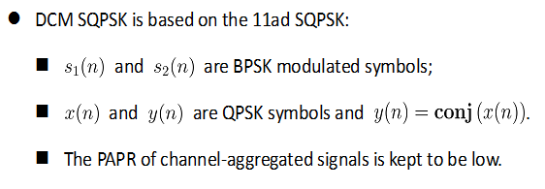
DCM SQPSK

Slide 7
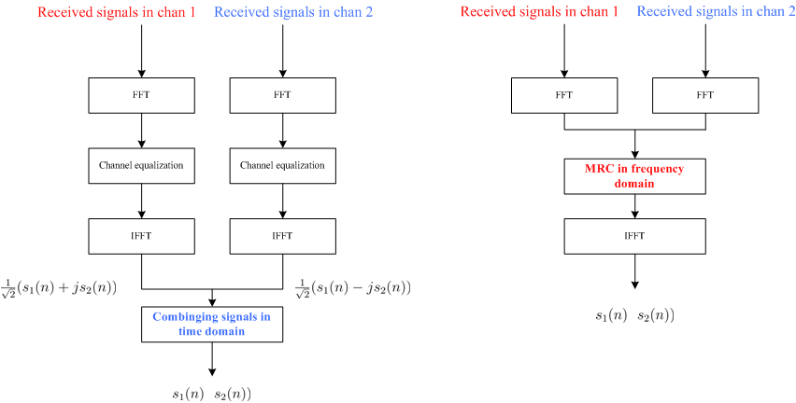
Receiver Algorithm: combining the signals in time/frequency domain
Combining signals in frequency domain can yield more than 0.4dB gain over combining signals in time domain.

Slide 8
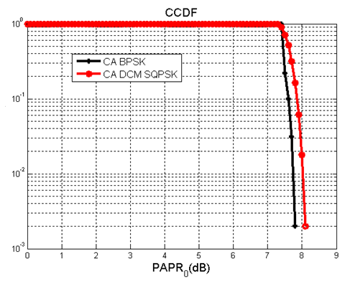
PAPR of DCM SQPSK
PAPR>PRPR₀
The simulation results above show that:
  the PAPR characteristics of DCM SQPSK signals in channel aggregation (CA DCM SQPSK) is comparable to that of BPSK in channel aggregation (CA BPSK).

Slide 9
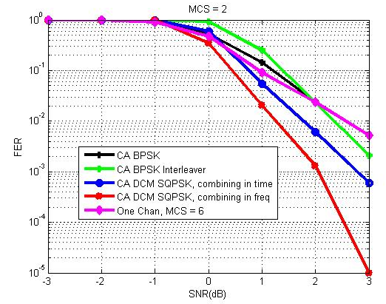
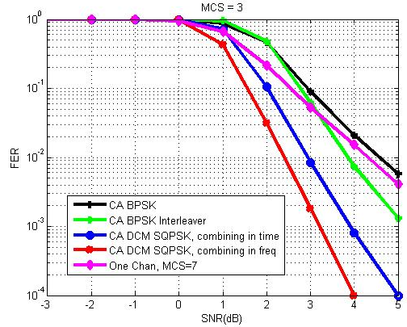
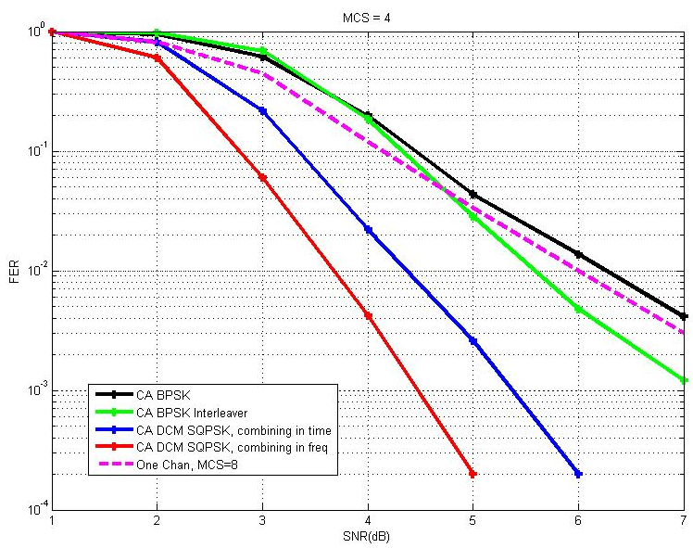
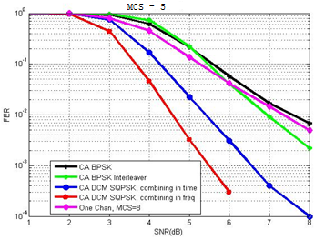
Simulated FER of DCM SQPSK

Slide 10
Performance Comparison
SNR for FER =1%
Throughput gain for DCM SQPSK FER = 1%
MCS (in each aggregated channel) | CA BPSK | CA BPSK Interleaver | CA DCM SQPSK Combining in time domain | CA DCM SQPSK Combining in freq domain | QPSK (one channel) | Data Rate (Mbps)
2 | 2.6 | 2.6 | 1.9 | 1.5 | 2.5 | 762.3
3 | 4.7 | 4.0 | 3.0 | 2.6 | 4.4 | 952.9
4 | 6.3 | 5.8 | 4.6 | 3.9 | 6.0 | 1143.5
5 | 7.6 | 6.9 | 5.6 | 4.8 | 7.5 | 1238.7
Compared with the method of CA BPSK Interleaver , DCM SQPSK can yield performance gains in a range of 1.1 dB to 2.1 dB according to different MCS configurations.
Compared with the different receiver algorithm for CA DCM SQPSK, combing signals in frequency domain can yield more than 0.4 dB gain over combing signals in time domain .
10

Slide 11
Summary
In this contribution, we compared the performance of the DCM SQPSK, the BPSK with interleaver across two channels and the QPSK in one channel in single carrier transmission.
Based on our simulation, DCM SQPSK over two aggregated channels can yield up to 2.1 dB gain compared to BPSK signals interleaved over two aggregated channels and 2.7 dB gain compared to QPSK over one channel.
We suggest to adopt the DCM SQPSK in two-channel aggregation in the single carrier mode of 11ay.

Slide 12
Straw Poll/Motion
Do you agree to add the following text to the SFD ?
  In the Single Carrier mode in 11ay, DCM SQPSK signals transmitted over two aggregated channels presented in page 6 may be supported.
  Yes
  No
  Abstain

Slide 13
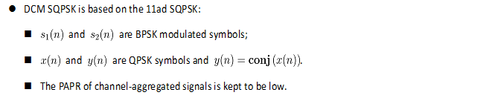
Appendix: Introduction of Receiver Algorithm

Slide 14
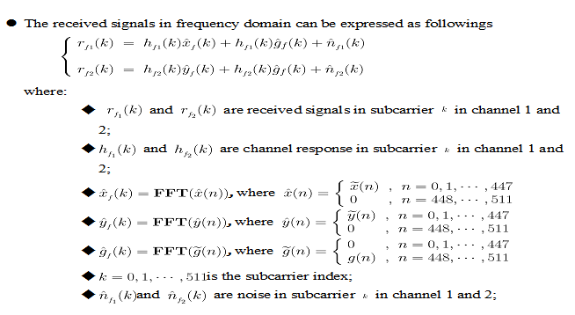
Appendix 1: Combining the signals in time domain

Slide 15
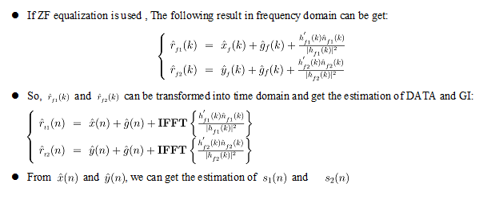
Appendix 1: Combining the signals in time domain

Slide 16
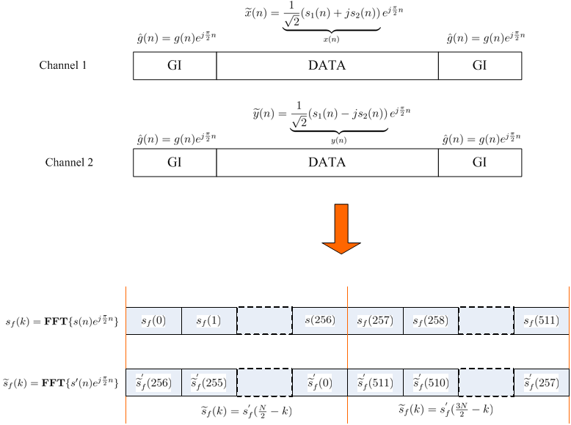
Appendix 2: Combining the signals in frequency domain

Slide 17
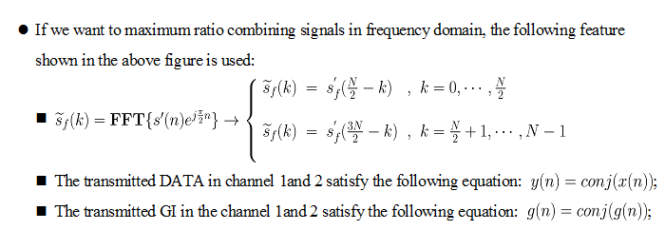
Appendix 2: Combining the signals in frequency domain

Slide 18
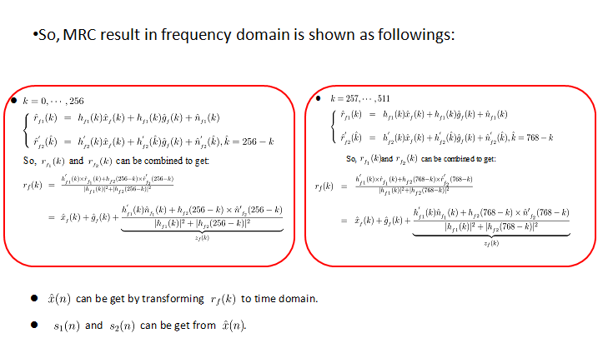
Appendix 2: Combining the signals in frequency domain

