Slide 1
DCM QPSK For Channel Aggregation in 11ay
Date: 2016-11-08
Name | Affiliation | Email
Tao Wu | Huawei Technologies | walnut.wutao@huawei.com
Yan Xin | Huawei Technologies | Yan.Xin@huawei.com
Edward Au | Huawei Technologies | edward.ks.au@ huawei.com

Slide 2
Introduction
In this presentation, we compare the performance of DCM QPSK with other methods with consideration of the same data rate transmitted over two aggregated channels or single channel in the SC mode. They include:
  QPSK over two aggregated channels(CA QPSK);
  QPSK with the regular Interleaver over two aggregated channels(CA QPSK Interleaver);
  DCM QPSK over two aggregated channels (CA DCM SQPSK);
  16QAM over one channel(One Channel);
Based on the simulation result, we found that:
  QPSK in two channel aggregation can yield better performance than 16QAM over one channel with the same transmission power;
  DCM QPSK in 11ad was not the best scheme because of the PAPR limit;
  The optimal DCM QPSK method with low PAPR can obtain a maximum performance gain of 4.8 dB when compared with the regular interleaver;
So, we suggest that DCM QPSK is used for two-channel aggregation in single carrier transmission mode.

Slide 3
Simulation Assumptions
Single Carrier system:
  DCM QPSK and QPSK modulations with no back off;
  16QAM with backoff 8dB;
  Regular interleaver;
  Two-channel aggregation and One channel;
  11ad CR NLOS channel;
  11ad phase noise model;
  11ad non–linear PA model;
  Non-Ideal channel estimation;
  L-MMSE Equalization;
  11ad LDPC code;

Slide 4
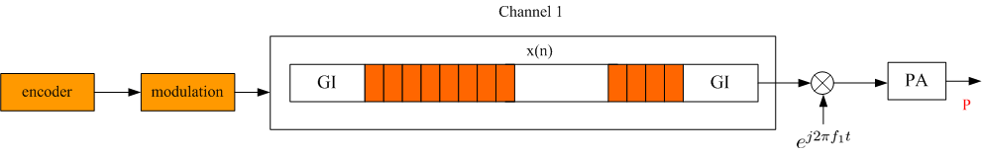
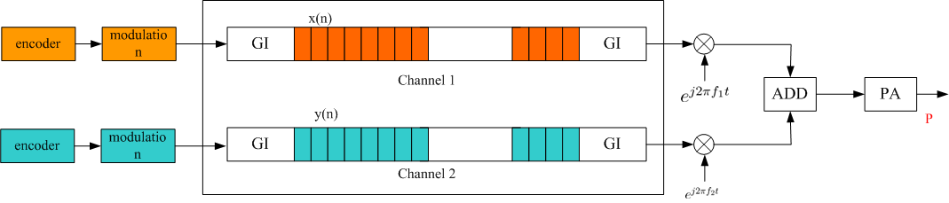
Channel Aggregation
One Channel Model
Two Channel Aggregation Model
In the simulation, the transmitter power in one channel and two channel aggregation model is the same.
In two channel aggregation model, the transmitted signals in a channel are encoded and modulated independently.

Slide 5
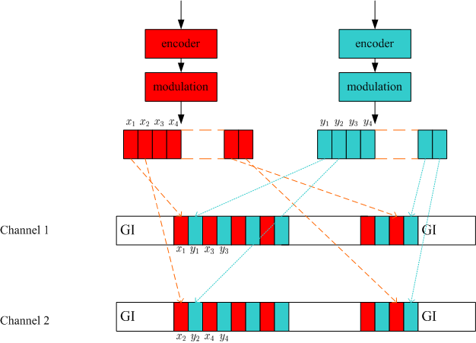
Regular interleaver for channel aggregation
After interleaving, the transmitted signals over each channel include coded bits from the both encoders:
  The output of two encoder are transmitted alternately in one channel;

Slide 6
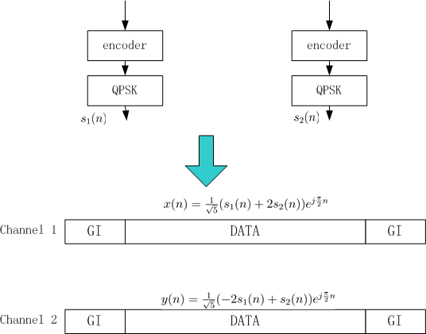
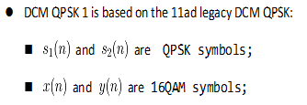
DCM QPSK Method 1 - 16QAM

Slide 7

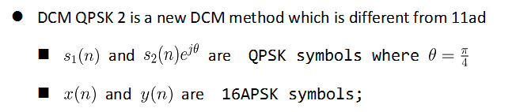
DCM QPSK Method 2-16APSK

Slide 8
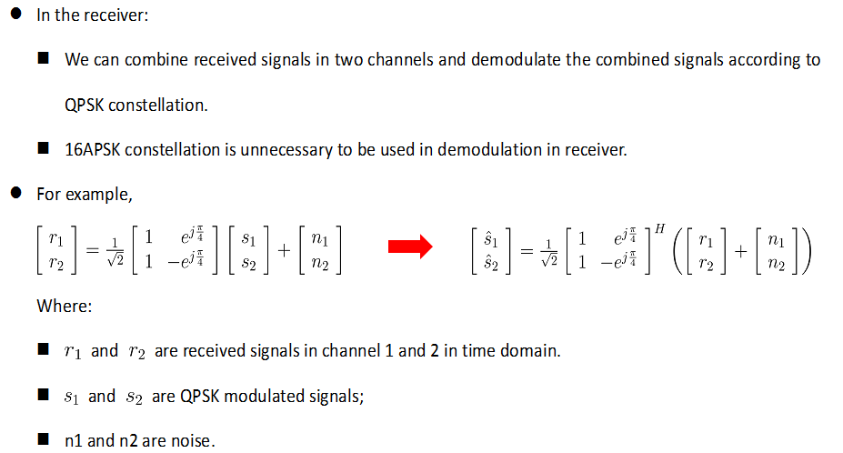
DCM QPSK Method 2-16APSK

Slide 9
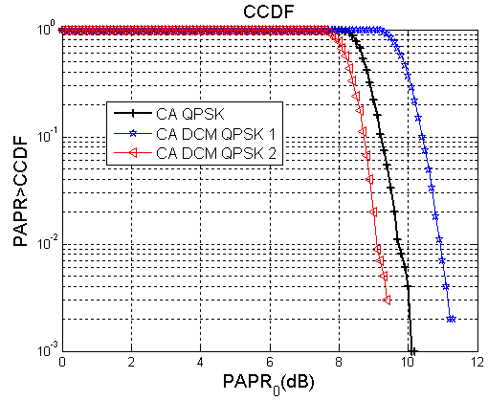
Simulation result on DCM QPSK PAPR
According to the simulation, it is easy to see that:
  PAPR of DCM QPSK model 1(16QAM) is 1dB higher than CA QPSK method .
  PAPR of DCM QPSK model 2 (16APSK) is lower than CA QPSK method.

Slide 10
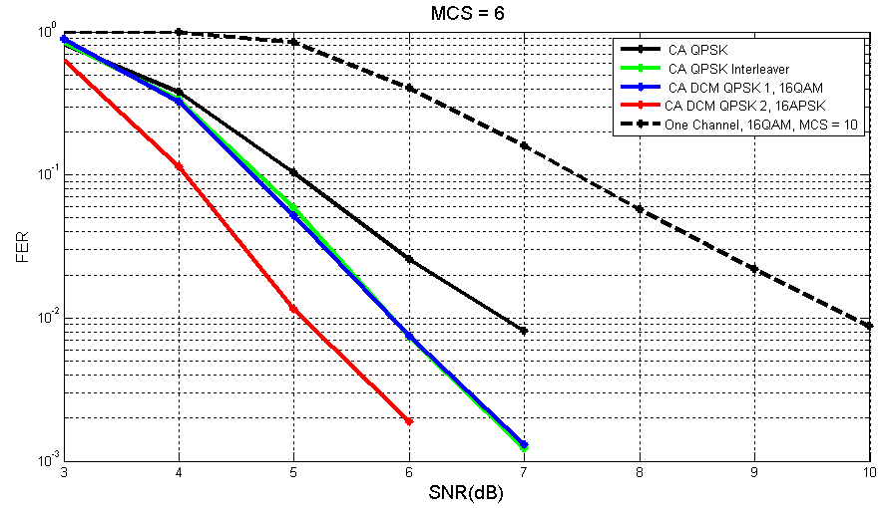
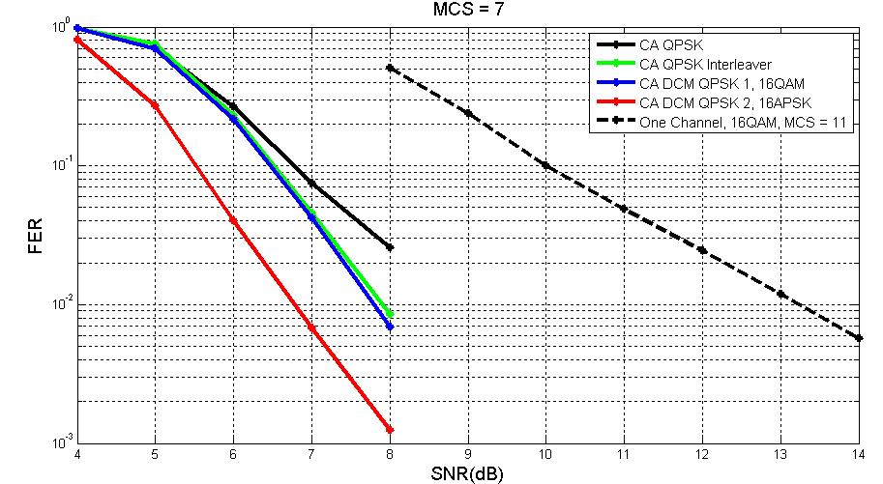
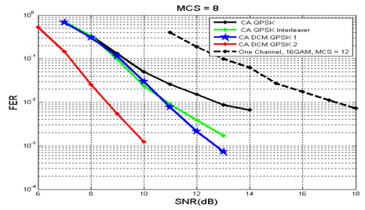
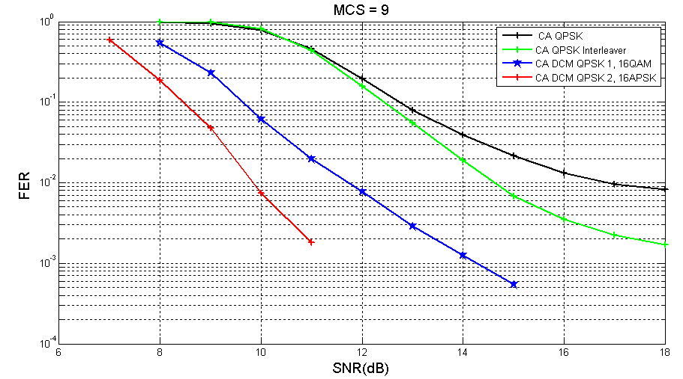
Simulated FER of DCM QPSK

Slide 11
Performance Comparison
Throughput gain for DCM QPSK 2 FER = 1%
SNR for FER =1e-2
MCS (in each aggregated channel) | CA+QPSK | CA +QPSK interleaver | CA + DCM QPSK 1 (16QAM) | CA + DCM QPSK 2 (16APSK) | Data Rate (Mbps)
6 | 6.8 | 5.86 | 5.84 | 5.0 | 1524
7 | 9.0 | 7.9 | 7.8 | 6.7 | 1906
8 | 12.7 | 10.9 | 10.8 | 8.6 | 2287
9 | 16.8 | 14.6 | 11.7 | 9.8 | 2476
Compared with the method of CA QPSK Interleaver , DCM QPSK 2 can yield performance gains in a range of 0.8dB to 4.8dB according to different MCS configurations
So we suggest to use the DCM QPSK 2 in 11ay.

Slide 12
Summary
In this contribution, we compared the performance of the two DCM QPSK methods with QPSK with the regular interleaver over two-aggregated channels and 16QAM over one channel in single carrier transmission.
Based on our simulation, DCM QPSK method 2 over two aggregated channels can yield up to 4.8 dB gain compared to QPSK signals interleaved over two aggregated channels and more than 4.0 dB gain compared to 16QAM in one channel.
It is suggested to introduce the DCM QPSK method 2 to the two channel aggregation in single carrier transmission.

Slide 13
Straw Poll/Motion
Do you agree to add the following text to the SFD ?
  In the Single Carrier mode in 11ay, DCM QPSK 2 signals transmitted over two aggregated channels presented in page 7 is supported.
  Yes
  No
  Abstain

