Slide 1
Carrier Sense for Multi-Channel Allocation
Date: 2016-11-09
Authors:

Slide 2
Introduction
The current SFD includes the multi-channel allocation as follows:
  “The 11ay specification shall support allocation of SP(s) and CBAP(s) over more than one channel and over a bonded channel through DMG Beacon frame, Announce frame, and Grant frame.”
  “The allocation does not have to include the primary channel.”
  “Channel access during the allocation shall be limited to the channels describing the allocation.”
There are remaining issues that should be defined in the case of the allocation not including the primary channel.
One of the remaining issues is about the carrier sense mechanism for multi-channel allocation.

Slide 3
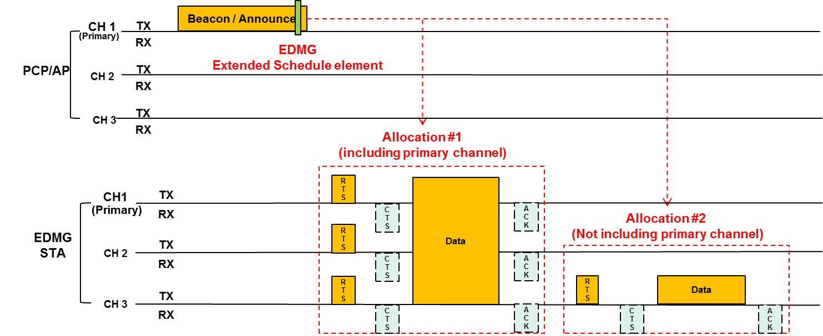
Multi-channel allocations in 11ay: without primary channel
According to the current SFD, the below allocations can be supported.
  Allocation#1: The case of an allocation which includes primary channel can use existing CS mechanism. → no issues
  Allocation#2: How does the case of an allocation which does not include the primary channel work? → should be considered

Slide 4
Carrier sense mechanism for the allocation: without primary channel
In the current SFD, the CS mechanism is defined as follows:
  Full carrier sense (physical and virtual) shall be maintained on a primary channel.
  At least CCA of energy detection shall be performed on each non-primary channel.
The above definition about carrier sense mechanism is not clear for the allocation which does not include primary channel.
If only ‘physical carrier sense’ applies to this allocation, the EDMG STAs allocated to a non-primary channel cannot set the NAV.
  Collision probability would be increased in OBSS environment.
We propose that if an allocation does not include primary channel, full carrier sense (physical and virtual) shall be performed on the channel which does not include the primary channel during the allocation.

Slide 5
Conclusion
Some cases of allocation still has remaining issues.
  Allocation which does not include the primary channel
Current standard, there is no clarification on the virtual CS on non-primary channel. So, we need to define the channel which supports virtual CS.
We proposed the CS mechanism for the case of an allocation which does not include the primary channel.

Slide 6
SP #1
Do you agree to add the following text to the SFD ?
  For CBAP allocation that does not include the primary channel, full carrier sense (physical and virtual) shall be performed during the allocation.

Slide 7
Motion #1
Do you agree to add the following text to the SFD ?
  For CBAP allocation that does not include the primary channel, full carrier sense (physical and virtual) shall be performed during the allocation.

