Slide 1
On the Single Carrier Waveforms for 11ay
Date: 2016-11-7
Authors:

Slide 2
Abstract
TGay has agreed that [1]
11ay shall enable both SC and OFDM modulations for SU-MIMO and MU-MIMO data transmission.
The bandwidth of bonded channels can be up to 8.64GHz
11ay supports channel-wise DL OFDMA. This means that in a bonded channel, a PCP or AP can simultaneously transmit to multiple STAs allocated to different frequency resources in the unit of one channel bandwidth.
In this contribution we discuss the feasibility of adopting SC waveforms based on DFT spread OFDM for 11ay to support single or multiple user transmission over wideband channels.

Slide 3
Problem Statement (1/2)
As shown in [2] and [3], with directional transmission in a 60GHz channel, the delay spread can be as large as several hundreds of ns due to rich NLoS paths, especially in outdoor scenarios, which makes the those channels highly frequency selective.
In wideband and frequency selective channels, the performance of SC may be degraded due to frequency selectivity.
The performance of an OFDM waveform can take advantage of channel frequency selectivity with a proper coding and scheduling schemes.
However, the high PAPR of the OFDM requires large power back-off to avoid in-band signal distortion and out-of-band leakage from nonlinear power amplifiers, which results in low PA efficiency.
11ad SC has low PAPR, but the SC makes it difficult to achieve frequency domain multiple access (FDMA) with bonded channel in DL.

Slide 4
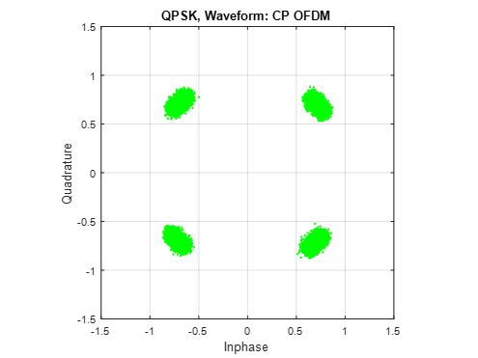
Problem Statement (2/2)
BW: 4x1.83 GHz
PN in time domain creates distortion in both amplitude and phase directions in frequency domain.
OFDM over wider channel creates higher PAPR.
(Simulation assumptions are in appendix)

Slide 5
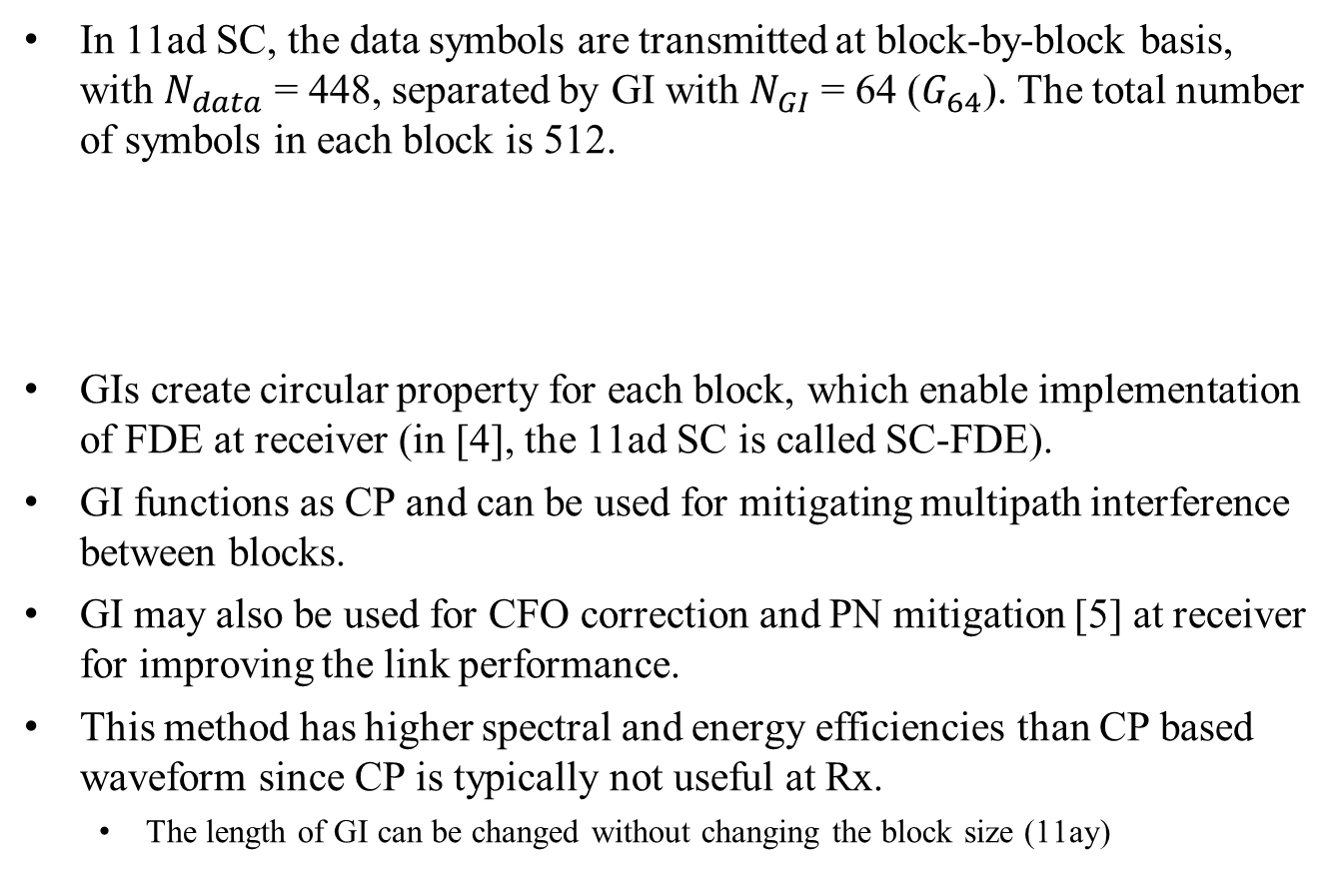
Properties of SC in 11ad
In 11ad SC, the data symbols are transmitted at block-by-block basis, with $N_{data}$ = 448, separated by GI with $N_{GI}$ = 64 ($G_{64}$). The total number of symbols in each block is 512.
GIs create circular property for each block, which enable implementation of FDE at receiver (in [4], the 11ad SC is called SC-FDE).
GI functions as CP and can be used for mitigating multipath interference between blocks.
GI may also be used for CFO correction and PN mitigation [5] at receiver for improving the link performance.
This method has higher spectral and energy efficiencies than CP based waveform since CP is typically not useful at Rx.
The length of GI can be changed without changing the block size (11ay)
512

Slide 6
CP DFT-s-OFDM: Basic Structure
$$0$$
$$d$$
S/P
DFT
(M)
SC Mapping
IDFT
(N)
P/S
+CP
RF
$$0$$
$$≡$$
$$d$$
Upsample
(N/M)
$⊛$ Sinc
+CP
RF
CP DFT-s-OFDM is a SC waveform, similar to 11ad SC, except
Linear convolution with a pulse shaping filter in 11ad SC is replaced by circular convolution with a sinc function
To achieve block-wise circular property, CP is used, which is thrown away at Rx.
CP DFT-s-OFDM allows different users to orthogonally share the spectrum in frequency domain - FDMA.
CP DFT-s-OFDM has low PAPR as 11ad SC.
Is it possible to create DFT-s-OFDM without CP but have GI similar to 11ad SC?

Slide 7
CP-less DFT-s-OFDM
ZT DFT-s-OFDM [6]
GI DFT-s-OFDM [7]
UW DFT-s-OFDM [8,9]
“Zero” Tail
d
$$N$$
DFT
(M)
$$0$$
DFT
$$0$$
IDFT
IDFT
(N)
P/S
Data
$$0$$
$$t$$
$$0$$
$M_{d}(N/M$)
d
$$N$$
“g” can be Zadoff-Chu (ZC) sequence.
DFT
(M)
$$0$$
DFT
$$0$$
IDFT
IDFT
(N)
P/S
$$0$$
Data
g
$$0$$
[0 g]
$$t$$
$M_{d}(N/M$)
u’ is upsampled and pulse shaped of u.
$$N$$
d
DFT
(M)
u
IDFT
(N)
P/S
Data
u'
$$t$$
$$0$$
$M_{d}(N/M$)
$$M_{d} is the size of d$$

Slide 8
CP-less DFT-s-OFDM (cont.)
These waveforms share the same properties as CP DFT-s-OFDM
Low PAPR
Allow orthogonal FDMA
The functionality of “GI” or “UW” is similar to the “GI” in 11ad SC
Mitigate inter-block interference due to multipath of the channel
Create circular structure for each block so FDE can be used at the receiver
Use for channel tracking, CFO correction and PN mitigation at receiver
The length of ZT/GI/UW can change based on channel condition
The GI/UW can be carefully designed to control the OOB leakage
$d_{1}$
DFT
(M)
$d_{1}$
$$0$$
DFT
DFT
(M)
$$0$$
$u_{1}$
IDFT
$d_{2}$
IDFT
(N)
P/S
$d_{2}$
IDFT
(N)
P/S
DFT
(M)
$$0$$
DFT
$$0$$
DFT
(M)
$$0$$
[0 g]
$u_{2}$

Slide 9
DFT-s OFDM - PAPR
$$d_{1}$$
DFT
IDFT
…
$$d_{K}$$
DFT
Increasing the number of DFT precoders will lead to increasing in PAPR, but it is still smaller than OFDM.
(Simulation assumptions are in appendix)

Slide 10
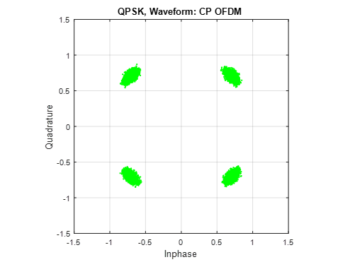
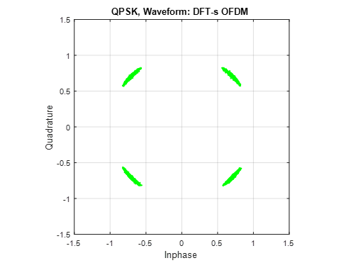
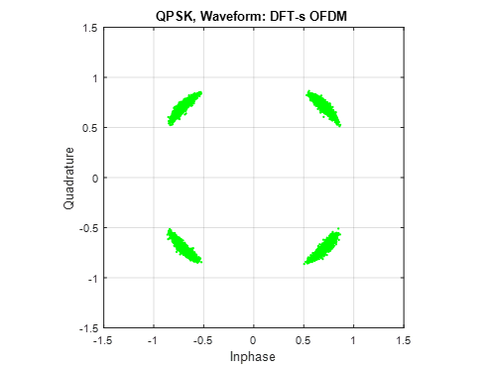
Phase Noise Immunity
CP OFDM
DFT-s OFDM
ICI: Hard to mitigate
Rotation: Easier to mitigate
BW:
1.83GHz
The noise along the magnitude direction is much smaller for DFT-s-OFDM than that for OFDM – A simple PN mitigation algorithm can be implemented for DFT-s-OFDM.
BW:
4x1.83 GHz
PN impact increasing with more tones

Slide 11
Conclusion
The bonded channel bandwidth of 11ay can be up to 8.64GHz, which makes implementing the transmitter with OFDMA capability difficult due to large PAPR.
GI/UW DFT-s-OFDM are attractive SC alternatives which have the similar properties as 11ad SC:
GI/WU can be used to avoid multipath interference and use FDE at receiver
GI/WU can be used as reference signal for CFO correction and PN mitigation at receiver
The length of GI/WU can be changed based on channel condition.
Using multiple DFT blocks, GI/UW DFT-s-OFDM
Exploit frequency selectivity of the multipath channel for SU/MU Tx
Enable orthogonal FDMA for MU Tx
PAPR of GI/UW DFT-s-OFDM can be much lower than OFDM.

Slide 12
References
[1] “Specification Framework for TGay,” IEEE 802.11-15/01358r6
[2] “Channel Models for IEEE 802.11ay,” IEEE 802.11-15/1150r7
[3] “Outdoor measurement for a rooftop to street scenario at 60 GHz,” IEEE 802.11-16/1221r0
[4] T. S. Rappaport, et.al., “Millimeter Wave Wireless Communications”, Prentice Hall 2015
[5] Nicholas Preyss, et.al., “Correlation Based Phase Noise Compensation in 60 GHz Wireless Systems,” 2014 IEEE 28-th Convention of Electrical and Electronics Engineers in Israel
[6] G. Berardinelli, et.al., “Zero-tail DFT-spread-OFDM signals,” Globecom 2013 Workshop - Broadband Wireless Access
[7] U. Kumar, et.al., “A Waveform for 5G: Guard Interval DFT-s-OFDM,” 2015 IEEE Globecom Workshops (GC Wkshps)
[8] F. Hasegawa, et.al., “Static Sequence Assisted Out-of-Band Power Suppression for DFT-s-OFDM,” Proc. IEEE 26th Annual International Symposium on Personal, Indoor, and Mobile Radio Communications (PIMRC), Hong Kong, 2015, pp. 61-66.
[9] A. Sahin, et.al., “An Improved Unique Word DFT-Spread OFDM Scheme for 5G Systems,” 2015 IEEE Globecom Workshops (GC Wkshps)
[10] K. Zeng et al, “Considerations on Phase Noise Model for 802.11ay ” IEEE doc. 11-16/0390r1

Slide 13
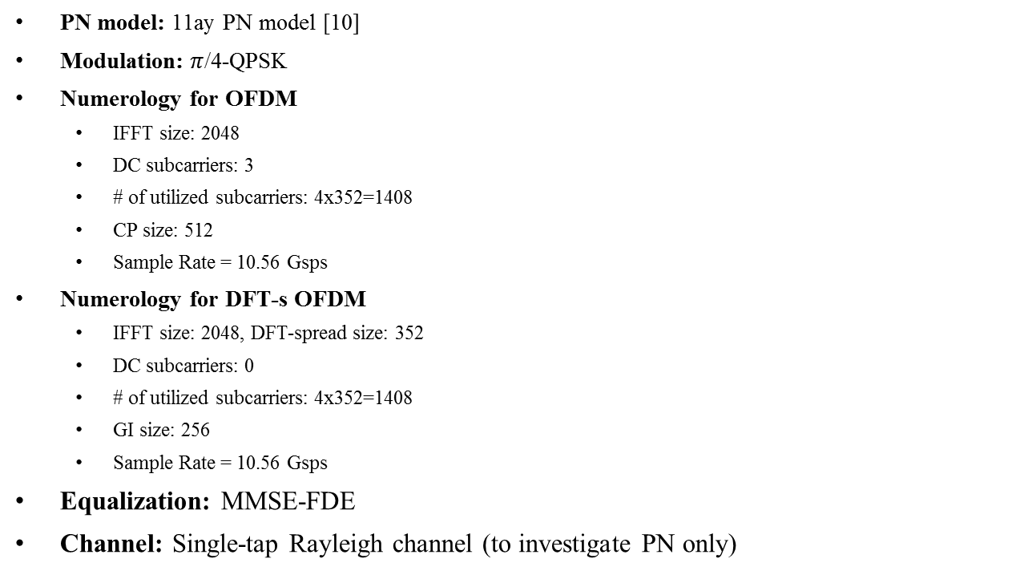
Appendix
Simulation Assumptions
PN model: 11ay PN model [10]
Modulation: $π$/4-QPSK
Numerology for OFDM
IFFT size: 2048
DC subcarriers: 3
# of utilized subcarriers: 4x352=1408
CP size: 512
Sample Rate = 10.56 Gsps
Numerology for DFT-s OFDM
IFFT size: 2048, DFT-spread size: 352
DC subcarriers: 0
# of utilized subcarriers: 4x352=1408
GI size: 256
Sample Rate = 10.56 Gsps
Equalization: MMSE-FDE
Channel: Single-tap Rayleigh channel (to investigate PN only)

Slide 14
Straw Poll (for Survey)
Do you agree that the TGay should further study the feasibility of including GI DFT-s-OFDM or UW DFT-s-OFDM as an alternative SC waveform for 11ay?

