Slide 1
Simulation Analysis of ED Threshold Levels
Date: 2016-11-04
Authors:
Name | Affiliation | Address | Email
Yuichi Morioka | Sony Corp. |  | Yuichi.Morioka@sony.com
Yusuke Tanaka |  |  | Yusuke.YT.Tanaka@sony.com
Kosuke Aio |  |  | Kosuke.Aio@sony.com

Slide 2
Introduction
IEEE 802.11 WG created the “PDED ad hoc” to consider potential response to 3GPP RAN1’s request to change 802.11’s ED threshold from -62[dBm] to -72[dBm]
IEEE802.11-16/1291r0 [1] suggests three experiments (by simulation and/or testing) to provide the basis to respond to the request
What happens if all 802.11 STAs uses ED of -72dBm
What happens if some 802.11 STA uses ED of -72dBm
What happens if both LAA UE and 802.11 STA operate at ED of -72dBm but with no PD communication
In this presentation, we show system simulation results for B) in dense environment
  B) is a realistic in the presence of legacy 802.11 STAs

Slide 3
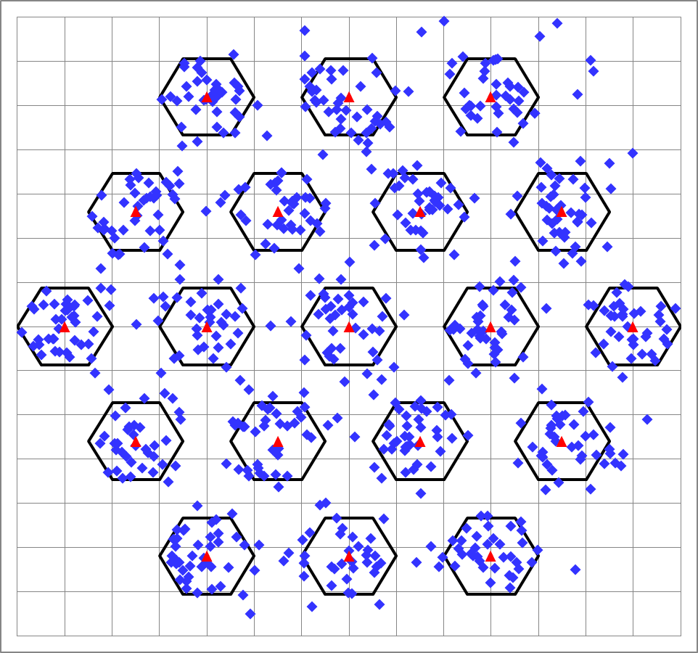
Simulation Scenario
Num of Drops [times] | 5
Traffic Model & Load & Duration | Approximated CBR UDP traffic model DL ... 12.0 Mbps x 20 flow (IP 1000byte) UL ... 12.0 Mbps x 4 flow (IP 1000byte)
Access Category | AC_BE CWmin=15, CWmax=1023, AIFSN=3, TXOP limit=0
Tx Power [dBm] | AP : 23dBm, STA : 15dBm
MCS Selection | SINR based (Tput maximizing) MCS selection
Guard Interval | short
Packet Length [byte] | (MPDU, MSDU, APP)=(1038, 1000, 972) Fixed
L2 Retry | 10
Ack Rate | Legacy 6.0Mbps
RTS/CTS | OFF
Max Aggregation Size | (A-MPDU, A-MSDU)=(65535, NA)
NF [dB] | 7
Channel | TGn Channel D (pathloss, shadowing, fading)
Channel Setting [MHz] | (CenterFreq, BW)=(5180, 80)
CCA-SD [dBm] | -82dBm
CCA-ED [dBm] | Parameters
Det. Cancel on PLCP err | Enable (Probability is based on Box5)
BSS COLOR operation | Enable, OBSS-PD = -82dBm
・SS3 (Indoor Small BSS defined in TGax) is used, as defined in [2]
・Half of STAs are 802.11ax STAs, other STAs are legacy 802.11 STAs.
・ All APs are 802.11ax STAs.
No Wrap Around.
Cell =10m
Freq. Reuse=3

Slide 4
Simulation Results – Ave. Throughput per BSS
Performance of 11ax STAs significantly degrade if the ED threshold is changed to -72dBm
・For 802.11ax STAs, throughput decreases to 63%
・For legacy 802.11 STAs, throughput increases to 117%

Slide 5
Simulation Results – CDF of UL Throughput
5% tile
802.11ax devices use ED = -62dBm,
Legacy 802.11 devices use ED = -62dBm
(B) 802.11ax devices use ED = -72dBm,
Legacy 802.11 devices use ED = -62dBm
Performance of 11ax STAs significantly degrade if the ED threshold is changed to -72dBm
・For 802.11ax STAs, 5% tile throughput decreases to 82%
・For legacy 802.11 STAs, 5% tile throughput increases to 530%

Slide 6
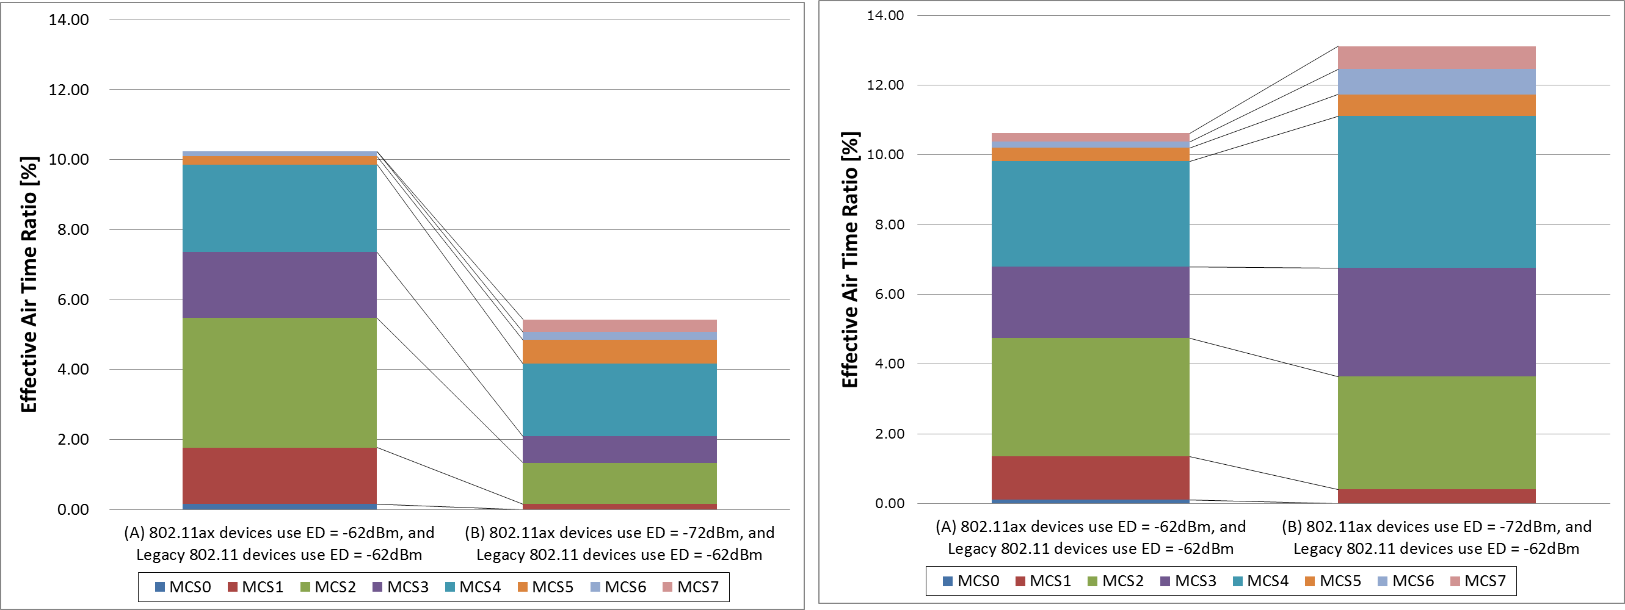
Simulation Results – Air Time Ratio
<802.11ax STAs>
<Legacy 802.11 STAs>
Performance of 11ax STAs significantly degrade if the ED threshold is changed to -72dBm
・For 802.11ax STAs, effective air time ratio decreases to 52%
・For legacy 802.11 STAs, effective air time ratio increases to 122%

Slide 7
Conclusion
In this contribution, we proposed to reject 3GPP RAN1’s request to change 802.11’s ED threshold from -62dBm to -72dBm
  As it is not realistic to change legacy STAs behavior, we analyzed case B) “some 802.11 STA uses ED of -72dBm”, where 802.11ax STAs use the new threshold
  In this coexistence scenario, performance of 802.11ax STAs significantly degrade, hence the request to change all new 802.11 STAs to adopt the new threshold should be rejected
Further analysis should be conducted for adjustable ED threshold according to transmission power, as defined in 3GPP LAA

Slide 8
References
[1] 11-16-1291-00-0000-pded-ad-hoc-agenda-27-sept-2016
[2] 11-14-0980-16-00ax-simulation-scenarios
[3] 11-14-0571-12-00ax-evaluation-methodology

