Slide 1
Issue on the CWmax value in MU EDCA
Date: 2016-11-09
Authors:

Slide 2
Abstract
Addressing an issue regarding CW value setting after a STA switches back to Legacy mode from MU mode

Slide 3
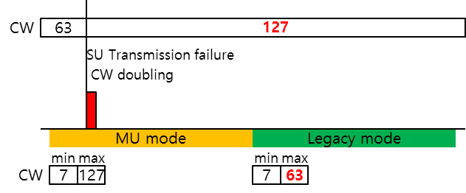
CWmax values in MU and Legacy modes
When an HE STA switches from MU mode to Legacy mode, its CW value may exceed the legacy CWmax value
MU EDCA parameter set is proposed to lower channel access probability of HE STAs
CWmax value of MU set is likely to be greater than that of Legacy set
If the STA experiences (internal) collision, it shall follow the procedure defined in 10.22.2.2 EDCA backoff procedure
collision

Slide 4
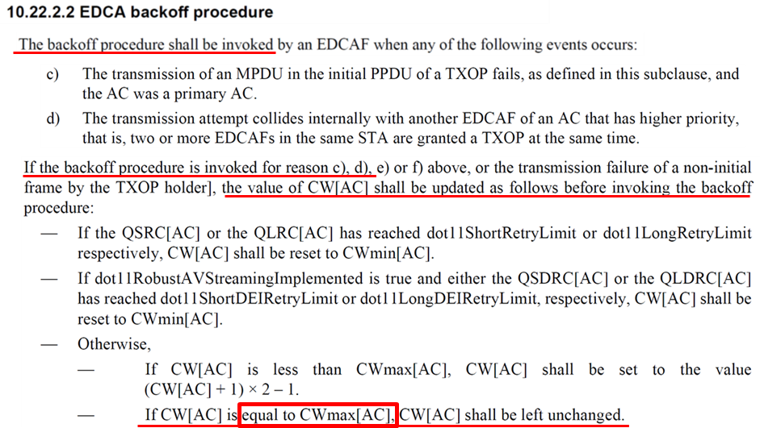
CW value resetting rule
In the current 11mc spec., CW value resetting rule in case the CW value is GREATER than the CWmax value hasn’t been defined

Slide 5
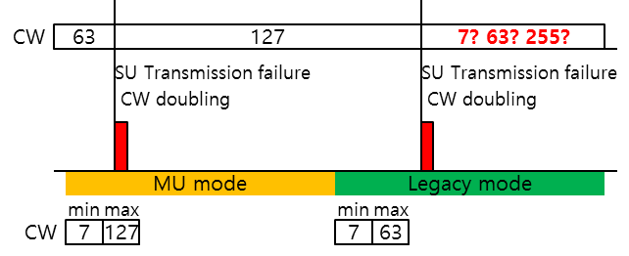
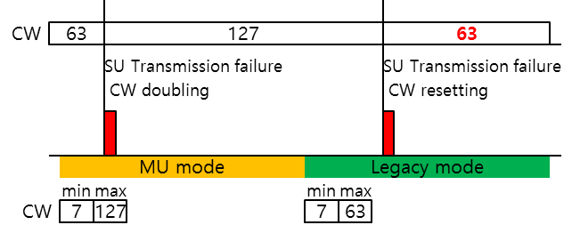
Proposed fix
If the STA experiences another collision, it follows the EDCA backoff procedure
When the current CW value exceeds the CWmax, there is no defined rule to refer
Therefore, we propose to modify the CW value resetting rule in case the current CW value already exceeds CWmax
For an HE STA, if CW[AC] is greater than CWmax[AC], CW[AC] shall be set to CWmax[AC].
collision
collision
collision
collision

Slide 6
Strawpoll
Do you agree to instruct TGax Editor to make the following change
10.22.2.2 EDCA backoff procedure
TGax Editor: insert the following paragraph from 11mc rev8.0 and add the new subbullet shown in red in 10.22.2.2 as below:
If the backoff procedure is invoked for reason c), d), e) or f) above, or the transmission failure of a non-initial frame by the TXOP holder, the value of CW[AC] shall be updated as follows before invoking the backoff procedure:
— If the QSRC[AC] or the QLRC[AC] has reached dot11ShortRetryLimit or dot11LongRetryLimit respectively, CW[AC] shall be reset to CWmin[AC].
— If dot11RobustAVStreamingImplemented is true and either the QSDRC[AC] or the QLDRC[AC] has reached dot11ShortDEIRetryLimit or dot11LongDEIRetryLimit, respectively, CW[AC] shall be reset to CWmin[AC].
— Otherwise,
— If CW[AC] is less than CWmax[AC], CW[AC] shall be set to the value (CW[AC] + 1) × 2 – 1.
— If CW[AC] is equal to CWmax[AC], CW[AC] shall be left unchanged.
— For an HE STA, if CW[AC] is greater than CWmax[AC], CW[AC] shall be set to CWmax[AC].

