Slide 1
Issue on the CWmax value in MU EDCA
Date: 2016-11-07
Authors:

Slide 2
Abstract
Addressing an issue regarding CW value setting after a STA switches back to Legacy mode from MU mode

Slide 3
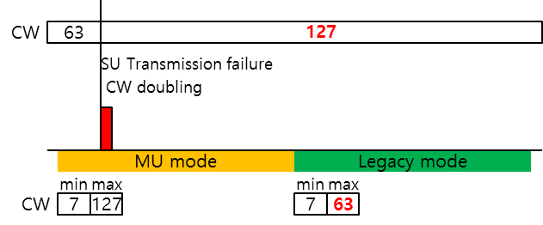
CWmax
When an HE STA switches from MU mode to Legacy mode, its CW value may exceed the legacy CWmax value
  MU EDCA parameter set is proposed to lower channel access probability of HE STAs
  CWmax value of MU set is likely to be greater than that of Legacy set
If the STA experiences (internal) collision, it shall follow the procedure defined in 10.22.2.2 EDCA backoff procedure
collision

Slide 4
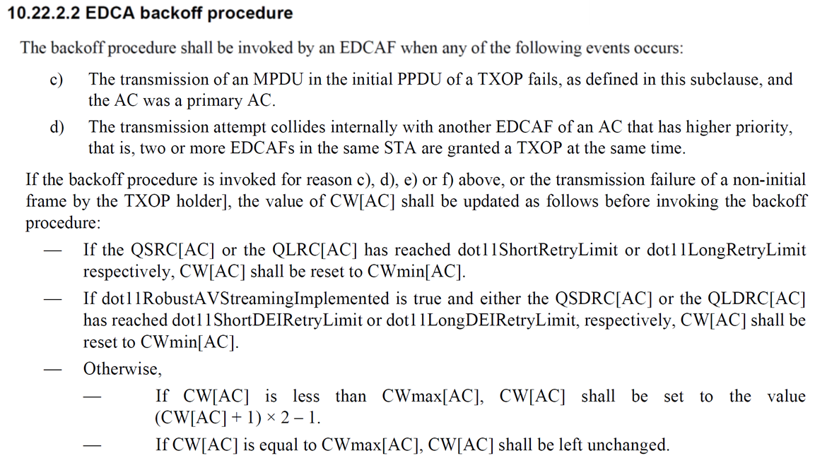
CW value resetting rule
In the current 11mc spec., CW value resetting rule in case the CW value is GREATER than the CWmax value hasn’t been defined

Slide 5
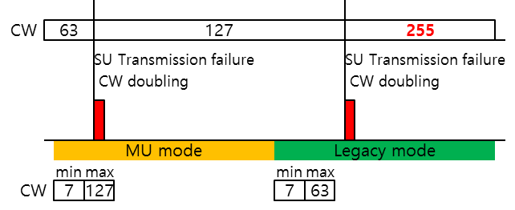

Proposed fix
In the aforementioned situation, the CW value will be doubled even if it exceeds the CWmax value
Therefore, we propose to modify the CW value resetting rule in case the current CW value already exceeds CWmax
  If CW[AC] is greater than CWmax[AC], CW[AC] shall be set to CWmax[AC].
collision
collision
collision
collision

Slide 6
Strawpoll
Do you agree to instruct TGax Editor to make the following change
TGax Editor: Change the paragraph below of 10.22.2.4 of 11mc D8.0 as follows:
  — Otherwise,
    — If CW[AC] is less than CWmax[AC], CW[AC] shall be set to the value (CW[AC] + 1) × 2 – 1.
    — If CW[AC] is equal to CWmax[AC], CW[AC] shall be left unchanged.
    — If CW[AC] is greater than CWmax[AC], CW[AC] shall be set to CWmax[AC].

