Slide 1
On Error Rate Performance of OOK in AWGN
Date: 2016-11-8
Authors:
Name | Affiliations | Address | Phone | Email
Shouxing Simon Qu | BlackBerry, Ltd. | 1001 Farrar Rd., Ottawa, ON, Canada | 1-613-595-4205 | squ@blackberry.com
James Lepp | BlackBerry, Ltd. |  |  | jlepp@blackberry.com
Michael Montemurro | BlackBerry, Ltd. |  |  | mmontemurro@blackberry.com
Stephen McCann | BlackBerry, Ltd. |  |  | smccann@blackberry.com

Slide 2
Abstract
Theoretic results of error rate performance of OOK in AWGN are reviewed, for both coherent and non-coherent detection.
Optimum threshold issue of non-coherent detection of OOK in AWGN is addressed.

Slide 3
Introduction
On-off keying (OOK) has been considered as the default modulation scheme for WUR [1].
Error rate performance of OOK was evaluated by simulation and reported recently [2]-[3].
Mature theoretical results are available [4]-[5] on OOK error rate performance in AWGN.
It should be helpful to review these theoretical results as a reference for performance evaluation.

Slide 4
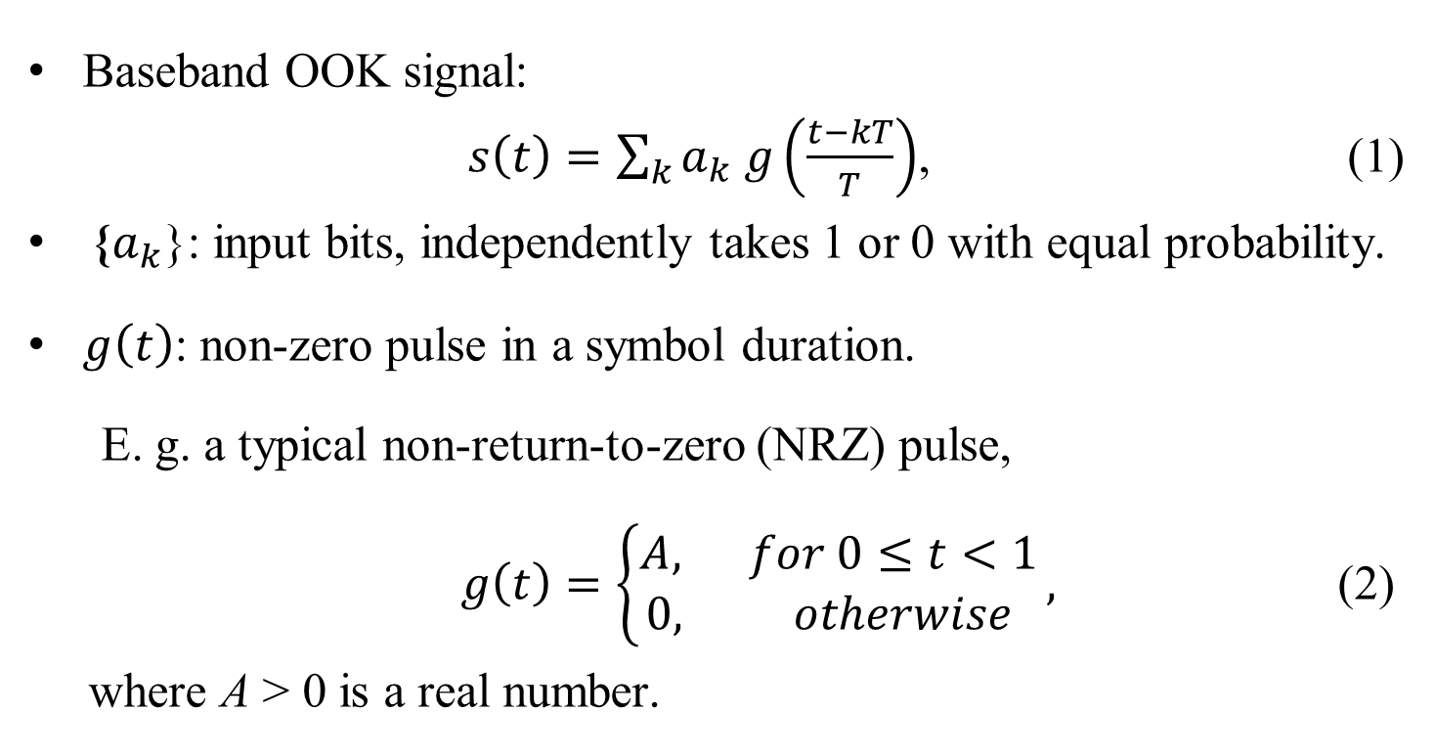
Introduction
Baseband OOK signal:
$s\left(t\right)=\sum_{k}{a_{k} g\left(\frac{t−kT}{T}\right)}$, (1)
{$a_{k}$}: input bits, independently takes 1 or 0 with equal probability.
$g\left(t\right)$: non-zero pulse in a symbol duration.
E. g. a typical non-return-to-zero (NRZ) pulse,
$g\left(t\right)=\left\{\begin{aligned}A, for 0≤t<1 \\ 0, otherwise \end{aligned}\right.,$ (2)
where A > 0 is a real number.

Slide 5
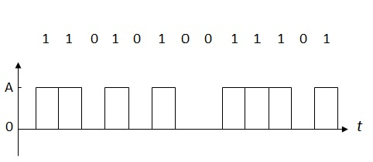
NRZ OOK Waveform
Non-coherent Detection (with envelope detector): based on the magnitude of received signal.
Coherent detection: base on the received signal value with phase synchronization.
The PDFs of the decision variable are different with coherent detection and non-coherent detection.

Slide 6
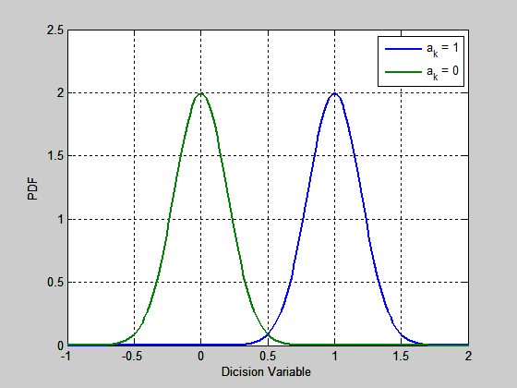
Coherent Detection
(A=1)
The decision variable is of Gaussian distribution, for either “ON” or “OFF” is transmitted.
BER: $P_{ber}=\frac{1}{2} erfc\left(\sqrt{ε/2}\right).$ (3)
where $ε$ is signal-to-noise ratio (SNR).

Slide 7
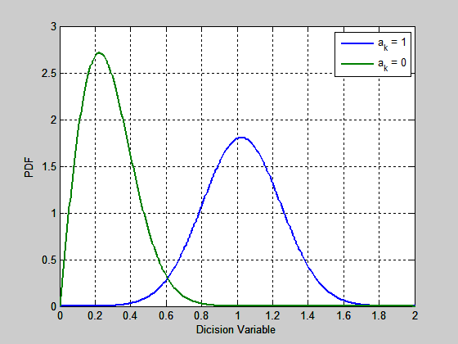
Non-Coherent Detection (Envelope Detector)
(A=1)
The decision variable is of
Rayleigh distribution when “OFF” is transmitted, or
Rice distribution when “ON” is transmitted.
BER: $P_{ber}≈\frac{1}{2}\left(1+\frac{1}{\sqrt{2πε}}\right)exp\left(−ε/2\right).$ (4)

Slide 8
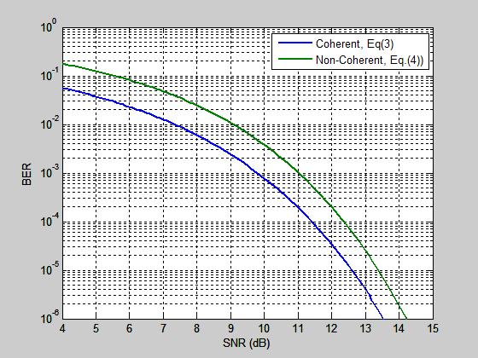
BER of OOK in AWGN
For BER=1e-3, the performance difference between coherent & non-coherent OOK is ~ 1.2 dB.

Slide 9
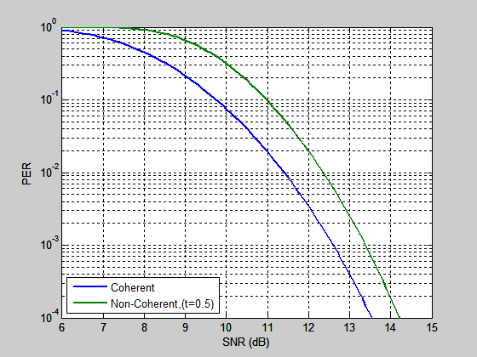
Packet-Error Rate (m=100)
m: Packet size
PER: $P_{per}=1−{\left(1−P_{ber}\right)}^{m}≈mP_{ber}.$ (5)
For PER=1e-1, the performance difference between coherent & non-coherent OOK is ~ 1.2 dB.

Slide 10
Optimum Threshold for Non-Coherent OOK Detection
For coherent OOK, optimum threshold is t = 0.5A.
For non-coherent OOK, the optimum threshold is SNR dependent.
t = 0.5A is not the optimum threshold in general$.$
From simulation with t = 0.55A, the BER performance is improved by 0.5 dB (for BER=1e-3) compared to the detection with t=0.5A.

Slide 11
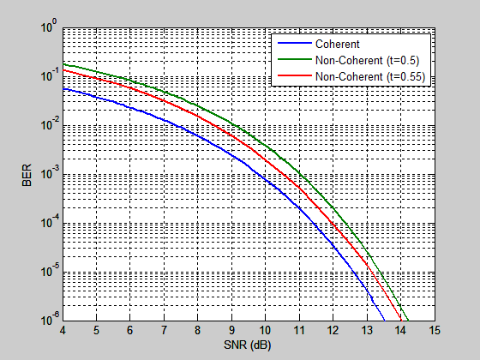
Envelope Detection for OOK with Threshold t = 0.55A
With t=0.55A, the difference between coherent & non-coherent OOK is ~0.7 dB (at BER=1e-3).

Slide 12
OOK with OFDM
In principle, the theoretical results are applicable to both single-carrier (SC) system and OFDM system.
If all subcarriers of OFDM are modulated with the same modulation scheme as SC, both have the same BER performance in AWGN.
If subcarriers have different SNRs, be careful with the difference between the SNR of the interested subcarrier and the average SNR of the whole OFDM symbol.
E.g.
64 tones in total; 63 tones are idle; 1 tone is in use.
SNR of the used tone = average SNR + 18 dB.
Use the SNR of interested subcarrier in above BER expressions.

Slide 13
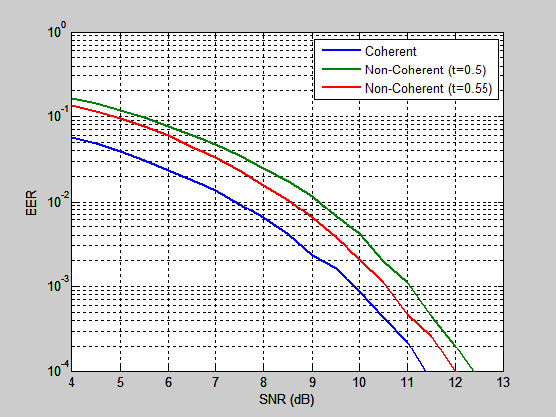
Simulation Result: OFDM-OOK in AWGN
64 subcarriers in total:
63 subcarriers are idle
1 subcarrier for OOK
Well onsistent with theoretical results.

Slide 14
Conclusions
Theoretical results of OOK error rate performance in AWGN are available, applicable to both SC and OFDM-OOK.
The detection threshold t=0.5A is optimum for coherent detector, but not optimum for non-coherent detector.
With threshold t = 0.55A for the envelope detector, the error rate performance of non-coherent OOK is improved by ~0.5 dB at BER = 1e-3 compared to t=0.5A.
The error-rate performance difference between coherent OOK and non-coherent OOK (with t=0.55A) in AWGN is around 0.7 dB (for BER=1e-3 and PER=0.1).

Slide 15
REFERENCES
:
[1] Minyoung Park at.al, “LP-WUR (Low-Power Wake-Up
Receiver) Follow-Up”, IEEE 802.11-16/0341r0, Mar. 14, 2016.
[2] Eunsung Park at.al, “Performance Investigation on Wake-Up
Receiver”, IEEE 802.11-16/0865r1, July 26, 2016.
[3] Eunsung Park at.al, “Further Investigation on WUR
Performance”, IEEE 802.11-16/1144r0, Sept. 12, 2016.
[4] Peyton Z. Peebles, Jr., Digital Communication Systems,
Prentice-Hall, 1987.
[5] Mischa Schwartz, Information Transmission, Modulation, and
Noise, McGraw-Hill Publishing Company, 4-th Edition, 1990.

