Slide 1
TRN Field Transmission for Channel Bonding
Date: 2016-11-08
Authors:

Slide 2
Background
There have been several presentations describing BF flows [1]-[4].
With regards to BF over multiple channels, we’ve learned the following key fact:
  Based on actual experiments, it is observed that an AWV obtained over one channel might not be applicable to an adjacent channel (i.e., AWVs are different)
This fact leads to an important conclusion that 11ay needs to support BF training to be done on the actual BW of the data transmission
  For both control PHY and SC PHY
We propose to define a TRN (and AGC) field structure that supports BF training over bonded channels

Slide 3
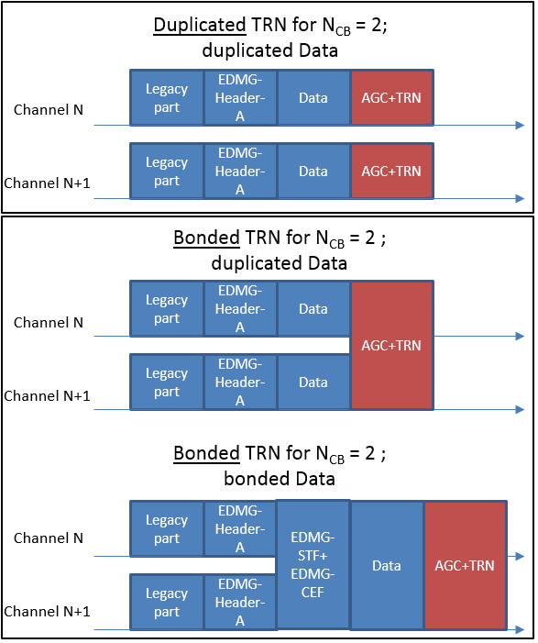
Options for TRN field transmissions with channel bonding
There are two options to transmit TRN (and AGC) fields when using channel bonding:
  Bonded TRN (and AGC)
  Duplicate TRN (and AGC)

Slide 4
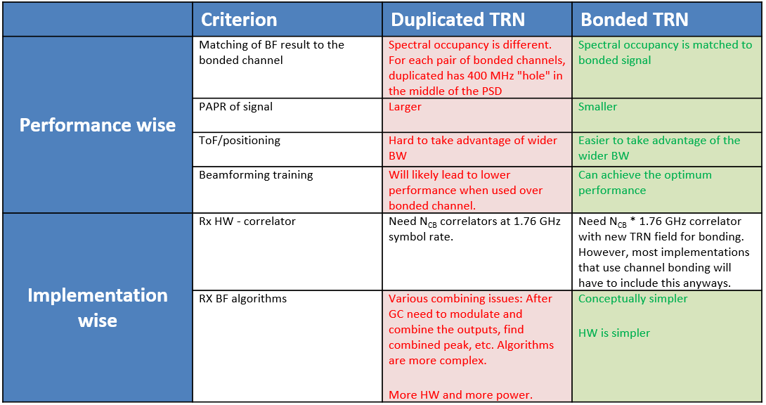
Comparison

Slide 5
Comparison Summary
From a performance point of view, bonded TRN fields are better.
From an implementation perspective the difference is not major, but even then bonded TRN has more advantages than duplicated TRN.

Slide 6
Recommendations
We recommend that bonded TRN/AGC be defined and used for BF training over bonded channels
  The next step would be to define the new TRN/AGC sequences to support channel bonding and MIMO over bonded channels
We also need to define in which cases the Data field is to be duplicated or not. If channel bonding is used, we recommend that:
  For control mode: Except for the AGC and TRN fields, all the fields of a control mode PPDU transmitted by an EDMG STA shall be duplicated
  For SC and OFDM: further study is needed

Slide 7
SP 1
Do you agree to insert the following in the SFD: “
The BRP protocol shall be extended to support operation over channels with 4.32 GHz, 6.48 GHz and 8.64 GHz of bandwidth.
If BRP is performed on such a channel, the AGC and TRN fields sent as part of the BRP shall be transmitted over the entire signal bandwidth of the channel.”

Slide 8
SP 2
Do you agree to insert the following in the SFD: “Except for the AGC and TRN fields, all the fields of a control mode PPDU transmitted by an EDMG STA over a 4.32GHz, 6.48GHz or 8.64GHz channel shall be duplicated”

Slide 9
References
[1] IEEE 802.11-16/0398r1 Generalized Multi-Beamforming for 11ay
[2] IEEE 802.11-16/0092r1 Multi-Beamforming in Polarized Channels for 11ay
[3] IEEE 802.11-16/0103r0 beamforming-training-update
[4] IEEE 802.11-16/0809r0 Beamforming to Enable Concurrent Links for 802.11ay

