Slide 1
1st Vice Chair Report – November 2016 – San Antonio
Date: 2016-11-07
Authors:

Slide 2
Abstract
Agenda Items for 1st Vice Chair -
M3.3 II Other WG meeting plans
M3.4 II Meeting room locations
M3.5 II Next meeting reminder
M3.6 II Meeting registration
M3.7 II Recording attendance
M3.8 II File server
M3.9 II Breakfast, breaks, Social logistics
Friday:
F3.1.1 II Straw Poll of membership regarding this meeting location
F3.1.2 DT Future venues status and discussion

Slide 3
Monday– 802.11 Opening Plenary
802.11 First Vice Chair Report

Slide 4
M3.3 Other WG meeting plans
802.1cf: Wed, Nov 9th, 16:00-18:00 special session on 5G
802.1 802.3
802.11 802.15 802.16 802.18 802.19 802.21 802.24
Treasurer Report:
Patent policy (in IEEE-SA bylaws), patent policy (slide set), and antitrust guidelines

Slide 5
M3.4 Meeting room locations
Download the Combined Meeting Schedule
Download the Grand Hyatt San Antonio floor plans http://802world.org/plenary/files/2015/03/Grand-Hyatt-San-Antonio-Floor-Plan.pdf

Slide 6
Online Calendar
This session’s meetings are also shown on the 802.11 calendar on the 802.11 home page (http://www.ieee802.org/11).
This is a Google calendar “802_11_calendar@ieee.org”
There are multiple ways of accessing this information, for example from a cell-phone, or as a remote calendar.
Note: the schedule on this calendar will be updated as will IMAT.

Slide 7
M3.5 Next meeting reminder
802W Interim: 16-20 January 2016 –
Grand Hyatt Buckhead – Atlanta, Georgia
Registration targeted to Open Nov 9, 2016
Early-Bird Meeting Registration Deadline: December 9, 2016
802 Plenary: 13-17 March 2016 –
Hyatt Regency Vancouver/Fairmont Hotel
Vancouver, Canada
Registration targeted to Open Dec 2, 2016
Early-Bird Meeting Registration Deadline: 6 January 2017

Slide 8
M3.6 Meeting registration

Slide 9
M3.7 Recording attendance
It is a requirement that attendees record their participation at an 802.11 session and declare their affiliation. This record is usually made using the IMAT attendance system.
If you wish to participate without recording attendance, send an email per session to the WG 2nd vice chair declaring your participation and affiliation. You cannot gain or maintain 802.11 voting membership using this method.
You must record 75% attendance of required 802.11 slots in a session for that session to count towards gaining or maintaining 802.11 voting membership
You need a single IEEE-SA web account
The IEEE SA web account requires a working email address
do not remove your email address from the account
Use the email address associated with that web account when registering attendance
If you change email addresses, update the web account, don’t create a new web account, or your membership status may not be calculated properly
Record attendance using this URL: IMAT.IEEE.ORG/

Slide 10
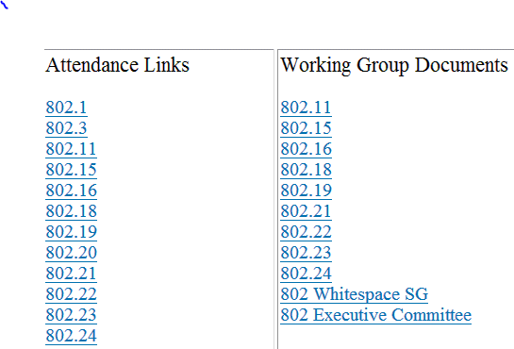
M3.8 Local File Document Server information
Local FTP server: ftp://griffin.events.ieee.org (anonymous)
External Document Server https://mentor.ieee.org/802.11/documents

Slide 11
M3.09 FOOD & BEVERAGE
Continental Breakfast 7:30 – 9 AM
Morning Coffee 9 – 11 AM
Afternoon Coffee & Tea 2 – 4pm
Afternoon Snacks
802.3 & 802.1 at 3 PM
Wireless Groups at 3:30 PM
For Registered Attendees Only

Slide 12
Network Assistance
WIRED CAFÉ
A wired café is situated in the Texas Ballroom Foyer. Please report any disruption of service in the café to VeriLAN staff.
NETWORK HELP DESK
For attendees experiencing difficulties accessing the meeting network a Help Desk will be located in Texas Ballroom Foyer.

Slide 14
Social Information
Social tickets are included with meeting registration for all paid IEEE 802 participants and their guests
Social:
*networking +
* 1 complimentary drink +
* entertainment & a view of the River Walk
Guest drink ticket is available upon entrance to the reception.

Slide 15
Hotel Outlets
Hotel Outlets:
PERKS is open 24 hours – coffee, drinks, pizzas, salad, and many more options
More info and options available at Meeting Information & posted on meeting boards.

Slide 16
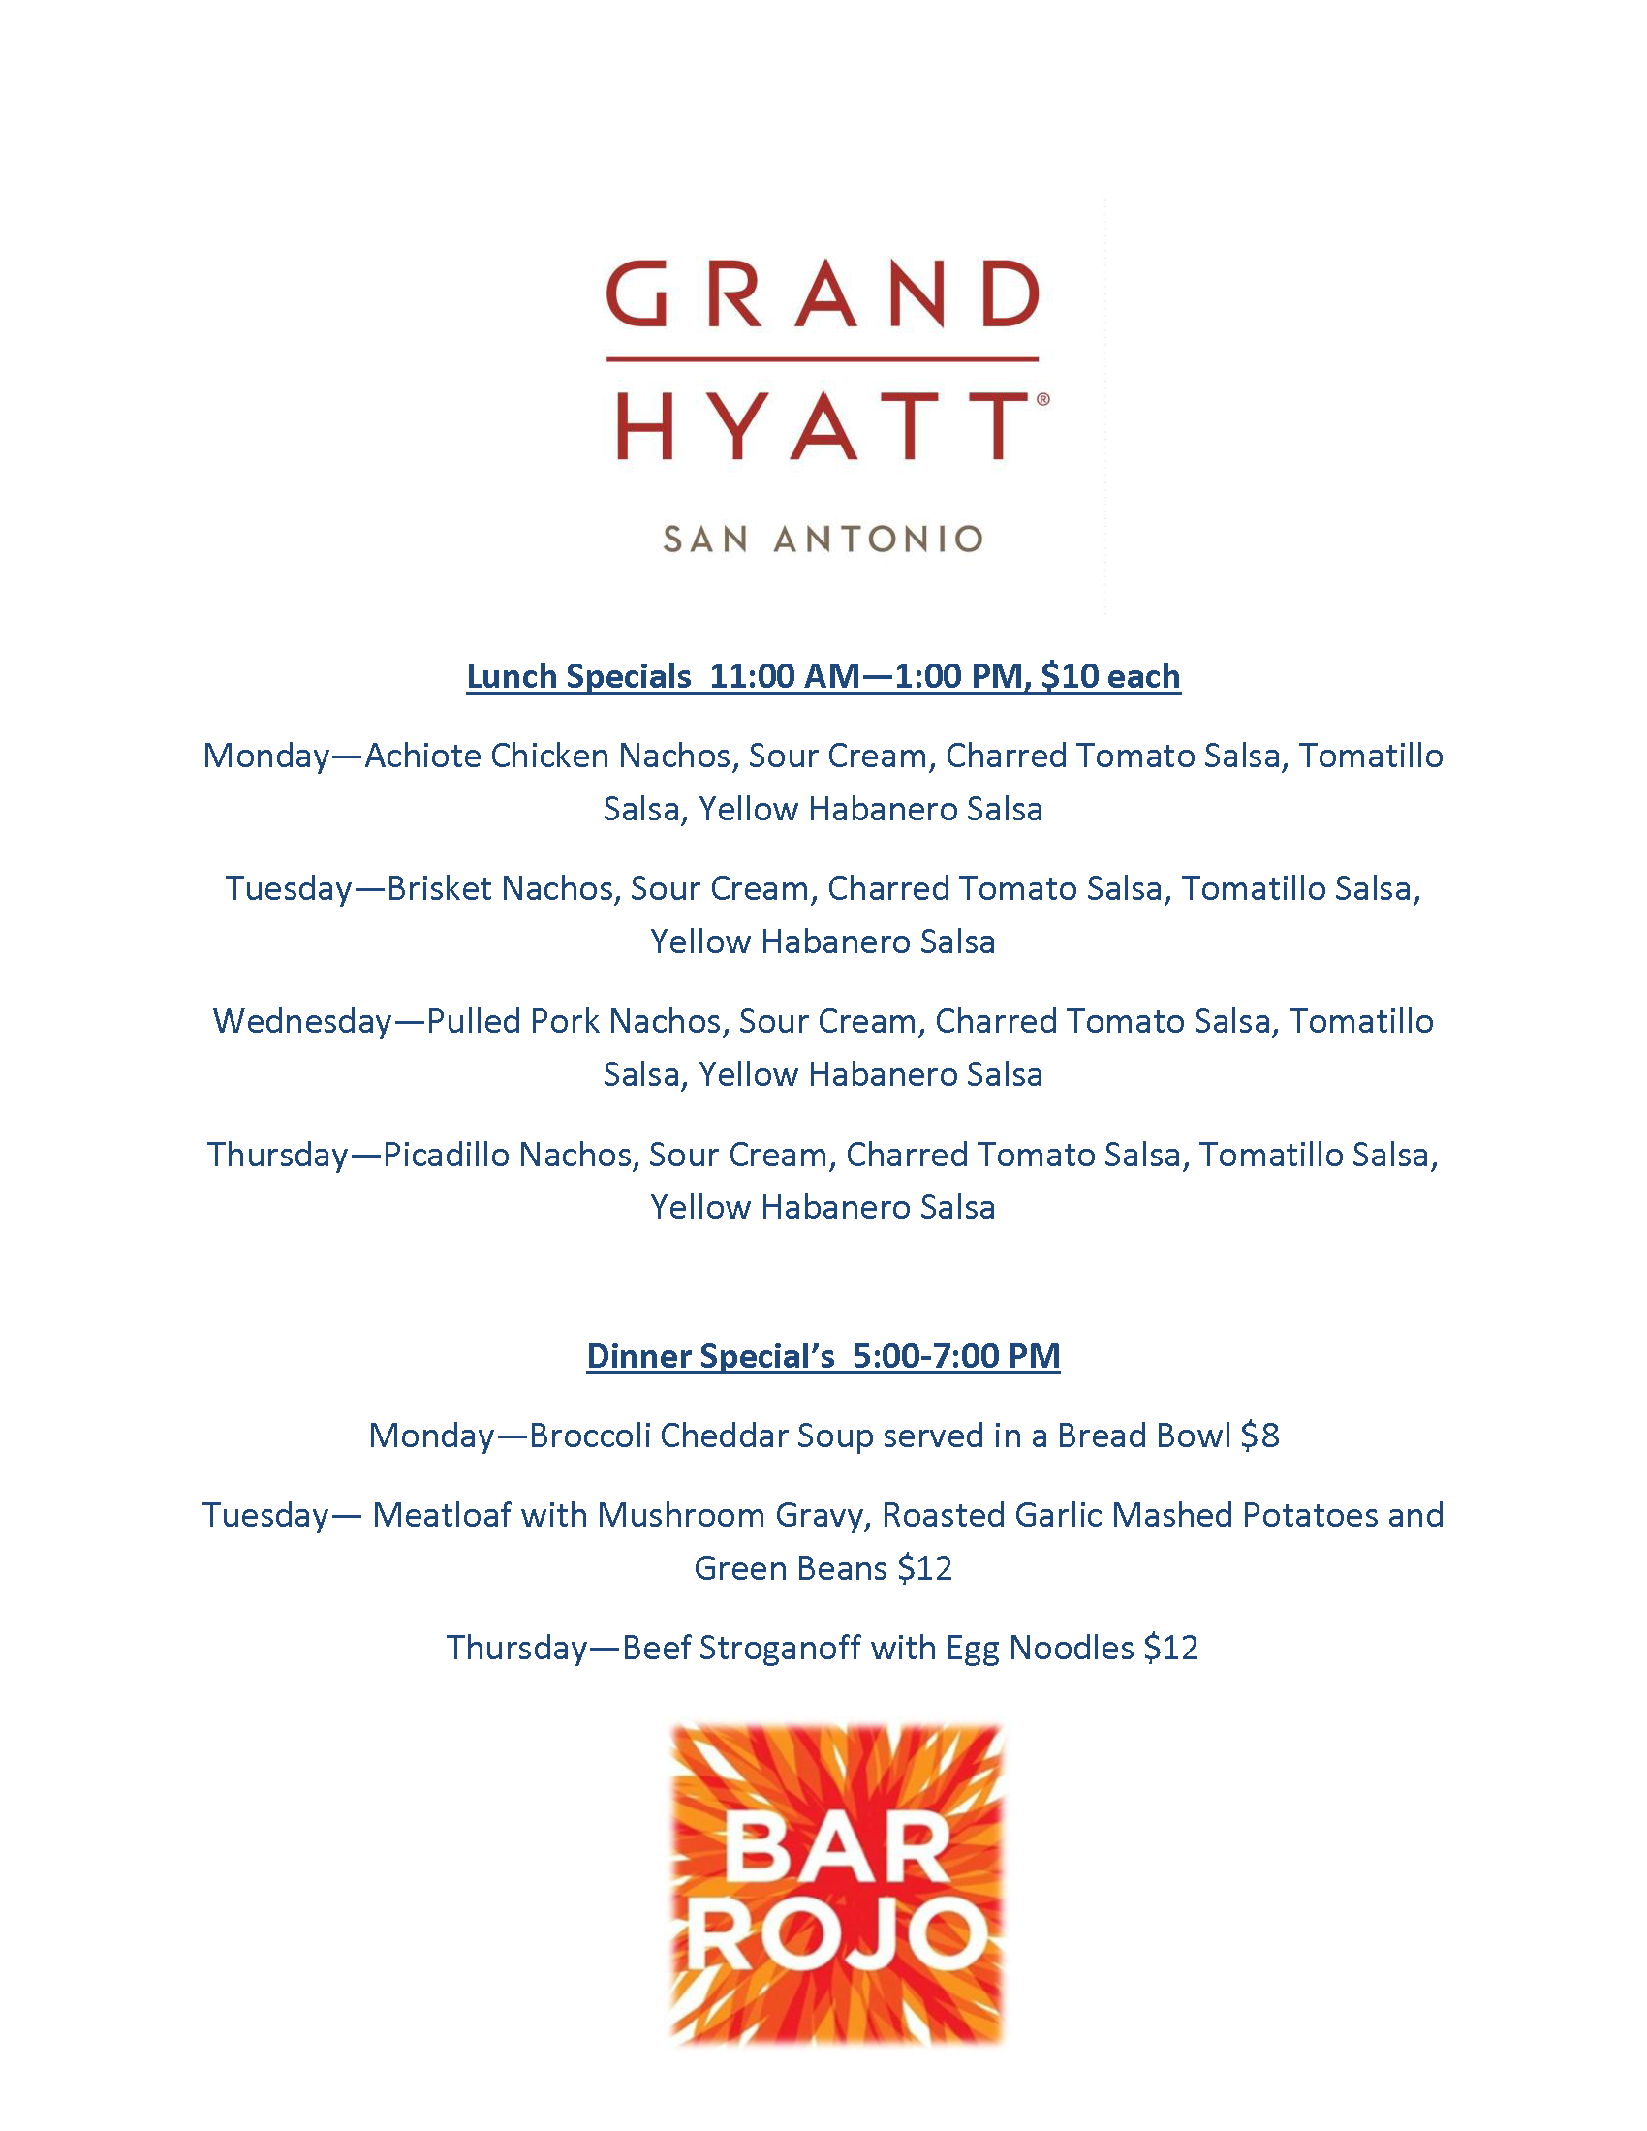

Slide 17
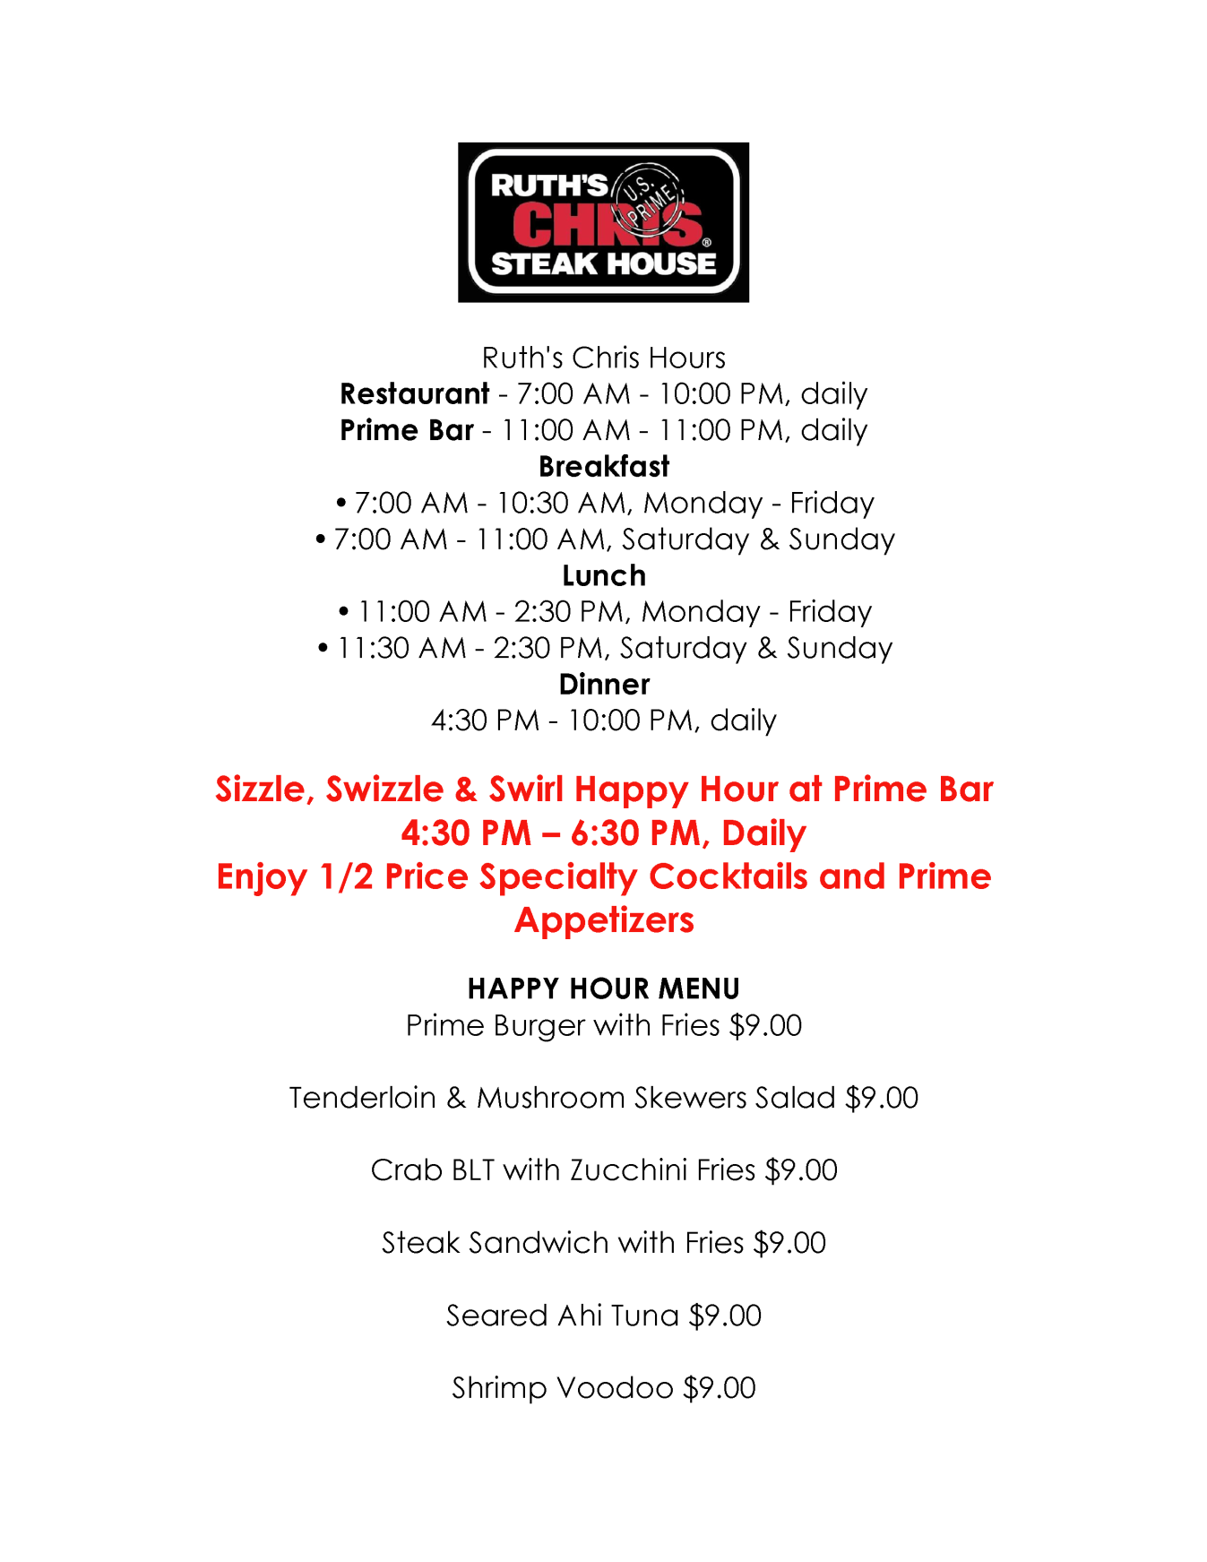

Slide 18
802.11 Mid-Week Plenary
Agenda Items:
2.5 – Announcements
5.1 – Room Change Reports

Slide 19
W5.1 Room Change Requests

Slide 20
802.11 WG Closing Plenary
Agenda Items:
3.1.1 – Straw Poll
3.1.2 -- Future venues status and discussion

Slide 21
F3.1.1 -Straw Poll of membership regarding this meeting location
Straw Poll:
How many people would like to come back to this venue?
Yes -
No –
Like the Social –
Disliked the Social –
Did not go to Social –

Slide 22
F3.1.2: Future Venue Insight
Future 802 Wireless Interims:
Jan 2017 Hyatt Regency Atlanta May 2017 Daejeon Convention Center, Korea Sept 2017 Hilton Waikoloa
Jan 2018 Hotel Irvine
May 2018 TBD Sept 2018 Hilton Waikoloa

Slide 23
F3.1.2: Future Venue Insight
Future 802 Plenary Sessions:
March 2017 Hyatt Regency/Fairmont – Vancouver
July 2017 Estrel Hotel – Berlin
Nov 2017 Caribe Hotel and Convention Center – Orlando
March 2018 Hyatt Regency O’Hare – Rosemont, IL
July 2018 Manchester Grand Hyatt – San Diego
Nov 2018 Suzhou, China - TBC
(New facility, pricing model being negotiated, Sponsor capability investigation)

Slide 24
References
https://mentor.ieee.org/802-ec/dcn/12/ec-12-0040-11-00EC-802-plenary-future-venue-contract-status.xlsx

