Slide 1
802.11 November 2016 Closing Reports
Date: 2016-11-11
Authors:

Slide 2
Abstract
This document is a digest of the closing reports of all 802.11 sub-groups for presentation at the November 2016 closing plenary meeting. Attendance information and liaison reports (including liaison reports from the mid-week plenary) are also included.

Slide 3
Attendance
Group | # Mtgs | Avg | Total | Min | Max
ARC | 2 | 12 | 24 | 10 | 14
Editors Meeting | 1 | 14 | 14
TGaj | 3 | 5 | 17 | 4 | 7
TGak | 5 | 6 | 31 | 2 | 8
TGaq | 6 | 10 | 64 | 5 | 17
WNG | 1 | 165 | 165
TGax | 12 | 163 | 1966 | 4 | 219
CAC | 1 | 17 | 17
Mid-Week Plenary | 1 | 248 | 248
New Members | 1 | 14 | 14
Opening Plenary | 1 | 227 | 227
REG | 1 | 35 | 35
TGay | 5 | 52 | 264 | 19 | 74
TGaz | 4 | 37 | 148 | 22 | 59
PAR Review SC | 3 | 7 | 23 | 4 | 13
WUR SG | 4 | 111 | 445 | 57 | 150
AANI SC | 3 | 29 | 88 | 20 | 41
802 JTC1 | 1 | 8 | 8
PDED Ad-hoc | 2 | 16 | 32 | 15 | 17
Data as of 2016-11-10
16:00

Slide 4
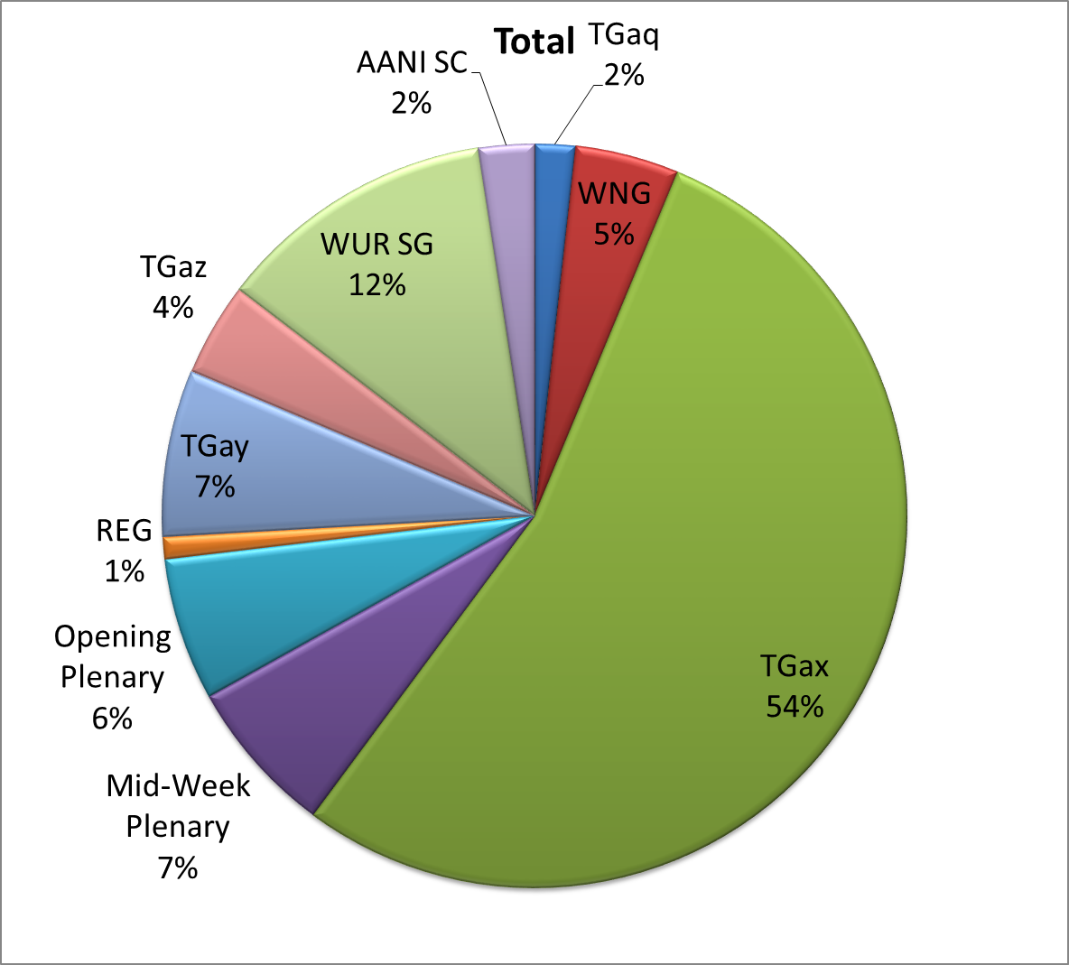
Attendance Total

Slide 5
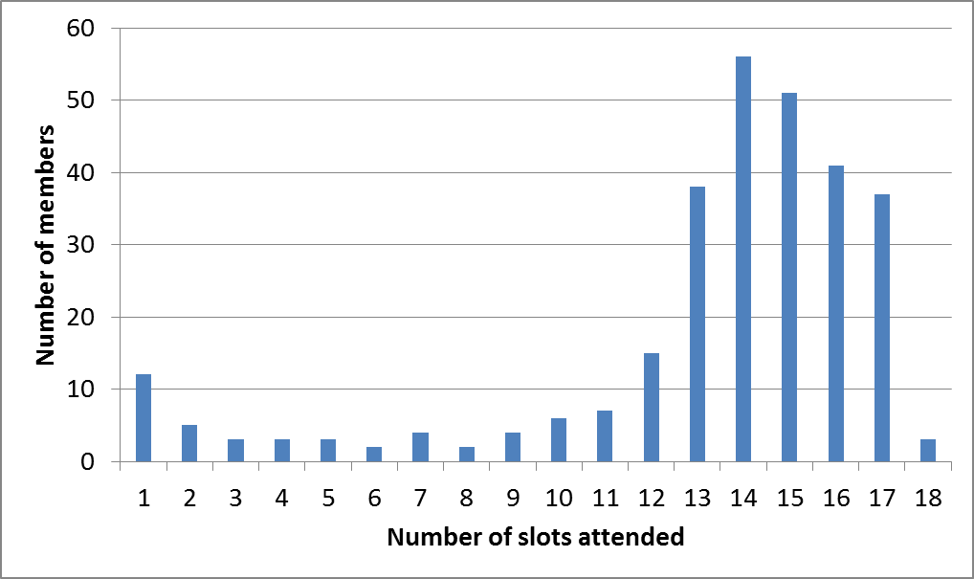
Attendance Histogram

Slide 6
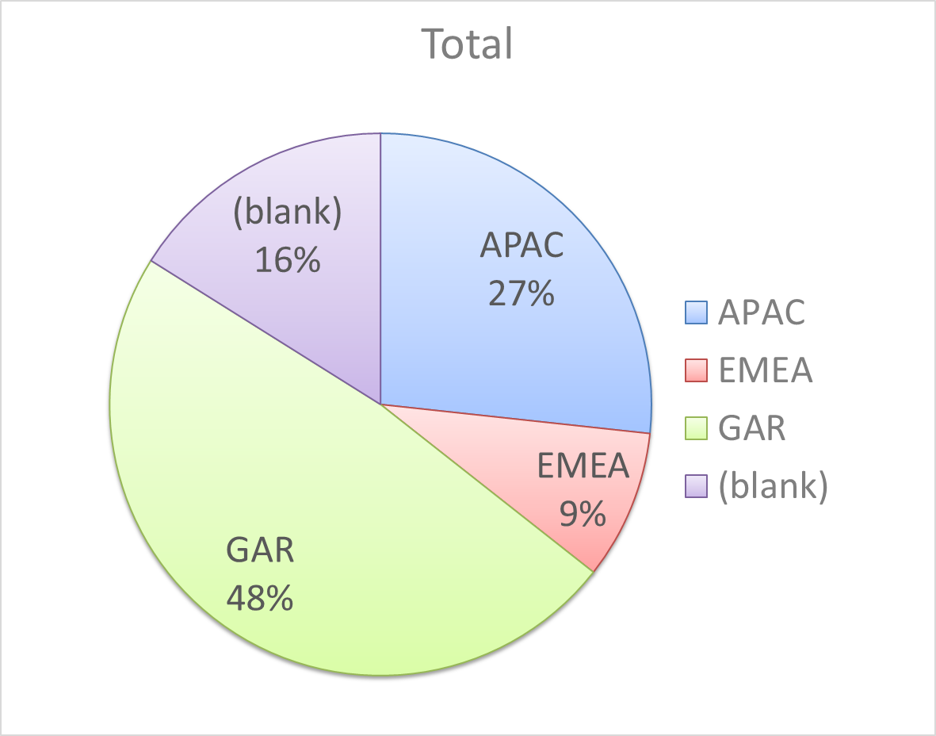
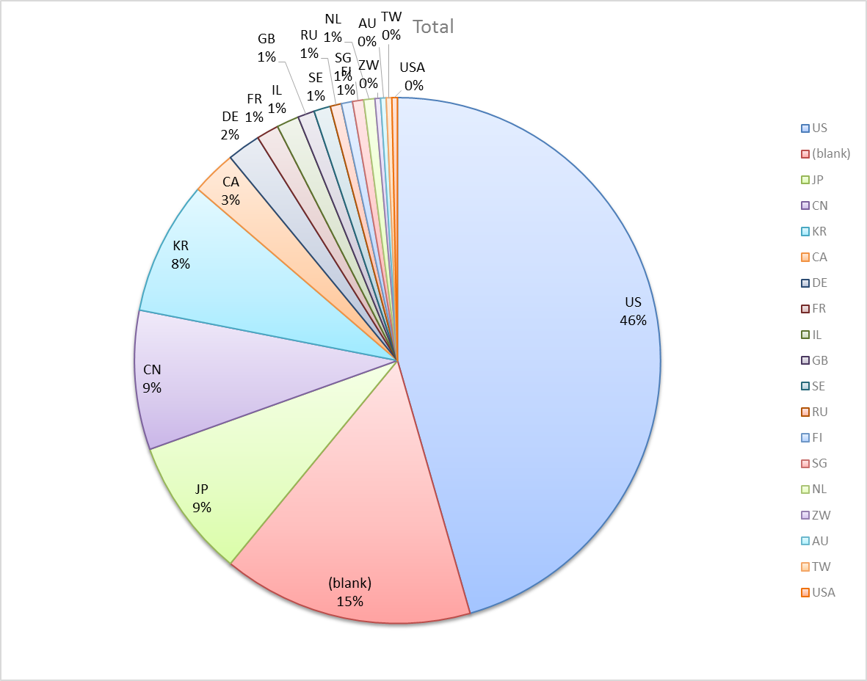
Attendance by Country

Slide 7
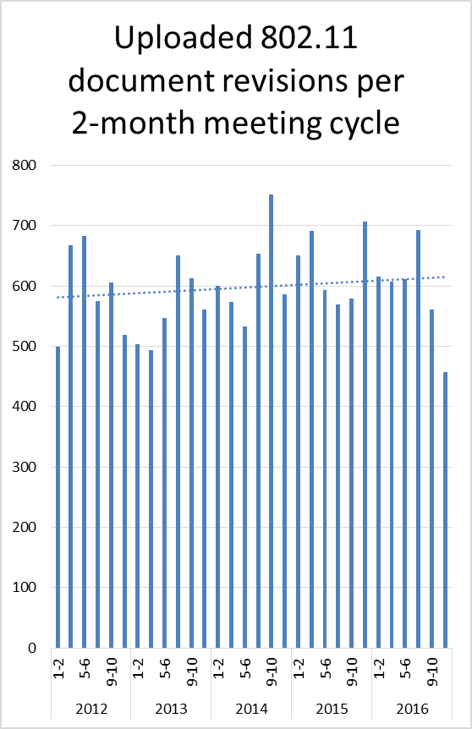
Doc Revision uploads by meeting (month #)

Slide 8
802.11 WG Editor’s Meeting (Nov ‘16)
Date: 2016-11-07
Authors:
from slide 1/10 of 11-16-1373 by Peter Ecclesine (Self)
Notes:
July 2007

Slide 9
Volunteer Editor Contacts
TGmc – Adrian Stephens – adrian.p.stephens@ieee.org , Edward Au – edward.ks.au@huawei.com, Emily Qi – emily.h.qi@intel.com
TGah – Yongho Seok yongho.seok@gmail.com, Alfred Asterjadhi – aasterja@qti.qualcomm.com
TGai – Lee Armstrong – LRA@tiac.net, Ping FANG Ping.FANG@huawei.com
TGaj – Jiamin CHEN – jiamin.chen@mail01.huawei.com , Shiwen He – shiwenhe@seu.edu.cn
TGak – Donald Eastlake – d3e3e3@gmail.com, Norm Finn – ?
TGaq – Lee Armstrong – LRA@tiac.net
  TGax – Robert Stacey – robert.stacey@intel.com
  TGay – Carlos Cordeiro – carlos.cordeiro@intel.com
  TGaz – Chao Chun Wang – chaochun.wang@mediatek.com
  Editors Emeritus:
  TGaa – Alex Ashley – alex.ashley@hotmail.co.uk
  TGac – Robert Stacey – robert.stacey@intel.com
  TGad – Carlos Cordeiro – carlos.cordeiro@intel.com
  TGae – Henry Ptasinski – henry@LOGOUT.COM
  TGaf – Peter Ecclesine – petere@ieee.org
  TGaq – Dan Gal – ddrgal@gmail.com
from slide 2/10 of 11-16-1373 by Peter Ecclesine (Self)
Notes:
July 2007

Slide 10
802.11-2016 and amendment publication
802.11-2016 will be published by yearend 2016.
Our IEEE amendments publication editor is not available in January and February
802.11ai may be published in 2016, but it looks like 11ah is too large to publish this year
For continuity and coherence, it looks like delaying publication of 11ah to March/April is possible
We will revisit 11ah publication in January
from slide 3/10 of 11-16-1373 by Peter Ecclesine (Self)

Slide 11
Review MDR findings for 802.11aj
TGaj MDR report
  https://mentor.ieee.org/802.11/dcn/16/11-16-1333-02-0000-tgaj-mdr-report.docx
from slide 4/10 of 11-16-1373 by Peter Ecclesine (Self)

Slide 12
New amendment style review
D0.1 clause 25 is HE MAC behavior modifying clauses 10 and 11; clause 26 is HE PHY behavior.
Comments on the new style are “mixed”. See 16/1472r0 slide 3 hierarchy diagram (next slide in 16/1373).
Some discussion on how amendment becomes core in next revision.
Will have January time to continue discussion
from slide 5/10 of 11-16-1373 by Peter Ecclesine (Cisco Systems)

Slide 13
The proliferation of STA types and their requirement inheritance
S1G
S1G relay
(unadorned)
STA
QoS
HT
VHT
HE
TVHT
DMG
EDMG
Mesh
One technique we use to define feature set applicability is the STA type
CDMG
45MG
FILS
GLK
from slide 6/10 of 11-16-1373 by Robert Stacey, Intel

Slide 14
802.11 Style Guide
See 11-09-1034-11-0000-wg11-style-guide.doc
  We updated 802.11 WG Style Guide based on 2012 IEEE Standards Style Manual and consistency changes in final publication of the 802.11 standard
Editor’s responsibility includes checking the 2014 IEEE Standards Style Manual when creating or updating drafts. https://development.standards.ieee.org/myproject/Public/mytools/draft/styleman.pdf
Submissions with draft text should conform to both the WG11 Style Guide and IEEE Standards Style Manual
Note that the Style Guide evolves with our practice, expect a revision in March
from slide 7/10 of 11-16-1373 by Peter Ecclesine (Self)

Slide 15
Editor Amendment Ordering
Data as of Nov 2016
See http://grouper.ieee.org/groups/802/11/Reports/802.11_Timelines.htm
In July 2016, Editors changed the running order and will revisit in Mar 2017, maintaining this order in the interim
Amendment Number | Task Group | Projected REVCOM Date
802.11REVmc | TGmc - 3648 | Dec 2016
802.11-2016 Amendment 1 | TGai - 170 | Dec 2016
802.11-2016 Amendment 2 | TGah - 627 | Dec 2016
802.11-2016 Amendment 3 | TGaq - 34 | Mar 2017
802.11-2016 Amendment 4 | TGaj - 288 | Jul 2017
802.11-2016 Amendment 5 | TGak - 86 | Jan 2018
802.11-2016 Amendment 6 | TGax - 317 | Dec 2018
802.11-2016 Amendment 7 | TGay | Nov 2019
802.11-2016 Amendment 8 | TGaz | Mar 2020
Amendment numbering is editorial! No need to make ballot comments on these dynamic numbers!
from slide 8/10 of 11-16-1373 by Peter Ecclesine (Self)
Notes:
July 2007

Slide 16
Draft Development Snapshot
Nov 2016
TG | Published or Draft Baseline Documents |  |  |  |  |  |  |  |  |  | Source | MDR | Style Guide | Editor | Snapshot Date
 | Published | mc | ai | ah | aq | ak | aj | ax | ay | az
mc | Y | 8.0 |  |  |  |  |  |  |  |  | Frame 12.0 | Yes | 2012 | Adrian Stephens Edward Au, Emily Qi | 12-Sep
ai | N | 8.0 | 11.0 |  |  |  |  |  |  |  | Frame 12.0 | Yes | 2012 | Lee Armstrong Ping FANG | 4-Nov
ah | N | 8.0 |  | 10.0 |  |  |  |  |  |  | Frame 11.0 | Yes | 2012 | Yongho Seok Alfred Asterjadhi | 13-Sep
aq | N | 8.0 |  |  | 7.0 |  |  |  |  |  | Frame 12.0 | No | 2012 | Lee Armstrong | 4-Nov
ak | N | 5.0 | 6.0 | 5.0 | 1.2 | 2.5 |  |  |  |  | Word | No | 2012 | Donald Eastlake Norm Finn | 10-Nov
aj | N | 7.0 | 6.2 | 5.0 | 3.0 | 1.3 | 3.0 |  |  |  | Frame 10.0 | No | 2012 | Jiamin Chen Shiwen He | 7-Nov
ax | N | 8.0 | 10.0 | 9.0 | 3.0 | 2.0 | 1.0 | 0.5 |  |  | Frame 12.0 | No | 2012 | Robert Stacey | 4-Nov
ay |  |  |  |  |  |  |  |  |  |  |  | No | 2012 | Carlos Cordeiro | 3-Nov
az |  |  |  |  |  |  |  |  |  |  |  |  |  | Chao Chun Wang | 12-Sep
Changes from last report shown in red.
Most current doc shaded green.
from slide 9/10 of 11-16-1373 by Peter Ecclesine (Self)
Notes:
July 2009
July 2007
Peter Ecclesine (Cisco Systems)
Page 16

Slide 17
MIB style, Visio and Frame practices
I’m going to suggest going forward we use a single style with appropriately set tabs, and use leading Tabs to distinguish the syntax and description parts. (Adrian Stephens Feb 9, 2010)
Two ways to format a figure & its caption in frame:
  Insert a table. Insert anchored frame inside table cell to hold graphics. Use table caption as figure caption.
  Insert an anchored frame. Insert caption inside a text frame inside the anchored frame. Insert graphics inside the anchored frame.
Keep embedded figures using visio as long as possible
  Near the end of sponsor ballot, turn these all into .wmf (windows meta file) format files (you can do this from visio using “save as”). Keep separate files for the .vsd source and the .wmf file that is linked to from frame. There is likelihood we should use .emf
Frame templates for 11aa, 11ac, 11af
from slide 10/10 of 11-16-1373 by Peter Ecclesine (Self)

Slide 18
AANI SC Closing Report November
Date: 2016-11-11
Authors:
from slide 1/4 of 11-16-1542 by Joseph Levy (Interdigital)

Slide 19
Abstract
This Document is the closing report for AANI SC,
November 2016 Meeting in San Antonio, TX
from slide 2/4 of 11-16-1542 by Joseph Levy (Interdigital)

Slide 20
802.11 AANI SC – November 2016
Meeting Goals:
  Discuss 802.11 activity in IC for “IEEE “5G” Specification”
  Continue to define/promote engagement with 3GPP RAN and SA
  Send reply liaison to RAN2 on “Throughput” (11-16/1384r0)
Meeting Activity:
Reported on 3GPP replies to 802.11 LS (11-16/1101r10)
Straw Polled interest in new LS to 3GPP RAN and SA
  Polls indicated some support: 8/0/19 and 7/0/14, respectively
Discussed Industrial projects - informative - no conclusions
Reply liaison to RAN2 draft created – still being discussed, not agreed, plan competition @ January meeting.
from slide 3/4 of 11-16-1542 by Joseph Levy (Interdigital)

Slide 21
802.11 AANI SC – Plans
Teleconferences all at @ 10:00 ET
  Thursday 1 December
  Thursday 15 December
  Thursday 5 January
Meeting plans for January;
  Two meeting slots planned
  Complete liaison to RAN2 on “Throughput” (11-16/1384r0), current draft in 11-16/1510r1
  Create draft liaisons to 3GPP RAN and SA to define/promote engagement
  Continue to report on 802.1CF OmniRAN – Industrial Connections activity
from slide 4/4 of 11-16-1542 by Joseph Levy (Interdigital)

Slide 22
ARC Closing Report
Date: 2016-11-10
Authors:
from slide 1/6 of 11-16-1541 by Mark Hamilton, Ruckus/Brocade

Slide 23
Abstract
This document is the closing report for ARC SC,
November 2016 Meeting in San Antonio, Texas, USA
from slide 2/6 of 11-16-1541 by Mark Hamilton, Ruckus/Brocade

Slide 24
Work Completed
Agenda is here: https://mentor.ieee.org/802.11/dcn/16/11-16-1323-02-0arc-arc-sc-agenda-november-2016.pptx
Noted status of IEEE 1588 mapping to IEEE 802.11
  No changes. No action needed.
Noted IEEE 802 activities relevant to 802.11/ARC
  802.1Qbz-2016 has been published
  802.1AC going to RevCom
  802.1Q revision under consideration. Roll-in.
Status of joint topics with TGak (General Links – joint mtg)
  11-16-1512-00-0arc-glk-802-1q-bridge.pptx
Status of joint topics with TGaq (Pre-association Discovery)
  Nothing significant at this time.
from slide 3/6 of 11-16-1541 by Mark Hamilton, Ruckus/Brocade

Slide 25
Work Completed (cont)
MIB Design Pattern work item
  Discussed https://mentor.ieee.org/802.11/dcn/15/11-15-0355-04-0arc-mib-truthvalue-usage-patterns.docx.
  Have reviewed and discussed all known open issues, with consensus direction given.
  Chair will update, per direction, for (hopefully final) review and approval in January.
YANG/NETCONF
  Very general introduction only, so far.
  Anybody with experience on these, please come help us out!
from slide 4/6 of 11-16-1541 by Mark Hamilton, Ruckus/Brocade

Slide 26
Teleconference(s)
Planning December 12 (Monday), 11am ET, 1 hour
To discuss YANG/NETCONF
May cancel if insufficient materials ready
from slide 5/6 of 11-16-1541 by Mark Hamilton, Ruckus/Brocade

Slide 27
January 2017 Plans
Two standalone meeting slots planned:
  Finish Design Pattern for MIB attribute use
  Consider use of YANG/NETCONF by 802.11
  DS/AP/Portal architecture discussions, and “what is an ESS?”
  Status of IETF work, IEEE 1588 work
One joint session with TGak
Same or another slot joint with 802.1
  Discussion about YANG/NETCONF models, and what 802.1 is doing and has learned
from slide 6/6 of 11-16-1541 by Mark Hamilton, Ruckus/Brocade

Slide 28
PAR Review - Meeting Agenda and Comment slides - San Antonio 2016
Date: 2016-11-10
Authors:
from slide 1/42 of 11-16-1326 by Jon Rosdahl, (Qualcomm)

Slide 29
Report to 802.11
IEEE 802.11 PAR Review SC report to 802.11 WG.
The Standing Committee reviewed 6 PARs.
Feedback for 802.1CS (slide 8), 802.3cg (slide 9), 802.19.2 (slides 10-12) and 802.11 WUR (slides 13-14) was provided by the Tuesday 6:30pm deadline.
Responses were received from 802.19.2 (slides 17-21), 802.11 WUR (slides 23-27), 802.3cg (slides 29-31); 802.1CS (slides 32-38).
We had no comments for 802C or 802.1AR.
from slide 40/42 of 11-16-1326 by Jon Rosdahl, (Qualcomm)

Slide 30
IEEE 802.11/15 Regulatory SC
San Antonio Closing Report
Date: 2016-11-11
Authors:
from slide 1/7 of 11-16-1538 by Rich Kennedy, Hewlett Packard Enterprise

Slide 31
Abstract
This presentation is the closing report for the November 2016 IEEE 802.11/15 Regulatory Standing Committee meeting in San Antonio.
from slide 2/7 of 11-16-1538 by Rich Kennedy, Hewlett Packard Enterprise

Slide 32
Agenda
Administrative items
Introduction
Approve Warsaw minutes
Discussion items
  Regulatory work in progress
  Status of completed work
Actions required
  TBD
  …
AOB and Adjourn
from slide 3/7 of 11-16-1538 by Rich Kennedy, Hewlett Packard Enterprise

Slide 33
Regulatory Updates
ETSI BRAN and ERM TG11 updates
FCC WRC-19 Advisory Committee (WAC)
CEPT CPG PT-D
EU Radio Equipment Directive implications
FCC 16-149 2016 Biennial Review
ETSI RED workshop December 1st
  http://www.etsi.org/news-events/events/1102-53-shades-of-re-d-six-months-to-go
from slide 4/7 of 11-16-1538 by Rich Kennedy, Hewlett Packard Enterprise

Slide 34
Input for 802.18
Consider responding to the FCC 16-149 2016 Biennial Review Public Notice
from slide 5/7 of 11-16-1538 by Rich Kennedy, Hewlett Packard Enterprise

Slide 35
Teleconferences, etc.
No more Regulatory SC teleconferences
This is the final meeting of the Regulatory SC
from slide 6/7 of 11-16-1538 by Rich Kennedy, Hewlett Packard Enterprise

Slide 36
The End
To all of you who have contributed to the success of the Regulatory Standing Committee, Thank you!
from slide 7/7 of 11-16-1538 by Rich Kennedy, Hewlett Packard Enterprise

Slide 37
Closing Report
Date: 2016-11-11
Authors:
from slide 1/3 of 11-16-1540 by Jim Lansford, Chair (Qualcomm)

Slide 38
Abstract
Closing report for WNG SC for November 2016 in San Antonio, Texas (USA)
from slide 2/3 of 11-16-1540 by Jim Lansford, Chair (Qualcomm)

Slide 39
Final Agenda
https://mentor.ieee.org/802.11/dcn/16/11-16-1322-02-0wng-agenda-for-wng-2016-11.ppt
Presentations at November 2016 meeting
    “Privacy Issues in 802.11 Networks”, Mathieu Cunche (U Lyon/Inria), J C Zuniga (Sigfox), Mathy Vanhoef (KU Leuven), Celestin Matte (U Lyon/Inria)
      https://mentor.ieee.org/802.11/dcn/16/11-16-1492-00-0wng-privacy-issues-in-802-11-networks.pptx
    Straw poll:
      Do you think 802.11 specifications should include privacy recommendations about the usage of its protocols and parameters?
      Straw poll Result: yes 30/ no 12/ abstain 57
  “LiFi – Light communication for 802.11”, Nikola Serafimovsky, (PureLiFi)
      https://mentor.ieee.org/802.11/dcn/16/11-16-1499-01-0wng-lifi-light-communication-for-802-11.pptx
    Straw Polls:
      Form a Study Group? yes 20 / no 44/ ab 33
      Form a TIG? 76/ no 4/ ab 24
Minutes
  https://mentor.ieee.org/802.11/dcn/16/11-16-1515-00-0wng-wng-meeting-minutes-of-2016-november-san-antonio.docx
Plans for January 2016
  TBD
No motions, no conference calls
from slide 3/3 of 11-16-1540 by Jim Lansford, Chair (Qualcomm)

Slide 40
PDED Ad Hoc closing report in San Antonio in November 2016
November 2016
11 Nov 2016
Authors:
Name | Company | Phone | email
Andrew Myles | Cisco | +61 2 84461010 +61 418 656587 | amyles@cisco.com
Adrian Stephens, Intel Corporation
from slide 1/3 of 11-16-1549 by Andrew Myles, Cisco

Slide 41
The IEEE 802.11 PDED ad hoc achieved its goals this week in San Antonio
November 2016
IEEE 802.11 PDED achievements in San Antonio in Nov 2016
  Approved liaison to 3GPP RAN1 in response to their request for future 802.11 PHYs to adopt ED = -72dBm
    See 11-16-1493-04; Note: this LS will now be approved by 802 EC
  Agreed to continue IEEE 802.11 PDED ad hoc in short term to:
    Address any reply from 3GPP RAN1
    Develop further data (based on simulation and testing?) for future LS’s
    Address the question of ED threshold in EN 301 893 that applies to 802.11ax
  Agreed to respond to LS (16-11-1343) from 3GPP RAN1 by asking the 802.11 WG Chair to respond informally to 3GPP RAN1 Chair, noting:
    The LS was received, The issues are important and so timely resolution is also important
    The WG looks forward to 3GPP RAN1’s response
Adrian Stephens, Intel Corporation
from slide 2/3 of 11-16-1549 by Andrew Myles, Cisco

Slide 42
The IEEE 802.11 PDED ad hoc will continue its work until at least the Atlanta meeting in Jan 2017
IEEE 802.11 PDED plans in Atlanta in Jan 2017
  Use e-mail reflector for discussions and to encourage work
    It is hoped that members will contribute more simulations
  Hold one or more teleconferences as required
    Will be called with 10 days notice
    Christmas might limit opportunities
  Hold two sessions in Atlanta
Adrian Stephens, Intel Corporation
from slide 3/3 of 11-16-1549 by Andrew Myles, Cisco

Slide 43
IEEE 802 JTC1 Standing Committee
Nov 2016 closing report
November 2016
11 November 2016
Authors:
Name | Company | Phone | email
Andrew Myles (Chair) | Cisco | +61 2 84461010 +61 418 656587 | amyles@cisco.com
Peter Yee (Vice Chair) | AKAYLA | +1 415 215 7733 | peter@akayla.com
Adrian Stephens, Intel Corporation
from slide 1/3 of 11-16-1551 by Andrew Myles, Cisco

Slide 44
The IEEE 802 JTC1 SC mainly focused on executing the PSDO process in San Antonio in Nov 2016
November 2016
IEEE 802 JTC1 achievements in San Antonio in Nov 2016
  Processed PSDO submissions
    Noted status of 39 standards in the PSDO pipeline
    Resolved IEEE 802.1Qcd 60 day ballot comments
    Resolved IEEE 802.3bw 60 day ballot comments
    Resolved IEEE 802.15.3 60 day ballot comments
  Considered ways of encouraging the China NB to provide more detail on their concerns related to 802.1X security
  Considered ways of encouraging NBs to vote yes or no rather tan abstain
  Agreed to start sending corrigenda into special PSDO process
  Issued call to WG Chairs for status updates in Jan 2017
Adrian Stephens, Intel Corporation
from slide 2/3 of 11-16-1551 by Andrew Myles, Cisco

Slide 45
The IEEE 802 JTC1 SC mainly focused on executing the PSDO process in San Antonio in Nov 2016
November 2016
IEEE 802 JTC1 plans for in Atlanta in Jan 2017
  Execute PSDO process
  Issue invitation to China NB to provide more detail on their concerns related to 802.1X security
  Reach out to NBs to understand why an increasing number are abstaining
  Prepare for SC6 meeting in Feb 2017
    Review WG status updates
Adrian Stephens, Intel Corporation
from slide 3/3 of 11-16-1551 by Andrew Myles, Cisco

Slide 46
IEEE 802.11aj November 2016 Closing Report
Date: 2016-11-10
Author:
from slide 1/7 of 11-16-1536 by Jiamin Chen (Huawei)

Slide 47
Abstract
This document is the TGaj closing report for the November 2016 session.
from slide 2/7 of 11-16-1536 by Jiamin Chen (Huawei)

Slide 48
Work Completed (1/2)
  Approved July meeting minutes (11-16/1061r0)
The following comment resolution proposals have been presented
    11-16/1145r1 - Proposed resolution to CID 506, 508, 509, 510, 511, 512, 513 and 514 in LB223
    11-16/1467r3 - Proposed resolutions for CID 502,503,504,520 11aj LB223
    11-16/1479r0 – Proposed resolution to CID 505 in LB223
    11-16/1491r0 – Proposed resolution to CID 507 in LB223
    11-16/1463r0 – Proposed resolutions to CID 521 in LB223
    11-16/1462r1 – Proposed resolutions to CID 516-519 in LB223
    11-16/1527r2 – Proposed resolutions to CID 501, 515
Completed all comment resolution of the LB223 for D3.0
Approved those comment resolutions and instruct editor to incorporate them into D4.0.
from slide 3/7 of 11-16-1536 by Jiamin Chen (Huawei)

Slide 49
Work Completed (2/2)
Approved resolutions for TGaj MDR report.
    11-16/1333r4 – TGaj MDR report
Approved a 15 day Working Group Technical Recirculation Letter Ballot asking the question “Should P802.11aj D4.0 be forwarded to Sponsor Ballot?”
Updated Task Group timeline
from slide 4/7 of 11-16-1536 by Jiamin Chen (Huawei)

Slide 50
Plan for November meeting
Comment resolution for 802.11aj WG Recirculation Letter Ballot
Discussion on conditional Sponsor Ballot
from slide 5/7 of 11-16-1536 by Jiamin Chen (Huawei)

Slide 51
Conference Call Time
  15th December, 2016, 8pm ET for 1hour
  (16th December, 2016, 9am Beijing Time)
  5th January, 2017, 8 pm ET for 1 hour
  (6th January, 2017, 9am Beijing Time)
from slide 6/7 of 11-16-1536 by Jiamin Chen (Huawei)

Slide 52
November 2016
Thank you！
from slide 7/7 of 11-16-1536 by Jiamin Chen (Huawei)

Slide 53
TGak November Closing Report
Date: 2016-11-10
Authors:
Abstract
Closing Report of the 802.11 TGak meeting November 2016 in San Antonio, Texas.
from slide 1/4 of 11-16-1544 by Donald Eastlake, Huawei Technologies

Slide 54
TGak Closing Report
Accomplishments
  TGak entered the week with only12 of the 346 comments from recirculation LB218 unresolved. During the week, it resolved all of these 12 comments and will ask the WG to approve a re-circulation.
  Met jointly with 802.11 ARC SC Thursday AM1.
  An annotated agenda is in 11-16/1304.
  The minutes will be in 11-16/1489.
from slide 2/4 of 11-16-1544 by Donald Eastlake, Huawei Technologies

Slide 55
TGak Closing Report
Submissions
  11-16/1512, “GLK 802.1Q Bridge”, Mark Hamilton
  11-16/1533, “LB218 Hamilton proposed comment resolutions”, Mark Hamilton
  11-16/1507, “Yet More 11ak LB218 CIDs Assigned Donald Eastlake”, Donald Eastlake
  11-15/556, Comment Reslutions, Donald Eastlake
from slide 3/4 of 11-16-1544 by Donald Eastlake, Huawei Technologies

Slide 56
TGak Closing Report
Teleconferences
  Decided to hold 1 ½ hour (except 1 hour on the 12th) teleconferences, to be joint with 802.1Qbz if mutually convenient, through the January 2017 802.11 meeting on Monday 21st and 28th November and 12th and 19th December at 10am Eastern US Time.
January 2017 Plans
  Work on comments on re-ciruclation LB on 11ak D3.0.
  Joint meeting with 802.11 ARC SC.
from slide 4/4 of 11-16-1544 by Donald Eastlake, Huawei Technologies

Slide 57
TGaq Closing Report
Date: 2016-11-10
Authors:
from slide 1/3 of 11-16-1534 by Stephen McCann, BlackBerry

Slide 58
Abstract
Closing report for TGaq (Pre-Association Discovery) for November 2016, San Antonio, Texas, USA.
from slide 2/3 of 11-16-1534 by Stephen McCann, BlackBerry

Slide 59
Sponsor Ballot status
  Initial sponsor ballot finished on 4th November
  235 comments, 87% approval
  90 technical comments unresolved.
Teleconferences
  Throughout December and January.
Plans for January 2017 2016
  Further sponsor ballot comment resolution
  Possible joint meeting with ARC
from slide 3/3 of 11-16-1534 by Stephen McCann, BlackBerry

Slide 60
TGax November 2016 Closing Report
Date: 2016-11-11
Authors:
from slide 1/5 of 11-16-1546 by Osama Aboul-Magd (Huawei Technologies)

Slide 61
Abstract
This document is the closing report for the TGax for the November 2016 session.
from slide 2/5 of 11-16-1546 by Osama Aboul-Magd (Huawei Technologies)

Slide 62
Work Completed
The TG completed the discussion of all the submissions received.
Completed resolution of most of the comments received on draft D0.1
Passed a motion to prepare draft D1.0 and start 30-day WG LB
Agenda and motions are available at: https://mentor.ieee.org/802.11/dcn/16/11-16-1310-05-00ax-tgax-november-2016-meeting-agenda.ppt
from slide 3/5 of 11-16-1546 by Osama Aboul-Magd (Huawei Technologies)

Slide 63
January 2017 Goals
Start resolution of comments on draft D1.0
from slide 4/5 of 11-16-1546 by Osama Aboul-Magd (Huawei Technologies)

Slide 64
Conference Call Times
Dec. 1, 8, and 15 21:00 ET 2hrs
January 5, 2017 11:00 ET 2hrs
January 12, 2017 20:00 ET 2hrs
from slide 5/5 of 11-16-1546 by Osama Aboul-Magd (Huawei Technologies)

Slide 65
Task Group AY
November 2016 Closing Report
Date: 2016-11-10
Authors:
from slide 1/5 of 11-16-1505 by Edward Au (Huawei Technologies)

Slide 66
Abstract
This document is the closing report for Task Group AY for the November 2016 session.
from slide 2/5 of 11-16-1505 by Edward Au (Huawei Technologies)

Slide 67
Work Completed
27 submissions were covered during the meeting covering areas related to:
  Channel model
  Specification framework document
Significant progress is made in the development of specification framework document
Revised timeline is approved
  Delay D0.1 and D1.0 by 2 months
  Keep D2.0 and amendment completion the same
from slide 3/5 of 11-16-1505 by Edward Au (Huawei Technologies)

Slide 68
Goals for January 2017 interim
Advance on Specification Framework document
Technical presentation
Preparation on Draft 0.1
from slide 4/5 of 11-16-1505 by Edward Au (Huawei Technologies)

Slide 69
Teleconference Schedule
January 4 (Wednesday), 10:00am ET – 11:00am ET
from slide 5/5 of 11-16-1505 by Edward Au (Huawei Technologies)

Slide 70
TGaz Next Generation Positioning
Nov. Closing Report
Date: 2016-11-10
Authors:
from slide 1/5 of 11-16-1548 by Jonathan Segev, Intel Corporation

Slide 71
Abstract
This document is the TGaz Next Generation Positioning closing report for the San Antonio meeting, Nov. 2016.
from slide 2/5 of 11-16-1548 by Jonathan Segev, Intel Corporation

Slide 72
Work Completed This Week
Reviewed and approved 3GPP Liaison letter on WLAN RTT accuracy.
Reviewed and adopted text to Spec. Framework on protocol elementary stages: discovery, negotiation and measurement exchange.
Reviewed technical submissions on measurement exchange, negotiation and secured location.
Set telecon times and goals for Nov. meeting.
Agenda: See 11-16/1309r5.
from slide 3/5 of 11-16-1548 by Jonathan Segev, Intel Corporation

Slide 73
Goals For The January Meeting
Continue development of FRD and SFD development.
Review technical submissions on measurement phase approaches, negotiation phase, adaptation to 11ax MU mode and secured location schemes.
from slide 4/5 of 11-16-1548 by Jonathan Segev, Intel Corporation

Slide 74
Teleconference Schedule
Nov. 30th 10:00AM ET for 1hr.
from slide 5/5 of 11-16-1548 by Jonathan Segev, Intel Corporation

Slide 75
Wake-up Radio (WUR) SG
November 2016 Closing Report
Date: 2016-11-10
Authors:
from slide 1/10 of 11-16-1543 by Minyoung Park (Intel Corp.)

Slide 76
Abstract
This document is the Wake-up Radio Study Group closing report for the San Antonio meeting, November 2016
from slide 2/10 of 11-16-1543 by Minyoung Park (Intel Corp.)

Slide 77
Work Completed
Reviewed the comments on the PAR and CSD from 802.11 PAR SC, other WGs, and EC
Resolved all the comments and revised the PAR and CSD
  Revised PAR: 802.11-16/1045r9
  Revised CSD: 802.11-16/936r4
The revised PAR and CSD have been approved by the SG and 802.11 WG (see Slide 4 and Slide 5)
Approved the comment responses (802.11-16/1528r0, see Slide 6)
Approved SG extension (see Slide 7)
Reviewed the presentations (see Slide 8)
Reviewed the SG timeline
Set goals for the January 2017 meeting and teleconference schedule
Agenda: see doc.: IEEE 802.11-16/1324r7
from slide 3/10 of 11-16-1543 by Minyoung Park (Intel Corp.)

Slide 78
Motion – WUR Updated PAR
Believing that the PAR contained in the document referenced below meets IEEE-SA guidelines,
Request that the PAR contained in [doc:802.11-16/1045r9] be approved and submit to IEEE 802 EC for approval to submit to NesCom.
Moved: Minyoung Park
Seconded: VK Jones
Result: 119-0-14 Passes
WUR SG result: Moved:, Shahrnaz Azizi, Seconded:Leif Wilhelmsson, Result: Y: 34, N: 0, A: 1
from slide 4/10 of 11-16-1543 by Minyoung Park (Intel Corp.)

Slide 79
Motion – WUR CSD
Believing that the CSD contained in the document referenced below meets IEEE 802 guidelines,
Request that the CSD contained in [doc:802.11-16/936r4] be approved and submitted to IEEE 802 EC for approval.
Moved: Yunsong Yang
Seconded: Guido Hiertz
Result: 115-0-11 Passes
WUR SG result: Moved:, Yongho Seok, Seconded:, Bin Tian, Result: Y: 28, N:0, A:0
from slide 5/10 of 11-16-1543 by Minyoung Park (Intel Corp.)

Slide 80
Motion – WUR PAR comment responses
Approve the comment responses as indicated in https://mentor.ieee.org/802.11/dcn/16/11-16-1528-00-0wur-comments-on-wur-sg-par-and-csd.ppt
Moved: Minyoung Park
Seconded: Shahrnaz Azizi
Result: 103-0-10 Passes
from slide 6/10 of 11-16-1543 by Minyoung Park (Intel Corp.)

Slide 81
Motion: Study Group Extension
Request the IEEE 802 LMSC to extend the IEEE 802.11 Wake-up Radio Study Group (WUR SG)
[Moved by <name> on behalf of <group>]
WUR Study Group vote:
Move: Steve Shellhammer
Second: Young Hoon Kwon
Results: Y 45/N 0/A 3 Passes
from slide 7/10 of 11-16-1543 by Minyoung Park (Intel Corp.)

Slide 82
Call for Submissions
11-16/1379, “On error rate performance of OOK in AWGN” Simon Qu (Blackberry), 20min
11-16/1400r0, “Power Efficient WUR AP Discovery” Xiaofei Wang (InterDigital)
11-16/1445 “Overall MAC Procedure for WUR” Kiseon Ryu (LG Electronics)
11-16/1501, “AP Discovery using WUR,” Igor Kim (ETRI)
11-16/1504, “Discussion of WUR Packets Design,” Ke Yao (ZTE)
11-16/1506r0, “Coexistence Mechanism for Wakeup Radio Signal Follow-up,” Yongho Seok (NEWRACOM)
11-16/1465, “WUR usage model,” Ross (Huawei)
11-16/1470, “Wake-up and Data Exchange Sequences,” John Son (WILUS)
11-16/1460, “WUR MAC discussion,” Liwen Chu (Marvell)
11-16/1326r1, “Feedback from the 802.11 PAR Review SC,” Jon Rosdahl
from slide 8/10 of 11-16-1543 by Minyoung Park (Intel Corp.)

Slide 83
Goal for January 2017
(subject to EC/NesCom approval of the PAR)
Decide Task Group leadership structure
Decide TG specification development process
Review TG timeline
Review technical presentations
from slide 9/10 of 11-16-1543 by Minyoung Park (Intel Corp.)

Slide 84
Teleconference Call Schedule
  December 12th Monday 18:00 ET (1 hour)
from slide 10/10 of 11-16-1543 by Minyoung Park (Intel Corp.)

Slide 85
Report on 802.15
Date: 2016-11-11
Authors:
from slide 1/19 of 11-16-1553 by Clint Chaplin, Imagicon
Notes:
January 2009September 2008
September 2008

Slide 86
Abstract
Report on 802.15 as presented to 802.11
from slide 2/19 of 11-16-1553 by Clint Chaplin, Imagicon
Notes:
January 2009September 2008
September 2008

Slide 87
802.15.3d
100 Gb/s
Worked on finishing up a pre-ballot version of the draft
Will start work in January on a PAR for 802.1AC amendment
Slide 87
Slide 87
from slide 3/19 of 11-16-1553 by Clint Chaplin, Imagicon
Notes:
January 2009September 2008
doc.: IEEE 802.11-08/xxxxr0
September 2008
Clint Chaplin, Samsung Electronics
Page 87
doc.: IEEE 802.11-08/0697r0
May 2008
Clint Chaplin, Samsung
Page 87

Slide 88
802.15.3e
High Rate Close Proximity (HRCP)
Initial sponsor ballot of draft 4.0 closed on August 28. Results: 75 yes, 4 no, 0 abstain; passes! 256 comments received
First recirculation sponsor ballot closed October 16. Results: 76 yes, 4 no, 1 abstain. 88 comments received.
Second recirculation sponsor ballot closed November 6. Results: 86 yes, 0 no, 1 abstain. 26 comments received.
Planning on a third recirculation after this meeting. BRC formed.
Asking EC for conditional approval to publish.
Slide 88
Slide 88
from slide 4/19 of 11-16-1553 by Clint Chaplin, Imagicon
Notes:
January 2009September 2008
doc.: IEEE 802.11-08/xxxxr0
September 2008
Clint Chaplin, Samsung Electronics
Page 88
doc.: IEEE 802.11-08/0697r0
May 2008
Clint Chaplin, Samsung
Page 88

Slide 89
802.15.4s
Spectrum Resources Usage
Initial WG ballot closed September 8. Results: 52 yes, 6 no, 5 abstain; passes! 202 comments received.
Still addressing comments
Formed BRC to finish comments and to handle recirculations and comment resolutions.
Slide 89
Slide 89
from slide 5/19 of 11-16-1553 by Clint Chaplin, Imagicon
Notes:
January 2009September 2008
doc.: IEEE 802.11-08/xxxxr0
September 2008
Clint Chaplin, Samsung Electronics
Page 89
doc.: IEEE 802.11-08/0697r0
May 2008
Clint Chaplin, Samsung
Page 89

Slide 90
802.15.4t
Higher Rate
First sponsor ballot closed October 8. Results: 52 yes, 1 no, 0 abstain; passes! 25 comments received.
Second sponsor ballot closed November 7. Results: 53 yes, 1 no, 0 abstain. 5 comments received.
All comments addressed.
Will start sponsor ballot recirculation after meeting.
Asking EC for conditional approval to publish
Slide 90
Slide 90
from slide 6/19 of 11-16-1553 by Clint Chaplin, Imagicon
Notes:
January 2009September 2008
doc.: IEEE 802.11-08/xxxxr0
September 2008
Clint Chaplin, Samsung Electronics
Page 90
doc.: IEEE 802.11-08/0697r0
May 2008
Clint Chaplin, Samsung
Page 90

Slide 91
802.15.4u
Support for India Bands
Second sponsor ballot closed August 12. Results: 66 yes, 0 no, 1 abstain. No comments received.
Conditions for conditional approval met; draft forwarded to RevCom
Slide 91
Slide 91
from slide 7/19 of 11-16-1553 by Clint Chaplin, Imagicon
Notes:
January 2009September 2008
doc.: IEEE 802.11-08/xxxxr0
September 2008
Clint Chaplin, Samsung Electronics
Page 91
doc.: IEEE 802.11-08/0697r0
May 2008
Clint Chaplin, Samsung
Page 91

Slide 92
802.15.4v
Regional SUB 1GHz Bands
  Second WG recirculation closed November 7. Results: 58 yes, 1 no, 5 abstain. 11 comments received.
  Going out for recirculation after this meeting.
  Asking EC for conditional approval to go out for sponsor ballot.
Slide 92
Slide 92
from slide 8/19 of 11-16-1553 by Clint Chaplin, Imagicon
Notes:
January 2009September 2008
doc.: IEEE 802.11-08/xxxxr0
September 2008
Clint Chaplin, Samsung Electronics
Page 92
doc.: IEEE 802.11-08/0697r0
May 2008
Clint Chaplin, Samsung
Page 92

Slide 93
802.15.7r1 Optical Camera Communication
Finished Draft D1.
Initiated internal commenting period on D1
Slide 93
Slide 93
from slide 9/19 of 11-16-1553 by Clint Chaplin, Imagicon
Notes:
January 2009September 2008
doc.: IEEE 802.11-08/xxxxr0
September 2008
Clint Chaplin, Samsung Electronics
Page 93
doc.: IEEE 802.11-08/0697r0
May 2008
Clint Chaplin, Samsung
Page 93

Slide 94
802.15.8 Peer Aware Communications
Finished resolving comments on the initial WG ballot.
Going out for recirculation after this meeting.
Forming a BRC to handle comments
Slide 94
Slide 94
from slide 10/19 of 11-16-1553 by Clint Chaplin, Imagicon
Notes:
January 2009September 2008
doc.: IEEE 802.11-08/xxxxr0
September 2008
Clint Chaplin, Samsung Electronics
Page 94
doc.: IEEE 802.11-08/0697r0
May 2008
Clint Chaplin, Samsung
Page 94

Slide 95
802.15.10 Layer 2/Mesh Under Routing (L2R)
Initial Recirculation Sponsor Ballot closed September 10, 2016. Results: 76 yes, 3 no, 6 abstain. 39 comments, 2 MBS.
Second Recirculation Sponsor Ballot closed October 3, 2016. Results: 81 yes, 1 no, 6 abstain. 8 comments, 1 MBS.
Third Recirculation Sponsor Ballot closed October 22, 2016. Results: 83 yes, 0 no, 6 abstain. 2 comments.
Fourth Recirculation Sponsor Ballot closed November 6, 2016. Results: 86 yes, 0 no, 7 abstain. 0 comments.
Asking the EC for unconditional approval to publish.
Slide 95
Slide 95
from slide 11/19 of 11-16-1553 by Clint Chaplin, Imagicon
Notes:
January 2009September 2008
doc.: IEEE 802.11-08/xxxxr0
September 2008
Clint Chaplin, Samsung Electronics
Page 95
doc.: IEEE 802.11-08/0697r0
May 2008
Clint Chaplin, Samsung
Page 95

Slide 96
802.15.12
ULI (Upper Layer Interface)
Discussion on the concepts necessary for 802.15.12
  Ranging Protocol Module
    Work in progress, concept has been defined
  L2R
    Reviewed Warsaw’s presentation, some changes resulting from draft update have been added
  Management Protocol Module
    PHY configuration table will use the capability IE as starting point
Discussion on the architecture for 802.15.12
  IE devices will use a payload IE designated for ULI; devices not responding are either non-ULI or non-IE capable(multiple discovery packets should be sent since a packet may not be received)
  Non-IE device discovery will use a “well known” key to secure a discovery ULI packet, devices not responding to this discovery packet could be assumed to be non-ULI (multiple discovery packets should be sent since a packet may not be received)
  Non-IE devices will use 0xff as 1st payload octet in accordance with 6LoWPAN Paging Dispatch, the 2nd octet denotes page 15 and will be defined in the future
Slide 96
Slide 96
from slide 12/19 of 11-16-1553 by Clint Chaplin, Imagicon
Notes:
January 2009September 2008
doc.: IEEE 802.11-08/xxxxr0
September 2008
Clint Chaplin, Samsung Electronics
Page 96
doc.: IEEE 802.11-08/0697r0
May 2008
Clint Chaplin, Samsung
Page 96

Slide 97
Dependable IG
Review of Responses to Call for Interest(CFI)
  Review of Call for Interest(CFI): doc.#15-14-0449-06-0dep
  Review of Summary of Responses for CFI: doc.#15-15-0217-06-0dep
  Review of Scope and Focused Applications with Different QoS Levels;
  doc.#15-16-0111-00-0dep
  4. . Update of Demand for Focused Applications of Enhanced Dependability in
  Wireless Links doc.#15-16-0496-00-0dep
  5. Update Technical Requirement doc.#15-16-0557-01-0dep
  6. Review and revise PAR for IEEE 802.15.13 doc.#15-16-0290-01-0dep
Presentation
  Expanded Used Cases and Related Areas for Dependable Wireless Network
  doc.#15-16-0777-00-0dep
Slide 97
Slide 97
from slide 13/19 of 11-16-1553 by Clint Chaplin, Imagicon
Notes:
January 2009September 2008
doc.: IEEE 802.11-08/xxxxr0
September 2008
Clint Chaplin, Samsung Electronics
Page 97
doc.: IEEE 802.11-08/0697r0
May 2008
Clint Chaplin, Samsung
Page 97

Slide 98
High Rate Rail Communications IG
Listening contributions
  MHN-E System for HRRC (15-16-0756-00-hrrc)
    Background
    Overview of MHN-E System
    Demonstration Plan
  Recent Studies on HRRC Technologies (15-16-0757-01-hrrc)
    Mobility management
    Numerology study
Discussion on other issues
  Additional technical discussions on HRRC
  Discussion on future plans
  Draft PAR and CSD
Slide 98
Slide 98
from slide 14/19 of 11-16-1553 by Clint Chaplin, Imagicon
Notes:
January 2009September 2008
doc.: IEEE 802.11-08/xxxxr0
September 2008
Clint Chaplin, Samsung Electronics
Page 98
doc.: IEEE 802.11-08/0697r0
May 2008
Clint Chaplin, Samsung
Page 98

Slide 99
THz IG
1 joint meeting with TG3d on Mon PM2
  10 participants
1 contribution:
    T.Kürner (TU Braunschweig), “On the future Working Method of the IG THz,” (15-16-0776r00)
    Discussion on picking the places for meetings from the full list of Plenary and Wireless Interims rather than a fixed schedule, i. e. meeting on Plenaries only
    Organization of Workshops at IEEE scientific conference may be another opportunity to attract more interest
Slide 99
Slide 99
from slide 15/19 of 11-16-1553 by Clint Chaplin, Imagicon
Notes:
January 2009September 2008
doc.: IEEE 802.11-08/xxxxr0
September 2008
Clint Chaplin, Samsung Electronics
Page 99
doc.: IEEE 802.11-08/0697r0
May 2008
Clint Chaplin, Samsung
Page 99

Slide 100
WNG SC
  Presentation:
  Long Range Optical Wireless Communication for Automotive applications (15-16-0793-00) from Yeong Min Jang
Slide 100
Slide 100
from slide 16/19 of 11-16-1553 by Clint Chaplin, Imagicon
Notes:
January 2009September 2008
doc.: IEEE 802.11-08/xxxxr0
September 2008
Clint Chaplin, Samsung Electronics
Page 100
doc.: IEEE 802.11-08/0697r0
May 2008
Clint Chaplin, Samsung
Page 100

Slide 101
Maintenance SC
  No Standards issues reported
  No issues with Operations Manual reported
Slide 101
Slide 101
from slide 17/19 of 11-16-1553 by Clint Chaplin, Imagicon
Notes:
January 2009September 2008
doc.: IEEE 802.11-08/xxxxr0
September 2008
Clint Chaplin, Samsung Electronics
Page 101
doc.: IEEE 802.11-08/0697r0
May 2008
Clint Chaplin, Samsung
Page 101

Slide 102
IETF SC
Status Updates
6tisch
Core
6lo
Roll
Detnet
lp-wan
t2trg
Ace
IEEE 802.15 and IETF liaison communications
Slide 102
Slide 102
from slide 18/19 of 11-16-1553 by Clint Chaplin, Imagicon
Notes:
January 2009September 2008
doc.: IEEE 802.11-08/xxxxr0
September 2008
Clint Chaplin, Samsung Electronics
Page 102
doc.: IEEE 802.11-08/0697r0
May 2008
Clint Chaplin, Samsung
Page 102

Slide 103
References
This document
All Documents
  https://mentor.ieee.org/802.15/documents
    Current draft is in the members-only area
      http://www.ieee802.org/15 → Members_Only_Area
      802.11 members log in using 802.11 username and password
Slide 103
from slide 19/19 of 11-16-1553 by Clint Chaplin, Imagicon
Notes:
January 2009September 2008
September 2008
doc.: IEEE 802.11-08/0697r0
May 2008
Clint Chaplin, Samsung
Page 103

Slide 104
RR-TAG (802.18) to 802.11 Liaison Report
Date: 2016-11-11
Authors:
from slide 1/4 of 11-16-1539 by Rich Kennedy, HP Enterprise

Slide 105
Overview
This document summarizes the activities of the IEEE 802.18 Radio Regulatory Technical Advisory Group (RR-TAG) during the IEEE 802 Plenary in November 2016 in San Antonio.
from slide 2/4 of 11-16-1539 by Rich Kennedy, HP Enterprise

Slide 106
RR-TAG Actions Taken
Responded to the Regulatory SC request to consider responding to the FCC 16-149 2016 Biennial Review
Decided to respond during the Reply Comments period
  Request 1920-1930 MHz band rules be changed to support wider range of applications
  Respond to an Comments received for FCC Part 15
Reviewed the terms of the revised Globalstar TLPS plan
Decided to assemble a regulatory calendar, with an emphasis on WRC-19 planning
Planned to provide IEEE 802 position paper on appropriate WRC-19 agenda items, per request to Glenn Parsons from developing countries’ regulators
from slide 3/4 of 11-16-1539 by Rich Kennedy, HP Enterprise

Slide 107
Approved Motion
The Chair is directed to conduct, as necessary, teleconferences on Thursdays at 2:30pm ET through May 4, 2017.
Moved: John Notor
Seconded: MJ Lynch
Discussion?
Vote: Unanimous consent
from slide 4/4 of 11-16-1539 by Rich Kennedy, HP Enterprise

Slide 108
Report on 802.21
Date: 2016-11-11
Authors:
from slide 1/6 of 11-16-1554 by Clint Chaplin, Imagicon
Notes:
January 2009September 2008
September 2008

Slide 109
Abstract
Report on 802.21 as presented to 802.11
from slide 2/6 of 11-16-1554 by Clint Chaplin, Imagicon
Notes:
January 2009September 2008
September 2008

Slide 110
802.21.1 (SAUC)
Asking for unconditional approval to publish
Slide 110
Slide 110
from slide 3/6 of 11-16-1554 by Clint Chaplin, Imagicon
Notes:
January 2009September 2008
doc.: IEEE 802.11-08/xxxxr0
September 2008
Clint Chaplin, Samsung Electronics
Page 110
doc.: IEEE 802.11-08/0697r0
May 2008
Clint Chaplin, Samsung
Page 110

Slide 111
802.21m (REVP)
802.21-2008 Revision Project
Asking for conditional approval to publish
Slide 111
Slide 111
from slide 4/6 of 11-16-1554 by Clint Chaplin, Imagicon
Notes:
January 2009September 2008
doc.: IEEE 802.11-08/xxxxr0
September 2008
Clint Chaplin, Samsung Electronics
Page 111
doc.: IEEE 802.11-08/0697r0
May 2008
Clint Chaplin, Samsung
Page 111

Slide 112
802.21
Soliciting ideas for new standards
If nothing found, will start process to hibernate in March
Slide 112
Slide 112
from slide 5/6 of 11-16-1554 by Clint Chaplin, Imagicon
Notes:
January 2009September 2008
doc.: IEEE 802.11-08/xxxxr0
September 2008
Clint Chaplin, Samsung Electronics
Page 112
doc.: IEEE 802.11-08/0697r0
May 2008
Clint Chaplin, Samsung
Page 112

Slide 113
References
This document
    Thanks to Subir Das, Chair of 802.21
All Documents
  https://mentor.ieee.org/802.21/documents
    Current draft is in the members-only area
      http://www.ieee802.org/21 → Members_Only_Area
      802.11 members log in using 802.11 username and password
Slide 113
from slide 6/6 of 11-16-1554 by Clint Chaplin, Imagicon
Notes:
January 2009September 2008
September 2008
doc.: IEEE 802.11-08/0697r0
May 2008
Clint Chaplin, Samsung
Page 113

Slide 114
802.24 Vertical Applications
Technical Advisory Group
Liaison Report
Date: 2016-11-10
Author:
from slide 1/3 of 11-16-1545 by Tim Godfrey, EPRI

Slide 115
802.24 Overview
802.24 Vertical Applications TAG
802.24.1 Smart Grid TG
802.24.2 IoT TG
802.24.1 Smart Grid Task Group
  Internal / external coordination in matters related application of IEEE 802 standards for Smart Grid
  802.24.1 TG meets at Plenaries and Wireless Interims
802.24.2 IoT Task Group
  Internal / external coordination in matters related application of IEEE 802 standards for Internet of Things (IoT)
  802.24.2 TG meets at Plenaries and 802 Interims
Nov Agenda: 24-16-0033r0
Closing Report 24-16-0037r0
Minutes 24-16-0035r0
from slide 2/3 of 11-16-1545 by Tim Godfrey, EPRI

Slide 116
802.24 Activities – Nov 2016
Completed white paper on Sub 1 GHz wireless
  Document 24-16-0036r0
Discussion on SGIP PAP2 Wireless Matrix Update
Liaison update on IEEE P2413 IoT Architecture
  “Thin draft” to be released in 1Q 2017
Joint Session with 802.1 for white paper on applications of IEEE 802 Time Sensitive Networking (TSN) for utilities
from slide 3/3 of 11-16-1545 by Tim Godfrey, EPRI

Slide 117
IEEE 802.1 OmniRAN TG Status Report to IEEE 802 WGs
Date: 2016-11-10
Authors:
from slide 1/4 of 11-16-1542 by Max Riegel, Nokia Bell Labs

Slide 118
IEEE 802.1 OmniRAN TG Resources
OmniRAN TG maintains a Wiki page on mentor to reflect its status and achievements
  https://mentor.ieee.org/omniran/bp/StartPage
  Also showing meeting announcements and conference call dial-in information
OmniRAN filespace on mentor is used for contributions and meeting documents
  https://mentor.ieee.org/omniran/documents
Recent P802.1CF D0.3 draft is available by
  http://www.ieee802.org/1/files/private/cf-drafts/d0/802-1cf-d0-3.pdf
    w/ 802.11 credentials
FYI: OmniRAN P802.1 PAR
  https://development.standards.ieee.org/get-file/P802.1CF.pdf?t=81644900003
from slide 2/4 of 11-16-1542 by Max Riegel, Nokia Bell Labs

Slide 119
OmniRAN TG Achievements
San Antonio meeting, Nov 7th – 10th
Comment resolution of TG ballot recirculation on draft D0.3
  Recirculation took place October 18th – Nov 3rd
  Roughly 50 comments received and 35 resolved during meeting
    Agreement to restructure section 7.1 on network initialization
    Base agreement on concept for network instantiation
    Discussion about ASA vs. TVWS
Discussion on going forward to draft D0.4
  D0.4 should address current flaws in Functional Description chapter
    Description of attributes
    Relation to existing IEEE 802 standards
    Restructuring section 7.1 on network initialization
Slide set for introduction of P802.1CF to IETF in Seoul next week.
Estimated timeline for P802.1CF within current scope:
  Starting WG ballot after March 2017, Sponsor Ballot Nov 2017
Special session on 5G SC Action A on Nov 9th
  Productive session. Progressing towards common understanding of targets
  Achieved (much) better understanding of role and operation of Industry Connections
  Initial draft of ICAID available, but not discussed yet
from slide 3/4 of 11-16-1542 by Max Riegel, Nokia Bell Labs

Slide 120
Looking forward to next session in
Atlanta, GA, Jan 16-19, 2017
Envisioned topics:
  Completion of comment resolution of P802.1CF-D0.3
  Enhancements to Functional Description chapter
    Description of attributes
    Relation to existing IEEE 802 standards
    Restructuring section 7.1 on network initialization
  Special session on progressing the planning for Industry Connections activity on 5G SC Action A
    Progress ICAID
Conference calls:
  Upcoming conference calls
    December 6th , 09:30am ET
      5G SC Action A: Discuss ICAID proposal
    December 13th , 09:30am ET
      P802.1CF: Progress D0.3 comment resolution
from slide 4/4 of 11-16-1542 by Max Riegel, Nokia Bell Labs

Slide 121
IEEE 802.11-IETF Liaison Report
Date: 2016-11-10
Authors:
from slide 1/19 of 11-16-1315 by Dorothy Stanley, HPE

Slide 122
Abstract
This presentation contains the IEEE 802.11 – IETF liaison report for November 2016.
from slide 2/19 of 11-16-1315 by Dorothy Stanley, HPE

Slide 123
IETF Meetings
Upcoming Meetings:
  November 13-18, 2016 – Seoul Korea
  March 26-31, 2017 – Chicago
  July 16-21, 2017 – Prague
  November 12-17, 2017 – Singapore
http://www.ietf.org
  Newcomer training: https://www.ietf.org/edu/process-oriented-tutorials.html#newcomers
  April 2016: Wireless Tutorial (Donald Eastlake), 802.11 & 802.15 tutorials (Dorothy Stanley, Charlie Perkins), see 11-16/500, July 2016: Pat Thaler & Juan Carlos – 802.1E (Privacy Considerations) and 802.c (Local MAC address usage) https://www.ietf.org/edu/tutorials.html
  http://tools.ietf.org/dailydose/
from slide 3/19 of 11-16-1315 by Dorothy Stanley, HPE

Slide 124
IETF- IEEE 802 Liaison Activity
Joint meetings, agenda and presentations
  http://www.iab.org/activities/joint-activities/iab-ieee-coordination/
  2016-09-09 teleconference held; topics included Multicast, ITS, OWE, 5G, IoT, IRTF activities
  Tutorial request: present 802.11/.15 updates in Nov 2016, see https://mentor.ieee.org/802.11/dcn/16/11-16-0500-01-0000-ietf-95-wireless-tutorial-802-11-overview.pptx
RFC 7241, “The IEEE 802/IETF Relationship” has been published (RFC4441 update)
  https://datatracker.ietf.org/doc/rfc7241/
IEEE 802 Liaisons list is available
  http://ieee-sa.centraldesktop.com/802liaisondb/FrontPage
802 EC “IETF/IAB/IESG” 802 EC Standing Committee
  Formed March 2014, Pat Thaler as chair
  Met during November 2016 Plenary: Tuesday PM1, reviewed joint activity status
  Next meeting during March 2017 plenary
from slide 4/19 of 11-16-1315 by Dorothy Stanley, HPE

Slide 125
Multicast Topics
Multicast issues were discussed at the IETF-IEEE 802 meeting Sept 29th 2015 and a presentation given at the November 2015 IETF meeting
  See https://mentor.ieee.org/802.11/dcn/15/11-15-1261-02-0arc-mulicast-performance-optimization-features-overview-for-ietf-nov-2015.ppt
  Further actions: ietf mailing list has been established for ongoing discussion, will include additional 802. wireless groups, see http://www.ieee802.org/11/email/stds-802-11/msg01838.html
  Multicast considerations Internet draft describing use cases, issues, etc. under development, see https://tools.ietf.org/html/draft-perkins-intarea-multicast-ieee802-01
Insights
  Multicast used for multiple types of traffic including ARP/ND, routing protocols, video applications, and these might need to be transmitted at different MCS
  Implementations might consider APIs to allow MCS differentiation
  Current Proxy ND support does not address Secure ND, see RFC 3971
  RFC 6775, Neighbor Discovery Optimization for IPv6 over Low-Power Wireless Personal Area Networks (6LoWPANs) defines a registration mechanism for accomplishing proxy ND: IoT and other applications motivating registration over discovery
from slide 5/19 of 11-16-1315 by Dorothy Stanley, HPE

Slide 126
IETF BOFs at IETF November 13-18, 2016 meeting
See https://datatracker.ietf.org/wg/bofs/
banana | BANdwidth Aggregation for interNet Access, also see https://datatracker.ietf.org/wg/banana/charter/ and https://datatracker.ietf.org/doc/draft-zhang-banana-problem-statement/
dnsbundled | Bundled Domains, also see https://datatracker.ietf.org/wg/dnsbundled/charter/
from slide 6/19 of 11-16-1315 by Dorothy Stanley, HPE

Slide 127
IETF Charters under consideration
IPv6 over Low Power Wide-Area Networks (lpwan), see https://datatracker.ietf.org/doc/charter-ietf-lpwan/ and also https://tools.ietf.org/html/draft-farrell-lpwan-overview-04
IP Wireless Access in Vehicular Environments (ipwave), see https://datatracker.ietf.org/doc/charter-ietf-ipwave/ and also https://datatracker.ietf.org/wg/its/documents/
from slide 7/19 of 11-16-1315 by Dorothy Stanley, HPE

Slide 128
IRTF Drafts of interest
Recall PKEX removed from 11ai, modified protocol review and discussion in IRTF: Password-authenticated protocol to allow two devices to exchange "raw" (uncertified) public keys and establish trust that the keys belong to their respective identities (PKEX) see https://www.ietf.org/id/draft-harkins-pkex-01.txt
from slide 8/19 of 11-16-1315 by Dorothy Stanley, HPE

Slide 129
Of Interest to Smart Grid
6LO
  Working Group website: http://datatracker.ietf.org/wg/6lo/charter/
  Focus: IPv6 over Networks of Resource-constrained Nodes
  See WNG presentation: https://mentor.ieee.org/802.11/dcn/15/11-15-1085-00-0wng-6lowpan-over-802-11.pptx and
  http://datatracker.ietf.org/doc/draft-delcarpio-6lo-wlanah/
  https://tools.ietf.org/html/draft-thubert-6lo-routing-dispatch-06
  https://tools.ietf.org/html/draft-thubert-6lo-backbone-router-02
  Unique IPv6 Prefix Per Host, https://tools.ietf.org/html/draft-jjmb-v6ops-unique-ipv6-prefix-per-host-00
    The concepts in this document were originally developed as part of a large scale, production deployment of IPv6 support for a community Wi-Fi service.
ROLL: Working Group website: http://datatracker.ietf.org/wg/roll/
  Focus: Routing over Low Power and Lossy Networks
  Of interest: https://tools.ietf.org/html/draft-ietf-6lo-ethertype-request-01
CORE : (Constrained RESTful Environments) Working Group website: http://datatracker.ietf.org/wg/core/
  Focus: framework for resource-oriented applications intended to run on constrained IP networks.
from slide 9/19 of 11-16-1315 by Dorothy Stanley, HPE

Slide 130
CAPPORT WG
CAPtive PORTal: https://datatracker.ietf.org/wg/capport/charter/
The CAPPORT Working Group will define secure mechanisms and protocols to
  allow endpoints to discover that they are in this sort of limited environment,
  provide a URL to interact with the Captive Portal, - allow endpoints to learn about the parameters of their confinement,
  interact with the Captive Portal to obtain information such as status and remaining access time, and
  optionally, advertise a service whereby devices can enable or disable access to the Internet without human interaction. (RFC 7710 may be a full or partial solution to the first two bullets)
Note: related to OWE proposal in TGmc, see https://mentor.ieee.org/802.11/dcn/15/11-15-1184-05-000m-owe.docx
IETF draft Last call to start shortly: see https://tools.ietf.org/html/draft-harkins-owe-04
from slide 10/19 of 11-16-1315 by Dorothy Stanley, HPE

Slide 131
RADEXT WG
See http://datatracker.ietf.org/wg/radext/
RADIUS Extensions
  The RADIUS Extensions Working Group will focus on extensions to the
  RADIUS protocol required to define extensions to the standard attribute space as well as to address cryptographic algorithm agility and use over new transports.
  In addition, RADEXT will work on RADIUS Design Guidelines and define new attributes for particular applications of authentication, authorization and
  accounting such as NAS management and local area network (LAN) usage.
Updates [Nov 2016]
  Submitted for publication: RADIUS Extensions for IP Port Configuration and Reporting. See https://datatracker.ietf.org/doc/draft-ietf-radext-ip-port-radius-ext/
  Considerations regarding the correct use of EAP-Response/Identity, see https://datatracker.ietf.org/doc/draft-ietf-radext-populating-eapidentity/
  (Related) RFC 7664, “Dragonfly Key Exchange” published, see https://datatracker.ietf.org/doc/rfc7664/
  Updated: Adding Support for Salted Password Databases to EAP-pwd has completed IETF last call, see https://datatracker.ietf.org/doc/draft-harkins-salted-eap-pwd/
from slide 11/19 of 11-16-1315 by Dorothy Stanley, HPE

Slide 132
Home Networking (homenet) WG
See https://datatracker.ietf.org/wg/homenet/
This working group focuses on the evolving networking technology
within and among relatively small "residential home" networks
  The task of the group is to produce an architecture document that outlines how to construct home networks involving multiple routers and subnets.
  Home Networking Architecture for IPv6, Published as IPv6 Home Networking Architecture Principle: http://datatracker.ietf.org/doc/rfc7368/
  Home Networking Control Protocol, published as RFC 7788, see https://datatracker.ietf.org/doc/rfc7788/
Updates [Nov 2016] Documents of interest:
  New individual submission: Special Use Top Level Domain '.homenet‘, see https://datatracker.ietf.org/doc/draft-pfister-homenet-dot/
  Home Networking Control Protocol (revisions), see https://datatracker.ietf.org/doc/draft-ietf-homenet-hncp-bis/
  Of Interest (no longer active): Home Network Wi-Fi Roaming, see https://datatracker.ietf.org/doc/draft-barth-homenet-wifi-roaming/
from slide 12/19 of 11-16-1315 by Dorothy Stanley, HPE

Slide 133
Operations Area Working Group
http://datatracker.ietf.org/wg/opsawg/
  Area WG processes submissions related to Operations Area WGs that have closed
  Control and Provisioning of Wireless Access Points (CAPWAP) Working Group closed in 2009
Responded to requests from OPSAWG chairs for IEEE 802.11 review
  “Alternate Tunnel Encapsulation for Data Frames in CAPWAP” http://www.ietf.org/id/draft-zhang-opsawg-capwap-cds-02.txt , see Slide 5 in11-14-0368-01
  “IEEE 802.11 MAC Profile for CAPWAP” https://datatracker.ietf.org/doc/draft-ietf-opsawg-capwap-hybridmac/ , see 11-14-0684-01
  CAPWAP Hybrid MAC published as RFC7494, http://datatracker.ietf.org/doc/rfc7494/
  “CAPWAP extension for 802.11n and Power/channel Autoconfiguration” http://datatracker.ietf.org/doc/draft-ietf-opsawg-capwap-extension/ , see 11-14-0913-01
Updates [Nov 2016] Operations Area Working Group work group items
  Updated: The TACACS+ Protocol, see https://datatracker.ietf.org/doc/draft-ietf-opsawg-tacacs/
  Updated: In IESG evaluation: Alternate Tunnel Encapsulation for Data Frames in CAPWAP, see http://datatracker.ietf.org/doc/draft-ietf-opsawg-capwap-alt-tunnel/
  Of interest: RFC6632, An Overview of the IETF Network Management Protocols, see https://tools.ietf.org/html/rfc6632
  Of Interest: RFC7548, Management of Networks with Constrained Devices: Use Cases, see https://datatracker.ietf.org/doc/rfc7548/
from slide 13/19 of 11-16-1315 by Dorothy Stanley, HPE

Slide 134
Transport Layer Security (TLS)
Transport Layer Security Working Group website: http://datatracker.ietf.org/wg/tls/charter/
Work underway on a new version of TLS (used in EAP methods): Transport Layer Security Protocol Version 1.3
Updates [Nov 2016]
  Updated: TLS version 1.3 https://datatracker.ietf.org/doc/draft-ietf-tls-tls13/
  Updated: Elliptic Curve Cryptography (ECC) Cipher Suites for Transport Layer Security (TLS) Versions 1.2 and Earlier, see http://datatracker.ietf.org/doc/draft-ietf-tls-rfc4492bis/
from slide 14/19 of 11-16-1315 by Dorothy Stanley, HPE

Slide 135
Extensions for Scalable DNS Service Discovery (dnssd)
Working Group website: http://datatracker.ietf.org/wg/dnssd/charter/
Charter: Develop scalable DNS-SD/mDNS Extension requirements and standard solutions to address problematic use of mDNS and DNS-SD in networks today
  mDNS discovery of services on other links is not possible
  Multicast transmissions over wireless are very expensive
  Addressed with different ad hoc technologies
Of interest to: Homenet, Zero configuration, Enterprise-grade vendors of 802.11 infrastructure, Multi-link mesh networking
Updates [Nov 2016]
  Updated: Hybrid Multicast/Unicast DNS-Based Service Discovery, see https://datatracker.ietf.org/doc/draft-ietf-dnssd-hybrid/
  Updated: DNS Push Notifications, see https://datatracker.ietf.org/doc/draft-ietf-dnssd-push/
  New: Privacy Extensions for DNS-SD, see https://datatracker.ietf.org/doc/draft-ietf-dnssd-privacy/
from slide 15/19 of 11-16-1315 by Dorothy Stanley, HPE

Slide 136
Of Interest: Network-Based Mobility Extensions (NETEXT)
NETEXT: http://datatracker.ietf.org/wg/netext/charter/
RFC 7561 published: Mapping PMIPv6 QoS Procedures with WLAN QoS Procedures, see http://datatracker.ietf.org/doc/rfc7561/
Abstract: This document provides guidelines for achieving end to end Quality- of-Service (QoS) in a Proxy Mobile IPv6 (PMIPv6) domain where the access network is based on IEEE 802.11. RFC 7222 describes QoS negotiation between a Mobility Access Gateway (MAG) and Local Mobility Anchor (LMA) in a PMIPv6 mobility domain. The negotiated QoS parameters can be used for QoS policing and marking of packets to enforce QoS differentiation on the path between the MAG and LMA. IEEE 802.11, Wi-Fi Multimedia - Admission Control (WMM-AC) describes methods for QoS negotiation between a Wi-Fi Station (MN in PMIPv6 terminology) and an Access Point. This document provides a mapping between the above two sets of QoS procedures and the associated QoS parameters. This document is intended to be used as a companion document to RFC 7222 to enable implementation of end to end QoS.
from slide 16/19 of 11-16-1315 by Dorothy Stanley, HPE

Slide 137
Protocols for IP Multicast (PIM)
PIM: http://datatracker.ietf.org/wg/pim/charter/
  The Working Group charter includes: “Optimization approaches for IGMP and MLD to adapt to link conditions in wireless and mobile networks and be more robust to packet loss.”
  And a work item (April 2016) “submit solutions for IGMP and MLD to adapt to wireless link conditions”
  RFC 7761 published, Protocol Independent Multicast - Sparse Mode (PIM-SM): Protocol Specification (Revised), https://datatracker.ietf.org/doc/rfc7761/
Of interest:
  Updated: A YANG data model for Protocol-Independent Multicast (PIM), see https://datatracker.ietf.org/doc/draft-ietf-pim-yang/ and A YANG data model for Internet Group Management Protocol (IGMP) and Multicast Listener Discovery (MLD), see https://datatracker.ietf.org/doc/draft-ietf-pim-igmp-mld-yang/
  RFC 2236: Internet Group Management Protocol, Version 2 (IPv4), https://tools.ietf.org/html/rfc2236
  RFC 2710: Multicast Listener Discovery (MLD) for IPv6, https://www.ietf.org/rfc/rfc2710.txt
from slide 17/19 of 11-16-1315 by Dorothy Stanley, HPE

Slide 138
Deterministic Networking (DETNET)
DETNET: https://datatracker.ietf.org/wg/detnet/charter/
  The Deterministic Networking (DetNet) Working Group focuses on deterministic data paths that operate over Layer 2 bridged and Layer 3 routed segments, where such paths can provide bounds on latency, loss, and packet delay variation (jitter), and high reliability.
  The Working Group addresses Layer 3 aspects in support of applications requiring deterministic networking.
  The Working Group collaborates with IEEE802.1 Time Sensitive Networking (TSN), which is responsible for Layer 2 operations, to define a common architecture for both Layer 2 and Layer 3.
  Example applications for deterministic networks include professional and home audio/video, multimedia in transportation, engine control systems, and other general industrial and vehicular applications being considered by the IEEE 802.1 TSN Task Group.
Of interest:
  New: DetNet Data Plane Protocol and Solution Alternatives, see https://datatracker.ietf.org/doc/draft-ietf-detnet-dp-alt/
  New: Deterministic Networking Architecture, see https://datatracker.ietf.org/doc/draft-ietf-detnet-architecture/
  Updated: Deterministic Networking Use Cases, see https://datatracker.ietf.org/doc/draft-ietf-detnet-use-cases/ (note 5.1.1, reference to WiFi)
  Updated: Deterministic Networking Problem Statement, see https://datatracker.ietf.org/doc/draft-ietf-detnet-problem-statement/
  Integrated Mobile Fronthaul and Backhaul, see https://datatracker.ietf.org/doc/draft-huang-detnet-xhaul/
from slide 18/19 of 11-16-1315 by Dorothy Stanley, HPE

Slide 139
Active Queue Management (AQM)
Active Queue Management and Packet Scheduling Working Group website: http://datatracker.ietf.org/wg/aqm/charter/
IETF Recommendations Regarding Active Queue Management to update https://datatracker.ietf.org/doc/rfc2309/
Updates [Nov 2016]
  Updated: Controlled Delay Active Queue Management, see https://datatracker.ietf.org/doc/draft-ietf-aqm-codel/
  Draft “Guidelines for DiffServ to IEEE 802.11 Mapping”: https://tools.ietf.org/html/draft-ietf-tsvwg-ieee-802-11-00 . It is not intended to make any changes in priority mapping in 802.11 but does mention it extensively in Section 2. Also see https://www.ietf.org/proceedings/96/slides/slides-96-tsvwg-2.pdf .
  In RFC Editor queue: The Benefits and Pitfalls of using Explicit Congestion Notification (ECN), see http://datatracker.ietf.org/doc/draft-ietf-aqm-ecn-benefits/
  Published as RFC 7928: AQM Characterization Guidelines, see https://datatracker.ietf.org/doc/rfc7928/
  RFC 7567 published: IETF Recommendations Regarding Active Queue Management, see https://tools.ietf.org/html/rfc7567
from slide 19/19 of 11-16-1315 by Dorothy Stanley, HPE

