Slide 1
802.11 Working Group Opening Report
September 2016
Date: 2016-11-08
Authors:

Slide 2
Introduction
This presentation, together with the reports cited on the next slide, forms the opening report of the IEEE 802.11 Working Group for November 2016.
Subgroup status is reported in the “Snapshots” submission (see documents slide for link). This is incorporated by reference into this opening report.
“Mx.y.z” terminology indicates that the item was on the tentative agenda for the Monday 802.11 plenary, and was agenda item x.y.z.

Slide 3
M1.3 Meeting Decorum
%
Photography or recording by permission only (December 2014 IEEE-SA Standards Board Ops Manual 5.3.3.2)
Press (i.e., anyone reporting publicly on this meeting) are to announce their presence (December 2015 IEEE-SA Standards Board Ops Manual 5.3.3.3)
Laptop speakers, cell phone / tablet ringers off
Wear your badges at all times in meeting areas
  Help the hotel security staff improve the general security of the meeting rooms
  Laptops HAVE BEEN STOLEN at previous meetings
  DO NOT assume that meeting areas are secure
Please observe proper decorum in meetings

Slide 4
M2.3.1 Summary of Liaisons - Outgoing
Outgoing from 802.11 to 3GPP: 11-16/1101r10. No Response received.
Outgoing from 802 to 3GPP: https://mentor.ieee.org/802-ec/dcn/16/ec-16-0158-00-00EC-final-liaison-1-to-pcg-from-802.pdf.
  Response: http://www.ieee802.org/secmail/msg20609.html
  Assigned to AANI for information

Slide 5
M2.3.1 Summary of Liaisons - Incoming
Old
  From 3GPP RAN4 on RSSI test case https://mentor.ieee.org/802.11/dcn/16/11-16-0772-00-0000-liaison-from-3gpp-ran4-on-rssi-test-cases.doc
    Action: Peter Ecclesine will generate a liaison response
New
  From 3GPP RAN2 on Estimated WLAN Throughput https://mentor.ieee.org/802.11/dcn/16/11-16-1384-00-0000-liaison-from-3gpp-ran2-on-estimated-throughput.doc
    Call for a volunteer to consider generating a response
  From 3GPP RAN4 on RTT accuracy https://mentor.ieee.org/802.11/dcn/16/11-16-1338-00-0000-liaison-from-3gpp-ran4-on-rtt-measurement-accuracy.doc
    Assigned to TGaz
  LS on LAA https://mentor.ieee.org/802.11/dcn/16/11-16-1343-00-0000-liaison-from-3gpp-ran1-on-laa.doc
    Assigned to PDED

Slide 6
M3.1 802.11 Working Group Session Documents
WG Session Reports
WG Agenda | https://mentor.ieee.org/802.11/dcn/11-16-1292
Opening report | https://mentor.ieee.org/802.11/dcn/11-16-1293
Snapshots | https://mentor.ieee.org/802.11/dcn/11-16-1311
1st vice chair | https://mentor.ieee.org/802.11/dcn/11-16-1327
2nd vice chair | https://mentor.ieee.org/802.11/dcn/11-16-1312
Treasurer | https://mentor.ieee.org/802.11/dcn/11-16-1330
Supplementary Material | https://mentor.ieee.org/802.11/dcn/11-16-1294
Motions | https://mentor.ieee.org/802.11/dcn/11-16-1313
Closing report | https://mentor.ieee.org/802.11/dcn/11-16-1314
Current Session Minutes | https://mentor.ieee.org/802.11/dcn/11-16-
Previous Session Minutes | https://mentor.ieee.org/802.11/dcn/11-16-1107

Slide 7
M3.2 Joint meetings and Reciprocal Credit
Internal Joint Meetings
  Thu am1: TGak & ARC
Reciprocal credit is provided to 802.11 voters for attendance at: 802.18, 802.19, 802.24, 802.1**
  Reciprocal credit for 802.1 is for 801.1Qbz, 802.1CF, 802E, 802c
** When meeting

Slide 8
M3.10 802 EC and IEEE-SA Standards Board decisions
Sept Standards Board – approved PAR extensions
    P802.11 (revision mc)
    P802.11ah
    P802.11ai
    P802.11aj
    P802.11ak
    P802.11aq
Oct 4th EC (see doc 11-16/1289r1) - approved:
  802.11REVmc liaison to ISO/IEC JTC1/SC6
  802.11aq to sponsor ballot
  802.11mc, 802.11ai, 802.11ah to RevCom

Slide 9
M4.1.1 Type of Groups
Type of Group | Description
WG | Working Group
SC | Standing Committee
TG | Task Group
SG | Study Group
TIG | Topic Interest Group

Slide 10
M4.1.1 Groups
Type | Group | Description
WG | WG11 | The IEEE 802.11 Working Group
SC | AANI | Advanced Access Networking Interface (AANI)
SC | ARC | Architecture
SC | PAR | PAR review
SC | REG | Regulatory
SC | WNG | Wireless Next Generation
802 SC | JTC1 | ISO/IEC JTC1/SC6
TG | MC | Revision mc (REVmc)
TG | AH | Operation in 900 MHz bands (S1G)
TG | AI | Fast Initial Link Setup (FILS)
TG | AJ | China Milli-Meter Wave (CMMW)
TG | AQ | Pre-association Discovery (PAD)
TG | AK | General Link (GLK)
TG | AX | High Efficiency Wireless LAN (HEW)
TG | AY | Next Generation 60 GHz (NG60)
TG | AZ | Next Generation Positioning (NGP)
SG | WUR | Wake-up Radio

Slide 11
M4.1.2 PAR Expiration/Renewal Schedule
Project | PAR Expiration Date
AH | 31-DEC-2017
AI | 31-DEC-2017
Revision MC | 31-DEC-2017
AJ | 31-DEC-2018
AK | 31-DEC-2018
AQ | 31-DEC-2018
AX | 31-DEC-2018
AY | 31-DEC-2019
AZ | 31-DEC-2019
Extensions approved 2016-09-22
http://www.ieee802.org/11/PARs/index.html

Slide 12
M4.1.3 802.11 WG Appointed positions
WG Secretary – Stephen McCann
Treasurer – Jon Rosdahl
ANA Authority – Robert Stacey
WG Technical Editors – Robert Stacey, Peter Ecclesine

Slide 13
M4.1.3 Officers
Cat | Group | Chair | Vice Chair | Technical Editor | Secretary
WG |  | Adrian STEPHENS | Jon ROSDAHL Dorothy STANLEY | Robert STACEY Peter ECCLESINE | Stephen MCCANN
SC | AANI | Joseph LEVY
SC | ARC | Mark HAMILTON | Joseph LEVY |  | Joseph LEVY
SC | REG | Richard KENNEDY
SC | PAR | Jon ROSDAHL | Michael MONTEMURRO
SC | WNG | Jim LANSFORD | Lei WANG
TG | MC | Dorothy STANLEY | Mark HAMILTON Jon ROSDAHL | Adrian STEPHENS, Sub-editors Emily QI and Edward AU | Jon ROSDAHL
TG | AH | Yongho SEOK | Alfred ASTERJADHI Zander LEI | Yongho SEOK Alfred ASTERJADHI | Zander LEI
TG | AI | Hiroshi MANO | Marc EMMELMANN | Lee ARMSTRONG Ping FANG | Hitoshi MORIOKA
TG | AJ | Jiamin CHEN | Haiming WANG | Jiamin CHEN Shiwen HE (subeditor) | Open
TG | AK | Donald EASTLAKE | Mark HAMILTON | Donald EASTLAKE Norm FINN | Open
TG | AQ | Stephen MCCANN | Yunsong YANG | Lee ARMSTRONG | Open
TG | AX | Osama ABOUL-MAGD | Simone MERLIN Ron PORAT | Robert STACEY | Yasuhiko INOUE
TG | AY | Edward AU | Sang Kim | Carlos CORDEIRO | Jeorge HURTARTE
TG | AZ | Jonathan SEGEV | Carlos ALDANA | CC WANG | Open
SG | WUR | Minyoung PARK | Yunsong YANG |  | Leif Wilhelmsson
Changed since last session

Slide 14
M4.1.3 Officers – Nov Session
Cat | Group | Chair | Vice Chair | Technical Editor | Secretary
WG |  | Adrian STEPHENS | Jon ROSDAHL Dorothy STANLEY | Robert STACEY Peter ECCLESINE | Stephen MCCANN
SC | AANI | Joseph LEVY
SC | ARC | Mark HAMILTON | Joseph LEVY |  | Joseph LEVY
SC | REG | Richard KENNEDY
SC | PAR | Jon ROSDAHL | Michael MONTEMURRO
SC | WNG | Jim LANSFORD | Lei WANG
TG | MC | Dorothy STANLEY | Mark HAMILTON Jon ROSDAHL | Adrian STEPHENS, Sub-editors Emily QI and Edward AU | Jon ROSDAHL
TG | AH | Yongho SEOK | Alfred ASTERJADHI Zander LEI | Yongho SEOK Alfred ASTERJADHI | Zander LEI
TG | AI | Hiroshi MANO | Marc EMMELMANN | Lee ARMSTRONG Ping FANG | Hitoshi MORIOKA
TG | AJ | Jiamin CHEN | Haiming WANG | Jiamin CHEN Shiwen HE (subeditor) | Open
TG | AK | Donald EASTLAKE | Mark HAMILTON | Donald EASTLAKE Norm FINN | Open
TG | AQ | Stephen MCCANN | Yunsong YANG | Lee ARMSTRONG | Open
TG | AX | Osama ABOUL-MAGD | Simone MERLIN Ron PORAT | Robert STACEY | Yasuhiko INOUE
TG | AY | Edward AU | Sang Kim | Carlos CORDEIRO | Jeorge HURTARTE
TG | AZ | Jonathan SEGEV | Carlos ALDANA | CC WANG | Open
SG | WUR | Minyoung PARK | Yunsong YANG |  | Leif Wilhelmsson
Changed since last session

Slide 15
IEEE 802.11 Revisions
802.11
-2003
802.11
-2007
802.11
-2012
802.11
-2016 (TBC)
MAC
11k
RRM
11s
Mesh
11aa
Video Transport
11e
QoS
IEEE
Std
802.11
-1997
11h
DFS & TPC
11u
WIEN
11v
Network
Management
11ae
QoS Mgt Frames
11d
Intl roaming
11i
Security
11z
TDLS
11w
Management
Frame
Security
11f
Inter AP
11r
Fast Roam
11n
High
Throughput
(>100 Mbps)
11af
TV Whitespace
11a
54 Mbps
5GHz
11j
JP bands
11ac -VHT
>1 Gbps @ 5GHz
11b
11 Mbps
2.4GHz
11g
54 Mbps
2.4GHz
11p
WAVE
11y
Contention
Based
Protocol
11ad - VHT
>1 Gbps @ 60GHz
MAC
&
PHY
Notes:
doc.: IEEE 802.11-11/0483r0
May 2011
Bruce Kraemer (Marvell)
Page 15

Slide 16
IEEE 802.11 Standards Pipeline
MAC
802.11
-2016
802.11
-2012
802.11aq
PAD
802.11aa
Video Transport
802.11ak
GLK
802.11ae
QoS Mgt Frames
802.11ai
FILS
WUR SG
Wake-up
Radio
802.11az
NGP
WNG
802.11ax
HEW
802.11ah
< 1Ghz
802.11af
TVWS
802.11ac
VHT 5GHz
802.11ay
NG60
802.11ad
VHT 60 GHz
802.11aj
CMMW
MAC & PHY
Discussion Topics
TIG/Study
groups
TG without
Approved draft
WG
Letter Ballot
Sponsor
Ballot
Published
Amendment
Published
Standard
16
Notes:
doc.: IEEE 802.11-11/0483r0
May 2011
Bruce Kraemer (Marvell)
Page 16

Slide 17
M4.1.5 Summary of ballots and comment collections
Type | Label | Group | Opened (mm-dd) | Dur (d) | # Comments | Pool | Approve | Disapprove + invalid | Abstain | Return % | Approve % | Result
WR | 224 | TGaq | 09-10 | 15 | 0 | 357 | 225 | 8 | 47 | 78 | 97 | P
SR | RC5 | TGai | 09-20 | 10 | 0 | 160 | 123 | 6 | 5 | 84 | 95 | P
SR | RC5 | TGah | 09-20 | 10 | 0 | 176 | 133 | 6+1 | 14 | 87 | 96 | P
SI |  | TGaq | 10-05 | 30 | 235 | 125 | 91 | 13 | 1 | 84 | 87 | P

Slide 18
M4.1.5 – P802.11aq comment resolution
The WG chair delegates resolution of sponsor ballot comments to TGaq, acting as a comment resolution committee (CRC).
Any voting member of 802.11 can vote
The TGaq CRC will meet during 802.11 F2F sessions. It can also meet by telecon. The TGaq CRC can approve resolutions and initiate recirculations without further WG involvement.
At the end of the recirculation series, the report to the EC and request to the EC to forward P802.11aq to RevCom requires WG approval.

Slide 19
M4.1.6 Current Membership Status
Status | Number
Aspirant | 105
Potential Voter | 38
Voter | 389
Ex Officio Voter | 11
Definitions:
  Aspirant: a member who has attended 1 qualifying meeting
  Potential Voter: a member who has attended 2 qualifying meetings and will become a voter at the start of the next plenary they attend
  Ex Officio Voter: a voter who has voting rights by virtue of their membership of the 802 EC and has requested to be recorded as an ex officio voter in 802.11
Data as of 2016-09-21

Slide 20
M4.1.6 Recent voting member history

Slide 21
background data

Slide 22
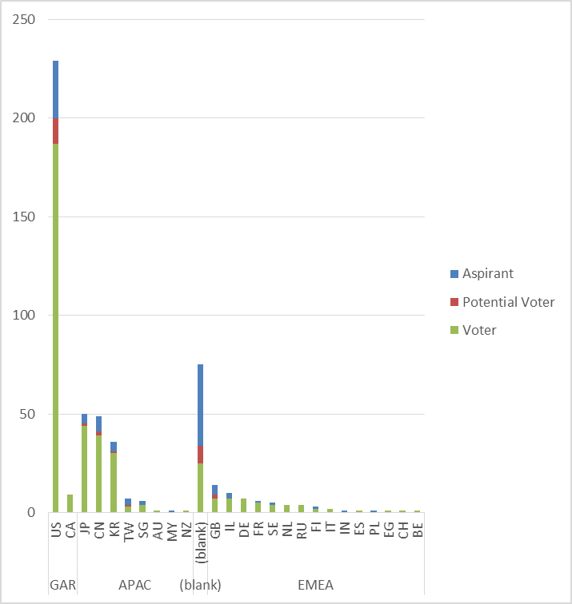
Membership by Country and Region

Slide 23
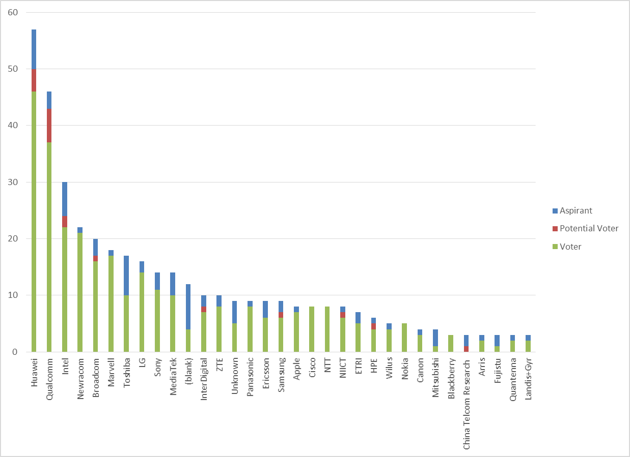
Members by Affiliation

Slide 24
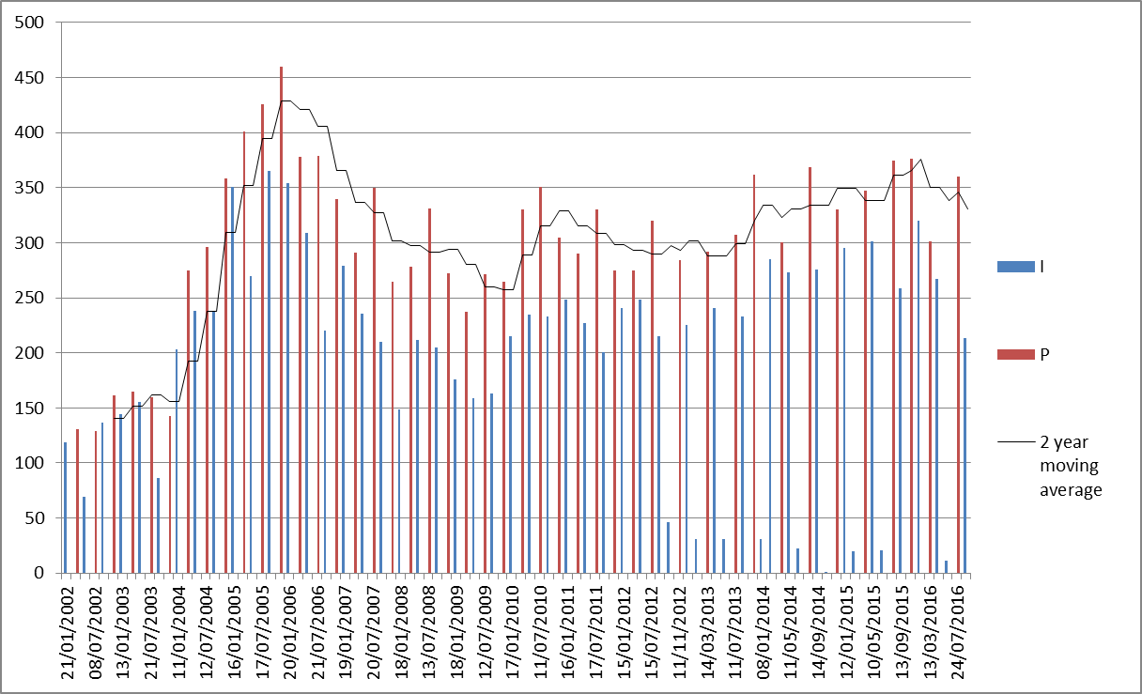
Meeting Attendance – Historic Data

Slide 25
Membership – Historic Data

