Slide 1
Multi-User access for Wake-Up Radio
Date: 2016-09-12
Authors:

Slide 2
Introduction
Wake-up radio can achieve low standby power and low latency in low arrival rate of traffic[1-4]:
  New capability for 802.11
    LP-WUR enables energy efficient data reception mode without increase of latency
  Independent of 802.11 PHY
    LP-WUR can be used for any existing and future 802.11 PHY amendments (i.e. 802.11 a/b/g/n/ac/ad/ax/…)
  Feasibility
    LP-WUR is well-defined technology with many proof points of feasibility
  Limited and well-defined scope of work
However, for Multi-user case in 11ax scenario, if there are data to group of STAs, it is hard to achieve low latency for some STAs
In this presentation, some options to achieve different latency and power consumption for multi-user case with Wake-Up radio are discussed

Slide 3
Recap: Wake-up radio procedure
Example of Wake-up radio protocol [5]
  The AP wakes the receiver up with a Wake-up packet.
  The 802.11 transceiver is woken up by the wake-up receiver and transmits a wake-up poll packet.
  The AP sends data frame after receiving the poll frame.
  The STA acknowledges the data frame reception status.

Slide 4
Multi-user case in WLAN environment
As in [4], WUR can be applied to any 802.11 amendment including 11ax, with AP-STA communication model
According to PAR proposal [6],
  The new amendment improves energy efficiency for data reception without a significant increase in latency.
  The WUR decreases overall power consumption of the STA without increase of latency in transferring user data packets.
However, in dense scenario or for data to group of STAs, previous protocol causes delay to some STAs because of repetition of transmit procedure
  It may not achieve delay constraints in some STAs

Slide 5
Multi-user transmission for Wake-up radio
Multi-user transmission can be options to meet the requirements of power consumption and delay
For multi-user(MU) transmission, waking up multiple transceivers is needed
In order to see the delay and power consumption performance, two possible examples for multiple STAs WURs are used.
  Waking up STAs with multiple Wake-up packets (Single)
  Using Wake-up packet with broadcast address and sleep back if there is no data (Multiple)

Slide 6
Example 1: Using multiple Wake-up packets to wakes the STAs up (Single)
Waking up with multiple packets:
  Use multiple Wake-up packets to wake up each STA, then use trigger frame for MU transmission
  Using this method may cause delay to wake up all STAs for MU transmission and more power consumption because of longer awake state of main transceiver

Slide 7
Example 2: Wakes up all packets first and sleeps if there is no data for STA (Multiple)
Use broadcast address to wake up all packet, and STAs go back to sleep mode if there is no trigger frame for the STA
This method reduces MAC access delay as short as waking up single STA, but it causes power consumption of non-destination STAs, and a little more complexity to notice the broadcast address

Slide 8
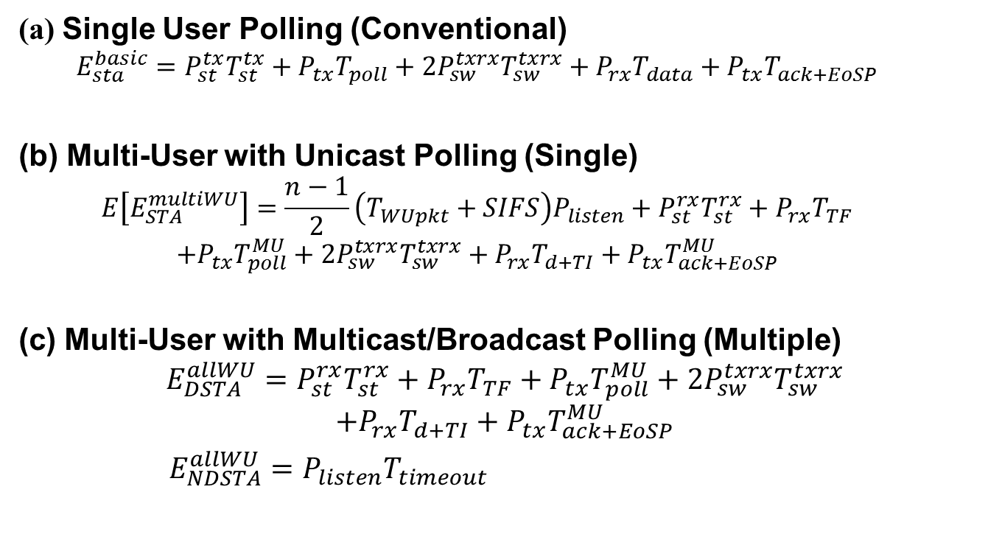
Energy Consumption analysis
(a) Single User Polling (Conventional)
  $$E_{sta}^{basic}=P_{st}^{tx}T_{st}^{tx}+P_{tx}T_{poll}+2P_{sw}^{txrx}T_{sw}^{txrx}+P_{rx}T_{data}+P_{tx}T_{ack+EoSP}$$
(b) Multi-User with Unicast Polling (Single)
  $$E\left[E_{STA}^{multiWU}\right]=\frac{n−1}{2}\left(T_{WUpkt}+SIFS\right)P_{listen}+P_{st}^{rx}T_{st}^{rx}+P_{rx}T_{TF}$$
  $$+P_{tx}T_{poll}^{MU}+2P_{sw}^{txrx}T_{sw}^{txrx}+P_{rx}T_{d+TI}+P_{tx}T_{ack+EoSP}^{MU}$$
(c) Multi-User with Multicast/Broadcast Polling (Multiple)
$$E_{DSTA}^{allWU}=P_{st}^{rx}T_{st}^{rx}+P_{rx}T_{TF}+P_{tx}T_{poll}^{MU}+2P_{sw}^{txrx}T_{sw}^{txrx}$$
$$+P_{rx}T_{d+TI}+P_{tx}T_{ack+EoSP}^{MU}$$
    $E_{NDSTA}^{allWU}=P_{listen}T_{timeout}$

Slide 9
Energy Consumption analysis
Notes:
N=100, total energy in system

Slide 10
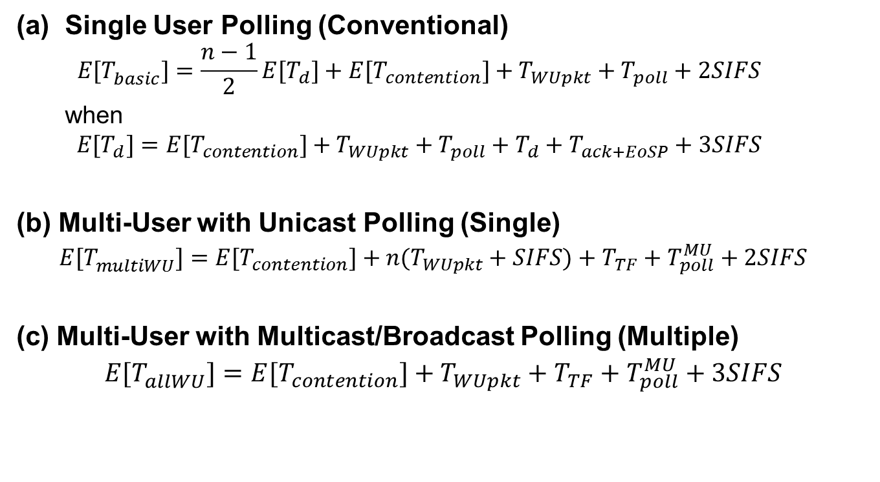
Delay analysis
Single User Polling (Conventional)
  $$E[T_{basic}^{}]=\frac{n−1}{2}E[T_{d}]+E[T_{contention}]+T_{WUpkt}+T_{poll}+2SIFS$$
  when
  $$E[T_{d}]=E[T_{contention}]+T_{WUpkt}+T_{poll}+T_{d}+T_{ack+EoSP}+3SIFS$$
(b) Multi-User with Unicast Polling (Single)
  $$E[T_{multiWU}^{}]=E[T_{contention}]+n(T_{WUpkt}+SIFS)+T_{TF}+T_{poll}^{MU}+2SIFS$$
(c) Multi-User with Multicast/Broadcast Polling (Multiple)
$$E[T_{allWU}^{}]=E[T_{contention}]+T_{WUpkt}+T_{TF}+T_{poll}^{MU}+3SIFS$$

Slide 11
Delay analysis

Slide 12
Conclusion
Wake-up radio can achieve low standby power and low latency for low packet arrival rate in sensor network
However, since wake-up radio can be applied to any 802.11 amendment, the multi-user case in dense scenario should be considered.
The multi-user transmission can be a possible option to meet the requirement s of latency and energy consumption
There are two possible examples to wake the STAs up
  Waking up STAs with multiple Wake-up packets
  Using Wake-up packet with broadcast address and sleep back if there is no data
We propose to consider multi-user transmission to meet the requirements of latency and energy consumption in developing WUR

Slide 13
Reference
[1] IEEE 802.11-15/1307r1, “Low-power wake-up receiver for 802.11”
[2] IEEE 802.11-16/0027r0, “LP-WUR (Low-Power Wake-Up Receiver):
Enabling Low-Power and Low-Latency Capability for 802.11”
[3] IEEE 802.11-16/0381r0 “Discussion of Wake-Up Receivers for LRLP ”
[4] IEEE 802.11-16/0605r3 “Proposal for LP-WUR (Low-Power Wake-Up Receiver) Study Group”
[5] N. Seyed Mazloum, O. Edfors, Performance Analysis and Energy Optimization of Wake-Up Receiver Schemes for Wireless Low-Power Applications, IEEE Transactions on Wireless Communications, Vol. 13, No. 12, pp. 7050-7061, 2014.
[6] IEEE 802.11-16/1045r1 “A PAR Proposal for Wake-up Radio”

