Slide 1
Meeting PAR requirement with UL OFDMA
Date: 2016-09-12
Authors:
Name | Affiliation | Address | Phone | Email
Ron Porat | Broadcom |  |  | ron.porat@broadcom.com
Sriram Venkateswaran |  |  |  | sriram.venkateswaran@broadcom.com

Slide 2
Outline
UL OFDMA, introduced in 11ax, allows multiple STAs to send data to AP simultaneously
  Example use case: ACKs from multiple STAs → scheduled UL OFDMA eliminates losses due to contention and collision
Goal of this presentation: check if UL OFDMA can meet 4x throughput gain stated in the PAR in one scenario
Gains over 11ac
  SNR gains, most useful for far-away users
    Users concentrate power in smaller RUs available in OFDMA
    Eg: 20 MHz BSS, STA has SNR 6 dB below required SNR for 20 MHz MCS 0
    11ac – impossible to communicate
    11ax ‒ concentrate power in 26 tone RU → 9.7 dB gain
  Better PHY rates for same SNR in outdoor channels
    11ax has longer GI, larger FFT size to handle channels with longer delay spread
    Orthogonal to OFDMA
  Channel access is more efficient with UL OFDMA (avoids collisions)
Focus here: quantify gains due to (a) & (b) in simplified version of outdoor large BSS scenario

Slide 3
Deployment geometry
Simpler version of outdoor large BSS (#4 in Simulation Scenarios document)
  Single BSS, 80 MHz
  ICD = 130 m → Hexagon side = 75 m
  Approximate by circle of radius 75 m
  STAs deployed uniformly at random inside circle
Configuration & channel models
  AP: 4 antennas, STA: 1 antenna
  Transmit power at each STA: 15 dBm
  Channel Models: UMi-LoS and UMi-NLoS
AP
Radius = 75 m
UMi-LoS or UMi-NLoS
Single BSS, 80 MHz bandwidth

Slide 4
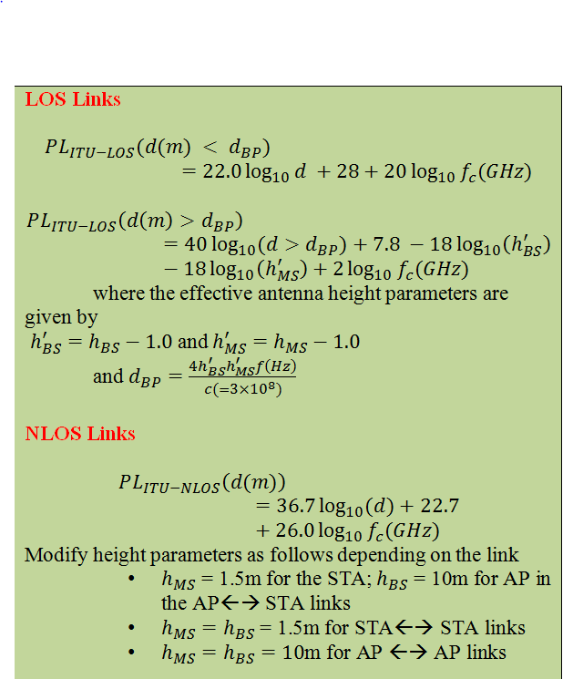
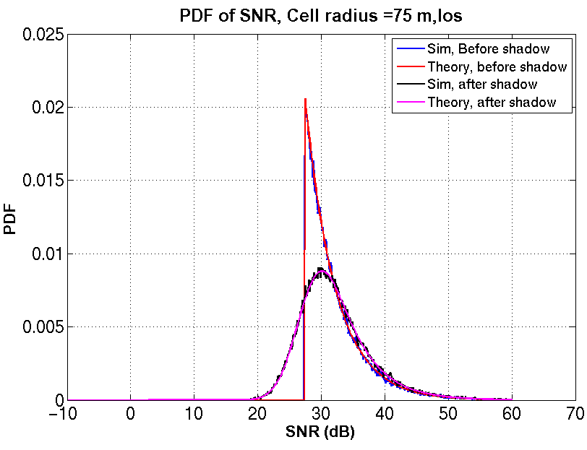
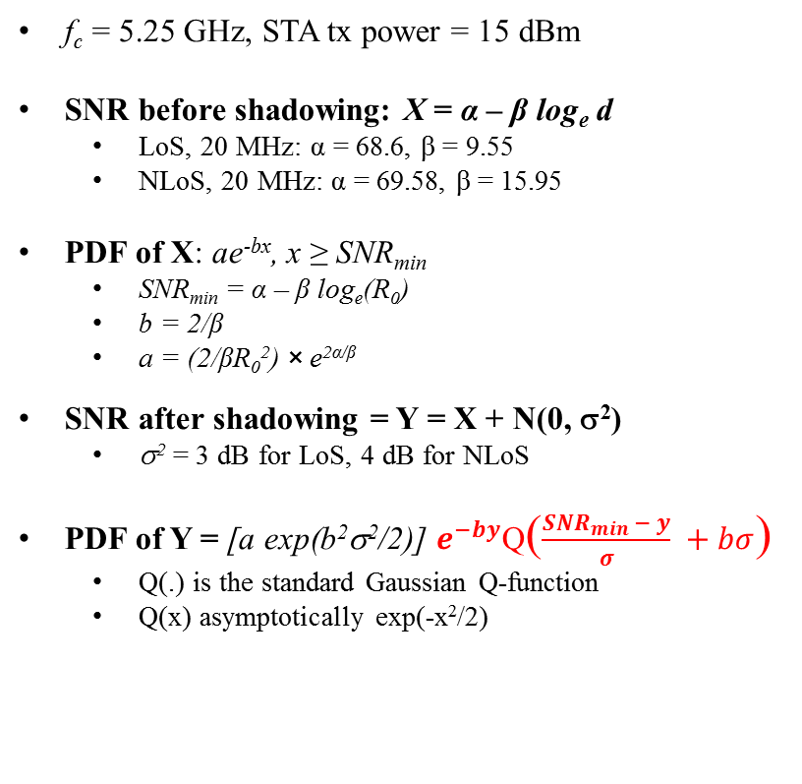
SNR statistics
f_{c} = 5.25 GHz, STA tx power = 15 dBm
SNR before shadowing: X = α ‒ β log_{e} d
  LoS, 20 MHz: α = 68.6, β = 9.55
  NLoS, 20 MHz: α = 69.58, β = 15.95
PDF of X: ae^{-bx}, x ≥ SNR_{min}
  SNR_{min} = α ‒ β log_{e}(R₀)
  b = 2/β
  a = (2/βR₀²) × e^{2α/β}
SNR after shadowing = Y = X + N(0, σ²)
  σ² = 3 dB for LoS, 4 dB for NLoS
PDF of Y = [a exp(b²σ²/2)] $e^{−by}$Q($\frac{{SNR}_{min }− y}{σ} +bσ$)
  Q(.) is the standard Gaussian Q-function
  Q(x) asymptotically exp(-x²/2)

Slide 5
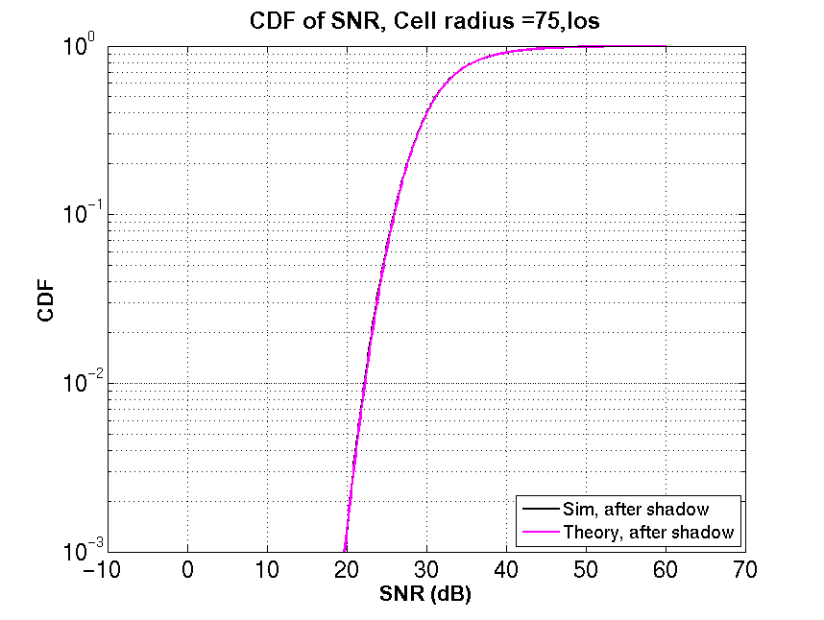
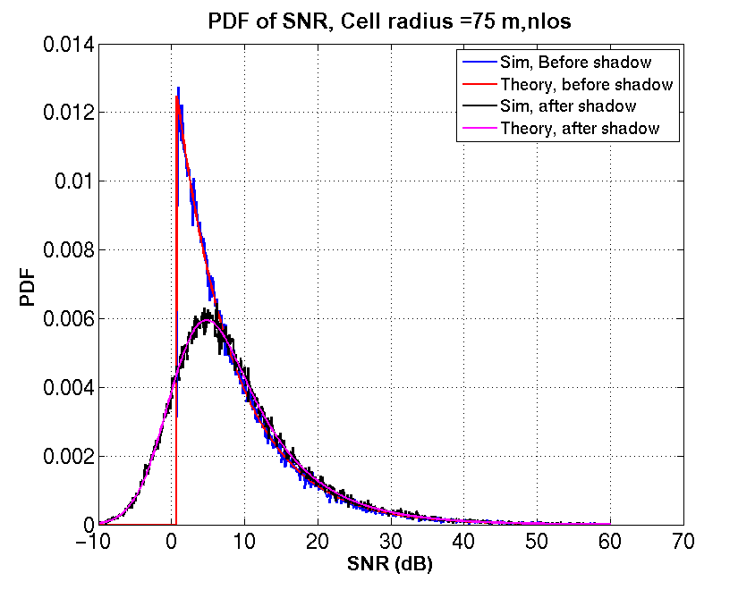
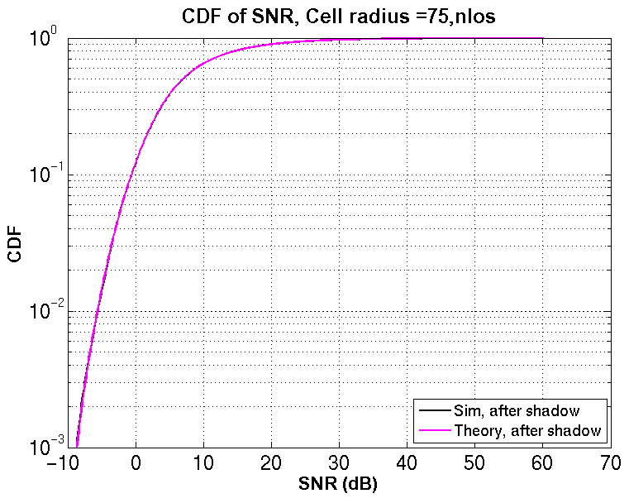
SNR statistics over 20 MHz
LoS
NLoS

Slide 6
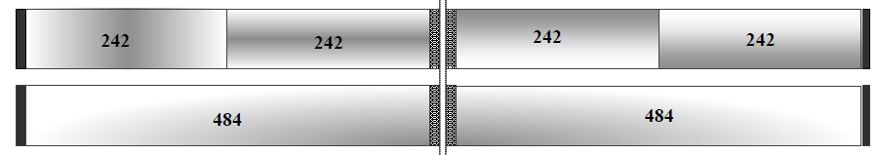
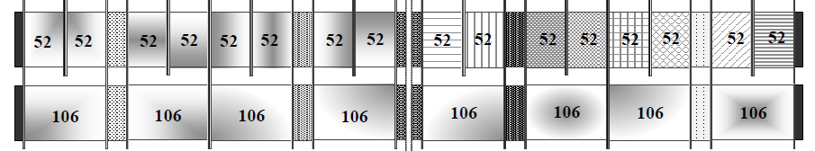
Simulation setup for UL OFDMA vs 11ac
Scheme A: Baseline, 11ac
STA chooses best rate among
  80 MHz MCS 0-9
  40 MHz MCS 0
  20 MHz MCS 0
80 MHz
Scheme B: OFDMA with 4 users
Pick better sum throughput among
  4 x 242 RU
  1 x 484 RU + 2 x 242 RU + 1 x 26 RU
User on
  242 RU ≈ 6 dB gain, 484 RU ≈ 3 dB gain, 26 RU ≈ 15 dB gain
    User with higher SNR is allotted to larger RU. STA picks best MCS from 0 to 9
Scheme C: OFDMA with 16 users
Best throughput among [x 106 RUs (16-2x) 52 RUs x 26 RUs], x = 0,1,2,3,4,5
User with higher SNR is allotted to larger RU. STA picks best MCS from 0 to 9
User on
  106 RU ≈ 9 dB gain, 52 RU ≈ 12 dB gain, 26 RU ≈ 15 dB gain

Slide 7
Can the AP reach the user at cell edge in NLoS channels?
STA must hear beacons and trigger frames from AP for UL OFDMA to work
Noise power with 20 MHz bandwidth: ‒96 dBm
SNR required for MCS 0: 7.5 dB (slide 14, Nrx = 1)
UMi-NLoS path loss at 75 m: 110.2 dB
Shadowing: 4 dB × Q⁻¹(0.1) = 5.2 dB
  Accounts for all but the worst 10% of shadowing losses
Transmit power = Noise power + SNR required + Path Loss + Shadowing Loss
= ‒ 96 + 7.5 + 110.2 + 5.2 dBm
= 26.9 dBm
Around typical transmit power of APs, so power budget sufficient with 20 MHz beacons/trigger frames

Slide 8
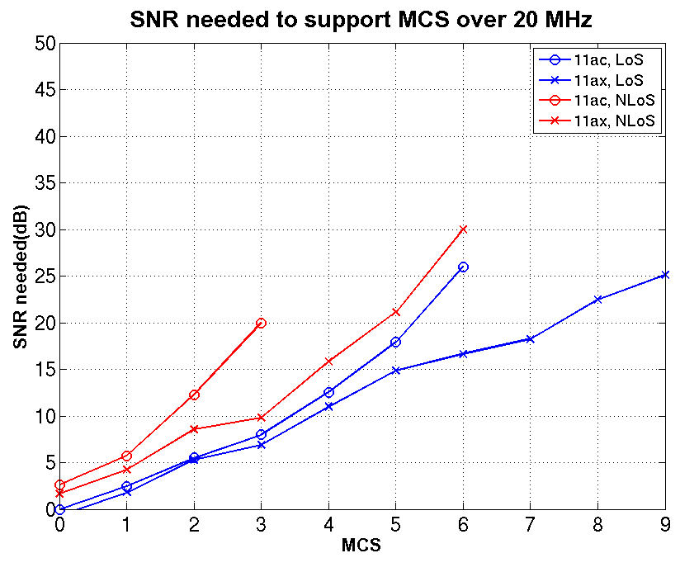
SNR to MCS mapping
Larger GI, FFT size → 11ax can support higher MCS at same SNR
Target PER = 10%
No SNR value for MCS → floor > 10% PER
11ac baseline
  SNR for 40 MHz MCS 0 = SNR for 20 MHz MCS 0 + 3 dB
  SNR for 80 MHz MCS x = SNR for 20 MHz MCS x + 6 dB
11ax OFDMA
  SNR for 484 RU = SNR for 242 RU + 3 dB
  SNR for 106 RU = SNR for 242 RU ‒ 3.6 dB
  SNR for 52 RU = SNR for 242 RU ‒ 6.7 dB
  SNR for 26 RU = SNR for 242 RU ‒ 9.7 dB
Reference: See appendix for figures

Slide 9
Throughput comparison
UMi-LoS
 | Mean (Mbps) | 50 percentile (Mbps) | 5 percentile (Mbps)
11ac | 244.95 | 234 | 234
4 user UL OFDMA (Sum throughput) | 444.11 1.83x | 444.44 1.89x | 444.44 1.89x
UMi-NLoS
 | Mean (Mbps) | 50 percentile (Mbps) | 5 percentile (Mbps)
11ac | 29 | 13.5 | 0
4 user UL OFDMA (Sum throughput) | 120.01 4.14x | 116.25 8.61x | 40.62 Inf x
16 user UL OFDMA (Sum throughput) | 174.92 6.03x | 175.21 12.98x | 136.67 Inf x

Slide 10
Conclusions
Checked whether UL OFDMA in 11ax can provide 4x gain over 11ac in one scenario
Source of gains
  Higher SNR for far away users by transmitting on smaller RUs
  Better handling of long delay spread channels (orthogonal to OFDMA)
  Does not include channel access gains
In LoS, gain ~ 1.83x with 4 user OFDMA
In NLoS , gain ~ 8.6x with 4 user OFDMA, 13x with 16 user OFDMA at 50 percentile point

Slide 11
Appendix

Slide 12
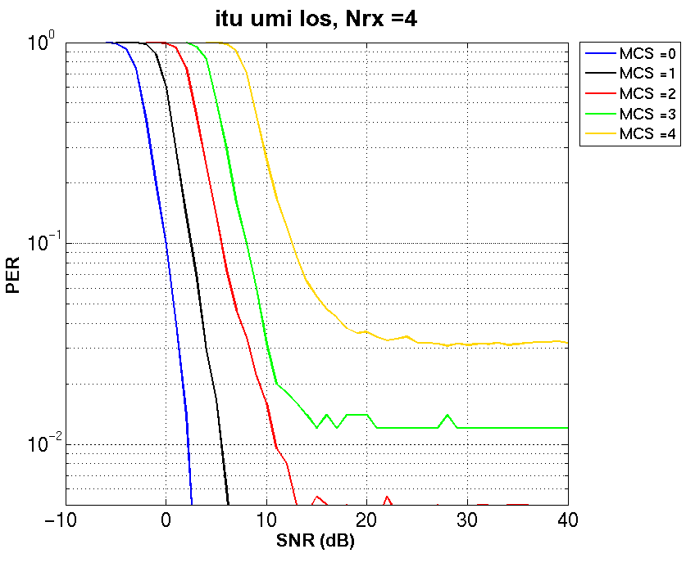
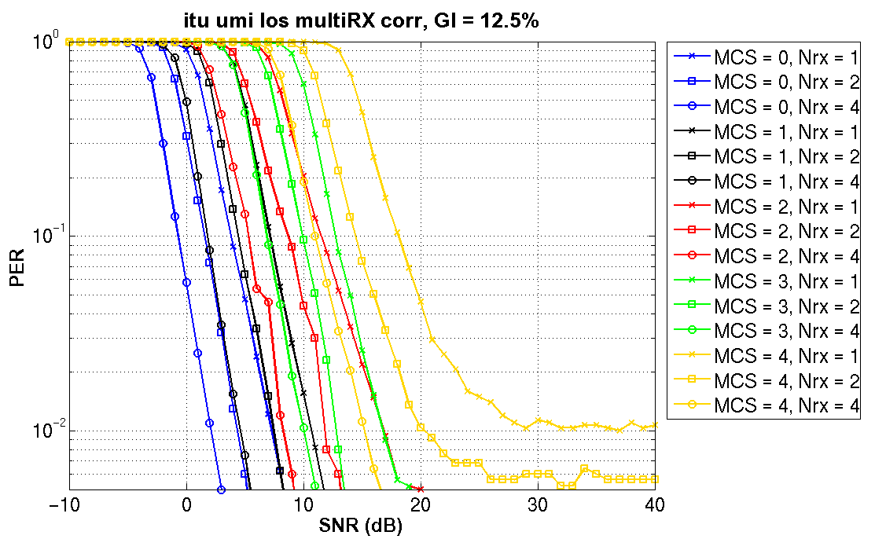
UMi-LoS, MCS 0 to 4
11ac
11ax

Slide 13
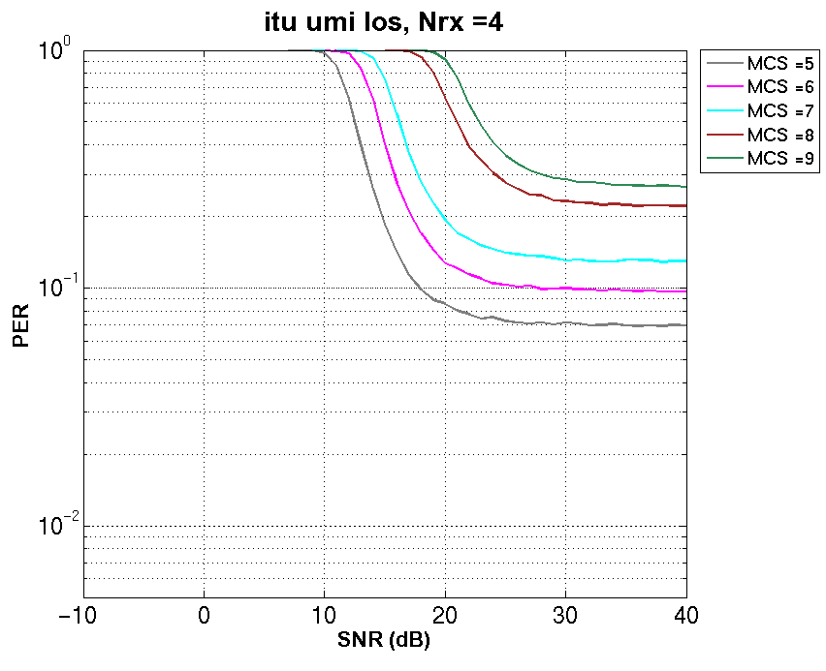
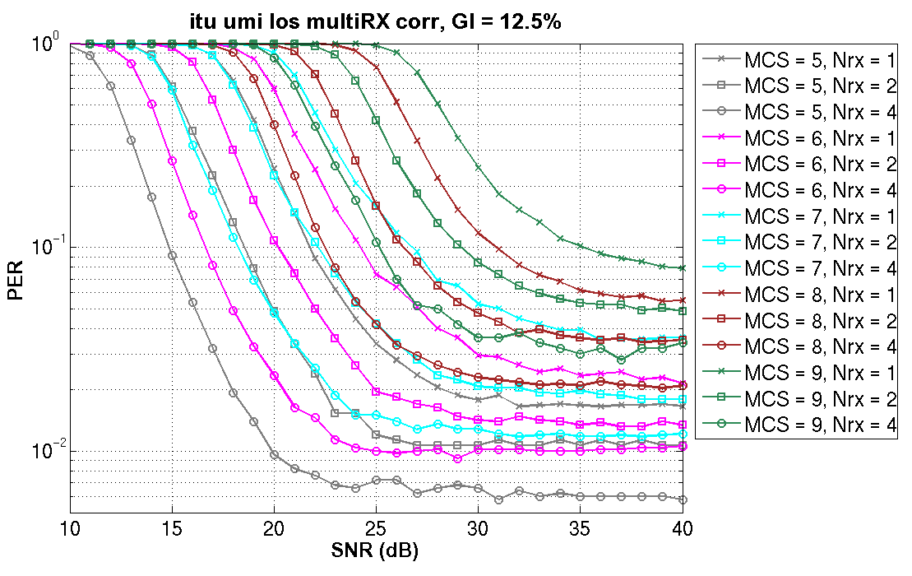
UMi-LoS, MCS 5 to 9
11ac
11ax

Slide 14
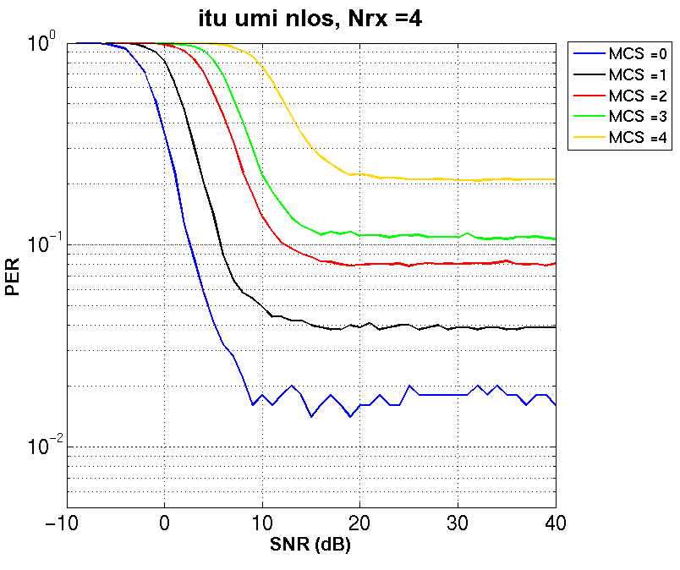
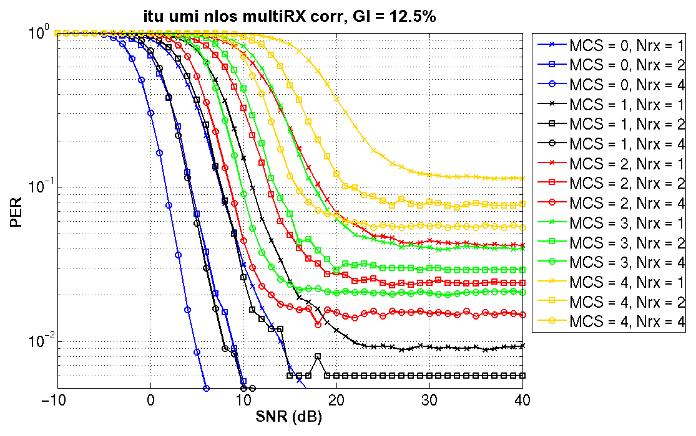
UMi-NLoS, MCS 0 to 4
11ac
11ax

Slide 15
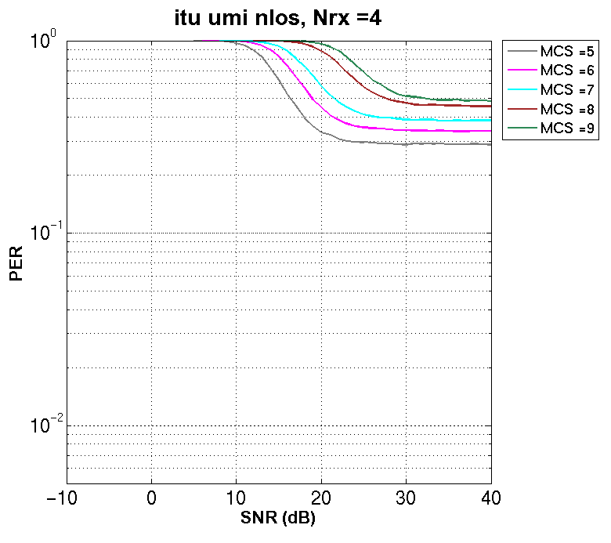
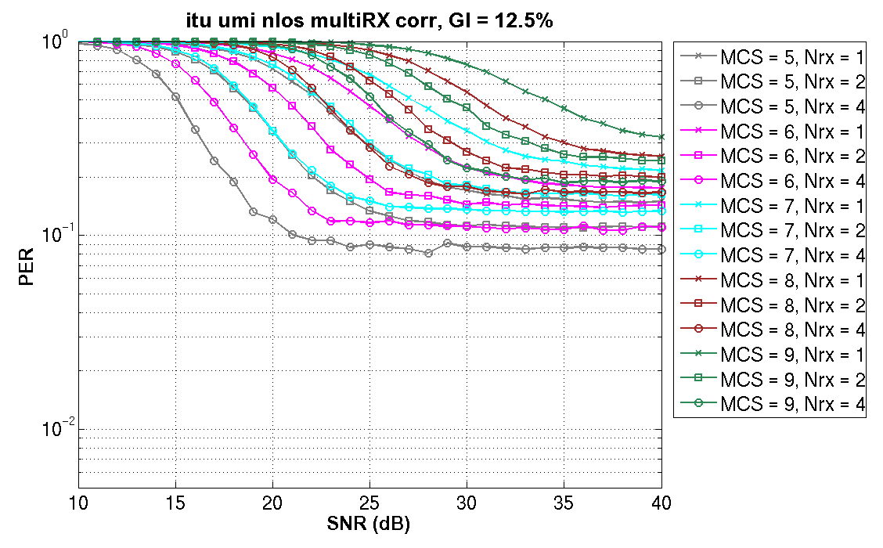
UMi-NLoS, MCS 5 to 9
11ac
11ax

