Slide 1
Simulation-based evaluation of
OBSS_PD-based SR default parameters
Date: 2016-September
Authors:

Slide 2
1. Context
September 2016
OBSS_PD-based-SR
  Increase SR by using OBSS_PD i.e.:
    For an intra-BSS PPDU, keep using the legacy threshold
    For an inter-BSS PPDU, use OBSS_PD threshold (OBSS_PD_{Threshold}) generally higher
  At the same time, the transmission power (TX_PWR) is adjusted for even greater SR
[1] proposed default parameters for OBSS_PD-based SR
In this submission we,
  Investigate the performances of OBSS_PD-based SR default values for the reference scenario used to test SR [2] and for the enterprise scenario [3]
  Propose a simple method to compute OBSS_PD_{Threshold} based on beacon RSSI
  Highlight the fact that there is trade-off between maximum throughput reachable and fairness

Slide 3
2. OBSS_PD-based SR mode
September 2016
How does it work?
  Proportional rule between TX_PWR and OBSS_PD_{Threshold} and boundaries
OBSS_PD_{Threshold_min}
Minimum
OBSS_PD_{Threshold_max}
Maximum
OBSS_PD_{Threshold}= max
min
OBSS_PD_{Threshold_min} + (TX_PWR_{ref} – TX_PWR)
Adaptation zone
  [1] sets the following default parameters for 80MHz
  OBSS_PD_{Threshold_min} = -76dBm
  OBSS_PD_{Threshold_max} = -56dBm
  TX_PWR_{ref} = 23dBm
TX_PWR = TX_PWR_{Ref} – (OBSS_PD_{Threshold} – OBSS_PD_{Threshold_min})
Zone 1
Zone 2
Zone 3
OBSS_PD_{Threshold_max}
OBSS_PD_{Threshold_min}

Slide 4
3. Reference scenario (1/3)
September 2016
Topology
Main parameters
  STAs send UDP traffic to their AP in saturation condition
  MCS used for transmission is fixed to 5 (around 200Mbps)
  OBSS_PD-based SR: Naïve approach => Vary TX_PWR (and thus OBSS_PD_{Threshold}) from 1 to 21dB
  Measure BSSs aggregated throughput (throughput observed at AP1+AP2)
  Simulator: ns-3
Goals
  Check on a simple scenario if OBSS_PD-based SR allows to increase SR
  Check if OBSS_PD-based SR boundaries (OBSS_PD_{Threshold_min} and OBSS_PD_{Threshold_max}) fits to the reference scenario
STA1
STA3
BSS1
BSS2
3m
30m
3m
AP1
AP2
STA2
STA4

Slide 5
3. Reference scenario (2/3)
September 2016
Results
Observation
  Zone 1: No throughput – TX_PWR used is too weak for allowing frame to be decoded
  Zone 2: BSSs throughput is almost twice than the MCS throughput – Both BSS are able to transmit at the same time – Increase of SR
  Zone 3: BSSs throughput is equal to MCS throughput – No Increase of SR
  Boundaries: OBSS_PD_{Threshold_max} = -56dBm which corresponds to a TX_PWR of 3dBm and reference scenario configures STA to transmit with 15dBm => OBSS_PD-based SR corresponds to zone 2
Conclusions
  OBSS_PD-based SR allows SR increase and default parameters work fine for the reference scenario
  Reference scenario = Simple symmetric scenario => Naïve approach: Use the same TX_PWR for all STAs
    More complex scenarios: Need to have a method to dynamically adapt to the network conditions
Zone 1
Zone 2
Zone 3

Slide 6
4. OBSS_PD_{Threshold} or TX_PWR?
September 2016
We have the relationship between OBSS_PD_{Threshold} and TX_PWR are but one is needed to compute the other
  How to obtain one of them and which one to use is implementation dependent
  In this submission, we define a simple method to obtain OBSS_PD_{Threshold}
How to obtain OBSS_PD_{Threshold}?
  Use of a margin OBSS_PD_{margin}
  When receiving a beacon, a STA keeps its RSSI and compute OBSS_PD_{Threshold} in the following way:
    OBSS_PD_{Threshold} = Beacon_{RSSI} – OBSS_PD_{margin}
    Then, compute the associated TX_PWR

Slide 7
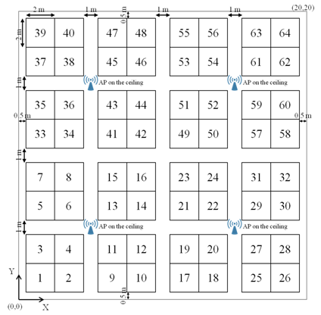
5. Enterprise scenario (1/6)
September 2016
Topology
  Single floor office building,
    8 offices: 4 APs per office i.e. 32 APs
    64 cubicles per office
    Each cubicle has 4 STAs so 8*64*4 = 2048 STAs
1 Cubicle = 4 STAs
8 offices
1 Office = 64 cubicles

Slide 8
5. Enterprise scenario (2/6)
September 2016
Channel allocation: 5GHz
  Four 80MHz channels (Ch1 to Ch4)
Main parameters
  STAs send UDP traffic to their AP in saturation condition
  MCS used for transmission is fixed to 5 (around 200Mbps)
AP
Channel
1
2
3
4
Four 80MHz channels

Slide 9
September 2016
5. Enterprise scenario (3/6)
Results: Throughput
Zone 1
Zone 2
Zone 3
Zone 1
Zone 2
Zone 3
Observations
  3 zones
    Zone 1: Aggregated throughput is less than the legacy one (around 30% of decrease) => TX_PWR computed is too weak for furthest away STAs – Confirmed by the 5th percentile throughput result
    Zone 2: Increase of aggregated throughput around 55% - 5th percentile throughput per STA is close to the average per STA (20% of difference)
    Zone 3: Increase of aggregated throughput up to 80% - However, 5th percentile throughput results tend to be very different from the average per STA one (up to 74% of difference)
Conclusions
  OBSS_PD_{Margin} highly affects OBSS_PD-based SR performances
  OBSS_PD-based SR default values allow to increase aggregated throughput and to obtain a good fairness

Slide 10
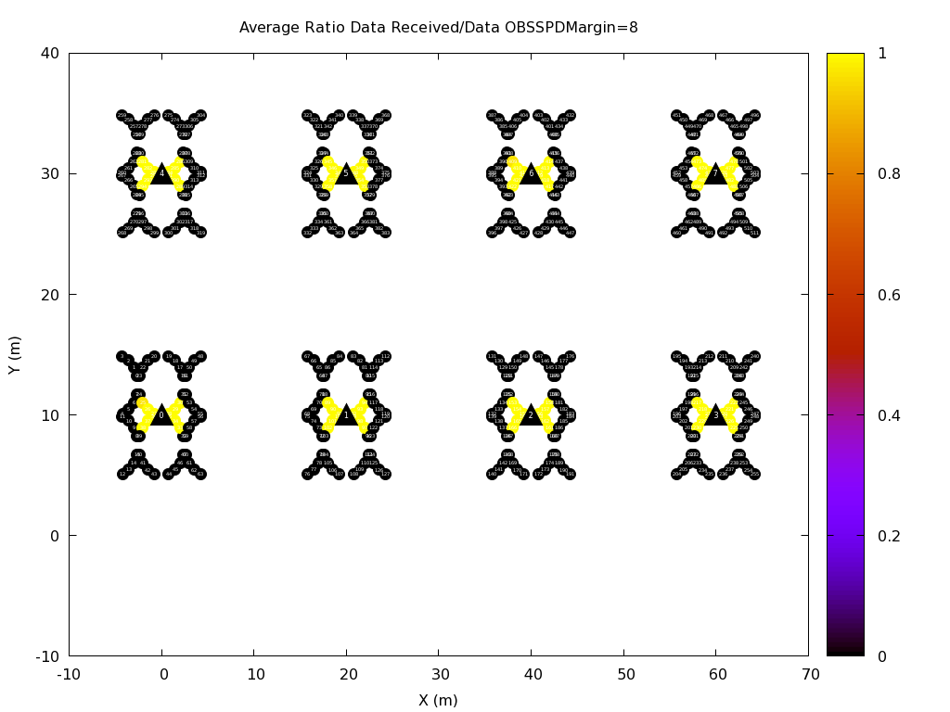
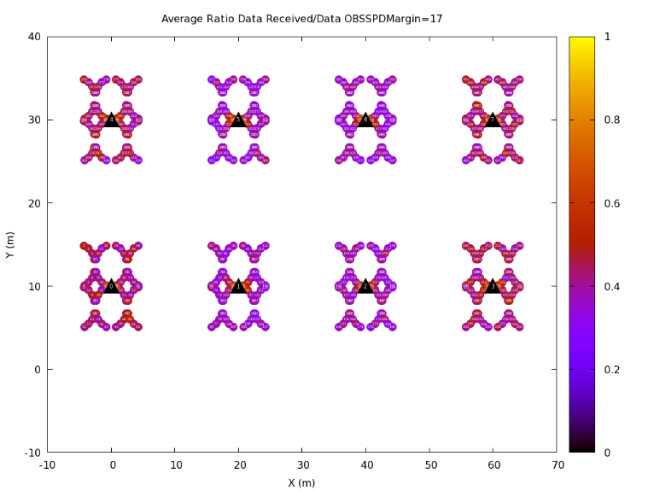
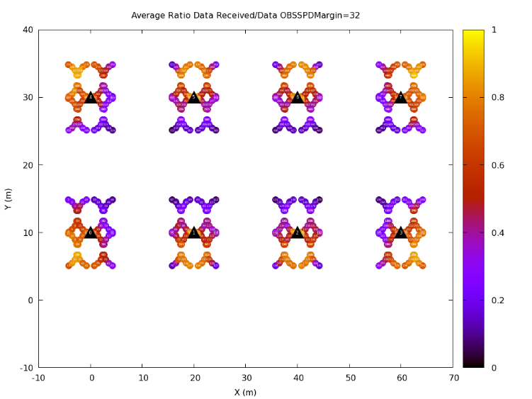
5. Enterprise scenario (4/6)
September 2016
How is materialized concretely every zone? Goodput Ratio
  Goodput ratio GR: STA Goodput Ratio: GR_{i} = #APUDPReceived_{i} / #STAUDPSent_{i}
Zone 1
Zone 2
Zone 3
Observations:
  Zone 1: Either a GR ratio of 1 or 0 => System is unfair
  Zone 2: Very homogenous GR (between 0.35 and 0.55) – All STA are experiencing the same fairness => System is fair
  Zone 3: Very heterogeneous GR with some STA experiencing a GR close to 0 while others are close to 0.9 => System is unfair
Conclusion:
  Best margin values depend from the objective: for best fairness, an OBSS_PD_{Margin} between 16 and 20dBm is recommended

Slide 11
5. Enterprise scenario (5/6)
September 2016
OBSS_PD-based SR is working
  [1] is proposing to use different OBSS_PD_{Treshold_min} – Test -72, -69 and -66 values
  Results for aggregated throughput
Observation
  Changing OBSS_PD_{Threshold_min} does not allow to increase maximum aggregated throughput
  It may gives better results for fairness?
Best aggregated throughput

Slide 12
5. Enterprise scenario (6/6)
September 2016
  Results for throughput per STA
Observation
  Changing OBSS_PD_{Threshold_min} does not allow to to obtain better throughput per STA/5th percentile throughput
Conclusion
  OBSS_PD-SR based default value for OBSS_PD_{Threshold_Min} value seems to be optimal for enterprise scenario in order to obtain the best throughput/fairness ratio

Slide 13
6. Conclusions/next steps
  Preliminary results for OBSS_PD-based SR
    OBSS_PD-based SR works and default parameters seem correct for both SR and enterprise scenario.
  Simple method to compute OBSS_PD_{Threshold}
    Parametrization is of crucial importance: A margin between 16 and 20 dBm is recommended
    Could be improved in many ways to obtain better results (cross-layer information such as ETX, or MCS)
  Compute the TX_PWR based on the network conditions instead of OBSS_PD_{Threshold}

Slide 14
7. References
Laurent Cariou et al., 11-16-0945-01 Clarification for OBSS_PD-based SR parameters
Masahito Mori et al., 11-15-0801-00 DCCA/DSC Reference Simulation Results
Improvements with Channel selection and Dynamic Sensitivity Control
TGax group, 11-14-0980-16 TGax Simulation Scenarios

Slide 15
8. Annex

Slide 16
Reference scenario
September 2016
Results
Zone 1
Zone 2
Zone 3
Channel sensed Free
Channel sensed Busy
RX_PWR is becoming higher than OBSS_PD_{Threshold}
RX sensitivity is reached when the STA is transmitting with a TX_PWR >= 3dBm
RX_PWR at AP when a STA sends to its AP
Reception power when STA from one BSS transmit to STA in the other BSS
AP RX sensitivity (-56dBm)
OBSS_PD_{Thresold}

Slide 17
Enterprise scenario parameters
September 2016
Parameters | Values
Traffic type | UDP CBR uplink transmissions in saturation conditions
MPDU size | 1538 Bytes (from SSD) (1544 Bytes in total incl. all overhead)
Aggregation | Aggregation: 32 MPDUs with 4-byte MPDU delimiter per A-MPDU No A-MSDU Implicit immediate BA
PPDU of Data frame | VHT PPDU (MCS 5, fixed)
Guard Interval | Short
OBSS_PD-based SR | OBSS_PD_{Threshold_min} = -76dBm OBSS_PD_{Threshold_max} = -56dBm TX_PWR_{ref} = 23dBm
Simulator | ns-3

Slide 18
Influence of the margin?
September 2016
  Small margin values result in having furthest away node with a high OBSS_PD_{Threshold} i.e. OBSS_PD_{Threshold_max} and thus the minimum allowed transmission power (risky?)
  High margin results in closest nodes having the smallest OBSS_PD_{Threshold} i.e. OBSS_PD_{Threshold_min} and thus the maximum allowed transmission power (not efficient?)
  A good margin value is probably in-between – Try to find the optimal margin value for the enterprise scenario

