Slide 1
Simulation-based evaluation of
OBSS_PD-based SR default parameters
Date: 2016-September
Authors:

Slide 2
1. Context
September 2016
Spatial reuse in the SFD
  “The amendment shall include one or more mechanisms to improve spatial reuse by allowing adjustments to one or more of the CCA-ED, 802.11 Signal Detect CCA, OBSS_PD or TXPWR threshold values. The constraints on selecting threshold values are TBD”
  OBSS_PD based-SR (defined in 25.9.2 and 29.5.3) is one of these methods
[1] proposed default parameters for OBSS_PD-based SR
In this submission we,
  investigate the performances of OBSS_PD-based SR default values for the reference scenario used to test SR [2] and for the enterprise scenario [3]
  Propose a simple method to compute OBSS_PD_{Threshold} based on beacon RSSI
  Highlight the fact that there is trade-off between maximum throughput reachable and fairness

Slide 3
2. OBSS_PD-based SR mode (1/2)
September 2016
Goal
  Increase SR by using OBSS_PD i.e.:
    For an intra-BSS frame, keep using the legacy threshold
    For an inter-BSS, use OBSS_PD threshold (OBSS_PD_{Threshold}) generally higher
  At the same time, the transmission power (TX_PWR) is adjusted for even greater SR
How does it work?
  Proportional rule between TX_PWR and OBSS_PD_{Threshold}
OBSS_PD_{Threshold_min}
Minimum
OBSS_PD_{Threshold_max}
Maximum
OBSS_PD_{Threshold}= max
min
OBSS_PD_{Threshold_min} + (TX_PWR_{ref} – TX_PWR)
Adaptation zone
TX_PWR = TX_PWR_{Ref} – (OBSS_PD_{Threshold} – OBSS_PD_{Threshold_min})
  [1] sets the following default parameters for 80MHz
  OBSS_PD_{Threshold_min} = -76dBm
  OBSS_PD_{Threshold_max} = -56dBm
  TX_PWR_{ref} = 23dBm

Slide 4
2. OBSS_PD-based SR mode (2/2)
September 2016
OBSS_PD_{Threshold} and TX_PWR are proportional and bounded
  Result in 3 different zones
Zone 1
Zone 2
Zone 3
OBSS_PD_{Threshold_max}
OBSS_PD_{Threshold_min}
Zone 1: STA close to the AP
Highest OBBS_PD_{Threshold}
Smallest TX_PWR
Zone 3: STA far from the AP
Smallest OBSS_PD_{Threshold}
Highest TX_PWR
Zone 2: adaptation zone

Slide 5
3. Reference scenario (1/3)
September 2016
Topology
Main parameters
  STAs send UDP traffic to their AP in saturation condition
  MCS used for transmission is fixed to 5 (around 200Mbps)
  OBSS_PD-based SR: Naïve approach => Vary TX_PWR (and thus OBSS_PD_{Threshold}) from 1 to 21dB
  Measure BSSs aggregated throughput (throughput observed at AP1+AP2)
Goal
  Check on a simple scenario widely used to study SR if OBSS_PD-based SR allows to increase SR
  Check if OBSS_PD-based SR boundaries (OBSS_PD_{Threshold_min} and OBSS_PD_{Threshold_max}) fits to the reference scenario
STA1
STA3
BSS1
BSS2
3m
30m
3m
AP1
AP2
STA2
STA4

Slide 6
3. Reference scenario (2/3)
September 2016
Results
Zone 1
Zone 2
Zone 3
Channel sensed Free
Channel sensed Busy
RX_PWR is becoming higher than OBSS_PD_{Threshold}
RX sensitivity is reached when the STA is transmitting with a TX_PWR >= 3dBm
RX_PWR at AP when a STA sends to its AP
Reception power when STA from one BSS transmit to STA in the other BSS
AP RX sensitivity (-56dBm)
OBSS_PD_{Thresold}

Slide 7
3. Reference scenario (3/3)
September 2016
But OBSS_PD-based SR is bounded thanks to its default values
  OBSS_PD_{Threshold_Max} = -56dBm which bounds the TX_PWR_{min} to 3dB
  OBSS_PD_{Threshold_Min} = -76dBm which corresponds to a power of 23 dB however reference scenario defined STA TX_PWR to15dB so TX_PWR_{max}=15dBm
Observation
  All TX_PWR (and its associated OBSS_PD_{Threshold}) allows increase of SR
Conclusions
  OBSS_PD-based SR allows SR increase and default parameters work fine for the reference scenario
  Reference scenario = Simple symmetric scenario => Naïve approach: Use the same TX_PWR for all STAs
    More complex scenarios: Need to have a method to dynamically adapt to the network conditions
TX_PWR_{min}
TX_PWR_{max}

Slide 8
4. How to compute OBSS_PD_{Threshold}?
September 2016
We have the relationship between OBSS_PD_{Threshold} and TX_PWR are but one is needed to compute the other
  How to obtain one of of them is implementation dependent
  In this submission, we define a simple method to obtain OBSS_PD_{Threshold}
How to obtain OBSS_PD_{Threshold}?
  Use of a margin OBSS_PD_{margin}
  When receiving a beacon, a STA keeps its RSSI and compute OBSS_PD_{Threshold} in the following way:
    OBSS_PD_{Threshold} = Beacon_{RSSI} – OBSS_PD_{margin}
    Then, compute the associated TX_PWR
Influence of the margin
  Small margin values result in having furthest away node with a high OBSS_PD_{Threshold} i.e. OBSS_PD_{Threshold_max} and thus the minimum allowed transmission power (risky?)
  High margin results in closest nodes having the smallest OBSS_PD_{Threshold} i.e. OBSS_PD_{Threshold_min} and thus the maximum allowed transmission power (not efficient?)
  A good margin value is probably in-between – Try to find the optimal margin value for the enterprise scenario

Slide 9
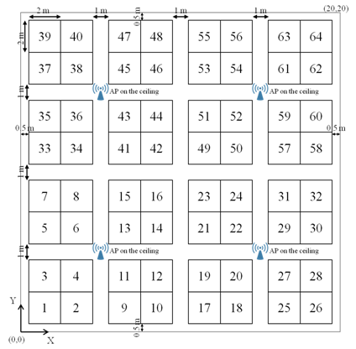
5. Enterprise scenarios (1/7)
September 2016
Topology
  Single floor office building,
    8 offices: 4 APs per office i.e. 32 APs
    64 cubicles per office
    Each cubicle has 4 STAs so 8*64*4 = 2048 STAs
1 Cubicle = 4 STAs
8 offices
1 Office = 64 cubicles

Slide 10
5. Enterprise scenarios (2/7)
September 2016
Channel allocation: 5GHz (based on [13])
  Four 80MHz channels (Ch1 to Ch4)
AP
Channel
1
2
3
4
Four 80MHz channels

Slide 11
5. Enterprise scenarios (3/7)
September 2016
Parameters | Values
Traffic type | UDP CBR uplink transmissions in saturation conditions
MPDU size | 1538 Bytes (from SSD) (1544 Bytes in total incl. all overhead)
Aggregation | Aggregation: 32 MPDUs with 4-byte MPDU delimiter per A-MPDU No A-MSDU Implicit immediate BA
PPDU of Data frame | VHT PPDU (MCS 5, fixed)
Guard Interval | Short
OBSS_PD-based SR | OBSS_PD_{Threshold_min} = -76dBm OBSS_PD_{Threshold_max} = -56dBm TX_PWR_{ref} = 23dBm
Simulator | ns-3

Slide 12
September 2016
5. Enterprise scenarios (4/7)
Results: Throughput
Zone 1
Zone 2
Zone 3
Zone 1
Zone 2
Zone 3
Observations
  3 zones
    Zone 1: Aggregated throughput is less than the legacy one (around 30% of decrease) => TX_PWR computed is too weak for furthest away STAs – Confirmed by the 5th percentile throughput result
    Zone 2: Increase of aggregated throughput around 55% - 5th percentile throughput per STA is close to the average per STA (20% of difference)
    Zone 3: Increase of aggregated throughput up to 80% - However, 5th percentile throughput results tend to be very different from the average per STA one (up to 74% of difference)
Conclusions
  OBSS_PD_{Margin} highly affects OBSS_PD-based SR performances
  OBSS_PD-based SR default values allow to increase aggregated throughput and to obtain a good fairness

Slide 13
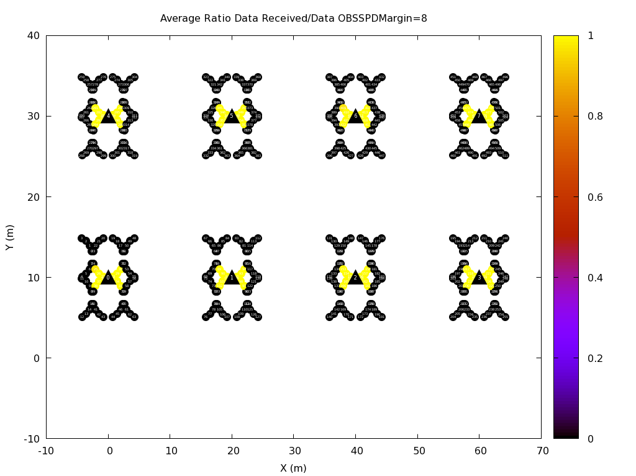
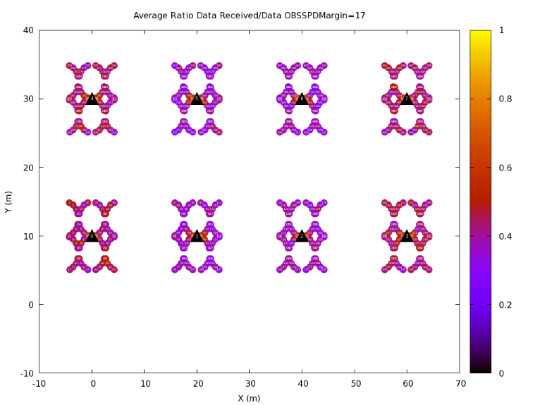
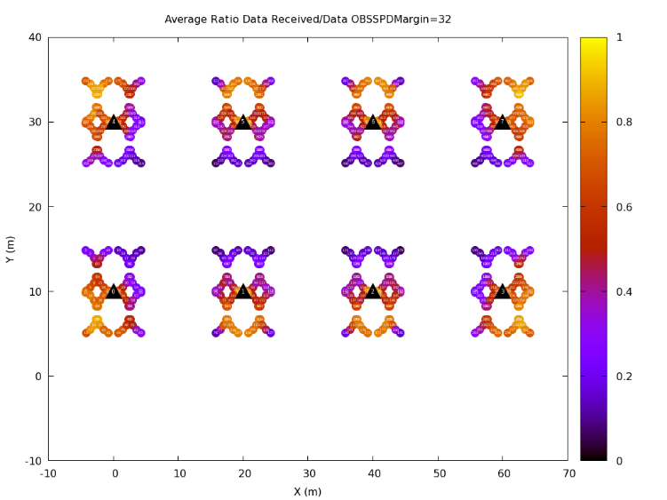
5. Enterprise scenarios (5/7)
September 2016
How is materialized concretely every zone? Goodput Ratio
  Goodput ratio GR: STA Goodput Ratio: GR_{i} = #APUDPReceived_{i} / #STAUDPSent_{i}
Zone 1
Zone 2
Zone 3
Observations:
  Zone 1: Either a GR ratio of 1 or 0 => System is unfair
  Zone 2: Very homogenous GR (between 0.35 and 0.55) – All STA are experiencing the same fairness => System is fair
  Zone 3: Very heterogeneous GR with some STA experiencing a GR close to 0 while others are close to 0.9 => System is unfair
Conclusion:
  Best margin values depend from the objective: for best fairness, an OBSS_PD_{Margin} between 16 and 20dBm is recommended
  OBSS_PD-SR based default value fit for the enterprise scenario: there is still one value that is improving both aggregated throughput and fairness

Slide 14
5. Enterprise scenarios (6/7)
September 2016
OBSS_PD-based SR is working
  Why not trying to use different OBSS_PD_{Treshold_min} (-72, -69 and -66) as [1] is proposing
Results for aggregated throughput
Observation
  Changing OBSS_PD_{Threshold_min} does not allow to increase maximum aggregated throughput
  It may gives better results for fairness?
Best aggregated throughput

Slide 15
5. Enterprise scenarios (7/7)
September 2016
Check the influence of different other OBSS_PD_{Treshold_min} (-72, -69 and -66)
  Results for throughput per STA
Observation
  Changing OBSS_PD_{Threshold_min} does not allow to increase neither throughput per STA neither 5th percentile throughput
Conclusion
  OBSS_PD-SR based default value for OBSS_PDThreshold_Min value seems to be optimal for enterprise scenario in order to obtain the best throughput/fairness ratio

Slide 16
6. Conclusions/next steps
  First results for OBSS_PD-based SR
    OBSS_PD-based SR scheme provides improvements in aggregated throughput but not always regarding to fairness and goodput. However, there is still an OBSS_PD_{Margin} value that allows increase in fairness, goodput and aggregated throughput. OBSS_PD-based SR works and default parameters seem correct for enterprise scenario.
    OBSS_PD-based SR parametrization is of crucial importance
  Simple method to compute OBSS_PD_{Threshold}
    Could be improved in many ways to obtain even better results (cross-layer information such as ETX, or MCS)
    Compute the TX_PWR based on the network conditions instead of OBSS_PD_{Threshold}

Slide 17
7. References
Laurent Cariou et al., 11-16-0945-01 Clarification for OBSS_PD-based SR parameters
Masahito Mori et al., 11-15-0801-00 DCCA/DSC Reference Simulation Results
Improvements with Channel selection and Dynamic Sensitivity Control
TGax group, 11-14-0980-16 TGax Simulation Scenarios

