Slide 1
802.11 September 2016 Closing Reports
Date: 2016-09-15
Authors:

Slide 2
Abstract
This document is a digest of the closing reports of all 802.11 sub-groups for presentation at the September 2016 closing plenary meeting. Attendance information and liaison reports (including liaison reports from the mid-week plenary) are also included.

Slide 3
Attendance
Group | # Mtgs | Avg | Total | Min | Max
ARC | 2 | 11 | 22 | 7 | 15
Editors Meeting | 1 | 8 | 8
JTC1 | 1 | 6 | 6
TGah | 1 | 18 | 18
TGai | 6 | 12 | 73 | 3 | 18
TGak | 8 | 7 | 62 | 3 | 12
TGaq | 2 | 7 | 15 | 6 | 9
TGmc | 1 | 14 | 14
TGax | 11 | 126 | 1386 | 105 | 152
CAC | 1 | 18 | 18
Mid-Week Plenary | 1 | 178 | 178
New Members | 1 | 3 | 3
Opening Plenary | 1 | 163 | 163
REG | 1 | 26 | 26
TGay | 3 | 46 | 139 | 44 | 49
TGaz | 2 | 32 | 65 | 24 | 41
WUR SG | 4 | 105 | 421 | 35 | 143
AANI SC | 2 | 39 | 79 | 23 | 56

Slide 4
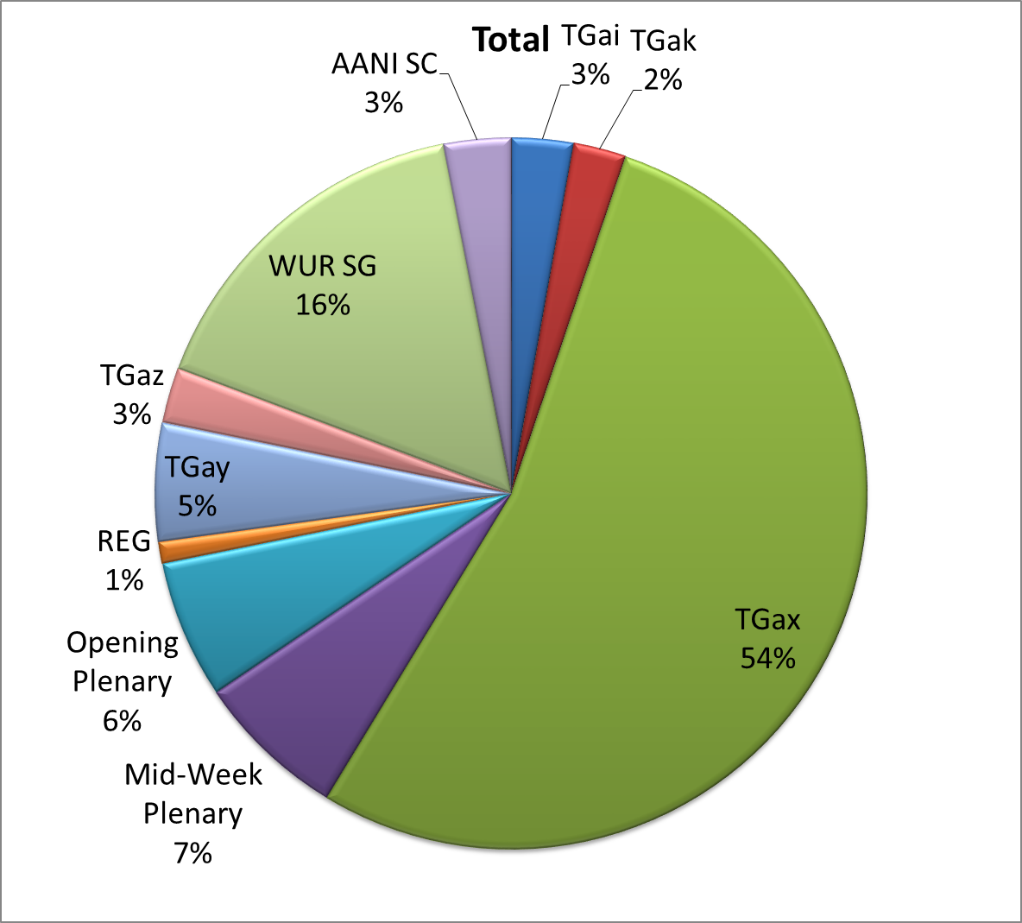
Attendance Total

Slide 5
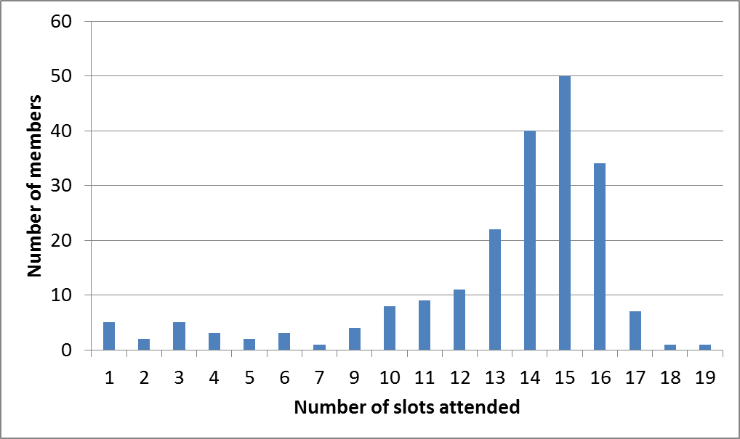
Attendance Histogram (Thu after pm1)

Slide 6
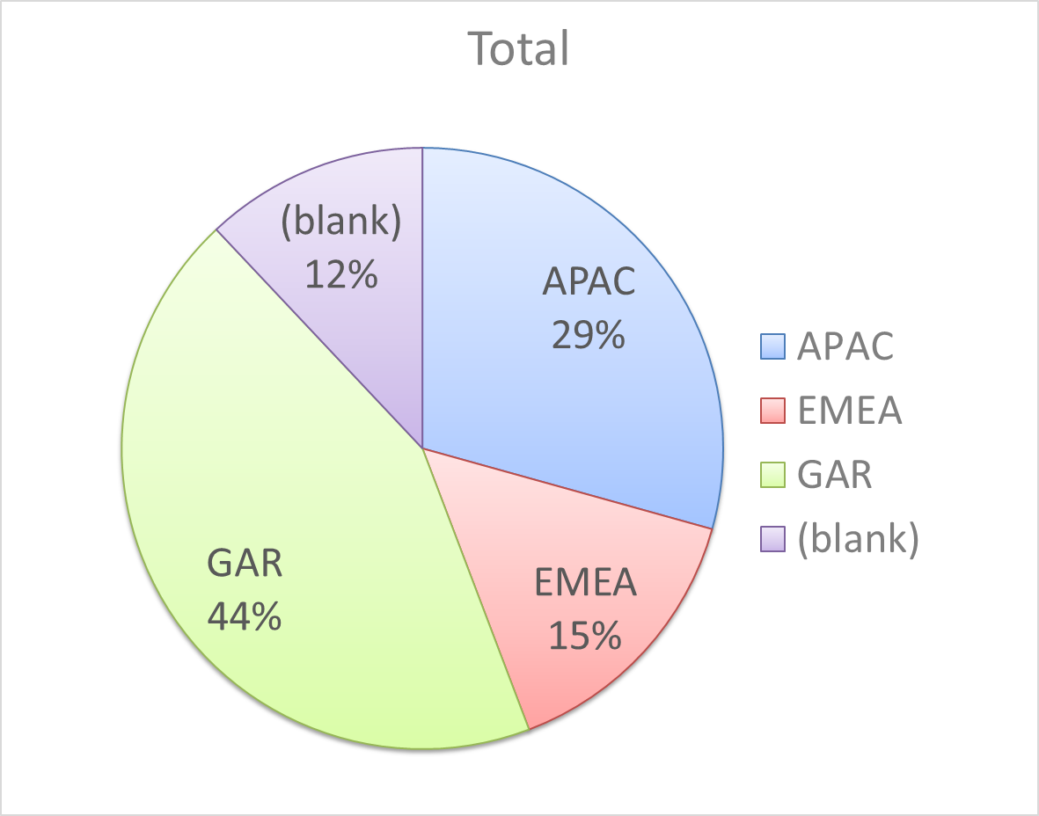
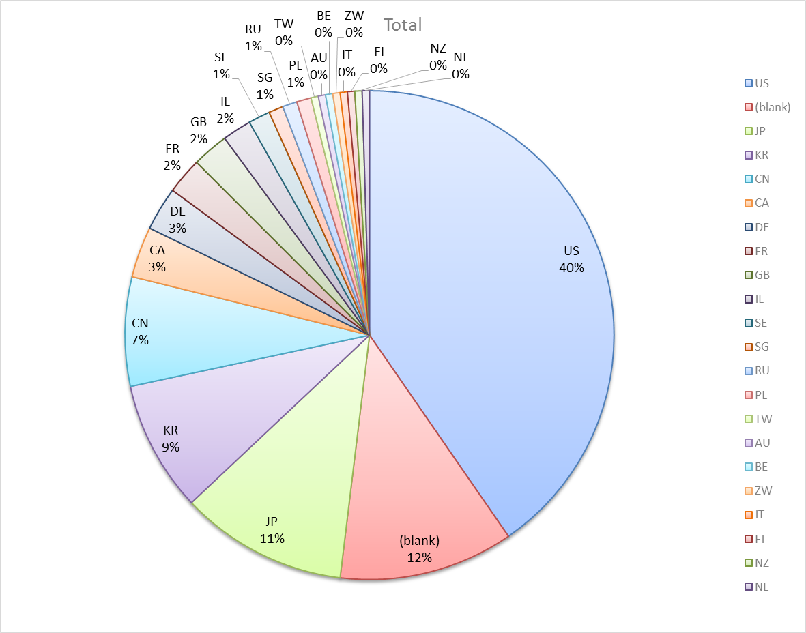
Attendance by Country

Slide 7
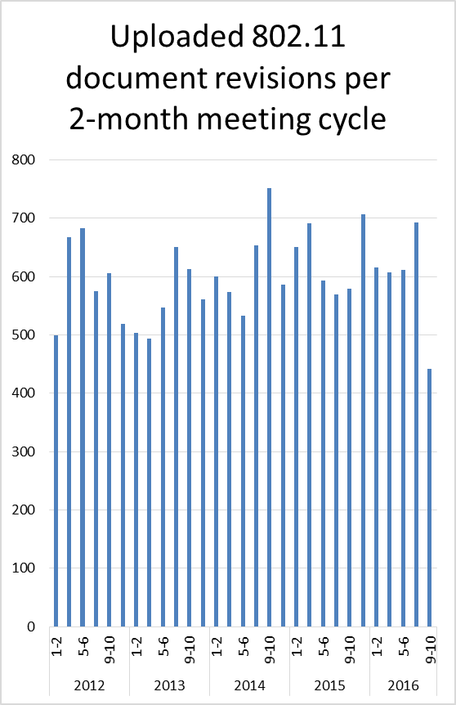
Doc Revision uploads by meeting (month #)

Slide 8
802.11 WG Editor’s Meeting (Sept ‘16)
Date: 2016-09-15
Authors:
from slide 1/6 of 11-16-1285 by Robert Stacey, Intel Corporation
Notes:
July 2007

Slide 9
Publication process
Adrian Stephens gave an overview of the publication process as REVmc, TGai and TGah near publication
from slide 2/6 of 11-16-1285 by Robert Stacey, Intel Corporation

Slide 10
TGai and TGah amendment order
The group discussed changing the amendment order of TGai and TGah
TGai chair:
  No real technical changes from comments of the last round
Might get a lot of comments in next round because of the attention given to security issue
Risk of errors is high if we reverse the order
Changing the order has technical implication:
  Will someone build a FILS S1G STA?
Dan Harkins has 4 pages of changes to TGai
  Remove security feature. Does not seem to be an objection to this.
No objection to keeping current order
The group accepts the risk of TGai pushing out TGah publication
from slide 3/6 of 11-16-1285 by Robert Stacey, Intel Corporation

Slide 11
Volunteer Editor Contacts
TGmc – Adrian Stephens – adrian.p.stephens@intel.com, Edward Au – edward.ks.au@huawei.com, Emily Qi – emily.h.qi@intel.com
TGah – Yongho Seok yongho.seok@gmail.com, Alfred Asterjadhi – aasterja@qti.qualcomm.com
TGai – Lee Armstrong – LRA@tiac.net, Ping FANG Ping.FANG@huawei.com
TGaj – Jiamin CHEN – jiamin.chen@mail01.huawei.com , Shiwen He – shiwenhe@seu.edu.cn
TGak – Donald Eastlake – d3e3e3@gmail.com, Norm Finn – nfinn@cisco.com
TGaq – Lee Armstrong – LRA@tiac.net
  TGax – Robert Stacey – robert.stacey@intel.com
  TGay – Carlos Cordeiro – carlos.cordeiro@intel.com
  TGaz – Chao Chun Wang – chaochun.wang@mediatek.com
  Editors Emeritus:
  TGaa – Alex Ashley – alex.ashley@hotmail.co.uk
  TGac – Robert Stacey – robert.stacey@intel.com
  TGad – Carlos Cordeiro – carlos.cordeiro@intel.com
  TGae – Henry Ptasinski – henry@LOGOUT.COM
  TGaf – Peter Ecclesine – pecclesi@cisco.com
  TGaq – Dan Gal – ddrgal@gmail.com
from slide 4/6 of 11-16-1285 by Robert Stacey, Intel Corporation
Notes:
July 2007

Slide 12
Editor Amendment Ordering
Amendment numbering is editorial! No need to make ballot comments on these dynamic numbers!
Data as of Sept 2016
See http://grouper.ieee.org/groups/802/11/Reports/802.11_Timelines.htm
In July 2016, Editors changed the running order and will revisit in Mar 2017, maintaining this order in the interim
Amendment Number | Task Group | Projected REVCOM Date
802.11REVmc | TGmc - 3650 | Jan 2017
802.11-2016 Amendment 1 | TGai - 170 | Jan 2017
802.11-2016 Amendment 2 | TGah - 627 | Jan 2017
802.11-2016 Amendment 3 | TGaq - 34 | Mar 2017
802.11-2016 Amendment 4 | TGaj - 288 | Jun 2017
802.11-2016 Amendment 5 | TGak - 86 | Sep 2017
802.11-2016 Amendment 6 | TGax - 317 | Mar 2019
802.11-2016 Amendment 7 | TGay | Dec 2019
802.11-2016 Amendment 8 | TGaz | Mar 2020
from slide 5/6 of 11-16-1285 by Robert Stacey, Intel Corporation
Notes:
July 2007

Slide 13
Draft Development Snapshot
Sept 2016
Changes from last report shown in red.
Most current doc shaded green.
TG | Published or Draft Baseline Documents |  |  |  |  |  |  |  |  |  | Source | MDR | Style Guide | Editor | Snapshot Date
 | Published | mc | ai | ah | aq | ak | aj | ax | ay | az
mc | Y | 8.0 |  |  |  |  |  |  |  |  | Frame 12.0 | Yes | 2012 | Adrian Stephens Edward Au, Emily Qi | 12-Sep
ai | N | 8.0 | 10.0 |  |  |  |  |  |  |  | Frame 12.0 | Yes | 2012 | Lee Armstrong Ping FANG | 12-Sep
ah | N | 5.0 |  | 10.0 |  |  |  |  |  |  | Frame 11.0 | Yes | 2012 | Yongho Seok Alfred Asterjadhi | 13-Sep
aq | N | 8.0 |  |  | 7.0 |  |  |  |  |  | Frame 12.0 | No | 2012 | Lee Armstrong | 12-Sep
ak | N | 5.0 | 6.0 | 5.0 | 1.2 | 2.4 |  |  |  |  | Word | No | 2012 | Donald Eastlake Norm Finn | 13-Sep
aj | N | 5.4 | 6.2 | 5.0 | 3.0 | 1.3 | 3.0 |  |  |  | Frame 10.0 | No | 2012 | Jiamin Chen Shiwen He | 13-Sep
ax | N | 5.0 | 6.0 | 5.0 | 3.0 | 1.0 | 1.0 | 0.4 |  |  | Frame 12.0 | No | 2012 | Robert Stacey | 13-Sep
ay |  |  |  |  |  |  |  |  |  |  |  | No | 2012 | Carlos Cordeiro | 12-Sep
az |  |  |  |  |  |  |  |  |  |  |  |  |  | Chao Chun Wang | 12-Sep
from slide 6/6 of 11-16-1285 by Robert Stacey, Intel Corporation
Notes:
July 2009
July 2007
Peter Ecclesine (Cisco Systems)
Page 13

Slide 14
AANI SC Closing Report September
Date: 2016-09-15
Authors:
from slide 1/3 of 11-16-1281 by Joseph Levy (Interdigital)

Slide 15
Abstract
This Document is the closing report for AANI SC,
September 2016 Meeting in Warsaw, Poland
from slide 2/3 of 11-16-1281 by Joseph Levy (Interdigital)

Slide 16
802.11 AANI SC – September 2016
Meeting Goal: Complete the LS from 802.11 to 3GPP RAN/SA for approval at the closing plenary, so it can be sent to the 3GPP Plenaries occurring September 19-23
Completed the LS for approval at the closing plenary
  11-16/1101r10
  “Draft LS from 802_11 to 3GPP RAN and SA on IMT 2020”
  Straw Poll in support of the Draft LS Y/N/A 16/0/0
OmniRAN held a Wednesday 14 Sept PM2 (16:00-18:00)
Teleconferences: September 27 and October 27 @ 10:00 ET
Meeting plans for November
  Update status of LS sent to 3GPP
  Respond to 3GPP response if available
  Begin discussion on 802.11 views of IEEE “5G” standards activities, led by OmniRAN
from slide 3/3 of 11-16-1281 by Joseph Levy (Interdigital)

Slide 17
ARC Closing Report
Date: 2016-09-15
Authors:
from slide 1/9 of 11-16-1282 by Mark Hamilton, Ruckus Wireless

Slide 18
Abstract
This document is the closing report for ARC SC,
September 2016 Meeting in Warsaw, Poland
from slide 2/9 of 11-16-1282 by Mark Hamilton, Ruckus Wireless

Slide 19
Work Completed
Agenda is here: https://mentor.ieee.org/802.11/dcn/16/11-16-1078-01-0arc-arc-sc-agenda-september-2016.pptx
Noted status of “802.11 as a component/5G/IMT-2020”
  Being handled in AANI SC. No action needed. Will stop tracking.
Noted status of IEEE 1588 mapping to IEEE 802.11
  No changes. No action needed.
  Aware of a concern about mapping IEEE 1588, by using 802.1AS, to 802.11, for multicast frames. This comes up when considering streaming video, for example.
from slide 3/9 of 11-16-1282 by Mark Hamilton, Ruckus Wireless

Slide 20
Work Completed (cont)
Noted status of IETF/802 Coordination
  No known action needed at this time.
  Work is ongoing externally on a concern about the proliferation of multicast-based protocols, and how those perform when run over 802.11.
Noted status of 802.1AC revision
  Clean recirc Sponsor Ballot has closed. Forwarding D4.0 to RevCom.
Status of joint topics with TGak (General Links)
  TGak is still struggling with what an ESS means in their context (if anything), and what SAP types are where in their architecture. ARC SC can help with this. Covered later in the agenda.
Status of joint topics with TGaq (Pre-association Discovery)
  TGaq would like to discuss the architectural model for SIC, SIR, ANQP server and other 11aq components. Covered later in the agenda.
from slide 4/9 of 11-16-1282 by Mark Hamilton, Ruckus Wireless

Slide 21
Work Completed (cont)
MIB Design Pattern work item
  Discussed.
  No real progress recently.
  REALLY, REALLY need to put focus and emphasis on this, to get a recommendation done that can be the basis for REVmd and related amendments, while we still have this window of opportunity.
YANG/NETCONF
  We need to get going looking at this, as well, while we have the window before REVmd gets too far along.
The above topics are likely to interrelate.
from slide 5/9 of 11-16-1282 by Mark Hamilton, Ruckus Wireless

Slide 22
Work Completed (cont)
What is an ESS?
  Long discussion. No consensus, yet.
  New suggestion that ESS be a set of APs (and not any associated STAs).
  Is the extent of an ESS defined by the limits of any mobility within it?
  Agreed an ESS probably most closely maps to a Bridged Network (or the wireless subset of a Bridged Network), in the 802.1 definition of that term.
  Will continue discussion. Also need to consider what changing this definition will really affect.
AP/DS/Portal architecture questions
  Reviewed the discussion document about whether SAPs should/must be shown as up and down (11-16/0720r0). Agreed this is our convention, with a history of purpose and value for it. Reviewed the start of a tutorial on why we do this.
  Reviewed a gedanken presentation on how the DS can be implemented with/relates to bridges (11-15/0454r0). Agreed to explore further.
from slide 6/9 of 11-16-1282 by Mark Hamilton, Ruckus Wireless

Slide 23
Work Completed (cont)
Joint meeting with TGak
  Focused on 11ak comment resolutions with architectural issued raised.
  Believe we covered the known topics and questions.
Joint meeting with TGaq
  Created two architecture models, with agreement from both groups.
  Believe we covered the known topics and questions.
from slide 7/9 of 11-16-1282 by Mark Hamilton, Ruckus Wireless

Slide 24
Teleconference(s)
None planned
May schedule with 10 days notice
from slide 8/9 of 11-16-1282 by Mark Hamilton, Ruckus Wireless

Slide 25
November 2016 Plans
Two standalone meeting slots planned:
  Design Pattern for MIB attribute use
  Consider use of YANG/NETCONF by 802.11
  DS/AP/Portal architecture discussions, and “what is an ESS?”
  Status of IETF work, IEEE 1588 work
One joint session with 802.1
  Discussion about YANG/NETCONF models, and what 802.1 is doing and has learned
from slide 9/9 of 11-16-1282 by Mark Hamilton, Ruckus Wireless

Slide 26
IEEE 802.11/15 Regulatory SC
Warsaw Closing Report
Date: 2016-09-16
Authors:
from slide 1/6 of 11-16-1085 by Rich Kennedy, Hewlett Packard Enterprise

Slide 27
Abstract
This presentation is the closing report for the September 2016 IEEE 802.11/15 Regulatory Standing Committee meeting in Warsaw.
from slide 2/6 of 11-16-1085 by Rich Kennedy, Hewlett Packard Enterprise

Slide 28
Agenda
Administrative items
Introduction
Approve San Diego minutes
Discussion items
  Regulatory work in progress
  Status of completed work
Actions required
  FCC 16-89 FNPRM
  WP5A liaison
  …
AOB and Adjourn
from slide 3/6 of 11-16-1085 by Rich Kennedy, Hewlett Packard Enterprise

Slide 29
Regulatory Updates
FCC 16-89 mmWave R&O
ETSI BRAN and ERM TG11 updates
  EN 300 328 (2.4 GHz) in final approval phase
  EN 301 893 (5 GHz) planning to complete in November
  EN 302 567 (60 GHz) to complete in November
  EN 301 598 (TVWS) to complete in November
FCC WRC-19 Advisory Committee (WAC)
CEPT CPG PT-D next week in Rome
EU Radio Equipment Directive implications
ETSI RED workshop December 1st
  http://www.etsi.org/news-events/events/1102-53-shades-of-re-d-six-months-to-go
from slide 4/6 of 11-16-1085 by Rich Kennedy, Hewlett Packard Enterprise

Slide 30
Input for 802.18
FCC 16-89 mmWave FNPRM
  Due September 30, 2016
  Will not file as we have no supporting data for requests
Complete the WP5A liaison started in July
from slide 5/6 of 11-16-1085 by Rich Kennedy, Hewlett Packard Enterprise

Slide 31
Teleconferences, etc.
No more Regulatory SC teleconferences
We will continue with SC meetings for two more meetings, until the transition to 802.18 is shown to be effective
I will continue to act as Chair until the end
from slide 6/6 of 11-16-1085 by Rich Kennedy, Hewlett Packard Enterprise

Slide 32
IEEE 802.11mc Closing Report for
September 2016
Date: 2016-09-14
Authors:
from slide 1/6 of 11-16-1262 by Dorothy Stanley, HP Enterprise

Slide 33
Abstract
This document contains the TGmc closing report for September 2016.
from slide 2/6 of 11-16-1262 by Dorothy Stanley, HP Enterprise

Slide 34
Status
Sponsor Ballot process has completed
  One (1) comment received from an “Approve” voter, resolved for 4th recirc SB (99% approval) on P802.11REVmc D8.0.
  Approved forwarding P802.11REVmc D8.0 to WG for approval to forward to Revcom
  Approved report to EC: 11-16-1094
Agenda, includes motions
  https://mentor.ieee.org/802.11/dcn/16/11-16-1088-02-000m-tgmc-brc-september-2016-agenda.pptx
Comment resolution spreadsheet
  https://mentor.ieee.org/802.11/dcn/15/11-15-0532-65-000m-revmc-sponsor-ballot-comments.xls
from slide 3/6 of 11-16-1262 by Dorothy Stanley, HP Enterprise

Slide 35
TGmc Plan of Record - modified
20 July 2012 – 12 Sept 2012 – Call for Comment/Input
29-30 Aug 2012 – NesCom, SASB PAR Approval
Sept 2012 – Begin to process CC input, 11aa, 11ae integration
Dec 2012 – March/May 2013 – 11ad integration
Jan 2013 – First WG Letter ballot - without 11ad – on D1.0
Sept 2013 – Letter ballot on D2.0
Dec 2013 – May 2014 – 11ac, 11af integration – D3.0 in May 2014
July 2014 – Mandatory Draft Review
Jan 2015 – D4.0 Recirculation
Form Sponsor Pool: Open Dec 15th or so, close Feb 20, 2015 –good for 6 months (end of July 2015)
D4.0 Initial Sponsor Ballot 2015-03-27 through 2015-04-26
D5.0 Jan 2016 Initial SB recirculation
D6.0 Second Recirculation 2016-06-07 through 2016-06-30
D7.0 & D8 August/September Third/Fourth Recirculation
October 2016 – WG/EC Final Approval Oct 4th telecon
December 2016 – RevCom/SASB Approval
Slide 35
from slide 4/6 of 11-16-1262 by Dorothy Stanley, HP Enterprise
Notes:
doc.: IEEE 802.11-10/0503r4
May 2010
Michael Montemurro, Research in Motion
Page 35

Slide 36
September- November 2016 Meeting Planning
Objectives:
  Obtain unconditional approval from the 802 EC for submitting P802.11REVmc D8.0 to RevCom (Oct 4th 802 EC teleconference)
Conference calls scheduled with 10 day notice
Availability of 11mc in the IEEE store
  D8.0 is available, see http://www.techstreet.com/ieee/products/1867583
Forward to ISO JTC1/SC6 WG1
  D6.0 forwarded; D8.0 will be forwarded
from slide 5/6 of 11-16-1262 by Dorothy Stanley, HP Enterprise

Slide 37
Thank you to all TGmc participants
TGmc work included roll in of 802.11aa, ae, ac, ad, and af together with numerous improvement and maintenance items
See Adrian’s July 2016 email requesting additions to the list of TGmc substantial contributors
  http://www.ieee802.org/11/email/stds-802-11-tgm/msg01096.html
  Please contact Adrian or Dorothy if you are missing from the list
from slide 6/6 of 11-16-1262 by Dorothy Stanley, HP Enterprise

Slide 38
IEEE 802.11ah Closing Report for
September 2016
Date: 2016-09-16
Authors:
from slide 1/6 of 11-16-1273 by Yongho Seok (NEWRACOM)

Slide 39
Abstract
This presentation is the closing report for the Warsaw meeting of the IEEE 802.11 TGah.
from slide 2/6 of 11-16-1273 by Yongho Seok (NEWRACOM)

Slide 40
Activity in TGah
TGah completed all comment resolution of the Sponsor Recirculation Ballot for Draft 9.0
  16/1218r1 SB4 Comment Spreadsheet
  And, instructed the editor to generate Draft 10.0 and moved to forward Sponsor Recirculation Ballot
  Agenda of September 2016 meeting: 11-16/1073r2
Also, WG motions (Forward P802.11ah D10.0 to RevCom, TGah Report to EC for forwarding P802.11ah D10.0 to RevCom) have passed
from slide 3/6 of 11-16-1273 by Yongho Seok (NEWRACOM)

Slide 41
Going forward
Start 5th Sponsor Recirculation Ballot for Draft 10.0
Address comments received from the Sponsor Recirculation Ballot for Draft 10.0
Ask an approval from EC for forwarding P802.11ah D10.0 to RevCom
from slide 4/6 of 11-16-1273 by Yongho Seok (NEWRACOM)

Slide 42
Teleconference
Weekly teleconferences between September 27th 2016 and November 1st 2016
  Tuesday 8PM ET for 1 hours
from slide 5/6 of 11-16-1273 by Yongho Seok (NEWRACOM)

Slide 43
TGah Timeline – Updates
Internal Task Group Ballot : May 2013
Initial Letter Ballot : September 2013
Initial Recirculation Letter Ballot : September 2014
Initial Sponsor Ballot : October 2015
Initial Recirculation Sponsor Ballot : January 2016
EC Approval : September October 2016
Revcom Approval : December 2016
from slide 6/6 of 11-16-1273 by Yongho Seok (NEWRACOM)

Slide 44
IEEE 802.11 TGai
Closing Report Warsaw September 2016
Date: 2016-09-16
Authors:
Name | Company | Address | Phone | email
Marc Emmelmann | SELF | Berlin, Germany |  | emmelmann@ieee.org
from slide 1/13 of 11-16-1174 by Marc Emmelmann, self

Slide 45
Abstract
This presentation is the closing report for the Warsaw meeting of the IEEE 802.11 TGai.
from slide 2/13 of 11-16-1174 by Marc Emmelmann, self

Slide 46
IEEE 802.11 FILS TGai – September 2016 Warsaw
Goals for the Sep Meeting:
  Approve minutes of past meeting and teleconference
  Continue on comment resolution for 4th Recirc SB
  Approve to forward the 5th recirc sponsor LB
  Approve Timeline
  Approve Teleconference schedule
  Approve plan for Nov
from slide 3/13 of 11-16-1174 by Marc Emmelmann, self

Slide 47
Accomplishments TGai
  Approve minutes of past meeting and teleconference
  Continue on comment resolution for 5th^{th} Recirc SB
  Approve to forward the 6th^{th} recirc sponsor LB
  Approve Timeline
  Approve Teleconference schedule
  Approve plan for Nov
  Resolution for avoiding any potential security issues in the draft
  Approve Report to EC to forward TGai D11 to RevCom
  Request conditional approval to forward TGai D11 to RevCom
  Motion to create D11.0 and initiate recirculation ballot
✔
✔
✔
✔
✔
✔
✔
✔
✔
✔
✔
✔
✔
✔
from slide 4/13 of 11-16-1174 by Marc Emmelmann, self

Slide 48
Motions external, to be reconfirmed in WG Plenary
from slide 5/13 of 11-16-1174 by Marc Emmelmann, self

Slide 49
TGai Draft D11.0 to RevCom
Motion
  Request the IEEE 802 Executive Committee to conditionally approve forwarding P802.11ai D11.0 to RevCom.
Result in TG
  Moved: Dan
  Second: Jon
  Y/N/A: 4-0-0
from slide 6/13 of 11-16-1174 by Marc Emmelmann, self

Slide 50
TGai Report to EC for forwarding P802.11ai D11.0 to RevCom
Motion:
  Approve document https://mentor.ieee.org/802.11/dcn/16/11-16-1270-02-00ai-p802-11ai-report-to-ec-on-conditional-approval-to-forward-draft-to-revcom.pptx as the report to the IEEE 802 Executive Committee on the requirements for conditional approval to forward P802.11ai D11.0 to RevCom, granting the chair editorial license.
Result in TG
  Moved: Peter
  Second: Dan
  Y/N/A: 4-0-0
from slide 7/13 of 11-16-1174 by Marc Emmelmann, self

Slide 51
Administrative
from slide 8/13 of 11-16-1174 by Marc Emmelmann, self

Slide 52
Timeline (unchanged)
  PAR Approved, Modified, or Extended 2010-12-08
  WG Letter Ballots Initial / Recirc Mar14/Sep14/Jan15/
  Mar15/Jul15/Aug15
  MEC Done Nov14
  Form Sponsor Ballot Pool / Reform Mar15
  IEEE-SA Sponsor Ballots Initial / Recirc Sep 15/Mar 16/Aug 16
  Sep 16/Oct 16
  Final 802.11 WG Approval Sep 16
  final or Conditional 802 EC Approval Oct 4th, 2016 (telco)
  RevCom & Standards Board Final or
  Continuous Process Approval Dec 16
from slide 9/13 of 11-16-1174 by Marc Emmelmann, self
Notes:
Need to be in SB on Oct 17 final SB on draft unchanged.
Note: Aug16 recirc to make final technical changes (D9.0) based on comment resolutions this week
Sep 16 (D10.0) only changes due to merging REVmc
Oct 16 (D10.0-unchanged) recirc of unchanged draft

Slide 53
Teleconference Schedule
Motion:
  Approve the following schedule of weekly teleconferences between Aug 16 to Nov 1st.
  Tuesdays 10:00 ET
  Duration 1.5 Hour
  Using WEB-EX that will be provided by Task Group Chair
  Moved: Marc Emelmann
  Second: George Calcev
Approved by unanimous consent during July Face-to-face meeting
Additional telecons will be announced on a 10-day notice.
from slide 10/13 of 11-16-1174 by Marc Emmelmann, self

Slide 54
Plan for November
Goals for the November Meeting:
  Approve minutes of past meeting and teleconference
from slide 11/13 of 11-16-1174 by Marc Emmelmann, self

Slide 55
Reference
TGai-Motion-deck (11-13/1186)
  https://mentor.ieee.org/802.11/documents?is_dcn=1186&is_group=00ai&is_year=2013
TGai Agenda
  https://mentor.ieee.org/802.11/documents?is_dcn=1258&is_group=00ai&is_year=2016
Comments from 4th recirc SB (11-16/1203)
  https://mentor.ieee.org/802.11/documents?is_dcn=1203&is_group=00ai&is_year=2016
Report to EC for forwarding TGai Draft to RevCom (11-16/270)
  https://mentor.ieee.org/802.11/documents?is_dcn=1270&is_group=00ai&is_year=2016
from slide 12/13 of 11-16-1174 by Marc Emmelmann, self

Slide 56
Thanks to all who participated!
from slide 13/13 of 11-16-1174 by Marc Emmelmann, self

Slide 57
TGak September Closing Report
Date: 2016-09-15
Authors:
from slide 1/4 of 11-16-1279 by Donald Eastlake, Huawei Technologies

Slide 58
Abstract
Closing Report of IEEE 802.11 Task Group ak at the IEEE Warsaw Marriott, Warsaw, Poland.
from slide 2/4 of 11-16-1279 by Donald Eastlake, Huawei Technologies

Slide 59
TGak Closing Report
Accomplishments
  Met jointly with 802.11 ARC SC Thursday AM1.
  Adjusted our timeline by moving remaining dates out by two months and final milestone out by 4 months.
  TGak entered the week with 73 of the 346 comments from recirculation LB218 unresolved. During the week, it resolved 61 comments leaving 12 comments unresolved.
  An annotated agenda is in 11-16/1075.
  The minutes will be in 11-16/1250.
from slide 3/4 of 11-16-1279 by Donald Eastlake, Huawei Technologies

Slide 60
TGak Closing Report
Teleconferences
  Decided to hold 1 ½ hour teleconferences, to be joint with 802.1Qbz if mutually convenient, on Monday, September 26, October 3, and October 24, all at 10am Eastern US time.
November 2016 Plans
  Resolve remaining comments from WG ballot 218 and go to recirculation.
  Joint meeting with 802.11 ARC SC and 802.1 TSN.
from slide 4/4 of 11-16-1279 by Donald Eastlake, Huawei Technologies

Slide 61
TGaq Closing Report
Date: 2016-09-15
Authors:
from slide 1/3 of 11-16-1268 by Stephen McCann, BlackBerry

Slide 62
Abstract
Closing report for TGaq (Pre-Association Discovery) for September 2016, Warsaw, Poland.
from slide 2/3 of 11-16-1268 by Stephen McCann, BlackBerry

Slide 63
Letter Ballot status
  LB222 comment resolution completed on September 1st teleconference
  LB224 11aq D7.0 start on September 10th, finish on September 25th.
  BRC teleconference meeting September 30th
  Possible clean Letter Ballot D7.0 in early October.
Conditional Sponsor Ballot Report
  Updated Report for the EC - 11-16-1026r3 (motion later)
  Start Sponsor Ballot in mid-October 2016
Joint meeting with ARC
  Discussions about TGaq architecture diagram
Plans for November 2016
  Start working as a Ballot Resolution Committee
from slide 3/3 of 11-16-1268 by Stephen McCann, BlackBerry

Slide 64
TGax September 2016 Closing Report
Date: 2016-09-15
Authors:
from slide 1/6 of 11-16-1284 by Osama Aboul-Magd (Huawei Technologies)

Slide 65
Abstract
This document is the closing report for the TGax for the September 2016 session.
from slide 2/6 of 11-16-1284 by Osama Aboul-Magd (Huawei Technologies)

Slide 66
Work Completed
The TG completed the discussion of all the submissions.
Good progress on comment resolution
Exact count of resolved CIDs will be published by the Editor.
The TG editor is planning to have draft revision D0.5 ready based on resolved comments.
Agenda and motions are available at: https://mentor.ieee.org/802.11/dcn/16/11-16-1077-05-00ax-tgax-september-2016-meeting-agenda.ppt
from slide 3/6 of 11-16-1284 by Osama Aboul-Magd (Huawei Technologies)

Slide 67
Timeline
Current Timeline
Modified Timeline
May 2014: start of the TG
Nov. 2014: First draft of the TG SFD was approved
Jan. 2016: proposed TG draft
March 2016: Draft D0.1 was approved and CC started
September 2016: Draft 1.0 and WG letter ballot
March 2017: Draft 2.0 and recirculation
July 2017: MDR (Mandatory Document Review)
November 2017: Formation of SB pool
March 2018: Sponsor Ballot
December 2018: RevCom
May 2014: start of the TG
Nov. 2014: First draft of the TG SFD was approved
Jan. 2016: proposed TG draft
March 2016: Draft D0.1 was approved and CC started
November 2016: Draft 1.0 and WG letter ballot
May 2017: Draft 2.0 and recirculation
Novemebr 2017: MDR (Mandatory Document Review)
January 2018: Formation of SB pool
March 2018: Sponsor Ballot
December 2018: RevCom
from slide 4/6 of 11-16-1284 by Osama Aboul-Magd (Huawei Technologies)

Slide 68
September 2016 Goals
Continue with the comment resolution
Prepare draft D1.0 and start a WG LB
from slide 5/6 of 11-16-1284 by Osama Aboul-Magd (Huawei Technologies)

Slide 69
Conference Call Times
Thursday Sept 29, Oct 20 10:00 – 12:00 ET
Thursday Oct 13 20:00 -22:00 ET
Thursday Oct 27 10:00 – 12:00 ET
Thursday Nov 17 10:00 -12:00 ET
from slide 6/6 of 11-16-1284 by Osama Aboul-Magd (Huawei Technologies)

Slide 70
Task Group AY
September 2016 Closing Report
Date: 2016-09-16
Authors:
from slide 1/6 of 11-16-1200 by Edward Au (Huawei Technologies)

Slide 71
Abstract
This document is the closing report for Task Group AY for the September 2016 session.
from slide 2/6 of 11-16-1200 by Edward Au (Huawei Technologies)

Slide 72
Work Completed
Vice Chair election result:
  Sang Kim (LG Electronics)
16 submissions were covered during the meeting covering areas related to:
  Channel model
  Specification framework document
Significant progress is made in the development of specification framework document
Timeline
from slide 3/6 of 11-16-1200 by Edward Au (Huawei Technologies)

Slide 73
Progress on Task Group documents
Doc. No. | Title of the Task Group documents | Status
15/0625r3 | IEEE 802.11 TGay use cases | Approved in November 2015 plenary as the baseline document
15/1150r7 | Channel models for IEEE 802.11ay | Draft proposals are under review and ongoing discussion
15/1074r0 | TGay functional requirements | Approved in May 2016 interim as the baseline document
15/0866r4 | TGay evaluation methodology | Approved in July 2016 plenary as the baseline document
15/1079r2 | TGay selection procedure | Approved in November 2015 plenary
15/1358r5 | Specification framework for TGay | Texts corresponding to motions #68-#71, and #73- #86 are inserted in the latest version after the July 2016 plenary
16/0266r3 | A compendium of motions related to the contents of the specification framework document for TGay | Updated after July 2016 plenary
from slide 4/6 of 11-16-1200 by Edward Au (Huawei Technologies)

Slide 74
Goals for November 2016 plenary
Advance on Task Group documents, with emphasis on Specification Framework document
Technical presentation
Timeline
from slide 5/6 of 11-16-1200 by Edward Au (Huawei Technologies)

Slide 75
Teleconference Schedule
October 26 (Wednesday), 10:00am ET – 11:00am ET
from slide 6/6 of 11-16-1200 by Edward Au (Huawei Technologies)

Slide 76
TGaz Next Generation Positioning
Sep. Closing Report
Date: 2016-09-15
Authors:
from slide 1/5 of 11-16-1280 by Jonathan Segev, Intel Corporation

Slide 77
Abstract
This document is the Next Generation Positioning TGaz closing report for the Warsaw meeting, Sep. 2016.
from slide 2/5 of 11-16-1280 by Jonathan Segev, Intel Corporation

Slide 78
Work Completed
Reviewed proposals on:
  Channel Sounding
  Security
  Negotiation in MU modes
  Functional Requirements
Set telecon times and goals for Nov. meeting.
Agenda: See 11-16/750r3.
from slide 3/5 of 11-16-1280 by Jonathan Segev, Intel Corporation

Slide 79
Goals for Nov. Meeting
Continue on Functional Requirement Document development.
Approve initial submissions of technical material towards SFD text where FRD is sufficiently mature.
Review technical submissions on measurement phase approaches, negotiation phase, adaptation to 11ax MU mode and secured location schemes.
from slide 4/5 of 11-16-1280 by Jonathan Segev, Intel Corporation

Slide 80
Teleconference Schedule
Nov. 2nd 10:00AM ET for 1hr.
from slide 5/5 of 11-16-1280 by Jonathan Segev, Intel Corporation

Slide 81
Wake-up Radio (WUR) SG
September 2016 Closing Report
Date: 2016-09-15
Authors:
from slide 1/8 of 11-16-1272 by Minyoung Park (Intel Corp.)

Slide 82
Abstract
This document is the Wake-up Radio Study Group closing report for the San Diego meeting, September 2016
from slide 2/8 of 11-16-1272 by Minyoung Park (Intel Corp.)

Slide 83
Work Completed
Completed the development of the PAR and CSD
  PAR: 11-16/1045r6
  CSD: 11-16/936r3
The PAR and CSD contained in 11-16/1045r6 and 11-16/936r3 have been approved by the SG and 802.11 WG to be posted to the IEEE 802 Executive Committee (EC) agenda for 802 WG preview and EC approval (see Slide 4 and Slide 5)
Reviewed the presentations (see Slide 6)
Reviewed the SG timeline
Set goals for the November meeting and teleconference schedule
Agenda: see doc.: IEEE 802.11-16/1080r6
from slide 3/8 of 11-16-1272 by Minyoung Park (Intel Corp.)

Slide 84
WUR SG PAR approval
Believing that the PAR contained in the document referenced below meets IEEE-SA guidelines,
Request that the PAR contained in 11-16/1045r6 be posted to the IEEE 802 Executive Committee (EC) agenda for 802 WG preview and EC approval to submit to NesCom.
Moved: Minyoung Park
Seconded: Osama Aboul-Magd
Result: 104-1-8 Passes
Moved: Shahrnaz Azizi, Seconded: Yunsong Yang, Result: 39-0-2
from slide 4/8 of 11-16-1272 by D. Stanley, HP Enterprise

Slide 85
WUR CSD approval
Believing that the CSD contained in the document referenced below meets IEEE 802 guidelines,
Request that the CSD contained in 11-16/936r3 be posted to the IEEE 802 Executive Committee (EC) agenda for 802 WG preview and EC approval.
Moved: Minyoung Park
Seconded: Osama Aboul-Magd
Result: 103-1-8 Passes
Moved: Osama Aboul-Magd, Seconded: Yunsong Yang,
Result: 43-0-3
from slide 5/8 of 11-16-1272 by D. Stanley, HP Enterprise

Slide 86
Submissions Reviewed
PAR related submissions:
11-16/1229r0, WUR update on PAR comment resolution, Shahrnaz Azizi (Intel)
11-16/1045r4, A PAR proposal for WUR SG, Shahrnaz Azizi (Intel)
CSD related submissions:
11-16/936r2, A CSD proposal for wake-up radio (WUR), Osama Aboul-Magd (Huawei)
Other submissions:
11-16/1144r0, Further investigation on WUR performance, Eunsung Park (LGE)
11-16/1147r0, WUR and efficiency tradeoffs (Newracom)
11-16/1215r0, Demand of Being Waken Up While Moving Follow-up, Ke Yao (ZTE)
11-16/1217r0, WUR based Broadcast Reference Signal, John Son (WILUS)
11-16/1243r0, Multi user access for Wakeup Radio, Hanseul Hong (Yonsei Univ.)
from slide 6/8 of 11-16-1272 by Minyoung Park (Intel Corp.)

Slide 87
Goal for November 2016
Review and resolve comments from other WGs and EC members by the WG mid-week plenary meeting
Revised PAR and CSD based on the resolutions
Submit the revised PAR and CSD for the 802.11 WG approval
from slide 7/8 of 11-16-1272 by Minyoung Park (Intel Corp.)

Slide 88
Teleconference Call Schedule
Approved to have 1 teleconference call before the November F2F meeting
  October 24th, Monday, 6 pm EDT, 1 hour
from slide 8/8 of 11-16-1272 by Minyoung Park (Intel Corp.)

Slide 89
RR-TAG (802.18) to 802.11 Liaison Report
Date: 2016-09-16
Authors:
from slide 1/7 of 11-16-1087 by Rich Kennedy, HP Enterprise

Slide 90
Overview
This document summarizes the activities of the IEEE 802.18 Radio Regulatory Technical Advisory Group (RR-TAG) during the IEEE 802 Wireless Interim September 2016 in Warsaw.
from slide 2/7 of 11-16-1087 by Rich Kennedy, HP Enterprise

Slide 91
RR-TAG Actions Taken
Completed and approved the liaison to ITU-R asking that WP5A request that Task Group 5/1 sharing studies in frequencies 66 GHz to 76 GHz consider WAS/RLAN Multiple Gigabit Wireless Systems operation in the lower adjacent bands in 57 GHz to 66 GHz, and the 66 GHz to 76 GHz bands.
Decided to not develop a response to FCC 16-89 FNPRM
Completed and approved two liaisons to WP5A and WP5C on frequencies above 275 GHz on behalf of the 802.15 Terahertz group
from slide 3/7 of 11-16-1087 by Rich Kennedy, HP Enterprise

Slide 92
Approved Motion #1
Approve https://mentor.ieee.org/802.18/dcn/16/18-16-0074-07-0000-wp5a-liaison-re-60-ghz.docx as our liaison to ITU-R WP5A, and submit to the IEEE 802 EC for 10-day ballot and transmittal to the ITU-R liaison. 802.18 Chair and ITU-R Liaison have editorial privileges.
Moved by: John Notor
Seconded by: Jim Petranovich
Discussion?
Vote: 11/0/1 Motion passes
from slide 4/7 of 11-16-1087 by Rich Kennedy, HP Enterprise

Slide 93
Approved Motion #2
Approve https://mentor.ieee.org/802.18/dcn/16/18-16-0078-01-0000-draft-reply-itu-r-f-300ghz-ms-char.docx, with document cover sheet https://mentor.ieee.org/802.18/dcn/16/18-16-0077-01-0000-draft-ls-to-wp5a-char-above-275ghz.docx as our liaison to ITU-R WP5A, and submit to the IEEE 802 EC for 10-day ballot and transmittal to the ITU-R liaison. 802.18 Chair and ITU-R Liaison have editorial privileges.
Moved by: John N.
Seconded by: Steve P.
Discussion?
Vote: 11/0/0 Motion passes
from slide 5/7 of 11-16-1087 by Rich Kennedy, HP Enterprise

Slide 94
Approved Motion #3
Approve https://mentor.ieee.org/802.18/dcn/16/18-16-0075-00-0000-draft-reply-itu-r-f-300ghz-fs-char.docx, with cover sheet https://mentor.ieee.org/802.18/dcn/16/18-16-0076-01-0000-draft-ls-to-wp5c-char-above-275ghz.docx as our liaison to ITU-R WP5C, and submit to the IEEE 802 EC for 10-day ballot and transmittal to the ITU-R liaison. 802.18 Chair and ITU-R Liaison have editorial privileges.
Moved by: Jay H
Seconded by: Tim J
Discussion?
Vote: 11/0/0 Motion passes
from slide 6/7 of 11-16-1087 by Rich Kennedy, HP Enterprise

Slide 95
Motion #4
Approve one hour weekly teleconferences Thursdays at 2:30 pm ET until December 29, 2016
Moved by: John N.
Seconded by: Steve P.
Discussion?
Vote: Unanimous consent
from slide 7/7 of 11-16-1087 by Rich Kennedy, HP Enterprise

Slide 96
802.24 Vertical Applications
Technical Advisory Group
Liaison Report
Date: 2016-09-15
Author:
from slide 1/3 of 11-16-1286 by Tim Godfrey, EPRI

Slide 97
802.24 Overview
802.24 Vertical Applications TAG
802.24.1 Smart Grid TG
802.24.2 IoT TG
802.24.1 Smart Grid Task Group
  Internal / external coordination in matters related application of IEEE 802 standards for Smart Grid
  802.24.1 TG meets at Plenaries and Wireless Interims
802.24.2 IoT Task Group
  Internal / external coordination in matters related application of IEEE 802 standards for Internet of Things (IoT)
  802.24.2 TG meets at Plenaries and 802 Interims
May Agenda: 24-16-0029r0
Report 24-16-0030r1
Minutes 24-16-0032r0
from slide 2/3 of 11-16-1286 by Tim Godfrey, EPRI

Slide 98
802.24 Activities – Sept 2016
24.1 Smart Grid TG:
  White paper development on Sub 1 GHz wireless
    Plan to complete in November- Draft at: 24-15-0029r10
  Update of NIST SGIP PAP 2 Wireless Comparison Matrix. Baseline version 802.24-13-0021r1
    Updates required to IEEE 802 standards due to amendments
    Seeking owners for columns
  Discussed new white paper on applications of IEEE 802 Time Sensitive Networking (TSN) for utilities
    Liaison request to IEEE PES Power Systems Relay Cmte.
    Will collaborate with 802.1 in November
from slide 3/3 of 11-16-1286 by Tim Godfrey, EPRI

Slide 99
IEEE 802.1 OmniRAN TG Status Report to IEEE 802 WGs
Date: 2016-09-15
Authors:
from slide 1/4 of 11-16-1283 by Max Riegel, Nokia Bell Labs

Slide 100
IEEE 802.1 OmniRAN TG Resources
OmniRAN TG maintains a Wiki page on mentor to reflect its status and achievements
  https://mentor.ieee.org/omniran/bp/StartPage
  Also showing meeting announcements and conference call dial-in information
OmniRAN filespace on mentor is used for contributions and meeting documents
  https://mentor.ieee.org/omniran/documents
Recent P802.1CF draft is available by
  http://www.ieee802.org/1/files/private/cf-drafts/d0/ w/ 802.11 credentials
FYI: OmniRAN P802.1 PAR
  https://development.standards.ieee.org/get-file/P802.1CF.pdf?t=81644900003
from slide 2/4 of 11-16-1283 by Max Riegel, Nokia Bell Labs

Slide 101
OmniRAN TG Achievements
Warsaw meeting, Sept 12th – 15th
Comment resolution of initial TG ballot on draft D0.2
  TG ballot is pre-WG balloting with structured refinements and additions of new content
    802.1 does not vote on text contributions to drafts
  Ballot took place Aug 8th – Sep 9th
  Roughly 60 comments received and resolved during meeting
    No serious issues, mainly alignment of style and terminology
    Two contributions to fill missing content
Plan for creation of draft D0.3 and recirculation
  Draft ready for start of recirculation until October 16th
  Comments due on draft D0.3 until Nov 3rd
  Everybody is invited to review and submit comments
Special session on 5G SC Action A on Sep 14th
  Lively discussion, interest to move on, but uncertainty about the final targets
  To be continued in Nov plenary meeting with more concrete proposal (MSO)
Assumed timeline for P802.1CF within current scope:
  Starting WG ballot after March 2017, Sponsor Ballot Nov 2017
from slide 3/4 of 11-16-1283 by Max Riegel, Nokia Bell Labs

Slide 102
Looking forward to next session in
San Antonio, TX, Nov 7-10, 2016
Envisioned topics:
  Resolution of comments received for D0.3
  Enhancements to the specification text in particular on
    Deployment scenarios
    Datapath setup, relocation, and teardown
    Network instantiation
Special session on progressing the planning for Industry Connections activity on 5G SC Action A
  Step into more concrete assessment of potential approach
Upcoming conference calls
  September 27th, 09:30am ET
    Conclusion on content for draft D0.3
  October 25th , 09:30am ET
    Preparation for Nov F2F meeting
from slide 4/4 of 11-16-1283 by Max Riegel, Nokia Bell Labs

Slide 103
IEEE 802.11-IETF Liaison Report
Date: 2016-09-13
Authors:
from slide 1/20 of 11-16-1153 by Dorothy Stanley, HPE

Slide 104
Abstract
This presentation contains the IEEE 802.11 – IETF liaison report for September 2016.
from slide 2/20 of 11-16-1153 by Dorothy Stanley, HPE

Slide 105
IETF Meetings
Upcoming Meetings:
  November 13-18, 2016 – Seoul Korea
  March 26-31, 2017 – Chicago
  July 16-21, 2017 – Prague
  November 12-17, 2017 – Singapore
http://www.ietf.org
  Newcomer training: https://www.ietf.org/edu/process-oriented-tutorials.html#newcomers
  April 2016: Wireless Tutorial (Donald Eastlake), 802.11 & 802.15 tutorials (Dorothy Stanley, Charlie Perkins), see 11-16/500, July 2016: Pat Thaler & Juan Carlos – 802.1E (Privacy Considerations) and 802.c (Local MAC address usage) https://www.ietf.org/edu/tutorials.html
  http://tools.ietf.org/dailydose/
from slide 3/20 of 11-16-1153 by Dorothy Stanley, HPE

Slide 106
IETF- IEEE 802 Liaison Activity
Joint meetings, agenda and presentations
  http://www.iab.org/activities/joint-activities/iab-ieee-coordination/
  2016-09-09 teleconference held; topics included Multicast, ITS, OWE, 5G, IoT, IRTF activities
  Tutorial request: present 802.11/.15 updates in Nov 2016
RFC 7241, “The IEEE 802/IETF Relationship” has been published (RFC4441 update)
  https://datatracker.ietf.org/doc/rfc7241/
IEEE 802 Liaisons list is available
  http://ieee-sa.centraldesktop.com/802liaisondb/FrontPage
802 EC “IETF/IAB/IESG” 802 EC Standing Committee
  Formed March 2014, Pat Thaler as chair
  Next meeting at November 2016 Plenary: Monday PM2
from slide 4/20 of 11-16-1153 by Dorothy Stanley, HPE

Slide 107
Multicast Topics
Multicast issues were discussed at the IETF-IEEE 802 meeting Sept 29th 2015 and a presentation given at the November 2015 IETF meeting
  See https://mentor.ieee.org/802.11/dcn/15/11-15-1261-02-0arc-mulicast-performance-optimization-features-overview-for-ietf-nov-2015.ppt
  Further actions: ietf mailing list has been established for ongoing discussion, will include additional 802. wireless groups, see http://www.ieee802.org/11/email/stds-802-11/msg01838.html
  Multicast considerations Internet draft describing use cases, issues, etc. under development, see https://tools.ietf.org/html/draft-perkins-intarea-multicast-ieee802-00
Insights
  Multicast used for multiple types of traffic including ARP/ND, routing protocols, video applications, and these might need to be transmitted at different MCS
  Implementations might consider APIs to allow MCS differentiation
  Current Proxy ND support does not address Secure ND, see RFC 3971
  RFC 6775, Neighbor Discovery Optimization for IPv6 over Low-Power Wireless Personal Area Networks (6LoWPANs) defines a registration mechanism for accomplishing proxy ND: IoT and other applications motivating registration over discovery
from slide 5/20 of 11-16-1153 by Dorothy Stanley, HPE

Slide 108
ITS BOF – Draft Charter
Draft Charter: Intelligent transportation systems
  Automobiles and vehicles of all types are increasingly connected to the Internet. Comfort-enhancing entertainment applications, road safety applications using bidirectional data flows, and connected automated driving are but a few new features expected in automobiles to hit the roads from now to year 2020.
  Today, there are several deployed Vehicle-to-Internet technologies (V2Internet) that make use of embedded Internet modules, or through driver's cellular smartphone: mirrorlink, carplay, android auto. However, Vehicle-to-Vehicle (V2V) and Vehicle-to-Infrastructure (V2I, not to be mistaken with V2Internet) communications are still being developed.
  Some vehicle and infrastructure communications will use IP and others > will not. Multiple applications need to share one data link, including non-IP- based protocols sharing the data link with IP-based protocols.
  This group will work on V2V and V2I use-cases where IP is well-suited as a networking technology, supporting also applications that involve exchanges of safety-related messages between vehicles and infrastructure if necessary.
  This group will develop IP-based protocols to establish direct and secure connectivity between a vehicle, which is often comprised of moving networks, and other vehicles and stationary systems. Some communications will be extremely short lived, but others will last for many hours or days.
  Moving network to nearby moving or fixed network communications may involve various kinds of link layers: 802.11-OCB (Outside the Context of a Basic Service Set, also called 802.11p), 802.15.4 with 6lowpan, 802.11ad, VLC (Visible Light Communications), IrDA, LTE-D, LP-WAN.
  One of the most used link layers for vehicular networks is IEEE 802.11-OCB, as a basis for DSRC. However, IPv6 on 802.11-OCB is not yet defined.
  The group will work only on IPv6 solutions.
from slide 6/20 of 11-16-1153 by Dorothy Stanley, HPE

Slide 109
ITS BOF – Work items & Milestones
Draft Charter: Intelligent transportation systems
  The group will work only on IPv6 solutions.
  The group will leverage on technologies for Internet of Things (IoT) which are developed in other IETF and IRTF efforts: 6lo WG, LP-WAN WG, and T2T RG.
  Co-existence with techniques of infrastructure mobility management will be coordinated with the DMM WG, LISP WG, and other mobility solutions.
  The SDOs interested in this work are: ISO/TC204, ETSI TC ITS, 3GPP, NHTSA and more.
  This group will not work on V2V or V2I use-cases where IP is not well-suited. Without re-chartering, this group will not work on Delay-Tolerant Networking nor on Information-Centric Networking.
  If the group is successful in accomplishing its first goals, then it can be rechartered to work on other things (examples include but are not limited to: a 1-hop mechanism of IP prefix exchange between moving networks, an n- hop extension, naming for moving networks; generalization for trains, air, unmanned and space use-cases).
  WORK ITEMS: Standards Track RFC "IPv6 over 802.11p“, Potential Informational RFC "ITS General Problem Area" covering: What is ITS? Explain V2V, V2I, and related terms, Why is IPv6 needed?, Explain why some traffic will not use IPv6, Explain why other traffic will use IPv6. Use-cases, illustrating the expected areas for initial focus, Informative references, relationship with other SDOs. Potential Informational RFC "Problem Statement" covering: Problem statement, Security considerations, Privacy consideration
https://datatracker.ietf.org/wg/its/documents/
from slide 7/20 of 11-16-1153 by Dorothy Stanley, HPE

Slide 110
Opportunistic Wireless Encryption (OWE)
Request from Stephen Farrell (IETF Security Area Director) for ANA assignments approved in July 2016:
  an Authentication and Key Management (AKM) suite selector for OWE (ANA-1 in the internet draft) and
  an Element ID (ANA-2 in the internet draft) to be assigned to hold the Diffie-Hellman element
OWE internet draft available
  See https://tools.ietf.org/html/draft-harkins-owe-03
  Security review planned; IETF last call expected in 2016
from slide 8/20 of 11-16-1153 by Dorothy Stanley, HPE

Slide 111
IETF BOFs at IETF July 18-23 meeting
See https://datatracker.ietf.org/wg/bofs/
its | Intelligent Transportation Systems, also see https://datatracker.ietf.org/wg/its/charter/ and https://tools.ietf.org/html/draft-petrescu-ipv6-over-80211p-00
lpwan | Low-Power Wide Area Networks
lurk | Limited Use of Remote Keys
imtg | International Meeting Arrangements
l4s | Low Latency Low Loss Scalable throughput
quic | Quic (: A UDP-Based Multiplexed and Secure Transport) – proposed working group, see https://datatracker.ietf.org/wg/quic/charter/
plus | Path layer UDP substrate
ledger | Ledger (a payment protocol)
from slide 9/20 of 11-16-1153 by Dorothy Stanley, HPE

Slide 112
Of Interest to Smart Grid
6LO
  Working Group website: http://datatracker.ietf.org/wg/6lo/charter/
  Focus: IPv6 over Networks of Resource-constrained Nodes
  See WNG presentation: https://mentor.ieee.org/802.11/dcn/15/11-15-1085-00-0wng-6lowpan-over-802-11.pptx and
  http://datatracker.ietf.org/doc/draft-delcarpio-6lo-wlanah/
  https://tools.ietf.org/html/draft-thubert-6lo-routing-dispatch-06
  https://tools.ietf.org/html/draft-thubert-6lo-backbone-router-02
  Unique IPv6 Prefix Per Host, https://tools.ietf.org/html/draft-jjmb-v6ops-unique-ipv6-prefix-per-host-00
    The concepts in this document were originally developed as part of a large scale, production deployment of IPv6 support for a community Wi-Fi service.
  ROLL: Working Group website: http://datatracker.ietf.org/wg/roll/
  Focus: Routing over Low Power and Lossy Networks
  New: https://tools.ietf.org/html/draft-ietf-6lo-ethertype-request-01
CORE : (Constrained RESTful Environments) Working Group website: http://datatracker.ietf.org/wg/core/
  Focus: framework for resource-oriented applications intended to run on constrained IP networks.
from slide 10/20 of 11-16-1153 by Dorothy Stanley, HPE

Slide 113
CAPPORT WG
CAPtive PORTal: https://datatracker.ietf.org/wg/capport/charter/
The CAPPORT Working Group will define secure mechanisms and protocols to
  allow endpoints to discover that they are in this sort of limited environment,
  provide a URL to interact with the Captive Portal, - allow endpoints to learn about the parameters of their confinement,
  interact with the Captive Portal to obtain information such as status and remaining access time, and
  optionally, advertise a service whereby devices can enable or disable access to the Internet without human interaction. (RFC 7710 may be a full or partial solution to the first two bullets)
Note: related to OWE proposal in TGmc, see https://mentor.ieee.org/802.11/dcn/15/11-15-1184-05-000m-owe.docx
See https://tools.ietf.org/html/draft-harkins-owe-03
from slide 11/20 of 11-16-1153 by Dorothy Stanley, HPE

Slide 114
RADEXT WG
See http://datatracker.ietf.org/wg/radext/
RADIUS Extensions
  The RADIUS Extensions Working Group will focus on extensions to the
  RADIUS protocol required to define extensions to the standard attribute space as well as to address cryptographic algorithm agility and use over new transports.
  In addition, RADEXT will work on RADIUS Design Guidelines and define new attributes for particular applications of authentication, authorization and
  accounting such as NAS management and local area network (LAN) usage.
Updates [Sept 2016]
  Considerations regarding the correct use of EAP-Response/Identity, see https://datatracker.ietf.org/doc/draft-ietf-radext-populating-eapidentity/
  RFC 7930, “Larger Packets for RADIUS over TCP” published, see https://datatracker.ietf.org/doc/rfc7930/
  (Related) RFC 7664, “Dragonfly Key Exchange” published, see https://datatracker.ietf.org/doc/rfc7664/
  Updated: Adding Support for Salted Password Databases to EAP-pwd is in IETF last call, see https://datatracker.ietf.org/doc/draft-harkins-salted-eap-pwd/?include_text=1
from slide 12/20 of 11-16-1153 by Dorothy Stanley, HPE

Slide 115
Home Networking (homenet) WG
See https://datatracker.ietf.org/wg/homenet/
This working group focuses on the evolving networking technology
within and among relatively small "residential home" networks
  The task of the group is to produce an architecture document that outlines how to construct home networks involving multiple routers and subnets.
  This document is expected to apply the IPv6 addressing architecture, prefix delegation, global and ULA addresses, source address selection rules and other existing components of the IPv6
  architecture, as appropriate.
  Home Networking Architecture for IPv6, Published as IPv6 Home Networking Architecture Principle: http://datatracker.ietf.org/doc/rfc7368/
  Home Networking Control Protocol, published as RFC 7788, see https://datatracker.ietf.org/doc/rfc7788/
Updates [Sept 2016] Documents of interest:
  Home Networking Control Protocol (revisions), see https://datatracker.ietf.org/doc/draft-ietf-homenet-hncp-bis/
  Of Interest (no longer active): Home Network Wi-Fi Roaming, see https://datatracker.ietf.org/doc/draft-barth-homenet-wifi-roaming/
from slide 13/20 of 11-16-1153 by Dorothy Stanley, HPE

Slide 116
Operations Area Working Group
http://datatracker.ietf.org/wg/opsawg/
  Area WG processes submissions related to Operations Area WGs that have closed
  Control and Provisioning of Wireless Access Points (CAPWAP) Working Group closed in 2009
Responded to requests from OPSAWG chairs for IEEE 802.11 review
  “Alternate Tunnel Encapsulation for Data Frames in CAPWAP” http://www.ietf.org/id/draft-zhang-opsawg-capwap-cds-02.txt , see Slide 5 in11-14-0368-01
  “IEEE 802.11 MAC Profile for CAPWAP” https://datatracker.ietf.org/doc/draft-ietf-opsawg-capwap-hybridmac/ , see 11-14-0684-01
  CAPWAP Hybrid MAC published as RFC7494, http://datatracker.ietf.org/doc/rfc7494/
  “CAPWAP extension for 802.11n and Power/channel Autoconfiguration” http://datatracker.ietf.org/doc/draft-ietf-opsawg-capwap-extension/ , see 11-14-0913-01
Updates [Sept 2016] Operations Area Working Group work group items
  Updated: The TACACS+ Protocol, see https://datatracker.ietf.org/doc/draft-ietf-opsawg-tacacs/
  In WG last call: Alternate Tunnel Encapsulation for Data Frames in CAPWAP, see http://datatracker.ietf.org/doc/draft-ietf-opsawg-capwap-alt-tunnel/
  Of interest: RFC6632, An Overview of the IETF Network Management Protocols, see https://tools.ietf.org/html/rfc6632
  Of Interest: RFC7548, Management of Networks with Constrained Devices: Use Cases, see https://datatracker.ietf.org/doc/rfc7548/
from slide 14/20 of 11-16-1153 by Dorothy Stanley, HPE

Slide 117
Transport Layer Security (TLS)
Transport Layer Security Working Group website: http://datatracker.ietf.org/wg/tls/charter/
Work underway on a new version of TLS (used in EAP methods): Transport Layer Security Protocol Version 1.3
Updates [Sept 2016]
  Updated: TLS version 1.3 https://datatracker.ietf.org/doc/draft-ietf-tls-tls13/
  Published as RFC 7918 Transport Layer Security (TLS) False Start, see https://datatracker.ietf.org/doc/rfc7918/
  Published as 7919: Negotiated Finite Field Diffie-Hellman Ephemeral Parameters for TLS, see https://datatracker.ietf.org/doc/rfc7919/
  Of interest: Elliptic Curve Cryptography (ECC) Cipher Suites for Transport Layer Security (TLS) Versions 1.2 and Earlier, see http://datatracker.ietf.org/doc/draft-ietf-tls-rfc4492bis/
from slide 15/20 of 11-16-1153 by Dorothy Stanley, HPE

Slide 118
Extensions for Scalable DNS Service Discovery (dnssd)
Working Group website: http://datatracker.ietf.org/wg/dnssd/charter/
Charter: Develop scalable DNS-SD/mDNS Extension requirements and standard solutions to address problematic use of mDNS and DNS-SD in networks today
  mDNS discovery of services on other links is not possible
  Multicast transmissions over wireless are very expensive
  Addressed with different ad hoc technologies
Of interest to: Homenet, Zero configuration, Enterprise-grade vendors of 802.11 infrastructure, Multi-link mesh networking
Updates [Sept 2016]
  Of interest: DNS Push Notifications, see https://datatracker.ietf.org/doc/draft-ietf-dnssd-push/
  Of interest: Hybrid Multicast/Unicast DNS-Based Service Discovery, see https://datatracker.ietf.org/doc/draft-ietf-dnssd-hybrid/
  Of interest: Scalable DNS-SD (SSD) Threats, see http://datatracker.ietf.org/doc/draft-otis-dnssd-scalable-dns-sd-threats/
from slide 16/20 of 11-16-1153 by Dorothy Stanley, HPE

Slide 119
Of Interest: Network-Based Mobility Extensions (NETEXT)
NETEXT: http://datatracker.ietf.org/wg/netext/charter/
RFC 7561 published: Mapping PMIPv6 QoS Procedures with WLAN QoS Procedures, see http://datatracker.ietf.org/doc/rfc7561/
Abstract: This document provides guidelines for achieving end to end Quality- of-Service (QoS) in a Proxy Mobile IPv6 (PMIPv6) domain where the access network is based on IEEE 802.11. RFC 7222 describes QoS negotiation between a Mobility Access Gateway (MAG) and Local Mobility Anchor (LMA) in a PMIPv6 mobility domain. The negotiated QoS parameters can be used for QoS policing and marking of packets to enforce QoS differentiation on the path between the MAG and LMA. IEEE 802.11, Wi-Fi Multimedia - Admission Control (WMM-AC) describes methods for QoS negotiation between a Wi-Fi Station (MN in PMIPv6 terminology) and an Access Point. This document provides a mapping between the above two sets of QoS procedures and the associated QoS parameters. This document is intended to be used as a companion document to RFC 7222 to enable implementation of end to end QoS.
from slide 17/20 of 11-16-1153 by Dorothy Stanley, HPE

Slide 120
Protocols for IP Multicast (PIM)
PIM: http://datatracker.ietf.org/wg/pim/charter/
  The Working Group charter includes: “Optimization approaches for IGMP and MLD to adapt to link conditions in wireless and mobile networks and be more robust to packet loss.”
  And a work item (April 2016) “submit solutions for IGMP and MLD to adapt to wireless link conditions”
  RFC 7761 published, Protocol Independent Multicast - Sparse Mode (PIM-SM): Protocol Specification (Revised), https://datatracker.ietf.org/doc/rfc7761/
Of interest:
  Updated and New: A YANG data model for Protocol-Independent Multicast (PIM), see https://datatracker.ietf.org/doc/draft-ietf-pim-yang/ and A YANG data model for Internet Group Management Protocol (IGMP) and Multicast Listener Discovery (MLD), see https://datatracker.ietf.org/doc/draft-ietf-pim-igmp-mld-yang/
  Published as RFC 7887: Hierarchical Join/Prune Attributes, see https://datatracker.ietf.org/doc/rfc7887/
  RFC 2236: Internet Group Management Protocol, Version 2 (IPv4), https://tools.ietf.org/html/rfc2236
  RFC 2710: Multicast Listener Discovery (MLD) for IPv6, https://www.ietf.org/rfc/rfc2710.txt
from slide 18/20 of 11-16-1153 by Dorothy Stanley, HPE

Slide 121
Deterministic Networking (DETNET)
DETNET: https://datatracker.ietf.org/wg/detnet/charter/
  The Deterministic Networking (DetNet) Working Group focuses on deterministic data paths that operate over Layer 2 bridged and Layer 3 routed segments, where such paths can provide bounds on latency, loss, and packet delay variation (jitter), and high reliability.
  The Working Group addresses Layer 3 aspects in support of applications requiring deterministic networking.
  The Working Group collaborates with IEEE802.1 Time Sensitive Networking (TSN), which is responsible for Layer 2 operations, to define a common architecture for both Layer 2 and Layer 3.
  Example applications for deterministic networks include professional and home audio/video, multimedia in transportation, engine control systems, and other general industrial and vehicular applications being considered by the IEEE 802.1 TSN Task Group.
Of interest:
  Updated: Deterministic Networking Use Cases, see https://datatracker.ietf.org/doc/draft-ietf-detnet-use-cases/ (note 5.1.1, reference to WiFi)
  Deterministic Networking Problem Statement, see https://datatracker.ietf.org/doc/draft-ietf-detnet-problem-statement/
  Integrated Mobile Fronthaul and Backhaul, see https://datatracker.ietf.org/doc/draft-huang-detnet-xhaul/
from slide 19/20 of 11-16-1153 by Dorothy Stanley, HPE

Slide 122
Active Queue Management (AQM)
Active Queue Management and Packet Scheduling Working Group website: http://datatracker.ietf.org/wg/aqm/charter/
IETF Recommendations Regarding Active Queue Management to update https://datatracker.ietf.org/doc/rfc2309/
Updates [Sept 2016]
  New draft “Guidelines for DiffServ to IEEE 802.11 Mapping”: https://tools.ietf.org/html/draft-ietf-tsvwg-ieee-802-11-00 . It is not intended to make any changes in priority mapping in 802.11 but does mention it extensively in Section 2. Also see https://www.ietf.org/proceedings/96/slides/slides-96-tsvwg-2.pdf .
  In RFC Editor queue: The Benefits and Pitfalls of using Explicit Congestion Notification (ECN), see http://datatracker.ietf.org/doc/draft-ietf-aqm-ecn-benefits/
  Published as RFC 7928: AQM Characterization Guidelines, see https://datatracker.ietf.org/doc/rfc7928/
  RFC 7567 published: IETF Recommendations Regarding Active Queue Management, see https://tools.ietf.org/html/rfc7567
from slide 20/20 of 11-16-1153 by Dorothy Stanley, HPE

