Slide 1
Coexistence Mechanism for Wakeup Radio Signal
Date: 2016-08-26
Authors:

Slide 2
Comment collection on PAR
CID | Commenter | Comment | Proposed Change
9 | Yongho Seok | "The new amendment enables coexistence with legacy IEEE 802.11 devices operating in the same band." The new amendment shall also provide a coexistence with non-802.11 devices (e.g., LAA). For example, any portion of the wake-up packet does not make non-802.11 devices to access the wireless medium. In a case of the LAA, if any 25us time interval of paylod within the wake-up packet is idle, the LAA devices can access the wireless medium and makes an interfernece on the the wake-up packet. | The commenter may submit a discussion document in Sep F2F meeting.

Slide 3
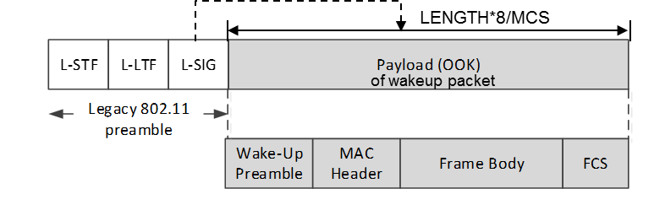

Background [11-16/0722r1]
Wakeup packet = Legacy 802.11 preamble (OFDM)
+ new LP-WUR signal waveform (OOK)
  Legacy 802.11 preamble provides coexistence with legacy STAs
802.11 stations can detect
beginning of this packet
802.11 stations know
end of this packet
CRC
Wakeup packet may carry other information
Receiver address
Wakeup preamble (e.g. PN sequence)
Example signal waveform
1bit /1 OFDM symbol period (= 4usec) = 250kbps
Legacy 802.11
preamble
Wake-up
preamble
MAC Header + Frame Body + FCS

Slide 4
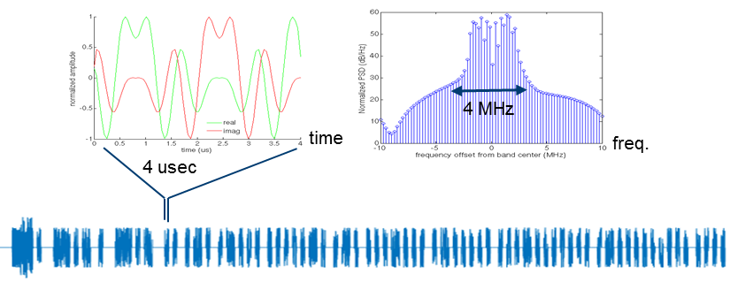
Background [11-16/0722r1]
OOK pulse design:
  Reuse 802.11 OFDM transmitter for OOK pulse generation
  Example:
    Subcarrier width = 312.5 kHz, OOK pulse BW = 13 subcarriers (4.06 MHz)
    s= {13 subcarrier tone sequence}
    X_{t} = IFFT(s), followed by 0.8 µsec cyclic prefix extension
    → 4us symbol period

Slide 5
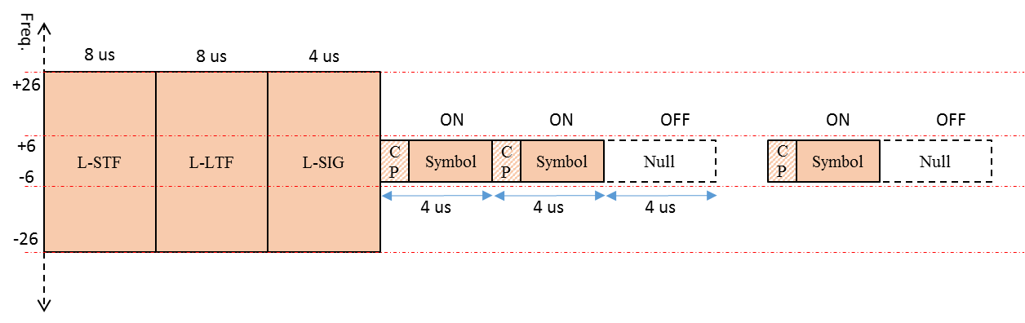
Wakeup Radio Signal Stucture
Based on 11-16/722r1, the Wakeup Radio Signal structure is as the following
  IT IS NOT OUR PROPOSED FORMAT OF WAKEUP RADIO SIGNAL.

Slide 6
Coexistence Mechanism based on L-SIG
As proposed in 11-16/0722r1, L-SIG protection can be used for the coexistence with 802.11 device
  If a valid L-SIG parity bit is indicated, the 802.11 device maintain PHY-CCA.indication(BUSY, channellist) primitive for the predicted duration of the transmitted PPDU, as defined by RXTIME
WUR
Transmitter
BUSY
EIFS
802.11 STA
802.11 PPDU

Slide 7
Coexistence Mechanism based on Energy Detection
Energy Detection (ED) based protection can be utilized for the coexistence with 802.11 device and non-802.11 device
  In LAA, the eNB may transmit a transmission including PDSCH on a carrier on which LAA Scell(s) transmission(s) are performed , after first sensing the channel to be idle during the slot durations of a defer duration T_{d} (Minimum 25us); and after the counter (similar to a back-off counter of 802.11) is zero in step 4.
Table 9.1.1-1: Channel access parameters for PDSCH
Parameter | Unit | Value
LBT measurement bandwidth | MHz | 20
Energy detection threshold | dBm/20MHz | -72
Maximum channel occupancy time | ms | 8

Slide 8
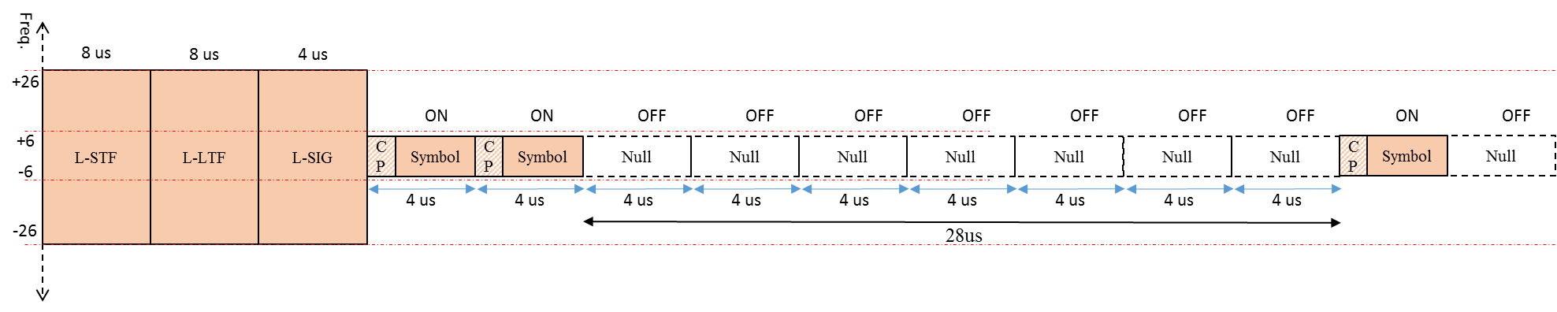
Coexistence Mechanism based on Energy Detection
Consecutive OFF symbols in a wakeup radio signal may have a coexistence problem
  In LAA, the eNB may transmit a transmission if 7 consecutive OFF symbols (=28us) are present in a wakeup radio signal
WUR
Transmitter
25us
BUSY
IDLE
eNB
PDSCH

Slide 9
Coexistence Mechanism based on Energy Detection
Wakeup radio signal should consider some mechanism for enhancing the coexistence of 802.11 device and non-802.11 device
  Coding mechanism such as Bit stuffing, Manchester coding, etc.
  Scrambling mechanism of wakeup radio signal
  Waveform design of ON/OFF symbol having always signal
  Etc.

Slide 10
Discussion
Do you think that WUR SG PAR Scope (5.2.b) should mention a coexistence with other devices operating in the same band?
Otherwise, at least the Coexistence Assurance (CA) document of WUR should explain how the wakeup radio signal can provide a coexistence with legacy IEEE 802.11 devices and other devices

Slide 11
References
[1] https://mentor.ieee.org/802.11/dcn/16/11-16-0722-01-0000-proposal-for-wake-up-receiver-study-group.pptx

