Slide 1
1st Vice Chair Report –
September 2016 – Warsaw
Date: 2016-09-12
Authors:

Slide 2
Abstract
Agenda Items for 1st Vice Chair -
M3.3 II Other WG meeting plans
M3.4 II Meeting room locations
M3.5 II Next meeting reminder
M3.6 II Meeting registration
M3.7 II Recording attendance
M3.8 II File server
M3.9 II Breakfast, breaks, Social logistics
Friday:
  F3.1.1 II Straw Poll of membership regarding this meeting location
  F3.1.2 DT Future venues status and discussion

Slide 3
Monday–
802.11 Opening Plenary
802.11 First Vice Chair Report

Slide 4
M3.3 Other WG meeting plans
802.11 802.15 802.16 802.18 802.19 802.21 802.24
Treasurer Report:
Patent policy (in IEEE-SA bylaws), patent policy (slide set), and antitrust guidelines

Slide 5
M3.4 Meeting room locations
Download the Combined Meeting Schedule
Download the Marriott Warsaw Floor plans
Level 2
Level 3

Slide 6
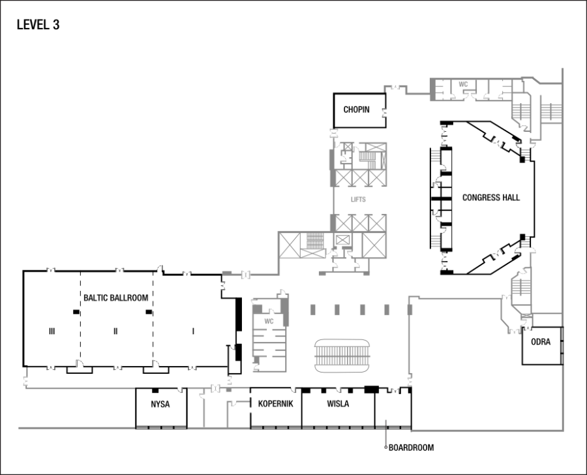

Slide 7
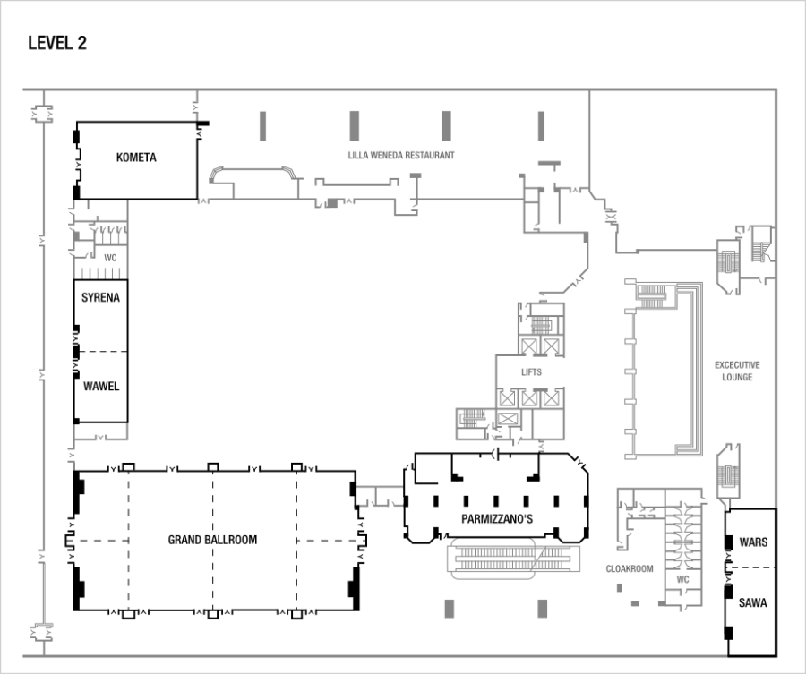

Slide 8
Online Calendar
This session’s meetings are also shown on the 802.11 calendar on the 802.11 home page (http://www.ieee802.org/11).
This is a Google calendar “802_11_calendar@ieee.org”
There are multiple ways of accessing this information, for example from a cell-phone, or as a remote calendar.
Note: the schedule on this calendar will be updated as will IMAT.

Slide 9
M3.5 Next meeting reminder
802 Plenary: 6-11 November 2016
Grand Hyatt San Antonio , San Antonio, TX, USA
Registration to Open Sept 14
Early-Bird Meeting Registration Deadline: 30 Sept 2016

Slide 10
M3.6 Meeting registration
No. of countries | COUNTRY BREAKDOWN | 2015 No. | 2016 % | 2015 % | 2014 %
1 | AUSTRALIA | 1 | 0.3% | 0.3% | 0.3%
2 | BELGIUM | 1 | 0.3% | 0.3%
3 | CANADA | 8 | 3% | 2.4% | 2.4%
4 | CHINA | 20 | 7.5% | 10.7% | 8.5%
5 | FINLAND | 1 | 0.3% | 1.2% | 1.8%
6 | FRANCE | 5 | 1.9% | 1.2% | 1.8%
7 | GERMANY | 11 | 4.12% | 2.1% | 2.4%
8 | IRELAND | 1 | 0.3% | 0.3% | 0.3%
9 | ISRAEL | 4 | 1.4% | 0.6% | 1.2%
10 | ITALY | 1 | 0.3% | 0.3% | 0.3%
11 | JAPAN | 42 | 15.7% | 14.4% | 15.4%
12 | KOREA, REPUBLIC OF | 34 | 12.7% | 11.9% | 15.4%
13 | NETHERLANDS | 2 | 0.75% | 1.2% | 1.5%
14 | POLAND | 2 | 0.75%
15 | RUSSIA | 3 | 1.1% | 1.2% | 0.6%
16 | SINGAPORE | 2 | 0.75% | 0.9% | 0.6%
17 | SWEDEN | 4 | 1.5% | 1.5% | 1.5%
18 | SWITZERLAND | 1 | 0.3%
19 | TAIWAN, PROVINCE OF CHINA | 1 | 0.3% | 1.2% | 2.1%
20 | TURKEY | 2 | 0.75% | 0.3%
21 | UK | 8 | 2.8% | 2.8% | 3.3%
22 | USA | 113 | 42.3% | 44.0% | 38.4%
 | TOTAL | 267 |  | 100%
Updated 2016-09-08

Slide 11
M3.7 Recording attendance
It is a requirement that attendees record their participation at an 802.11 session and declare their affiliation. This record is usually made using the IMAT attendance system.
  If you wish to participate without recording attendance, send an email per session to the WG 2nd vice chair declaring your participation and affiliation. You cannot gain or maintain 802.11 voting membership using this method.
You must record 75% attendance of required 802.11 slots in a session for that session to count towards gaining or maintaining 802.11 voting membership
  You need a single IEEE-SA web account
    The IEEE SA web account requires a working email address
    do not remove your email address from the account
  Use the email address associated with that web account when registering attendance
    If you change email addresses, update the web account, don’t create a new web account, or your membership status may not be calculated properly
  Record attendance using this URL: IMAT.IEEE.ORG/

Slide 12
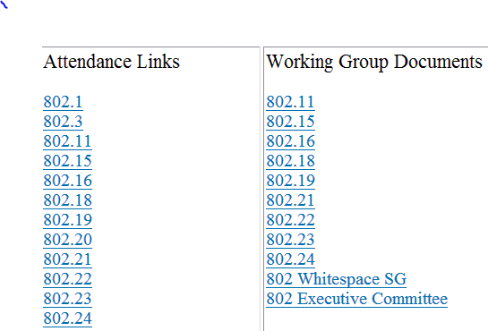
M3.8 Local File Document Server information
Local FTP server: ftp://griffin.events.ieee.org (anonymous)
External Document Server https://mentor.ieee.org/802.11/documents

Slide 13
Breakfast: 07:30 to 09:00
Morning Coffee/Tea 10:00 to 11:00
Afternoon Coffee/Tea/Snacks 15:00 to 16:00
For Registered Attendees Only

Slide 14
Meals
- Breakfast is included in your room rate if you booked via the Marriott Hotel link
- Morning and Afternoon tea will be served in the foyer areas on level 2 and 3
- Lunch will be available from 1200 – 1330 and will be served from the foyer areas on level 2 and 3
M3.09 FOOD & BEVERAGE

Slide 15
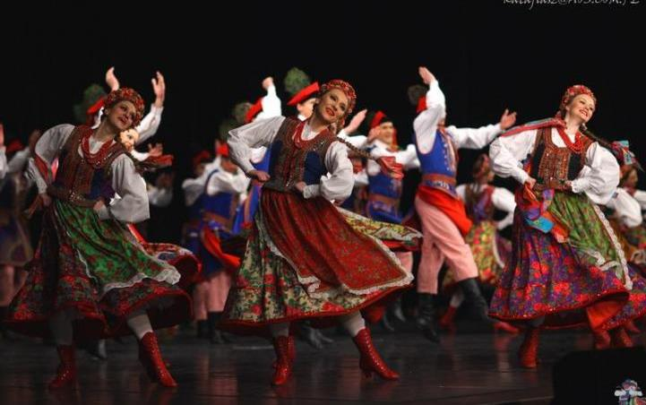
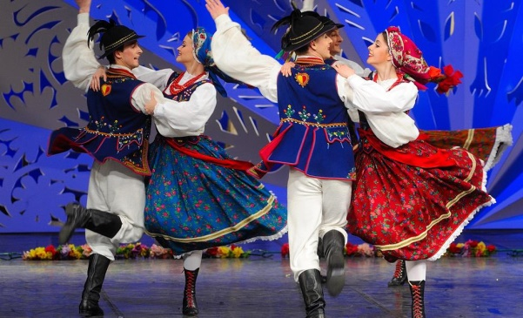
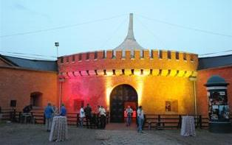
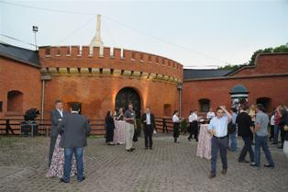
Wednesday Social
Dinner in the Fortress
The Wednesday Social is included in your meeting fee for all attendees
Stand up dinner within the old Fortress, including local Folk Dance performances
Coach pick up: 6pm, Marriott Foyer. ( approx 10 min by coach)
Timings: dinner from 630pm, Cultural performances from 730pm, return buses from 830pm onwards
The Fortress is approx 10 min walking distance from the Old Town for those of you would like to continue there after dinner.
For catering and transport purposes, if you can not attend, please let the registration desk know. Any questions please see Sara or Daniel on the registration desk.

Slide 16
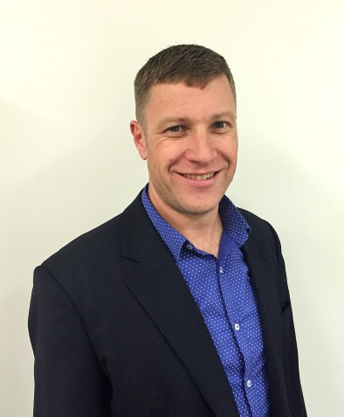
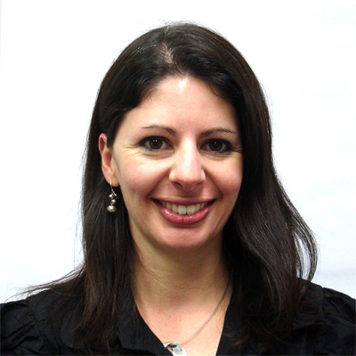
Any Questions
- Please see Daniel or Sara on the registration desk!

Slide 17
802.11 Mid-Week Plenary
Agenda Items:
2.5 – Announcements
5.1 – Room Change Reports

Slide 18
W5.1 Room Change Requests

Slide 19
802.11 WG Closing Plenary
Agenda Items:
3.1.1 – Straw Poll
3.1.2 -- Future venues status and discussion

Slide 20
F3.1.1 -Straw Poll of membership regarding this meeting location
Straw Poll:
How many people would like to come back to this venue?
Yes -
No –
Like the Social –
Disliked the Social –
Did not go to Social –

Slide 21
F3.1.2: Future Venue Insight
Future 802 Wireless Interims:
Jan 2017 Hyatt Regency Atlanta
May 2017 Daejeon Convention Center, Korea
Sept 2017 Hilton Waikoloa
Jan 2018 Hotel Irvine
May 2018 TBD
Sept 2018 Hilton Waikoloa

Slide 22
F3.1.2: Future Venue Insight
Future 802 Plenary Sessions:
  Nov 2016 Grand Hyatt San Antonio
  March 2017 Hyatt Regency/Fairmont – Vancouver
  July 2017 Estrel Hotel – Berlin
  Nov 2017 Caribe Hotel and Convention Center – Orlando
  March 2018 Hyatt Regency O’Hare – Rosemont, IL
  July 2018 Manchester Grand Hyatt – San Diego
  Nov 2018 Suzhou, China - TBC
    (New facility, pricing model being negotiated, Sponsor capability investigation)

Slide 23
References
https://mentor.ieee.org/802-ec/dcn/12/ec-12-0040-11-00EC-802-plenary-future-venue-contract-status.xlsx

