Slide 1
EDMG STF and CEF Design for SC PHY in 11ay
Date: 2016-07-27
Authors:

Slide 2
Introduction
This presentation proposes EDMG-STF and CEF fields design of EDMG portion of preamble for SC PHY defined in the SFD, [1].
First, the general structure of the EDMG-STF and CEF fields utilizing the Golay complementary sequences is proposed and then exact definition of the Golay sequences is provided.
The EDMG-STF and CEF fields are defined for SISO and MIMO transmission and channel bonding of 2 and 4 channels.

Slide 3
EDMG-STF & CEF Structure

Slide 4
Legacy DMG-STF in 11ad
The legacy DMG-STF is defined using Ga₁₂₈ Golay sequence of length 128 chips and consists of 16 repetitions of Ga₁₂₈ and the sequence with inverse sign -Ga₁₂₈ at the end, [2].
The DMG-STF field is used for:
  Frame detection;
  Initial acquisition and sync;
  AGC setup;
  Carrier frequency offset estimation;
  Other possible estimations, including noise power measurement, etc.;

Slide 5
Proposed EDMG-STF in 11ay
The EDMG-STF field is present in the frame transmitted over the number of contiguous 2.16 GHz channels and/or several spatial streams in MIMO case.
The proposed EDMG-STF field also uses Ga Golay sequence in their definition, however introduces additional lengths of 256 and 512 for the CB = 2 and 4 accordingly.
The primary purpose of the EDMG-STF:
  AGC setup;
  Possibly a refinement of the sync operating at the higher sampling rate;

Slide 6
Proposed EDMG-STF Structure (Cont’d)
The EDMG-STF field for spatial stream “i” is built of the multiple repetitions of the Gw^{i} sequence defined as follows:
  Gw^{i} = [Ga^{i}_{N}, Ga^{i}_{N}, Ga^{i}_{N}, -Ga^{i}_{N}];
  The number of Gw^{i} sequences in the EDMG-STF field is TBD;
  Ga^{i}_{N} is a Golay sequence of length N;
  N is a sequence length, equal to 128, 256, and 512 for the CB = 1, 2, and 4 accordingly;
  NOTE: regardless of the CB type (or BW) the EDMG-STF has the same time duration;
  Chip duration: Tc = 0.57 ns;

Slide 7
Legacy DMG-CEF in 11ad
The legacy DMG-CEF is defined using Golay pair of complementary sequences Ga₁₂₈ and Gb₁₂₈ of length 128 chips, [2].
The primary purpose of DMG-CEF field:
  Channel estimation in time and frequency domain;
The CEF field is composed of Gu₅₁₂ and Gv₅₁₂ sequences:
  Gu₅₁₂ = [-Gb₁₂₈, -Ga₁₂₈, +Gb₁₂₈, -Ga₁₂₈];
  Gv₅₁₂ = [-Gb₁₂₈, +Ga₁₂₈, -Gb₁₂₈, -Ga₁₂₈];
Appended with the -Gb₁₂₈ sequence at the end.

Slide 8
CIR Estimation in Time Domain
The Channel Impulse Response (CIR) estimation is based on the complementary property of the Ga and Gb sequences.
The sum of autocorrelation function for Ga_{N} and Gb_{N} of length N is a delta Dirac function:
where symbol × denotes circular convolution, -n index defines the inverse order of samples in the Ga_{N}/Gb_{N} sequence.
Applying that property the CIR estimation h(n) can be simply realized as follows:

Slide 9
Requirements for EDMG-CEF in 11ay
The proposed EDMG-CEF design meets the following requirements:
  Reuses the legacy DMG-CEF structure based on the Golay sequences;
  Allows channel estimation in time and frequency domain;
  Provides channel estimation for channel bonding of several frequency channels;
  Supports MIMO channel estimation;
  The design should be extendable for an arbitrary number of spatial streams;
Similar to the EDMG-STF field for the channel bonding of 2 and 4, the Golay sequences of length N = 256 and 512 are used accordingly.

Slide 10
EDMG-CEF Design for 2 Streams
The design of the CEF for 2x2 MIMO case is based on the Zero Cross Correlation (ZCC) property of the Golay sequences.
It can be shown that 2 complementary pairs of Golay sequences (Ga¹_{N}, Gb¹_{N}) and (Ga²_{N}, Gb²_{N}) have ZCC if the following property is satisfied:
The sequences have identical elements for even values of the index n and elements with inverse polarity for the odd values of index n.
The ZCC property can be written as follows:

Slide 11
EDMG-CEF Design for 2 Streams (Cont’d)
The EDMG-CEF design for 2x2 MIMO case is shown in figure below:
  Gu¹_{4N} and Gv¹_{4N} are composed of Ga¹_{N}/Gb¹_{N} Golay sequences;
  Gu²_{4N} and Gv²_{4N} are composed of Ga²_{N}/Gb²_{N} Golay sequences;
  CEFs for spatial streams #1 and #2 have the same structure as a legacy CEF;

Slide 12
Channel Estimation for 2 Streams
The channel estimation can be done in time and frequency domain. For the sake of algorithm explanation the channel estimation is considered in frequency domain.
Let’s introduce U^{i}_{4N} and V^{i}_{4N} vector definitions as a DFT of the corresponding time domain signals Gu^{i}_{4N} and Gv^{i}_{4N} as follows (the length 4N is skipped for simplicity):
The receive vectors at the first RX antenna in frequency domain can be defined as follows:
H₁₁ and H₁₂ are target channel coefficients to be estimated, Z¹ and Z² are additive noise vectors.

Slide 13
Channel Estimation for 2 Streams (Cont’d)
Channel estimation for H₁₁ coefficient can be found by application of matched filter solution to vectors U¹ and V¹ as follows:
Note that the inter-stream interference term is cancelled out due to the ZCC property of the sequences.
Similar the channel estimation for H₁₂ coefficient can be found as follows:
Here matched filtering is done for vectors U² and V².

Slide 14
EDMG-CEF Design for 4 Streams
The proposed method for the EDMG-CEF construction can be generalized for the high order MIMO. Let’s consider an example of 4x4 MIMO.
The original complementary Golay pairs (Ga¹_{N}, Gb¹_{N}) and (Ga²_{N}, Gb²_{N}) are supplemented with the two additional pairs (Ga³_{N}, Gb³_{N}) and (Ga⁴_{N}, Gb⁴_{N}).
Note that (Ga³_{N}, Gb³_{N}) and (Ga⁴_{N}, Gb⁴_{N}) have ZCC similar to the pairs (Ga¹_{N}, Gb¹_{N}) and (Ga²_{N}, Gb²_{N}).
Additionally, all Golay sequences utilized in the design are orthogonal to each other.

Slide 15
EDMG-CEF Design for 4 Streams (Cont’d)
4 streams are transmitted during 2 time intervals as shown below.
Sequences for streams #3 and #4 have inverse sign for T2.

Slide 16
Channel Estimation for 4 Streams
Let’s consider channel estimation for the first RX antenna in frequency domain. The received vectors in frequency domain during time intervals T₁ and T₂:
Channel estimation for H₁₁ coefficient can be written as follows:
Summation with the signal from the second time interval cancels out the inter-stream interference from streams #3 and #4.

Slide 17
Channel Estimation for 4 Streams (Cont’d)
Channel estimation for H₁₂ coefficient:
Channel estimation for H₁₃ coefficient:
Channel estimation for H₁₄ coefficient:
Similar channel estimations can be applied for other RX antennas.

Slide 18
EDMG-CEF Design for 8 Streams
Sign matrix P definition:
P = T1 T2 T3 T4
row #1: [1 1 1 1
row #2: 1 -1 1 -1
row #3: 1 1 -1 -1
row #4: 1 -1 -1 1]
Duration of CEF:
  2 streams: T = T1;
  Starting from 3 and up to 4 streams: T = T1 + T2;
  Starting from 5 and up to 8 streams: T = T1 + T2 + T3 + T4;

Slide 19
Golay Sequences Definition

Slide 20
Golay Sequence Set
The EDMG-STF and CEF fields use the Golay complementary pairs in their definition of length N = 128, 256, and 512 for the CB = 1, 2, and 4 accordingly.
For the MIMO case a Golay Sequence Set (GSS) is introduced to defined the (Ga^{i}_{N}, Gb^{i}_{N}) where “i” is an index of the spatial stream, i = 1:M.
The maximum number of spatial streams currently defined in the SFD is equal to M = 8, [1].

Slide 21
Design Rules & Requirements
Requirements:
  (Ga^{i}_{N}, Gb^{i}_{N}) is a complementary Golay pair, for i = 1:M (trivial);
  All sequences are orthogonal to each other, i.e. the scalar products (Ga^{i}_{N}, Ga^{j}_{N}) = 0, (Gb^{i}_{N}, Gb^{j}_{N}) = 0, (Ga^{i}_{N}, Gb^{j}_{N}) = 0 for any i ≠ j;
    Comment: 11ac makes circular shift of the symbols in time domain to avoid signals coherent transmission;
  Each complementary pair in the set (Ga^{i}_{N}, Gb^{i}_{N}) has its Zero Cross Correlation (ZCC) counterpart (Ga^{j}_{N}, Gb^{j}_{N}), i.e. Ga^{i}_{N}×Ga^{j}_{N} + Gb^{i}_{N}×Gb^{j}_{N} = 0, where i ≠ j;
    Comment: this property is required for EDMG-CEF design;
  The original Golay pair of length N = 128 defined in the legacy 11ad standard should be a part of the designed set, it is defined as a core pair in the GSS;
    Comment: this is required to make the MIMO design consistent to the SISO case;

Slide 22
Design Rules & Requirements (Cont’d)
Requirements (cont’d):
  The GSS uses the same delay vector as defined in the 11ad standard, for example, in case of N = 128, D = [1,8,2,4,16,32,64] and different weight vectors W to construct the set, [2];
    Comment: it provides the same implementation complexity of correlator as in the legacy case except of the weights W and reuse of the HW, the characteristics of generated signals in the GSS are very similar, and this creates a “homogeneous” signals set;
  The number of +1/-1 should be the same as in the original Golay sequences Ga and Gb defined in the legacy 11ad standard or core pair of sequences;
    Comment: it keeps the same level of DC as in the legacy devices, also it provides other very similar characteristics including PAPR;

Slide 23
Design Rules & Requirements (Cont’d)
Requirements (cont’d):
  Each complementary pair in the designed Golay set should have similar characteristics including autocorrelation, PAPR at the output of shape filter and others;
    Comment: this is related to the requirement to have the same delay vector D;
  The Golay sets should be designed for the sequence lengths N = 128 and N = 256, N = 512 for CB = 1, 2, and 4 accordingly;
    Comment: the delay vectors for N = 256 and N = 512 are obtained by the direct extension of D vector for the N = 128;

Slide 24
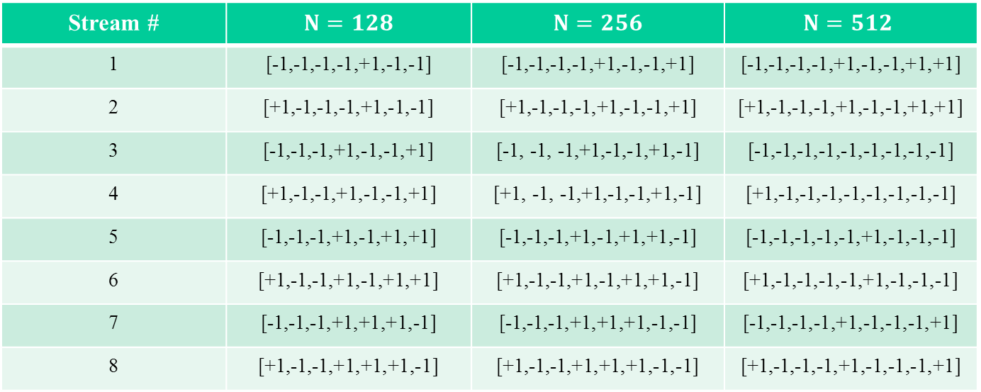
Proposed GSS
The delay vector D is constant for fixed length N. The weight vectors set is provided in the Table 1 below.
  N = 128: D = [1,8,2,4,16,32,64];
  N = 256: D = [1,8,2,4,16,32,64,128];
  N = 512: D = [1,8,2,4,16,32,64,128,256];
Table 1: Golay sequences set weight vectors definition.
Stream # | $N=128$ | $N=256$ | $$N=512$$
1 | [-1,-1,-1,-1,+1,-1,-1] | [-1,-1,-1,-1,+1,-1,-1,+1] | [-1,-1,-1,-1,+1,-1,-1,+1,+1]
2 | [+1,-1,-1,-1,+1,-1,-1] | [+1,-1,-1,-1,+1,-1,-1,+1] | [+1,-1,-1,-1,+1,-1,-1,+1,+1]
3 | [-1,-1,-1,+1,-1,-1,+1] | [-1, -1, -1,+1,-1,-1,+1,-1] | [-1,-1,-1,-1,-1,-1,-1,-1,-1]
4 | [+1,-1,-1,+1,-1,-1,+1] | [+1, -1, -1,+1,-1,-1,+1,-1] | [+1,-1,-1,-1,-1,-1,-1,-1,-1]
5 | [-1,-1,-1,+1,-1,+1,+1] | [-1,-1,-1,+1,-1,+1,+1,-1] | [-1,-1,-1,-1,-1,+1,-1,-1,-1]
6 | [+1,-1,-1,+1,-1,+1,+1] | [+1,-1,-1,+1,-1,+1,+1,-1] | [+1,-1,-1,-1,-1,+1,-1,-1,-1]
7 | [-1,-1,-1,+1,+1,+1,-1] | [-1,-1,-1,+1,+1,+1,-1,-1] | [-1,-1,-1,-1,+1,-1,-1,-1,+1]
8 | [+1,-1,-1,+1,+1,+1,-1] | [+1,-1,-1,+1,+1,+1,-1,-1] | [+1,-1,-1,-1,+1,-1,-1,-1,+1]

Slide 25
Characteristics Analysis
To analyze the properties of the designed set the following signal characteristics were estimated:
  Peak to Average Power Ratio (PAPR) after pulse shaping;
  Peak to Total Power Ratio (PTPR) at the output of Matched Filter (MF);
  The ratio of the power of main tap and the 2nd most significant tap at the output of MF;
  K-factor, the ratio of the power of the main tap and the total power of the rest of taps at the output of MF;

Slide 26
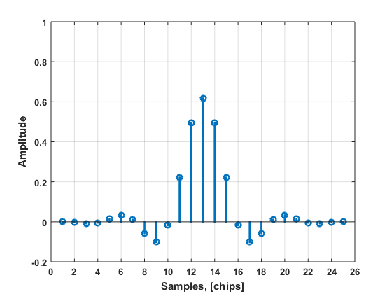
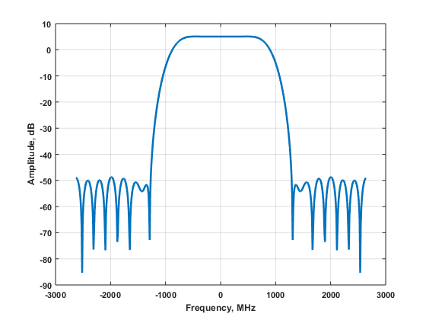
Shape Filter Definition
The shape filter uses impulse response defined at the 3*1.76 GHz = 5.28 GHz sample rate. The resampling procedure is applied with 1.5x sample rate conversion as defined in the legacy 11ad standard, [2].
Its impulse response and frequency response are shown below.

Slide 27
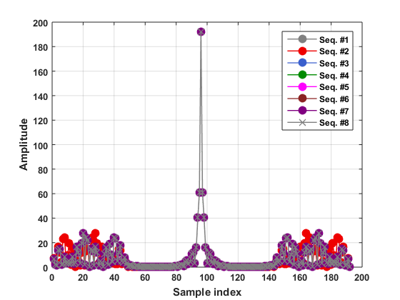

Golay Set Properties Analysis N = 128
Figure below shows MF output for 8 sequences in the set, for Ga and Gb separately. It is shown that all sequences in the set have very similar autocorrelation properties (except of side lobes).
Graphs are shown after application of Matlab FFT shift function.
Ga sequences
Gb sequences

Slide 28
Golay Set Properties Analysis N = 128 (Cont’d)
Table 2 below summarizes the measured characteristics of the designed Golay set with N = 128 and D = [1,8,2,4,16,32,64].
The sequences comprising the GSS have very similar characteristics.
Table 2: Golay set measured characteristics with N = 128 and D = [1,8,2,4,16,32,64].
Golay seq. | PAPR, dB | PTPR, dB | P_{main}/P_{second}, dB | P_{main}/P_{rest}, dB
Ga | 1.3898 | -2.7254 | 6.9065 | 0.5899
Gb | 1.3898 | -2.7248 | 6.9092 | 0.5911

Slide 29
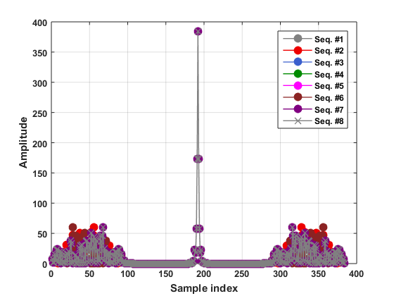
Golay Set Properties Analysis N = 256
Figure below shows MF output for 8 sequences in the set, for Ga and Gb separately. It is shown that all sequences in the set have very similar autocorrelation properties (except of side lobes).
Graphs are shown after application of Matlab FFT shift function.
Ga sequences
Gb sequences

Slide 30
Golay Set Properties Analysis N = 256 (Cont’d)
Table 3 below summarizes the measured characteristics of the designed Golay set with N = 256 and D = [1,8,2,4,16,32,64,128].
The sequences comprising the GSS have very similar characteristics.
Table 3: Golay set measured characteristics with N = 256 and D = [1,8,2,4,16,32,64,128].
Golay seq. | PAPR, dB | PTPR, dB | P_{main}/P_{second}, dB | P_{main}/P_{rest}, dB
Ga | 1.3898 | -2.9953 | 6.9092 | 0.0300
Gb | 1.3898 | -2.9956 | 6.9079 | 0.0294

Slide 31
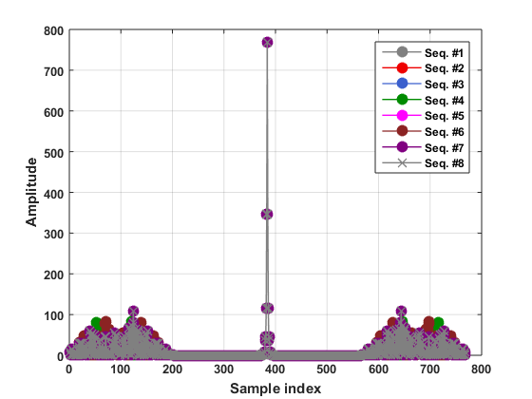
Golay Set Properties Analysis N = 512
Figure below shows MF output for 8 sequences in the set, for Ga and Gb separately. It is shown that all sequences in the set have very similar autocorrelation properties (except of side lobes).
Graphs are shown after application of Matlab FFT shift function.
Ga sequences
Gb sequences

Slide 32
Golay Set Properties Analysis N = 512 (Cont’d)
Table 4 below summarizes the measured characteristics of the designed Golay set with N = 512 and D = [1,8,2,4,16,32,64,128,256].
The sequences comprising the GSS have very similar characteristics.
Table 4: Golay set measured characteristics with N = 512 and D = [1,8,2,4,16,32,64,128,256].
Golay seq. | PAPR, dB | PTPR, dB | P_{main}/P_{second}, dB | P_{main}/P_{rest}, dB
Ga | 1.3898 | -2.8621 | 6.9085 | 0.3017
Gb | 1.3898 | -2.8619 | 6.9092 | 0.3020

Slide 33
Channel Estimation Performance

Slide 34
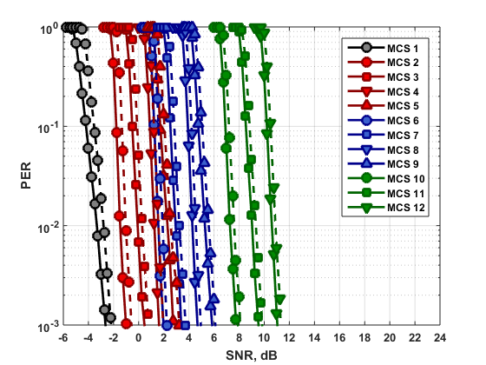
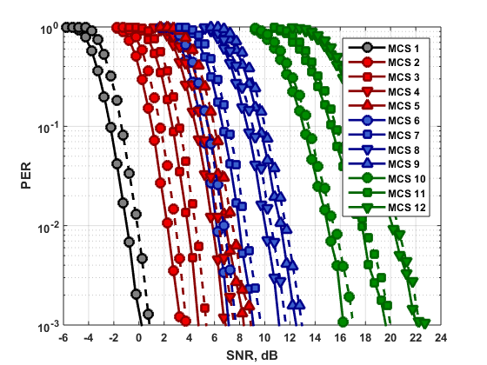
SISO Simulation Results
Channel estimation in frequency domain:
  Estimation time interval T = T1;
  Solid line – perfect channel knowledge, dashed line – channel estimation;
LOS channel, flat
NLOS channel, Rayleigh, RMS = 3 ns
  LOS channel: min SNR degradation ~0.3 dB, max SNR degradation ~0.5 dB
  NLOS channel: min SNR degradation ~0.4 dB, max SNR degradation ~0.9 dB

Slide 35
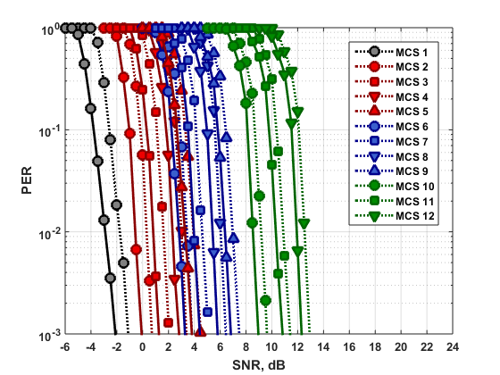
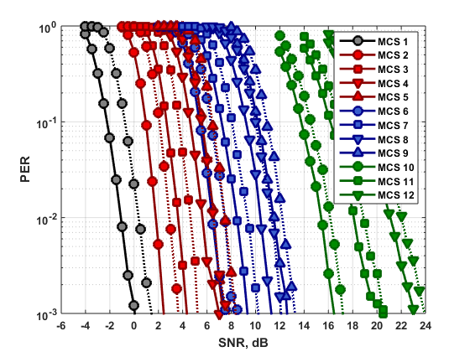
MIMO Simulation Results
Channel estimation in frequency domain:
  Estimation time interval T = T1 is used only;
  Solid line – perfect channel knowledge, dashed line – channel estimation;
LOS channel, α = -10 dB
NLOS channel, Rayleigh, RMS = 3 ns
  LOS channel: min SNR degradation ~0.6 dB, max SNR degradation ~1.1 dB
  NLOS channel: min SNR degradation ~0.7 dB, max SNR degradation ~1.5 dB

Slide 36
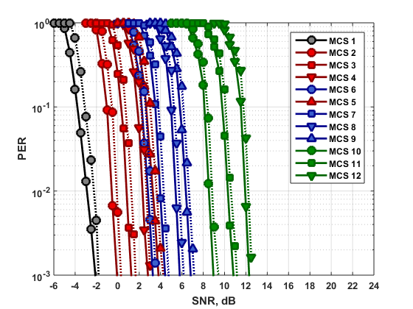
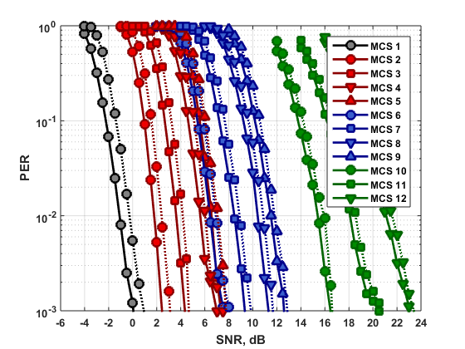
MIMO Simulation Results (Cont’d)
Channel estimation in frequency domain:
  Estimation time interval T = T1 + T2 is used;
  Solid line – perfect channel knowledge, dashed line – channel estimation;
LOS channel, α = -10 dB
NLOS channel, Rayleigh, RMS = 3 ns
  LOS channel: min SNR degradation ~0.3 dB, max SNR degradation ~0.6 dB
  NLOS channel: min SNR degradation ~0.3 dB, max SNR degradation ~0.8 dB

Slide 37
Simulation Results Summary
Table 5: Sensitivity SNR (PER = 10⁻²) degradation due to channel estimation in frequency domain.
MCS | SISO Time interval: T = T1 |  | MIMO Time interval: T = T1 |  | MIMO Time interval: T = T1 + T2
 | LOS | NLOS | LOS | NLOS | LOS | NLOS
1 | 0.5 dB | 0.9 dB | 1.1 dB | 1.5 dB | 0.6 dB | 0.8 dB
2 | 0.5 dB | 0.6 dB | 0.9 dB | 1.1 dB | 0.5 dB | 0.6 dB
3 | 0.4 dB | 0.6 dB | 0.8 dB | 1.0 dB | 0.5 dB | 0.6 dB
4 | 0.3 dB | 0.5 dB | 0.7 dB | 1.0 dB | 0.4 dB | 0.5 dB
5 | 0.3 dB | 0.5 dB | 0.6 dB | 0.9 dB | 0.3 dB | 0.5 dB
6 | 0.3 dB | 0.5 dB | 0.7 dB | 1.1 dB | 0.3 dB | 0.5 dB
7 | 0.3 dB | 0.5 dB | 0.6 dB | 0.9 dB | 0.3 dB | 0.4 dB
8 | 0.3 dB | 0.4 dB | 0.6 dB | 0.9 dB | 0.3 dB | 0.5 dB
9 | 0.3 dB | 0.5 dB | 0.6 dB | 0.7 dB | 0.3 dB | 0.3 dB
10 | 0.3 dB | 0.4 dB | 0.6 dB | 0.7 dB | 0.3 dB | 0.4 dB
11 | 0.3 dB | 0.4 dB | 0.6 dB | 0.8 dB | 0.3 dB | 0.4 dB
12 | 0.3 dB | 0.4 dB | 0.6 dB | 0.9 dB | 0.3 dB | 0.5 dB

Slide 38
Conclusions
This presentation proposes EDMG-STF and CEF fields design of EDMG portion of preamble for SC PHY.

Slide 39
Straw Poll
  Do you agree to add the following to the SFD document:”
  An EDMG STA shall use for SC PHY the Golay sequences and STF and CEF fields definition for SISO, MIMO and channel bonding CB = 1, 2, 4 as defined on slides #6, #18, and #24 in the 11-16-0994-00-00ay.”
  “

Slide 40
References
11-15-1358-04-00ay-specification-framework-for-tgay
Draft P802.11REVmc_D5.4

