Slide 1
Non-EDMG Part of Preamble for MIMO in 11ay
Date: 2016-07-25
Authors:

Slide 2
Introduction
This presentation describes the non-EDMG portion of the preamble for MIMO in 11ay. It is based on the general frame format defined in the SFD, [1].

Slide 3
Preamble Frame Format Options
The defined preamble format in [1] includes legacy part, EDMG-Header-A received in the SISO mode. The EDMG-STF and EDMG-CEF are received using MIMO mode.
The legacy part of the preamble can be received and decoded by any device (legacy or EDMG).
The EDMG-Header-A can be received and decoded by EDMG device in SISO mode to extract MIMO parameters.
There are 2 basic options to transmit legacy preamble:
  Option #1: transmit the legacy preamble from one of the antennas only, switch on MIMO transmission starting from EDMG-STF;
  Option #2: Transmit the legacy preamble from all antennas simultaneously with time delay shift T_{shift} to avoid coherent signal transmission and unintentional beamforming;
EDMG PPDU format, [1]
L-STF | L-CEF | L-Header | EDMG-Header-A | EDMG-STF | EDMG-CEF | EDMG-Header-B | Data | AGC | TRN

Slide 4
Option #1 Preamble Format
The preamble frame format for option #1 assumes the legacy preamble, L-Header, and EDMG-Header-A transmission for one of the streams.
The antenna selection can be done based on the quality of the link, the best beamforming settings.
The frame format for the M streams is shown in figure below.

Slide 5
Option #1 Preamble Format with Channel Bonding
The generalization to the channel bonding with K frequency channels and M streams is shown in figure below.

Slide 6
Option #2 Preamble Format for 2x2 MIMO
T_{shift} – some time delay between the streams, it is defined in the chips units taken @1.76 GHz, should be smaller comparing to the GI length;
The part corresponding to the T_{shift} is used as a padding at the end of the legacy preamble part and inserted after EDMG-Header-A;
Hence there is some cyclic shift by T_{shift} is applied which is an optimization parameter;

Slide 7
Time Shift Purpose & Consequences
Time shift purpose:
  To prevent interference between the arrays;
  The time shift may not be needed for the single antenna array with orthogonal (V/H) polarizations or dual arrays transmitting with different polarizations;
Time shift consequences:
  Even for the LOS one gets a multipath channel, hence the interference issue is solved at the expense of the multipath propagation;
  This has a significant impact on the frame detection and headers decoding performance;

Slide 8
Time Shift Requirements
Time shift requirements:
  The total duration of the time shift for the maximum 8 streams transmission should not exceed a half of the GI duration;
  The T_{shift} value should be enough to reduce the impact of the interference;
  Channel frequency selectivity issue should be considered to avoid the impact on the packet detection and headers decoding;
  It should be an even number in order to have an integer number of samples for the OFDM after 1.5x sampling rate conversion;
Proposal:
  It is proposed to define T_{shift} = 4 chips = 2.2727 ns (TBD);
  T_{shift} may be a flexible parameter depending on what type of the antenna is used, since for the orthogonal polarizations it is not needed;

Slide 9
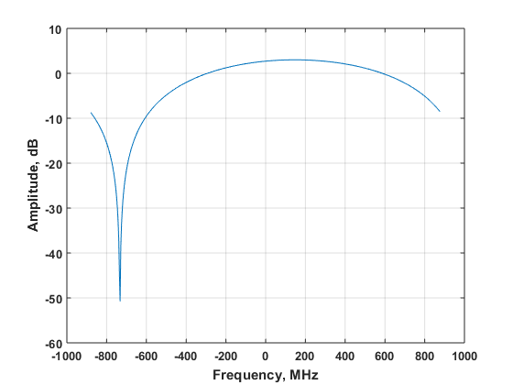
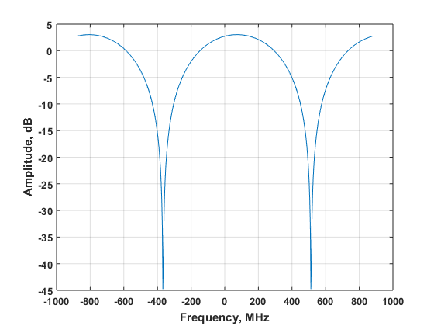
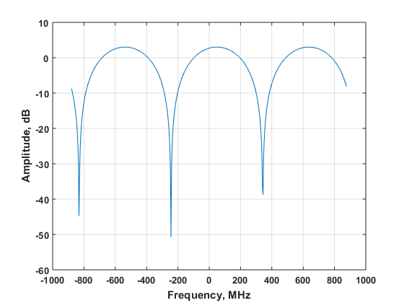
Channel Realizations with 2 Rays
Delay = 1 chip
Delay = 2 chips
Delay = 3 chips
In case of LOS, delaying of the signal corresponding to the second stream produces effective two-ray channel.
Rays have almost equal power, may have different phases, and delayed by a number of chips. In that case channel has “hostile” frequency response with deep notches. The number of notches is equal to the delay in chips.
Figures above show the frequency responses for different time delays 1, 2, and 3 chips. The phase difference between the rays is fixed and equal to Δφ = 30⁰.

Slide 10
Legacy Header Coding & Modulation
The legacy header has sophisticated encoding process composed of the following steps:
  64 header bits (b1,b2, …, b64) is padded with zeros to the length of 504 and encoded with LDPC code with rate ¾:
  The output is calculated parity of length 168 bits (p1,p2, …, p168);
  Then 2 codewords cs1 and cs2 are defined as concatenation of systematic header bits (b1,b2, …, b64) and parity bits with discarded tail and middle parts accordingly:
  Finally, cs1 and cs2 are joined into the codeword cs = (cs1, cs2);
  It is modulated using π/2-BPSK modulation and appended with GI, the SC symbol is repeated 2 times.
The legacy header has a robust encoding and may operate under the “hard” multipath channel condition. However additional justification by simulations is required.

Slide 11
Option #2 Preamble Format for 4x4 MIMO
The legacy part of each stream is delayed by a multiple integral of T_{shift} time. Legacy part of stream #4 is delayed relative to the stream #1 by 3*T_{shift} time shift.
For 8 streams the generalization is straightforward, the maximum delay will be 7*T_{shift} = 24 chips = 15.9 ns. This is less than a half of the GI = 64 chips = 36.3636 ns.

Slide 12
Option #2 2x2 MIMO & Channel Bonding 2x
Figure above shows preamble frame format for combination of 2x2 MIMO and channel bonding 2x.
Similar to the MIMO frames presented at the previous slides padding is done for the legacy part. Padding is identical for all bonded channels pertained to the same stream.

Slide 13
Simulation Assumptions
L-Header error rate performance is analyzed, 2 options for preamble definition are compared.
Option #1:
  Line Of Sight (LOS) channel, transmission is done using single antenna, channel has single tap in time domain and an ideal flat characteristic in frequency domain;
Option #2:
  LOS channel, transmission is done using 2 (or 4) antennas, channel has 2 (or 4) rays delayed by the T_{shift} in time domain and selective characteristic in frequency domain;
  In this case one has 2 (or 4) times more power comparing to the option #1, hence it leads to the advantage in 3 dB (or 6 dB) in SNR;
Channel model:
  Channel has 1, 2 or 4 rays of equal power, phases of rays are independent random variables in [0, 2π], rays are delayed by T_{shift} time intervals;

Slide 14
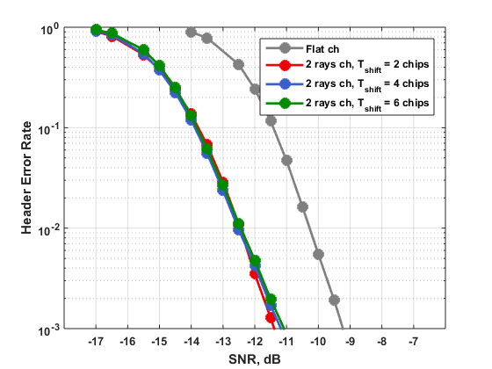
Simulation Results – 2 Streams
Header Error Rate (HER) performance comparison
Figure compares Header Error Rate performance for 2 options;
Option #1: flat channel (gray curve);
Option #2: 2 ray channel (colored curves), it has 2 times higher power, hence 3 dB advantage in SNR;
The performance changes not dramatically with changing of T _{shift} = 2, 4, 6 chips;
Option #2 has an advantage in ~2.0 dB for HER = 10⁻³;

Slide 15
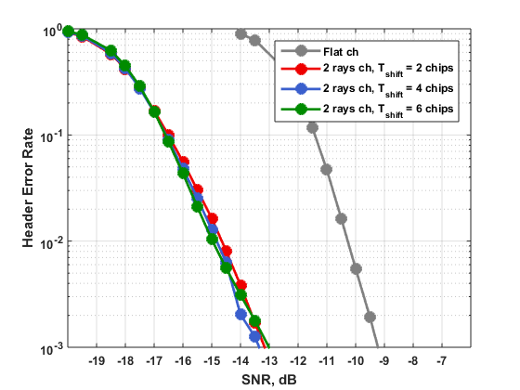
Simulation Results – 4 Streams
Header Error Rate (HER) performance comparison
Figure compares Header Error Rate performance for 2 options;
Option #1: flat channel (gray curve);
Option #2: 4 ray channel (colored curves), it has 4 times higher power, hence 6 dB advantage in SNR;
The performance changes not dramatically with changing of T _{shift} = 2, 4, 6 chips;
Option #2 has an advantage in ~3.8 dB for HER = 10⁻³;

Slide 16
Conclusions
This presentation proposes a definition of the non-EDMG portion of the preamble for MIMO in 11ay.
Two options for the non-EDMG preamble were considered. It was shown that the option with the cyclic shift has an advantage in terms of SNR required to achieve a reliable header reception.

Slide 17
Straw Poll
Would you agree to insert the following in section 7 of the SFD:”
  For SC MIMO transmissions, the 11ay specification shall support a preamble structure with cyclic shift. A cyclic shift T^{i}_{SC} value is used for the L-STF, L-CEF, L-Header and EDMG-Header-A fields of the PPDU for stream i out of a total of N streams, where 1 ≤ i ≤ N. T^{i}_{SC} is defined in SC chip units at 1.76 GHz for single channel or multiple channels transmission. T^{i}_{SC} shall be inserted after EDMG-Header-A. The particular value for each configuration is TBD.
  ”
  “

Slide 18
References
11-15-1358-04-00ay-specification-framework-for-tgay

