Slide 1
Discussion of Duty-Cycled Wake-Up Receivers
Date: 2016-07-25
Authors:

Slide 2
Abstract
This contribution addresses duty-cycled WURs, in particular different trade-offs. It somewhat builds on [3]
The presentation is in part based on [1], where the total power consumption is the metric used to find suitable parameters for the duty cycle
We also discuss the trade-off between low power consumption in the sensor node and spectrum requirements for the wake-up signal (WUS)

Slide 3
Outline
Recap of duty-cycled WURs
Designing the duty-cycle based on total power consumption
Discussion of the trade-off between power consumption in the duty-cycled WUR and spectrum usage
Conclusions

Slide 4
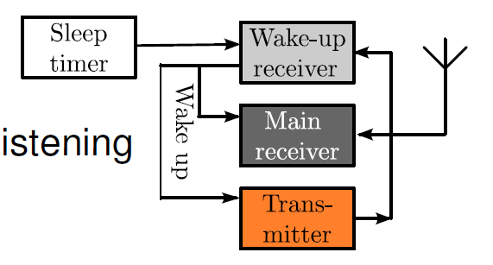
Duty-cycled wake-up schemes
To further decrease the power consumption of the WUR, it may be duty-cycled, i.e., it is only turned on during certain (periodic) intervals
Could also be seen as a way to achieve really low power consumption with “non-optimized” WUR

Slide 5
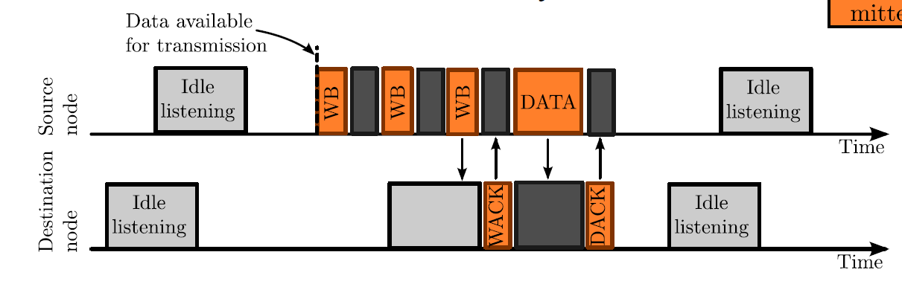
Duty-cycled wake-up schemes
To wake up a duty-cycled WUR means that the WUS must be transmitted when the WUR is actually listening
The reception of the WUS is then acknowledged and the data packet is not sent until an ACK of the WUS is received

Slide 6
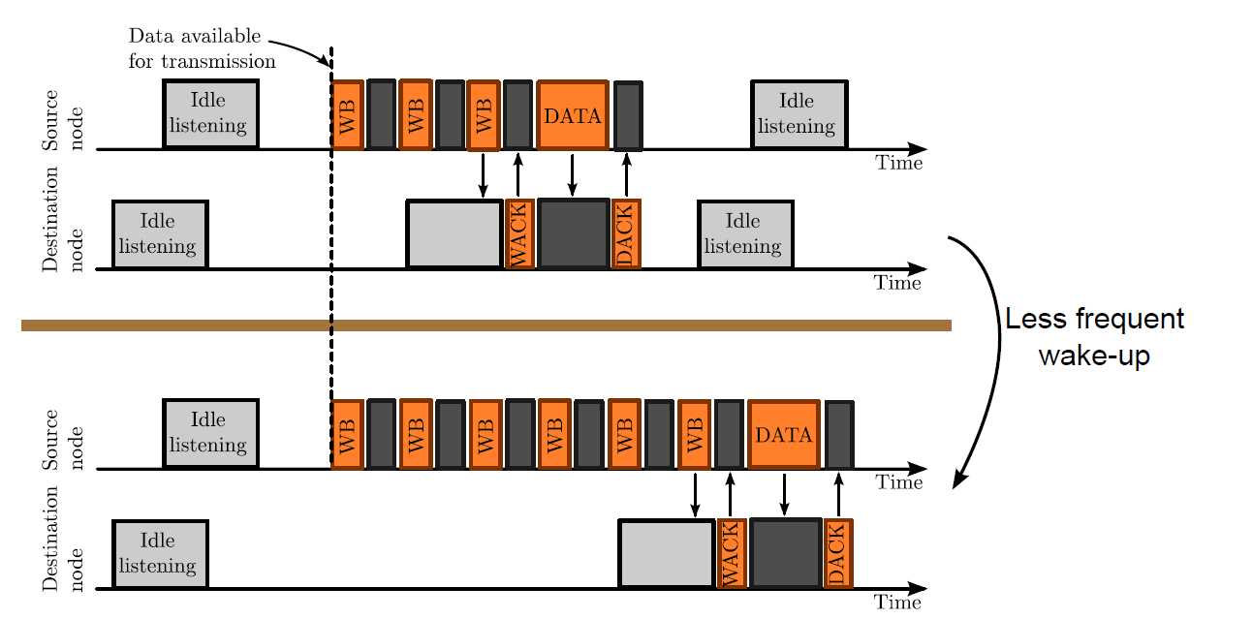
How to select the duty-cycle?
Low duty cycle: Higher transmission cost, both energy and channel allocation. In addition to larger delay
High duty cycle: The gain by using WUR reduced

Slide 7
Design based on total power consumption [1]
The idea is here to have a model that accounts for
  Transmit power of WUS at AP
  Power at the intended WUS
  Power at all other devices having a WUR
Considered parameters are
  WUS length (false alarm vs. miss probability)
  Impact of sensitivity

Slide 8
WUR energy vs. spectrum efficiency
A low duty cycle means lower power consumption in the WUR, but it also means the wake-up signal needs to be transmitted more times on average to wake up the WUR
If the WUS requires more transmission time, it may potentially have an impact on the transmission time available for data if sent in-band. Depends on number of WURs, and how often it needs to be used…

Slide 9
Conclusions
Duty-cycled WURs is an attractive means to achieve very low energy consumption
Duty-cycled WURs also have some drawbacks, in terms of
  Delay
  Spectrum usage (transmission time) for the WUS
  Power consumption at the TX side

Slide 10
Straw Poll
Should duty-cycling be considered when specifying the WUR (e.g. in terms of target power consumption, should power consumption relate to the “ON” state for the WUR, or is it OK if this is achieved by duty cycling?)
Y/N/A:

Slide 11
Straw Poll
Assuming the wake-up signal is transmitted in-band, do you expect there may be scenarios where the total transmission time for WUSs may have a noticeable impact on the available transmission time for data?
Y/N/A:

Slide 12
References
N. Seyed Mazloum and O. Edfors, Performance “Analysis and Energy Optimization of Wake-Up Receiver Schemes for Wireless Low-Power Applications”, IEEE Transactions on Wireless Communications, Vol. 13, No. 12, pp. 7050-7061, 2014.
M. Park, S. Azizi, R. Stacey, and E. Perahia. LP-WUR (Low-Power Wake-Up Receiver): Enabling Low-Power and Low-Latency Capability for 802.11, IEEE 802.11-16/0027r0
L. Wilhelmsson, T. Olsson, and H. Sjöland, “Discussion of Wake-Up Receivers for LRLP”, IEEE 802.11-16/0381r0

