Slide 1
Open Loop Spatial Multiplexing with Phase Hopping for 11ay
Date: 2016-07-25
Authors:

Slide 2
Introduction
Several MIMO scenarios for 11ay have been proposed [1], and the contribution of [2] proposed open loop spatial multiplexing (OLSM) + PH(Phase Hopping) as OLSM and showed PER(Packet Error Rate) performance.
This presentation shows new simulation results in OLSM + PH with precoding and discusses benefit of precoding.

Slide 3
SU-MIMO Scenario: Open Loop Spatial Multiplexing (OLSM) (1/2)
    Two or more streams are transmitted by using spatial multiplexing to increase data throughput.
    2x2 OLSM MIMO system has 2 TX array antennas and 2 RX array/quasi-omni
    antennas.
    Introduction of interference cancellation in RX is possible.
    OLSM can operate with long range by including basic beamforming (BF) training.
RF
RF
2-stream
Encoder
Spatial Multiplexing
or Pre-coder
Spatial De-Multiplexing
or Pre-coder decoding
2-stream
Decoder
RF
RF

Slide 4
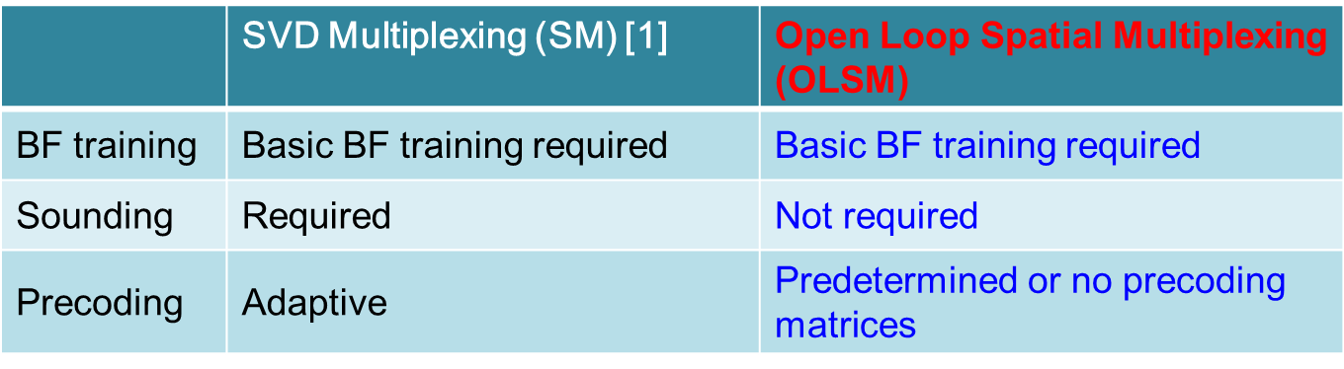
SU-MIMO Scenario: OLSM (2/2)
    Definition of OLSM:
    No Sounding except for BF
    - OLSM is one of suitable SU-MIMO scenarios at a mobile case.
    → In MIMO scenarios with sounding, performance becomes worse
    by feedback delay of sounding.
    OLSM uses predetermined or no precoding matrices.

Slide 5








OLSM + PH [2]
Precoding + PH
(Changes the phase in one of the antennas to randomize information and avoid destructive interference along a codeword)
Precoding
(Linear combination of streams to increase diversity)
No precoding
Constellation in Precoding + PH
QPSK
After Precoding
PH
$$s_{1}\left(i\right)$$
$$u_{1}\left(i\right)$$
$${Tx}_{1}\left(i\right)$$
Bit
-
LDPC
inter
symbol
-
Mapper
$$s_{2}\left(i\right)$$
Pre-coder
leaver
$$u_{2}\left(i\right)$$
$${Tx}_{2}\left(i\right)$$
PH
Precoding
Precoding + PH
$$\left[\begin{matrix}{Tx}_{1}\left(i\right) \\ {Tx}_{2}\left(i\right)\end{matrix}\right]=\left[\begin{matrix}1 & 0 \\ 0 & e^{jγ\left(i\right)}\end{matrix}\right]\left[\begin{matrix}\cos{θ} & −\sin{θ} \\ \sin{θ} & \cos{θ}\end{matrix}\right]\left[\begin{matrix}s_{1}\left(i\right) \\ s_{2}\left(i\right)\end{matrix}\right]$$
No Precoding + PH
$$\left[\begin{matrix}{Tx}_{1}\left(i\right) \\ {Tx}_{2}\left(i\right)\end{matrix}\right]=\left[\begin{matrix}1 & 0 \\ 0 & e^{jγ\left(i\right)}\end{matrix}\right] \left[\begin{matrix}1 & 0 \\ 0 & 1\end{matrix}\right] \left[\begin{matrix}s_{1}\left(i\right) \\ s_{2}\left(i\right)\end{matrix}\right]$$
-> This presentation focuses on Precoding + PH.

Slide 6
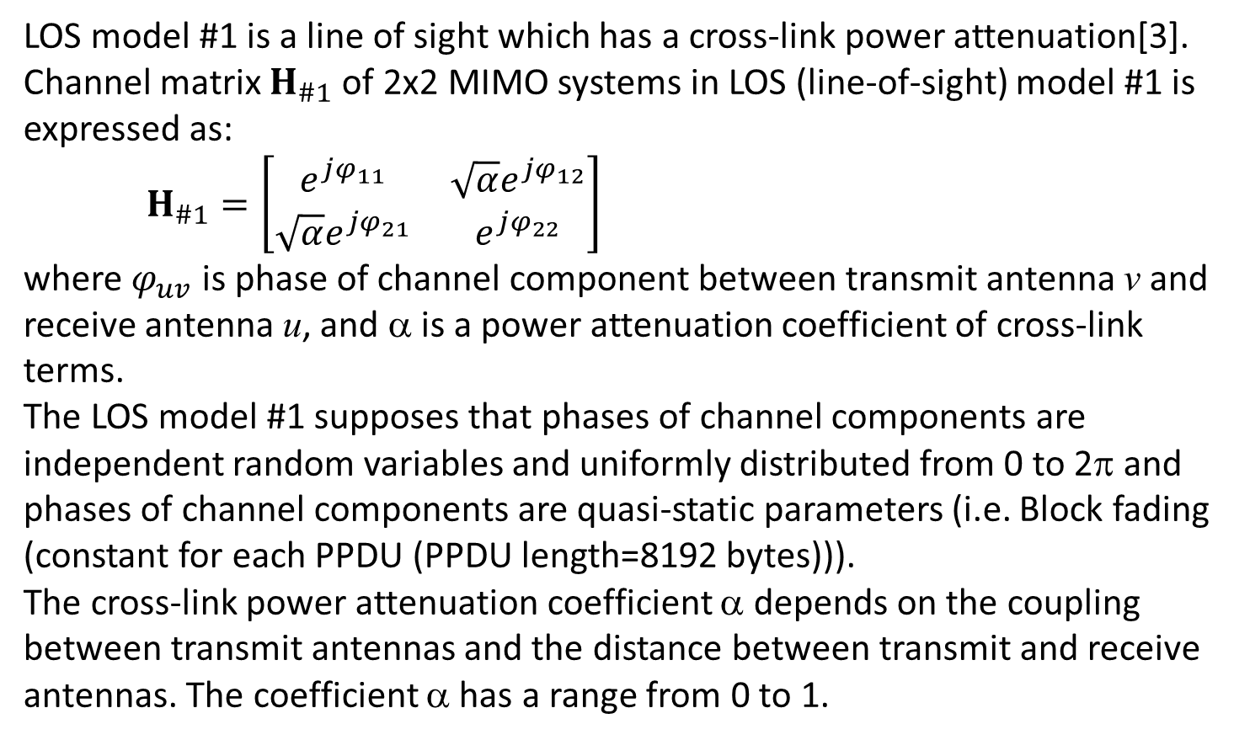
LOS Model #1 [3]
    LOS model #1 is a line of sight which has a cross-link power attenuation[3]. Channel matrix $H_{\#1}$ of 2x2 MIMO systems in LOS (line-of-sight) model #1 is expressed as:
    $H_{\#1}=\left[\begin{matrix}e^{jφ_{11}} & \sqrt{α}e^{jφ_{12}} \\ {\sqrt{α}e}^{jφ_{21}} & e^{jφ_{22}}\end{matrix}\right]$
    where $φ_{uv}$ is phase of channel component between transmit antenna v and receive antenna u, and α is a power attenuation coefficient of cross-link terms.
    The LOS model #1 supposes that phases of channel components are independent random variables and uniformly distributed from 0 to 2π and phases of channel components are quasi-static parameters (i.e. Block fading (constant for each PPDU (PPDU length=8192 bytes))).
    The cross-link power attenuation coefficient α depends on the coupling between transmit antennas and the distance between transmit and receive antennas. The coefficient α has a range from 0 to 1.

Slide 7
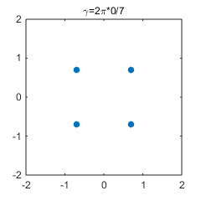
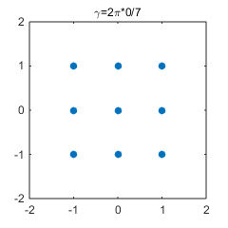

Benefits of PH (1/2)
    The LOS model #1 supposes that phases of channel components are independent random variables and uniformly distributed from 0 to 2π and phases of channel components are quasi-static parameters (i.e. Block fading (constant for each PPDU (PPDU length=8192 bytes))).
    Ex.) Block fading with α=1 and $φ_{11}$ = $φ_{12}$ = $φ_{21}$ = $φ_{22}$ = 0 radian of
    channel matrix $H_{\#1}=\left[\begin{matrix}e^{jφ_{11}} & \sqrt{α}e^{jφ_{12}} \\ {\sqrt{α}e}^{jφ_{21}} & e^{jφ_{22}}\end{matrix}\right]$is assumed*.
    No precoding without PH:
Received state is static
Transmitter
Receiver
constellation degeneracy (9=16-7 signal points)
S1(i) and S2(i) : QPSK
s₁(i)
Rx₁(i)
r=2π*1/7
r=2π*2/7
s₂(i)
Rx₂(i)
r=2π*1/7
r=2π*2/7
symbol
symbol
#0
#1
#2
#0
#1
#2
In this case, received state of signal points falls into destructive interference (constellation degeneracy).
*Note that this assumption is an example to help easy understanding of PH operation.

Slide 8
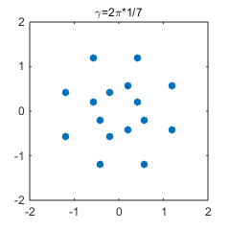
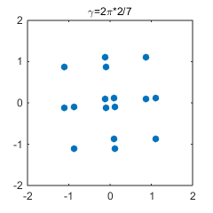
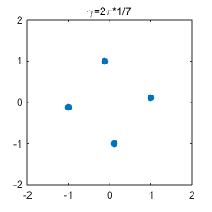
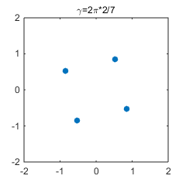
Benefits of PH (2/2)
    No precoding with PH:
The receiver avoids falling into destructive interference (constellation degeneracy) in LOS environment by PH (scattering the channel phase).
    Circuit cost is negligible, because transmitter and receiver need to add only the phase changer.
Received state is varying
Transmitter
S1(i) and S2(i) : QPSK
Receiver
s₁(i)
Rx₁(i)
r=2π*1/7
r=2π*2/7
s₂(i)
PH
Rx₂(i)
symbol
symbol
#0
#1
#2
#0
#1
#2

Slide 9
Performance in LOS model #1
Performance of precoding + PH in LOS model #1 are shown in Appendix, and it can be confirmed that:
Precoding+ PH has large gain, compared with no PH.
This presentation focuses on discussing effectiveness by introducing precoding.

Slide 10
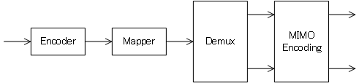
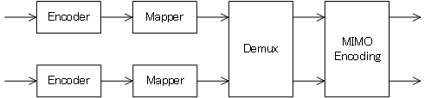
Vertical and Horizontal MIMO Architecture
The contribution of [3] discussed vertical and horizontal mapping.
    Vertical encoding
    Horizontal encoding
    - One encoder and one mapper
    => Setting one MCS is necessary
    - High speed encoder/decoder
    - Multiple encoder and multiple mapper
    => Setting multiple MCS is possible
    - Encoder/decoder has large complexity
-> Performances with vertical encoding are evaluated.

Slide 11
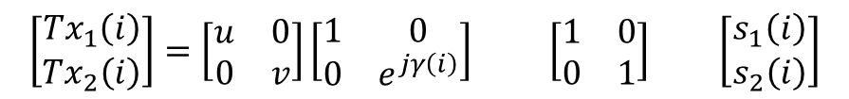
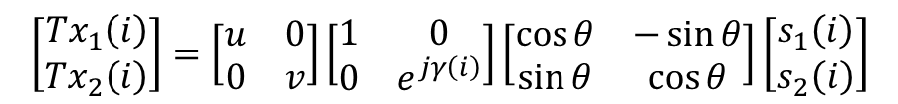
UEP(unequal power) Environment
Two assumptions are considered.
A#1:
Considering individual difference of transmitter difference of antenna gain between 2 transmit antennas exists.
A#2:
Gain difference of two transmission beams exists.
Therefore, when employing MIMO+PH, transmission signals Tx1(i) and Tx2(i) are expressed as:
Gain difference
PH
Precoding
Precoding + PH
$$\left[\begin{matrix}{Tx}_{1}\left(i\right) \\ {Tx}_{2}\left(i\right)\end{matrix}\right]=\left[\begin{matrix}u & 0 \\ 0 & v\end{matrix}\right]\left[\begin{matrix}1 & 0 \\ 0 & e^{jγ\left(i\right)}\end{matrix}\right]\left[\begin{matrix}\cos{θ} & −\sin{θ} \\ \sin{θ} & \cos{θ}\end{matrix}\right]\left[\begin{matrix}s_{1}\left(i\right) \\ s_{2}\left(i\right)\end{matrix}\right]$$
No Precoding + PH
$$\left[\begin{matrix}{Tx}_{1}\left(i\right) \\ {Tx}_{2}\left(i\right)\end{matrix}\right]=\left[\begin{matrix}u & 0 \\ 0 & v\end{matrix}\right]\left[\begin{matrix}1 & 0 \\ 0 & e^{jγ\left(i\right)}\end{matrix}\right] \left[\begin{matrix}1 & 0 \\ 0 & 1\end{matrix}\right] \left[\begin{matrix}s_{1}\left(i\right) \\ s_{2}\left(i\right)\end{matrix}\right]$$
Performance with vertical encoding when employing MIMO+PH is evaluated by simulation.

Slide 12
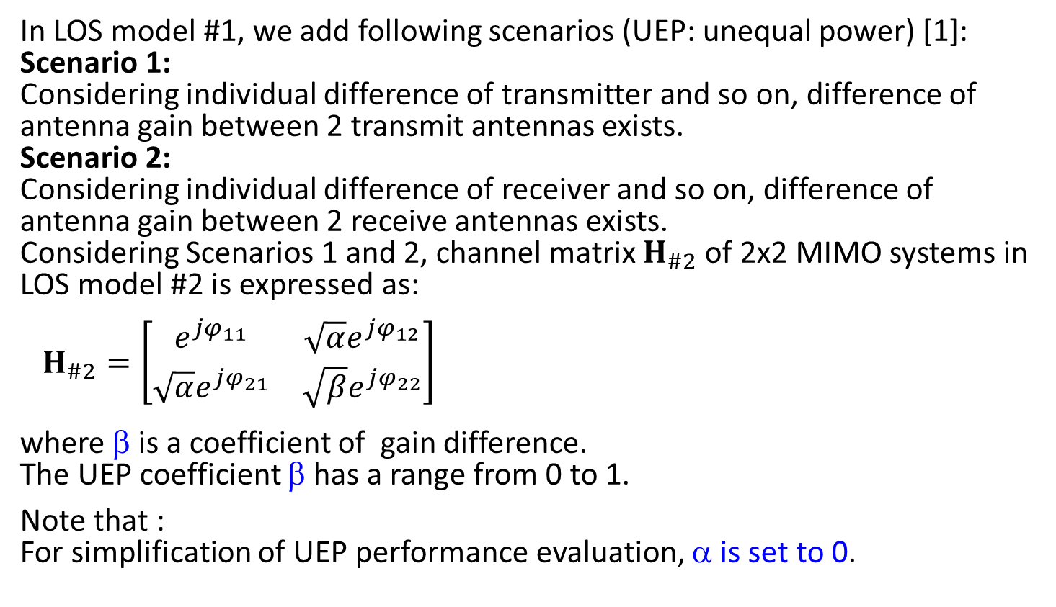
LOS Model #2
    In LOS model #1, we add following scenarios (UEP: unequal power) [1]:
    Scenario 1:
    Considering individual difference of transmitter and so on, difference of antenna gain between 2 transmit antennas exists.
    Scenario 2:
    Considering individual difference of receiver and so on, difference of antenna gain between 2 receive antennas exists.
    Considering Scenarios 1 and 2, channel matrix $H_{\#2}$ of 2x2 MIMO systems in LOS model #2 is expressed as:
    $H_{\#2}=\left[\begin{matrix}e^{jφ_{11}} & \sqrt{α}e^{jφ_{12}} \\ {\sqrt{α}e}^{jφ_{21}} & {\sqrt{β}e}^{jφ_{22}}\end{matrix}\right]$
    where β is a coefficient of gain difference.
    The UEP coefficient β has a range from 0 to 1.
    Note that :
    For simplification of UEP performance evaluation, α is set to 0.

Slide 13

Simulation Conditions
    MIMO : 2x2 OLSM precoding with PH/no precoding with PH
    Period of PH is 7.
    Modulation set : (BPSK, BPSK), (QPSK,QPSK),
    (16QAM,16QAM),(64QAM,64QAM)
    Channel model : LOS model #2
    α=0
    β=0dB, -5dB, -10dB (Coefficient of gain difference in transmitter and receiver)
    FEC : 11ad LDPC codes (Codeword size=672 bits)
    Detection : ML (Maximum Likelihood)
    ZF (Zero Forcing)
    MMSE (Minimum Mean Square Error)
    *Equation for precoding with PH is expressed as
$$\left[\begin{matrix}{Tx}_{1}\left(i\right) \\ {Tx}_{2}\left(i\right)\end{matrix}\right]=\left[\begin{matrix}1 & 0 \\ 0 & e^{j}\frac{2π×\left(i mod 7\right)}{7}\end{matrix}\right]\left[\begin{matrix}\cos{\frac{π}{4}} & −\sin{\frac{π}{4}} \\ \sin{\frac{π}{4}} & \cos{\frac{π}{4}}\end{matrix}\right]\left[\begin{matrix}s_{1}\left(i\right) \\ s_{2}\left(i\right)\end{matrix}\right]$$
    In UEP case, it is suitable to set to θ to π/4 radian, because receivers can obtain equal power s1(i) and s2(i).

Slide 14
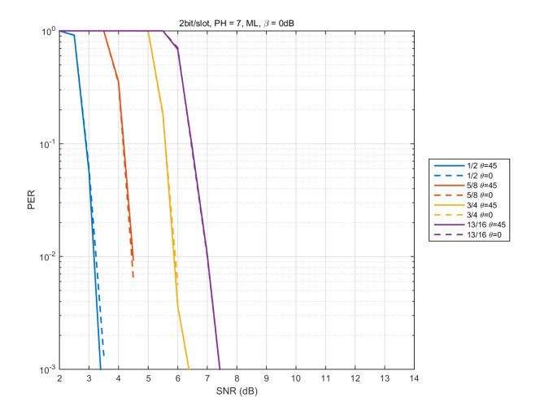
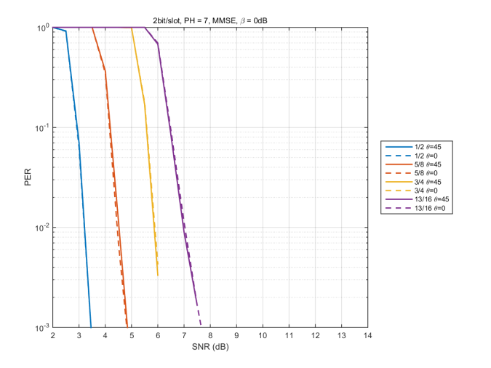
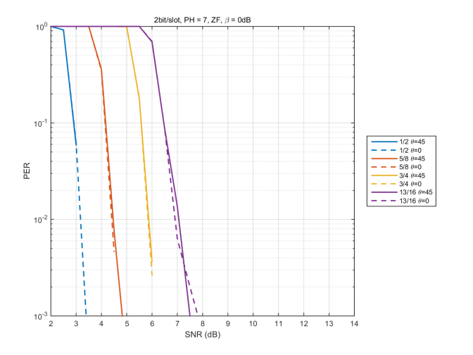
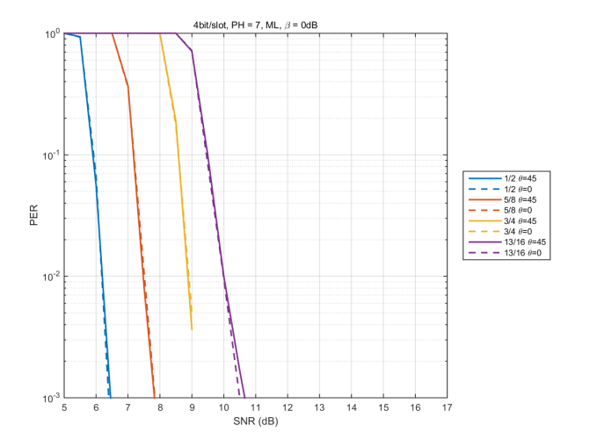
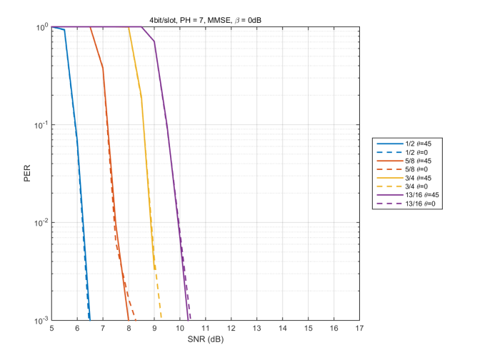
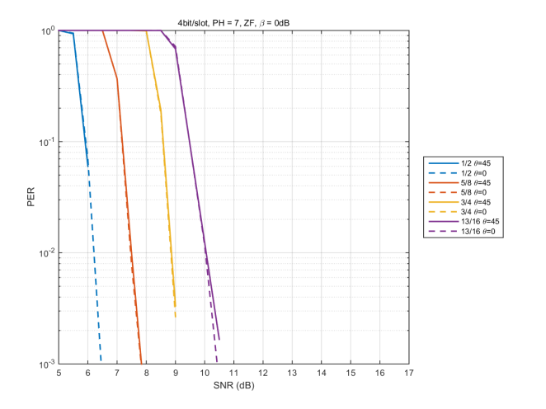
Comparison between Precoding and no precoding (β=0dB)
  β=0dB => No gain difference (Equal power environment)
ML
MMSE
ZF
(BPSK, BPSK)
(QPSK, QPSK)

Slide 15
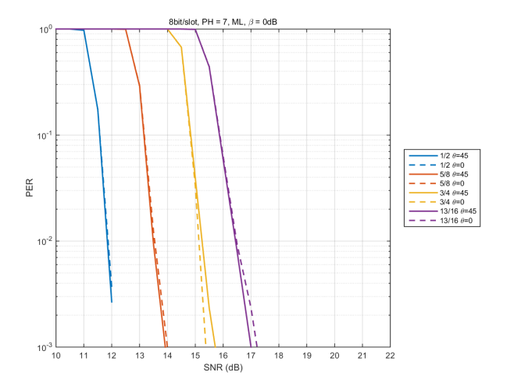
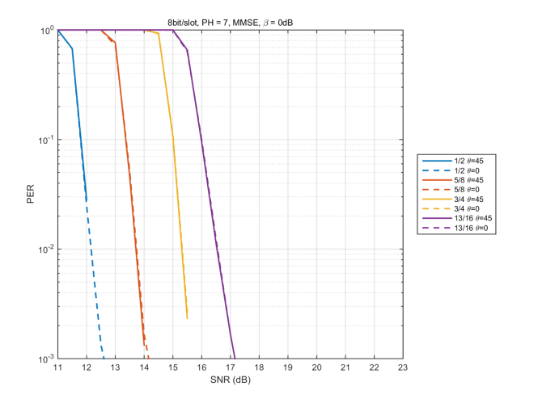
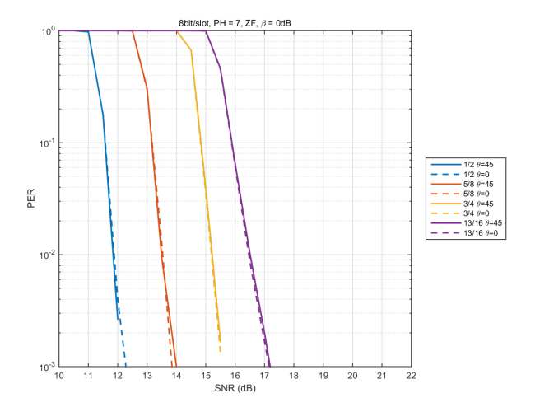
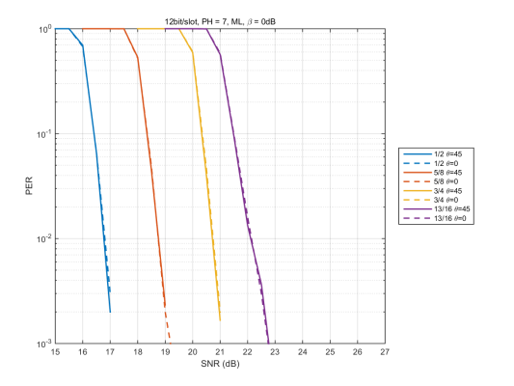
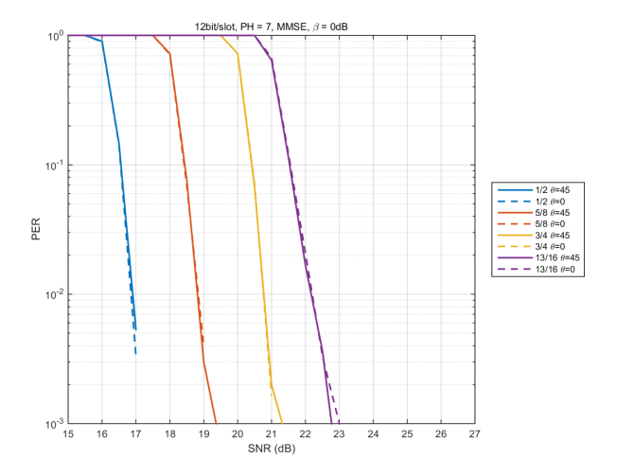
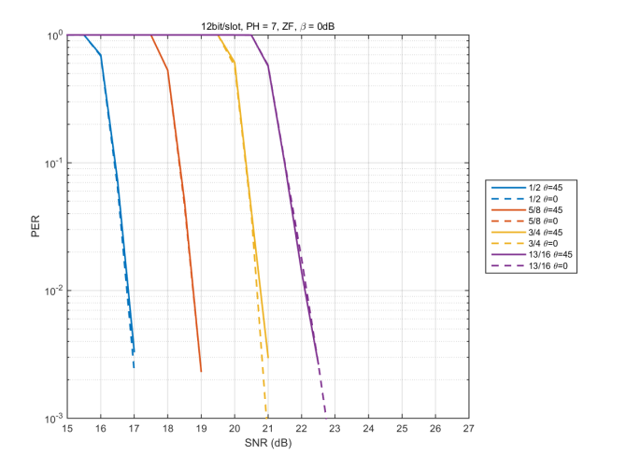
Comparison between Precoding and no precoding (β=0dB)
ML
MMSE
ZF
(16QAM, 16QAM)
(64QAM, 64QAM)
    - In equal power case (β=0dB), performances with precoding (+PH) and with no precoding (+ PH) are close.

Slide 16
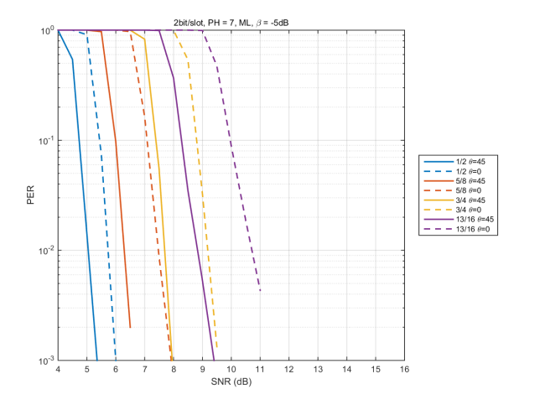
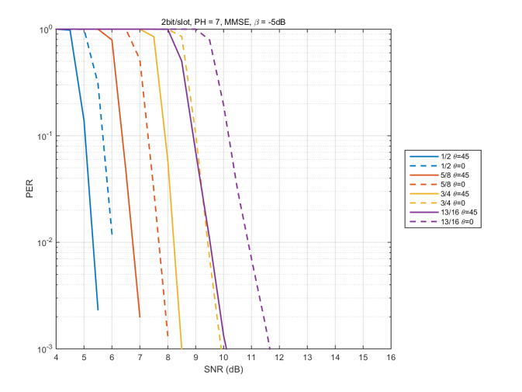
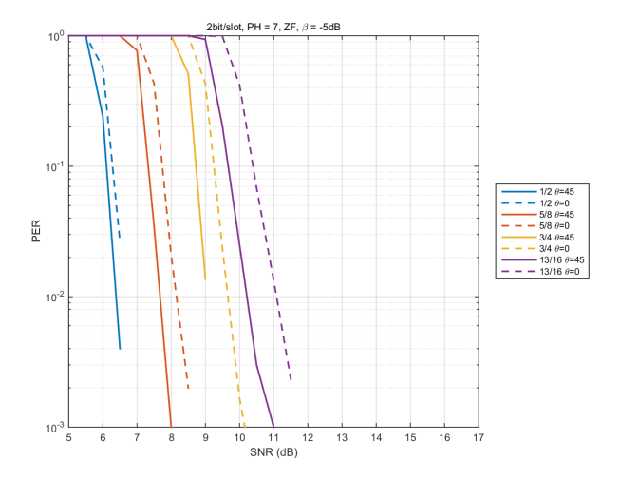
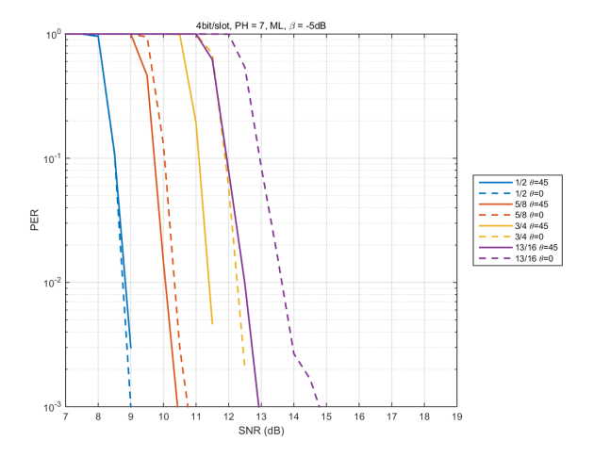
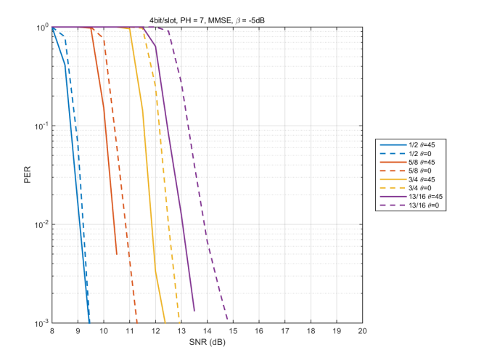
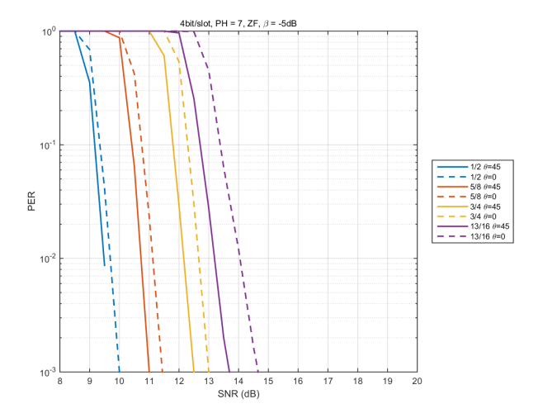
Comparison between Precoding and no precoding (β=-5dB)
ML
MMSE
ZF
(BPSK, BPSK)
(QPSK, QPSK)

Slide 17
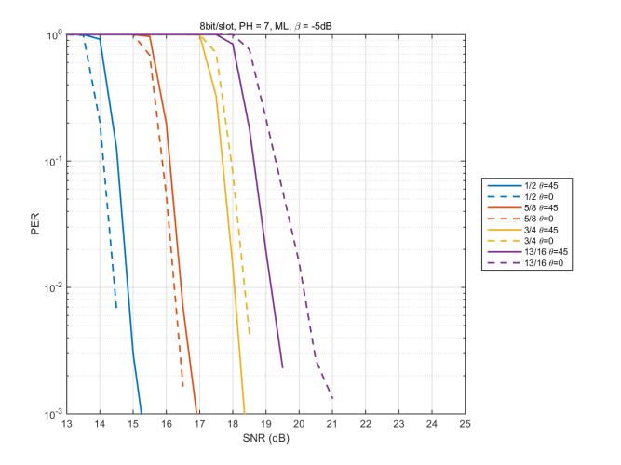

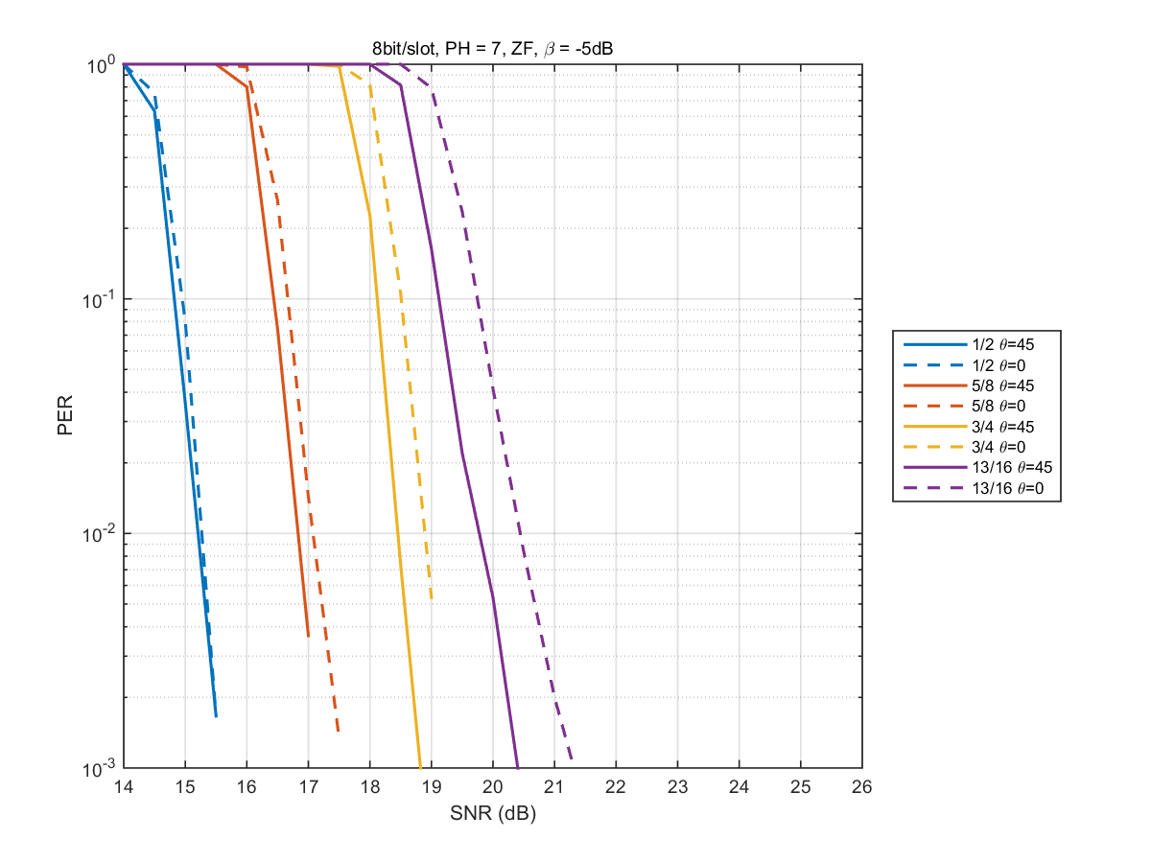
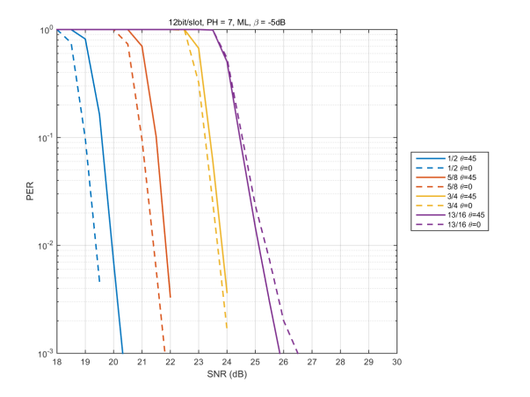
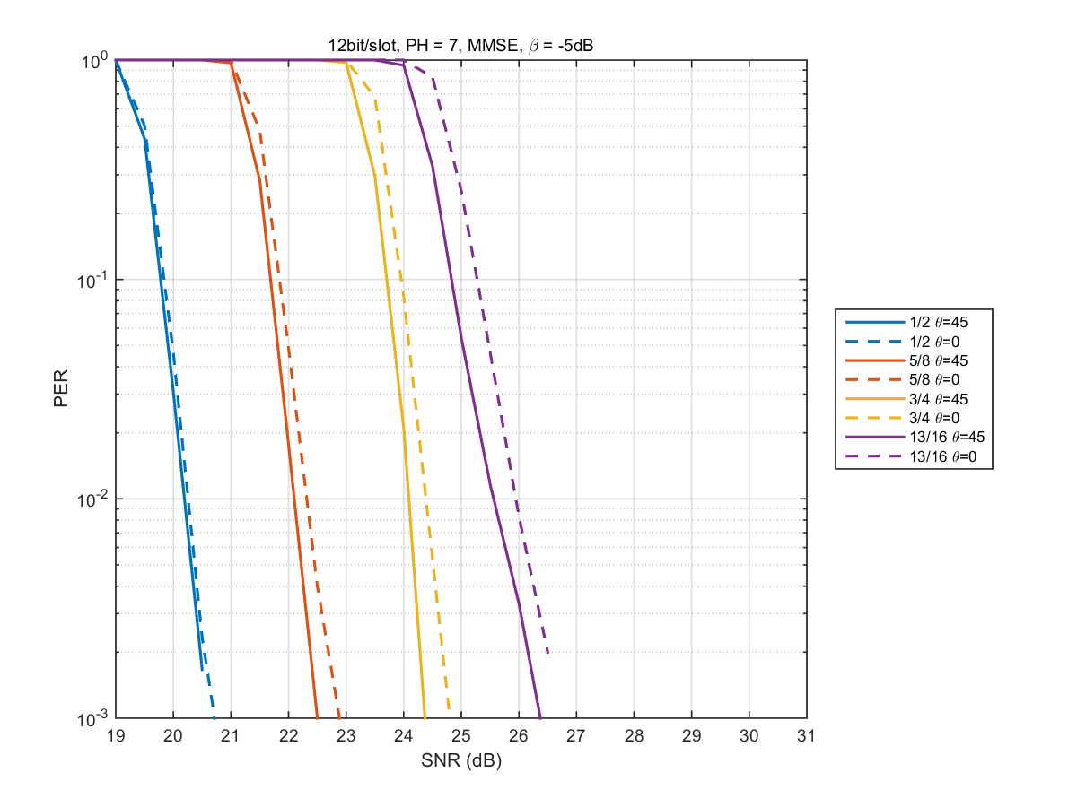
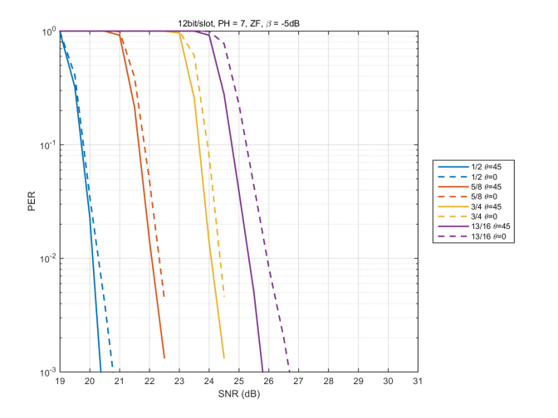
Comparison between Precoding and no precoding (β=-5dB)
ML
MMSE
ZF
(16QAM, 16QAM)
(64QAM, 64QAM)

Slide 18
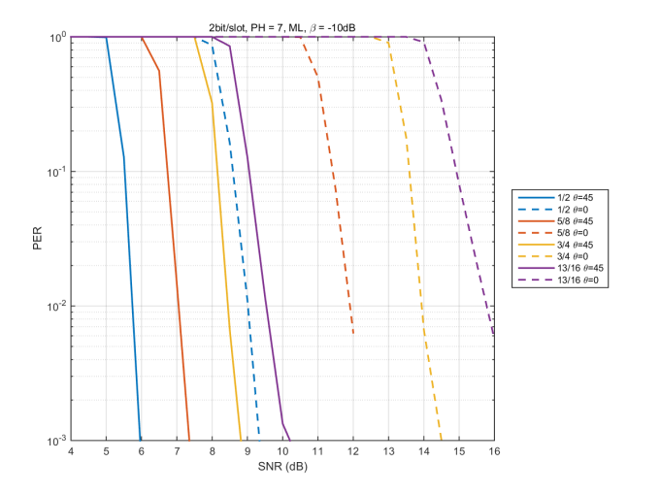
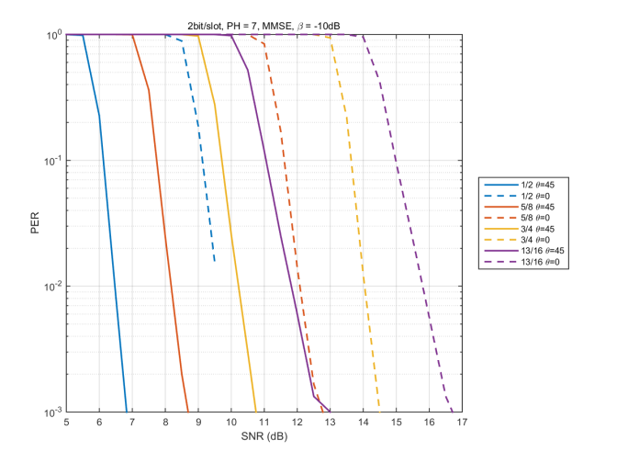
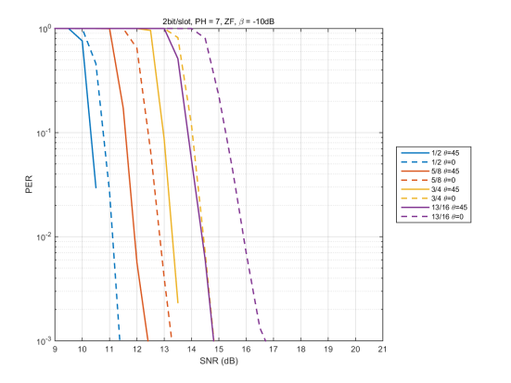
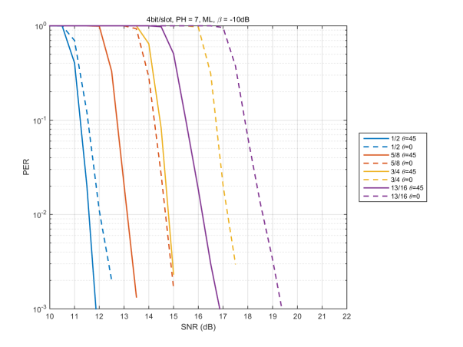
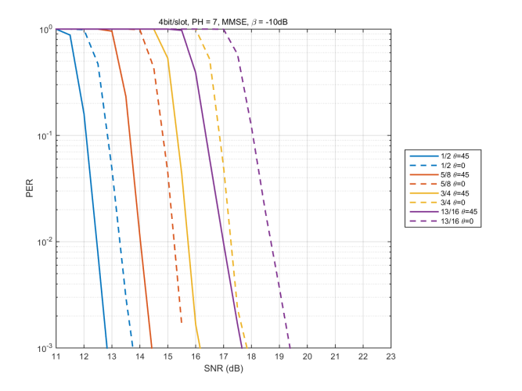
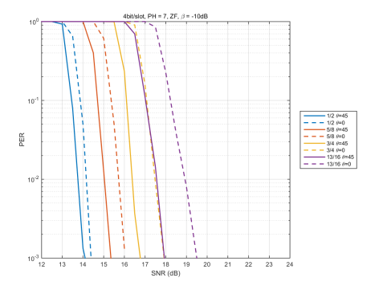
Comparison between Precoding and no precoding (β=-10dB)
ML
MMSE
ZF
(BPSK, BPSK)
(QPSK, QPSK)

Slide 19
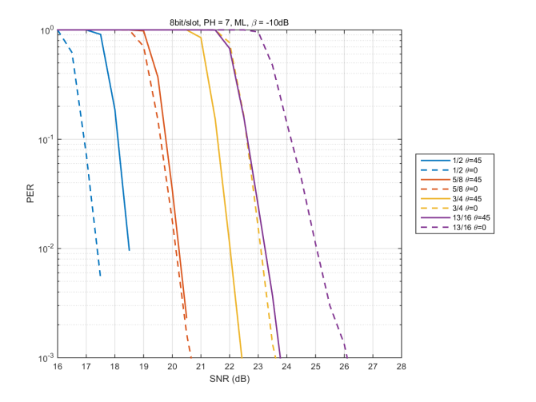
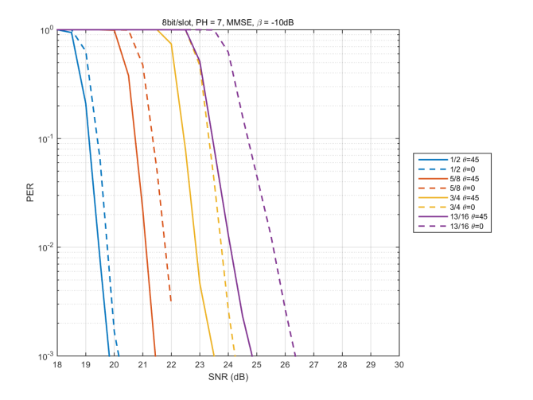
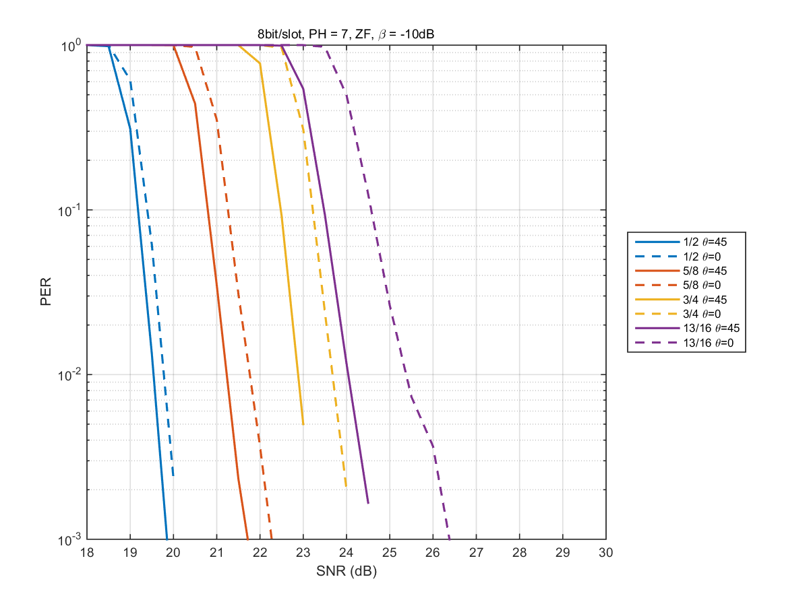
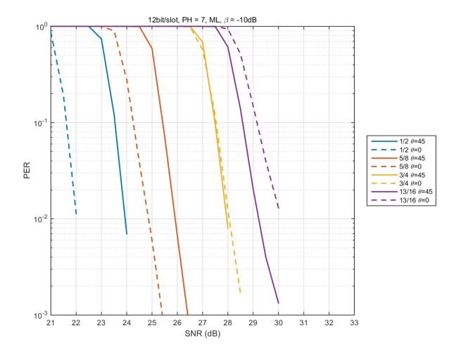
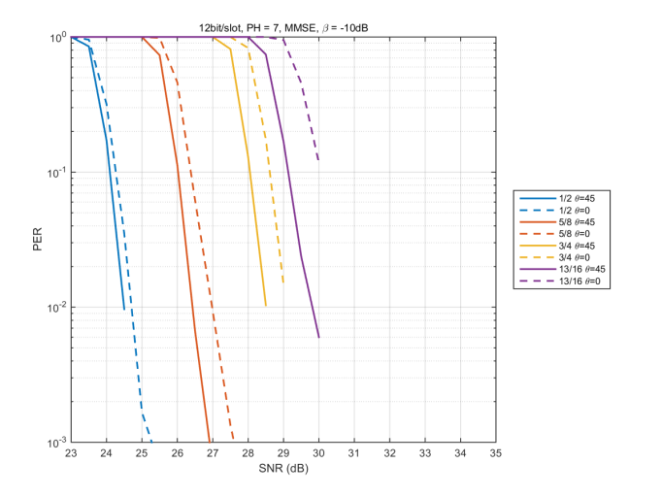
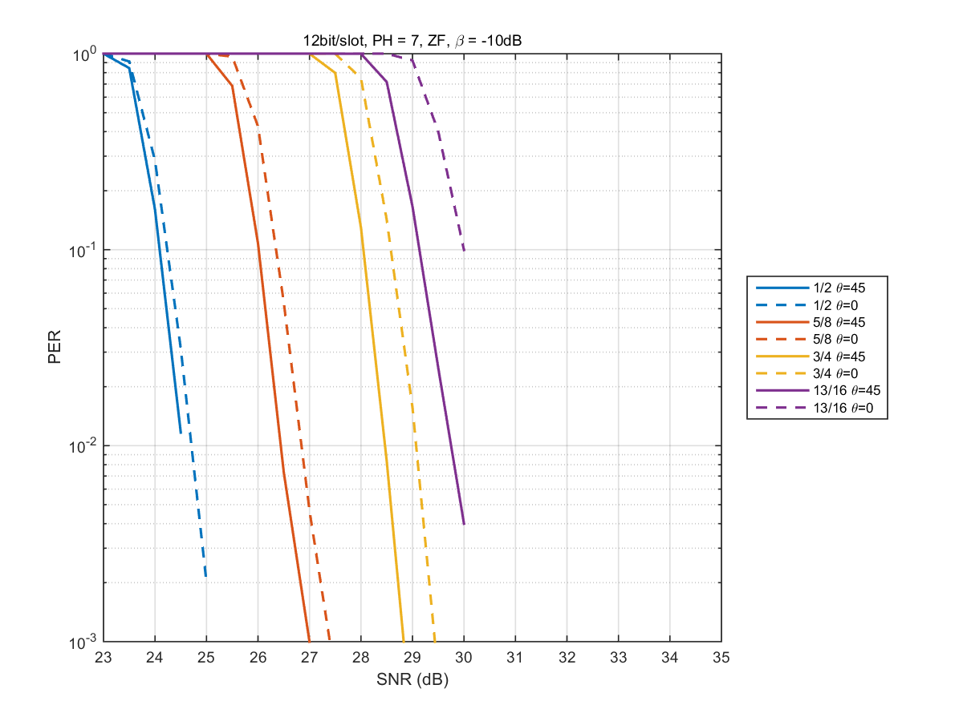
Comparison between Precoding and no precoding (β=-10dB)
ML
MMSE
ZF
(16QAM, 16QAM)
(64QAM, 64QAM)

Slide 20
Remark
In unequal power case:
When using MMSE and ZF, performance with precoding (+PH) is better than that with no precoding.
When using ML, performance with precoding (+PH) is better than that with no precoding except for low coding rate in (16QAM,16QAM) and (64QAM,64QAM)
When using vertical encoding, precoding + PH has advantage in unequal power case except for specific case as mentioned above.
Regarding simulation results, when using horizontal encoding, in order to employ 1 MCS for all spatial streams, introducing precoding is worthy.

Slide 21
Summary
Precoding + PH has advantage at unequal power case, compared with no precoding with PH. Therefore, introducing precoding is worthy.

Slide 22
Straw poll
  Do you agree to modify the following in clause 6.1 of the SFD:
  “For EDMG OFDM mode, the 11ay specification shall define SU EDMG PPDU transmission with and without phase hopping. An EDMG STA may support transmission and reception of SU EDMG PPDU with phase hopping. In this mechanism, the following apply:
  - Precoding may be used
  - The period of phase hopping is TBD.”

Slide 23
References
11-15-0334-01-ng60-mimo-framework
11-16-0669-01-00ay-open-loop-spatial-multiplexing-with-phase-hopping-for-11ay
11-16-0388-00-00ay-performance-analysis-of-open-loop-su-mimo-receivers-for-ieee-802-11ay

Slide 24
Appendix

Slide 25

Simulation Conditions
    MIMO : 2x2 OLSM + precoding with PH/without PH
    Period of PH is 7*.
    Modulation set : (BPSK,BPSK),(QPSK,QPSK),
    (16QAM,16QAM)(64QAM,64QAM)
    Channel model : LOS model #1
    α=-3dB, -5dB, -10dB
    (Power attenuation coefficient of cross-link terms)
    FEC : 11ad LDPC codes (Codeword size=672 bits)
    Detection : ML (Maximum Likelihood)
    ZF (Zero Forcing)
    MMSE (Minimum Mean Square Error)
    *Equation for precoding with PH is expressed as
$$\left[\begin{matrix}{Tx}_{1}\left(i\right) \\ {Tx}_{2}\left(i\right)\end{matrix}\right]=\left[\begin{matrix}1 & 0 \\ 0 & e^{j}\frac{2π×\left(i mod 7\right)}{7}\end{matrix}\right]\left[\begin{matrix}\cos{\frac{π}{4}} & −\sin{\frac{π}{4}} \\ \sin{\frac{π}{4}} & \cos{\frac{π}{4}}\end{matrix}\right]\left[\begin{matrix}s_{1}\left(i\right) \\ s_{2}\left(i\right)\end{matrix}\right]$$

Slide 26
(BPSK,BPSK),(QPSK,QPSK)

Slide 27
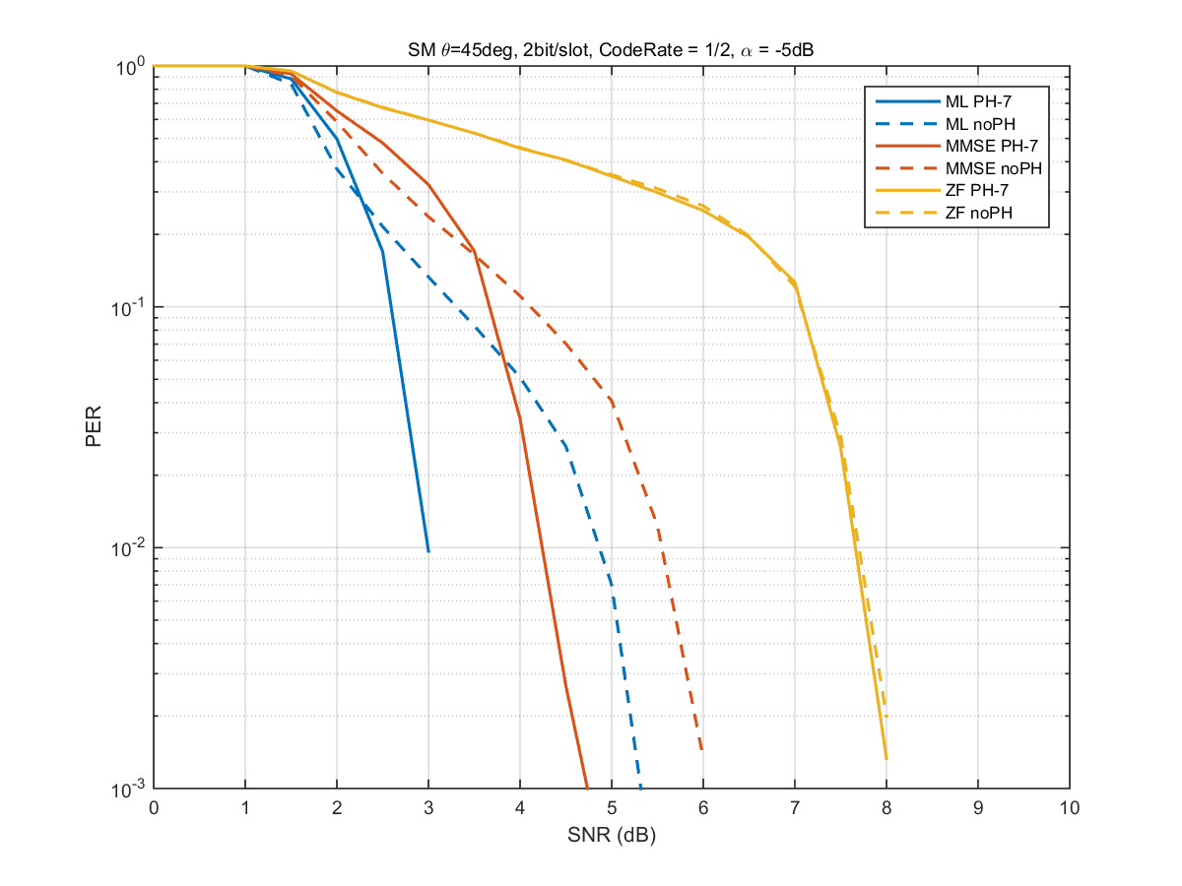



Comparison between PH and no PH (R=1/2)
α=-5dB
α=-10dB
(BPSK, BPSK)
(QPSK, QPSK)
- In (BPSK,BPSK), PH has gain, compared with no PH when using ML and MMSE.

Slide 28




Comparison between PH and no PH (R=5/8)
α=-5dB
α=-10dB
(BPSK, BPSK)
(QPSK, QPSK)

Slide 29




Comparison between PH and no PH (R=3/4)
α=-5dB
α=-10dB
(BPSK, BPSK)
(QPSK, QPSK)

Slide 30




Comparison between PH and no PH (R=13/16)
α=-5dB
α=-10dB
(BPSK, BPSK)
(QPSK, QPSK)
- PH has gain, compared with no PH when using ZF and MMSE and ML.

Slide 31
(16QAM,16QAM),(64QAM,64QAM)

Slide 32




Comparison between PH and no PH (R=1/2)
α=-5dB
α=-10dB
(16QAM, 16QAM)
(64QAM, 64QAM)

Slide 33




Comparison between PH and no PH (R=5/8)
α=-5dB
α=-10dB
(16QAM, 16QAM)
(64QAM, 64QAM)

Slide 34




Comparison between PH and no PH (R=3/4)
α=-5dB
α=-10dB
(16QAM, 16QAM)
(64QAM, 64QAM)

Slide 35




Comparison between PH and no PH (R=13/16)
α=-5dB
α=-10dB
(16QAM, 16QAM)
(64QAM, 64QAM)
- PH has gain, compared with no PH.

Slide 36
α=-3dB

Slide 37




Comparison between PH and no PH (α=-3dB, R=1/2)
(BPSK,BPSK)
(QPSK,QPSK)
(16QAM,16QAM)
(64QAM,64QAM)

Slide 38




Comparison between PH and no PH (α=-3dB, R=5/8)
(BPSK,BPSK)
(QPSK,QPSK)
(16QAM,16QAM)
(64QAM,64QAM)

Slide 39




Comparison between PH and no PH (α=-3dB, R=3/4)
(BPSK,BPSK)
(QPSK,QPSK)
(16QAM,16QAM)
(64QAM, 64QAM)

Slide 40




Comparison between PH and no PH (α=-3dB, R=13/16)
(BPSK,BPSK)
(QPSK,QPSK)
(16QAM,16QAM)
(64QAM,64QAM)
- In a=-3dB, PH has large gain, compared with no PH.

