Slide 1
Analysis of Cluster Effects under using Pencil Beam Antennas on Metal & Class Structures
Date: 2016-07-26
Authors:
Name | Affiliation | Address | Phone | Email
Jian Lou, Yan Xin, George Calcev | HUAWEI Technologies |  |  | Jianluo@Huawei.com Yan.xin@Huawei.com George.Calcev@huawei.com
Robert Müller, Stephan Häfner, Diego Dupleich, Reiner Thomä | Technische Universität Ilmenau |  |  | Mueller.Robert@tu-Ilmenau.de Reiner.thomae@tu-ilmrnau.de

Slide 2
Abstract
In this presentation, we show the characterization of entrance area in the entrance hall scenario at 60 GHz under using pencil beam antennas. The goals of this measurement and analysis are the intra-cluster analysis and parameter generation for large indoor scenarios.
This measurement can thus be used as a basis for calibration of a ray tracer and also for modelling of clusters for other channel models. Here we like to show the measurement and first beamforming analysis results.

Slide 3
Outline
Motivation
Pencil Beam 60 GHz Intra Cluster measurements in the Entrance Hall environment
Discussion of 60 GHz dual polarimertic scattering measurements in the entrance hall
Conclusion

Slide 4
Motivation
Broadband and full polarimetric characterization of Cluster
  To understand the broadband and polarimetric scattering of different structures
Advanced system concepts → define measurement and modelling requirements
  Massive MIMO/pencil beamforming → large spatial bandwidth
  Adaptive or switched selection beamforming to mitigate shadowing
  Channel bonding → large bandwidth
Propagation channel
  Double directional measurements are needed to characterize the full channel
  Polarization is an important aspect
  High dynamic range is essential to measure the different propagation effects
Channel characterization for different usage cases

Slide 5
60 GHz Intra-Cluster
Measurement Setup

Slide 6
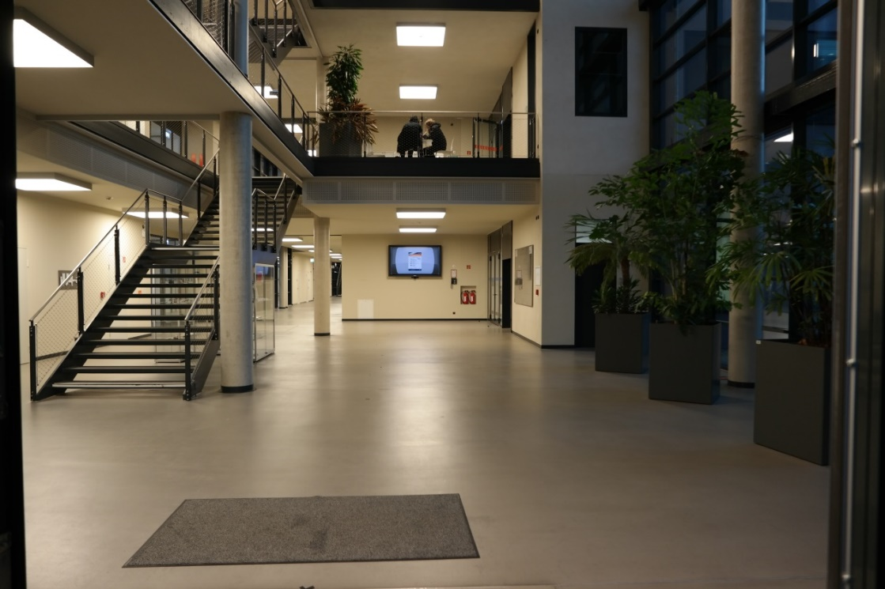
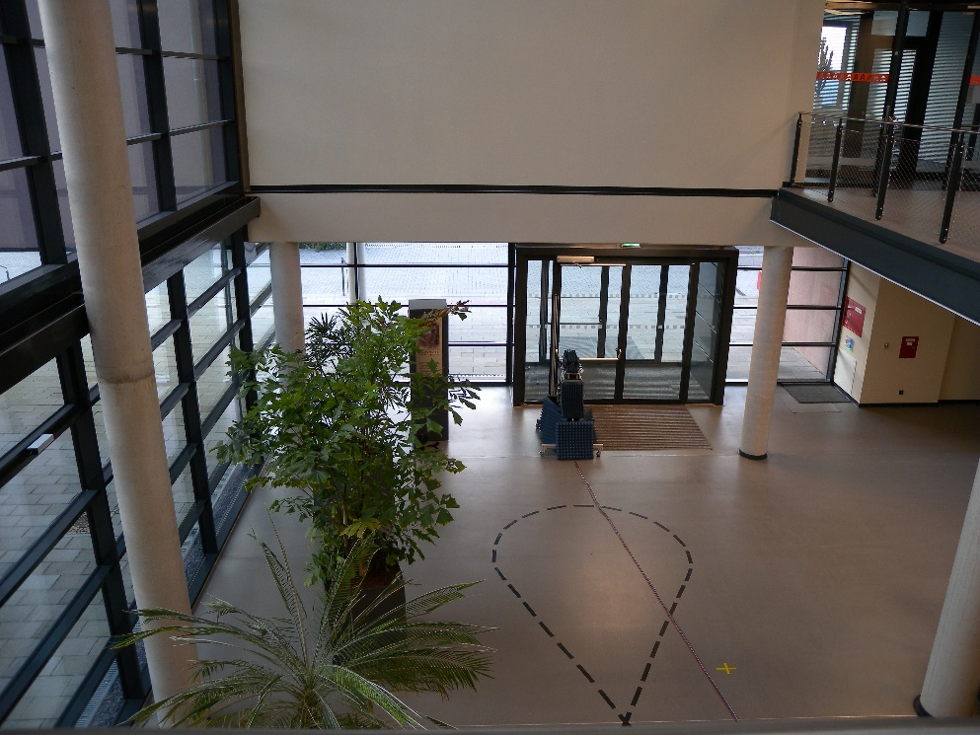
Measurement Objects
concrete pillar
Corner wall
Wall and big screen
Entrance door

Slide 7

60 GHz dual pol. Scattering Measurements Setup
$$α$$
positioner 1
positioner 2
h₁
h₂
rail positioner
2.85m
1.85m

Slide 8
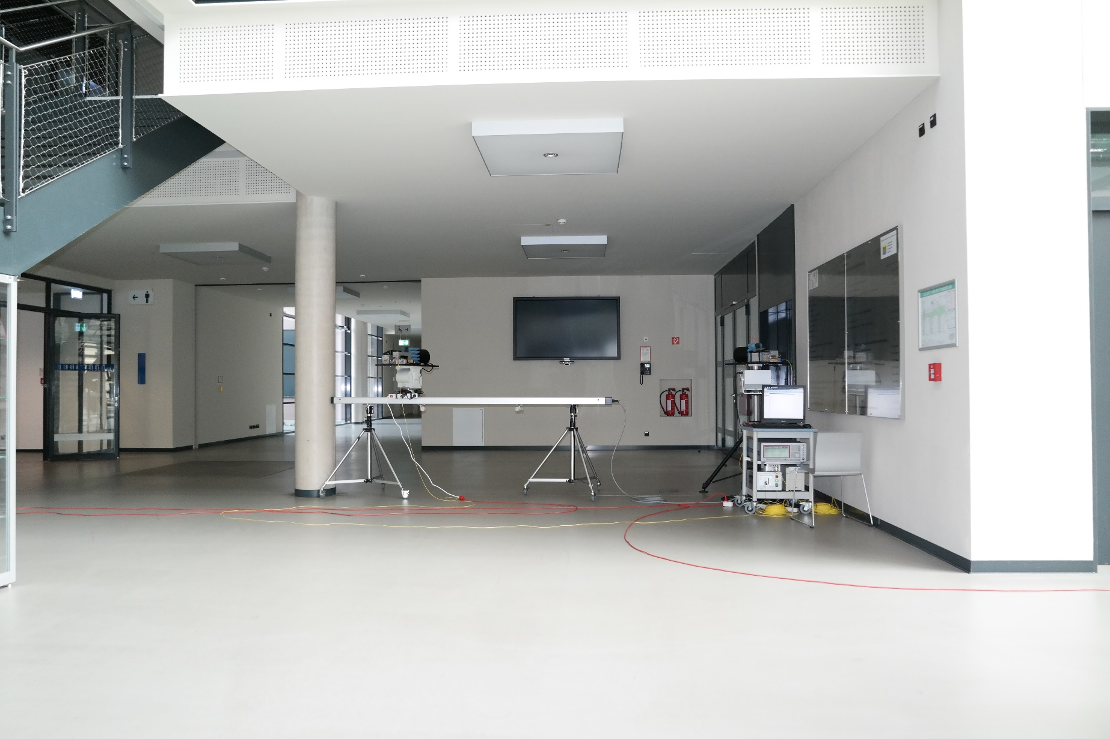
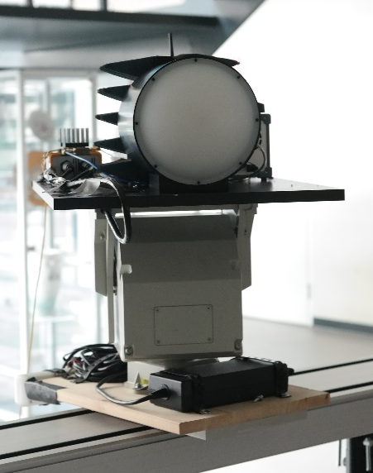
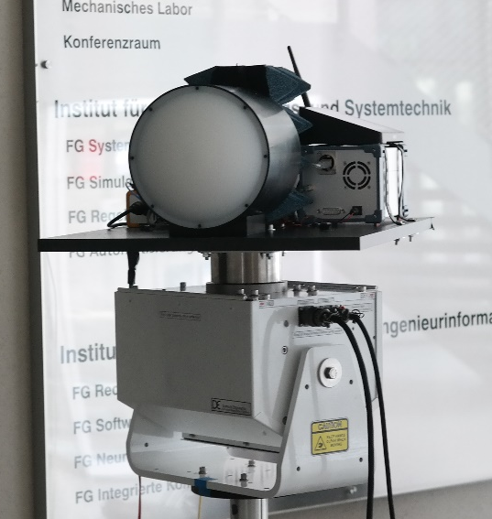
60 GHz Scattering Measurements Setup at the Wall

Slide 9
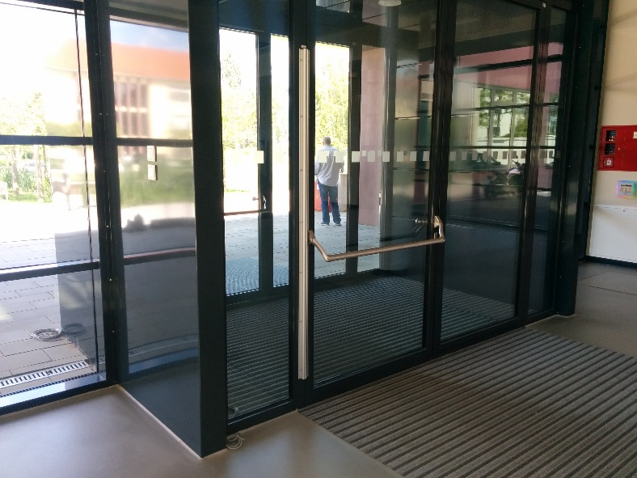
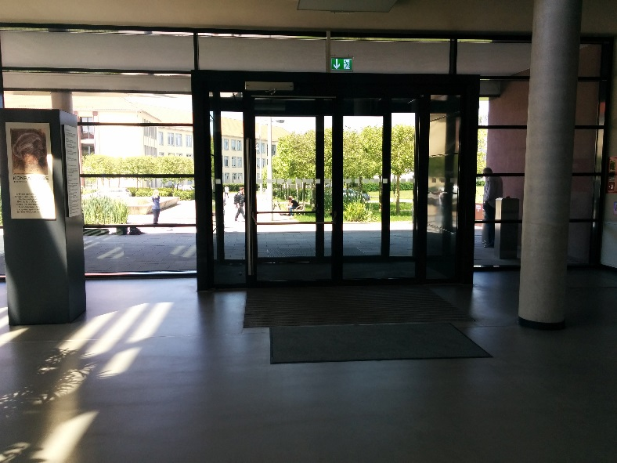
Measurements Description Entrance Door
Scenario 1: entrance door
Frequency Band: 57.4GHz - 64.1GHz
Height from ground 1.47 m
2°HPBW@60 GHz of the antenna (Gaussian Beam)
Scanning at Tx and Rx stage via positioners
Tx: Azimuth 0°2° 52°
Rx: Azimuth 0°2° 52°
Rail movment with 10cm steps
Tx
Rx

Slide 10
60 GHz
Measurement Results

Slide 11
Influence of Incident and Reflected Angles
Specularity of reflections: Entrance Door
The maximum is always close to the Tx – Rx azimuth range in which the incident and reflected angles are the same
(Tx Az = -Rx Az)
Tx
Rx
Tx Az
Rx Az
Rx position on the rail 0m
Rx position on the rail 0.8m
Rx position on the rail 1.8m

Slide 12
Influence of Incident and Reflected Angles
Specularity of reflections: Monitor on the Wall
The maximum is always close to the Tx – Rx azimuth range in which the incident and reflected angles are the same
(Tx Az = -Rx Az)
Tx
Rx
Tx Az
Rx Az
Rx position on the rail 0m
Rx position on the rail 0.8m
Rx position on the rail 1.8m

Slide 13
Incident and Reflected Angles
Tx and Rx Azimuth angles to the normal in which the received power is maximum
Small difference between incident and reflected angle (< 5°) → high specularity
Entrance Door
Monitor on the Wall

Slide 14
Scattering Properties
Sum over all Tx and Rx Azimuth and polarizations
  Summarize all scans and both polarizations
Monitor on the wall looks more regular than the entrance door
Entrance Door
Monitor on the Wall

Slide 15
Living Distance of Beams
Scenario
The Tx is pointing to the scatterer with a 2°HPBW
The Rx is moving parallel to the scatterer without updating the Rx beam
  Different HPBW considered at the Rx by adding consecutive 2°HPBW beams
  Same gain considered for different HPBW
Tx
Rx
Rx position on the rail

Slide 16
Living Distance of Beams
Entrance Door
Results normalized to the first position
For narrow beams at Rx (<10°HPBW), the signal is attenuated more than 20 dB after moving 0.35 m without any update in the beams at the Rx
After updating the beams at Rx at each position, a maximal loss (compared to the first position) of 20 dB is encountered
Without updating the beam at Rx
After updating the beam at Rx
Rx Position on the Rail [m]

Slide 17
Living Distance of Beams
Monitor on the Wall
Results normalized to the first position
For narrow beams at Rx (<10°HPBW), the signal is attenuated more than 20 dB after moving 0.6 m without any update in the beams at the Rx
After updating the beams at Rx at each position, a maximal loss (compared to the first position) of 12 dB is encountered
Without updating the beam at Rx
After updating the beam at Rx

Slide 18
Living Distance of Beams
Scenario
The Tx is pointing to the scatterer with a 2°HPBW
The Rx is moving parallel to the scatterer updating the Rx beam
  Different HPBW considered at the Rx by adding consecutive 2°HPBW beams
  Same gain considered for different HPBW
Tx
Rx
Rx position on the rail

Slide 19
Living Distance of Beams
Entrance Door
The optimal result is updating the beams at Tx and Rx in each position (in the figure the Tx beam HPBW is 2°)
Right figure shows the comparison of updating the Tx and Rx beams per position and the result without updating the beams
  With narrow beams (pencil beams) the update is necessary at Tx and Rx after moving 0.1m
After updating the beam at Rx and Tx
Rx Position on the Rail [m]

Slide 20
Living Distance of Beams
Monitor on the Wall
The optimal result is updating the beams at Tx and Rx in each position (in the figure the Tx beam HPBW is 2°)
Right figure shows the comparison of updating the Tx and Rx beams per position and the result without updating the beams
  With narrow beams (pencil beams) the update is necessary at Tx and Rx after moving 0.4m
After updating the beam at Rx and Tx
Rx Position on the Rail [m]

Slide 21
Conclusions
Power of the reflections highly depends on the incident angles
Specular-like reflections are the strongest
Wall and entrance door have different scattering properties. The wall is more regular than the entrance door
For modelling, if we talk about pencil beams, we need to have a precise information of the scatterer in order to describe the reflections, since a small change in the incident and reflected angles leads to high losses
  Spatial consistency is very important, more deterministic approaches
For beam-forming, with pencil beams an update is necessary more often (in location). Wider beams reduce the received power but also need to update the beam-former coefficients more often

Slide 22
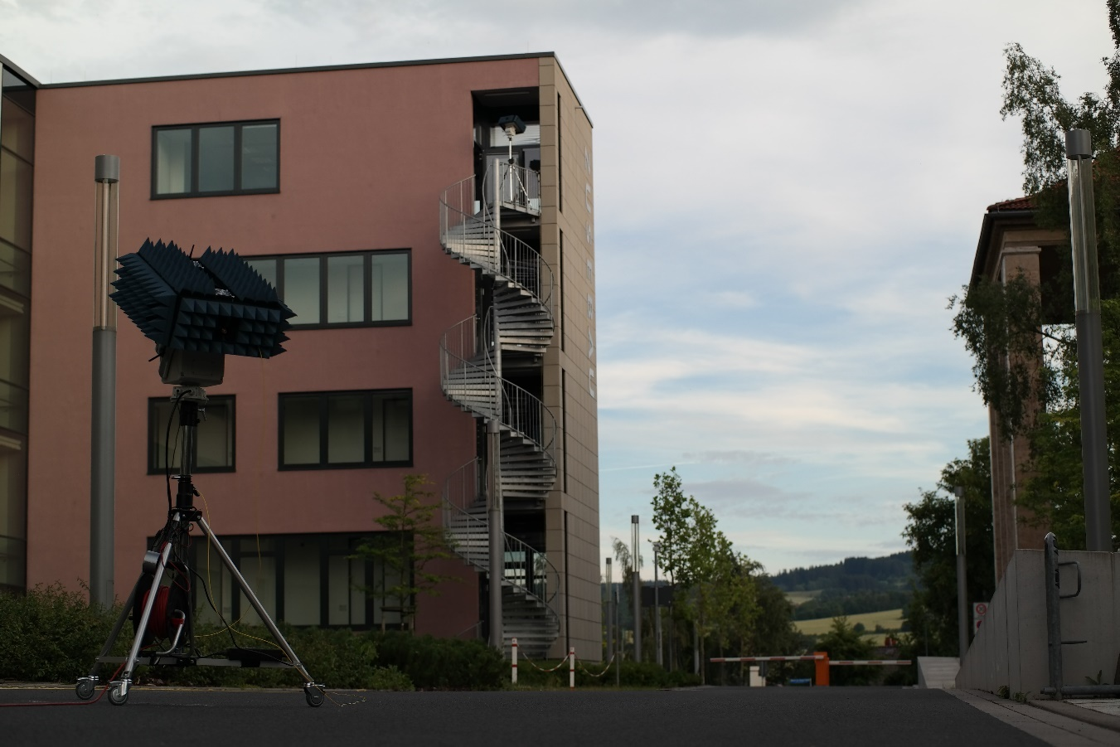
Conclusion/Discussion
Next Steps
  Analysis of outdoor measurements at 60 GHz
  Large indoor scenarios with distances larger than 40 m
  Dynamic measurements of human scattering inclusive Doppler shift up to 50 km/h

