Slide 1
On Random Access in A-BFT
Date: 2016-07-25
Authors:
Name | Company | Address | Phone | Email
Sang G. Kim | LG Electronics |  |  | Sanggook.kim@lge.com
Kyungtae Jo |  |  |  | kyungtae.jo@lge.com
SungJin Park |  |  |  | allean.park@lge.com
HanGyu Cho |  |  |  | hg.cho@lge.com
JinMin Kim |  |  |  | jinmin1230.kim@lge.com
Saehee Bang |  |  |  | saehee.bang@lge.com

Slide 2
Introduction
One of the key operations envisioned for 11ay system is in dense environments [1]
It is important to accommodate many STAs into the system
Current 11ad design provides the association of STAs through the random capturing of the slots in A-BFT
However, the number of slots in A-BFT is very limited (max 8) for the operations in dense environments
In this contribution, we consider the efficient utilization of limited number of slots assuming backward compatibility in play

Slide 3
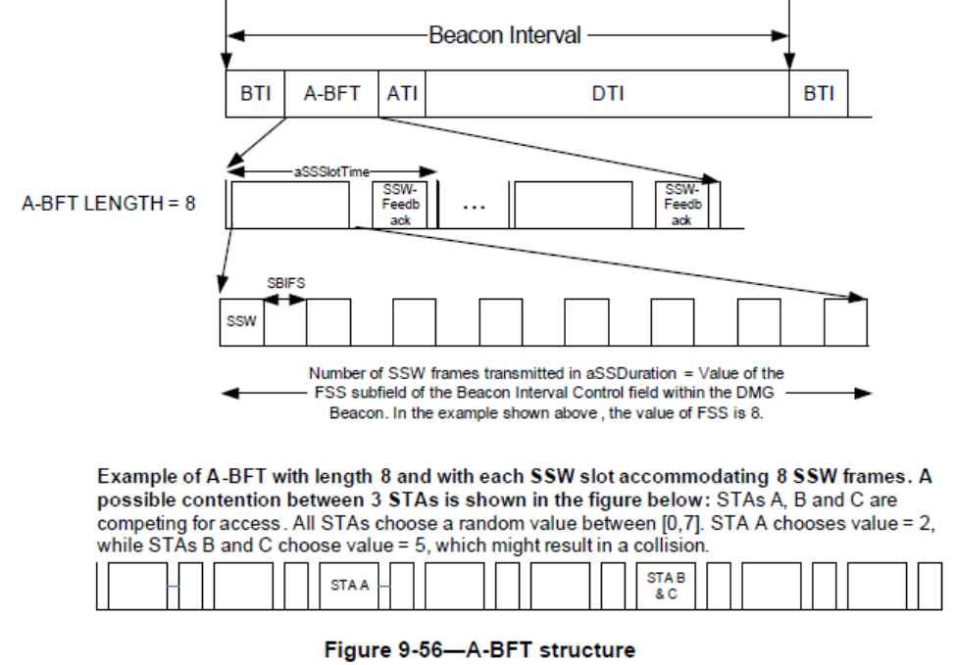
Background (1/2):
A-BFT in 11ad:

Slide 4
Background (2/2):
The maximum number of slots for association in A-BFT is 8
All STAs have to contend for these slots
Only 1 association is possible per slot
Maximum of 8 STAs can be associated per beacon interval at best

Slide 5
Proposed Methods (1/3)
When overload situation in A-BFT happens, it is necessary to spread out access attempts over time
PCP/AP may determine overload situation, e.g., by monitoring the utilization of SSW slots in A-BFT
The objective of the proposed method is to spread out the access attempts from 11ay STAs while maintaining 11ad designs and thus providing simple remedies for 11ay designs
dot11RSSRetryLimit and dot11RSSBackoff are defined for A-BFT operation for 11ad STAs
However, they are not easily adjustable
In this contribution, we propose dynamically adjustable operation for EDMG STAs in A-BFT when overload (frequent collision) situation is observed

Slide 6
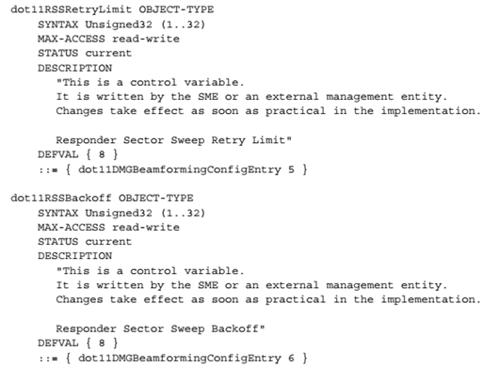
Proposed Methods (2/3)
dot11RSSRetryLimit and dot11RSSBackoff defined for A-BFT operation for 11ad STAs

Slide 7
Proposed Methods (3/3)
For 11ay STAs,
RSSRetryLimit specifies the maximum number of consecutive A-BFT access attempts
RSSBackoff specifies the maximum number of BI intervals to back-off when RSSRetryLimit is reached
EDMG STA randomly picks the numbers in [0, RSSRetryLimit – 1) and [0, RSSBackoff – 1)
RSSRetryLimit and RSSBackoff can be different for primary and secondary channels. They can be signaled per BI interval or with periodicity in BI intervals.
The benefits of this proposal is to easily coup with the collision situation by spreading out the random access attempts in dense environments over the time
The load balancing approach can be applied over multiple A-BFT channels using common or dedicated parameters
RSSRetryLimit and RSSBackoff can be the same or different for primary and secondary channels.

Slide 8
Summary
Accommodating many 11ad and 11ay STAs while maintaining existing 11ad designs
There is a bottleneck due to limited resources for access attempts that is inherent in existing 11ad A-BFT designs
In this contribution, we proposed efficient ways of handling the situation while maintaining existing 11ad designs and less impacts to 11ay designs

Slide 9
References
IEEE 802.11-2015/0625r3 IEEE 802.11 TGay Use Cases

Slide 10
Straw poll/motion #1
Do you agree to add the following text into SFD?
“11ay shall support dynamic load balancing in A-BFT by providing means to adjust necessary parameters (e.g. RSSBackoff or/and RSSRetryLimit).”
Y/N/A

