Slide 1
Introduction to SOMA
Date: 2016-07-27
Authors:

Slide 2
Authors (continued):

Slide 3
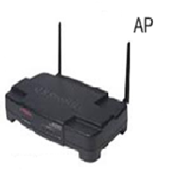

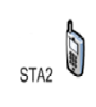
Radio Multiple Access
Orthogonal Multiple Access: TDMA, FDMA, CDMA, OFDMA
Power
TDMA
Time
Power
Superposition Transmission
Time

Slide 4
Superposition Transmission
Transmission Signals
OMA
Superposition
BW1=BW/2
P₁
Power
Power
BW2=BW/2
P₂
SNR = 0dB
Freq
SNR = 20dB
BW
Freq
OMA: P₁ = P₂ = 0.5
Superposition: P₁ = 0.2, P₂ = 0.8
 | OMA | Superposition
R₁ (bps/Hz) | 3.33 | 4.39 (+32%)
R₂ (bps/Hz) | 0.5 | 0.74 (+48%)
Source: Saito, et al, “Non-Orthogonal Multiple Access for Cellular Future Radio Access”, VTC, June 2013.

Slide 5
MultiUser Superposition Transmission (MUST) as a Work Item of 3GPP LTE
Source: 3GPP TSG RAN WG1 meeting 81, R1-152493

Slide 6
NOMA
Non-Orthogonal Multiple Access
  Superposition transmission with adaptive power ratio on component constellations and non-Gray-mapped superposed constellation
For Near-UE to decode Near-UE bits, Far-UE bits need to be known
The Far-UE decodes its own signal, and treats Near-UE as noise
  Performance degradation, due to the non-white Gaussian noise with the Near-UE signal
The Near-UE decodes the Far-UE signal, regenerate the interference caused by the Far UE message and cancel it from the received signal using Successive Interference Cancellation (SIC), then decodes its own signal
  Complexity and delay, when FEC based SIC is used
  Error propagation, when symbol-level SIC is used
Example of NOMA superposed constellation

Slide 7
SOMA
Semi-Orthogonal Multiple Access
  Superposition transmission with adaptive power ratio on component constellations and Gray-mapped superposed constellation
For Near-UE to decode Near-UE bits, Far-UE bits Not need to be known
The Far-UE decodes its own signal, and treats Near-UE as noise just like NOMA
The Near-UE performs the demodulation of the received signal, collecting the LLRs corresponding to the near coded bits, and then performs decoding of the near-UE codeword.
  Complexity in the Receiver side is reduced
Example of SOMA superposed constellation

Slide 8
System level simulation results
Full buffer traffic model
Burst buffer traffic model
Cell average gain (%) | Cell edge gain (%)
13.4 | 16.6
Resource Utilization (%) | Throughput gain (%)
 | Average UE Packet Throughput | 5% | 50% | 95%
66.2 | 2.3 | 3.5 | 3.7 | 0.0
87.8 | 11.8 | 15.7 | 16.5 | 6.4
Source : 3GPP LTE, R1-156110
NOMA and SOMA have the same system level performance
FEC-SIC used for Near-UE of NOMA, and about 14% cell-avg and 17% cell edge gains
achieved for full buffer traffic
Gain varies according to the traffic load for burst traffic model, ~12% avg gain, and
~16% cell edge gain can be achieved. The gain increases as Resource Utilization increases

Slide 9
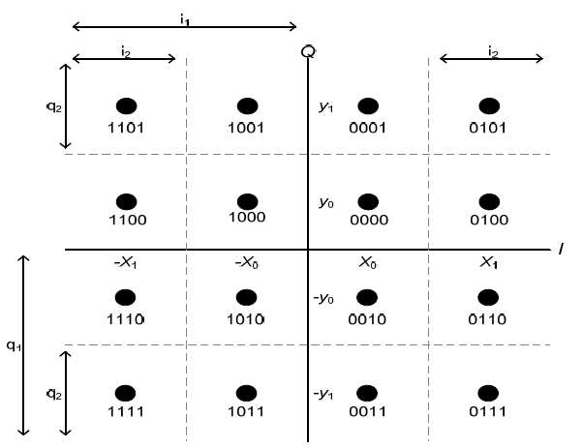
How to consider Superposition Transmission in WLAN
There are bits more reliable than others in a QAM constellation [4].
  The bits more reliable may be scheduled for a STA in lower SNR channel
  The bits less reliable may be scheduled for a STA in higher SNR channel
4 bits for 16-QAM: i₁i₂q₁q₂ where i₁i₂ are the in-phase components and q₁q₂ are the quadrature-phase components.
Here, i₁ and q₁ are the most reliable bits and i₂ and q₂ are the least reliable bits.
In the same way, for 6 bits (i₁i₂i₃q₁q₂q₃) of 64-QAM, i₁ and q₁ are the most reliable bits, i₂ and q₂ are the medium reliable bits, and i₃ and q₃ are the most reliable bits.
As for 256 QAM (i₁i₂i₃i₄q₁q₂q₃q₄) , i₁ and q₁ are the most reliable bits, i₂ and q₂ are the first medium reliable bits, i₃ and q₃ are the second medium reliable bits, and i₄ and q₄ are the least reliable bits.
16 QAM Constellation with Gray-mapping

Slide 10
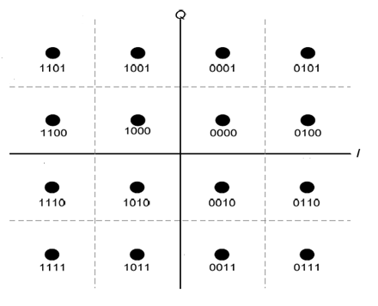
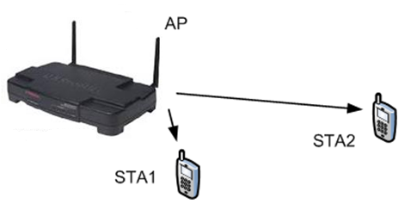
SOMA of WLAN
Those more and less reliable bits will be superposed in a constellation symbol for the scheduling of multiple STAs
  Semi Orthogonal Multiple Access (SOMA)
When the adaptive power ratio,
is 0.5 to the component constellations,
then the SOMA of WLAN is identical
to the SOMA of 3GPP LTE.
STA2
STA1

Slide 11
Summary
Superposition Transmission shows quite good throughput gain against the OFDMA transmission without it
SOMA achieves the same performance as the NOMA, but with the simpler receiver algorithm
Little change may be needed to the WLAN when we design the SOMA thoughtfully
Detail design, corresponding signaling, and the performance verification will follow

Slide 12
References
[1] Saito, et al, Non-Orthogonal Multiple Access (NOMA) for Cellular Future Radio Access, VTC’13, June 2013.
[2] 3GPP TSG RAN WG1 meeting 81, R1-152493
[3] 3GPP TSG RAN WG1 meeting 82, R1-156110
[4] S80216m-08_771r2, IEEE 802.16m-08_771r1, Enhanced HARQ Scheme with Signal Constellation Rearrangement

