Slide 1
Demand on Roaming for WUR
Date: 2016-07-25
Authors:
Name | Affiliation | Address | Email
Ke Yao | ZTE |  | yao.ke5@zte.com.cn
Bo Sun | ZTE |  | sun.bo1@zte.com.cn
Xuelin Zhang | ZTE |  | Zhang.x_l@zte.com.cn
Nan Li | ZTE |  | li.nan25@zte.com.cn

Slide 2
Abstract
The goal of WUR is to lower the power consumption of WLAN devices, especially to extend the battery life of the self-powered devices, to meet the requirement of very low power in IoT application.
In some IoT cases, the IoT terminals could move out of its original cell and into a new cell of the same WUR group during the deep sleep mode, while demanding to be waken up by the new cell for coming DL traffic.
We propose to consider the demand of power save requirements of roaming in WUR design.

Slide 3
Demand on Roaming in IoT
IoT applications with the demand on Roaming within a WUR group
Note: WUR group refers to a group of BSSs within which a served IoT terminal uses an unique wake-up ID
A lot of IoT applications request the IoT terminals to be moved when they are in deep sleep mode
WUR module is supposed to keep open and stay in a fixed channel(s) waiting for the wake-up signals
The WUR group roaming feature means the IoT terminals can be woken up by a new cell of the same WUR group.
More details are shown in the following slides

Slide 4
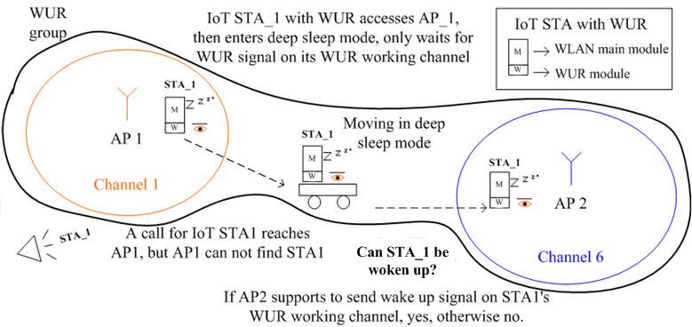
Demand on Roaming in IoT

Slide 5
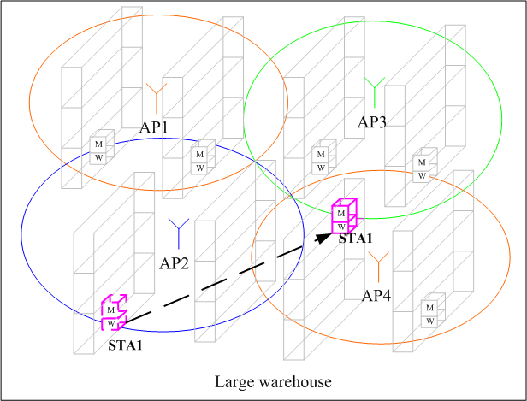
Use Cases 1
Storage
Large warehouses often have more than one cell, the goods may be attached with an IoT terminal, which could consist of a WLAN module with WUR
Goods needs to be moved from one cell’s coverage to another within a warehouse, most likely when the WLAN module s are in deep sleep mode
The administrator needs to track the goods for management purpose in every possible minute.

Slide 6
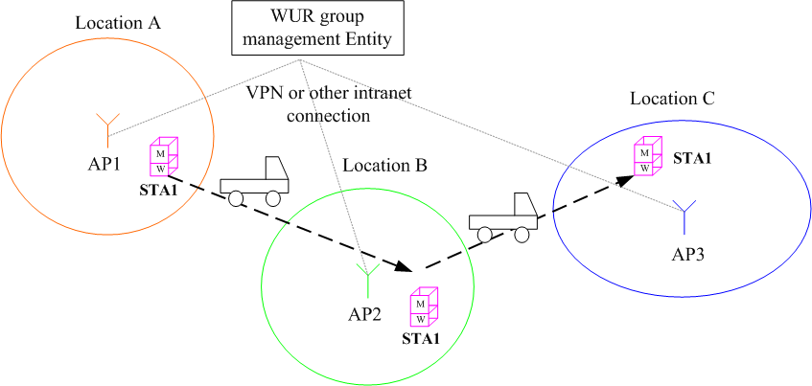
Use Cases 2
Freight-forwarding, express-delivery
During transportation the goods with WUR don’t need to report anything to a cell controller
In transfer stations, new cell controller needs to wake up the WUR for management

Slide 7
Analysis
WUR without roaming support
STA can not receive wake-up signal from its serving AP when it moves outside of the original cell. And the new cell will not wake it up because roaming is not supported. Then the STA must wake up its main module periodically to try to keep connection to a cell.
In some cases it’s not necessary for STA to wake up periodically, e.g. during transportation, it is a waste of power for unnecessary wake up.
WUR that supports roaming within WUR group
STA can be woken up on demand in the range of the whole WUR group.
Supporting roaming really needs higher layer network management, but at least WUR should take the roaming requirements into account during the scheme design, including but not limited to,
Wake up ID length
Fixed channel or flexible channel for WUR working channel
etc.

Slide 8
Conclusion
We discussed the demand on roaming within WUR group for some IoT applications
Suggest WUR to consider the power save requirements of roaming when discussing the detailed schemes.

Slide 9
Straw Poll
Do you agree that WUR should take into account the power save requirements of roaming?
Yes
No
Abstain

