Slide 1
EDMG-CEF Design for Control and SC PHY in MIMO Modes
Date: 2016-07-25
Authors:

Slide 2
Abstract
In this contribution we propose two EDMG-CEF design options for control and single carrier PHY to support 11ay SU and MU MIMO.

Slide 3
Background
TGay has agreed that 11ay will support SU-MIMO and MU-MIMO [1]
To support those MIMO schemes, it has also been agreed that the EDMG PPDU will have the following format [1]
“EDMG-CEF” needs to be designed to enable MIMO schemes.
It is desirable to design a set of orthogonal CE sequences, one for each spatial stream
  Analog beamforming may not be effective to completely separate spatial streams [3] [4]
L-STF | L-CEF | L-Header | EDMG-Header-A | EDMG-STF | EDMG-CEF | EDMG-Header-B | Data | AGC | TRN

Slide 4
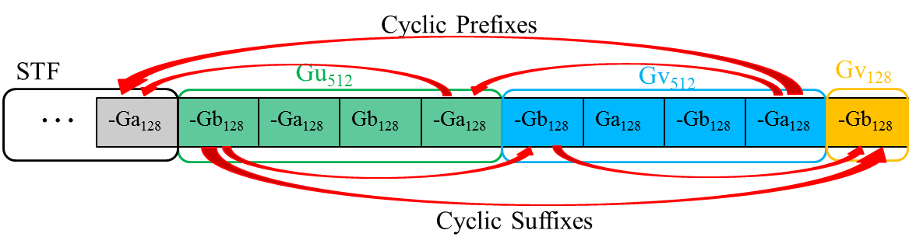


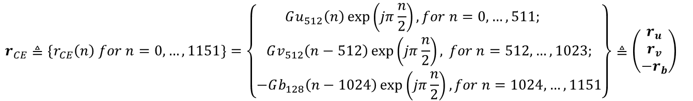
Properties of CEF in 11ad (1/2)
CEF for Control and SC PHY [2]
  Constructed using Golay complementary pair $(Ga_{128},Gb_{128})$
  “Circulant Property”: Having both cyclic prefix and cyclic suffix
Waveform (π/2 BPSK)
$$r_{CE}≜{\{r}_{CE}\left(n\right) for n=0,…,1151\}=\left\{\begin{matrix}Gu_{512}\left(n\right)\exp\left(jπ\frac{n}{2}\right), for n=0,…,511; \\ Gv_{512}\left(n−512\right)\exp\left(jπ\frac{n}{2}\right), for n=512,…,1023; \\ −Gb_{128}\left(n−1024\right)\exp\left(jπ\frac{n}{2}\right),for n=1024,…,1151\end{matrix}\right\}{≜\left(\begin{matrix}r_{u} \\ r_{v} \\ −r_{b}\end{matrix}\right)}_{}$$
$$r_{a}≜\left\{Ga_{128}\left(n\right)\exp\left(jπ\frac{n}{2}\right), n=0,1,…, 127\right\}$$

Slide 5

Properties of CEF in 11ad (2/2)
Cyclic Auto-Correlation of ${(r}_{u}, r_{v})$
  ${(r}_{u}, r_{v})$ is orthogonal to its up-to +/- 256-sample cyclic shifts
Using ${({−r}_{a},r}_{u}, r_{v}, −r_{b})$, the estimated channel impulse responses will not suffer from interference due to channel multipaths and sampling time offset up to +/- 256 samples
+/- 256 Samples

Slide 6
Variants of 11ad CEF
The length of 11ad CEF could be reduced by including only Gu512 or Gv512 (Reduced CEF)
  Reduces latency, but also reduces SNR and zero-correlation range
The length of 11ad CEF could also be extended by including multiple Gu512 and/or Gv512 (Extended CEF)
  Increases SNR and zero-correlation range, but also increases latency
In both cases, the circulant property is preserved.
STF
Reduced CEF
…
-Ga₁₂₈
Gu₅₁₂ or Gv₅₁₂
-Gb₁₂₈
+/- 128 Samples
STF
Extended CEF
…
-Ga₁₂₈
Gu₅₁₂ | Gv₅₁₂
Gu₅₁₂ | Gv₅₁₂
-Gb₁₂₈

Slide 7
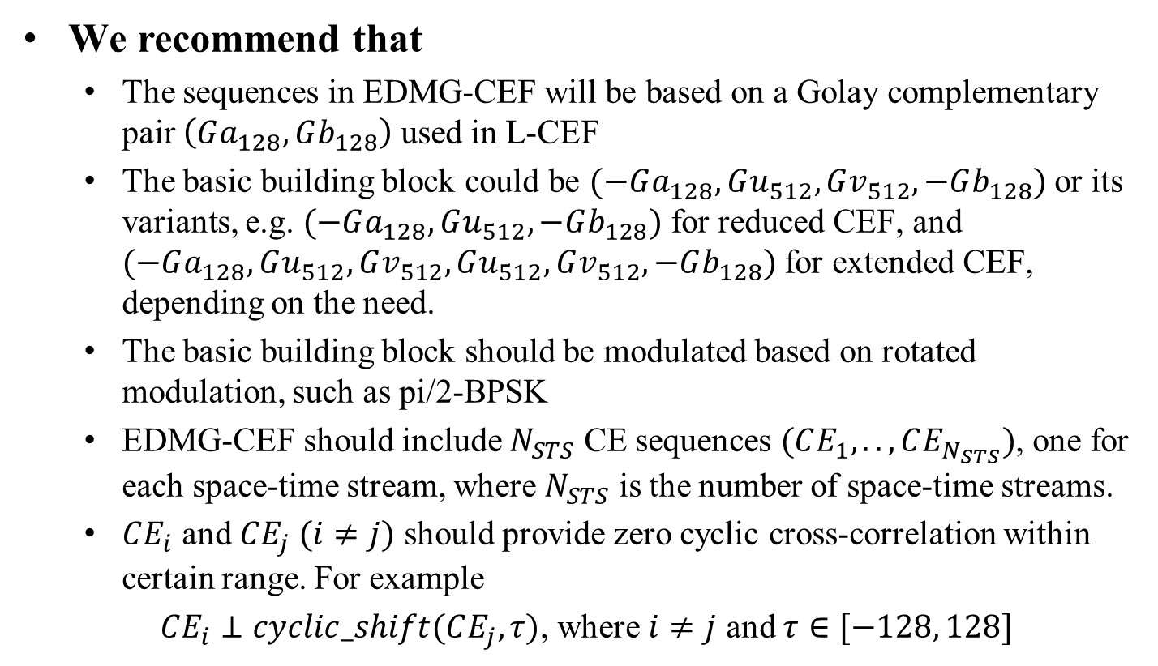
Proposals of EDMG-CEF for MIMO
We recommend that
  The sequences in EDMG-CEF will be based on a Golay complementary pair $\left(Ga_{128}, Gb_{128}\right)$ used in L-CEF
  The basic building block could be $(−Ga_{128},Gu_{512},Gv_{512},−Gb_{128})$ or its variants, e.g. $(−Ga_{128},Gu_{512},−Gb_{128})$ for reduced CEF, and $(−Ga_{128},Gu_{512},Gv_{512},Gu_{512},Gv_{512},−Gb_{128})$ for extended CEF, depending on the need.
  The basic building block should be modulated based on rotated modulation, such as pi/2-BPSK
  EDMG-CEF should include $N_{STS}$ CE sequences $(CE_{1}, .., CE_{N_{STS}})$, one for each space-time stream, where $N_{STS}$ is the number of space-time streams.
  $CE_{i}$ and $CE_{j} (i≠j)$ should provide zero cyclic cross-correlation within certain range. For example
  $CE_{i}⊥cyclic_shift(CE_{j}, τ)$, where $i≠j$ and $τ∈[−128, 128]$

Slide 8







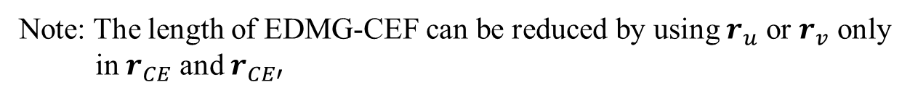


EDMG-CEF Options for Two-Stream MIMO (1/2)
Option 1: Using “P matrix” concept
  P matrix is an orthogonal matrix, e.g., $P=\left[\begin{matrix}1 & 1 \\ 1 & −1\end{matrix}\right]$
Stream 1
…
$${P_{11}(−r}_{a})$$
$$P_{11}r_{CE}$$
$${P_{12}r}_{CE′}$$
…
$${P_{21}(−r}_{a})$$
$$P_{21}r_{CE}$$
$${P_{22}r}_{CE′}$$
Stream 2
EDMG-CEF
This could be put at the end of EDMG-STF
$$r_{CE}≜(r_{u}, r_{v}, −r_{b})$$
$$r_{CE′}≜(−r_{a}, r_{u}, r_{v}, −r_{b})$$
Note: The length of EDMG-CEF can be reduced by using $r_{u}$ or $r_{v}$ only
in $r_{CE}$ and $r_{CE′}$

Slide 9








EDMG-CEF Options for Two-Stream MIMO (2/2)
Option 2: $CE_{2}$ = Conjugate($CE_{1}$)
Stream 1
…
$${−r}_{a}$$
$$r_{CE}$$
…
Stream 2
$$−r_{a}^{∗}$$
$$r_{CE}^{∗}$$
This could be put at the end of EDMG-STF
EDMG-CEF
Cyclic auto correlation
of $(r_{u}, r_{v})$
Cyclic auto correlation
of $(r_{u}^{∗}, r_{v}^{∗})$
Cyclic cross correlation
of $(r_{u}, r_{v})$and $(r_{u}^{∗}, r_{v}^{∗})$
Note: The length of EDMG-CEF can be extended by using multiple $r_{u}$ or/and $r_{v}$ in $r_{CE}$.

Slide 10
Simulation Results
Assume CIR:
h1(1)=1-j2; h1(20)=3-j4; h2(1)=-1+j2; h2(64)=-3+j4
Channel Estimation Using P-Matrix
Channel Estimation Using Conjugation

Slide 11
Further Design Considerations
In case of four-space-time-stream transmission, one can use either 4x4 P orthogonal matrix or combination of 2x2 P matrix and conjugation methods.
Reduced CEF and Extended CEF mechanisms can be used with trade-off between the latency and SNR, which may depend on the existence of LoS, antenna configurations, environment, etc.

Slide 12
References
[1] Carlos Cordeiro, “Specification Framework for TGay”, IEEE 802.11-15/01358r4
[2] Wireless LAN Medium Access Control (MAC) and Physical Layer (PHY) Specifications, Amendment 3: Enhancements for Very High Throughput in the 60 GHz Band
[3] Rui Yang, et. al., “Open Loop vs Closed Loop SU-MIMO for 11ay”, IEEE 802.11-16/0642r1
[4] Li-Hsiang Sun, et. al. “Link Level Performance Comparisons of Open Loop, Closed Loop and Antenna Selection for SU-MIMO”, IEEE 802.11-16/0911r0

Slide 13
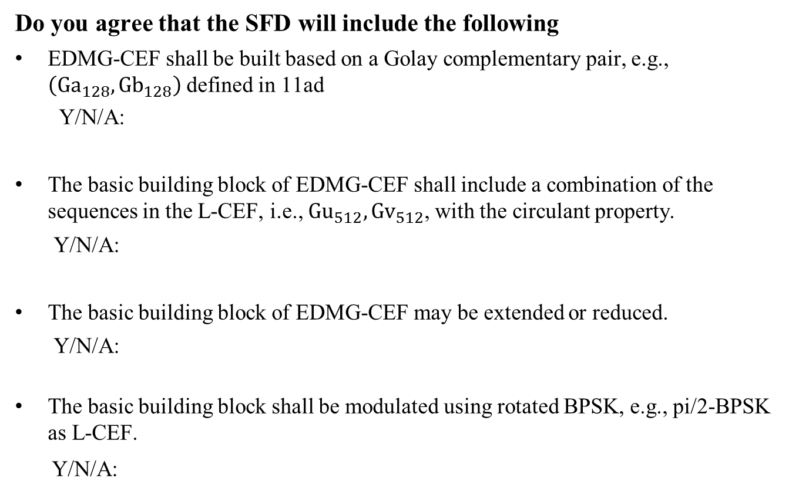
SP
Do you agree that the SFD will include the following
EDMG-CEF shall be built based on a Golay complementary pair, e.g., $\left(Ga_{128}, Gb_{128}\right)$ defined in 11ad
  Y/N/A:
The basic building block of EDMG-CEF shall include a combination of the sequences in the L-CEF, i.e., $Gu_{512},Gv_{512}$, with the circulant property.
    Y/N/A:
The basic building block of EDMG-CEF may be extended or reduced.
    Y/N/A:
  The basic building block shall be modulated using rotated BPSK, e.g., pi/2-BPSK as L-CEF.
  Y/N/A:

