Slide 1
DL MU-MIMO Hybrid BF and CSI Feedback for 11ay
Date: 2016-07-xx
Authors:

Slide 2
Introduction
In [1], DL MU-MIMO scheme and CSI feedback for 802.11ay was introduced.
DL MU-MIMO throughput might be degraded due to CSI feedback overhead.
In this presentation, we consider a new hybrid BF method which controls multiple pencil beams, and we show it enables DL MU-MIMO w/o CSI feedback.

Slide 3
CSI Feedback in 11ad
CSI can be reported in Channel Measurement Feedback element of BRP frame in 11ad
Payload size of the frame is calculated as
MAC Header(28) + FCS(4) + Body(14 + x) = 46 + x [octets]
x: Channel Measurement Feedback Element size
BRP frame
Octets
2
2
6
6
6
2
4
0-2328
4
Frame Control
Duration
Address 1
Address 2
Address 3
Sequence Control
HT Control
Frame Body
FCS
Octets
1
1
1
4
7
x
Category
Unprotected DMG Action
Dialog Token
BRP Request field
DMG Beam Refinement element
Channel Measurement Feedback element
Octets
1
1
N_{meas}
2N_{taps}N_{meas}
N_{taps}
N_{meas}
Element ID
Length
SNR
Channel Measurement
Tap Delay
Sector ID Order
N_{meas}: number of measurements
N_{taps}: number of taps

Slide 4
CSI Feedback Overhead
CSI feedback consumes about 3us ~ 4us per STA when each STA reports SNR & Channel measurement with MCS4 in 11ad
STF + CEF + Header : 2.5us
Payload length: 0.4 ~ 1.7us
Payload size: 46 + x octets
Channel Measurement Feedback element size(x): 2 + N_{meas} + 2N_{meas} octets (N_{meas}: up to 64) (when N_{taps} = 1)
MCS4 (Single Carrier): data rate is 1152Mbps
Total duration of CSI feedback from all STAs in MU-MIMO operation is estimated as several ten [us] or more.
Thus, DL MU-MIMO operation that cause little interference between STAs w/o CSI feedback is preferred.
Channel Measurement Feedback element
Octets
1
1
N_{meas}
2N_{meas}
Element ID
Length
SNR
Channel Measurement

Slide 5
DL MU-MIMO w/o CSI
When AP forms broad beams for DL MU-MIMO operation,
large interference occurs between beams
CSI is important to mitigate interference
But when AP forms sharp beams for DL MU-MIMO operation,
large interference does not occur between beams
CSI is not needed
MU-MIMO with broad beam
MU-MIMO with sharp beam
AP
STA
AP
STA
large interference
little interference
STA
STA

Slide 6
Interleaved Hybrid BF Method
We propose an interleaved hybrid BF method.
Multiple pencil beams can be created by applying digital beamforming in an interleaved subarray configuration.
Conventional hybrid BF
Proposed hybrid BF
B
A
A
B
D/A
D/A
A+B
D/A
D/A
A-B
digital beamforming
digital beamforming
A
B
A
B

Slide 7
Principle of Interleaved HBF Method
In the interleaved hybrid BF, a beam of each subarray has main lobe and grating lobes because of large antenna spacing.
Phase difference between the main lobe and each grating lobe is different from each subarray.
Thus, by combining the beams via digital beamforming, each user’s signal can be transmitted in each of the main lobe or the grating lobes directions.
B
subarray#1
subarray#2
A
phase:0deg
phase:0deg
phase:0deg
phase:180deg
A+B
D/A
D/A
A-B
D/A
D/A
D/A
D/A
B
A
B
digital beamforming
A
A
B

Slide 8
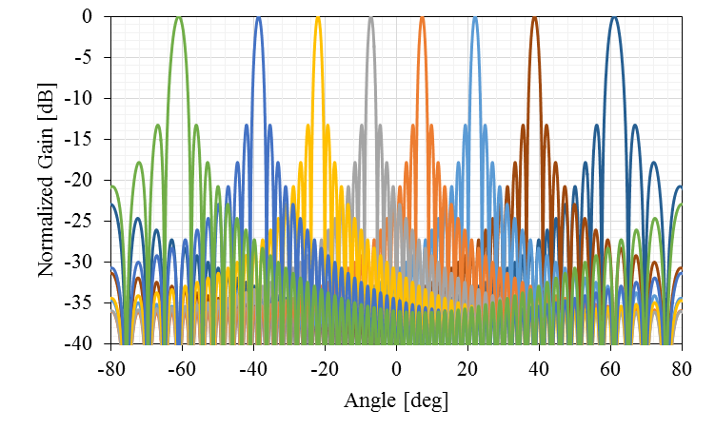
Beam Pattern of Interleaved HBF
Interleaved HBF can create very sharp beams, which cause little interference to each other in main lobe region.
Thus, MU-MIMO operation w/o CSI feedback is possible by using this method.
Beam pattern (3dB beam width: 1.6degrees)
64 antennas
8 subarrays
0.5 wavelength antenna spacing

Slide 9
Conclusions
CSI feedback overhead in DL MU-MIMO operation is evaluated.
A new interleaved hybrid BF method for MU-MIMO is proposed.

Slide 10
STRAW POLL 1
Do you agree to insert the following text into the SFD “11ay supports MU-MIMO BF with or without CSI feedback.“
Yes
No
Abstain

Slide 11
Reference
[1] IEEE 802.11-16/0405r1, “11ay DL MU-MIMO BF Training and User Selection”

Slide 12
Appendix

Slide 13
Principle of Interleaved HBF Method 1
In the interleaved hybrid BF, each subarray creates main lobe and grating lobes, and their phases are different from each subarray
beam pattern of subarray#i
$v_{i}\left(θ\right)=\sum_{k=0}^{K/M−1}{exp\left[j2π\frac{d}{λ}\left(i+kM\right)\left(\sin{θ}−\sin{θ_{0}}\right)\right]}$
grating lobes are formed in direction $θ_{m}$ that satisfy
$\sin{θ_{m}}−\sin{θ_{0}}=m\frac{λ}{Md} (m=±1,±2,…)$ ($θ_{m=0}$: main lobe direction)
beam pattern in $θ_{m}$: $v_{i}\left(θ_{m}\right)=\frac{K}{M}exp\left[j2π\frac{im}{M}\right]$
$θ_{0}$:beam direction
λ:wavelength
phase:0deg
phase:0deg
phase:0deg
phase:180deg
d
d
K
K
M
D/A
D/A
M
D/A
D/A
A
B
A
B

Slide 14
Principle of Interleaved HBF Method 2
The beams of subarrays are combined with inter-subarray coding weight for equal-phase combining in n-th lobe direction
$\sum_{i=0}^{M−1}{v_{i}\left(θ_{m}\right)exp\left[−j2π\frac{in}{M}\right]}=\frac{K}{M}\sum_{i=0}^{M−1}{exp\left[j2π\frac{i\left(m−n\right)}{M}\right]}=\left\{\begin{matrix}K if m=n \\ 0 if m ≠n\end{matrix}\right.$
In this method, multiple beams without inter-beam interference can be created in each directions satisfy $\sin{θ_{m}}−\sin{θ_{0}}=m\frac{λ}{Md}$
2B = (A+B) – (A-B)
2A = (A+B) + (A-B)
K
A+B
D/A
D/A
A-B
M
Inter-subarray coding
A
B

