Slide 1
Potential of channel access for 11ay
Date: 2016-07-22
Authors:

Slide 2
Abstract
This contribution describes the potential of enhanced channel access for mobile offloading in the outdoor open area .
  The mmW system using high power transmission and beam forming encounters the directional hidden terminal problem.

Slide 3
Background
Mobile Offloading is an important use case to address increasing traffic.
  Wi-Fi Alliance gives the 2nd priority to mobile offloading [1].
  Especially, we consider offloading in dense outdoor area important.
Slide 3

Slide 4
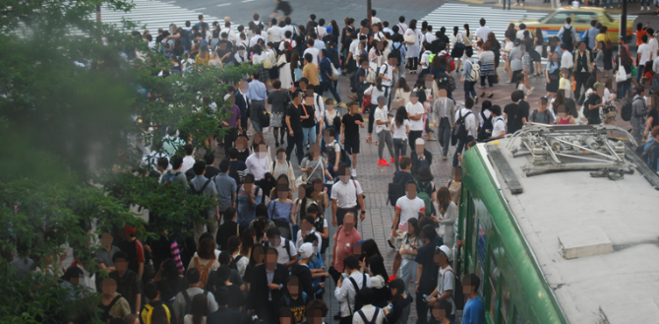
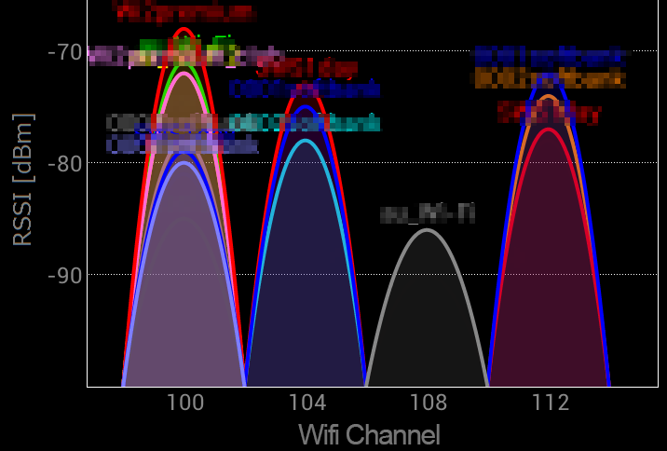
Background (Cont.)
Outdoor open area: high density and overlapped APs.
An example of outdoor open area in Japan
Population density
Utilization of 5GHz
High density users
MAX 6 APs overlap
on the same channel
TX power limitation of 60GHz band: EIRP <= 40dB,
  Maximum EIRP is limited to 40dBm in some regions.
  Note: Japanese regulation was revised.
    Maximum TX power : 10 mW → 250 mW (and EIRP <= 40dBm)
Slide 4

Slide 5

Potential Issues in outdoor open area
Beam forming (BF) may cause an additional problem; the directional hidden terminal problem.
  On the other hand, sharp beam forming in mmW may be able to mitigate interference.
Directional hidden terminal problem
1. AP1 is transmitting signal to STA1
STA1
AP1
Interference
2. AP2 start to transmit signal because AP2 cannot sense the medium was busy due to BF.
STA2
AP2

Slide 6
Simulation Models
We introduce individually the dense APs (DA) model to simulate a high density environment.
  Base model is MAC-layer SLS scenario 3 [2].
  The DA model includes multi-operators. Related parameters are shown in Table 1.
Operator#1’s AP
・
・
Operator#2’s AP
x19
・
・
Table 1. layout parameters
・
・
・
Parameters / model | DA | MAC SLS
The number of operator (OP) | 2 | 1
The number of APs per OP in one grid | 3 | 1
The number of STA per OP in one grid | 50 | 50
・
・
・
・
・
130m
・
・
・
・
・
・
・
Frequency reuse1
・

Slide 7
Simulation Models (Cont.)
Traffic:
  Full buffer model (DL Data + UL L2 ACK).
Beamforming model:
  TX: Basic Steerable Directional Antenna Model of 11ad [3]
    Half-value angle (θ_{-3dB}) : 15 or 60 degree
  RX: 3dBi Omni
TX power limitation:
  Maximum EIRP: 40dB
  Maximum TX power: 250mW (AP), 20mW (STA)
Frame format:
  11ad DMG-SC (MCS 1-12)
Propagation model:
  D-rays modeling (Direct ray only) [4]
Other parameters are shown in Appendix 1.

Slide 8
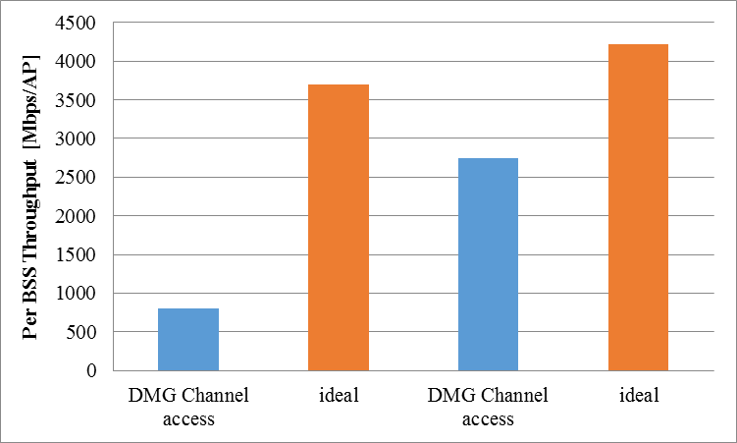
Simulation Results
Simulation result shows the negative impact of directional hidden terminal problem.
  We think that it is necessary to study solution about this problem.
  The use of shaper beam mitigates the degradation in the throughput.
DMG channel access
  APs start to transmit data packets when CSMA/CA mechanism is completed.
  Note: APs cannot sense signals from other APs due to the long distance.
Ideal
  We assume that APs can ideally avoid the interference. Therefore, Per BSS throughput depends on SNR and MCS only.
1.4Gbps
2.9Gbps
Data retry
25%
Data retry
65%
θ_{-3dBm}=60°
θ_{-3dBm}=15°
Notes:
★値の正当性
■ IntelのSim
5%値：1.5Gbps
50%値：2.3Gbps
95%値：4.5Gbps
■ KDDIのSim
5%値：1.5Gbps
50%値：2.5Gbps
95%値：4.0Gbps

Slide 9
Examples of enhanced DMG channel access
We think that enhanced DMG channel access improves throughput in outdoor open area.
    Ex 1) Possible measures for the directional hidden terminal problem
    RTS/CTS beam-formed
    Other feedback procedure from STA
    Ex 2) Channel efficiency improvement
    If AP can estimate whether interference occurs between other pair, BF transmission without relying on CCA status can improve spatial capacity.
CCA status = busy
STA2
# AP1 is sending data to STA1
AP2
AP1
STA1

Slide 10
Straw poll
  Do you agree to study channel access scheme to improve mmW performance in outdoor usage as described in this submission?
  Yes:
  No:
  Abstain:
  # This straw poll is not for motion.

Slide 11
References
[1] IEEE 802.11-15/934r0: Wi-Fi Alliance feedback on 802.11 Task Group AY usage models
[2] IEEE 802.11-09/0296r16: TGay Evaluation Methodology
[3] IEEE 802.11-09/0334r08: Channel Models for 60 GHz WLAN Systems
[4] IEEE 802.11-15/1150r03: Channel Models for IEEE 802.11ay

Slide 12
Appendix

Slide 13
Appendix 1. Evaluation Assumptions in dense APs (DA) model
Parameters |  | value
Layout | STA deployment | Uniform random
 | Wrap-around | no use
 | height | AP: 6 [m], STA: 1.5 [m]
Frequency | Center frequency | 58.32 [GHz]
 | Band width | 1.76 [GHz]
Channel model | D-rays modeling | LOS, Q-D Free space + O2 absorption 【Note】 O2 absorption parameter: -13 [dBm/m]
Frame format | Packet length | 8192 [byte] * 33 [A-MPDU]
Other | ACK timeout timer | 50 [us]
 | Maximum number of retransmission | 6 [times]

