Slide 1
Issue of Buffer Status reporting
Date: 2016-07-25
Authors:
Name | Affiliation | Address | Email
Stéphane BARON | Canon | Cesson-Sevigné, France | stephane.baron@crf.canon.fr
Patrice NEZOU |  |  | patrice.nezou@crf.canon.fr
Romain GUIGNARD |  |  | romain.guignard@crf.canon.fr
Pascal VIGER |  |  | pascal.viger@crf.canon.fr

Slide 2
Introduction
One of the main features introduced in 11ax is UL MU operation
  AP allocates UL resources used by multiple STAs to transmit their data
For an efficient allocation the AP needs to know UL buffer status (BS) of its STAs. The BS knowledge allows the AP to:
  Allocate resources to those STAs that have something to transmit in UL
  Calculate correctly the UL resources needed by the STAs.
In this contribution, we suggest addressing the unmanaged P2P flows in order to increase efficiency of buffer status reporting.
This contribution addresses two CIDS: #178, #1066.

Slide 3
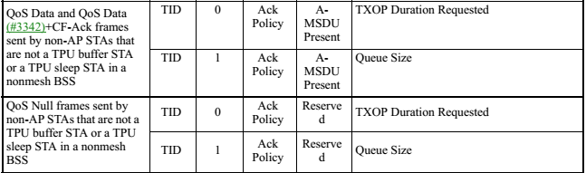
QoS Control field
QoS Control field ([4] table 9-6)
  BS information is only related to the TID of the current data frame.
  “The Queue Size subfield… indicates the amount of buffered traffic at the STA sending this frame.”
BSR A-Control, in HE Control field [2]
  Used to allow HE STA to send a buffer status information for multiple TIDs/ACs
“BS Report”
Control ID: 3
Buffer Status Report
TBD

Slide 4
Problem Statement
P2P transmissions in between non-AP STAs :
  Example protocols: Direct Link (DLS), or TDLS, or WiFi-Miracast
  Wireless Display scenario, from Evaluation Methodology Document [3]:
    typically low-compressed video, which requires huge bandwidth (from 1080p60 up to 8K UHD).
Issue :
  Even if such flows are not numerous, the amount of data per flow is huge.
  At the minimum, the AP, which is the central control entity for UL MU allocation, should not be misinformed by such amount of data waiting in STA queue(s).
  Otherwise, AP grants UL resources to a STA … which finally is not able to use the offered resource ! (because this is not uplink data)

Slide 5
Proposal (1/2)
Specify that a HE STA avoids counting P2P traffic for its Buffer Status Report
Add into Draft spec 0.2:
  25.5.2.5 HE buffer status feedback operation for UL MU :
    To report the buffer status, an HE STA shall only consider the amount of data queued in uplink direction to the AP.
    For example, this report does not include transmissions from HE STA to a peer non-AP STA once a direct link transmission is established in between.
[ST#1]

Slide 6
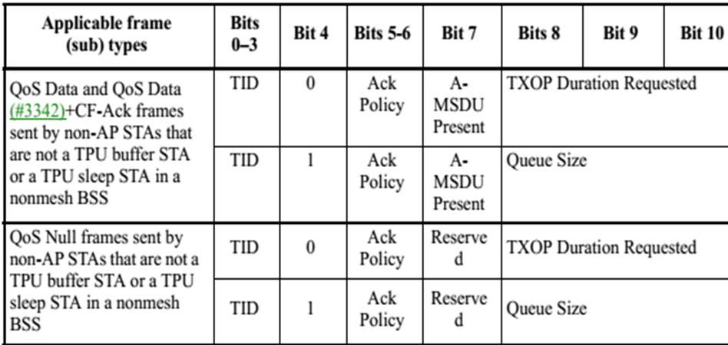
Proposal (2/2)
“QoS Control field” usage for HE STA :
  Legacy BSR inside QoS Data/Null frames
Add into Draft spec 0.2:
  clause 9.2.4.5.6 : Queue Size subfield
    “Queue Size” indicates the amount of buffered traffic to be sent to the STA receiving this frame; and excludes MSDU or A-MSDU not intended to the receiving STA.
  clause 9.2.4.5.7 : TXOP Duration Requested subfield
    “TXOP Duration Requested” is used by a STA to indicate its need for its next TXOP.
    Duration seems not relevant for UL MU (meaningless): even if duration value may be 20MHz-normalized, AP finally decides of STA configuration (e.g. RU size, MCS).
    Proposal: forbid usage of “TXOP Duration” format for HE STA (in favor of only using the “queue size” format) for HE buffer status feedback operation for UL MU.
[ST#2]
[ST#3]

Slide 7
Conclusion
We note that a HE STA should build a buffer status information only with regards to uplink transmissions (that is to say, directed towards or relayed by the AP).
The direct link transmissions (also called unmanaged P2P) must not be considered once the direct link session is established.

Slide 8
Straw Poll 1
Do You agree to add to the 802.11ax draft specification v0.2 the following text :
  25.5.2.5 HE buffer status feedback operation for UL MU :
    {end of chapter}
    To report the buffer status, an HE STA shall only consider the amount of data queued in direction to the AP (for uplink transmission).
    For example, this report does not include transmissions from HE STA to a peer non-AP STA once a direct link transmission is established in between.
Y/N/A

Slide 9
Straw Poll 2
Do You agree to modify the 802.11ax draft specification v0.2 according to the following text:
  9.2.4.5.6 Queue Size subfield
  The Queue Size subfield is an 8-bit field that indicates the amount of buffered traffic, to be sent to the station receiving this frame, for a given TC or TS at the STA sending this frame.
  The queue size value is the total size, (…), of all MSDUs and A-MSDUs buffered at the STA (excluding the MSDU or A-MSDU of the present QoS Data frame, and excluding MSDU or A-MSDU not intended to the receiving STA) in the delivery queue used for MSDUs and A-MSDUs with TID values equal to the value in the TID subfield of this QoS Control field.
Y/N/A

Slide 10
Straw Poll 3
Do You agree to add to the 802.11ax draft specification v0.2 the following text:
  9.2.4.5.7 TXOP Duration Requested subfield
  During HE buffer status feedback operation for UL MU, the “TXOP Duration Requested” subfield format is not used in QoS Data frames sent by HE STAs.
  Instead, an HE STA shall only use the “queue size” format in QoS Data frames.
Y/N/A

Slide 11
References
[1] 11-15/0132r15 “Tgax Specification Framework”,
[2] 11-16/0628r1 “Buffer Status Report in HE Control field”
[3] 11-14/0571r10 “Evaluation Methodology Document”, Appendix 2 – Traffic model descriptions
[4] IEEE P802.11-REVmc/D5.3

