Slide 1
TGax PHY Ad Hoc May 2016 Meeting Agenda
Date: 2016-05-17
Authors:

Slide 2
IEEE 802.11 TGax
High Efficiency WLAN
PHY Ad Hoc
Co-Chairs:
Bo Sun (ZTE)
Jianhan Liu (Mediatek)
Hongyuan Zhang (Marvell)

Slide 3
Agenda Items
Call meeting to order
Patent policy, etc. (Call for Potentially Essential Patents)
Review ad hoc rules
Set and approve agenda
Technical Presentations approved by 802.11ax for presentation this week, and related straw polls
  Proposals impact the SFD will be prioritized, then CRs.
Any other technical presentations
Bo Sun (ZTE)

Slide 4
Meeting Protocol, Attendance, Voting & Document Status
Please announce your affiliation when you first address the group during a meeting slot
Cell Phones to be silent or Off
Register your attendance via https://imat.ieee.org while on meeting SSID (e.g. Verilan-secure)
Make sure your badges are correct
If you plan to make a submission be sure it does not contain company logos or advertising
Questions on Voting status, Ballot pool, Access to Reflector, Documentation, Member’s Area
  Contact Jon Rosdahl – jrosdahl@ieee.org
Slide 4

Slide 5
Patent Policy and Other Guidelines
Following 5 slides

Slide 6
Instructions for the WG Chair
The IEEE-SA strongly recommends that at each WG meeting the chair or a designee:
  Show slides #1 through #4 of this presentation
  Advise the WG attendees that:
    The IEEE’s patent policy is consistent with the ANSI patent policy and is described in Clause 6 of the IEEE-SA Standards Board Bylaws;
    Early identification of patent claims which may be essential for the use of standards under development is strongly encouraged;
    There may be Essential Patent Claims of which the IEEE is not aware. Additionally, neither the IEEE, the WG, nor the WG chair can ensure the accuracy or completeness of any assurance or whether any such assurance is, in fact, of a Patent Claim that is essential for the use of the standard under development.
  Instruct the WG Secretary to record in the minutes of the relevant WG meeting:
    That the foregoing information was provided and that slides 1 through 4 (and this slide 0, if applicable) were shown;
    That the chair or designee provided an opportunity for participants to identify patent claim(s)/patent application claim(s) and/or the holder of patent claim(s)/patent application claim(s) of which the participant is personally aware and that may be essential for the use of that standard
    Any responses that were given, specifically the patent claim(s)/patent application claim(s) and/or the holder of the patent claim(s)/patent application claim(s) that were identified (if any) and by whom.
  The WG Chair shall ensure that a request is made to any identified holders of potential essential patent claim(s) to complete and submit a Letter of Assurance.
  It is recommended that the WG chair review the guidance in IEEE-SA Standards Board Operations Manual 6.3.5 and in FAQs 12 and 12a on inclusion of potential Essential Patent Claims by incorporation or by reference.
  Note: WG includes Working Groups, Task Groups, and other standards-developing committees with a PAR approved by the IEEE-SA Standards Board.

Slide 7
Participants, Patents, and Duty to Inform
All participants in this meeting have certain obligations under the IEEE-SA Patent Policy. Participants:
  “Shall inform the IEEE (or cause the IEEE to be informed)” of the identity of each “holder of any potential Essential Patent Claims of which they are personally aware” if the claims are owned or controlled by the participant or the entity the participant is from, employed by, or otherwise represents
    “Personal awareness” means that the participant “is personally aware that the holder may have a potential Essential Patent Claim,” even if the participant is not personally aware of the specific patents or patent claims
  “Should inform the IEEE (or cause the IEEE to be informed)” of the identity of “any other holders of such potential Essential Patent Claims” (that is, third parties that are not affiliated with the participant, with the participant’s employer, or with anyone else that the participant is from or otherwise represents)
  The above does not apply if the patent claim is already the subject of an Accepted Letter of Assurance that applies to the proposed standard(s) under consideration by this group
Quoted text excerpted from IEEE-SA Standards Board Bylaws subclause 6.2
Early identification of holders of potential Essential Patent Claims is strongly encouraged
No duty to perform a patent search
Slide #1

Slide 8
Patent Related Links
  All participants should be familiar with their obligations under the IEEE-SA Policies & Procedures for standards development.
  Patent Policy is stated in these sources:
  IEEE-SA Standards Boards Bylaws
  http://standards.ieee.org/guides/bylaws/sect6-7.html#6
  IEEE-SA Standards Board Operations Manual
  http://standards.ieee.org/guides/opman/sect6.html#6.3
  Material about the patent policy is available at
  http://standards.ieee.org/board/pat/pat-material.html
If you have questions, contact the IEEE-SA Standards Board Patent Committee Administrator at patcom@ieee.org or visit http://standards.ieee.org/board/pat/index.html
This slide set is available at http://standards.ieee.org/board/pat/pat-slideset.ppt
Slide #2

Slide 9
Call for Potentially Essential Patents
If anyone in this meeting is personally aware of the holder of any patent claims that are potentially essential to implementation of the proposed standard(s) under consideration by this group and that are not already the subject of an Accepted Letter of Assurance:
  Either speak up now or
  Provide the chair of this group with the identity of the holder(s) of any and all such claims as soon as possible or
  Cause an LOA to be submitted
Slide #3

Slide 10
Other Guidelines for IEEE WG Meetings
All IEEE-SA standards meetings shall be conducted in compliance with all applicable laws, including antitrust and competition laws.
  Don’t discuss the interpretation, validity, or essentiality of patents/patent claims.
  Don’t discuss specific license rates, terms, or conditions.
    Relative costs, including licensing costs of essential patent claims, of different technical approaches may be discussed in standards development meetings.
      Technical considerations remain primary focus
  Don’t discuss or engage in the fixing of product prices, allocation of customers, or division of sales markets.
  Don’t discuss the status or substance of ongoing or threatened litigation.
  Don’t be silent if inappropriate topics are discussed … do formally object.
---------------------------------------------------------------
See IEEE-SA Standards Board Operations Manual, clause 5.3.10 and “Promoting Competition and Innovation: What You Need to Know about the IEEE Standards Association's Antitrust and Competition Policy” for more details.
Slide #4

Slide 11
Ad Hoc Groups Operation
Straw Polls are only allowed during Ad Hoc group meeting // no motions, anyone can vote
A straw poll affecting the Spec Framework has to start with,
  Do you agree to add to the TG Specification Frame work document?
A straw poll needs to achieves at least 75% to be converted to a motion at the TG level.
Each Presentation will be limited to 15 minutes.

Slide 12
TGax PHY Schedule in a Glance
 | Monday |  | Tuesday |  | Wednesday |  | Thursday
AM1
AM2 | TGax |  | PHY | MAC/SR |  |  | TGax
PM1 |  |  |  |  | PHY | MAC/SR
PM2 | PHY | MAC/SR | PHY | MU | PHY | MAC/SR | TGax
EVE | PHY | MU | TGax

Slide 13
PHY Submissions (1/3)
Notes:
  Docs in green color have been presented.
  Docs in red color have been withdrawn.
  Docs in black color have NOT been presented.
DCN | Title | Author | Ad Hoc
11-16/0608 | Beamforming Feedback Report Structure | Sameer Vermani | PHY
11-16/0611 | Remaining Issues in Trigger Frame Design | Sameer Vermani | PHY
11-16/0613 | SIG-B Related Issues | Lochan Verma | PHY
11-16/0617 | Remaining Topics in Power Control | Bin Tian | PHY
11-16/0618 | 11ax CSD Design | Bin Tian | PHY
11-16/0619 | PAPR Reduction of HE-SIGB | Bin Tian | PHY
11-16/0620 | DCM PHY Parameters | Hongyuan Zhang | PHY
11-16/0621 | DCM Interleaver | Tianyu Wu | PHY
11-16/0655 | On MCS0 DCM Modulation and DCM Capability | Jianhan Liu | PHY
11-16/0622 | 16 QAM Napping for DCM | Sudhir Srinivasa | PHY

Slide 14
PHY Submissions (2/3)
Notes:
  Docs in green color have been presented.
  Docs in red color have been withdrawn.
  Docs in black color have NOT been presented.
DCN | Title | Author | Ad Hoc
11-16/0626 | Feedback Element Compression for 802.11ax | Kome Oteri | PHY
11-16/0633 | Left over Issues in RU Signaling for HE-SIGB | Yan Zhang | PHY
11-16/0635 | BW indication for Non-contiguous Channel Bonding | Yunbo Li | PHY
11-16/0636 | TXOP Duration field in HE-SIG-A | Jeongki Kim | PHY
11-16/0637 | Load balancing indication for MU-MIMO over 484-tone and larger RU in OFDMA | Ming Gan | PHY
11-16/0638 | Discussions for Non-contiguous Channel Bonding | John Son | PHY
11-16/0639 | Follow-up on HE-SIG-B user-specific field | Jinsoo Choi | PHY
11-16/0649 | Feedback Tone Map and Quantization | Sriram Venkateswaran | PHY
11-16/0652 | Power scaling of 4 extra tones | Xiaogang Chen | PHY
11-16/0654 | CP and LTF Options and Signaling | Ron Porat | PHY
11-16/0656 | 1024QAM Modulation | Jianhan Liu | PHY

Slide 15
PHY Submissions (3/3)
Notes:
  Docs in green color have been presented.
  Docs in red color have been withdrawn.
  Docs in black color have NOT been presented.
DCN | Title | Author | Ad Hoc
11-16/0610 | CR HE-SIG-A Part I | Ross Jian Yu | PHY
11-16/0614 | Comment Resolution on Clause 26.1.1 Part 1 | Lochan Verma | PHY
11-16/0615 | Comment Resolution on Clause 26.3.12 Part 1 | Lochan Verma | PHY
11-16/0623 | CR on Section 26.3.10.12 | Bin Tian | PHY
11-16/0625 | CR on Section 26.3.6 | Bin Tian | PHY
11-16/0634 | 11ax Comment Resolutions for Clauses 26.3.2 | Yan Zhang | PHY
11-16/0653 | CR on section 26.3.3 | Xiaogang Chen | PHY
11-16/0658 | CR on 26.3.7.1 | Jinsoo Choi | PHY
11-16/0659 | CR on 26.3.9.9 and 26.3.5 | Eunsung Park | PHY
11-16/0663 | CR on Secition 26.2.2 | Ke Yao | PHY
11-16/0681 | Comment Resolution CID 215 2486 | Daewon Lee | PHY
11-16/0682 | CR CID on PHY data field other | Daewon Lee | PHY

Slide 16
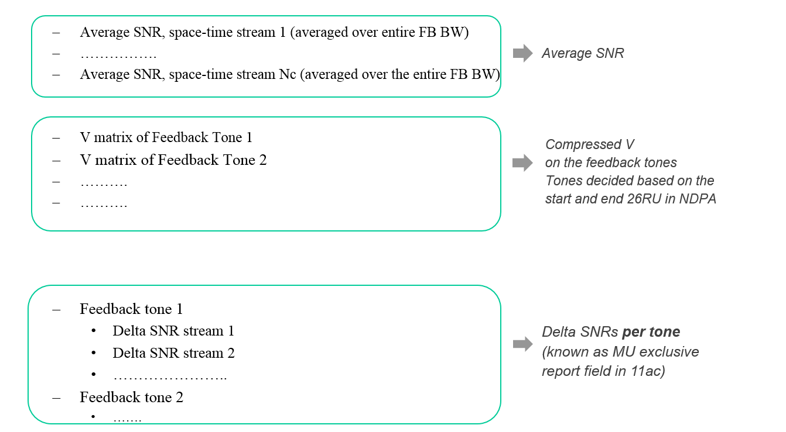
Straw-poll 1 (#1, 11-16/0608r0)
Do you agree to add the following feedback structure for MU type feedback to 11ax SFD:
46Y/0N/3A; SP passed.

Slide 17
Straw-poll 2 (#2, 11-16/0608r0)
Do you agree to add the following feedback structure for SU type feedback to 11ax SFD?
  Average SNR, space-time stream 1 (averaged over entire FB BW)
  …………….
  Average SNR, space-time stream Nc (averaged over entire FB BW)
  V matrix of Feedback Tone 1
  V matrix of Feedback Tone 2
  ……….......
Average SNR
Compressed V
on the feedback tones
Tone decided based on
start and end 26RU in NDPA
SP passed without objection

Slide 18
Straw-poll 3 (#3, 11-16/0608r0)
Do you agree to add the following feedback structure for CQI feedback to 11ax SFD :
  1st RU26
    Stream 1 SNR (only one number per RU)
    Stream 2 SNR (only one number per RU)
    ….....
  2nd RU26
    …….
    …….
  ……
  Each SNR is an absolute number represented by 6 bits, with 1 dB granularity and a range of -10 dB to 53 dB
Absolute SNRs per RU26
SP passed without objection

Slide 19
Straw-poll 4 (#4, 11-16/0608r0)
Do you agree to adopt the following design for the HE-MIMO control field and add it to the 11ax SFD?
  Changes from VHT are listed below
  BW (2 bits) – Same meaning as channel width field of VHT
  RU_Start_Index (7 bits) : The index of the first RU26 of the feedback being sent
  RU_End_Index (7 bits) : The index of the last RU26 of the feedback being sent
  Grouping is 1 bit
    0: Ng=4, 1: Ng=16
  Feedback type is 2 bits
    0: SU, 1: MU, 2: CQI only, 3: Reserved
  4 bits unused (reserved)
SP passed without objection

Slide 20
Straw-Poll 5 (#1, 11-16/0611r0)
Do you agree to add the following to the SFD?
  “BW subfield length in the Common Info Field of the Trigger frame is 2 bits”
SP passed without objection

Slide 21
Straw-Poll 6 (#2, 11-16/0611r0)
Do you agree to add the following to the SFD?
  “PE subfield length in the Common Info Field of the Trigger frame is 3 bits”
SP passed without objection

Slide 22
Straw-Poll 7 (#3, 11-16/0611r1)
Do you agree to add the following to the SFD?
  ‘CP and LTF Type’ subfield length in the Common Info Field of the Trigger frame is 2 bits”
SP passed without objection

Slide 23
Straw-Poll 8 (#4, 11-16/0611r0)
Do you agree to add the following to the SFD?
  The AP specifies in the Trigger frame, the value of SR and Reserved bits which is used by the STA in HE-SIG-A of a trigger-based PPDU.
SP passed without objection

Slide 24
Straw-Poll 9 (#5, 11-16/0611r0)
Do you agree to add the following to the SFD ?
  The HE AP shall set the MU MIMO LTF Mode bit in the trigger to indicate:
    Single-stream pilots for any OFDMA transmission (including the case where MU-MIMO happens on part of the BW)
    The appropriate LTF mode (single stream pilots or masked LTFs) for full BW MU-MIMO
SP passed without objection

Slide 25
Straw-Poll 10 (#6, 11-16/0611r0)
Do you agree to add the following ordering of the common info fields of the trigger frame to the SFD?
SP passed without objection

Slide 26
Straw-Poll 11 (#1, 11-16/0613r0)
Do you agree to add the following to the 11ax SFD ?
  “AID value of 2046 is reserved to indicate unallocated RUs in the user-specific HE-SIG-B content blocks”
SP passed without objection

Slide 27
Straw-Poll 12 (#2, 11-16/0613r0)
Do you agree to add the following to the 11ax SFD ?
  “For an 80 MHz and 160 MHz PPDUs, in each SIG-B content channel, the HE-SIG-B common blocks of the multiple 20MHz channels that the content channel corresponds to, are transmitted in an increasing order of the absolute frequency”
SP passed without objection

Slide 28
Straw-Poll 13 (#3, 11-16/0613r0)
Do you agree to add the following to the 11ax SFD ?
  “For MU-MIMO allocations of RU sizes larger than 242 tones, user specific content blocks are ordered across the two SIG-B content channels from left to right on the 1st SIG-B content channel, followed by left to right on 2nd SIG-B content channel”
SP passed without objection

Slide 29
Straw-Poll 14 (#4, 11-16/0613r0)
Do you agree to add the following to the 11ax SFD ?
  “For HE MU PPDU transmissions on the UL, the STA-ID field of the HE-SIG-B per-user field shall carry the AID of the transmitter assigned by the AP”
SP passed without objection

Slide 30
Straw-Poll 15 (#1, 11-16/0617r0)
Do you agree to add the following text to 11ax SFD
  The AP Tx power is signaled in trigger frame using 6 bits.
  Value 0 to 60 maps to -20dBm to 40dBm with 1dB resolution. Value 61, 62 and 63 are reserved.
  AP Tx power is defined as the averaged power in 20MHz unit and is the combined power over all Tx antennas.
SP passed without objection

Slide 31
Straw-Poll 16 (#2, 11-16/0617r0)
Do you agree to add the following text to 11ax SFD
  The target received power (RSSI) in trigger frame is signaled using 7 bits.
  Value 0 to 90 maps to -110 to -20dBm target received signal level with 1dB resolution.
  Value 127 indicates STA to transmit at its max power allowed for the assigned MCS
  Other values are reserved.
SP passed without objection

Slide 32
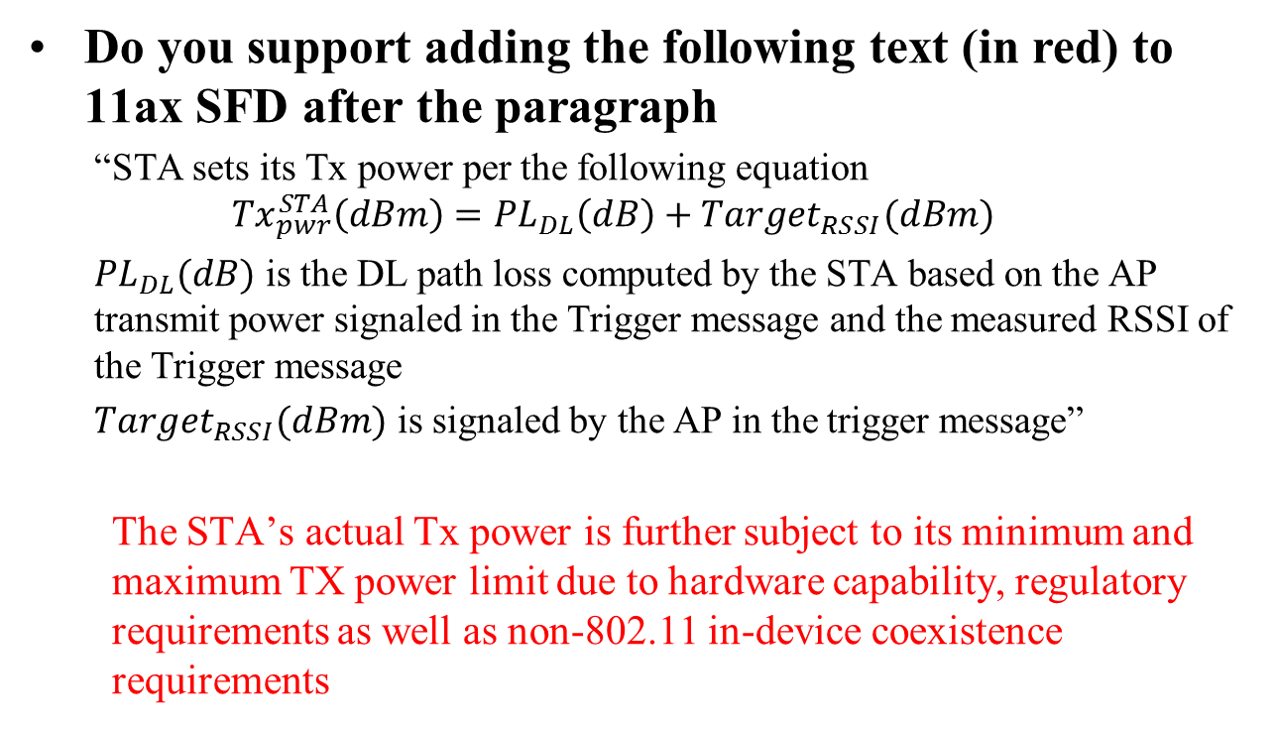
Straw-Poll 17 (#1, 11-16/0617r0)
Do you support adding the following text (in red) to 11ax SFD after the paragraph
  “STA sets its Tx power per the following equation
  $${Tx}_{pwr}^{STA}\left(dBm\right)={PL}_{DL}\left(dB\right)+Target_{RSSI}(dBm)$$
  ${PL}_{DL}(dB)$ is the DL path loss computed by the STA based on the AP transmit power signaled in the Trigger message and the measured RSSI of the Trigger message
  $Target_{RSSI}(dBm)$ is signaled by the AP in the trigger message”
  The STA’s actual Tx power is further subject to its minimum and maximum TX power limit due to hardware capability, regulatory requirements as well as non-802.11 in-device coexistence requirements
SP passed without objection

Slide 33

Straw-Poll 18 (#4, 11-16/0617r0)
Do you agree to add the following text to 11ax SFD
  STA’s power headroom is signaled using 6bits
  5 bits indicate the headroom value of [0 31]dB with resolution of 1dB
  1 bit flag indicates whether the minimum TX power of the current MCS is reached by the STA (=1: transmit at its minimum capable Tx power for current MCS)
  where a STA’s headroom is defined as: $HR_{STA}={TX}_{pwr}^{MAX}−{TX}_{pwr}^{STA},$ where
  ${TX}_{pwr}^{MAX}$ is the potential transmit power of the STA when target RSSI is set to value of 127, i.e. max power, for current MCS and current UL packet
  ${TX}_{pwr}^{STA}$ is the transmit power of the current UL packet
SP passed without objection

Slide 34
Straw-Poll 19 (#5, 11-16/0617r1)
Do you agree to make the following changes (highlighted in red) to 11ax SFD
  STAs that participate in HE trigger-based PPDU shall support the following absolute Tx power requirements and the RSSI measurement accuracy requirements for the two device classes:
  Class A:
    Tx power accuracy: +/-3dB
    RSSI measurement accuracy: +/-2dB +/- 3dB
  Class B:
    Tx power accuracy: +/-9dB
    RSSI accuracy: +/-5dB
  The RSSI accuracy requirements shall be applied to receive signal level range from -82dBm to -20dBm (2.4GHz) or -30dBm (5GHz). The requirement is stated for nominal (room) temperature conditions. RSSI is measured over legacy preamble
30Y/1N/8A. SP passed

Slide 35
Straw-Poll 20 (#1, 11-16/0618r1)
Do you support to reuse the 11ac per stream CSD values for all HE PPDU?
SP passed without objection

Slide 36
Straw-Poll 21 (#2, 11-16/0618r1)
Do you support that in UL MU-MIMO transmission the per stream CSD value is based on global stream index?
SP passed without objection

Slide 37
Straw-Poll 22 (#3, 11-16/0618r1)
Do you support per antenna CSD values for in Pre HE modulation
  Reuse the 11ac per antenna CSD values when beam change =1
  Not specified (absorbed in the Q matrix) when beam_change=0?
SP passed without objection

Slide 38
Straw-Poll 23 (#4, 11-16/0618r1)
Do you support that in UL MU transmission the per antenna CSD value is based on the antenna index of each STA (i.e. local index)?
SP passed without objection

Slide 39
Straw-Poll 24 (#1, 11-16/0619r0)
Do you support the following PAPR reduction scheme for HE SIG-B
  Phase rotation is applied to the HE SIG-B data tones after constellation mapping. For the kth data tone in the HE SIG-B, the phase rotation pattern is defined as
  1 for 0=<k<26 and (-1)^{k} for 26=<k<52
  For DCM + MCS0, since the same rotation has already been applied in the DCM BPSK bit mapping, this step of phase rotation after constellation mapping shall be skipped
  Legacy gamma rotation still applies among different 20MHz channels
SP passed without objection

Slide 40
Straw-Poll 25 (#1, 11-16/0620r0)
Do you agree to add the following text to the SFD:
  When DCM = 1, the NSD, NCBPS, and NDBPS are set by the following expressions:
  In the case of MCS0, DCM=1, Nss=1, 106-RU or 242-RU, if the coding is BCC, then for each OFDM symbol 1 bit is padded after the NDBPS*2 BCC encoded bit before going into the BCC interleaver; if the coding is LDPC, LDPC encoding flow should be based on NDBPS and NCBPS as defined in the above equations
SP passed without objection

Slide 41
Straw-Poll 26 (#2, 11-16/0620r0)
Do you agree to make the following changes to D0.1 MCS Tables:
  When DCM=1, change the NSD parameter to be ½ of DCM=0 cases for the same RU size.
  When DCM=1, change the NCBPS parameter to be ½ of DCM=0 case.
  When DCM=1, change the NDBPS parameter to be ½ of DCM=0 case, or take the floor for the two cases: 106-RU, MCS0, DCM=1, Nss=1, and 242-RU, MCS0, DCM=1, Nss=1.
  When DCM=1, change the coding rate R parameter to be identical to the DCM=0 case.
  Limit DCM=1 only to the allowed Nss.
SP passed without objection

Slide 42
Straw-Poll 27 (#1, 11-16/0621r1)
Do you agree to add the following text to the 11ax SFD?
  DCM+MCS0 has same transmission flow as other DCM MCSs.
SP passed without objection

Slide 43
Straw-Poll 28 (#2, 11-16/0621r1)
Do you agree to add the following text to 11ax SFD?
  The interleaver parameters for DCM are given in the following table:
Parameter for DCM | RU Size (tones)
 | 26 | 52 | 106 | 242
N_{COL} | 4 | 8 | 17 | 13
N_{ROW} | 3×N_{BPSCS} | 3×N_{BPSCS} | 3×N_{BPSCS} | 9×N_{BPSCS}
N_{ROT} | 2 | 2 | 11 | 29
  Value of N_{BPSCS} for DCM modulations equals to N_{BPSCS} of non DCM
  modulations with same constellation size.
SP passed without objection

Slide 44
Straw-Poll 29 (#3, 11-16/0621r1)
Do you agree to add the following text to 11ax SFD?
  The interleaver parameters for HE SIG B with DCM are given in the following table:
Parameter | HE SIG B (tones)
 | 56
N_{COL} | 13
N_{ROW} | 2×N_{BPSCS}
SP passed without objection

Slide 45
Straw-Poll 30 (#1, 11-16/0655r0)
Do you agree to add the 11ax SFD the following MCS0 DCM constellation mapping for data subcarriers k and k+N_{SD}
is BPSK modulated
Note: N_{SD} is defined for DCM which is half of .
SP passed without objection

Slide 46
Straw-Poll 31 (#2, 11-16/0655r0)
Do you agree to add the following usage of DCM to 11ax SFD?
  DCM is only applied to MCS0, MCS1, MCS3 and MCS4.
  DCM is only applied to 1 and 2 spatial streams.
  DCM is only applied to HE SU PPDU, HE extend range SU PPDU, and SU RUs in HE MU PPDU.
  DCM is not applied to MU-MIMO. The DCM field in the HE-SIGB per user for MU-MIMO is changed to a reserved field.
  DCM is not applied to STBC.
SP passed without objection

Slide 47
Straw-Poll 32 (#3, 11-16/0655r0)
Do you agree to add the following capability field of DCM to 11ax SFD?
  Max constellation supported: 2 bits.
    00: does not support DCM; 01: BPSK; 10: QPSK; 11: 16QAM
  Max number of streams supported: 1 bit.
    0: 1stream; 1: 2 streams
SP passed without objection

Slide 48
Straw-Poll 33 (#1, 11-16/0622r0)
Do you support to add the following to the 11ax SFD?
  When DCM=1, 16QAM constellation mapping is done by swapping b₀ and b₁, and also b₂ and b₃ for the second half of tones, where b₀ ~ b₃ are the encoded bits that maps to one 16QAM constellation for the first half of the tones, i.e.:
where N_{SD} is defined for DCM=1, which is half of the N_{SD} value for the same RU size when DCM=0.
SP passed without objection

Slide 49
Straw-Poll 34 (#1, 11-16/0626r1)
Do you agree to add the following to section 4.6 of the SFD ?
  802.11ax should provide mechanism that further compress the feedback elements of angel of compressed beamforming feedback as defined in section 8.4.1.48 in 802.11ac shall be considered.
  3Y/11 N/ Many A. SP Failed

Slide 50
Straw-Poll 35 (#1, 11-16/0633r3)
Do you support to add the following to the current SFD:
  For full BW 80MHz, add 1 bit to indicate if center 26-tone RU is allocated in the common block fields of both SIGB content channels with same value.
  For full BW160, 80+80 MHz, add 1 bit to indicate if center 26-tone RU is allocated for one individual 80MHz in common block fields of both SIGB content channels.
SP passed without objection

Slide 51
Straw-Poll 36 (#2, 11-16/0633r3)
Do you support to use 36 “Definition TBD” entries in Table 4 in the current SFD 3.2.5 HE-SIG-B sub-clause to indicate most frequently used partial bandwidth allocations, as shown in slide 16?
SP passed without objection

Slide 52
Straw-Poll 37 (#1, 11-16/0636r2)
Do you agree to add the following into SFD?
  In HE-SIG-A of HE (extended range) SU PPDU/HE MU PPDU/HE trigger-based PPDU, the size of TXOP Duration field is 7btis and 1 bit is reserved
SP passed without objection

Slide 53
Straw-Poll 38 (#1, 11-16/0635r1)
Do you agree add to the SFD that
  3 bits are used for the BW field in SIG-A of HE_MU PPDU?
SP passed without objection

Slide 54
Straw-Poll 39 (#1, 11-16/0637r0)
Do you agree to add the following entries in 8-bit table to the IEEE 802.11ax SFD
  two entries to indicate ‘Zero STA for 484-tone RU’ and ‘Zero STA for 996-tone RU’ respectively
SP passed without objection

Slide 55
Straw-Poll 40 (#1, 11-16/0638r2)
Do you agree to add the following underlined text into 11ax SFD ?
  3.1 General
  The non-contiguous channel bonding will be supported in 802.11ax by:
    Transmitting using OFDMA PPDU format by nulling the tones of one or more secondary channels in 80 MHz and 160 (80+80) MHz;
    Modes for non-contiguous channel bonding are TBD;
    Non-contiguous channels within primary or secondary 80 MHz only exists at AP side.
    When a secondary channel which is fully or partially overlapped with a center 26-tone RU is nulled, the center 26-tone RU is also nulled.
SP passed without objection

