Slide 1
Efficient Multi-Channel Operation in 11ay
Date: 2016-05-16
Authors:

Slide 2
Introduction
At the last TGay meeting in March the motion below was passed.
  “11ay shall support allocation of SP(s) and scheduled CBAP(s) over more than one channel and/or over a bonded channel.”
Related to the motion above, we propose allowing only secondary channel allocation in order to improve channel utilization in 11ay.
  It could be operated by beacon or announce fames.
  It does not need to define new frame and procedure.
In this contribution, we investigate the consideration points for allowing only secondary channel allocation.

Slide 3
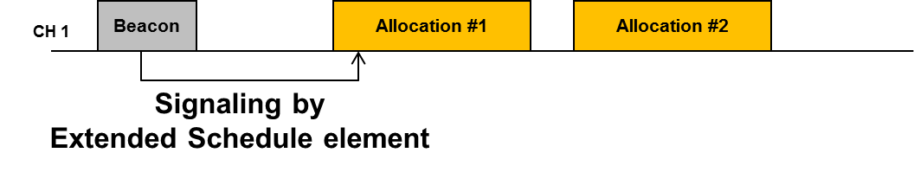
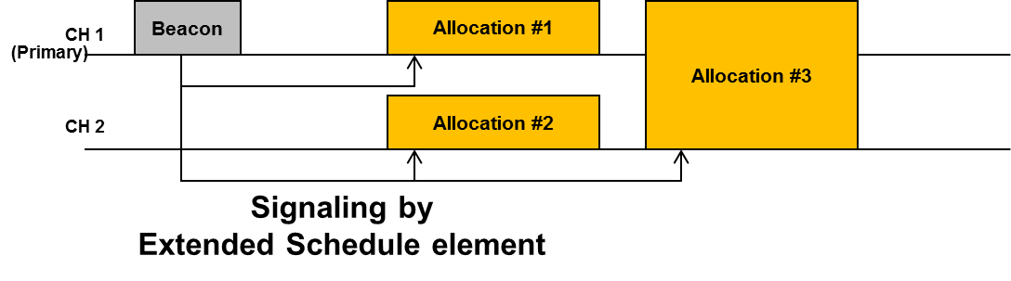
Proposed multi-channel operation
11ad
In 11ad DTI is coordinated as CBAP and SP using a schedule by PCP/AP.
In 11ay channel utilization can be improved by extending the allocation into the multi-channels.
Flexible channel allocation enables the channel utilization to be improved depending on STA’s capability of channel bonding and channel environment.
Proposed

Slide 4
Procedure of secondary channel allocation
EDMG STA can be allocated to only secondary channel by PCP/AP which transmits Beacon and announce frames through primary channel.
  The STAs are working on primary channel before the allocation.
During DTI, the allocation type can be one of CBAP or SP.
After expiring allocation time, this EDMG STA comes back to primary channel in a BSS and waits next allocation.

Slide 5
Consideration points of secondary channel allocation
Collision problem
  In the type of allocation on secondary channel is CBAP, EDMG STA can operate back-off procedure before getting the channel access. Therefore collision problem can be prevented.
  In the type of allocation on secondary channel is SP, EDMG STA can operate DMG protected SP access operation (handshaking RTS/DMG CTS) which already exists in 11ad. Therefore collision problem also can be prevented.
Maintenance of the role of primary channel in a BSS.
  It means that every EDMG STA in a BSS should be operated over primary channel before the allocation of secondary channel by PCP/AP.
  After end of an allocation, EDMG STA comes back to primary channel in a BSS.

Slide 6
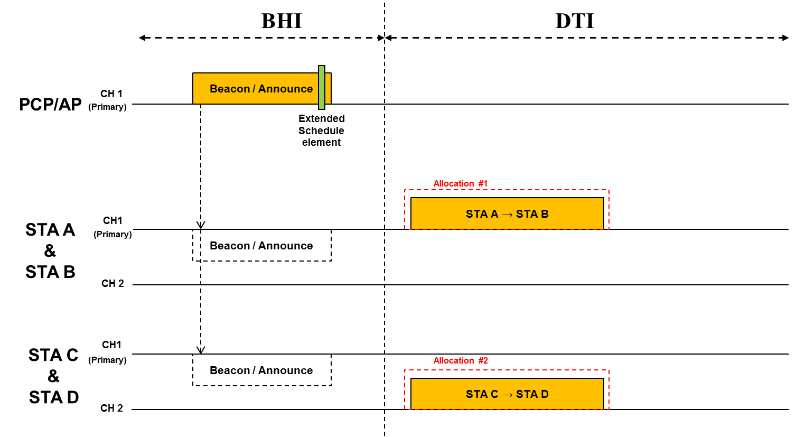
Example of Secondary channel allocation
PCP/AP has capability of 2 channels operation. PCP/AP schedules allocation #1 and #2 by Extended Schedule element within DMG beacon or announce frame transmitted through primary channel.
During the BHI, PCP/AP and STAs are operated over the primary channel in a BSS.
During the DTI, STA A transmits data packet through primary channel and STA C transmits data packet through the secondary channel.

Slide 7
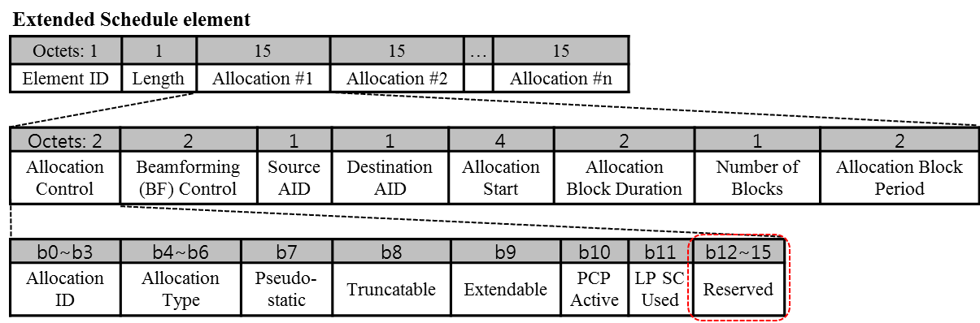
Signaling allocation by Beacon or Announce frame
Multi-channel allocation can be supported by modifying Extended Schedule element that already exists in 11ad.
There are reserved bits (4 bits) to be used for signaling to EDMG STAs.
  Operating channel(2 bits): indication of the channel for CCA and backoff.
  Bandwidth(2 bits): indication of the allocated bandwidth.

Slide 8
Conclusion
In 11ay channel utilization can be improved by extending the allocation defined in 11ad into the multi-channel operation.
We proposed the allocation not including primary channel for efficient multi-channel operation.
As we investigated the consideration points, the allocation of CBAP and SP over multiple channels can be supported by simple modification of 11ad.

Slide 9
Reference
[1] 11-16-0401-00-00ay-Multi-channel-operation-in-11ay

Slide 10
Straw poll #1
Do you agree to add the following text to the SFD ?
  “11ay shall support allocation of SP(s) and scheduled CBAP(s) over more than one channel and over a bonded channel. These allocations do not have to include the primary channel. When allocations over different channels overlap in time, the source and destination of such allocations shall be different. Channels used for such allocations shall be limited to the operating channels of the BSS.”
  Yes / No / Abstain

Slide 11
Motion #1
Do you agree to add the following text to the SFD ?
  “11ay shall support allocation of SP(s) and scheduled CBAP(s) over more than one channel and over a bonded channel. These allocations do not have to include the primary channel. When allocations over different channels overlap in time, the source and destination of such allocations shall be different. Channels used for such allocations shall be limited to the operating channels of the BSS.”
  Yes / No / Abstain

