Slide 1
Wearable Device Use Cases and Requirements for LRLP
Date: 2016-05-16
Authors:

Slide 2
Introduction
Several indoor and outdoor use cases have been proposed in LRLP TIG [1, 2, 3, 4]
Wearable devices (WDs) are considered as a main target area for IoT.
  A primary design consideration for wearable devices is low power.
In this contribution, we present the following use cases involving wearable devices and discuss the requirements associated with them:
  Wearable augmented reality (AR) devices
  Wearable activity/health monitoring devices

Slide 3
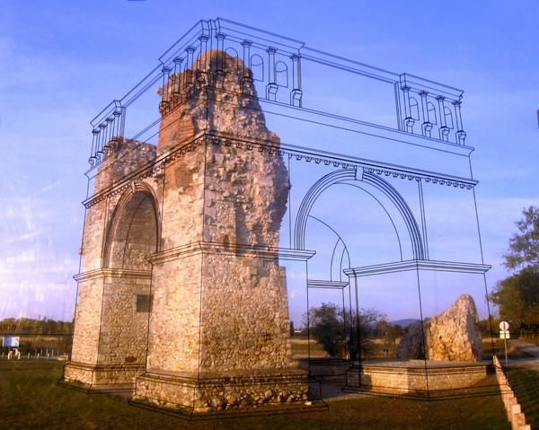

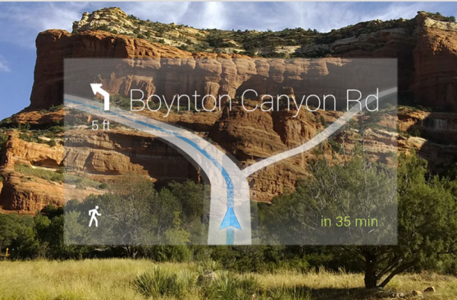
Wearable AR devices use case
Description
  A consumer wearable device supports augmented reality(AR) applications. Low power Wi-Fi is used to tether the wearable AR device with a smartphone for connecting to the Internet and Cloud.
Requirements
  Support of high data rate and throughput up to tens of Mbps.
  Support of low latency.
  Support of low transmission power to mitigate potential impact on eyes and to prolong the battery life.

Slide 4
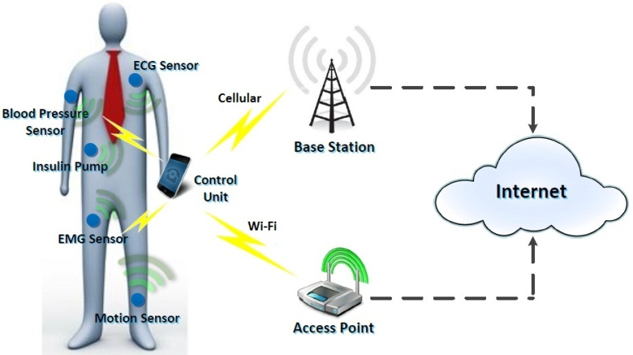
Wearable activity/health monitoring devices use case
Description
  A user wears activity and health monitoring devices. Low power Wi-Fi is used to tether these wearable devices with a smartphone for connecting to the Internet and Cloud.
Requirements
  Support of low transmission power
    To limit the signal coverage in order to mitigate eavesdropping
    To prolong the battery life on WDs
  Support of user privacy protection at Layer 2
    To prevent leaking user private information
    To prevent user tracking

Slide 5
Competitiveness against other technologies
Comparing to BLE/ZigBee
  802.11 supports higher data rate and throughput, which is desirable for AR applications
  802.11 is perceived to be more secure
Comparing to cellular
  802.11 supports higher data rate and throughput with lower total cost of ownership (TCO) than cellular based solutions
  802.11 with low power enhancement can achieve lower power consumption than cellular

Slide 6
Summary
We have presented two wearable device use cases for LRLP.
We have also proposed the following requirements associated with these use cases:
  Support of a wide range of data rates and throughputs, up to tens of Mbps
  Support of low latency
  Support of low transmission power
    To lower power consumption and prolong the battery life
    To limit the signal coverage in order to mitigate eavesdropping
  Support of user privacy protection at Layer 2
    To prevent leaking user private information
    To prevent user tracking

Slide 7
References
[1] IEEE 802.11-15/1140r1, Long range low power Use Cases for Indoor
[2] IEEE 802.11-15/1383r0, LRLP TIG - Use Cases for Indoor & Outdoor
[3] IEEE 802.11-15/1365r0, LRLP TIG - Use Cases of LRLP Operation for IoT
[4] IEEE 802.11-15/1112r1 Use Case of LRLP Operation for IoT
Slide 7

