Slide 1
Open Loop Spatial Multiplexing with Phase Hopping for 11ay
Date: 2016-05-16
Authors:

Slide 2
Introduction
Several MIMO scenarios for 11ay have been proposed [1], and this contribution focuses on SU-MIMO scenario for open loop spatial multiplexing (OLSM).
This presentation details a SU-MIMO scenario using OLSM and covers
- OLSM scenario
- Proposal of OLSM + Phase Hopping (PH)
- Benefits of PH
- Simulation results

Slide 3
SU-MIMO Scenario: Open Loop Spatial Multiplexing (OLSM) (1/2)
    Two or more streams are transmitted by using spatial multiplexing to increase data throughput.
    2x2 OLSM MIMO system has 2 TX array antennas and 2 RX array/quasi-omni
    antennas.
    Introduction of interference cancellation in RX is possible.
    OLSM can operate with long range by including basic beamforming (BF) training.
RF
RF
2-stream
Encoder
Spatial Multiplexing
or Pre-coder
Spatial De-Multiplexing
or Pre-coder decoding
2-stream
Decoder
RF
RF

Slide 4
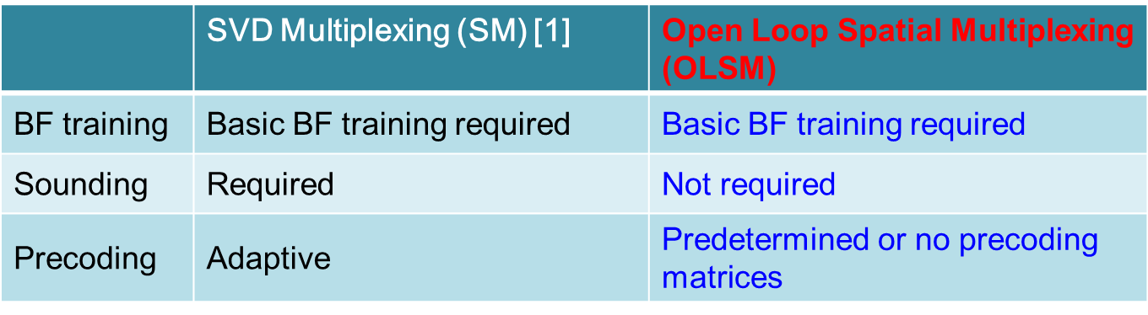
SU-MIMO Scenario: OLSM (2/2)
    Definition of OLSM:
    No Sounding except for BF
    - OLSM is one of suitable SU-MIMO scenarios at a mobile case.
    → In MIMO scenarios with sounding, performance become worse
    by feedback delay of sounding.
    OLSM uses predetermined or no precoding matrices.

Slide 5
Example #1: OLSM with TX and RX BF
    Both TX and RX BF training is required.
    - Long range can be covered.
    Low latency
    - Symbols for sounding is NOT required.
unnecessary
unnecessary

Slide 6
Example #2: OLSM with TX BF
    Only TX BF training is required. (No RX BF training)
    → Simple STAs can be provided.
Only TX BF
    Very low latency
    - Symbols for sounding and RX BF training is NOT required.
unnecessary
unnecessary
unnecessary
unnecessary

Slide 7








Proposed Phase Hopping (PH) for OLSM [2][3]
Precoding + PH
(Changes the phase in one of the antennas to randomize information and avoid destructive interference along a codeword)
Precoding
(Linear combination of streams to increase diversity)
No precoding
Constellation in Precoding + PH
QPSK
After Precoding
PH
$$s_{1}\left(i\right)$$
$$u_{1}\left(i\right)$$
$${Tx}_{1}\left(i\right)$$
Bit
-
LDPC
inter
symbol
-
Mapper
$$s_{2}\left(i\right)$$
Pre-coder
leaver
$$u_{2}\left(i\right)$$
$${Tx}_{2}\left(i\right)$$
PH
Precoding
Precoding + PH
$$\left[\begin{matrix}{Tx}_{1}\left(i\right) \\ {Tx}_{2}\left(i\right)\end{matrix}\right]=\left[\begin{matrix}1 & 0 \\ 0 & e^{jγ\left(i\right)}\end{matrix}\right]\left[\begin{matrix}\cos{θ} & −\sin{θ} \\ \sin{θ} & \cos{θ}\end{matrix}\right]\left[\begin{matrix}s_{1}\left(i\right) \\ s_{2}\left(i\right)\end{matrix}\right]$$
No Precoding + PH
$$\left[\begin{matrix}{Tx}_{1}\left(i\right) \\ {Tx}_{2}\left(i\right)\end{matrix}\right]=\left[\begin{matrix}1 & 0 \\ 0 & e^{jγ\left(i\right)}\end{matrix}\right] \left[\begin{matrix}1 & 0 \\ 0 & 1\end{matrix}\right] \left[\begin{matrix}s_{1}\left(i\right) \\ s_{2}\left(i\right)\end{matrix}\right]$$
-> For simple explanation of PH, this presentation focuses on no Precoding + PH.

Slide 8
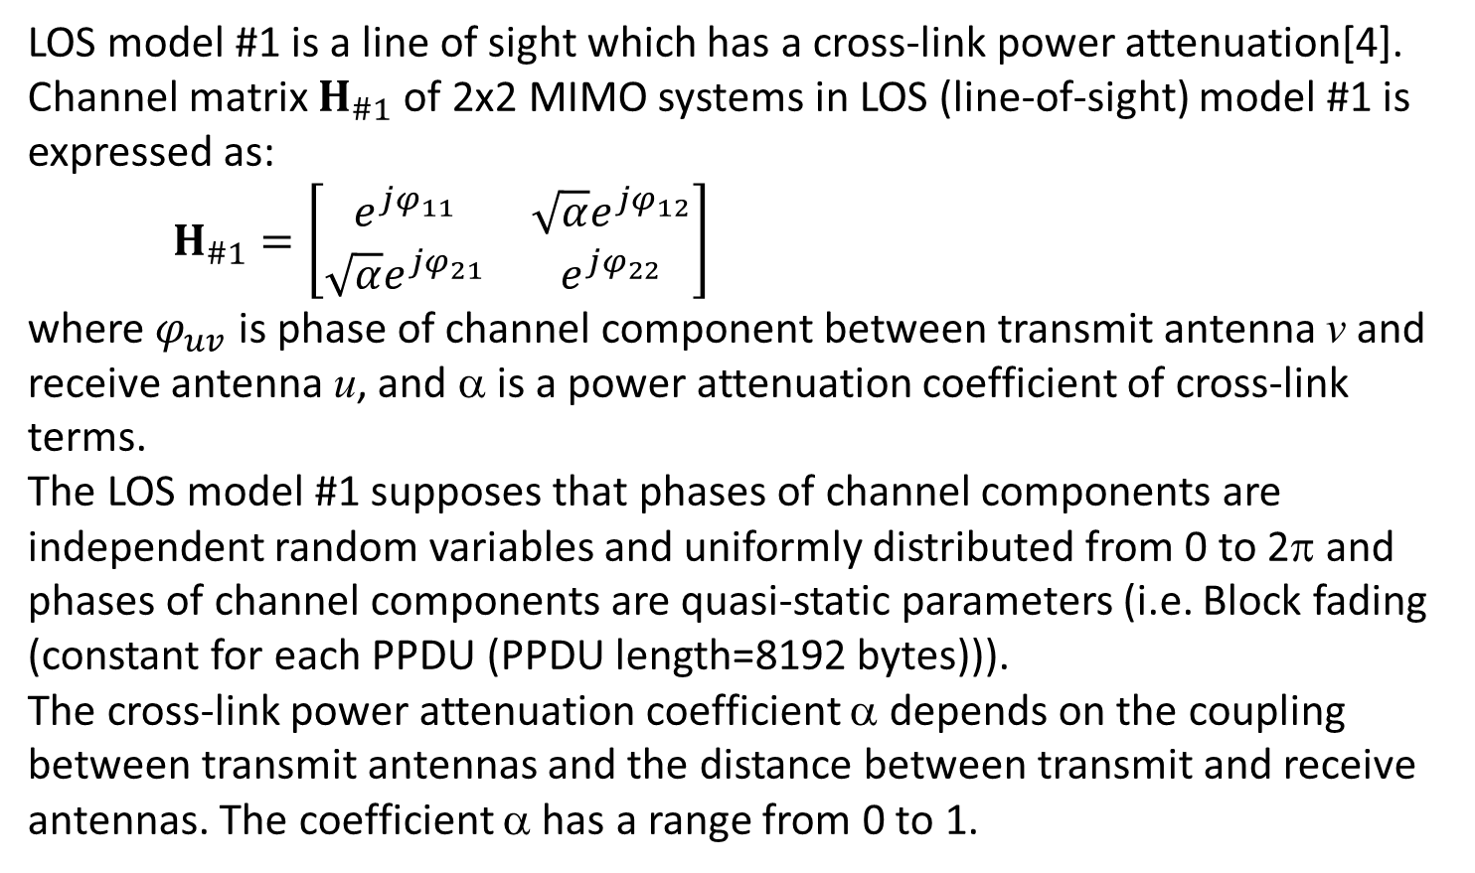
LOS Model #1 [4]
    LOS model #1 is a line of sight which has a cross-link power attenuation[4]. Channel matrix $H_{\#1}$ of 2x2 MIMO systems in LOS (line-of-sight) model #1 is expressed as:
    $H_{\#1}=\left[\begin{matrix}e^{jφ_{11}} & \sqrt{α}e^{jφ_{12}} \\ {\sqrt{α}e}^{jφ_{21}} & e^{jφ_{22}}\end{matrix}\right]$
    where $φ_{uv}$ is phase of channel component between transmit antenna v and receive antenna u, and α is a power attenuation coefficient of cross-link terms.
    The LOS model #1 supposes that phases of channel components are independent random variables and uniformly distributed from 0 to 2π and phases of channel components are quasi-static parameters (i.e. Block fading (constant for each PPDU (PPDU length=8192 bytes))).
    The cross-link power attenuation coefficient α depends on the coupling between transmit antennas and the distance between transmit and receive antennas. The coefficient α has a range from 0 to 1.

Slide 9
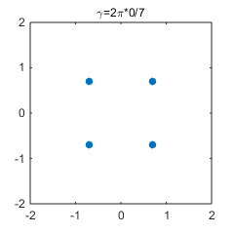
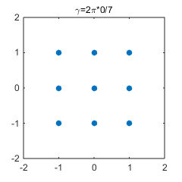

Benefits of PH (1/2)
    The LOS model #1 supposes that phases of channel components are independent random variables and uniformly distributed from 0 to 2π and phases of channel components are quasi-static parameters (i.e. Block fading (constant for each PPDU (PPDU length=8192 bytes))).
    Ex.) Block fading with α=1 and $φ_{11}$ = $φ_{12}$ = $φ_{21}$ = $φ_{22}$ = 0 radian of
    channel matrix $H_{\#1}=\left[\begin{matrix}e^{jφ_{11}} & \sqrt{α}e^{jφ_{12}} \\ {\sqrt{α}e}^{jφ_{21}} & e^{jφ_{22}}\end{matrix}\right]$is assumed*.
    No precoding without PH:
Received state is static
Transmitter
Receiver
constellation degeneracy (9=16-7 signal points)
S1(i) and S2(i) : QPSK
s₁(i)
Rx₁(i)
r=2π*1/7
r=2π*2/7
s₂(i)
Rx₂(i)
r=2π*1/7
r=2π*2/7
symbol
symbol
#0
#1
#2
#0
#1
#2
In this case, received state of signal points falls into destructive interference (constellation degeneracy).
*Note that this assumption is an example to help easy understanding of PH operation.

Slide 10
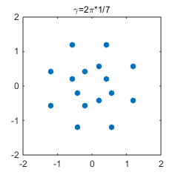
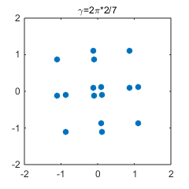
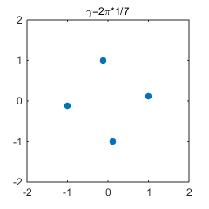
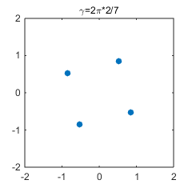
Benefits of PH (2/2)
    No precoding with PH:
The receiver avoids to fall into destructive interference (constellation degeneracy) in LOS environment by PH (scattering the channel phase).
    Circuit cost is negligible, because transmitter and receiver need to add only the phase changer.
Received state is varying
Transmitter
S1(i) and S2(i) : QPSK
Receiver
s₁(i)
Rx₁(i)
r=2π*1/7
r=2π*2/7
s₂(i)
PH
Rx₂(i)
symbol
symbol
#0
#1
#2
#0
#1
#2

Slide 11

Simulation Conditions
    MIMO : 2x2 OLSM no precoding with PH/without PH
    Period of PH is 7*.
    Modulation set : (BPSK,BPSK),(QPSK,QPSK)
    Channel model : LOS model #1
    α=-5dB, -10dB
    (Power attenuation coefficient of cross-link terms)
    FEC : 11ad LDPC codes (Codeword size=672 bits)
    Detection : ML (Maximum Likelihood)
    ZF (Zero Forcing)
    MMSE (Minimum Mean Square Error)
    *Equation for no precoding with PH is expressed as
$$\left[\begin{matrix}{Tx}_{1}\left(i\right) \\ {Tx}_{2}\left(i\right)\end{matrix}\right]=\left[\begin{matrix}1 & 0 \\ 0 & e^{j}\frac{2π×\left(i mod p\right)}{p}\end{matrix}\right]\left[\begin{matrix}1 & 0 \\ 0 & 1\end{matrix}\right]\left[\begin{matrix}s_{1}\left(i\right) \\ s_{2}\left(i\right)\end{matrix}\right]$$
    where p is a period of PH.

Slide 12
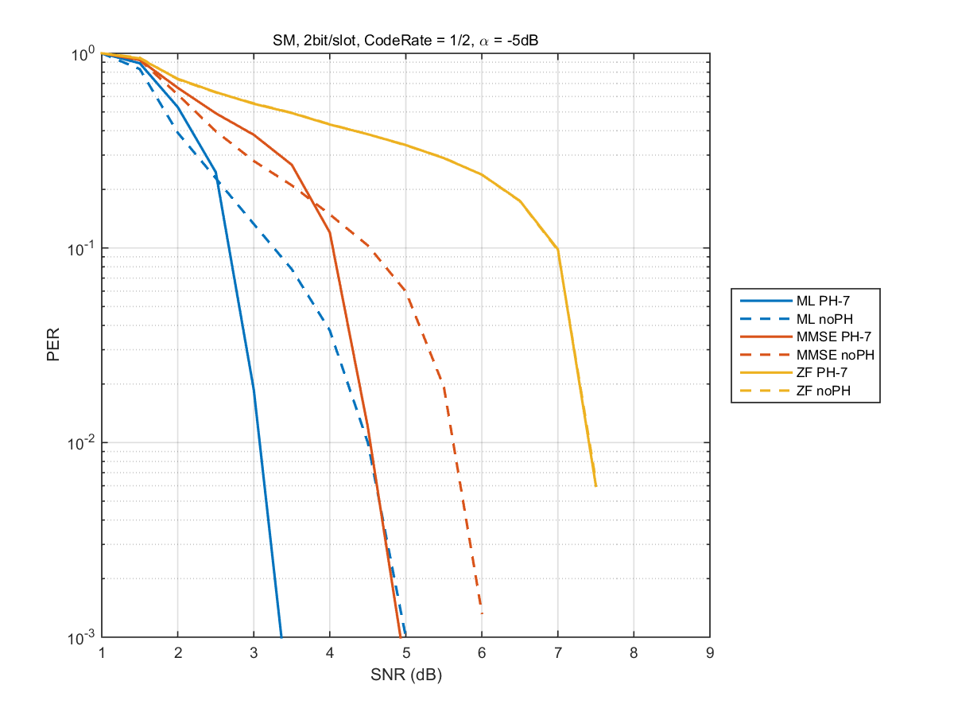
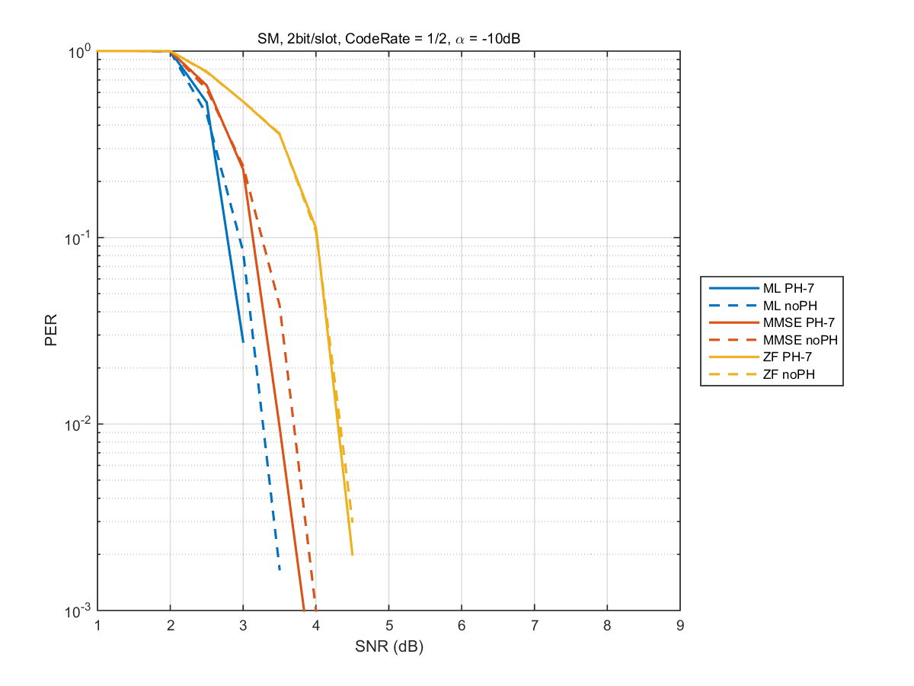
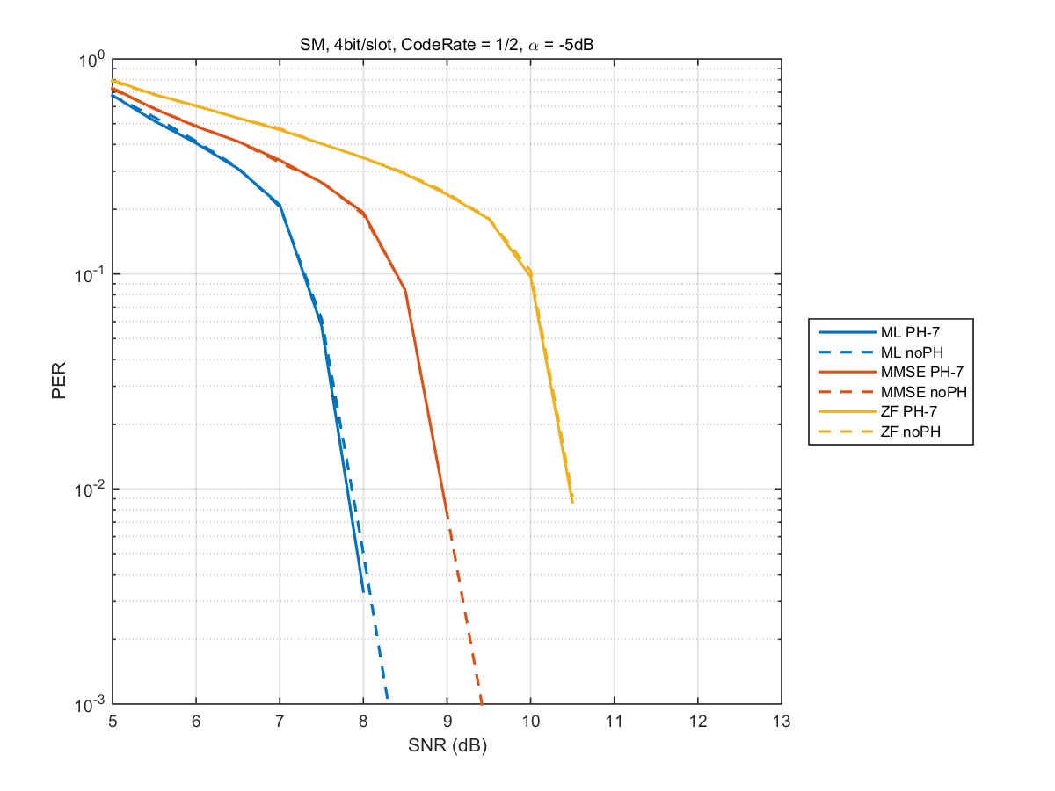
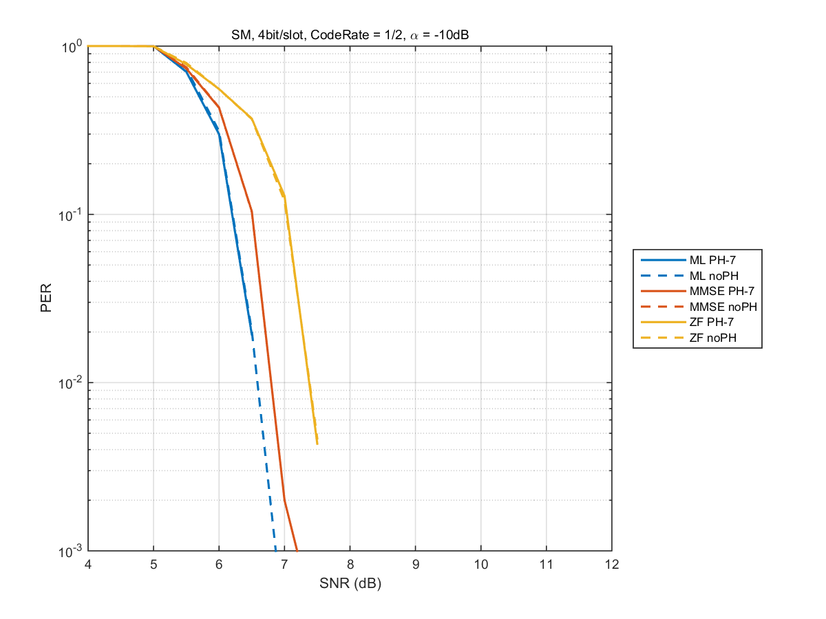
Comparison between PH and no PH (R=1/2)
α=-5dB
α=-10dB
(BPSK, BPSK)
(QPSK, QPSK)
- In (BPSK,BPSK), PH has gain, compared with no PH when using ML and MMSE.

Slide 13
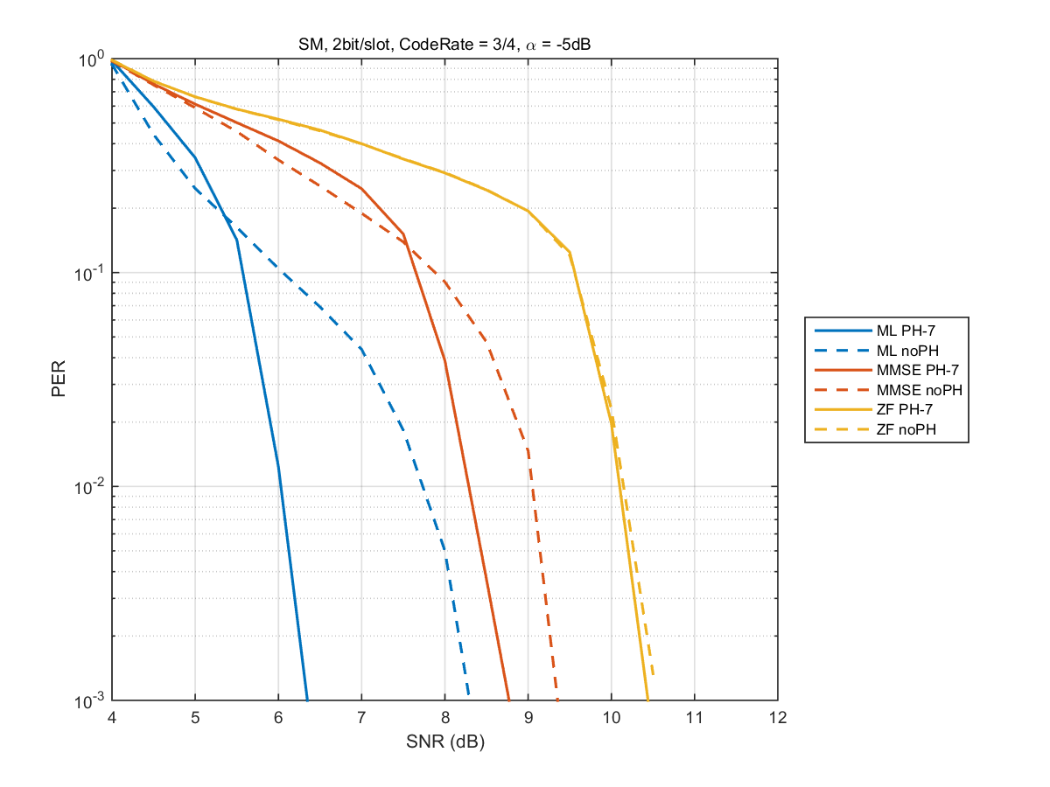
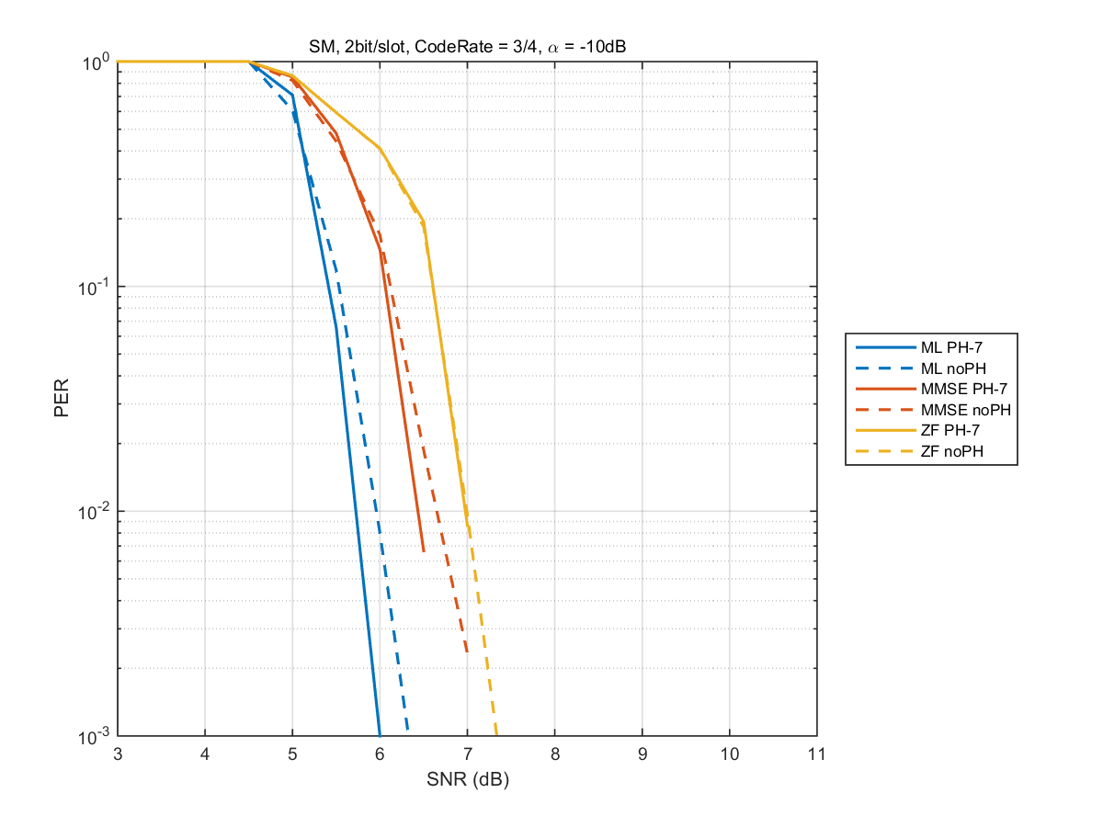
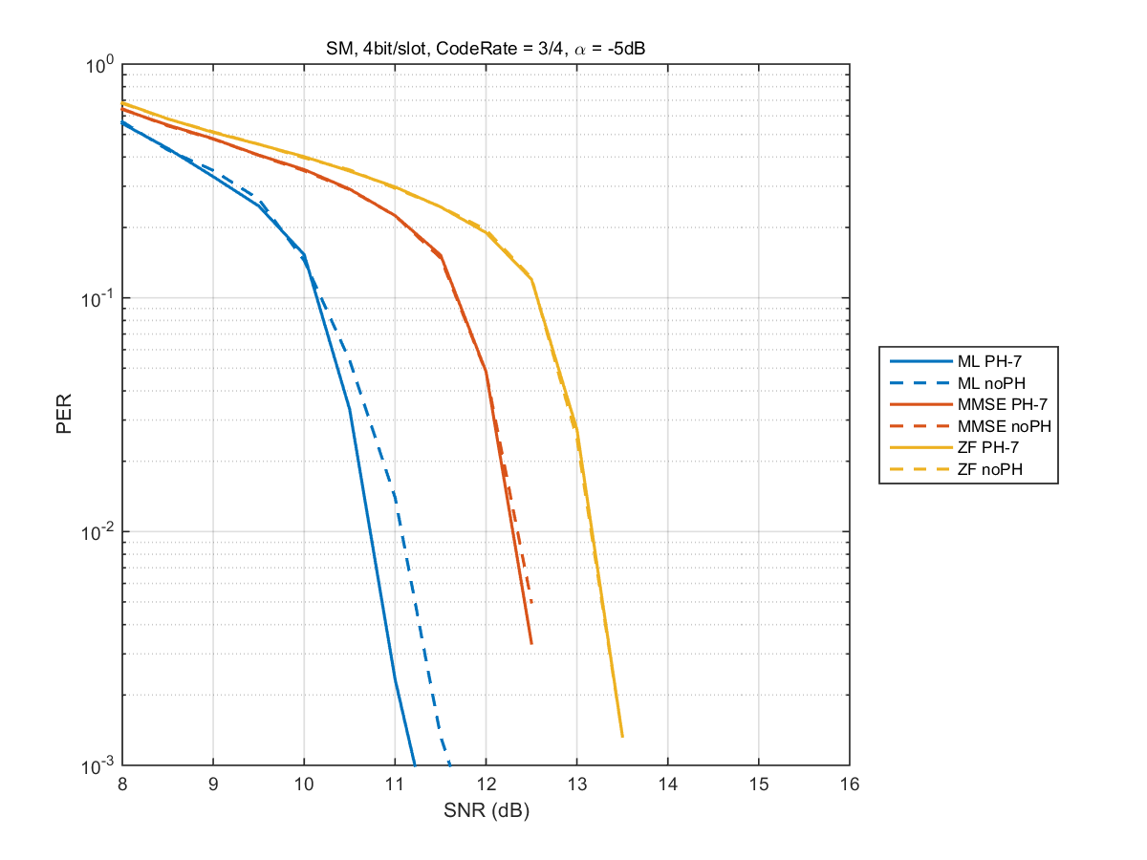
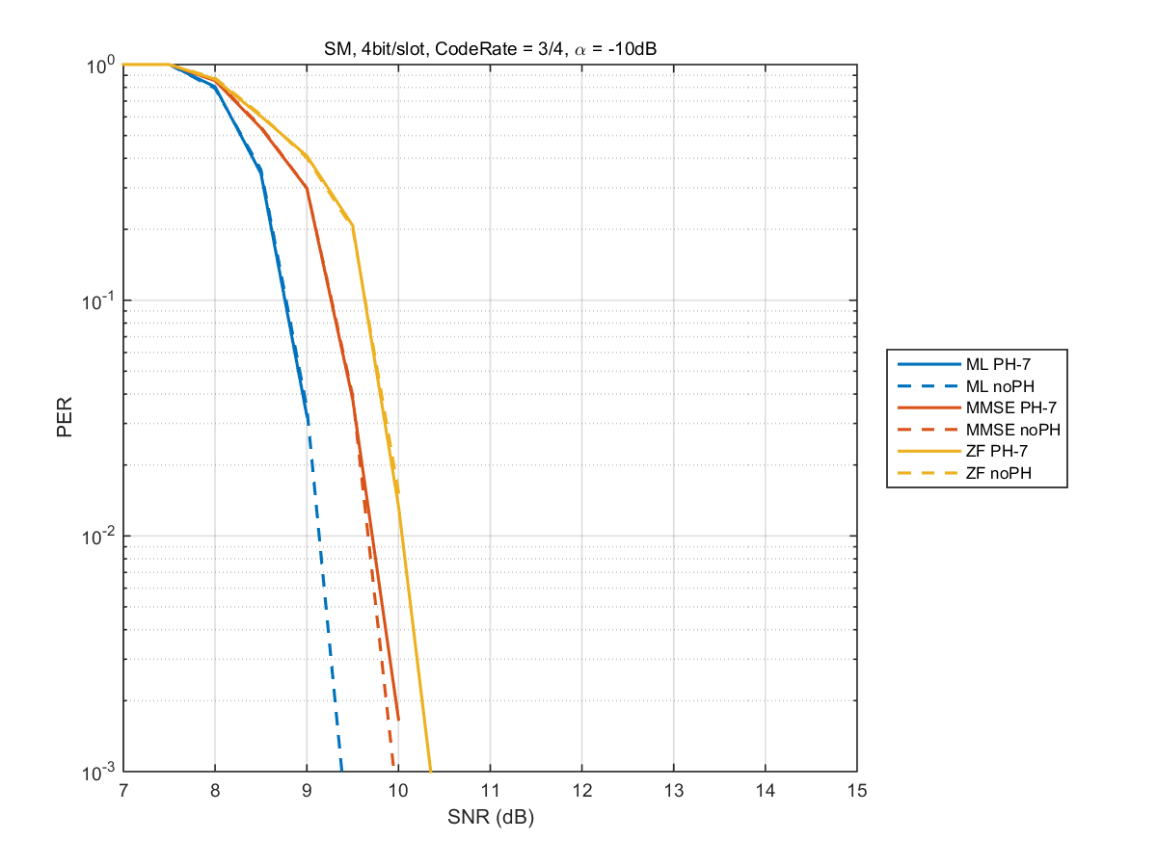
Comparison between PH and no PH (R=3/4)
α=-5dB
α=-10dB
(BPSK, BPSK)
(QPSK, QPSK)

Slide 14
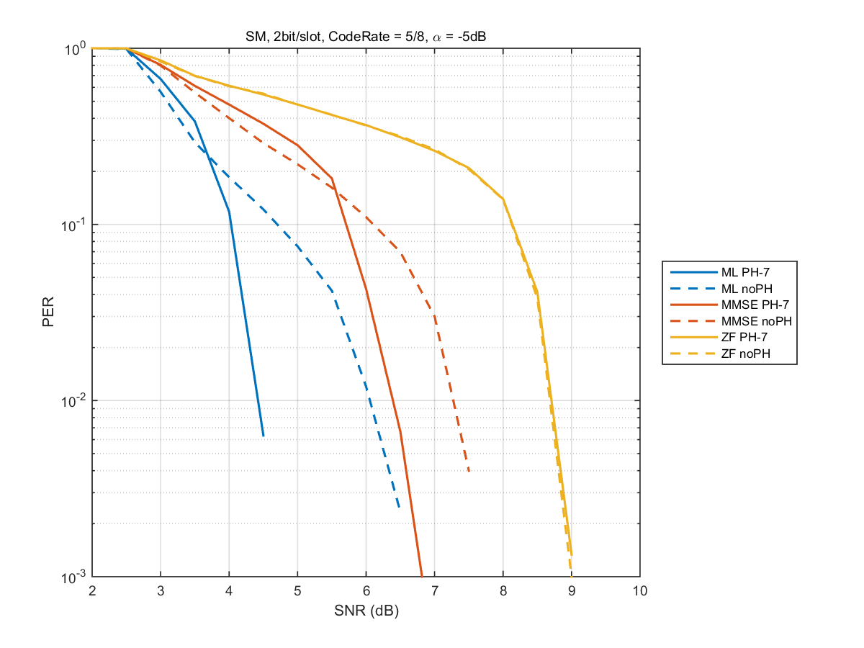
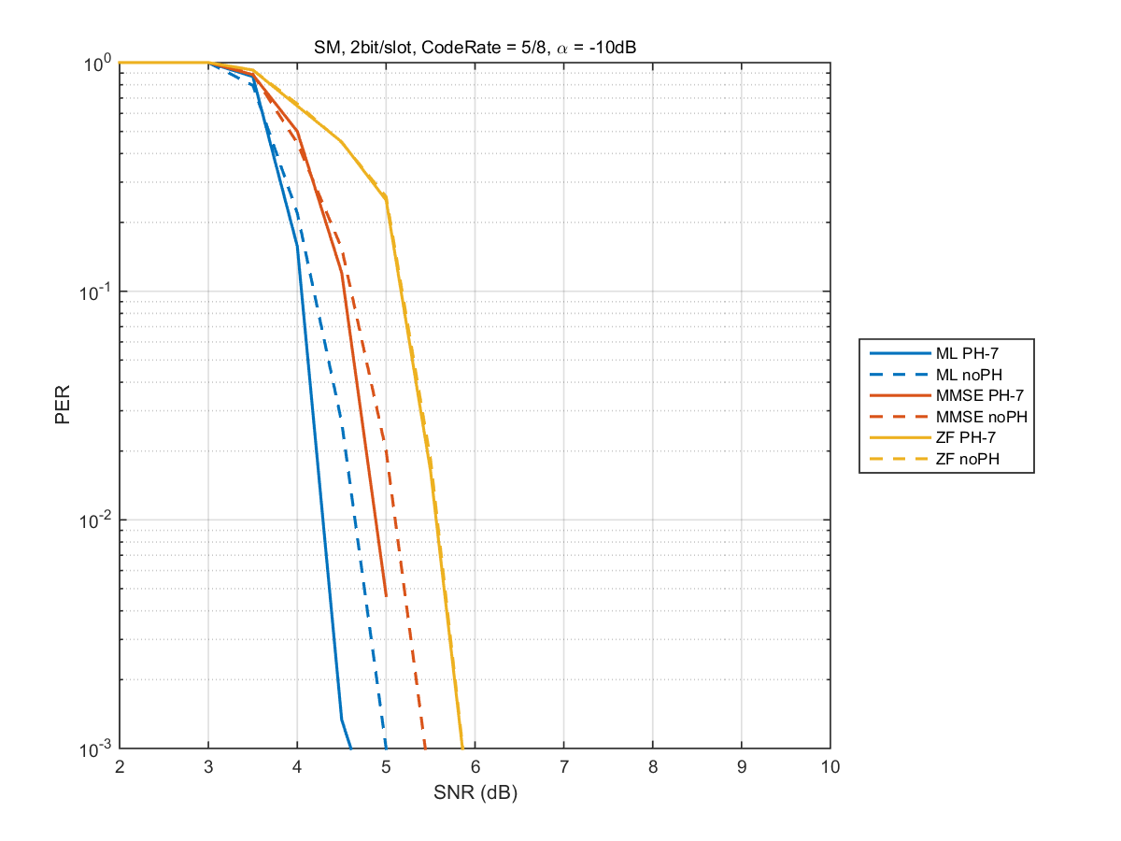
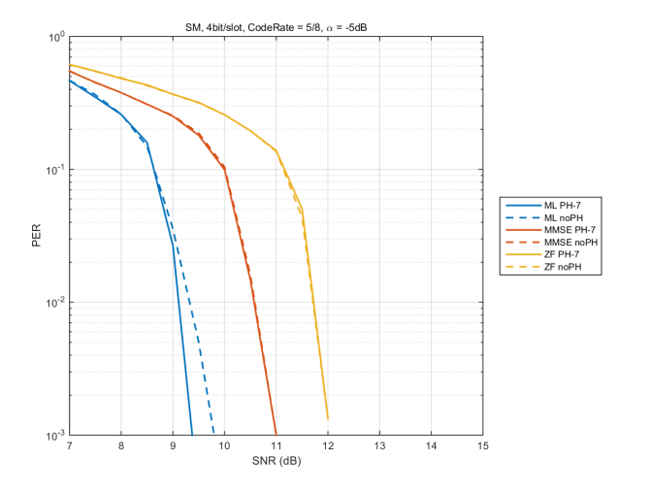
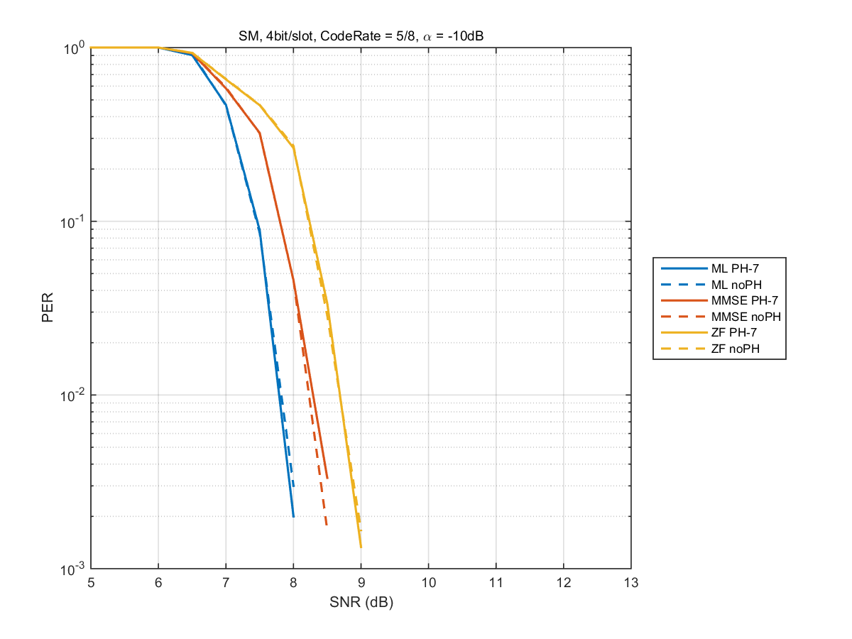
Comparison between PH and no PH (R=5/8)
α=-5dB
α=-10dB
(BPSK, BPSK)
(QPSK, QPSK)
- In (QPSK,QPSK), PH has gain, compared with no PH when using ML.

Slide 15
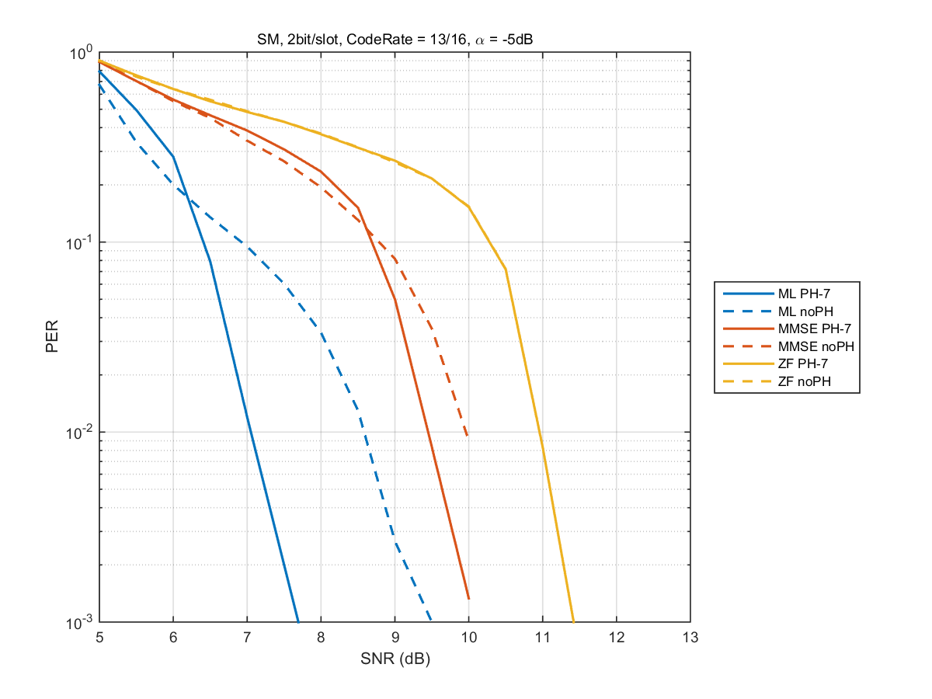
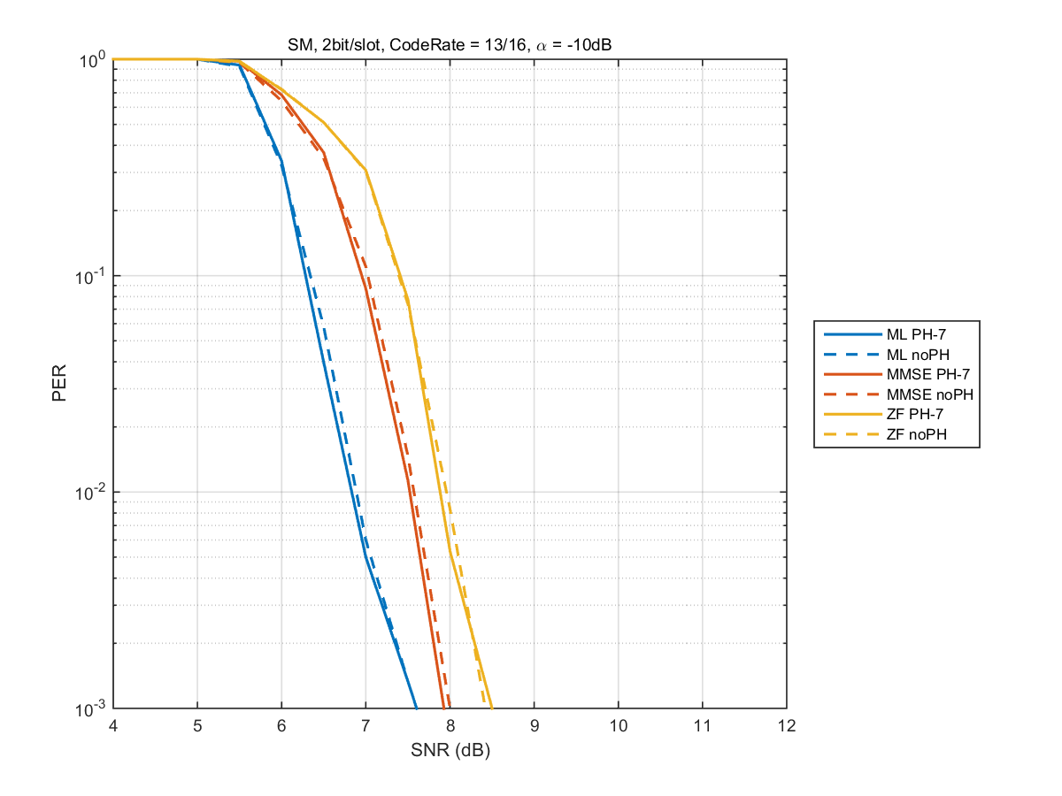
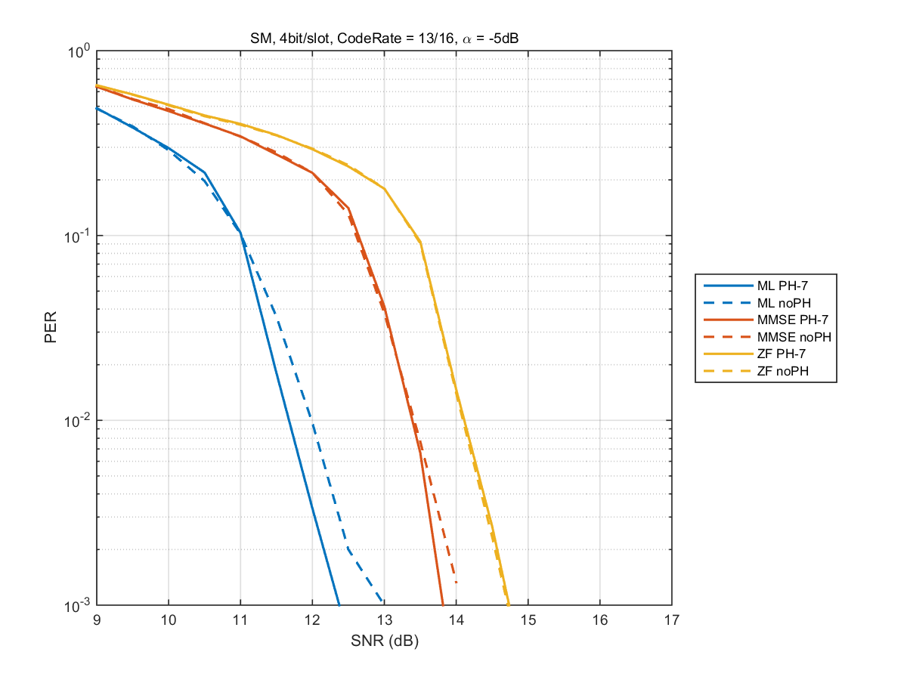
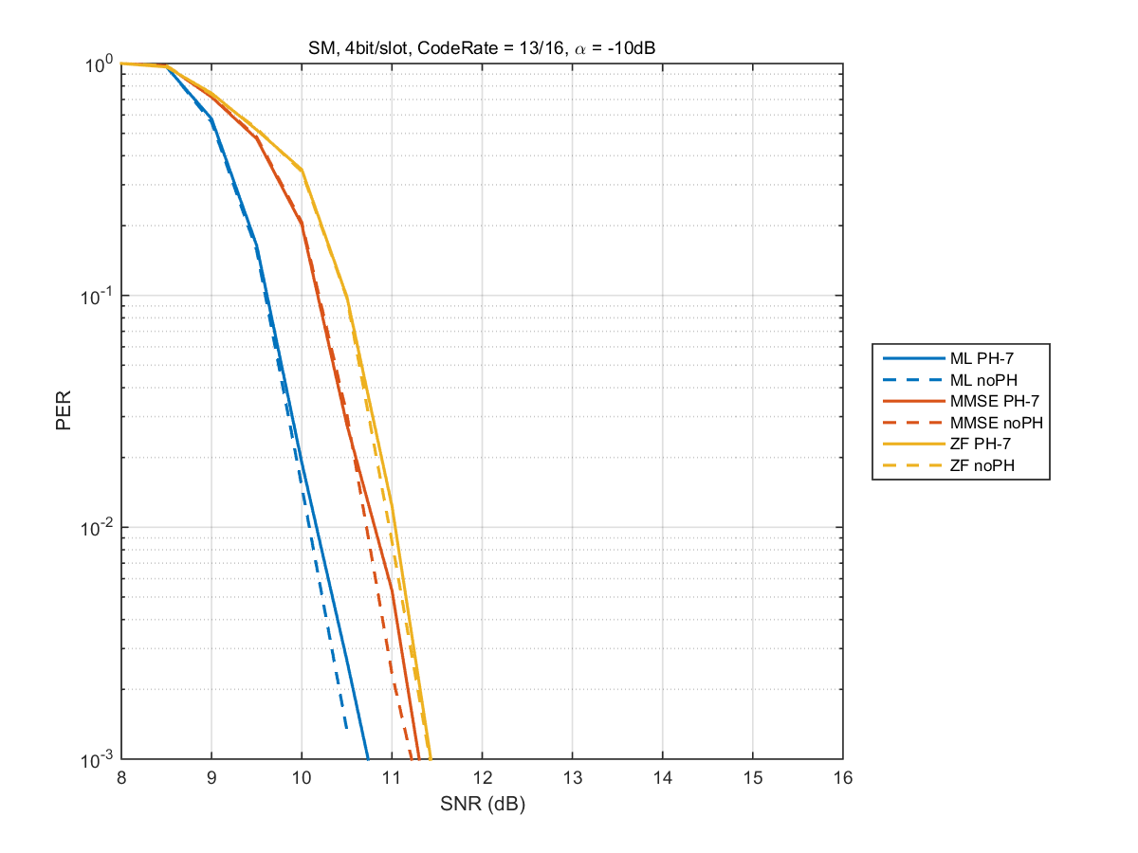
Comparison between PH and no PH (R=13/16)
α=-5dB
α=-10dB
(BPSK, BPSK)
(QPSK, QPSK)
- In all coding rates, there are no difference of performance between PH and no PH when using ZF.

Slide 16
Discussion of PH period (1/2)
    The codeword size of LDPC codes in 11ad is 672(= 2⁵x3x7)bits
    When a period of phase hopping is 7, the following slots are required for transmission of 1 codeword.
    (BPSK,BPSK) : 336 slots(=48 periods)
    (QPSK,QPSK) : 168 slots(=24 periods)
    (QPSK, 16-QAM) : 112 slots(=16 periods)
    (16-QAM,16-QAM) : 84 slots(=12 periods)
    (64-QAM,64-QAM) : 56 slots(=8 periods)
    These slots can be defined by multiplying integer and a PH period of 7.
    However, evaluation of the relationship between a PH period and PER (packet error rate) performance is necessary. In order to clarify the relationship between a PH period and PER performance, simulation results of PER performance with a PH period of 7, 8, 16, 32 and 64 are shown.

Slide 17
Simulation Conditions
    MIMO : 2x2 no precoding with PH/without PH
    Period of PH is 7, 8, 16, 32 and 64.
    Modulation set : (BPSK,BPSK),(QPSK,QPSK)
    Channel model : LOS model #1
    α=-5dB, -10dB
    (Power attenuation coefficient of cross-link terms)
    FEC : 11ad LDPC codes (Codeword size=672 bits)
    Detection : ML (Maximum Likelihood)

Slide 18
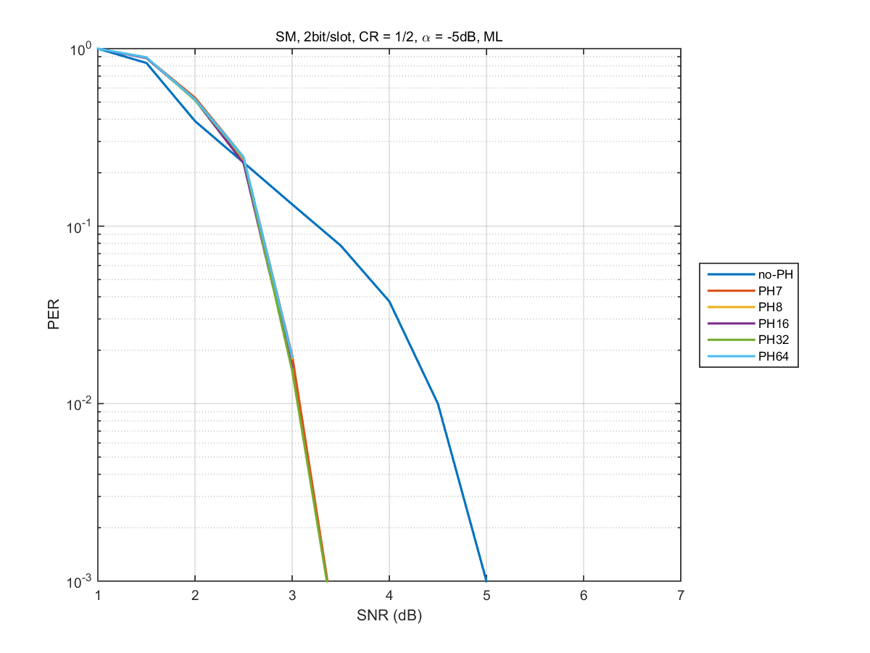
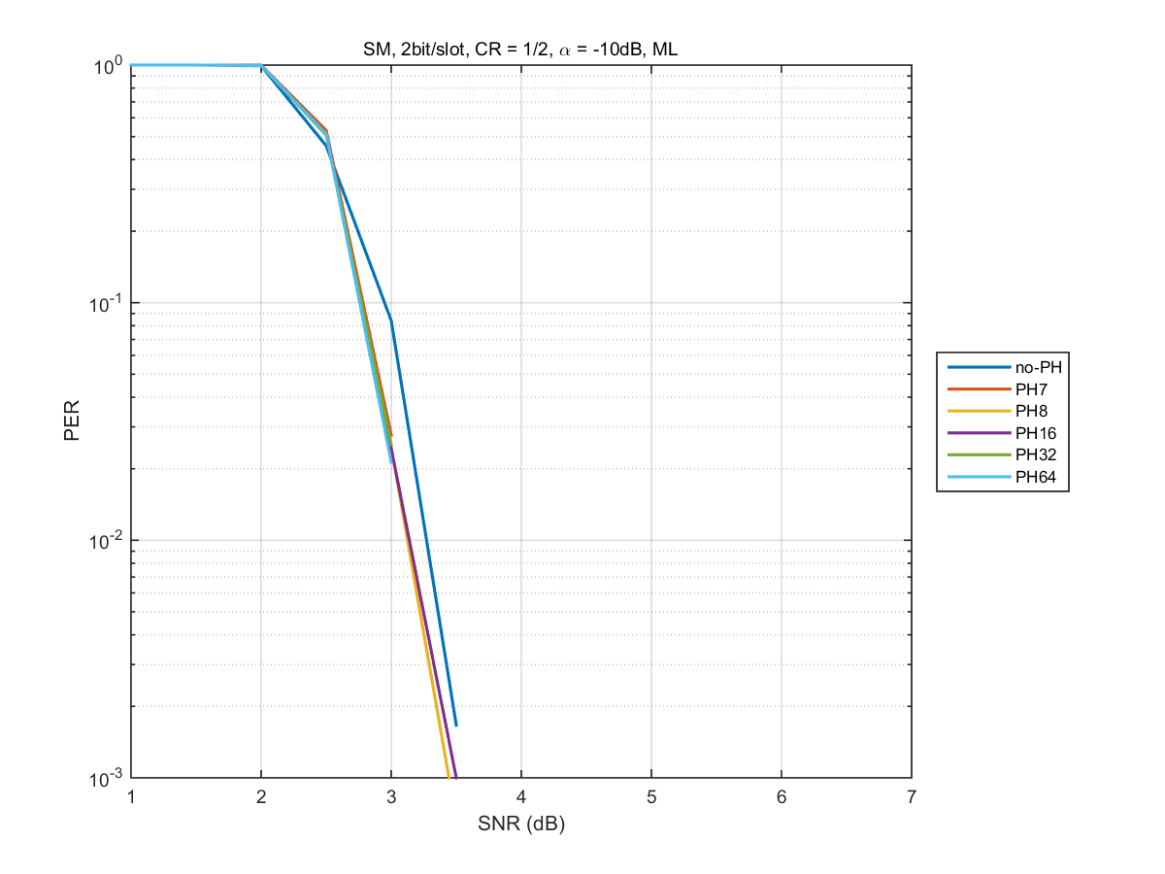
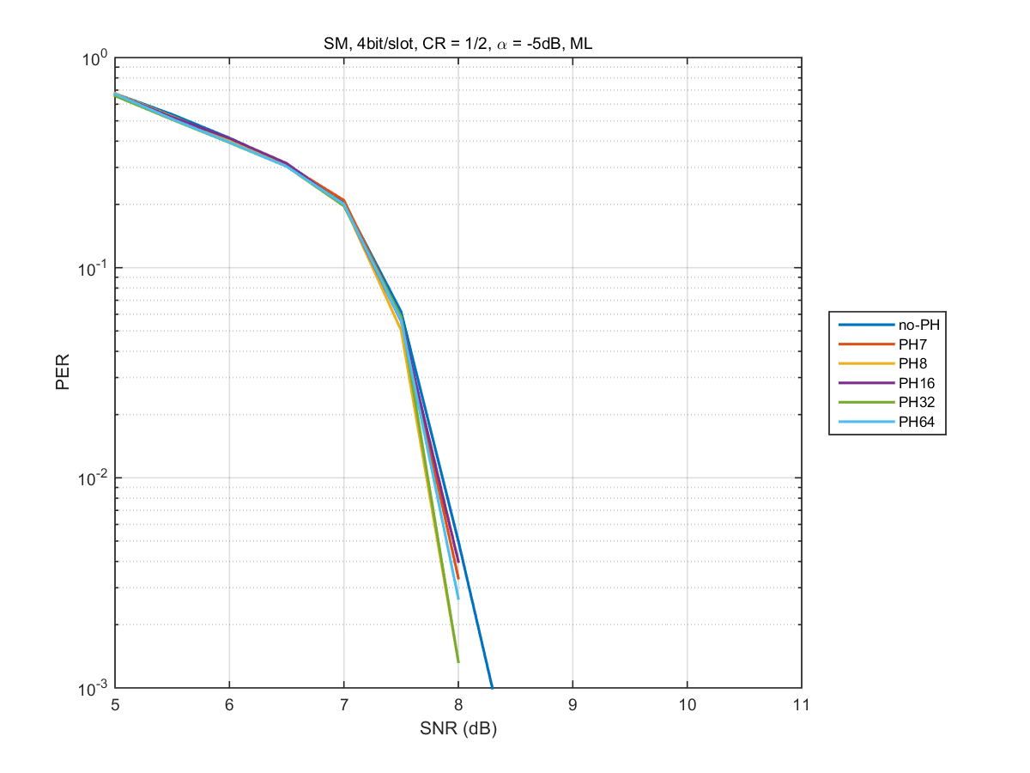
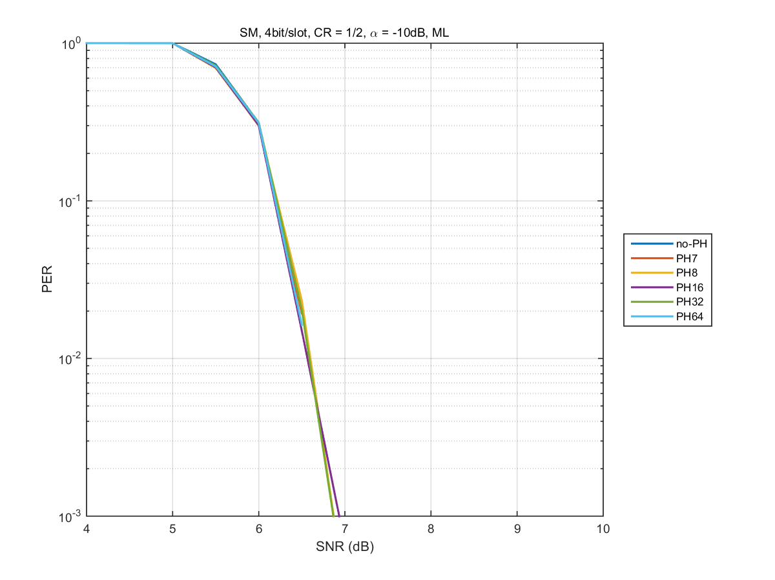
Results of Period 7, 8, 16, 32 and 64 (R=1/2)
α=-5dB
α=-10dB
(BPSK, BPSK)
(QPSK, QPSK)

Slide 19
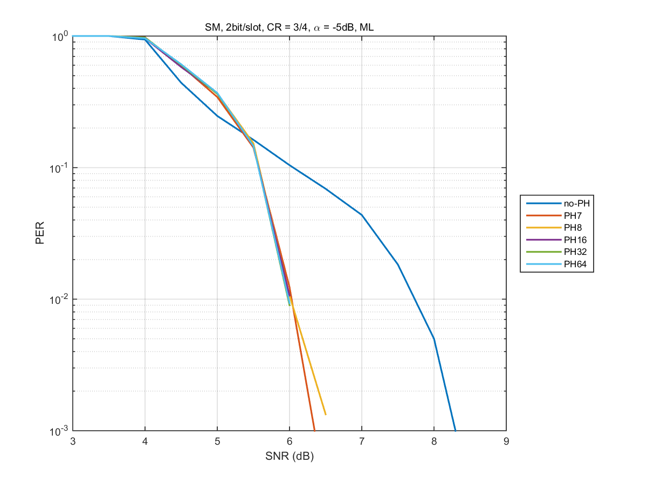
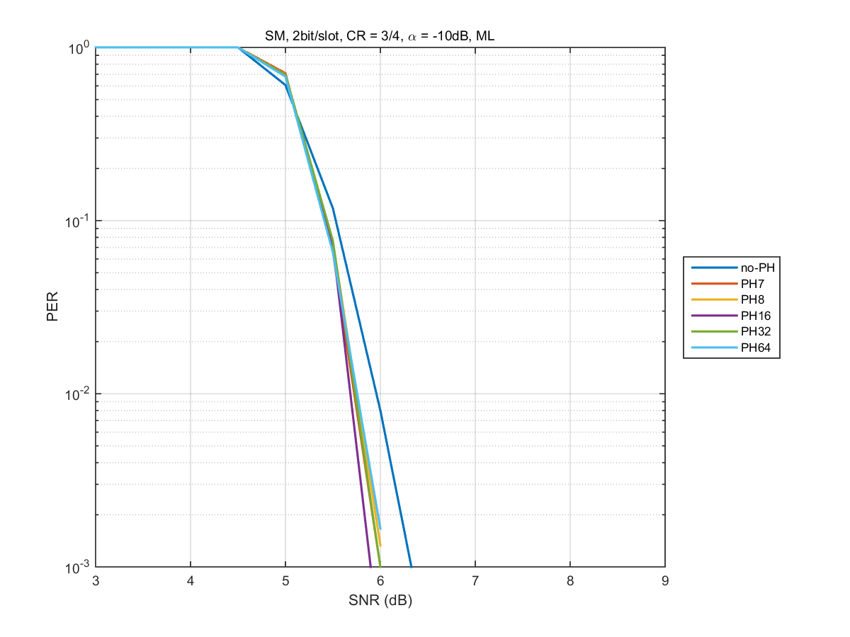
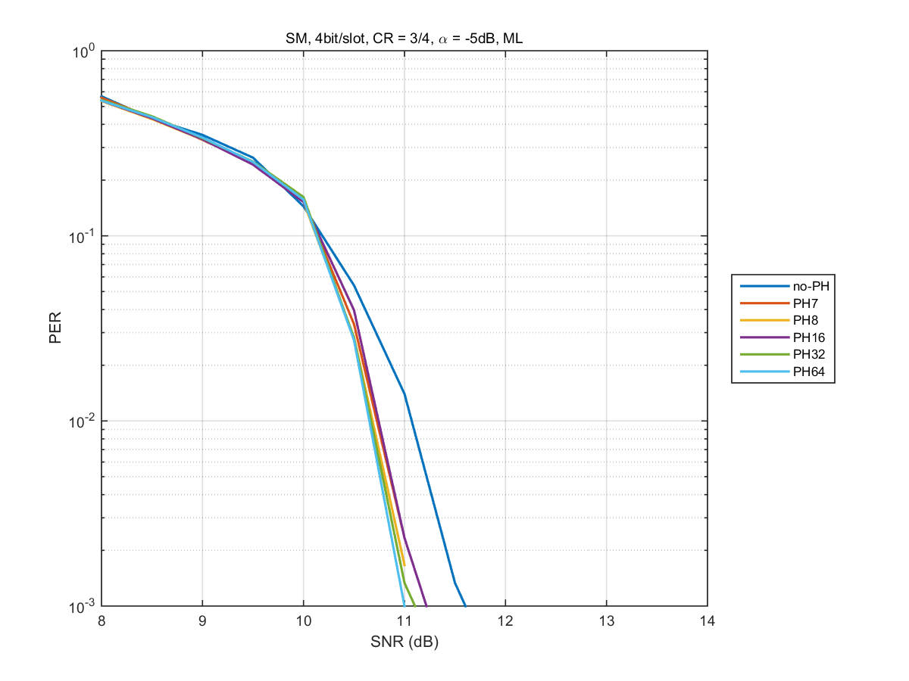
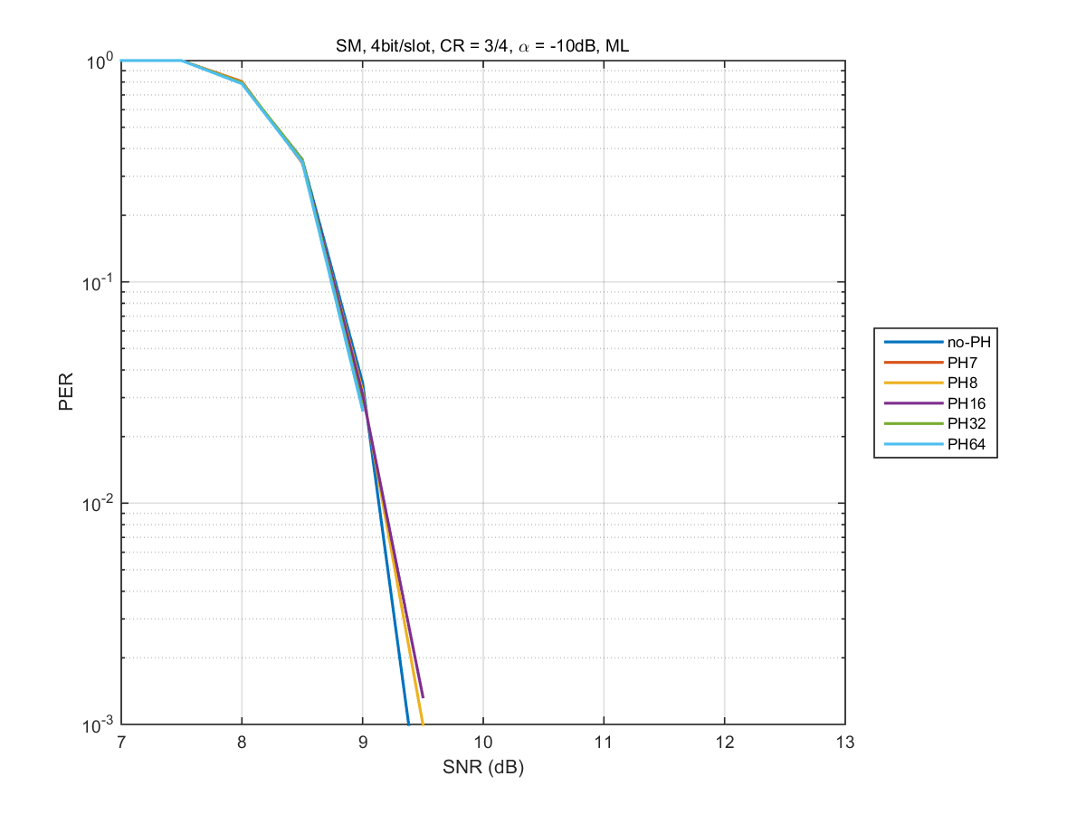
Results of Period 7, 8, 16, 32 and 64 (R=3/4)
α=-5dB
α=-10dB
(BPSK, BPSK)
(QPSK, QPSK)

Slide 20
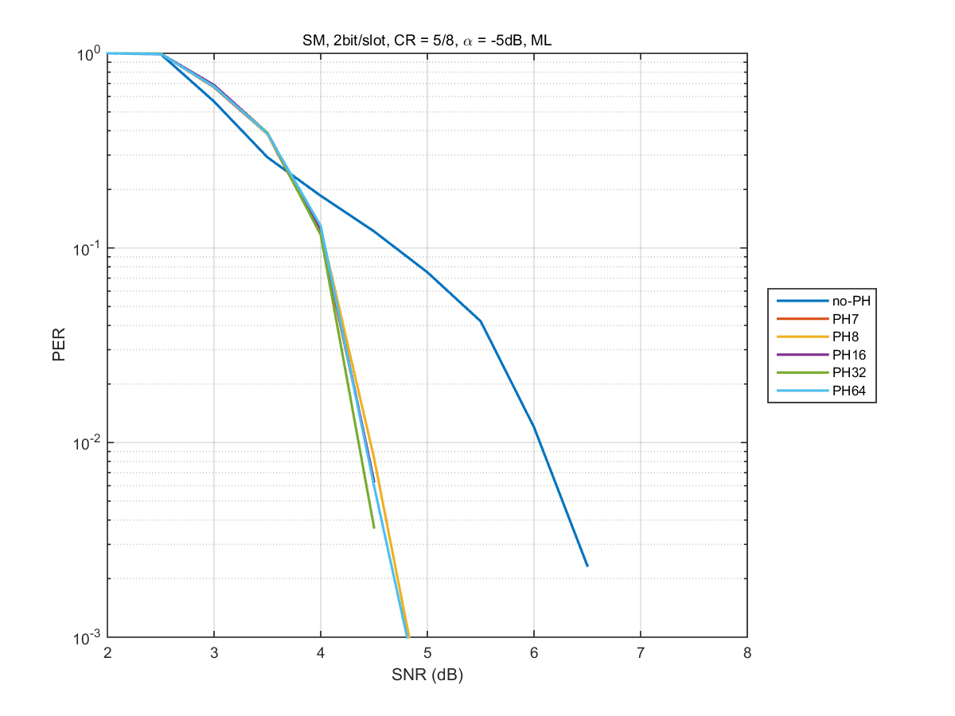
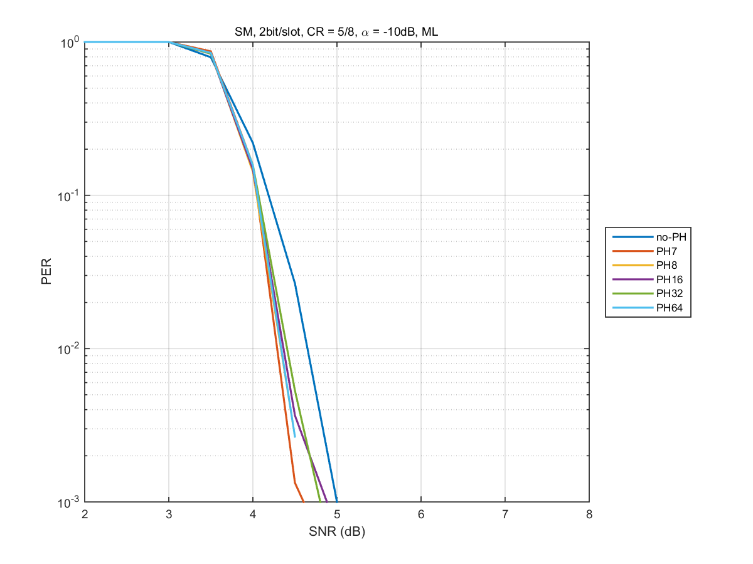
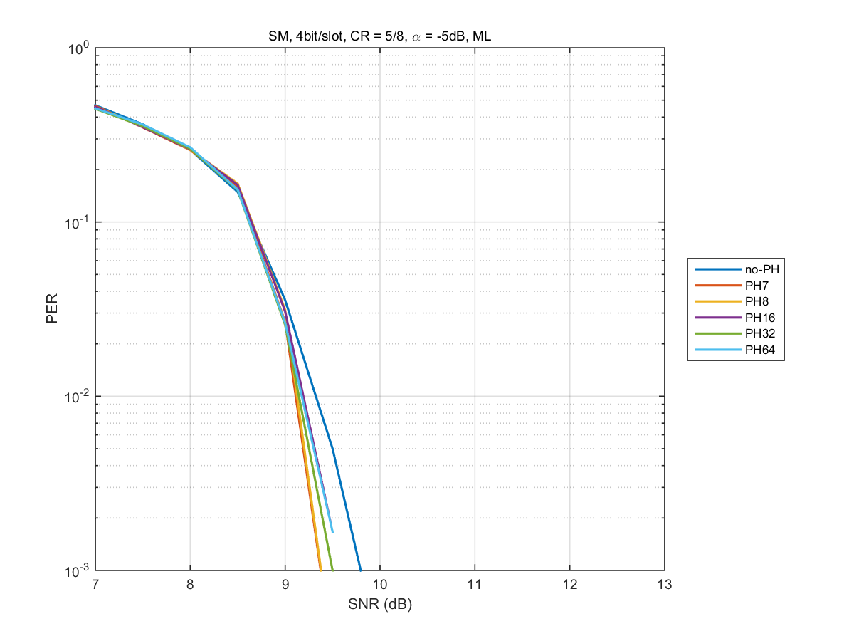
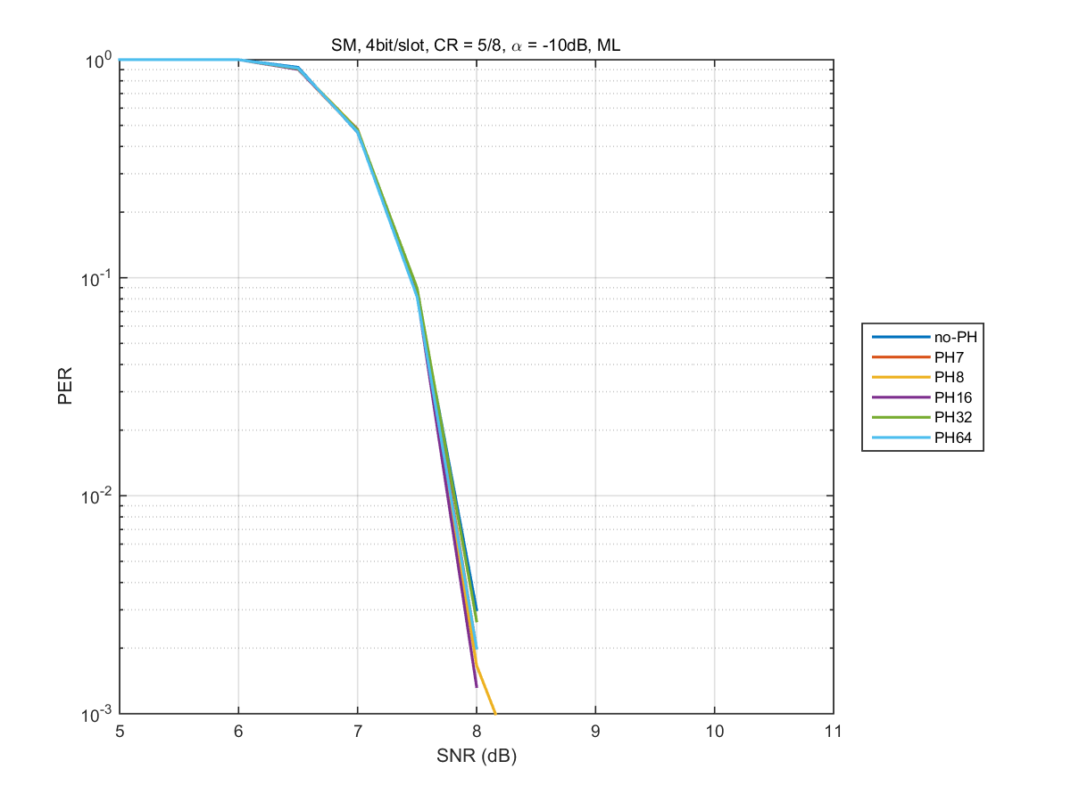
Results of Period 7, 8, 16, 32 and 64 (R=5/8)
α=-5dB
α=-10dB
(BPSK, BPSK)
(QPSK, QPSK)

Slide 21
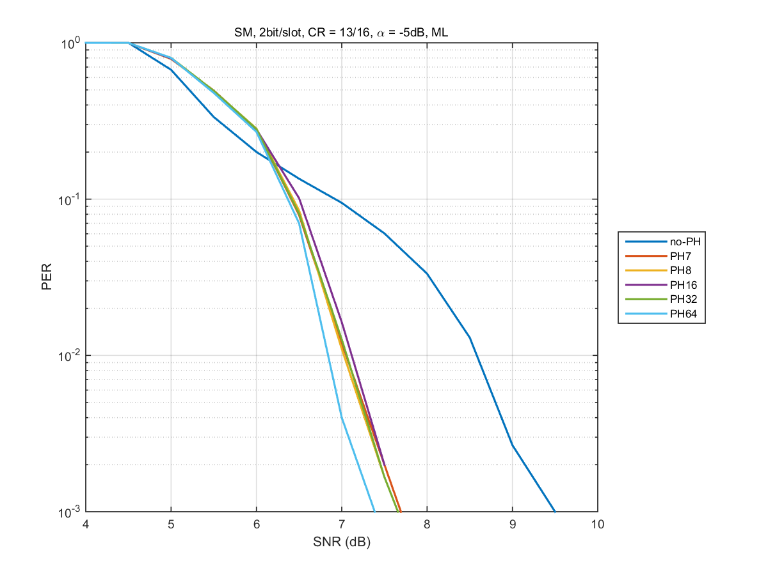
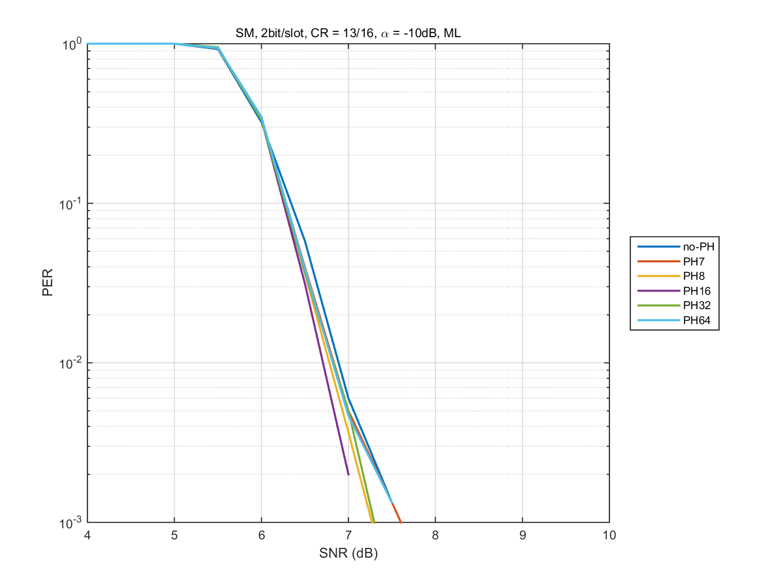
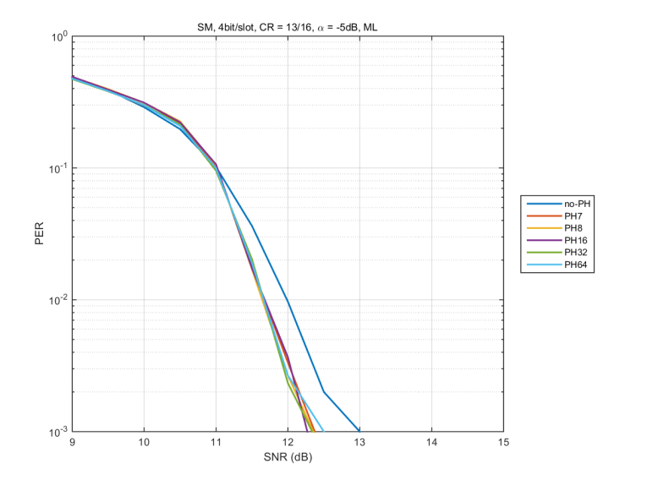
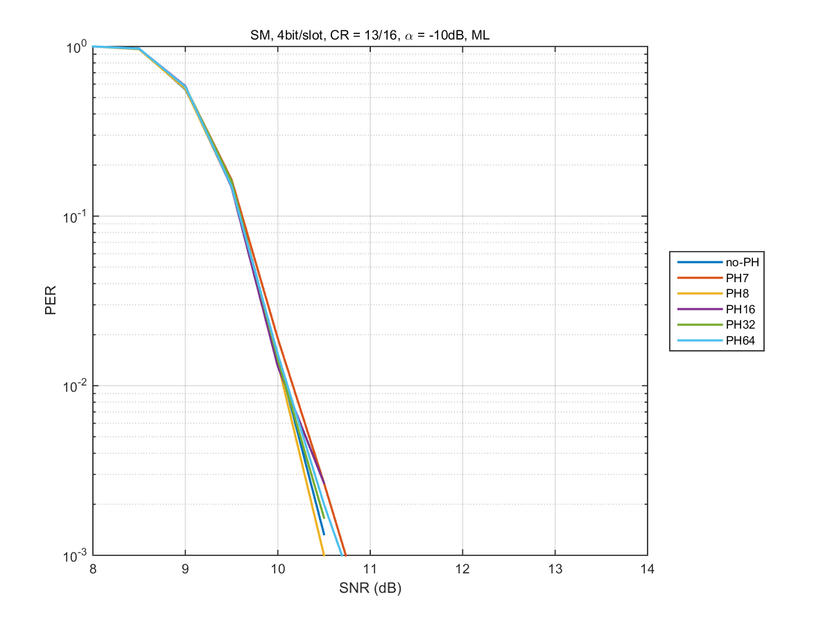
Results of Period 7, 8, 16, 32 and 64 (R=13/16)
α=-5dB
α=-10dB
(BPSK, BPSK)
(QPSK, QPSK)
- PER performances with period of 7, 8, 16, 32 and 64 are close.

Slide 22
Summary
OLSM is defined for SU-MIMO scenario and in consideration of performance in LOS environments, OLSM + PH is proposed.
PH helps avoidance of static destructive interference (constellation degeneracy) in LOS environments in the receivers.
In no precoding + PH with (BPSK, BPSK), PER performance is good when using ML and MMSE.
In no precoding + PH with (QPSK, QPSK), PER performance is good when using ML.
In no precoding case, there are no difference of PER performance between PH and no PH when receivers use ZF.
PER performances with period of 7, 8, 16, 32 and 64 are close. Therefore, a period of PH can be set to 7, 8, 16, 32 and 64.

Slide 23
Straw poll 1
  Do you agree to insert the following in clause 7 of the SFD:
  “The 11ay specification shall support SU-MIMO with
  predetermined and/or no precoding matrices.”

Slide 24
Straw poll 2
  Do you agree to insert the following in clause 7 of the SFD:
  “The 11ay specification shall define SU-MIMO transmission
  with and without phase hopping of EDMG-PPDU for EDMG OFDM PHY.
  An EDMG STA may support transmission and reception of SU-MIMO
  with phase hopping.”
  - “with/without precoding” is TBD.
  - Period of phase hopping is TBD.

Slide 25
References
11-15-0334-01-ng60-mimo-framework
D. Vargas, D. Gozálvez, D. Gómez-Barquero, and N. Cardona, “MIMO for DVB-NGH, the next generation mobile TV broadcasting,” IEEE Commun. Mag., vol.57, no.7, pp.130-137, July 2013.
S. Moon, W.-S. Ko, D. Vargas, M. D. Nisar, and V. Pauli, “Enhanced spatial multiplexing for rate-2 MIMO of DVB-NGH system,” 19th International conference on Telecommunication, 2012.
11-16-0388-00-00ay-performance-analysis-of-open-loop-su-mimo-receivers-for-ieee-802-11ay

Slide 26
Appendix

Slide 27
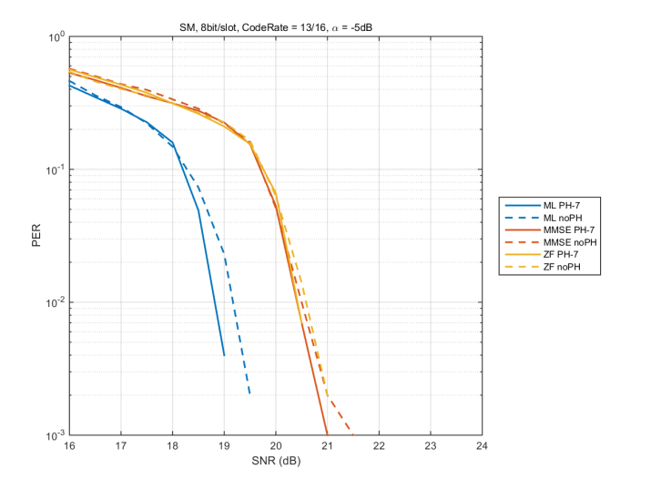
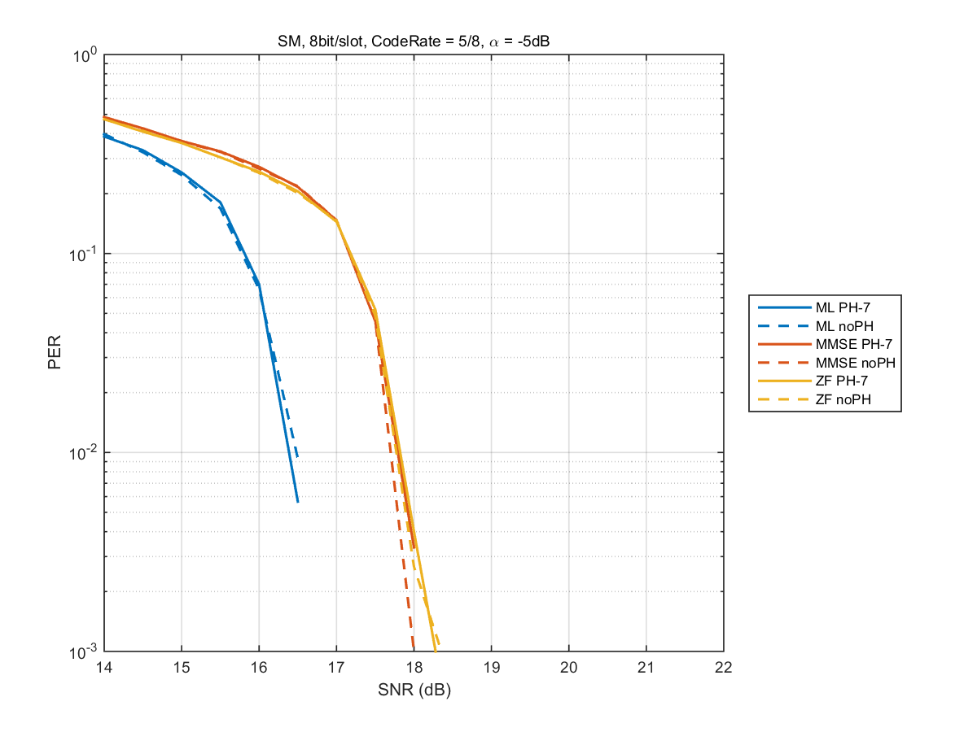
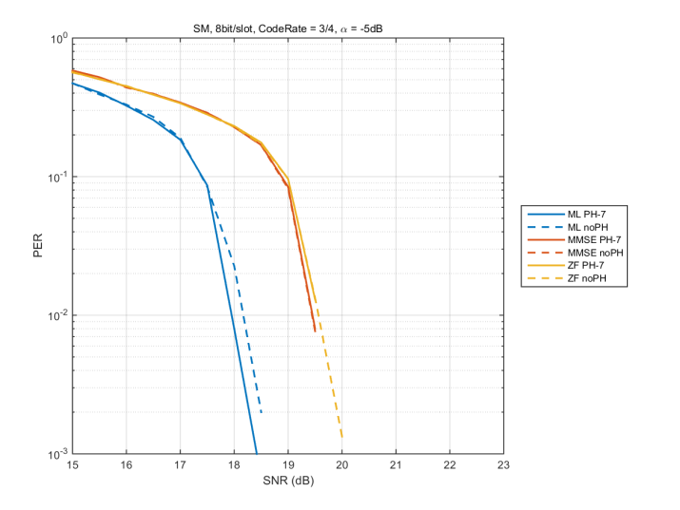
Comparison between PH and no PH (α=-5dB)
R=13/16
in LOS model #1
R=5/8
In LOS model #1
(16QAM, 16QAM)
R=3/4
In LOS model #1
(16QAM, 16QAM)
- In (16QAM,16QAM), PH has gain, compared with no PH when using ML and MMSE.

