Slide 1
Analysis of Intra-Cluster Effects Using Pencil Beam Antennas
Date: 2016-05-17
Authors:
Name | Affiliation | Address | Phone | Email
Jian Luo, Yan Xin, George Calcev | Huawei Technologies |  |  | Jianluo@Huawei.com Yan.xin@Huawei.com George.Calcev@huawei.com
Robert Müller, Stephan Häfner, Diego Dupleich, Reiner Thomä | Technische Universität Ilmenau |  |  | Mueller.Robert@tu-Ilmenau.de Reiner.thomae@tu-ilmrnau.de

Slide 2
Abstract
In this presentation, we show the characterization of a wall in the entrance hall scenario at 60 GHz under using pencil beam antennas. The goals of this measurement are to analyse different beamforming strategies and lifetime of clusters with different beam widths. Another possibility of this measurement is the detailed analysis of intra cluster properties in view of the attenuation, polarimetric scattering effects and reflection characteristic. This measurement can thus be used as a basis for calibration of a ray tracer and also for modelling of clusters for other channel models. Here we like to show the measurement and first beamforming analysis results.

Slide 3
Outline
Motivation
Overview of 60 GHz Entrance Hall Measurement
Pencil Beam 60 GHz Intra Cluster Measurements in the Entrance Hall Environment
60 GHz dual polarimertic Scattering Measurement Results
Discussion of 60 GHz dual polarimertic Scattering Measurements in the Entrance Hall
Conclusion

Slide 4
Motivation
Broadband and full polarimetric characterization of Cluster
  To understand the broadband and polarimetric scattering of different structures
Advanced System Concepts → define measurement and modelling requirements
  Massive MIMO/pencil beamforming → large spatial bandwidth
  Adaptive or switched selection beamforming to mitigate shadowing
  Channel bonding → large bandwidth
Propagation channel
  Double directional measurements are needed to characterize the full channel
  Polarization is an important aspect
  High dynamic range is essential to measure the different propagation effects
Channel characterization for different usage cases

Slide 5
Overview of 60 GHz Entrance Hall Measurement

Slide 6
Dual Polarimetric Ultra-Wideband Channel Sounder (DP-UMCS)
TX Module
PA min. 27 dBm
RX Module
Step
Attenuator
LNA
Gain : 35 dB
H Pol.
CH 1
UWB Sounder TX
0 – 3.5 GHz
3.5 GHz - 10.5 GHz
H Pol.
Switch
UWB Sounder RX
0 – 3.5 GHz
3.5 GHz - 10.5 GHz
56 - 66 GHz
56 - 66 GHz
V Pol.
Step
Attenuator
CH 2
LNA
Gain : 35 dB
V Pol.
PA min.
27 dBm
Multiplier
X8
Multiplier
X8
Optical link
7 GHz
Oscillator
Optical link
7 GHz BW up to 10 GHz measurable bandwidth
Maximum excess delay of 606 ns (180 m) in CS version 1
Dual polarization measurement capability
25 dB AGC (Automatic Gain Control) with 3.5 dB steps
High instantaneous dynamic range: up to 75 dB
Multi-Link and Massive MIMO capabilities
Double directional measurements (with 1 TX and 2 RX)

Slide 7
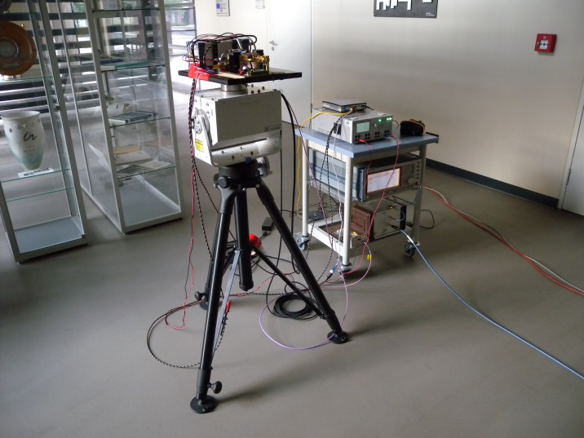
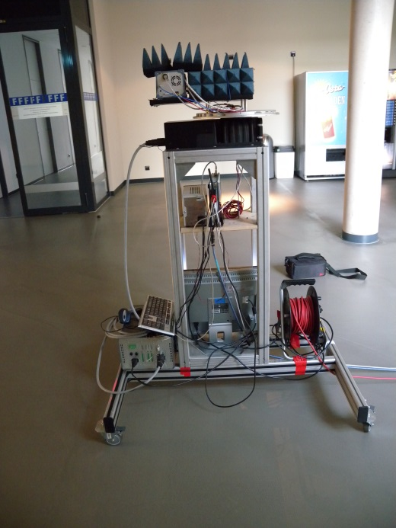
Measurement System and Setup
 | Value
Stimulus Signal | PRBS
Bandwidth | 6.75GHz
CIR length | 606ns
Dynamic range | 70dB
CIR averages | 1024
Transmit power | 20dBm ( max. 30dBm)
Frequency band | 57.4GHz-64.1GHz
Antenna HPBW | 30°
Antenna XPI | 25dB
Full polarimetric | Yes

Slide 8
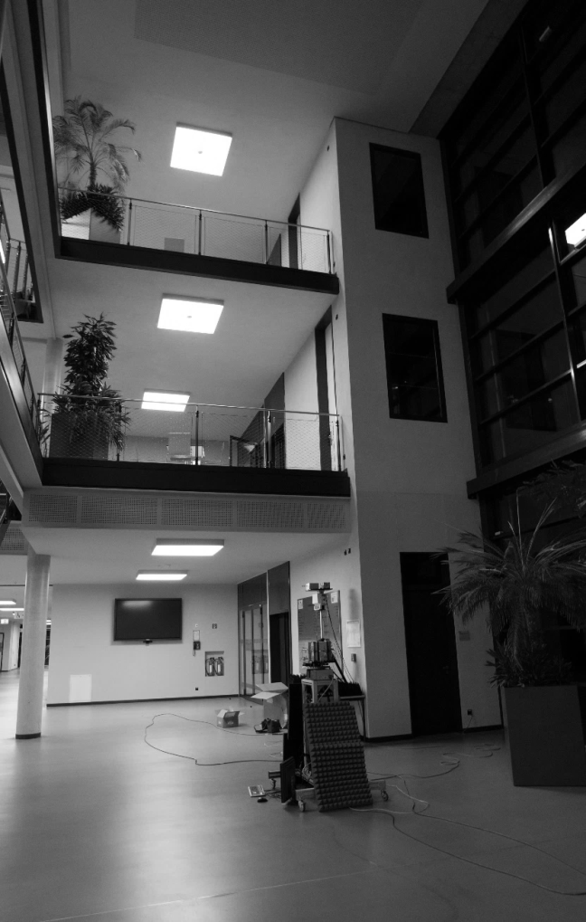
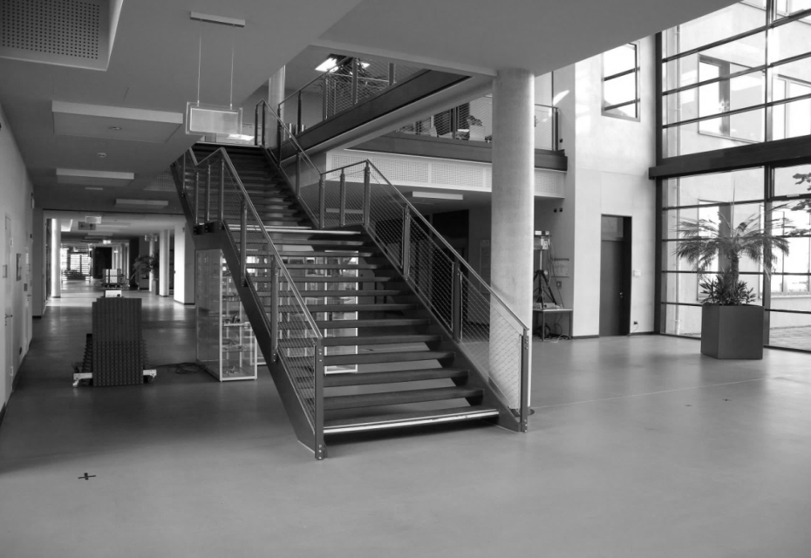
Overview of 60 GHz Entrance Hall Measurement
Entrance Hall of Zusebau at TU Ilmenau
  3 TX Positions (3 floors)
  9 RX Positions (ground floor)
Access-point scenario
Scanning at TX and RX
  RX: Azimuth:
  TX: Azimuth: ;Elevation:
TX 3
TX 2
TX 1
RX 14
RX 10
RX 4
RX 9
RX 2
RX 3
RX 1
RX 2
RX 1

Slide 9
Tx 1 – Rx 1 LOS
Overview of 60 GHz Entrance Hall Measurement
Normalized Power Elevation / Azimuth Profile at Tx
Normalized Power Azimuth / Azimuth Profile at Tx and Rx

Slide 10
Tx 1 – Rx 13 NLOS
Overview of 60 GHz Entrance Hall Measurement
Normalized Power Elevation / Azimuth Profile at Tx
Normalized Power Azimuth / Azimuth Profile at Tx and Rx

Slide 11
Conclusions
The results show a lot of clusters, which cannot be separate for deeper cluster analysis because of the spatial closeness and the used antennas (HPBW of 30°)
To understand the influence of the clusters to every path a spatial and time resolved measurement of different clusters are required to characterized the intra-cluster properties
Support the channel modeling task of Alexander Maltsev

Slide 12
Pencil Beam 60 GHz Intra Cluster Measurements in the Entrance Hall Environment

Slide 13
Motivation
  Analysis of the full pol. scattering properties
  Characterization of the backscattering in term of radiation pattern of different scatters
  Influence of material and structure to the 60 GHz broadband propagation
  Lifetime of clusters (beam width of antennas vs. lifetime of cluster )
  Enabling the analysis of beamforming strategies
  To model the clusters for realistic channel models

Slide 14
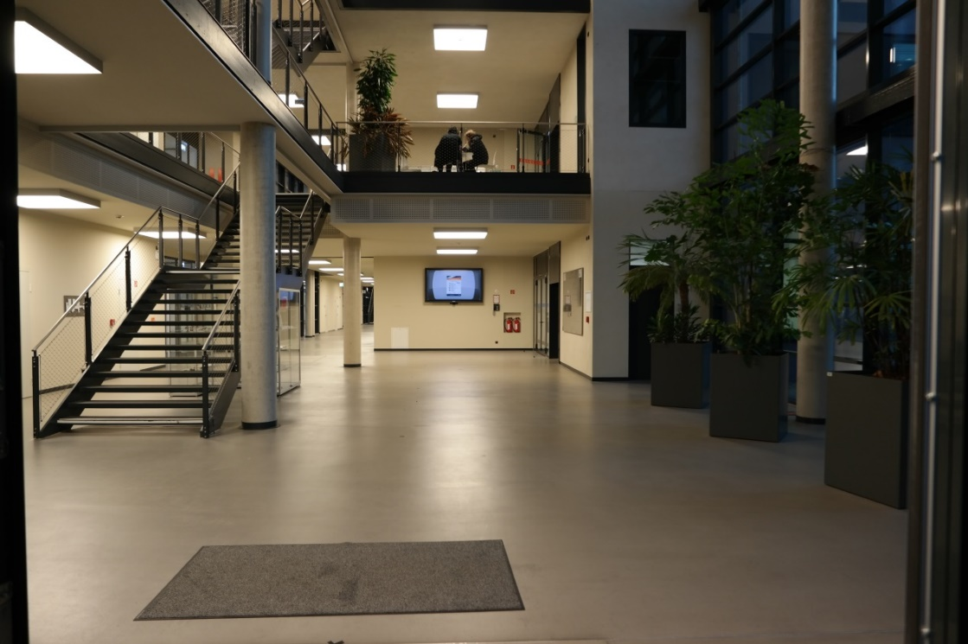
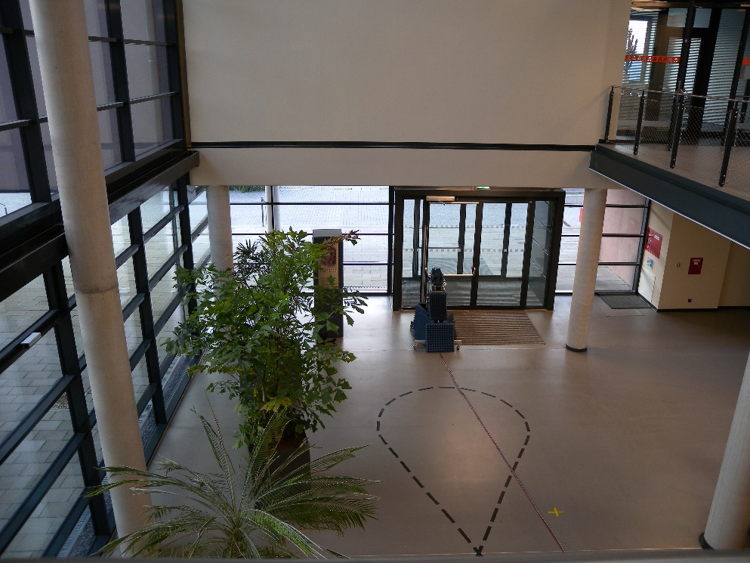
Measurement Objects
concrete pillar
Corner wall
Wall and big screen
Entrance door

Slide 15

60 GHz dual pol. Scattering Measurements Setup
$$α$$
positioner 1
positioner 2
h₁
h₂
rail positioner
2.85m
1.85m

Slide 16
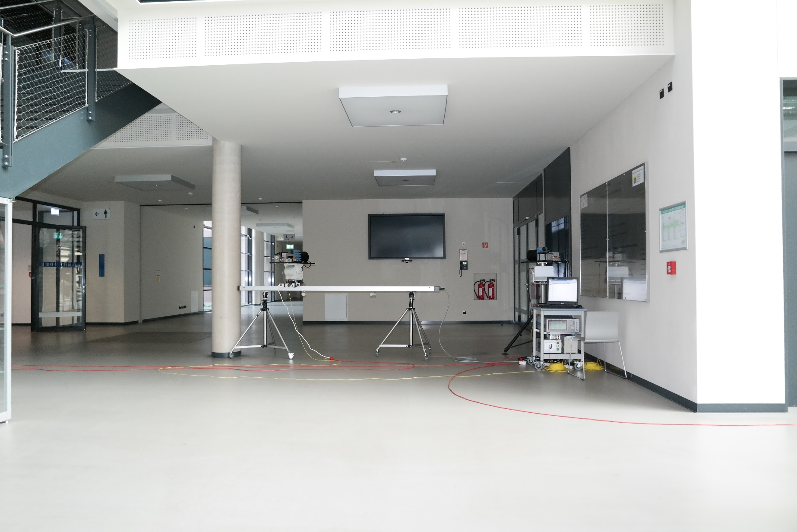
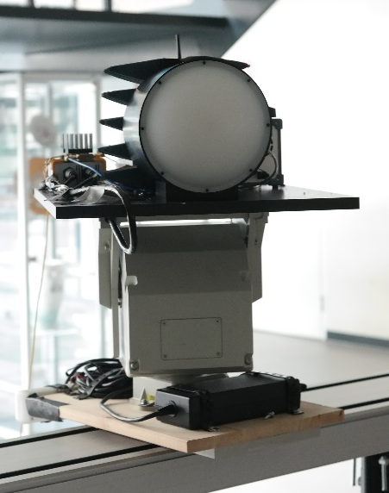
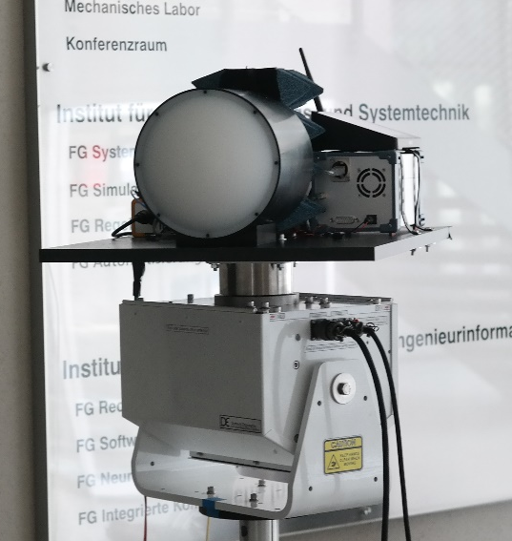
60 GHz Scattering Measurements Setup at the Wall

Slide 17
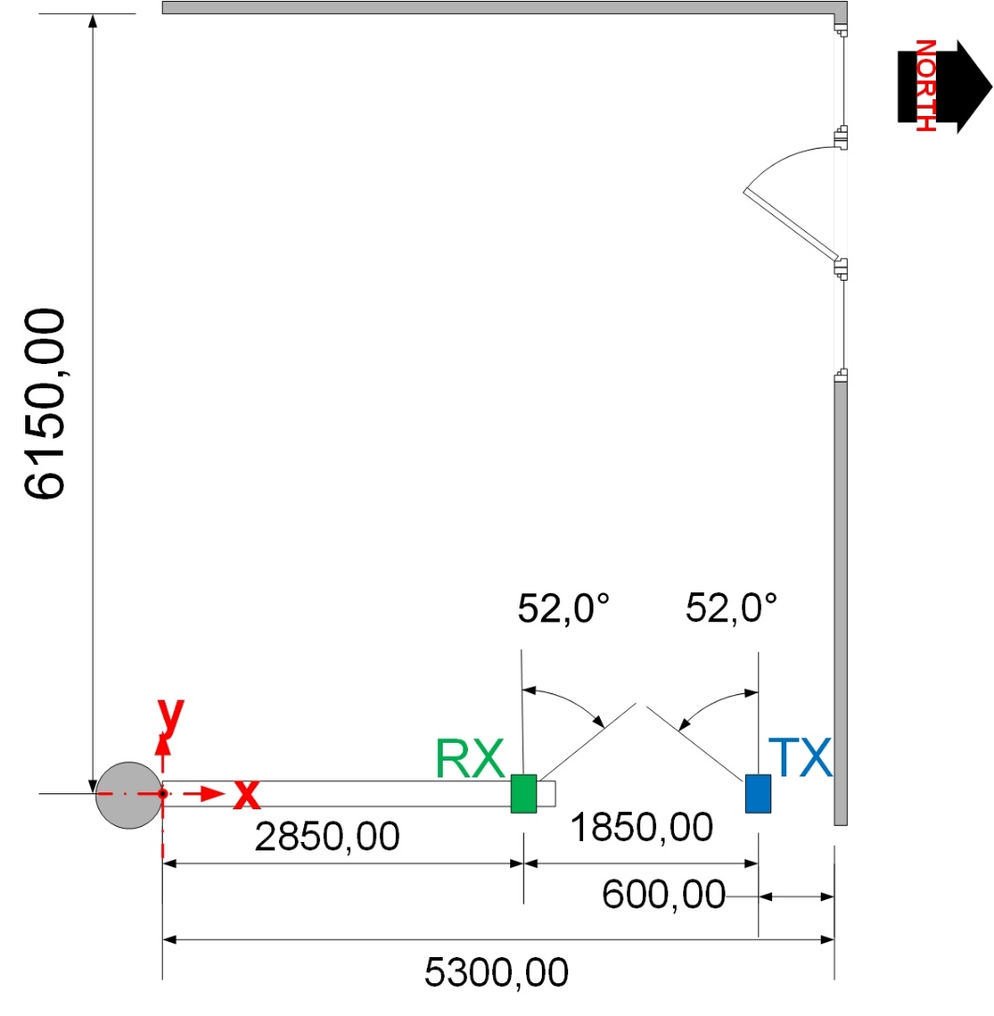
Intra-Cluster Measurement
Set-Up
Tx:
  Located on the side of the wall
  Height from ground 1.47 m
  2°HPBW@60 GHz of the antenna
  (Gaussian Beam → no side loops)
Rx:
  Located at on the side of the wall
  Height from ground 1.47 m
  2°HPBW@60 GHz of the antenna
  (Gaussian Beam → no side loops)
Scanning at Tx and Rx stage via positioners
Tx: Azimuth 0°2° 52°
Rx: Azimuth 0°2° 52°
Rail movment with 20cm steps

Slide 18
60 GHz dual polarimertic scattering measurement results

Slide 19
Influence of Incident and Reflected Angles
Tx
Rx
Scenario
The maximum is always close to the Tx – Rx azimuth range in which the incident and reflected angles are the same (Tx Az = -Rx Az)
Tx Az
Rx Az
Rx position on the rail 0 m
Rx position on the rail 0.8 m
Rx position on the rail 1.8 m

Slide 20
Influence of Incident and Reflected Angles
Rx positions and the different Tx and Rx azimuth beams (2° HPBW) for the maximum per Rx position
Only the direct reflection of the wall are contribute in this configuration energy
This kind of wall reflected primarily not diffuse

Slide 21
Living Distance of Beams
Scenario
The Tx is pointing to the wall with a 2°HPBW
The Rx is moving parallel to the wall without updating the Rx beam
  Different HPBW considered at the Rx by adding consecutive 2°HPBW beams
Tx
8°
Analysis Objectives
Beam width vs. Living time of clusters
Tx updating vs. Tx and Rx beam direction updating
12°
Rx
Rx position on the rail

Slide 22
Living Distance of Beams
Results
Results normalized to the first position
For narrow beams at Rx (<10°HPBW), the signal is attenuated more than 20 dB after moving 0.5 m without any update in the beams at the Rx
After updating the beams at Rx at each position, a maximal loss of 12 dB is encountered
Without updating the beam at Rx
After updating the beam at Rx
Rx Position on the Rail [m]
Rx Position on the Rail [m]

Slide 23
Living Distance of Beams
Results
The optimal result is updating the beams at Tx and Rx in each position (in the figure the Tx beam HPBW is 2°)
The right figure shows the comparison of updating the Tx and Rx beams per position and the result without updating the beams
  With narrow beams (pencil beams) the update is necessary at Tx and Rx after moving 0.4 m
After updating the beam at Rx and Tx
Comparison with and without update at Tx and Rx
Rx Position on the Rail [m]
Rx Position on the Rail [m]

Slide 24
Living Distance of Beams
Scenario
The Tx is pointing to the wall with different HPBW beams
The Rx is moving parallel to the wall without updating the Rx beam (2°HPBW)
Tx
8°
Analysis Objectives
Beam width vs. Living time of clusters
Tx updating vs. Tx and Rx beam direction updating
12°
Rx
Rx position on the rail

Slide 25
Living Distance of Beams
Results
For narrow beams at Tx (<10°HPBW), the signal is attenuated more than 20 dB after moving 0.5 m
However, with >10°HPBW the UE can be displaced up to 1 m having a loss of 10 dB

Slide 26
Conclusion
Power of the reflections highly depends on the incident angles
For modelling, if we talk about pencil beams, we need to have a precise information of the scatter in order to describe the reflections, since a small change in the incident and reflected angles leads to high losses
  Spatial consistency is very important, more deterministic approaches
For beam-forming, with pencil beams an update is necessary more often (in location)
Wider beams reduce the received power but also the need of updating the beam-former → save energy

Slide 27
Conclusion/Discussion
We present first dual pol. measurements with a pencil beam antenna to figure out the intra cluster properties
Also we use this data to analyze the lifetime of the reflection in comparison to the opening angle of the antennas
Next Steps
  Further measurements for the broadband and polarimertic characterization of scatters at 60 GHz
  Outdoor measurements at 60 GHz
  Large indoor scenarios with distances larger than 40 m
  Dynamic measurements of human scattering inclusive Doppler shift up to 50 km/h
  Compare different scatter for statistical analysis

